Slide 1
Battle of The Neighbourhoods.
Kanika Dhyani

Slide 2
Introduction/business problem
Our customer, the coffee shop chain “coffee-mugs” is interested in opening a new coffee shop in Toronto. Toronto is the fastest growing city in North America. It is an international centre of business, finance, arts, and culture, and is recognized as one of the most multicultural and cosmopolitan cities in the world. This would be our customer’s second location, after having successfully opened a venue in Adelaide, a very lively neighbourhood from Scarbrough.
Considering that our customer has had very good results with their current location, they have requested our data science team to find a neighbourhood with similar characteristics.
The problem question would be: What other neighbourhood from Toronto has the most similar characteristics in terms of entertainment and cafe options compared to Adelaide?

Slide 3
Data Used
Foursquare- It is a local search-and-discovery service which provides information on different types of entertainment, drinking and dining venues. Foursquare has an API that can be used to query their database and find information related to the venues, such as location, overall category, reviews, and tips.
Toronto Neighbourhood Names and geographic coordinates- We will scrap a Wikipedia page for the postal codes of the Burroughs and the URL "https://cocl.us/Geospatial data" for the geographic coordinates of each borough

Slide 4
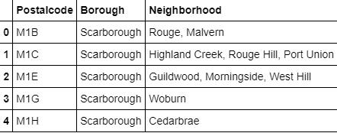
Methedology
Scraping the Wikipedia page to get the postal codes for each neighbourhood

Slide 5
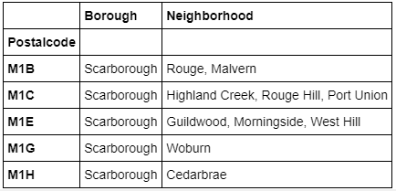
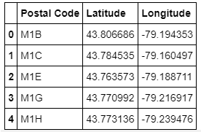
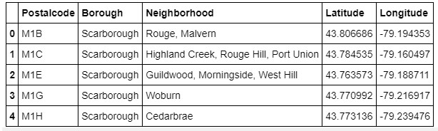
Getting the geolocation of each neighbourhood

Slide 6
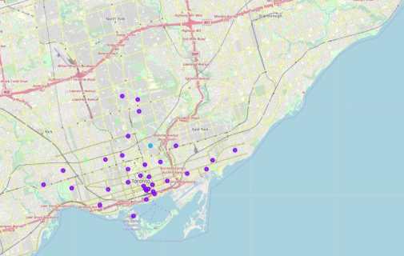
Toronto Neighbourhoods

Slide 7
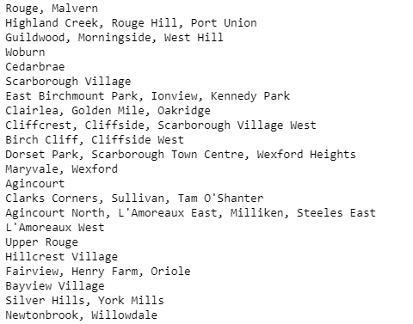
Foursquare API- Getting insights on each neighbourhood

Slide 8
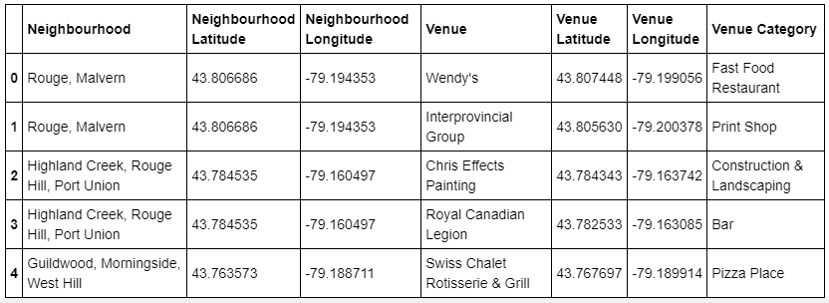
Venue categories

Slide 9
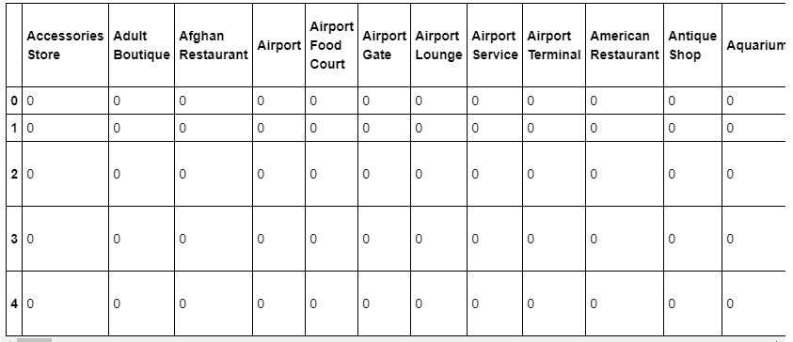
Applying one-hot-coding

Slide 10
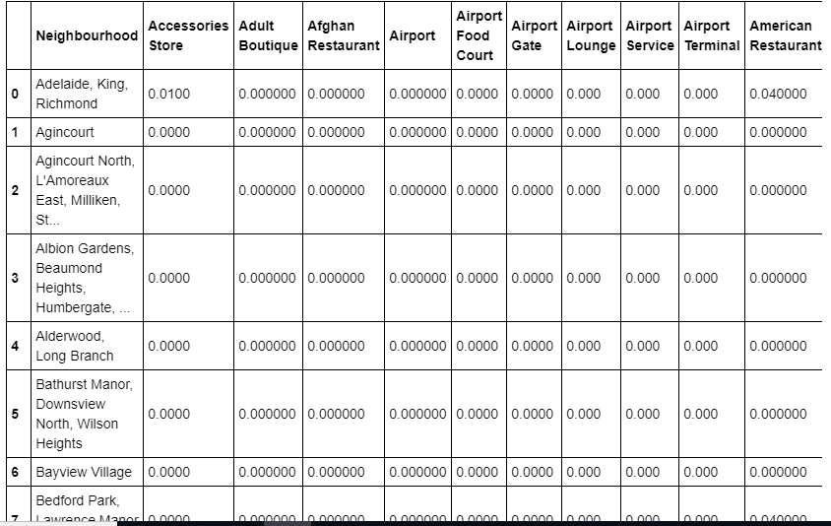

Slide 11
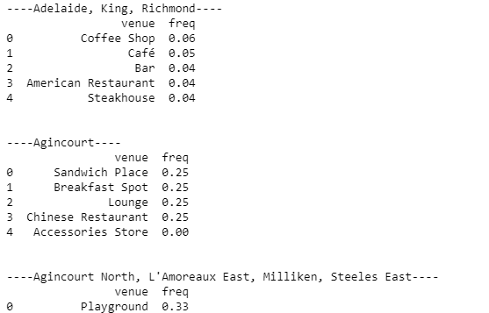
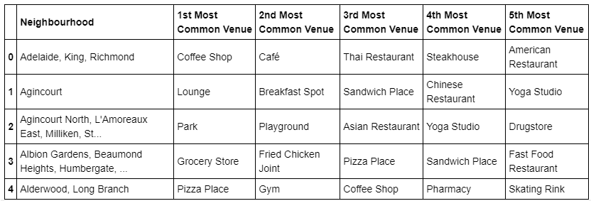
Getting the top five venues in each neighbourhood

Slide 12
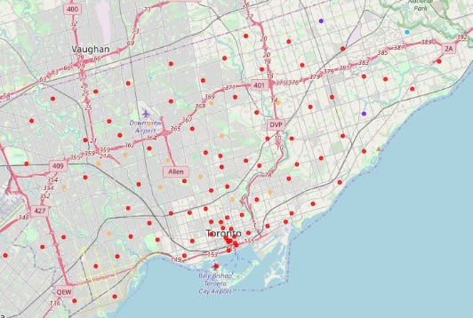
Clustering the neighbourhoods

Slide 13
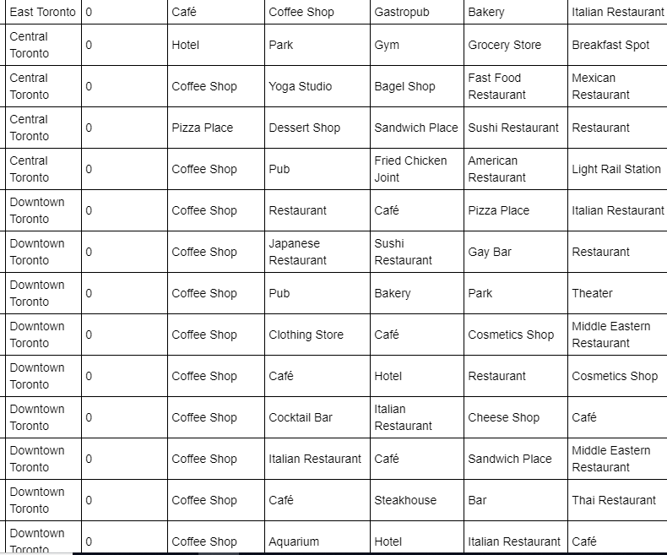
Result
We observe that downtown Toronto and central torontoarethe best location for a new branch for our customer “Cofee-mugs”

Slide 14
Conclusion
Our location, Adelaide lies in the cluster number 0.
We observe that downtown Toronto and central Toronto have successful caffe buisnesses just like our neighbourhood Adelaide.

