Slide 1

DevCops
problems
A LAW ENFORCCEMENT SOLUTION THAT MATTERS
future
thanks
features
challenges
team

Slide 2



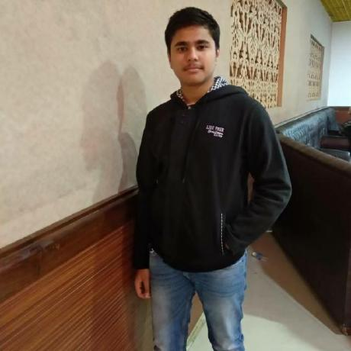
KARAN SANDHU
YATIN AHUJA
thanks
problems
DATA ENGINEER
FLUTTER DEVELOPER
features
future
challenges
team
DHYATA
DHAIRYA TANEJA
WEBSITE DEVELOPER
FLUTTER DEVELOPER

Slide 3



THE PROBLEM IT SOLVES
1
2
3
MANAGEMENT
MONITORING
AI ML
Cops can find all the cases and ongoing investigations at one place instead of having a different file for every case.
thanks
Citizens can monitor the progress of their case, which keeps them updated.
Cops can convert sketch of a person into a real image, which is done by AI ML model
problems
features
future
challenges
team

Slide 4
CHALLENGES WE RAN INTO
1
3
problems
future
thanks
challenges
features
team
AREA SPECIFIC
GOOGLE MAPS
Cops will only see complaints of their area so that they don’t mess up with other cases.
Google maps will be integrated so that cops can mark important places related to a case, which gives a better view of case.
2
4
MULTILINGUAL
SERVER DEPLOYMENT
Both the website and app will be available in multiple Indian languages so that each and every citizen can use it.
Currently sketch to image feature can only be used on emulator by running the flask server on localhost but soon it will be deployed such that all mobile users can access it.

Slide 5
FUTURE SCOPE
IMAGE AS A PROOF
INDICATORS
Citizens have an option to upload an image related to case, which servers as a proof for cops to investigate.
There are indicators for each case, which indicates the priority and status of case making it easy for cops to have a clear picture of that
problems
thanks
challenges
features
future
team
SKETCH TO IMAGE
Cops can get a real image of suspect from a sketch. This is done by ML model and helps caps to identify suspect in a much easier way.

Slide 6





FEATURES
DevCops Website
DevCops App
Dashboard
Sketch to Image
Proper and easy management of cases and ongoing investigations.
Cop can convert sketch to image of the suspect which will help in recognizing him easily.
Details Page
Complaint Portal
problems
thanks
challenges
features
Cops can easily perform various actions such as changing the progress of investigation, setting priority of case and adding details.
Register a new complaint in just a few clicks. One registered check its status and progress in My Complaints section.
future
team
Inquiry Section
Security
send us your inquiry in the contact us section.
App is secured by API and OTP verification.

Slide 7




problems
thanks
challenges
features
future
team

