Slide 1

Import behavior and booking pattern analysis and forecasting of PVC
Dhyey Patel
1st July - 29th August

Slide 2
Overview
The purpose of this project is to understand and predict the importers booking patterns.
The project is planned to be executed in three phases.
Phase 1 : The model will be developed only on the basis of historical import quantity data as an input feature. No other features (external influencers) affecting the imports would be considered. Output of this model would be prediction of total quantity of PVC imports.
Phase 2 : The model will be developed considering various supply features, demand features and other external influencers. Output of this model would be prediction of total quantity of PVC imports considering the influencing factors
Phase 3 : The model will be developed with major focus on the prediction of PVC import quantity pivoted on product grade, import country, sector, import prices, booking date and booking price (Free on board- FOB)
1

Slide 3
Project Workflow
Current modelling approach is adapted for the first phase where no external influences (like supply and demand ) are considered.
Current model is prepared considering 6 years data (1st April 2019 to 30th June 2025).
An Exploratory Data Analysis (EDA) is performed to get insight of the data and a dashboard has been created for the same.
Product grades are categorized based the K value as Low K (50 - 58), Medium K (59 - 62), High K (63 - 68), Very High K ( >=69).
Models have been developed on basis of this grades.
Prophet and XGBoost are used for modelling and forecast with tuned hyperparameters.
2

Slide 4
Project Workflow
For each grade, best performing model out of the 2 modelling techniques is been used for final prediction
Then after both the models should be trained upon entire dataset, and forecast of next 3 months is made.
Error is calculated using mean absolute percentage error metric which gives the mean error of the model in percentage.
Since, accuracy of time series model cannot be calculated as in case of classification, Approximate accuracy can be calculated as: Accuracy = 100% - MAPE (error%)
3

Slide 5
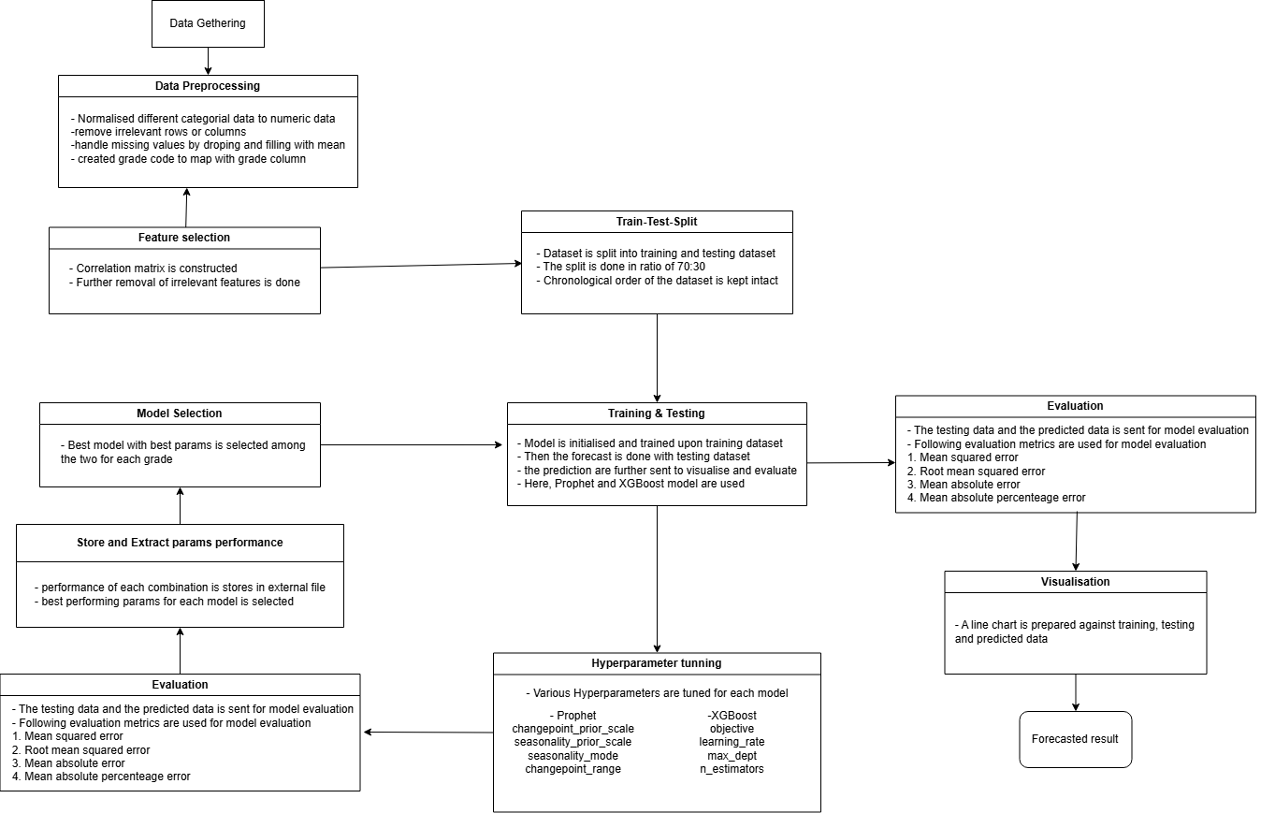

Slide 6
Data Preprocessing
Data Cleaning + Feature Engineering + Feature Selection
Initially, data is sourced from Excel files for each financial year.
These file are aggregated into single dataset for further analysis and modelling.
The final dataset consist of 100128 rows and 36 columns on average.
Dates are standardized into data time format.
A calculated field is created for assign K level ( very high k, high k, etc.) on the basis of respective k value.
Columns irrelevant to the requirement are dropped such as “cha no.”, “importer’s address”, “exporters address” etc.
Further the dataset is used for exploratory data analysis and an interactive multipage dashboard is developed for the same.
After which, categorical values are encoded into numerical values through manual assignment and then mapping into dataset.
5

Slide 7
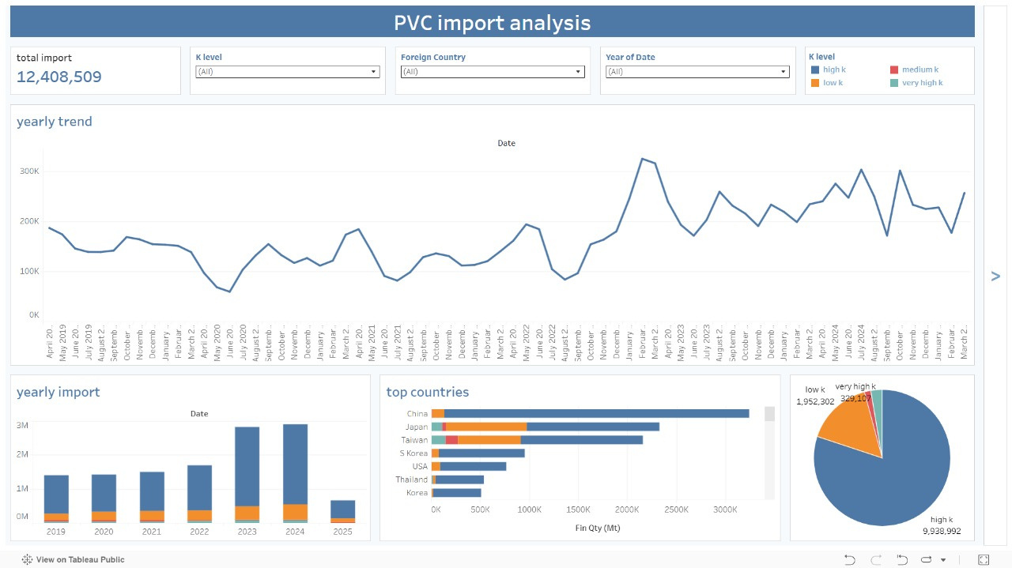
EDA Dashboard
6

Slide 8
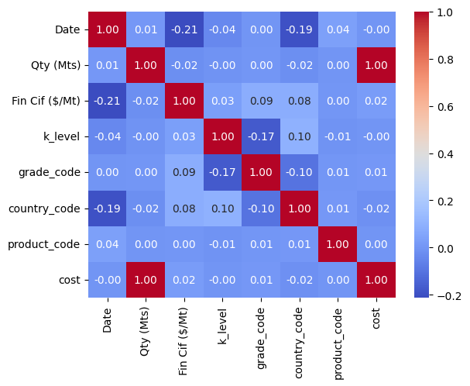
Data Preprocessing
According to importance of the feature, its missing values are dropped or imputed with mean, mode or the rolling mean.
Dataset is resampled into weekly frequency for better interpretability, also the external features for phase 2 will be in weekly format.
Some of the features are created as part of
feature engineering such as cost, lag feature
and extracted week number(xgboost)
At last, a correlation matrix is made for feature selection, and the features with high relation with are considered for further modeling.
Then, the data is split into training and testing dataset into 8:2 ratio.
7

Slide 9
Modelling Overview
Total of 2 models have been developed for each grade: Prophet & XGBoost
Prophet
Type: Additive time series forecasting model (trend + seasonality + holidays).
Strengths: Handles missing outliers, auto seasonality detection, easy to customize events.
Best for: Strong seasonal patterns, multiple years of data, business KPI forecasting.
XGBoost
Type: Optimized gradient boosting for regression/classification.
Strengths: Fast, handles missing data, models complex non-linear relationships, regularization to avoid overfitting.
Best for: Tabular data, engineered time series features (lags, rolling stats), predictive modeling in structured datasets.
8

Slide 10
Model training and testing
Both the models are training upon training dataset and tested against testing dataset
Once trained and tested , the output of the models are plotted against training, testing and prediction made by the model
Also, both the models are evaluated using Mean Squared Error, Root MSE, Mean Absolute Error, Mean Absolute Percentage Error an Accuracy approximation.
following slides shows the output of prophet and xgboost model
Note: Model hyperparameters tuned are not yet tuned in this phase
9

Slide 11
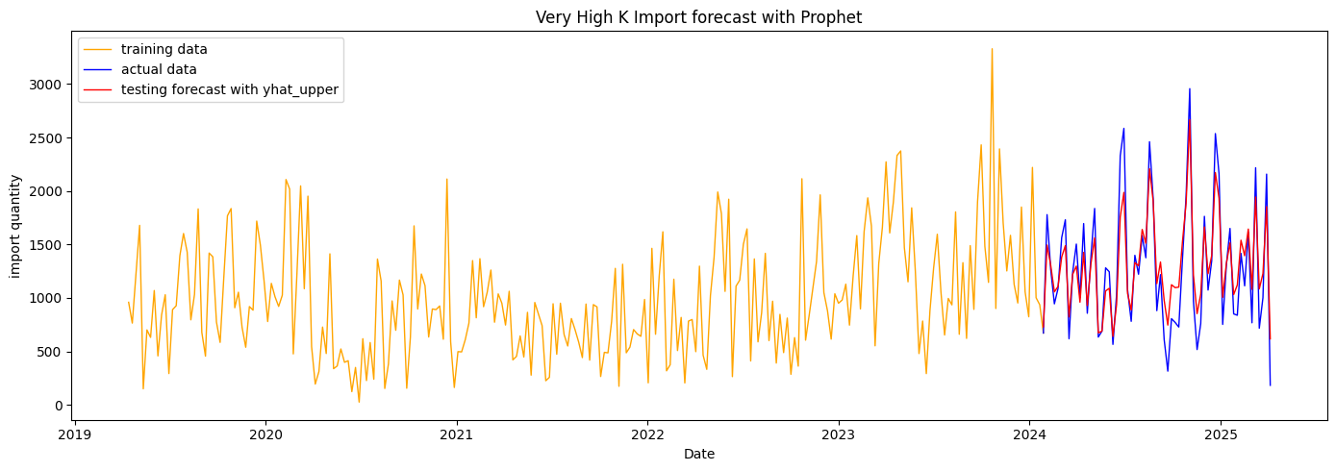
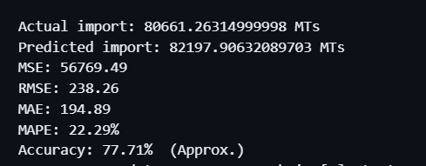
Very High K - Prohpet
10

Slide 12
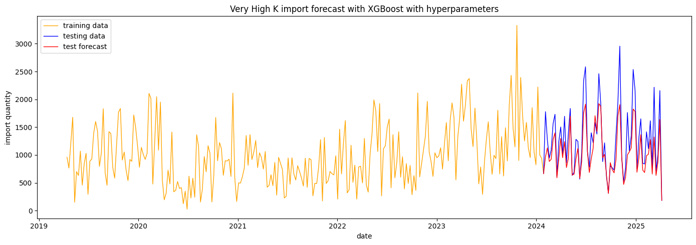
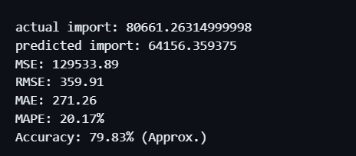
Very High K - XGBoost
10

Slide 13
Model Hyperparameters Tuning
Hyperparameters: Hyperparameters are the settings you choose before training a model that control how the learning process works, not learned from the data itself.
In, hyperparameter tuning the model is tuned on training dataset so as to prevent data leaking.
For each combination of hyperparameters, the model is trained and test, after which parameters which performs the best, is selected for further training and forecasting.
Once each model is tuned for dataset, the best performing model among the two is selected for the respective grade.
There are 2 major methods to hyper tune a model, here grid search method is used for its simplicity.
12

Slide 14
Prophet
There are total 640 combinations of hyperparameters of prophet that are tried for this project
changepoint_prior_scale: [0.001, 0.005, 0.01, 0.05, 0.1, 0.3, 0.5, 1.0]
seasonality_prior_scale: [0.1, 0.01, 1.0, 5.0, 10.0, 15.0, 20.0, 30.0]
seasonality_mode: ['additive', 'multiplicative']
changepoint_range: [0.6, 0.7, 0.8, 0.9, 0.95]
XGBoost
total 500 combinations of hyperparameters of XGBoost that are tried for this project
learning_rate = [0.01, 0.05, 0.1, 0.2, 0.3]
n_estimators = [100, 200, 300, 500, 700]
max_depth = [3, 5, 7, 9, 11]
objective = ['reg:squarederror', 'reg:absoluteerror']
eval_metric = ['rmse', 'mae']
Once hyper tuned, output of the model is again plotted for visual representation.
13

Slide 15
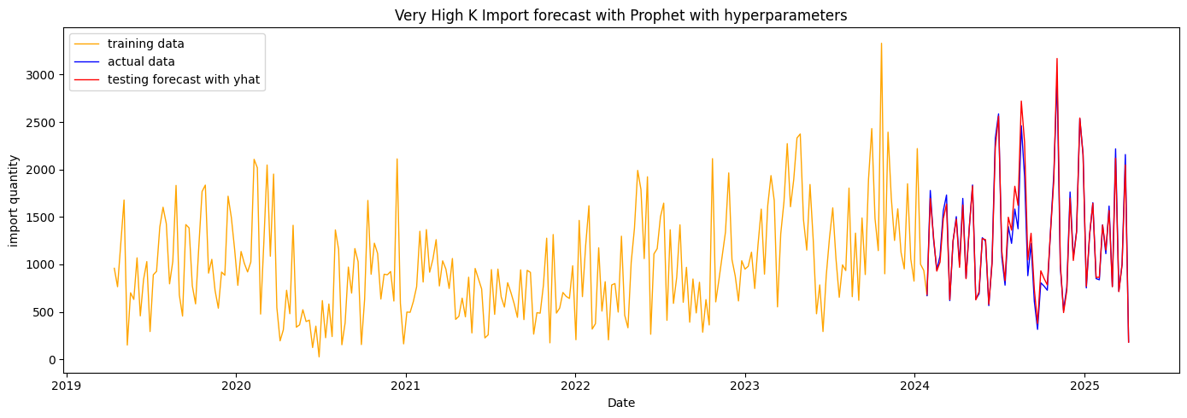
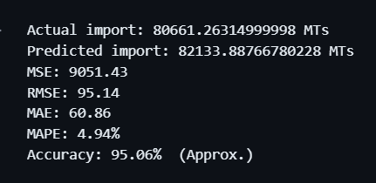
Very High K - Prohpet
10

Slide 16
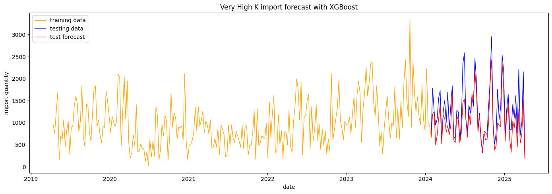
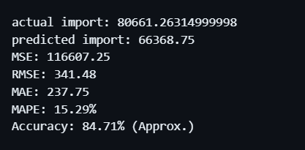
Very High K - XGBoost
10

Slide 17
Actual Forecasting
Once, the models are hyper-tuned and evaluated, the very next step is to perform actual forecasting.
Since, we have data till 31st March 2025, we will forecast for next 3 months i.e. from 1st July 2025 to 30th September 2025.
A dataset with all the features used for training is to be made for this forecast horizon.
To create a dataset for the forecasting horizon, three techniques are applied:
Mean Features
Rolling Mean
Forecasted Features
16

Slide 18
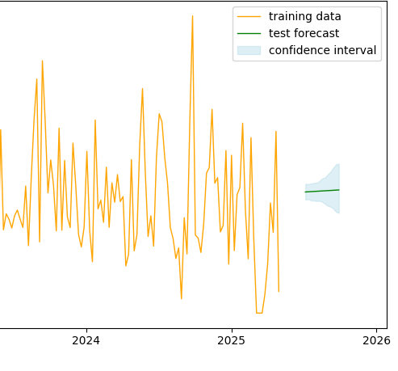
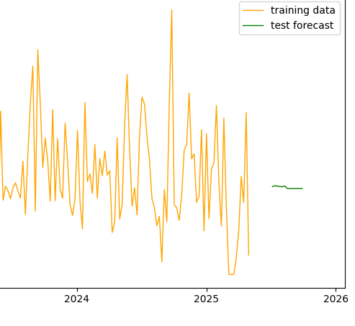
Mean Features - Prophet, XGBoost
Prohpet
XGBoost
Since, the features of future horizon dataset are same, the model will likely produces a steady line as the output, with a slight trend.
17

Slide 19
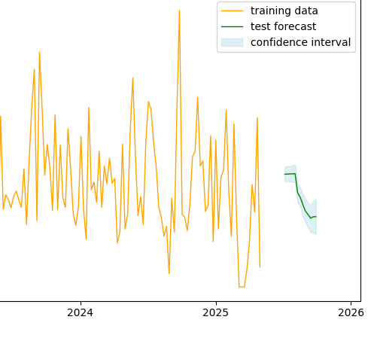

Rolling Mean - Prophet, XGBoost
Prohpet
XGBoost
Rolling mean, if used instead, can sometime generate the similar pattern from the window period it is calculated from.
18

Slide 20


Forecasted Features - Prophet, XGBoost
Prohpet
XGBoost
In this technique, prophet model (wo hyperparams) is used to forecast independent features which are further used for forecasting.
18

Slide 21
Issues to be resolved
There are still certain issues that needs to be rectify in order to improve accuracy and to minimize computational and human error.
More detailed analysis of the dataset should be done to learn and gain more insight about the dataset.
More precise data cleaning and aggregation should be done with minimum human error.
Feature engineering should be performed in depth to increase feature value.
Proper way to construct a dataset with future forecast horizon should be defined which directly affects accuracy.
Models should be prevented from overfitting.
Non-Linear relationships should also be identified and should be included and modelling should be done according.
19

Slide 22
THANK YOU

