Slide 1
AI engineering
system architecture

Slide 2
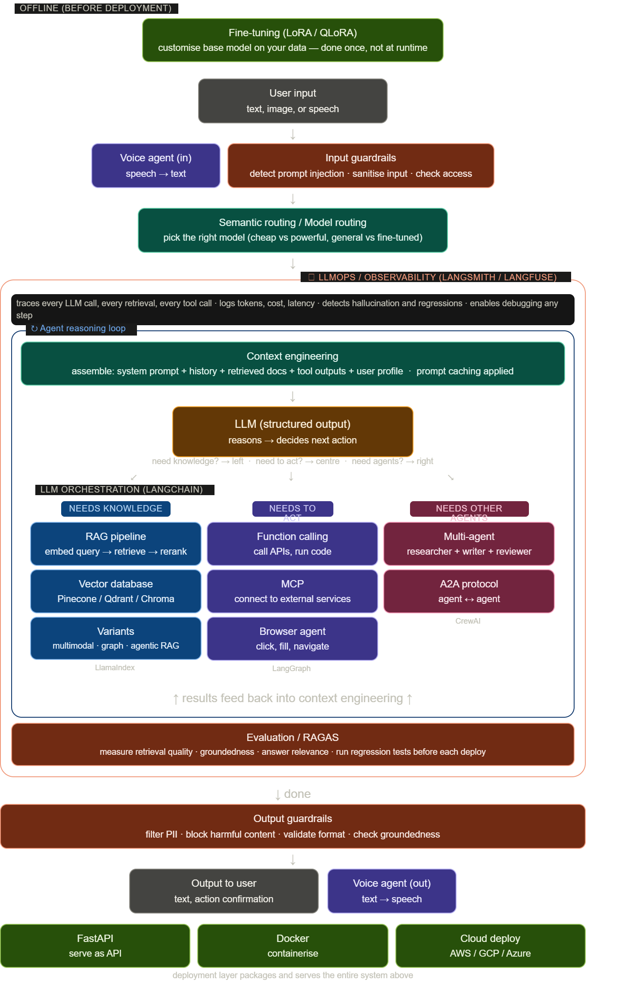

Slide 3
Complete system flow
OFFLINE
User input
Fine-tuning (LoRA / QLoRA)
text, image, speech
customise model before deployment
Voice agent (in)
Input guardrails
speech → text
prompt injection · sanitise · access
Semantic routing
pick the right model for this task
LLMOps / OBSERVABILITY — traces every LLM call, retrieval, tool call · logs cost + latency · detects regressions
↻ AGENT REASONING LOOP — repeat until task is complete
Context engineering
assemble: system prompt + history + retrieved docs + tool outputs · prompt caching applied
LLM (structured output)
reasons → decides next action
needs knowledge
needs to act
needs other agents
LLM
orchestration
(LangChain)
RAG pipeline
Function calling / MCP
Multi-agent (CrewAI)
embed → vector DB → retrieve → rerank
call APIs · connect external services
researcher + writer + reviewer
Variants: multimodal · graph · agentic RAG
Browser agent / Computer use
A2A protocol
LlamaIndex
LangGraph
agent ↔ agent communication
CrewAI
↑ results feed back into context engineering ↑
Evaluation / RAGAS
measure retrieval quality · groundedness · answer relevance · regression tests
Output guardrails
filter PII · block harmful · validate format · check groundedness
Output to user
Voice agent (out)
text → speech
FastAPI
Docker
serve as API
containerise
deployment layer packages and serves the entire system above

Slide 4
Branch A: RAG — needs knowledge
RAG gives the LLM access to your own data. The core operation is: embed a query → search a vector database → retrieve relevant chunks → feed them to the LLM.
User query
Embedding model
Vector database
Rerank
LLM
"How does X work?"
text → vector
similarity search
score relevance
answer
Variants
Basic RAG
Multimodal RAG
Graph RAG
Agentic RAG
text documents
single query → retrieve → answer
text + images
CLIP embeddings
your VPR skills apply here
knowledge graph (Neo4j)
connect facts across docs
agent controls retrieval
decides when/what to retrieve
bridge to agentic AI
Vector database options
Pinecone
Qdrant
ChromaDB
pgvector
managed cloud · easiest to start
open source · high performance
lightweight · local dev
PostgreSQL extension
Framework: LlamaIndex — specifically built for RAG pipelines

Slide 5
Branch B + C: Agentic AI — needs to act / needs other agents
An agent is an LLM in a loop. It reasons, calls tools, observes results, and repeats until the task is done.
Context assembled
LLM reasons
Execute action
docs + tools + history
what should I do next?
call tool / retrieve / delegate
↻ results feed back · loop repeats
What the agent can do
Function calling / Tool use
MCP (Model Context Protocol)
Browser agent / Computer use
LLM outputs JSON: {tool, arguments}
your code executes the function
standard connector: agent ↔ tools
like USB-C for AI agents
control browser: click, fill, navigate
OpenClaw is built on this
Multi-agent systems
Planner agent
Researcher agent
Writer agent
Reviewer agent
breaks task into sub-tasks
assigns to specialists
searches web
retrieves sources
synthesises research
produces report
checks accuracy
and quality
A2A protocol: how agents communicate with each other
Framework: CrewAI (role-based) · LangGraph (stateful workflows)
Frameworks
LangChain
LangGraph
CrewAI
general orchestration · spans all layers
agent workflows · state management
multi-agent collaboration · role-based

Slide 6
Layer 4: Production and safety
Nothing ships without this. These components wrap around the entire system.
Guardrails (both sides)
Input guardrails
Output guardrails
detect prompt injection · sanitise input
check access control · block malicious patterns
filter PII · block harmful content
validate format · check groundedness
LLMOps / Observability
Trace every call
Detect regressions
Enable debugging
Tools
LLM inputs/outputs
tokens · cost · latency
prompt changes broke quality?
model swap caused errors?
user reports bad answer
trace exact failure point
LangSmith · Langfuse
Helicone · Phoenix
Evaluation / RAGAS
Faithfulness
Answer relevancy
Context precision
Context recall
is the answer supported by
the retrieved documents?
does the response
answer the question?
are the retrieved docs
relevant to the query?
did retrieval find
all relevant docs?
Deployment
FastAPI
Docker
Cloud (AWS / GCP / Azure)
serve your AI system as a REST API
package everything into a container
deploy · auto-scale · GPU instances

Slide 7
Learning order
Each layer requires the ones below it. Do not skip ahead.
Layer 1: LLM fundamentals
LLM APIs · structured outputs · function calling · context engineering · semantic routing · fine-tuning · prompt caching
Layer 2: RAG
embeddings · vector databases · chunking · retrieval · reranking · multimodal RAG · graph RAG · evaluation (RAGAS)
Layer 3: Agentic AI
agent loops · tool use · MCP · LangGraph · multi-agent (CrewAI) · A2A · browser agents · voice agents
Layer 4: Production
guardrails · prompt injection defence · LLMOps / LangSmith · evaluation · FastAPI · Docker · cloud deployment

