Slide 1
Mediapro303 web design blog
by k. alloway

Slide 2
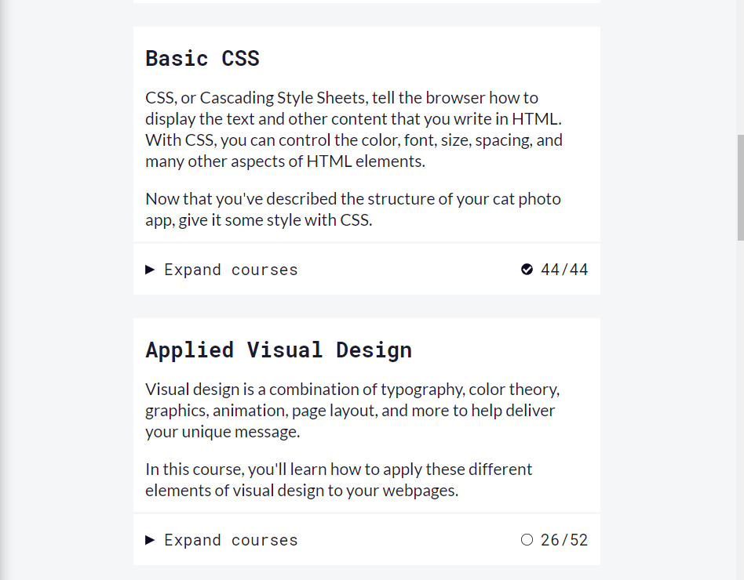
Free Code Camp
Free Code Camp, I think, was a big help. I had already gone up to 16 before but going through and beyond those sixteen helped me with our big project websites!

Slide 3
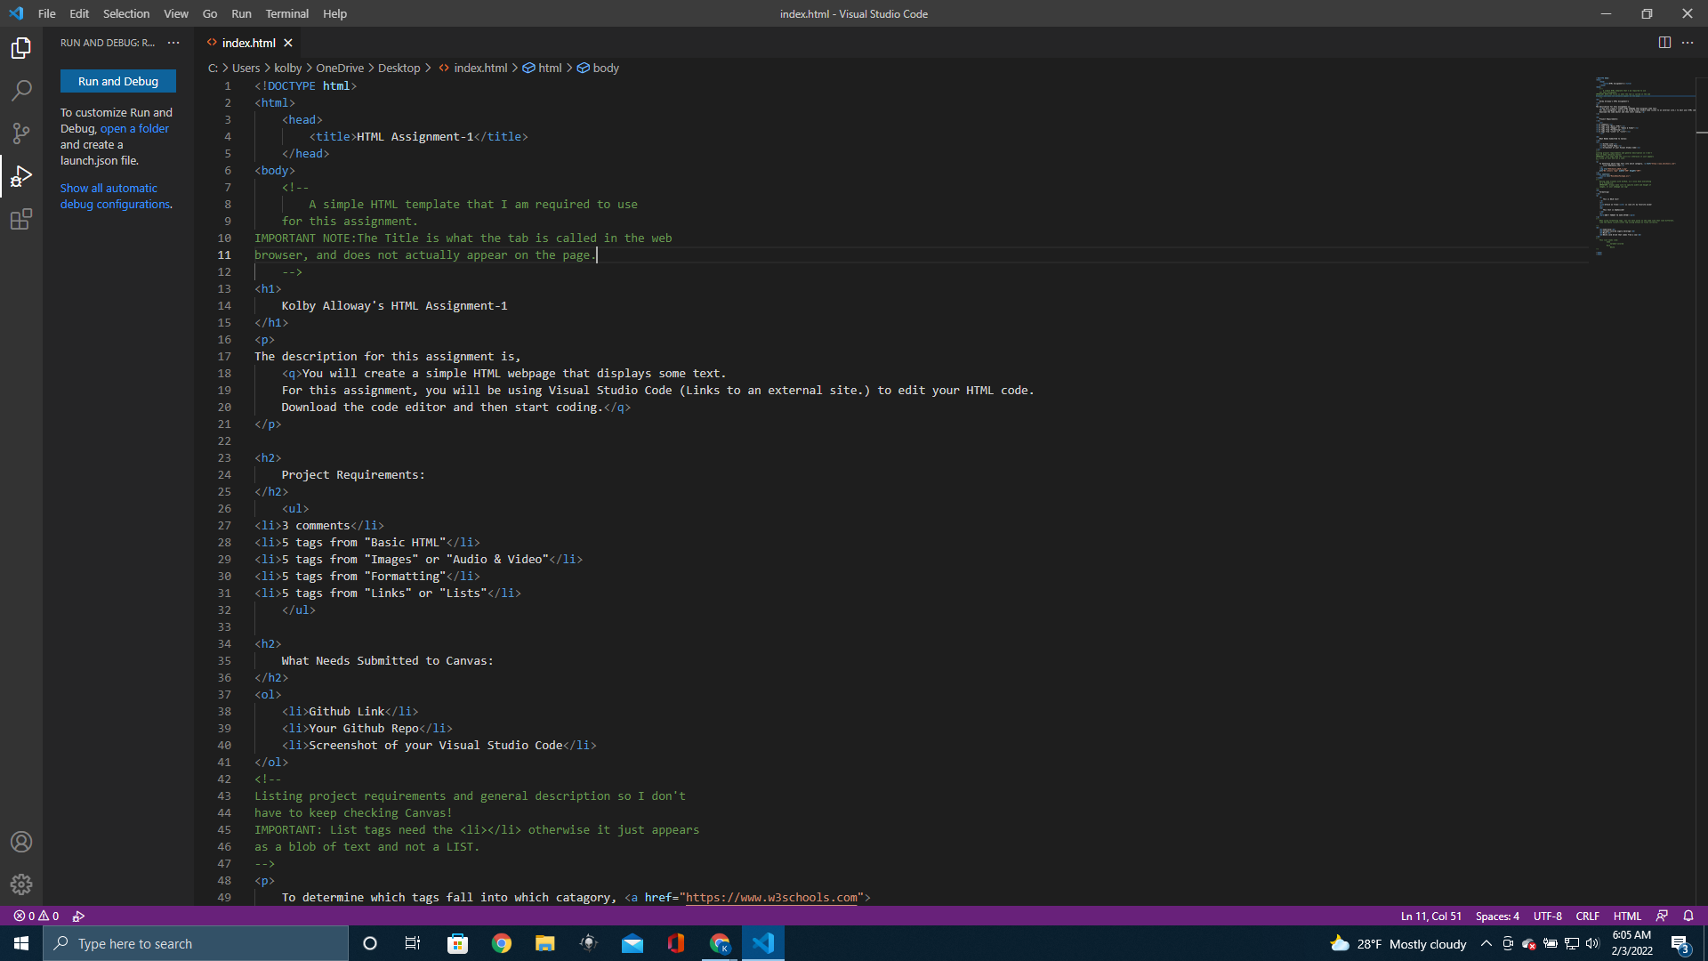
HTML Assignments 1&2
HTML Assignment 1 is when I first really started to get into wed design and enjoy it. My biggest asset for these assignments, I think, was W3 Schools.

Slide 4
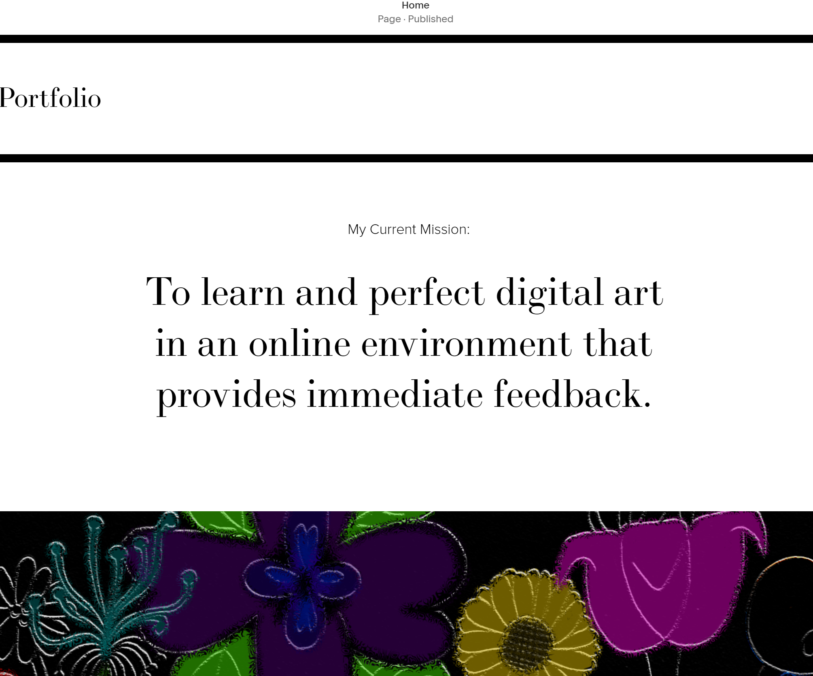
SquareSpace Website
Because I wasn’t as worried about the code aspect, I was able to really focus on design and art. I put a lot of art I’ve done over the years into this site!

Slide 5
Final Thoughts
I think the most valuable thing this class taught me was how to advance in web design for myself. Through this introductory class, I feel like I have the knowledge(or I at least know how to find the knowledge!) to be a professional web developer.

