Slide 1
Nuclear Plasma Disruption Prediction using various Machine Learning Techniques

Slide 2
Manamrit Singh(2022B1A31013G)
At Bhabha Atomic Research Centre, Visakhapatnam
A Practice School-I Station of BITS PILANI
June 2024

Slide 3
Objective
The objective of this project was to implement machine learning techniques for predicting nuclear plasma disruptions in Tokamak fusion reactors.
By leveraging advanced algorithms, the project aims to enhance the reliability and efficiency of disruption prediction systems, thus improving reactor safety and operational stability which I try to do using data analysis techniques and model training.

Slide 4
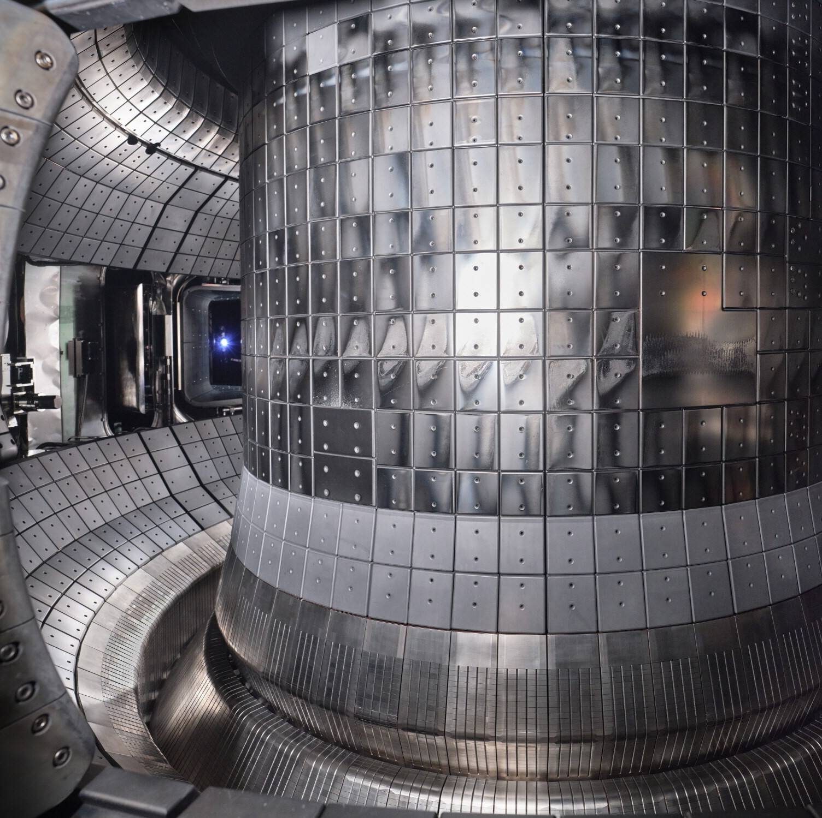
What are Tokamaks? Why need
early Predictions?
They confine Plasma in a toroidal chamber
End goal is to achieve controlled nuclear fusion.
Plasma is at extremely high temperatures (150 million degree Celsius) and a very strong magnetic field keeps it confined.
Disruptions are Sudden Catastrophic events when plasma loses its stability. These can cause severe damage to the Tokamak and the surrounding

Slide 5
Studying the parameters and
classifying their importance
Initially developed understanding of the physics inside Tokamaks and the variables (features) that will be used in the Machine Learning models via Research Papers.
This can be used to have a better understanding of which features to drop and which to give more importance or weightage in the final model.
https://docs.google.com/spreadsheets/d/1ZAg_LVyM-MQem7eGq4eDPyRTtiRHpg3OBH5EhbYWyd4/edit?gid=1044834239#gid=1044834239

Slide 6
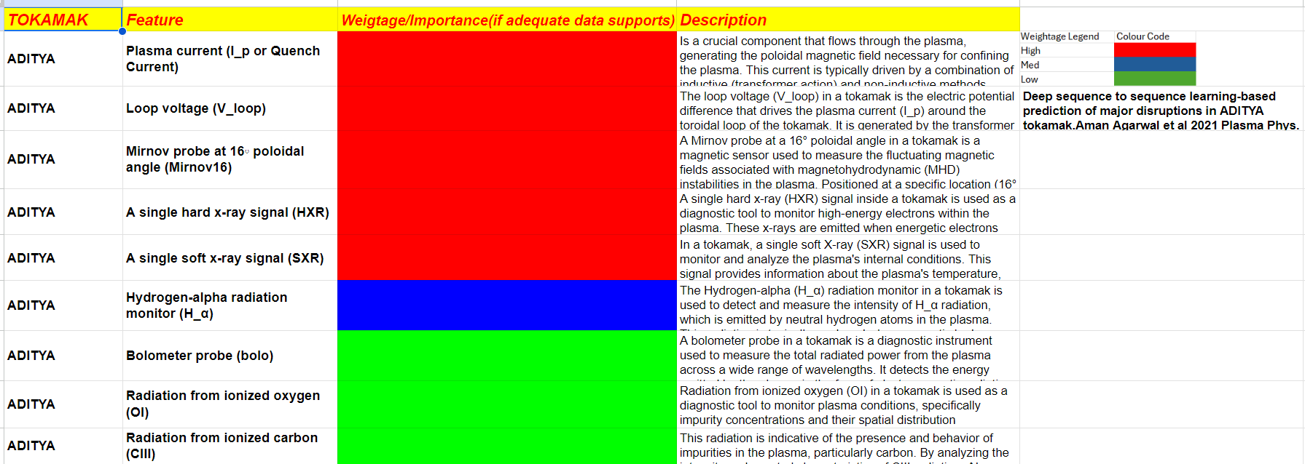
The Classification:-

Slide 7
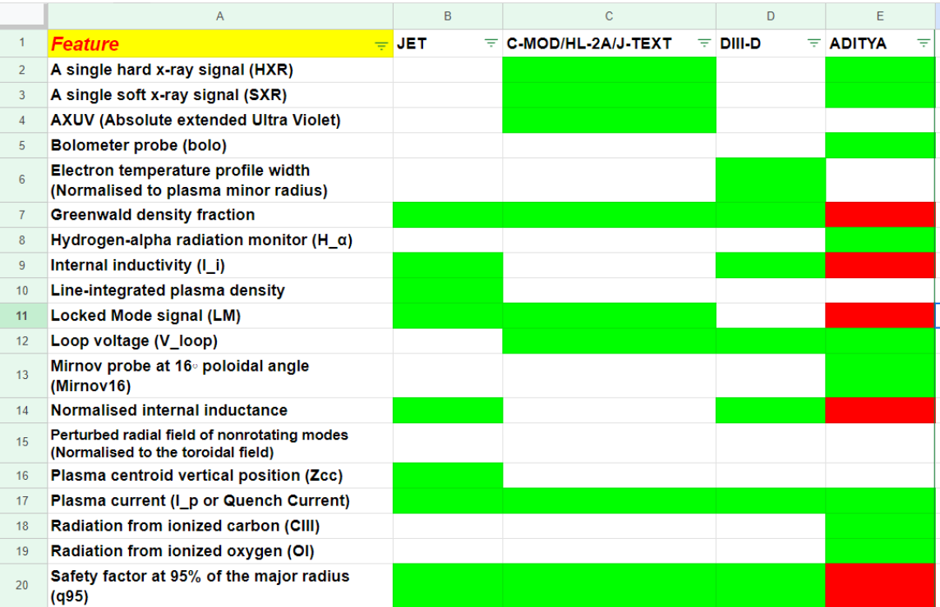
Other Tokamaks Compared

Slide 8
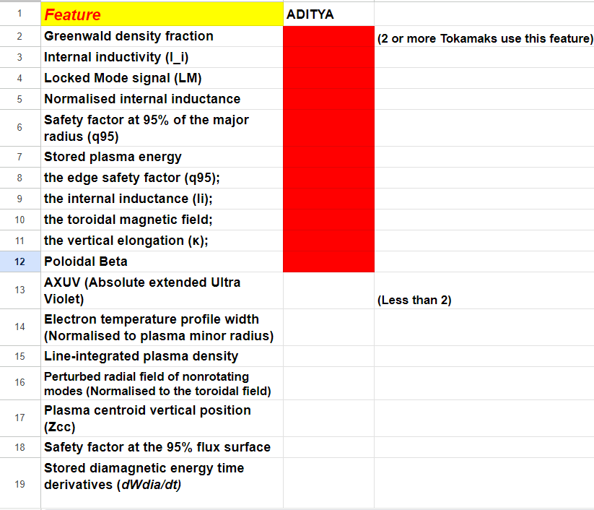
Missing Parameters

Slide 9
Data Analysis
I finally received Data to work on which was from the HL-2A Tokamak and I did some initial Data Analysis on it to develop a sense of which features matter more in our model.

Slide 10
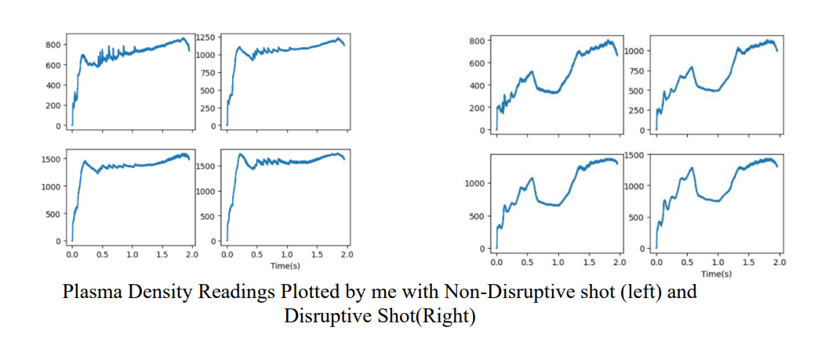
Data Analysis

Slide 11
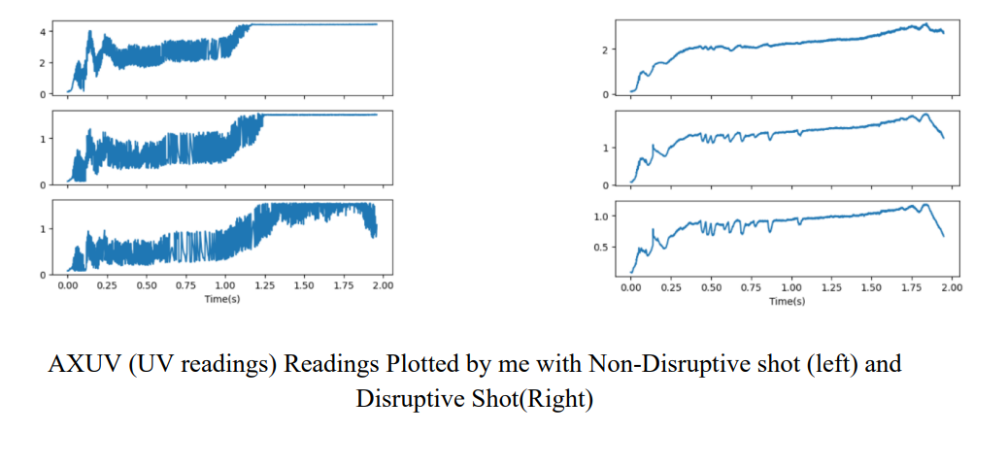
Data Analysis

Slide 12
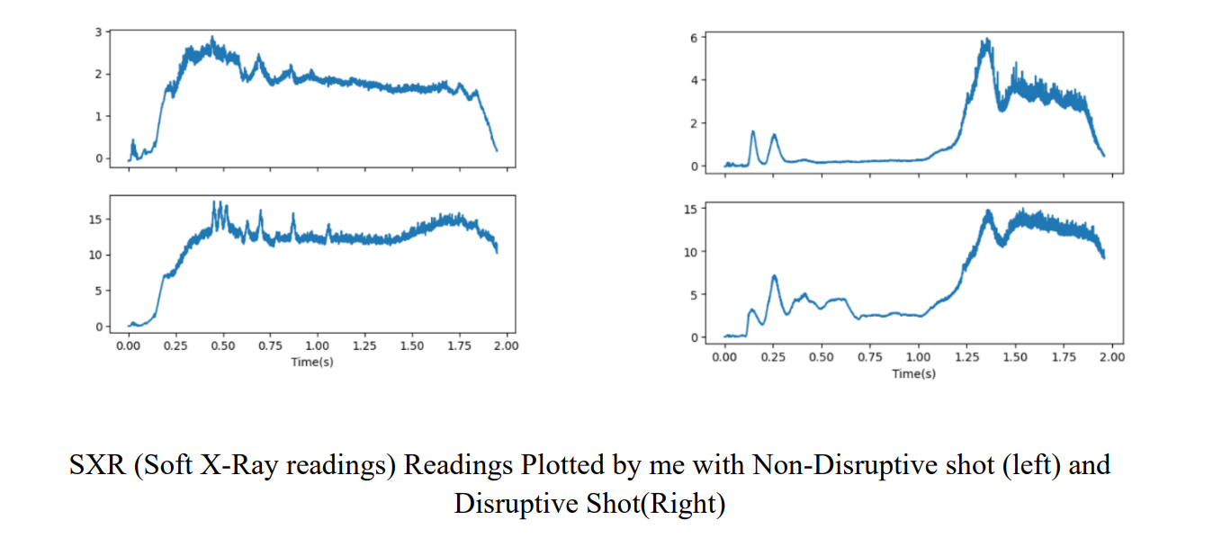
Data Analysis

Slide 13
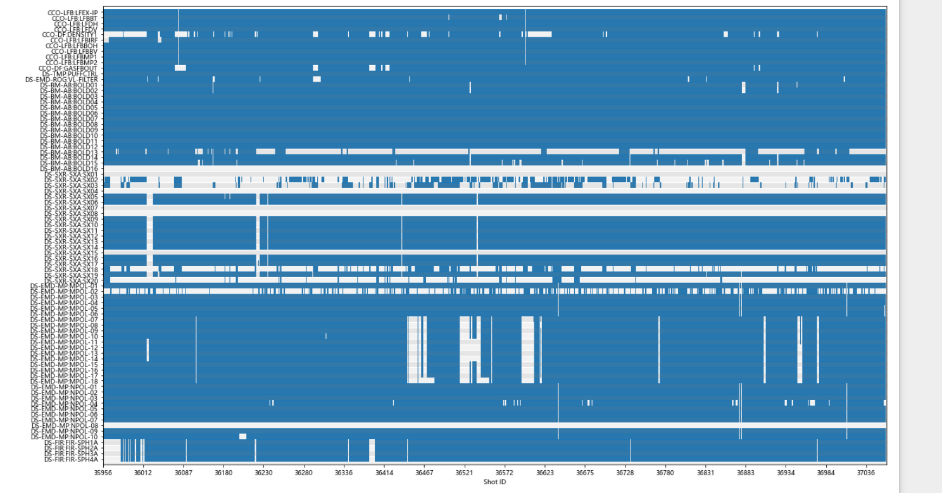
Data Cleaning
I finally received Data to work on which was from the HL-2A Tokamak and I did some initial Data Analysis on it to develop a sense of which features matter more in our model.

Slide 14
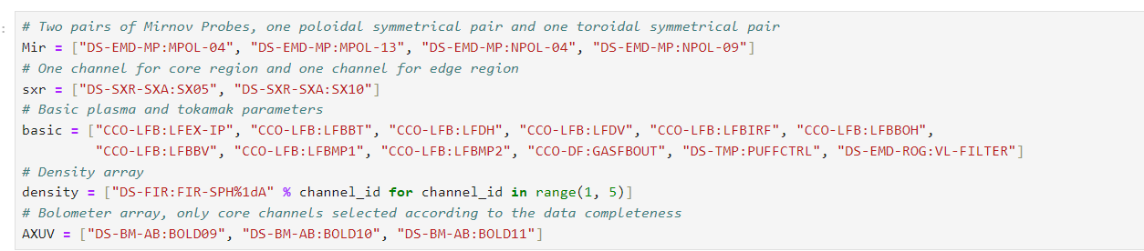
Data Cleaning
All the Features (parameters) chosen after data analysis and cleaning. Rest are dropped

Slide 15
Data Cleaning
All the Features (parameters) chosen after data cleaning

Slide 16
Data Cleaning
All the Features (parameters) chosen after data cleaning

Slide 17

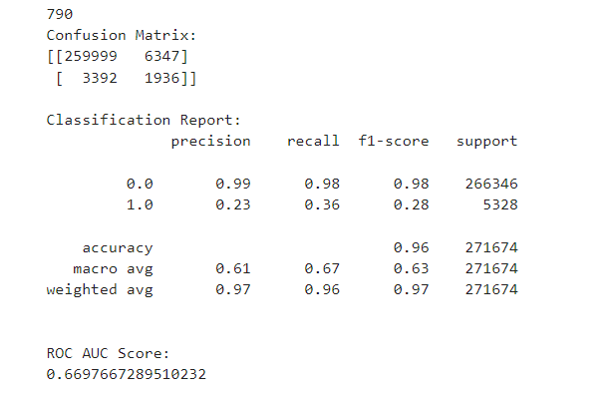
Data Cleaning

Slide 18
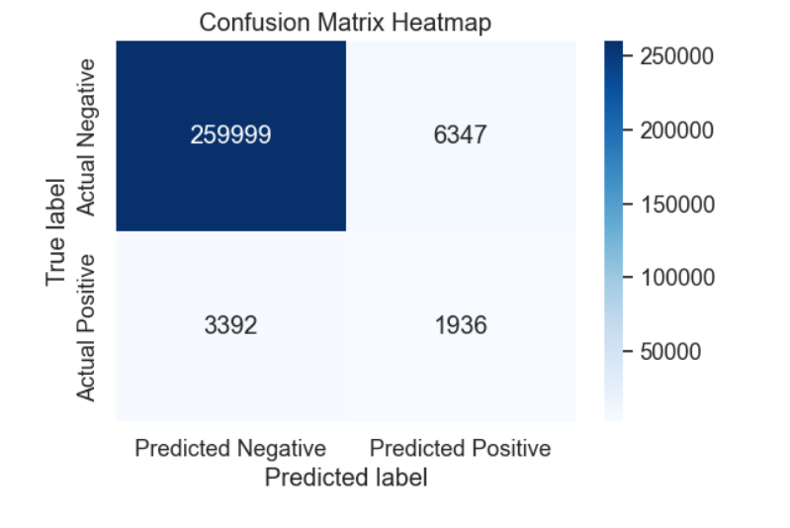
Data Cleaning

Slide 19
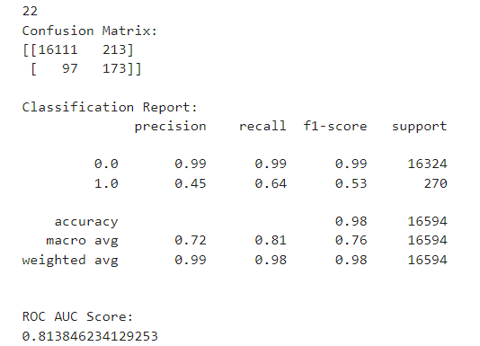

Slide 20
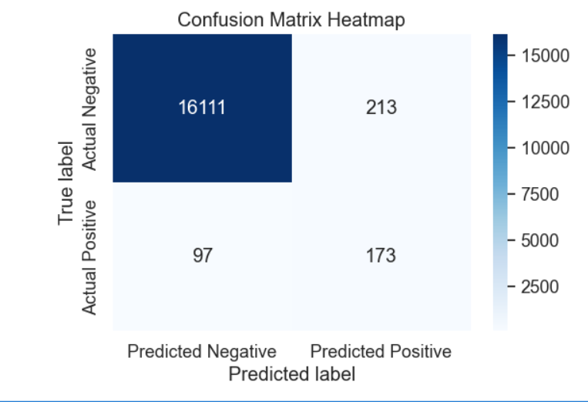

Slide 21

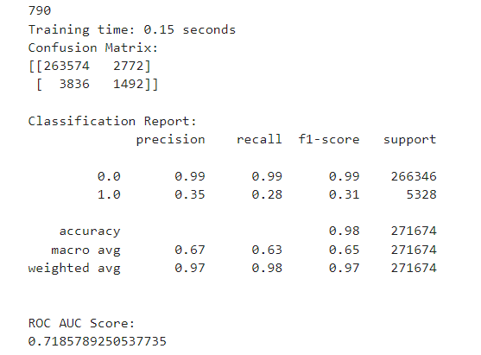

Slide 22
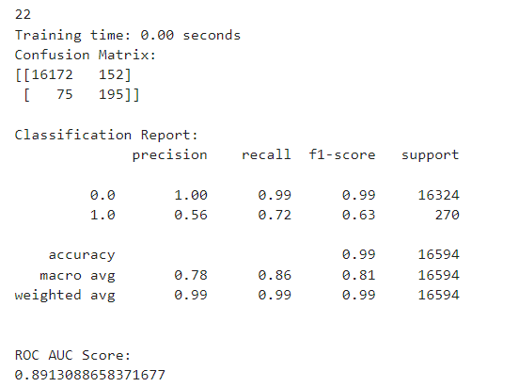


Slide 23
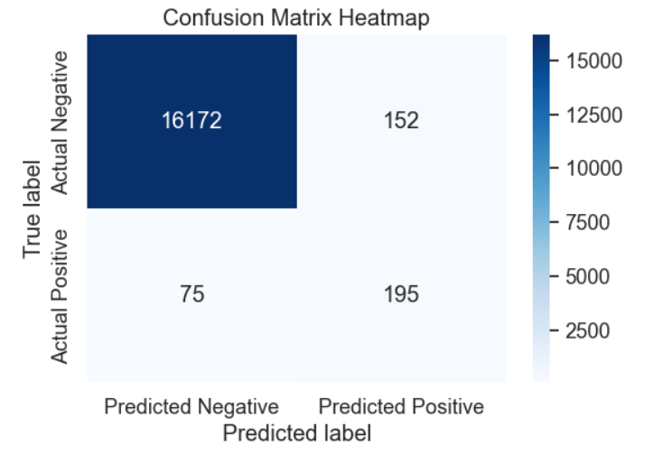

Slide 24
