Slide 1
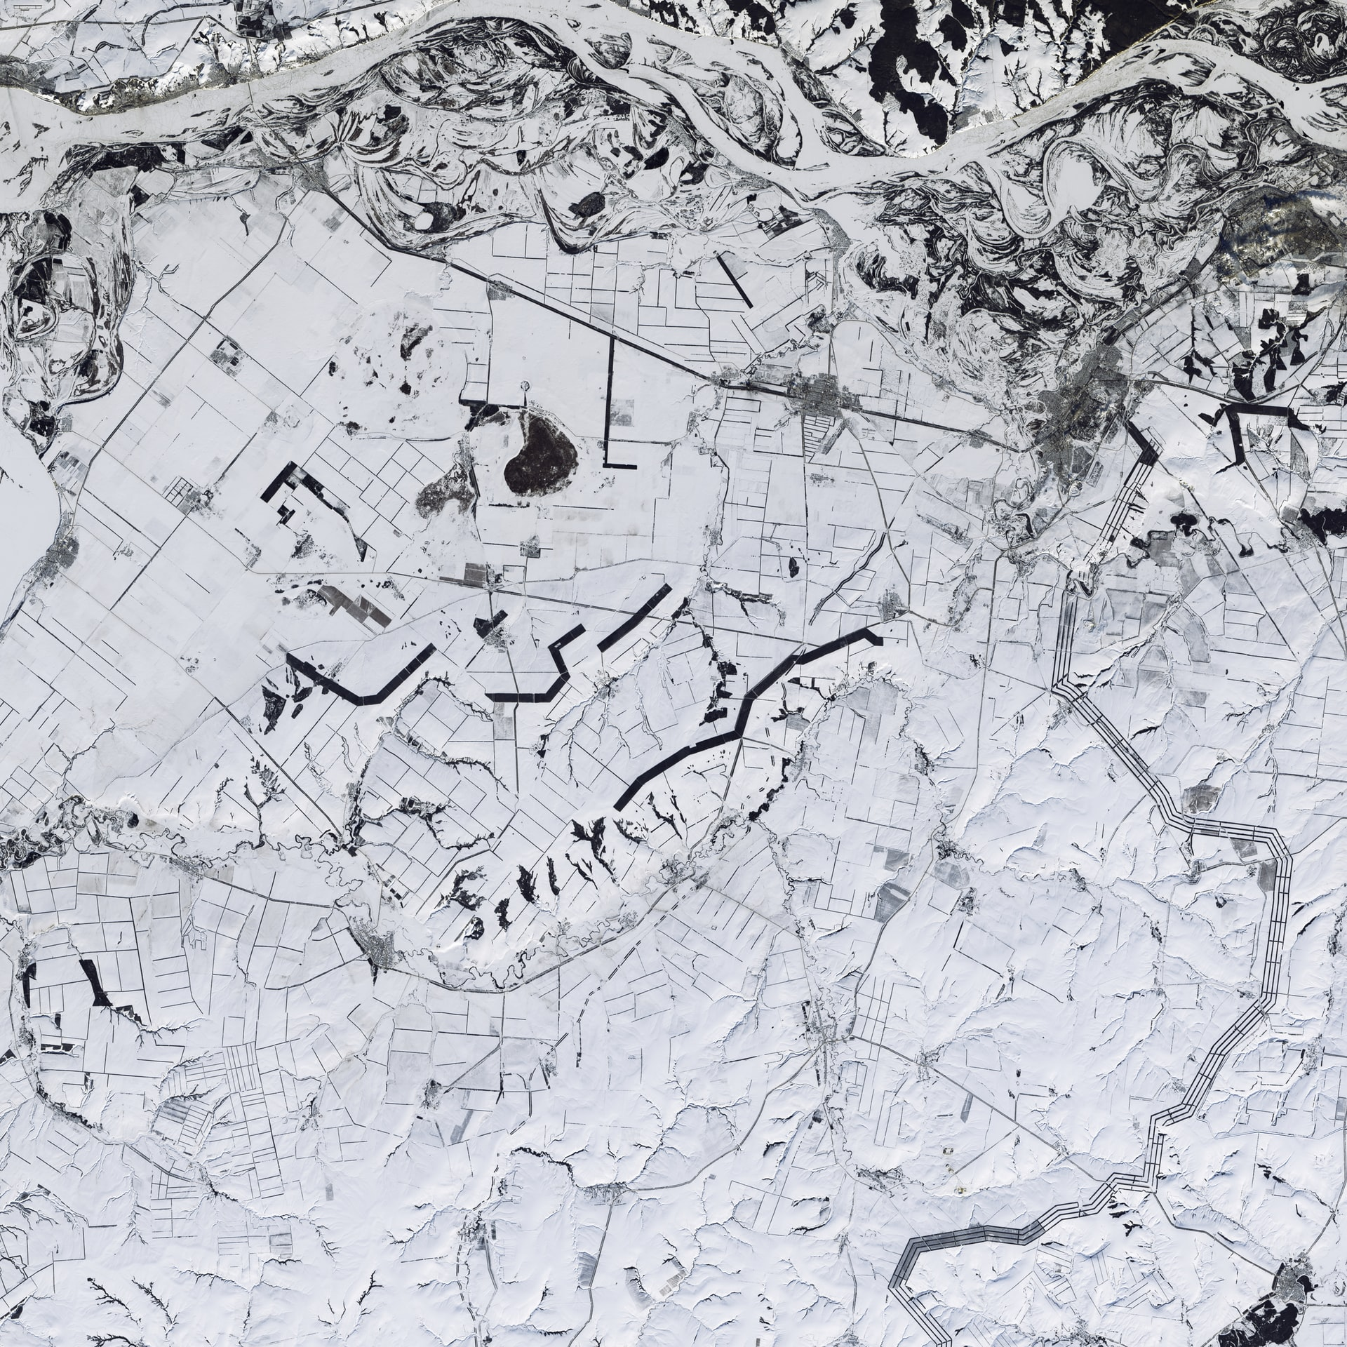
DATA DRIVEN DECISION MAKING APPLIED TO GEOSPATIAL DATA - The case of Airbnb in Tenerife -
IRONHACK DATA ANALYTICS BOOTCAMP – FINAL PROJECT
Diego Sánchez Pérez

Slide 2








The data
The main tools

Slide 3
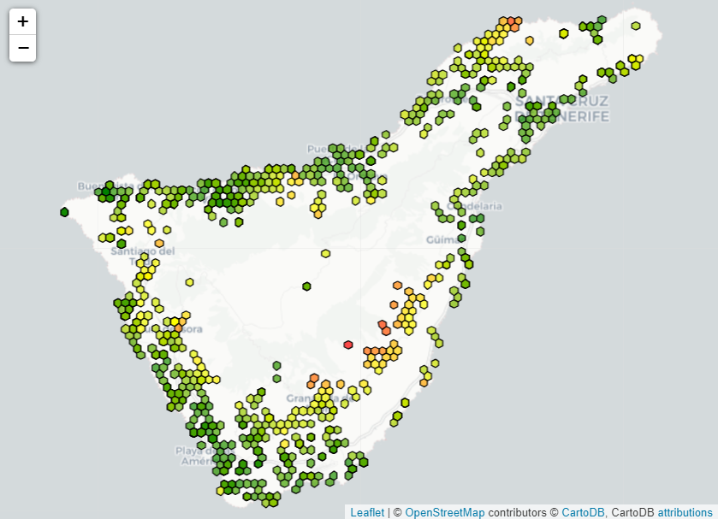
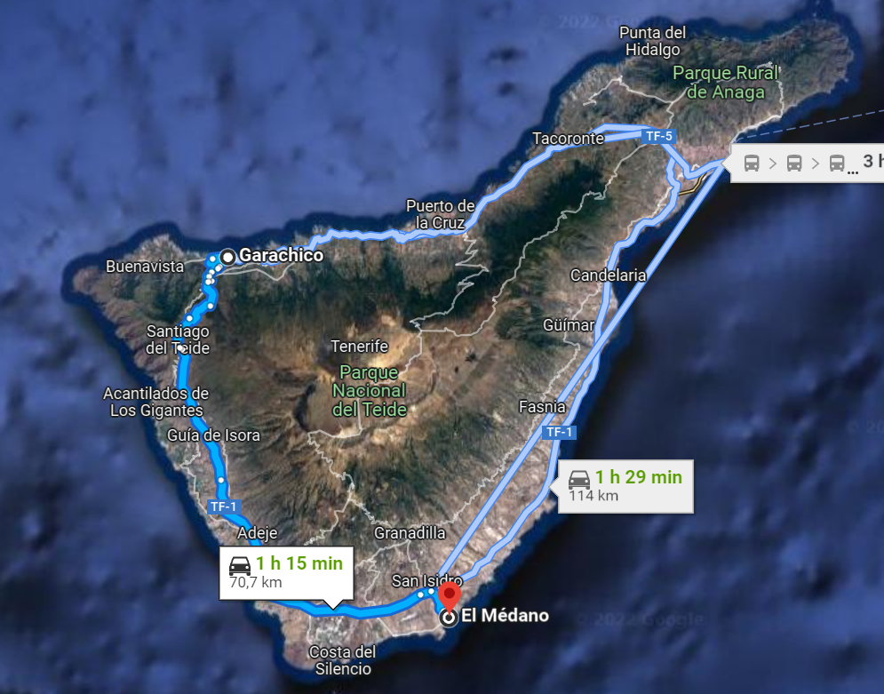
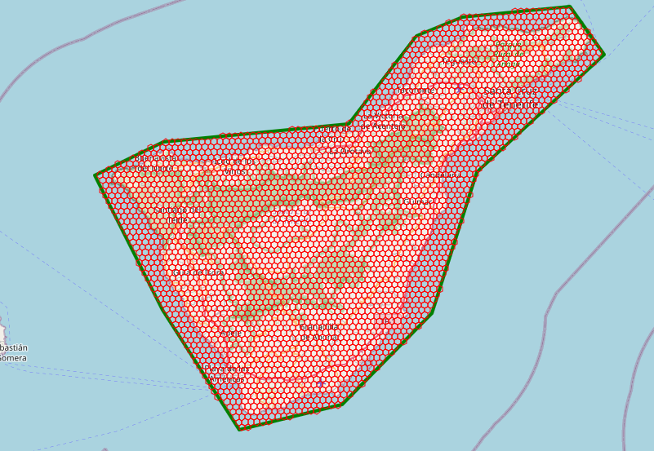
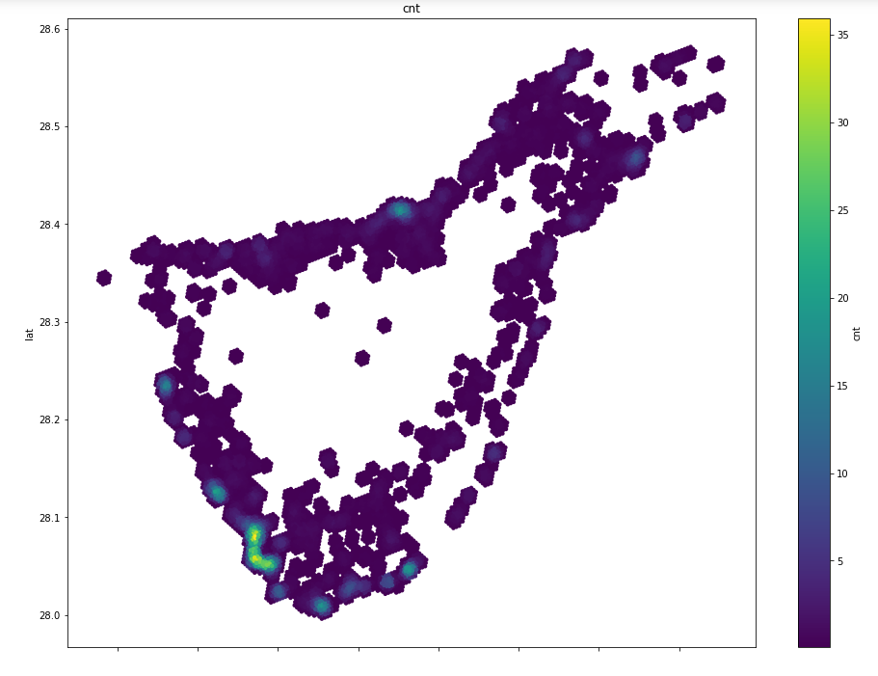
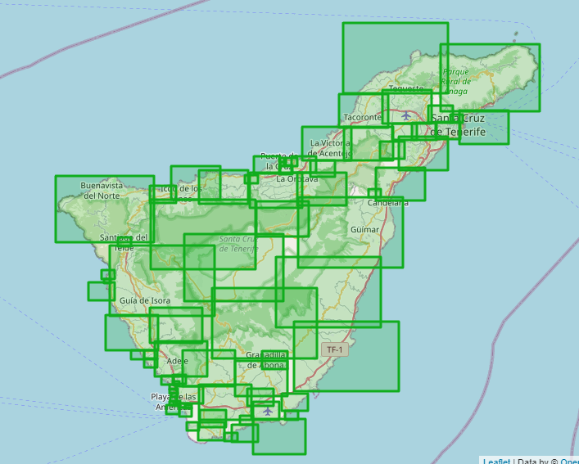
The process

Slide 4
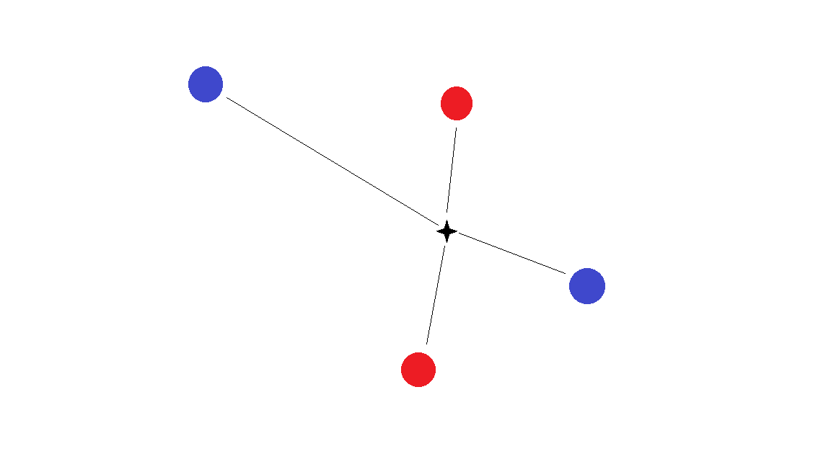


Slide 5

Thank you for listening!

