Slide 1

Football Popularity Measure
Seth W. Dice
Master of Science in Data Science, Bellevue University
DSC500-T302: Introduction to Data Science
Professor Fadi Alsaleem
May 14, 2023

Slide 2

Football Supreme
Tackle football will be discussed as this sport has repeated blows to head leading to concussions.
Football sits atop the viewership and TV rating numbers (Ojeagbase, 2022).
Football is a predominately male played sport which adds more credence to the sport being supreme versus other sports that have more participation amongst both genders (Football player demographics and statistics [2023]: Number of football players in the US, 2022).
Comparing football participation to basketball and baseball as these are listed two and three in terms of popularity, respectively (Petrova, 2023).

Slide 3

Survival of Football
Children are the future for society and sports such as football, and for football to survive it must have participants.
Research confirming links between repeated head trauma leading to Chronic Traumatic Encephalopathy (CTE).
NFL has been taking measures to reduce the risk of developing concussions/CTE with safety measures in form of rulings and player equipment.
Increased risk awareness of football could lead to less families wanting their loved ones to participate.

Slide 4
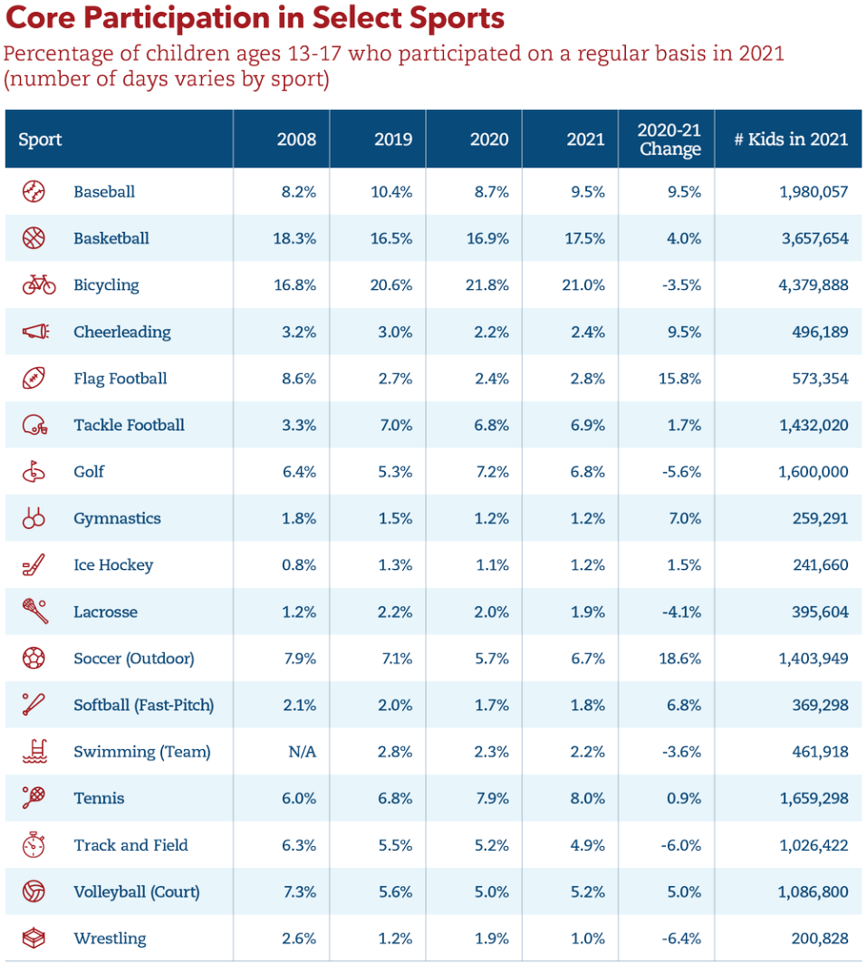
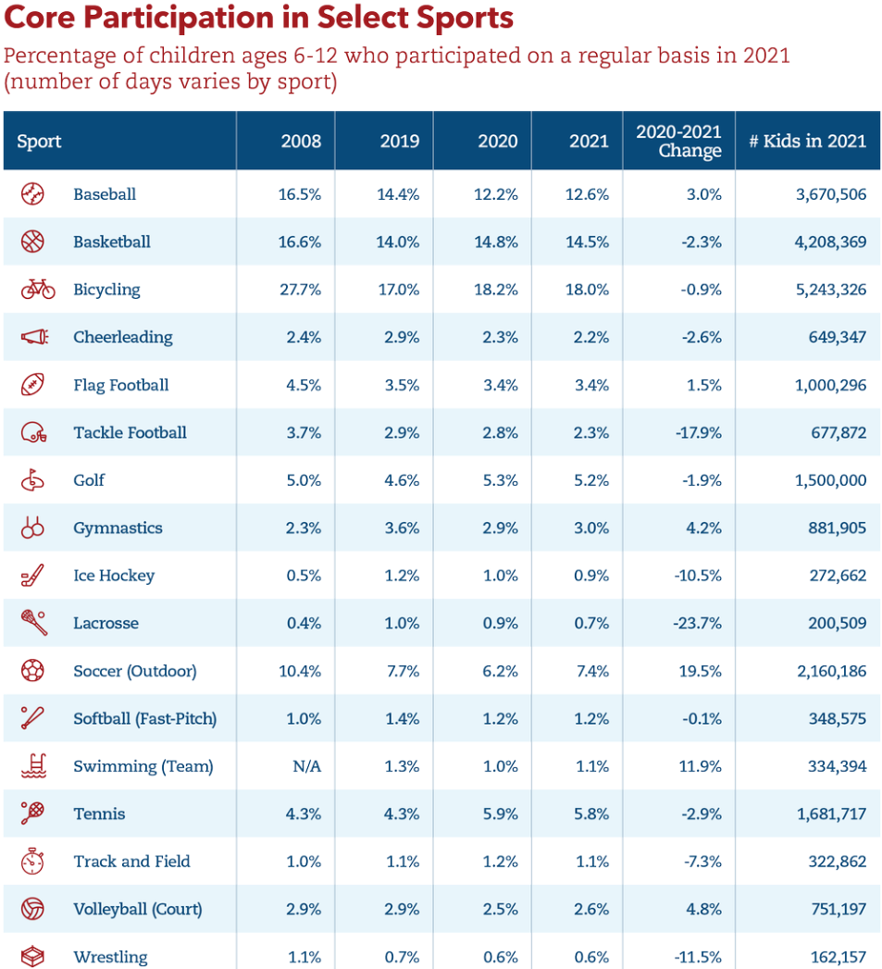
Select Football Participation Measured
Football has not seen the same increase in positive participation for 2020-2021 change versus baseball/basketball.
This chart shows Select Sports participation which is separate from other forms of sports participation such as school sports.

Slide 5
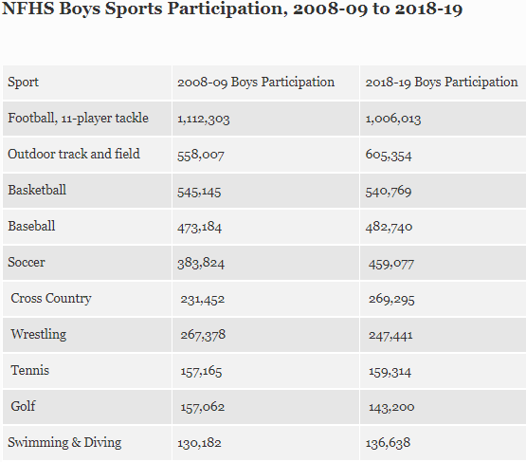
National Federation of High School Associations Participation Survey
Over time football participation decreased but remained greater than the other sports.
Shows that football has not been growing year-over-year which leaves opening for sports to gain increased participation.

Slide 6

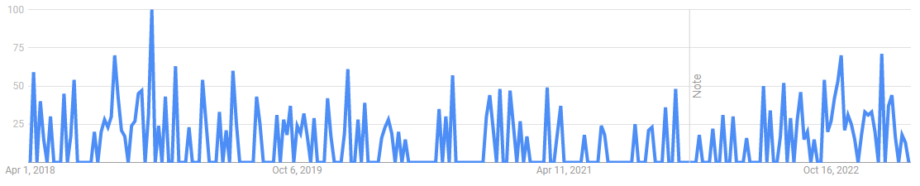
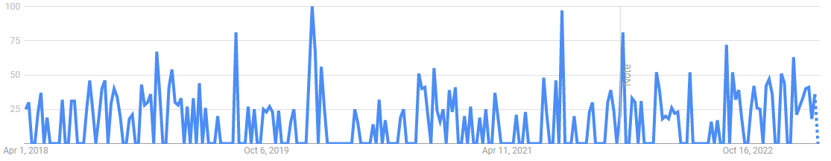
Chronic Traumatic Encephalopathy
Google Trend data “Concussions from Football” 2023
Google Trend data “Football and CTE” 2023
Chronic Traumatic Encephalopathy (CTE) is a devastating neurodegenerative disease with a 30% increase of developing for those participating in tackle football (Orsini et al., 2019).
Risk of CTE begins to double after every 2.6 years of play (Orsini et al., 2019).
Recent trend data showing public searches linking CTE and football with repeated concussions.
This information could lead to more families holding out their kids from participating in football, or even kids themselves no longer wanting to play.

Slide 7

What’s next?
K-means clustering analysis to find the areas of high football participation amongst youth in Select Sports and high school sports.
Survey the kids playing football in areas of high participation gauging football sentiment and desire to play.
Survey youth football players family for their desire to have their kid play, or if they would want them to stop playing.
Survey parents of those who don’t play football if they would want their kid to start playing.

Slide 8

Conclusion
TV viewership of football is increasing.
Football remains a popular sport among the youth to play.
Research confirming CTE linked to football with increased risks every 2.6 years of play.
Google Trends showing public beginning to become aware of CTE and football relationship while becoming informed of what CTE is.
Surveys and continued monitoring of participation levels from Select Sports and high school sports need to be continued to track football sentiment.

Slide 9
References
Football player demographics and statistics [2023]: Number of football players in the US. Football Player Demographics and Statistics [2023]: Number Of Football Players In The US. (2022, September 9). Retrieved April 20, 2023, from https://www.zippia.com/football-player-jobs/demographics/
Google Trends – concussions and football. (2023) Retrieve April 1, 2023 from https://trends.google.com/trends/explore?date=today%205
y&geo=US&q=concussions%20and%20football&hl=en
Google Trends – football and CTE. (2023) Retrieve April 1, 2023 from https://trends.google.com/trends/explore?date=today%205- y&geo=US&q=football%20and%20CTE&hl=en
Ojeagbase, S. (2022, November 23). Top 5 popular sports in the United States. Complete Sports. Retrieved April 20, 2023, from https://www.completesports.com/top-5-popular-sports-in-the-united-states/
Orsini, J. P., Crossan, S., Fleming, J., Strueh, B., &amp; Perkins-Berry, M. (2019, October 7). CTE risk more than doubles after just three years of playing football. Boston University. Retrieved April 2, 2023, from https://www.bu.edu/articles/2019/cte-football/
Petrova, A. (2023, April 13). The 10 most popular sports in the USA. The Sporting Blog. Retrieved April 20, 2023, from https://thesporting.blog/blog/the-10-most-popular-sports-in-the-us
Youth Sports Facts: Participation rates. The Aspen Institute Project Play. (2021). Retrieved April 20, 2023, from https://www.aspenprojectplay.org/youth-sports/facts/participation-rates

