Slide 1
Diabetes Feature Correlation and Ranking Using Multinomial Regression
Seth W. Dice
Data Science, Bellevue University
DSC630: Predictive Analytics
Dr. Toni Farley
August 10, 2025

Slide 2
Diabetes in the United States
Diabetes prevalence has been increasing yearly in the United States while being in the top 10 causes of death for persons in the U.S. (Centers for Disease Control and Prevention, 2025)
10% - 13% increase in Total Diabetes (diagnosed/undiagnosed) from years 2001-2020 (Statistics about diabetes, 2025)
Type 1 diabetes makes up 5% of population while Type 2 diabetes makes up 90-95% of population (About diabetes 2023)

Slide 3
Questions?
Which feature variables are more correlated with having diabetes presence/no diabetes and can this be used to predict future instances?
Are we able to rank feature variables in importance to give more focus to those factors?

Slide 4
Programs Used
Rstudio was used as the programming language (R) and the IDE.
Key package: nnet
Data imported from Excel document.

Slide 5
Data Overview
diabetes_012_health_indicators_BRFSS2015.xlsx
253,680 survey responses
21 feature variables with 1 target variable
Diabetes_012 as target variable:
0 – No diabetes or only during pregnancy
1 – Prediabetes
2 – Participant has diabetes

Slide 6
Model Selection
Multinomial Logistic Regression Model
Target variable having more than 2 categories.
Model to identify which predictors influence probability of not having diabetes, diabetes only during pregnancy, or having diabetes.
Feature variables are either continuous or categorical.

Slide 7
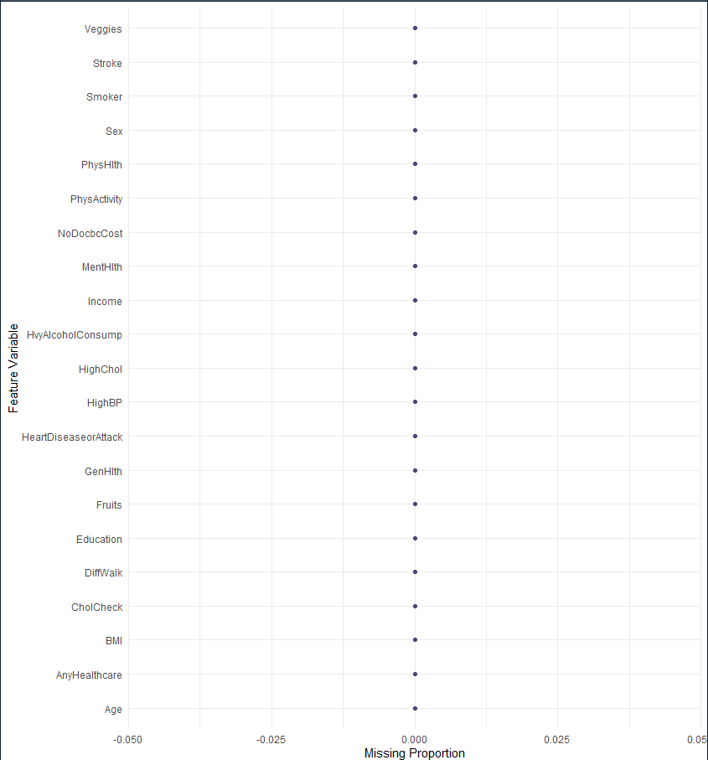
Data Visualization #1
Visualization shows that there are no missing values within the dataset.

Slide 8
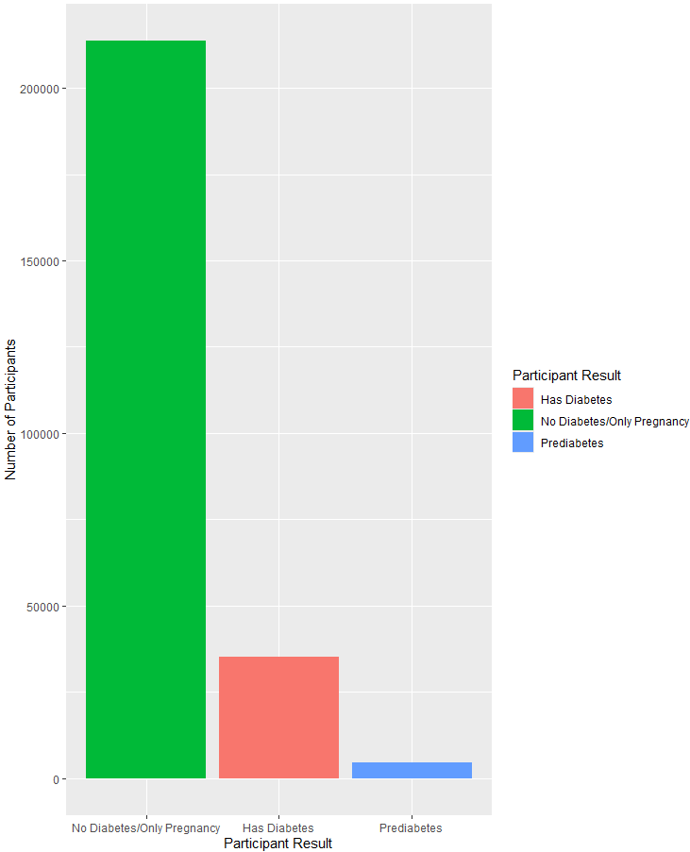
Data Visualization #2
The target variable is made up of more than 2 choices while also being what’s considered an unbalanced dataset.

Slide 9
Model Interpretation
The odds ratio provided show the increase (positive values) and decrease (negative values) that the feature variables have on the target variable.
The TRUE/FALSE is hypothesis test where TRUE showing p-values > 0.05 and FALSE showing p-values < 0.05.

Slide 10


Prediction Confirmation
Confirming that the predictions were all made on the training and test data sets.
Both the training (first) and testing (second) picture show that all the values from the target variable have been predicted.

Slide 11
Conclusion
The top 5 feature variables from dataset to predict diabetes risk:
1) HighBP
2) HighChol
3) CholCheck
4) GenHlth
5) BMI
Recommendation is to focus on above values to help identify those at risk of developing diabetes.

Slide 12
Ethical Risks
Ensure data inputs do not include sensitive information that could be tied back to an individual.
Ensure data being used to train/test model is not focusing on race demographic specific data.

Slide 13
References
About diabetes. Congressional Diabetes Caucus. (2023, August 21). https://diabetescaucus-degette.house.gov/facts-and-figures
Centers for Disease Control and Prevention. (2025, June 5). FASTSTATS - leading causes of death. Centers for Disease Control and Prevention. https://www.cdc.gov/nchs/fastats/leading-causes-of-death.htm
Statistics about diabetes. Diabetes in America: Prevalence, Statistics, and Economic Impact. (n.d.). https://diabetes.org/about-diabetes/statistics/about-diabetes

