Slide 1
Introdução ao Docker

Slide 2
DOCKER
Open Source
GoLang
2013/2014/2016
Cisco, Google, Huawei, IBM, Microsoft, Red Hat
Efêmero

Slide 3
WIKIPEDIA
Docker is an open-source project that automates the deployment of applications inside software containers, by providing an additional layer of abstraction and automation of operating-system-level virtualization on Linux.

Slide 4
Docker Comandos Básicos
docker ps
docker ps –a
docker stop {contID}
docker rm {contID}
docker run {image}

Slide 5
Hands ON Redis
docker run redis

Slide 6
Hands ON Ports
docker run -p 6379:6379 redis

Slide 7
Hands ON Daemon
docker run -d -p 6379:6379 redis

Slide 8
Hands ON Exec
docker exec -it {ContID} bash

Slide 9
Hands ON Volumes
docker run -d -p 6379:6379 -v /Users/disiqueira/Playground/Flisol/redis_data:/data redis

Slide 10
Hands ON Docker-Compose
docker-compose.yml
Descritivo
Fácil
docker-compose up
Estupidamente simples

Slide 11
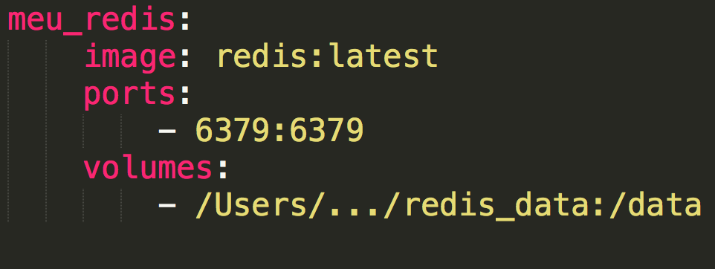
Hands ON Docker-Compose

Slide 12
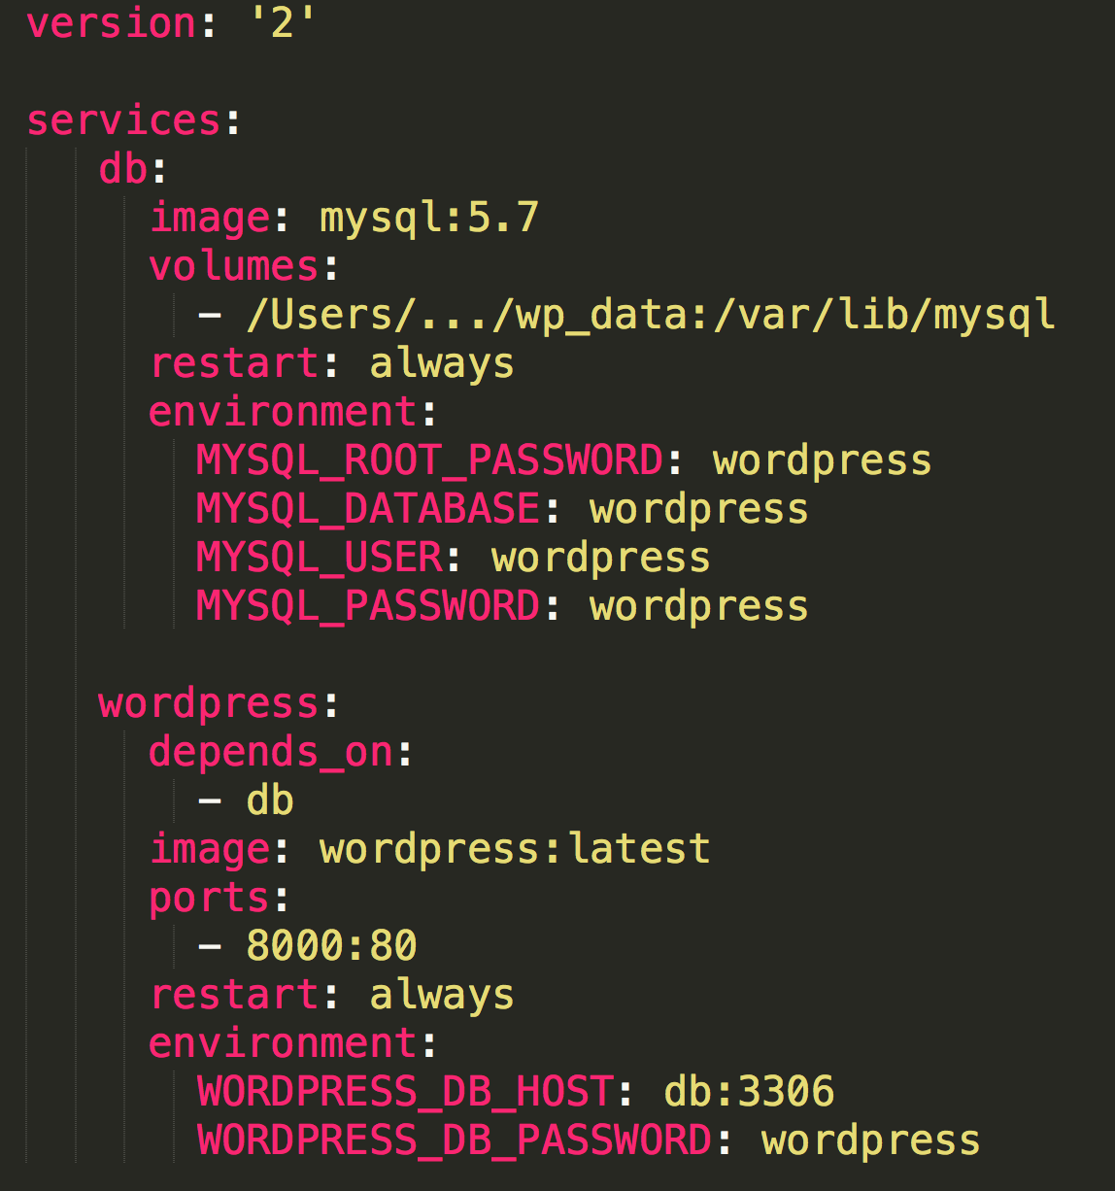
Hands ON Docker-Compose

Slide 13
Introdução ao Docker
OBRIGADO!!

