Slide 1
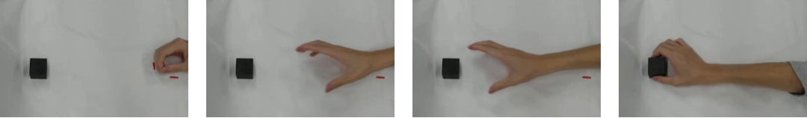
Typical Aperture Changes in Human Grasping
1. Initially Closed
2. Opening
3. Wide Open
4. Closing to Grasp
Actual grasping sequence (overhead camera view)
Finger aperture during grasping
1. Opening and closing
The fingers open during reaching and close
before contacting the object. [5]
2. Adjustment to object size
Larger objects generally lead to a larger
maximum grip aperture. [6]
3. Adjustment to movement conditions
Grip aperture adapts to movement speed
and accuracy requirements. [6, 7]
Schematic only; curves do not represent measured data
[5] Jeannerod M. J Mot Behav 16:235–254, 1984. [6] Smeets JBJ, Brenner E. Motor Control 3:237–271, 1999.
[7] Wing AM, Turton A, Fraser C. J Mot Behav 18:245–260, 1986.
Notes:
Background slide, not a report of the present experiments. The top photographs are user-supplied illustrations of an actual grasp. The editable chart is a qualitative schematic, with arbitrary aperture units and movement progress; its values and peak timing are not empirical estimates.
[5] Jeannerod M (1984). The Timing of Natural Prehension Movements. Journal of Motor Behavior 16(3):235–254. https://doi.org/10.1080/00222895.1984.10735319 https://pubmed.ncbi.nlm.nih.gov/15151851/
[6] Smeets JBJ, Brenner E (1999). A New View on Grasping. Motor Control 3(3):237–271. https://doi.org/10.1123/mcj.3.3.237 This paper integrates previous experimental findings with a theoretical alternative.
[7] Wing AM, Turton A, Fraser C (1986). Grasp Size and Accuracy of Approach in Reaching. Journal of Motor Behavior 18(3):245–260. https://doi.org/10.1080/00222895.1986.10735380
No universal numerical claims about maximum-aperture timing or speed-related percentage increases are made. This slide does not claim that all grasping is unconscious.

