Slide 1
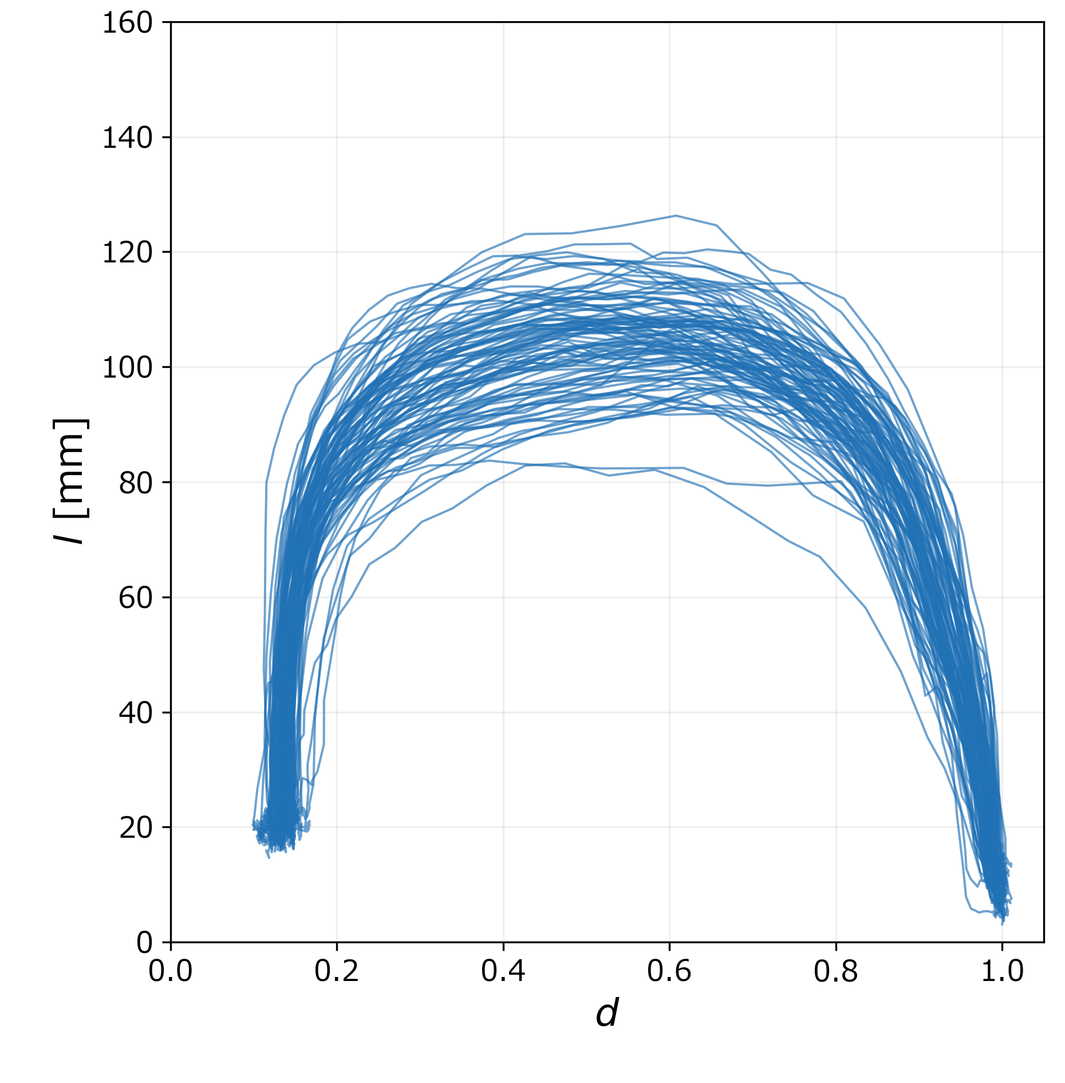
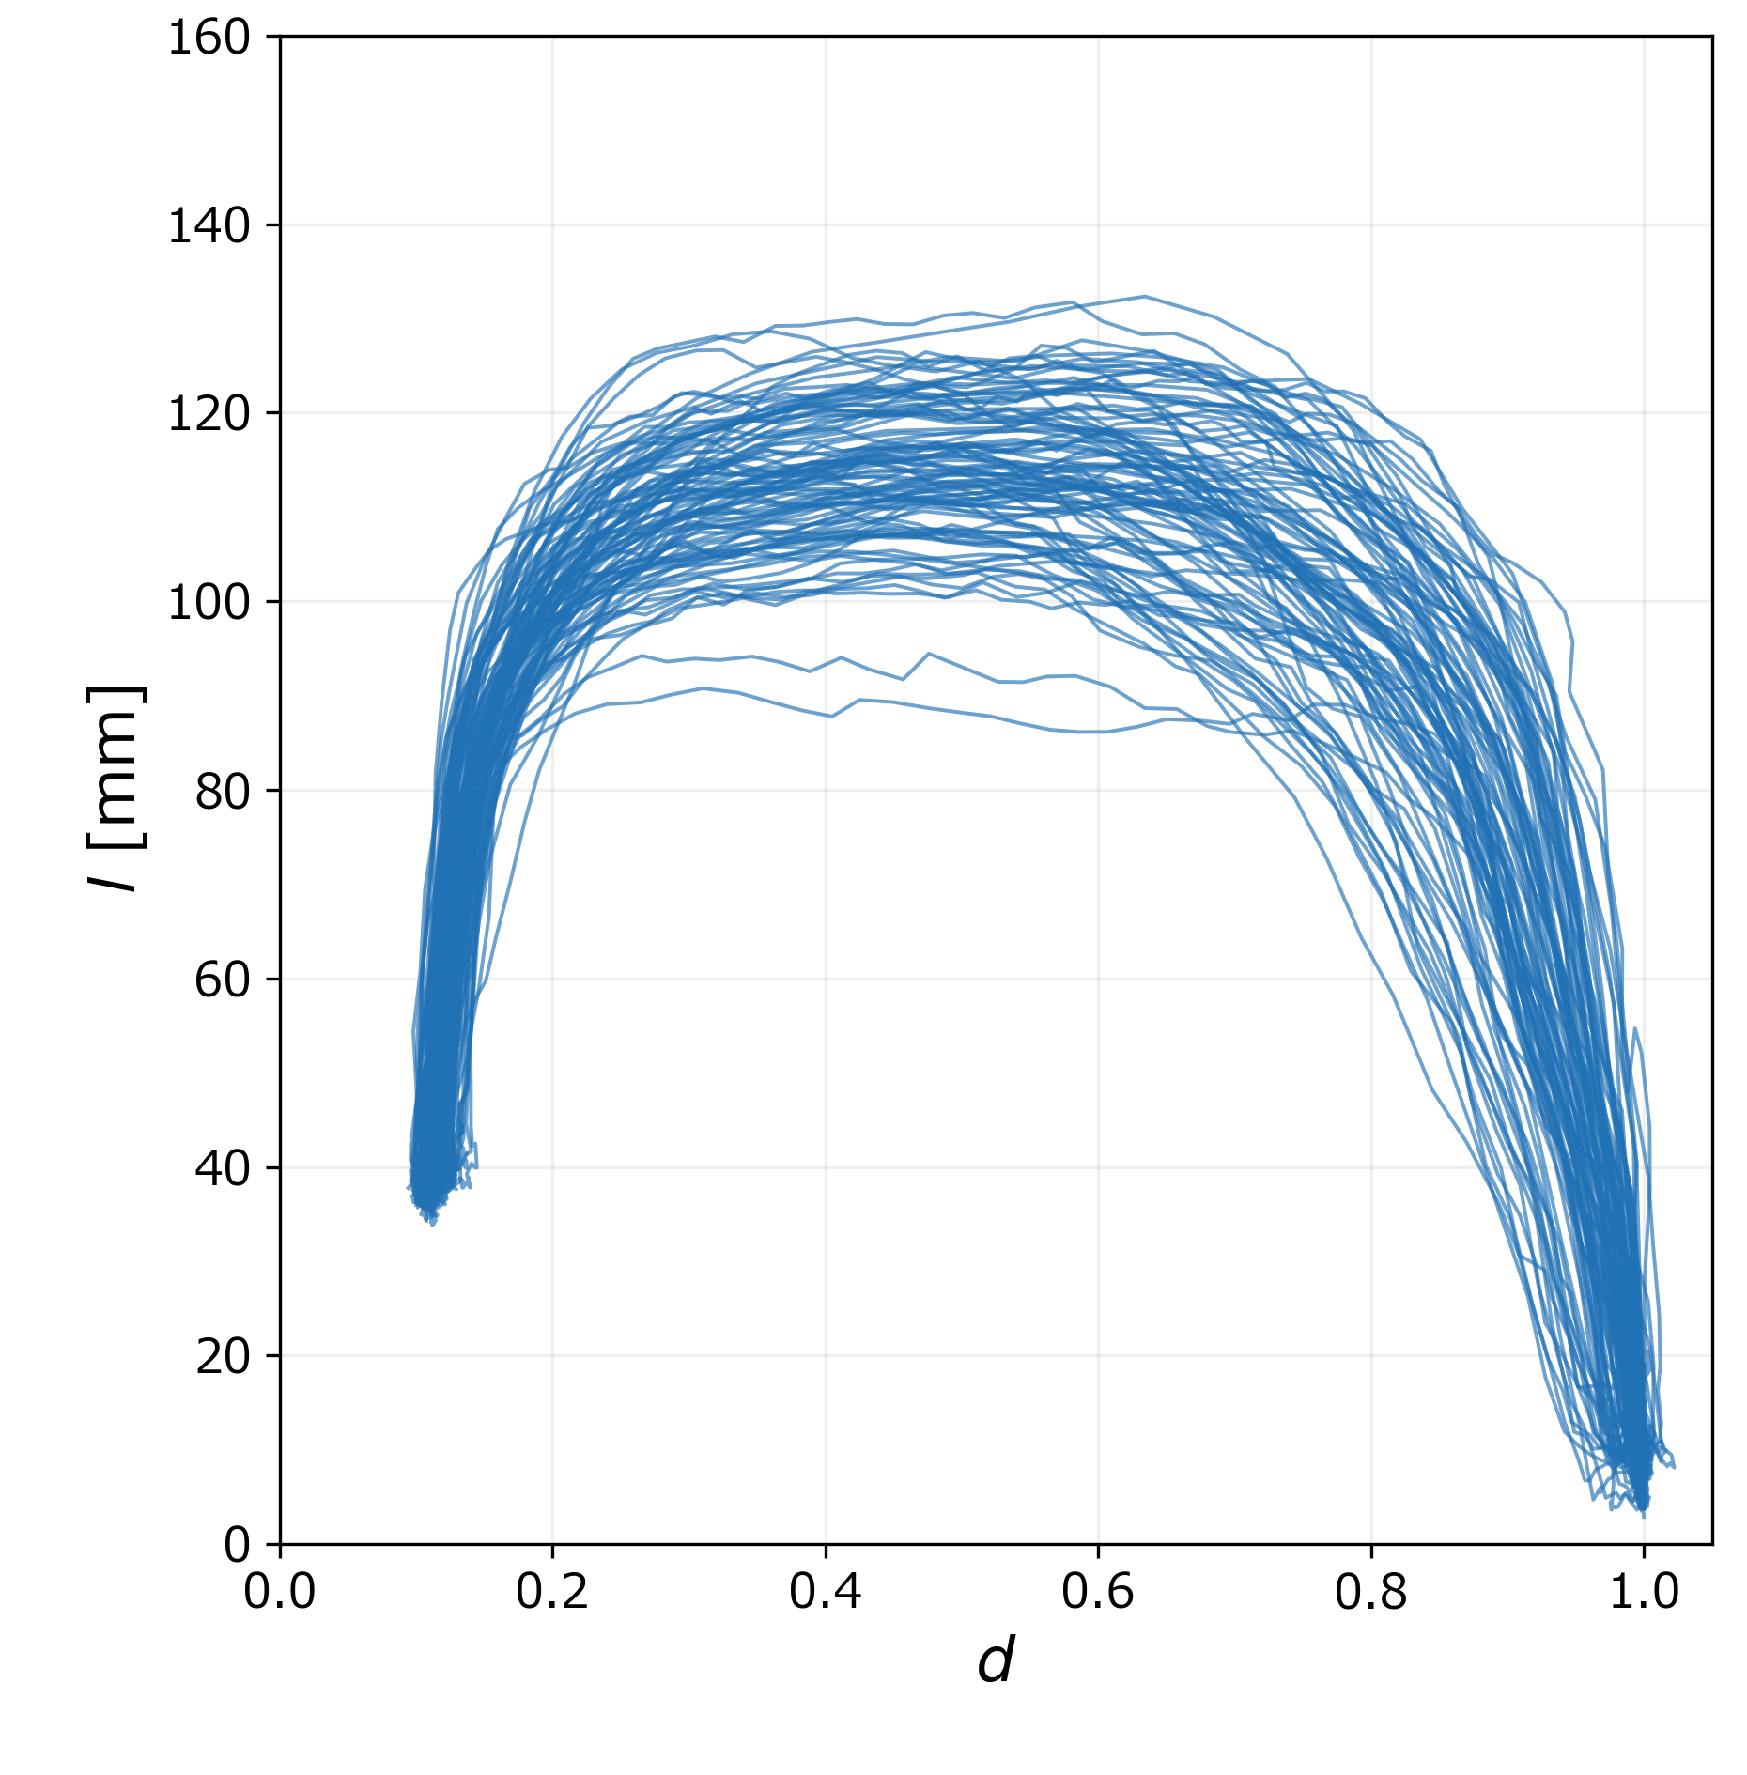
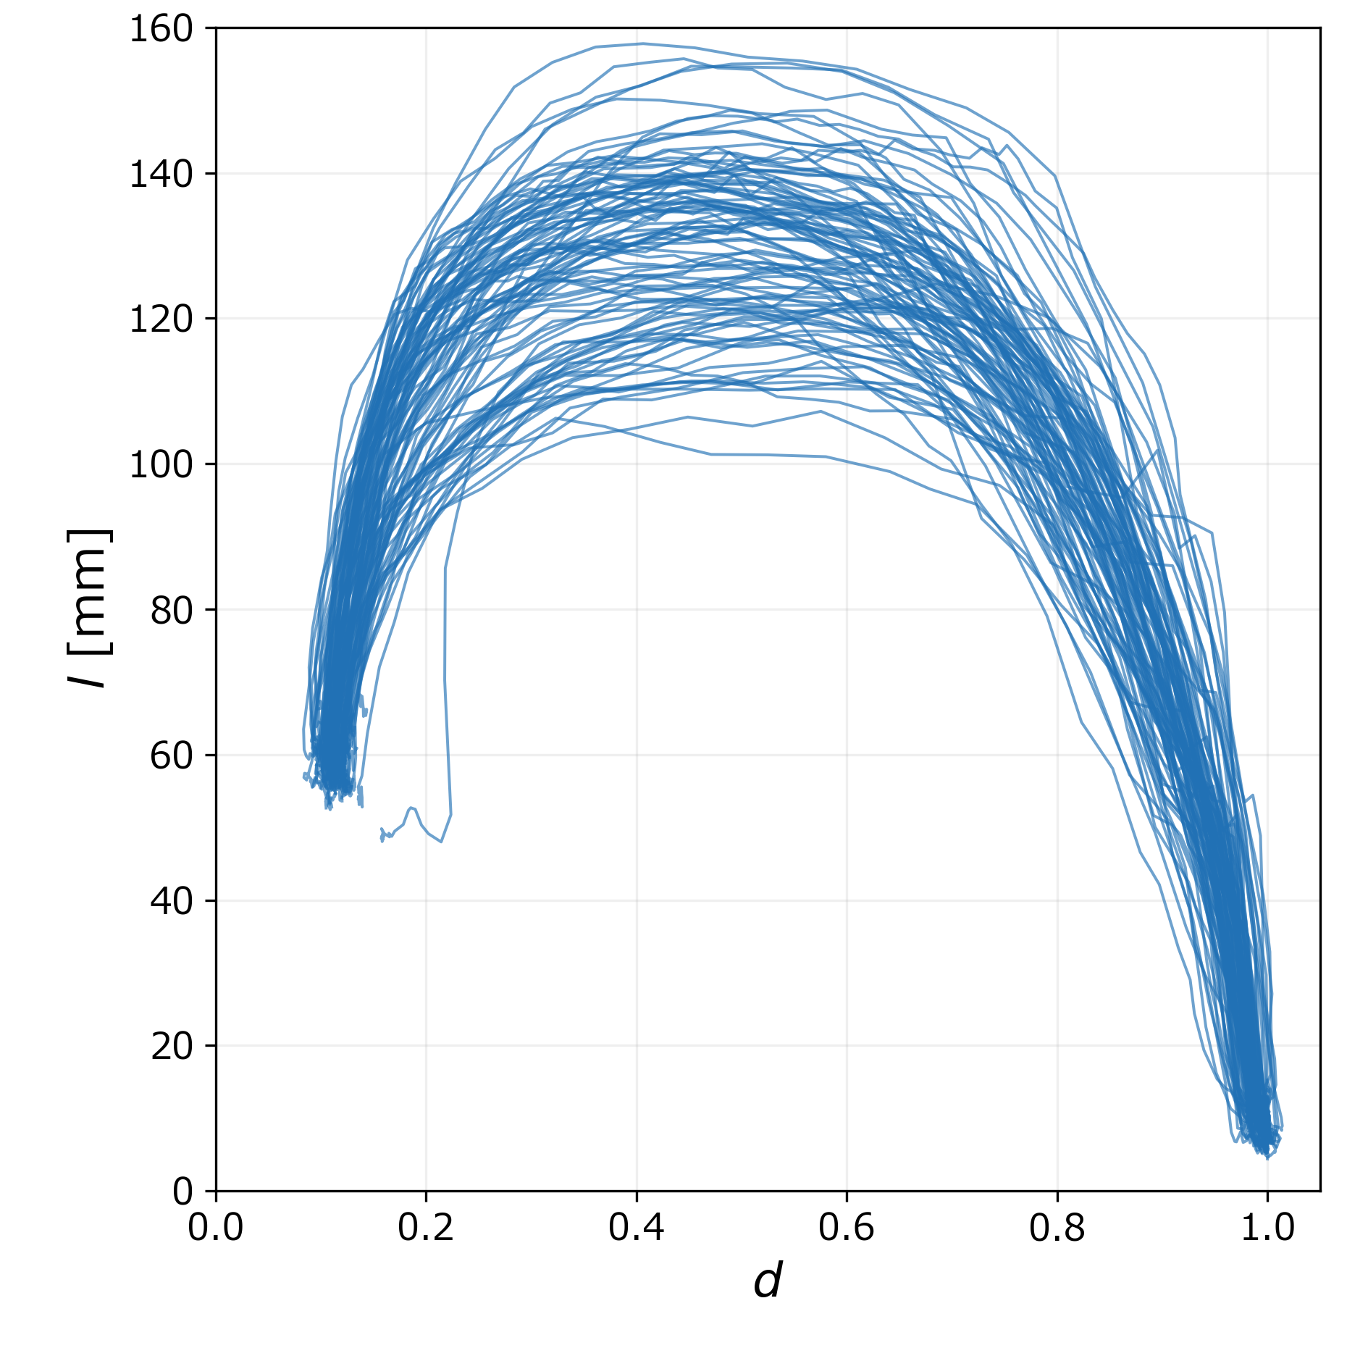
Overlaid Curves from 100 Trials for Each Cube Size
20mm
30mm
40mm
Distance normalized: The initial value set to 1 and the current value calculated as dₜ/d₀.
Grasping speed varied: Grasping durations ranging from 1 to 3 seconds.
Px to mm: mm = px / conversion factor (determined through prior measurements).
Base of the index finger was set as the hand point.
Notes:
モデルを比べる前に、まずデータを確認します。立方体ごとに100試行の d–l 曲線を重ね描きし、試行間で一貫しているか、最大開口がどこで現れるか、サイズや速さでどう変わるかを見ます。

Slide 2
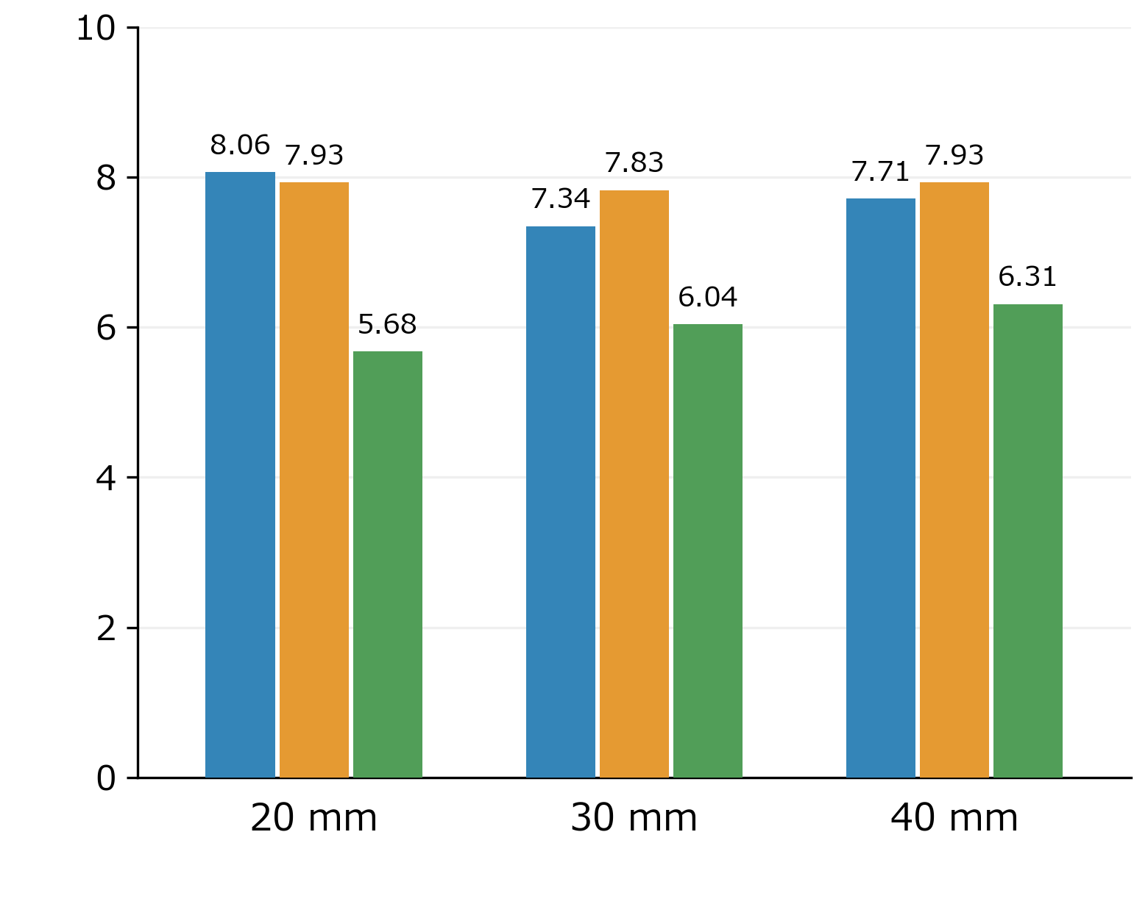
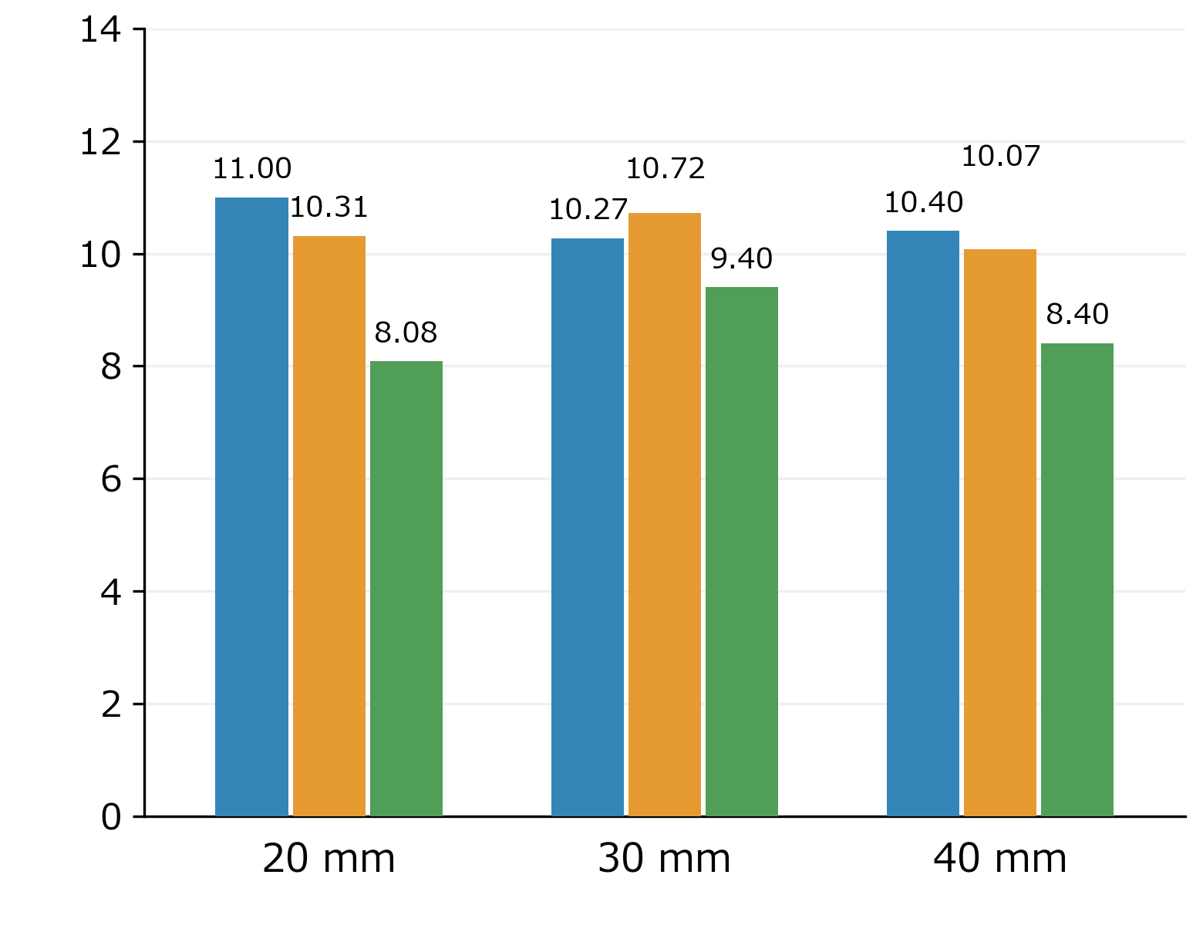
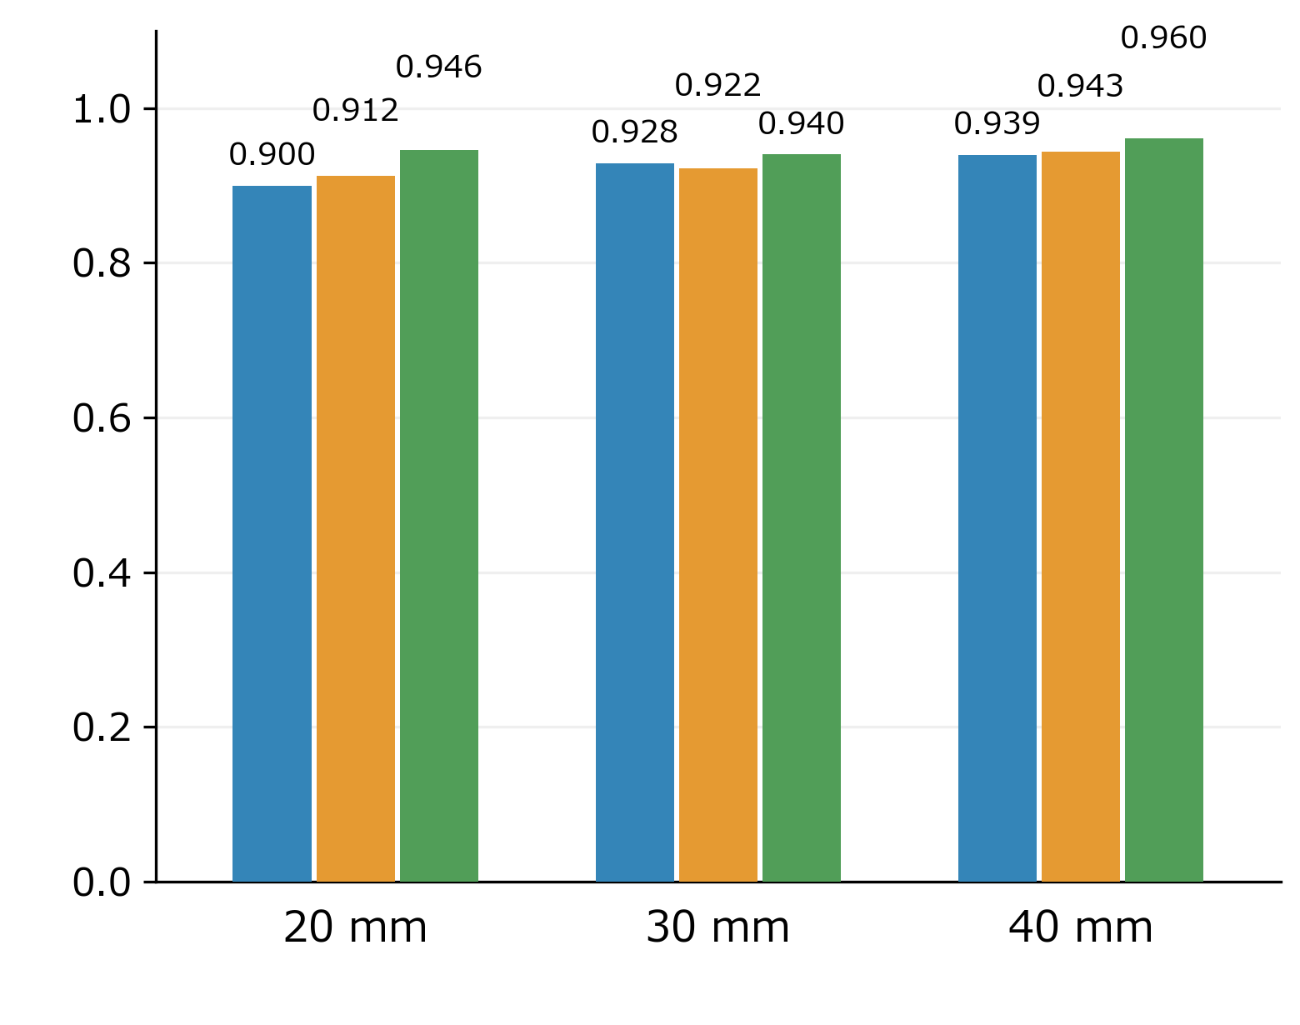
Prediction Performance
Training: 75 trials | Testing: 25 trials
MAE [mm] | 20 mm | 30 mm | 40 mm
Function Approximation | 8.06 | 7.34 | 7.71
MLP (5 Frame) | 7.93 | 7.83 | 7.93
LSTM (Full Frame) | 5.68 | 6.04 | 6.31
MAE [mm]
RMSE [mm]
  R²
Notes:
主な結果として、各モデル・各サイズの誤差を示します。RMSE と R² は補足スライドに入れます。

Slide 3
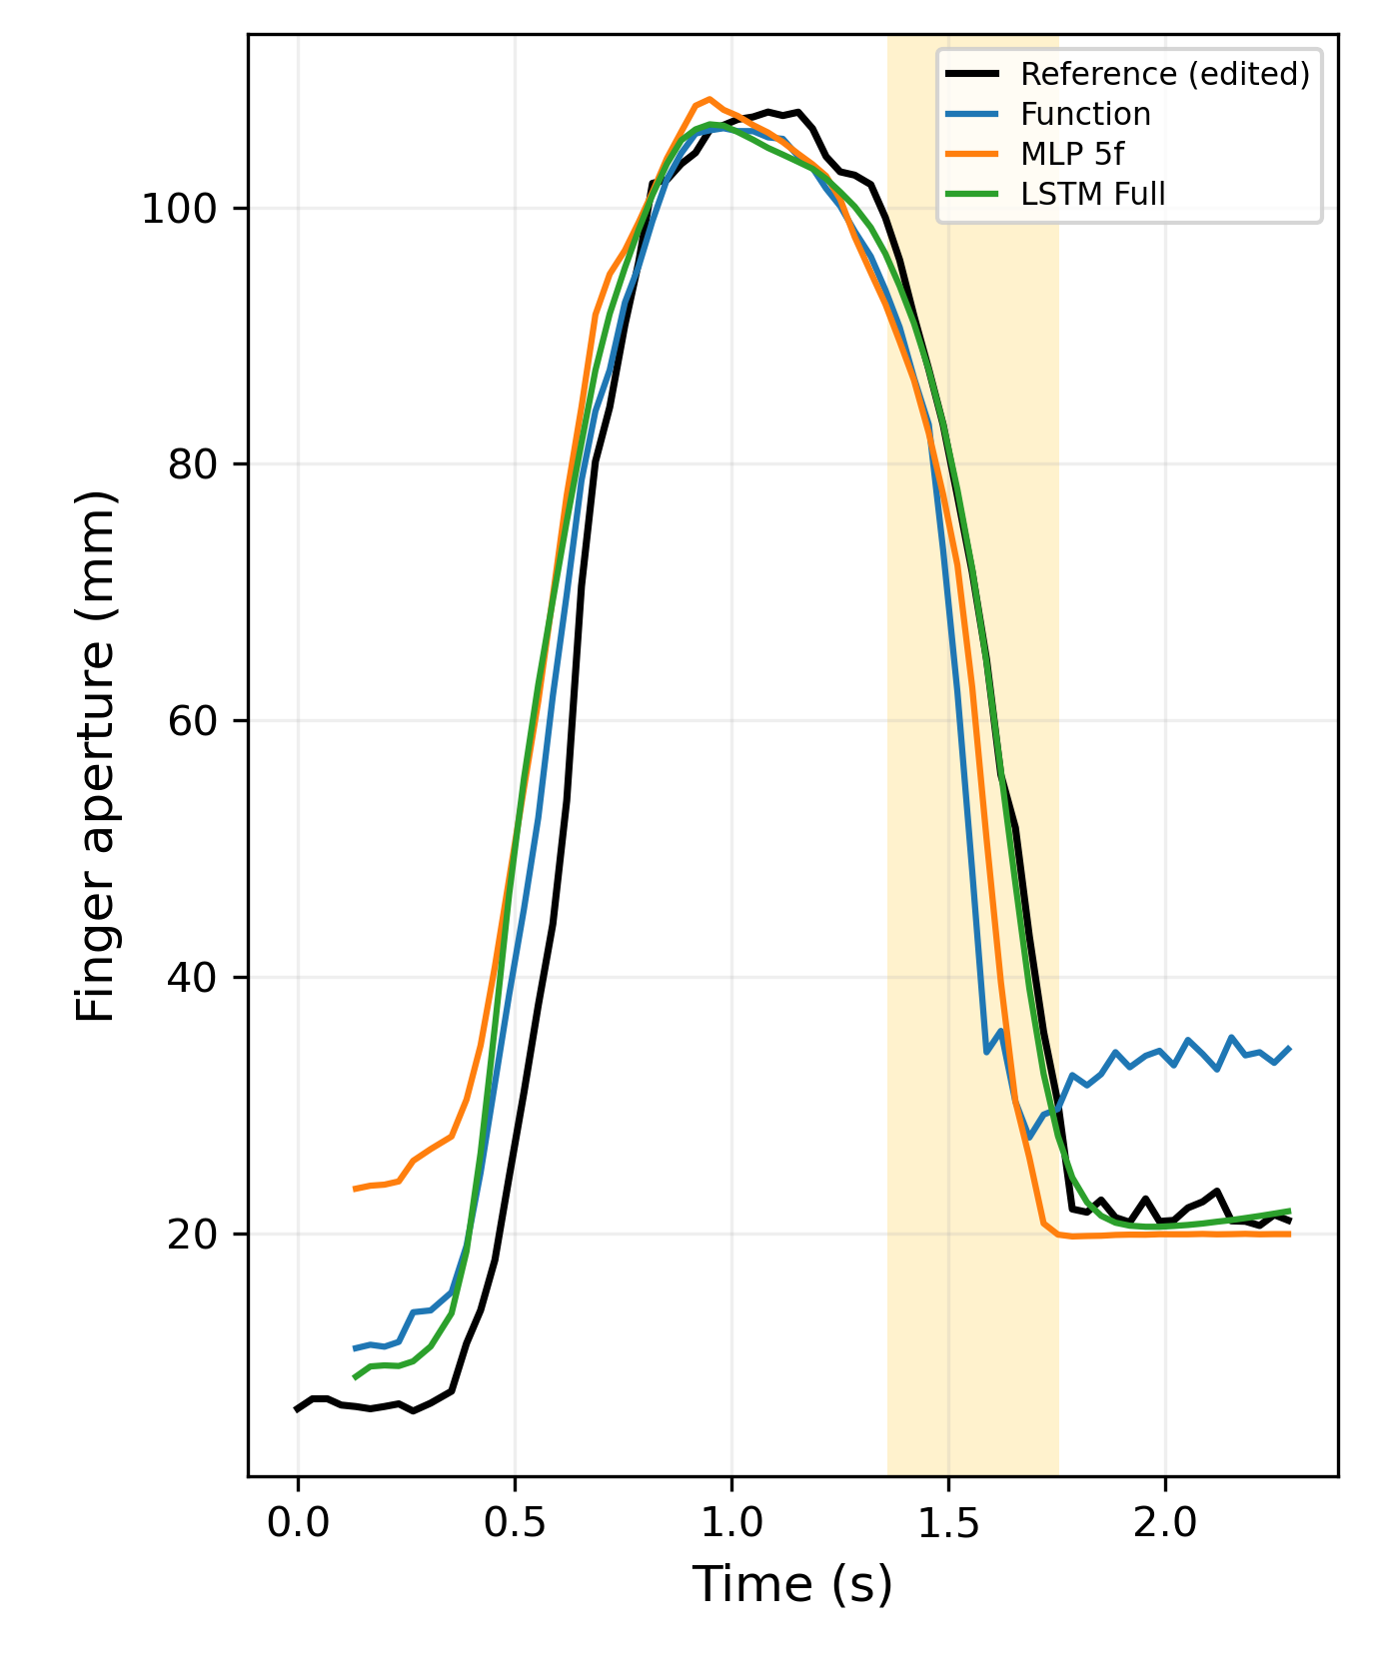
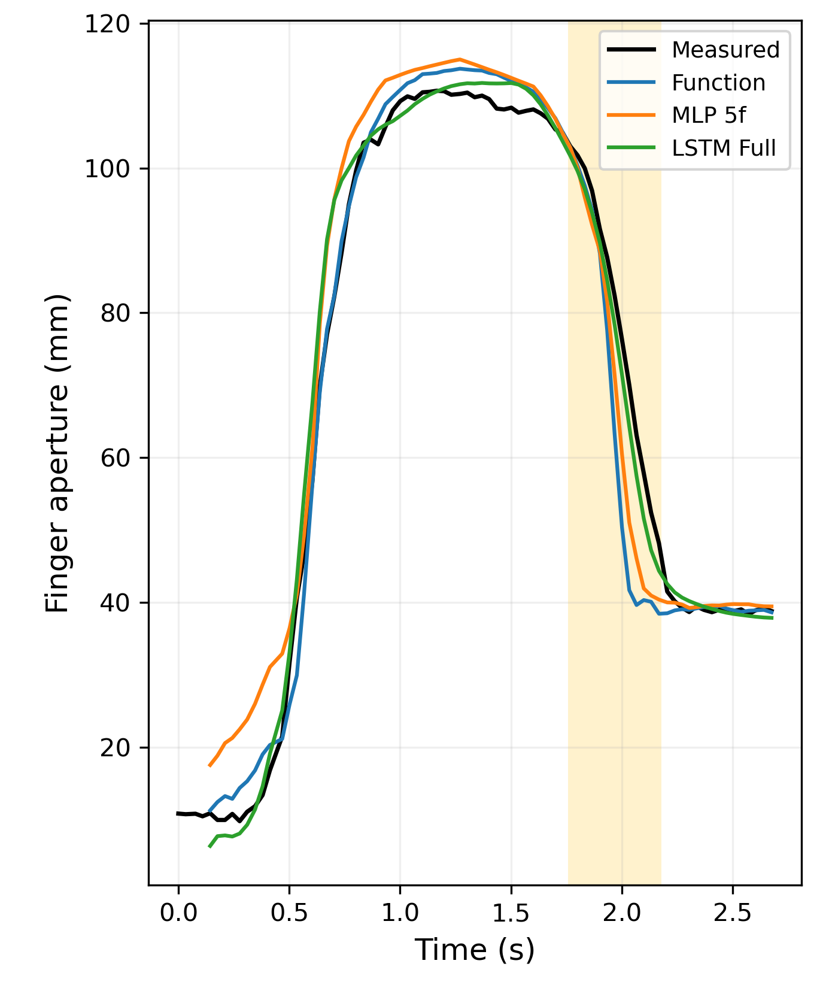
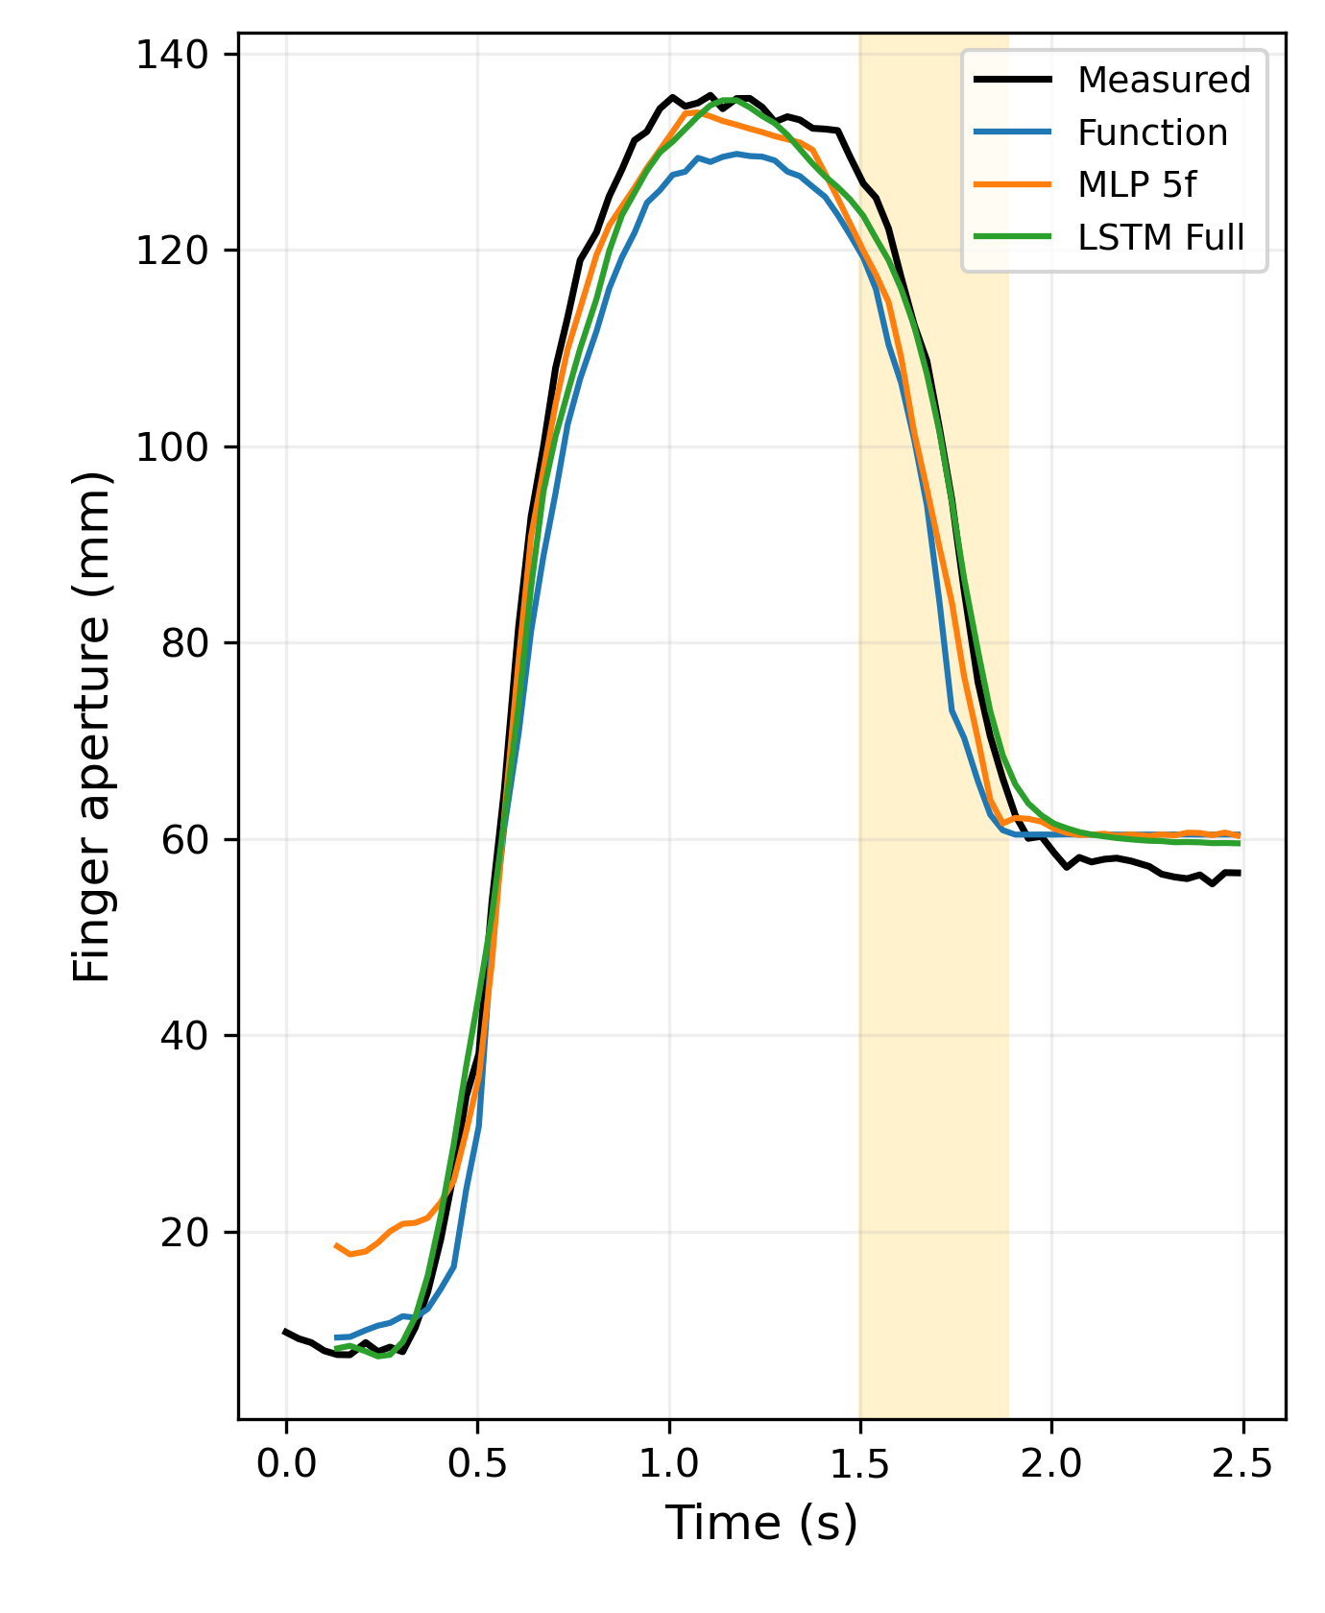
Prediction Examples Across Cube Sizes
20 mm
30 mm
40 mm
Analyze：
The advantage of full history is most evident during hand closing (yellow regions), suggesting that historical information helps capture closing dynamics.
Distance and its history can predict the overall trend. However, peak finger aperture varies across trials, and these inputs alone may not fully explain this variation.
Notes:
モデルを比べる前に、まずデータを確認します。立方体ごとに100試行の d–l 曲線を重ね描きし、試行間で一貫しているか、最大開口がどこで現れるか、サイズや速さでどう変わるかを見ます。

