Slide 1
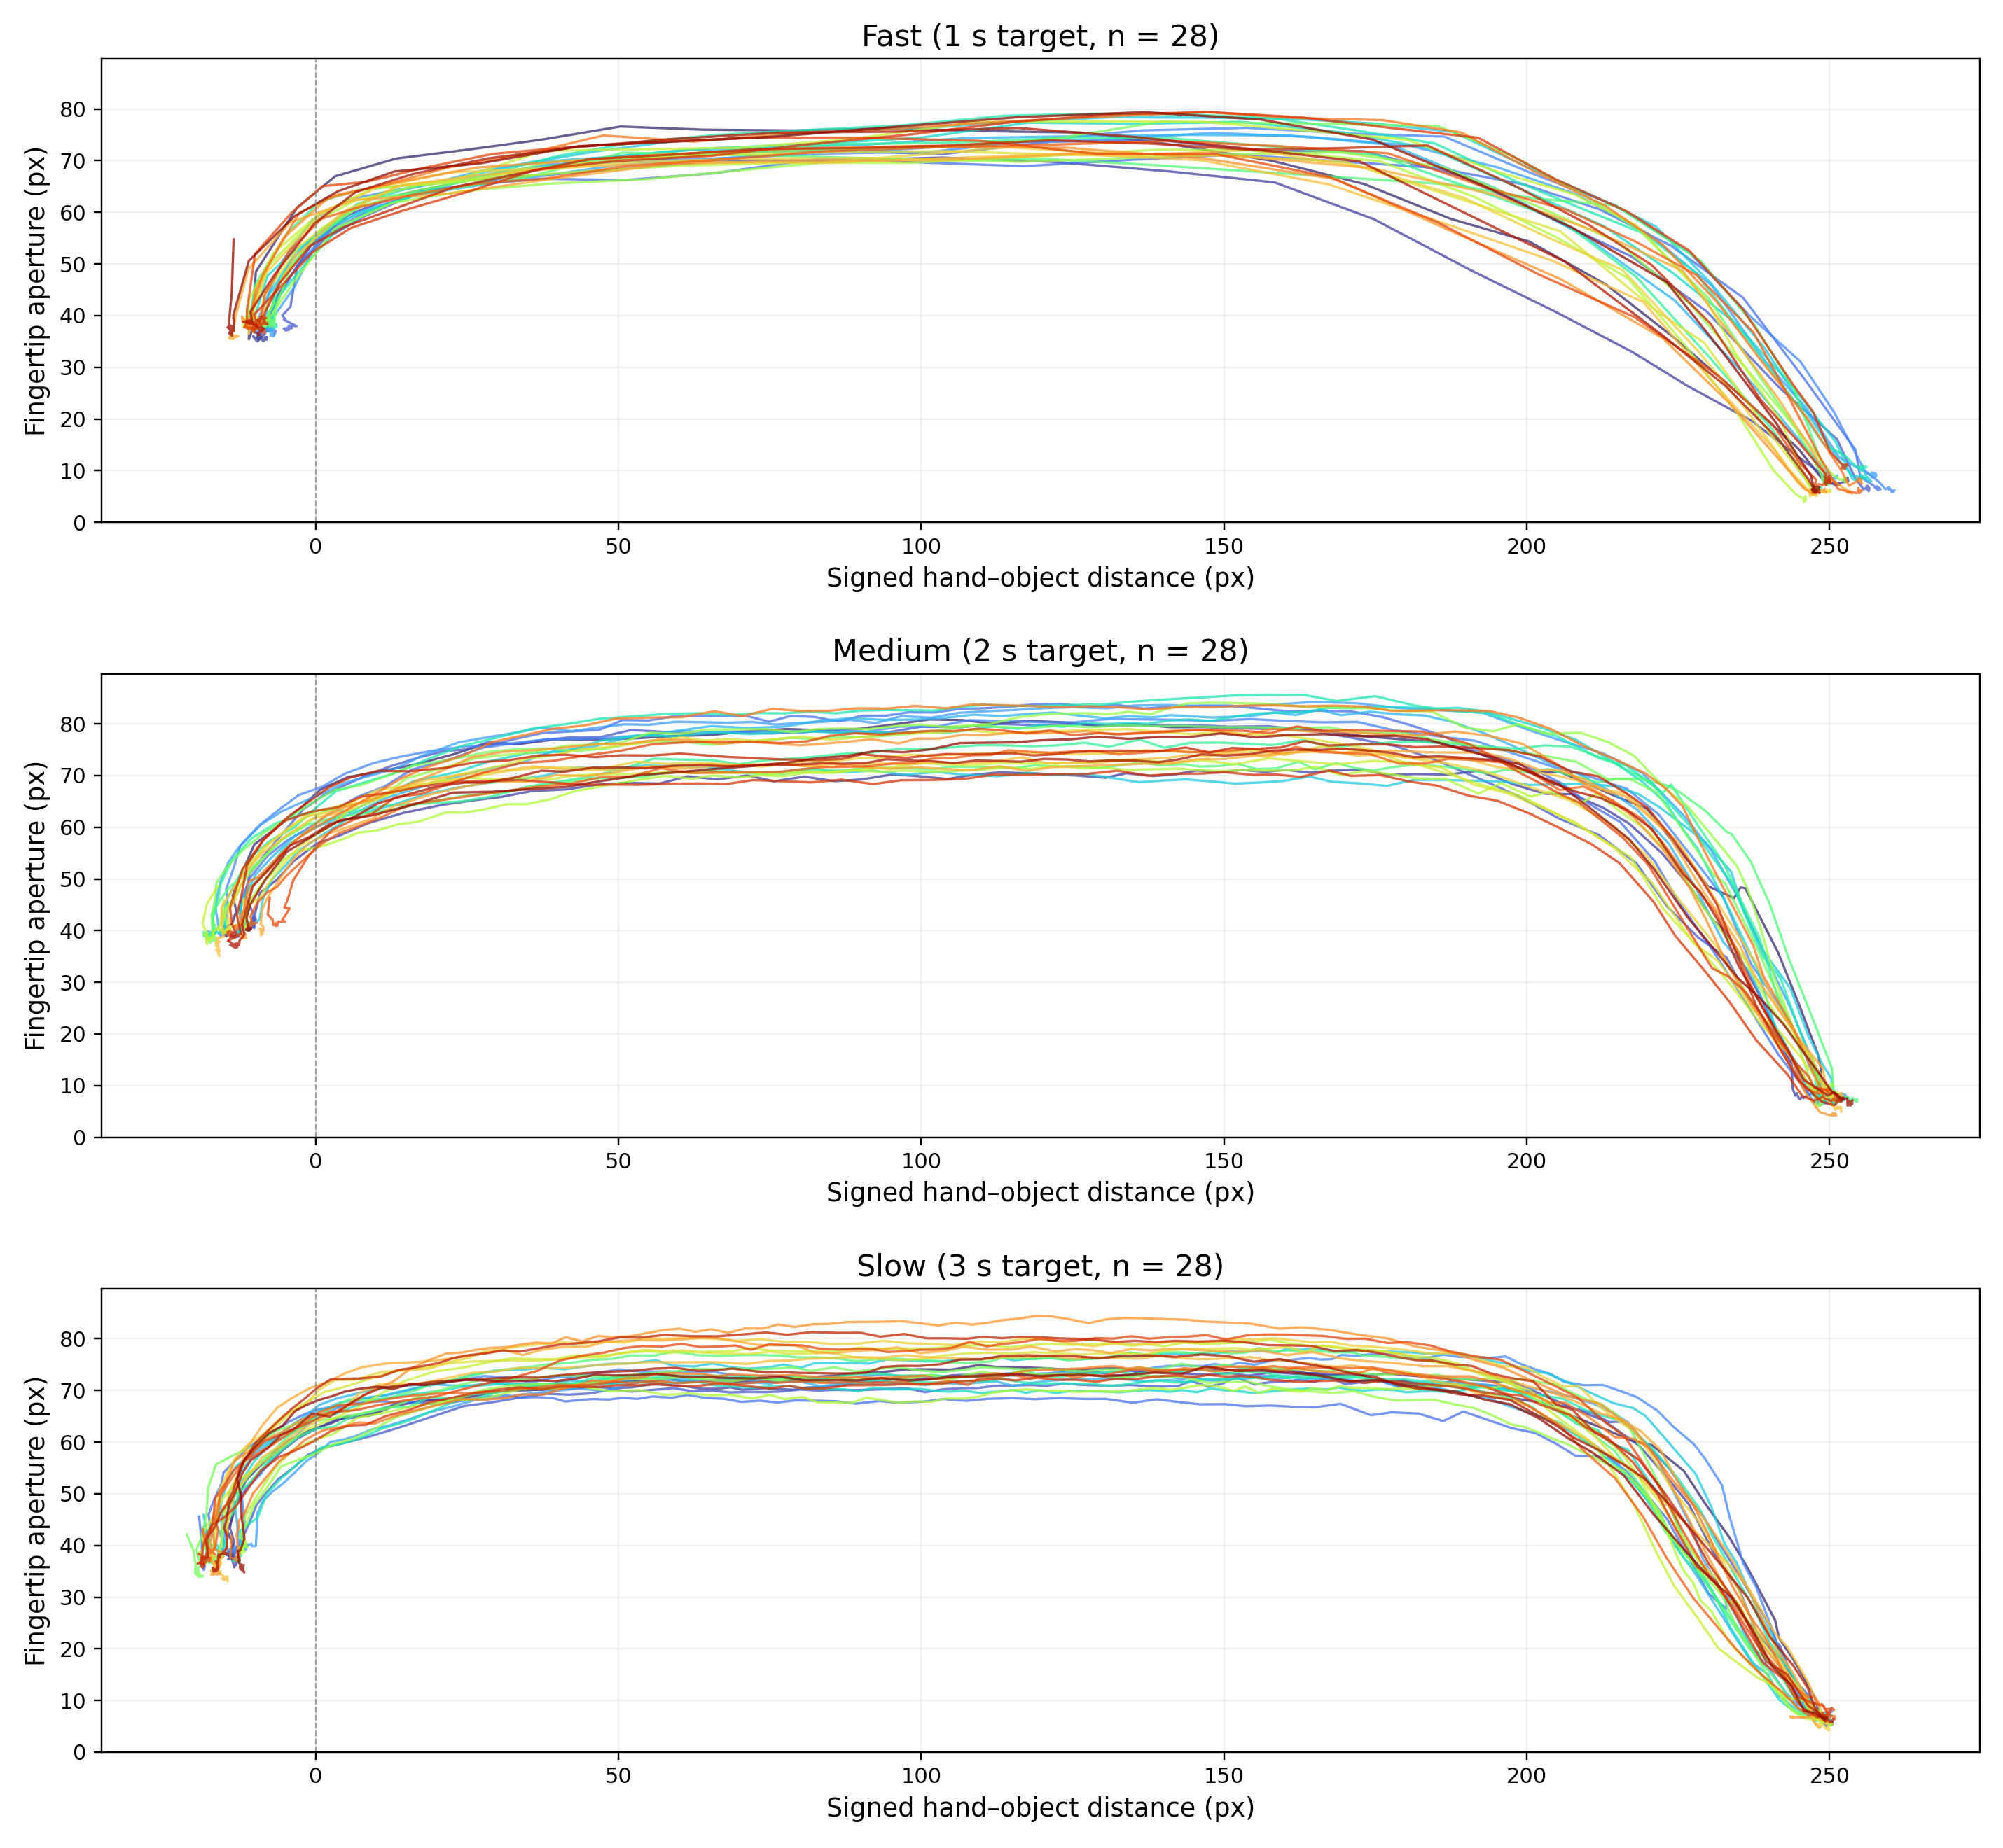
Each speed condition includes 28 trials: 21 for training and 7 for testing. I mistakenly selected two fewer test trials per condition than intended.

Slide 2
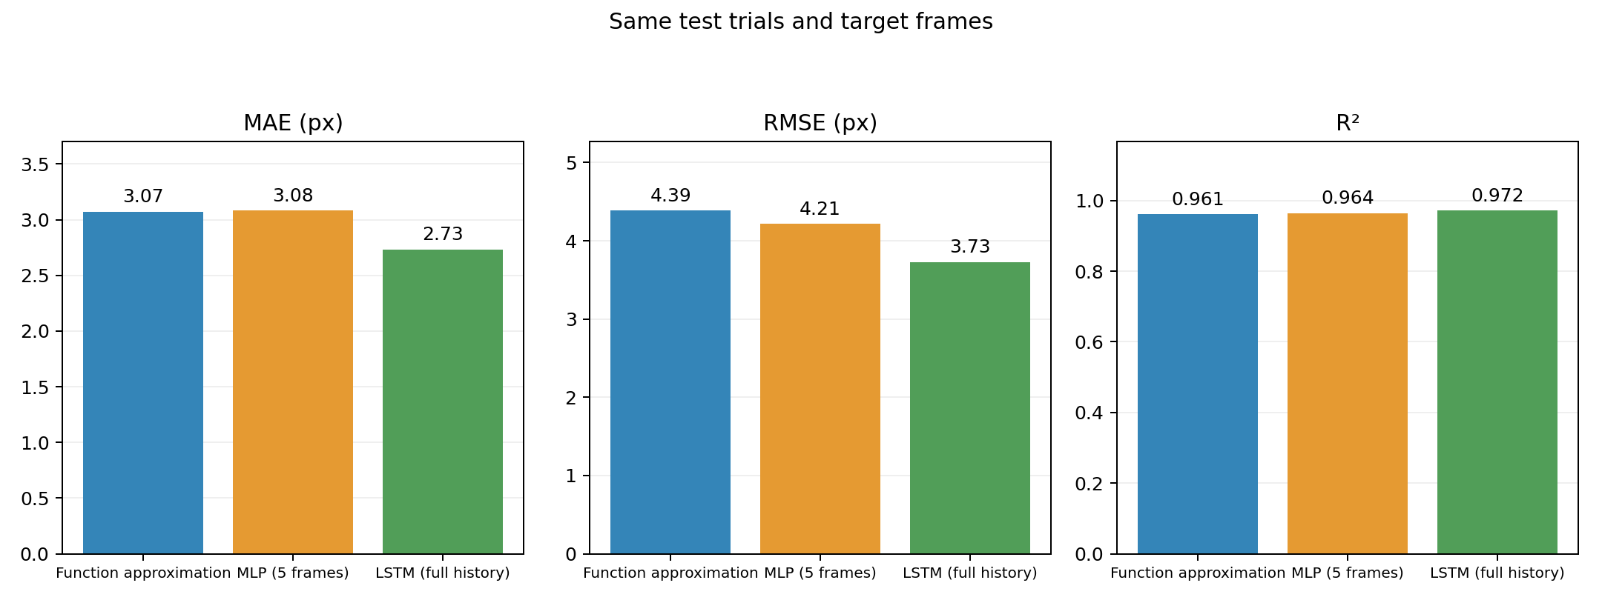
Offline Testing: Overall Performance
Three models：
smoothing spline，MLP (5 frames)，LSTM (from time 0 to the estimated time)

Slide 3
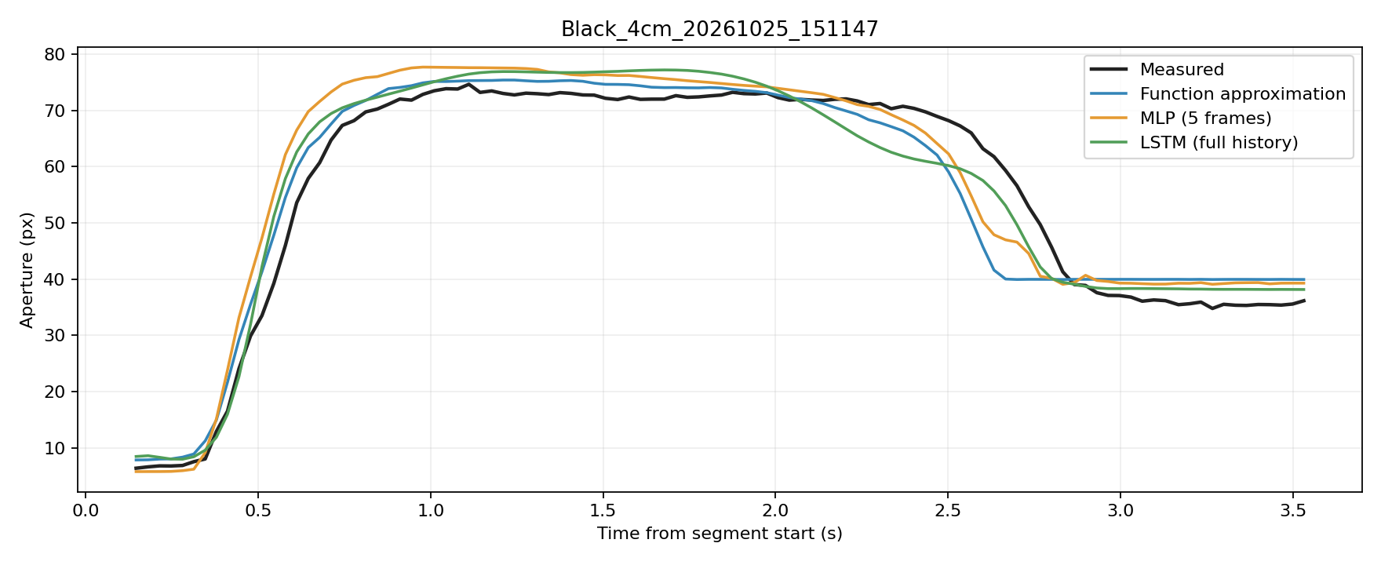
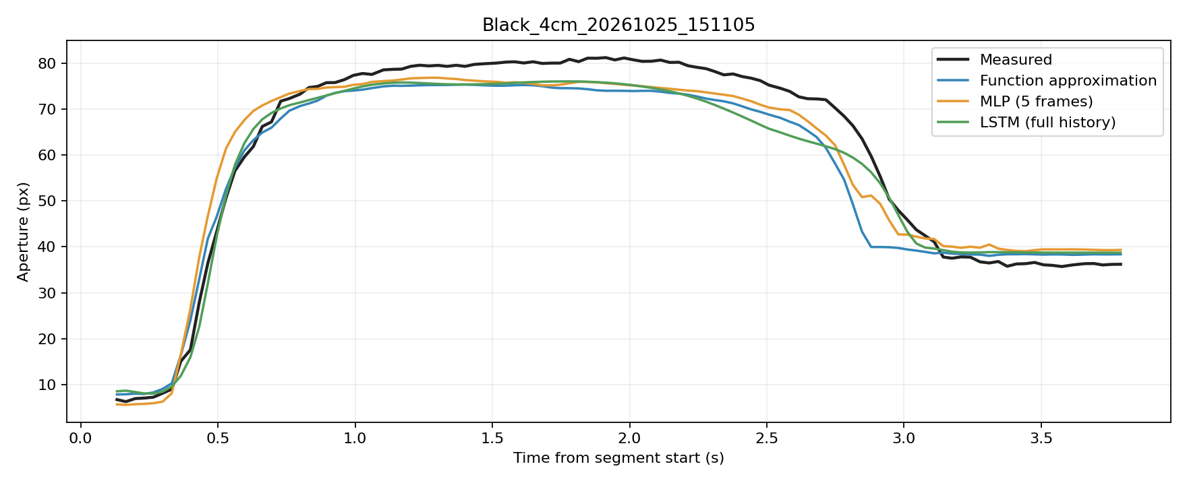
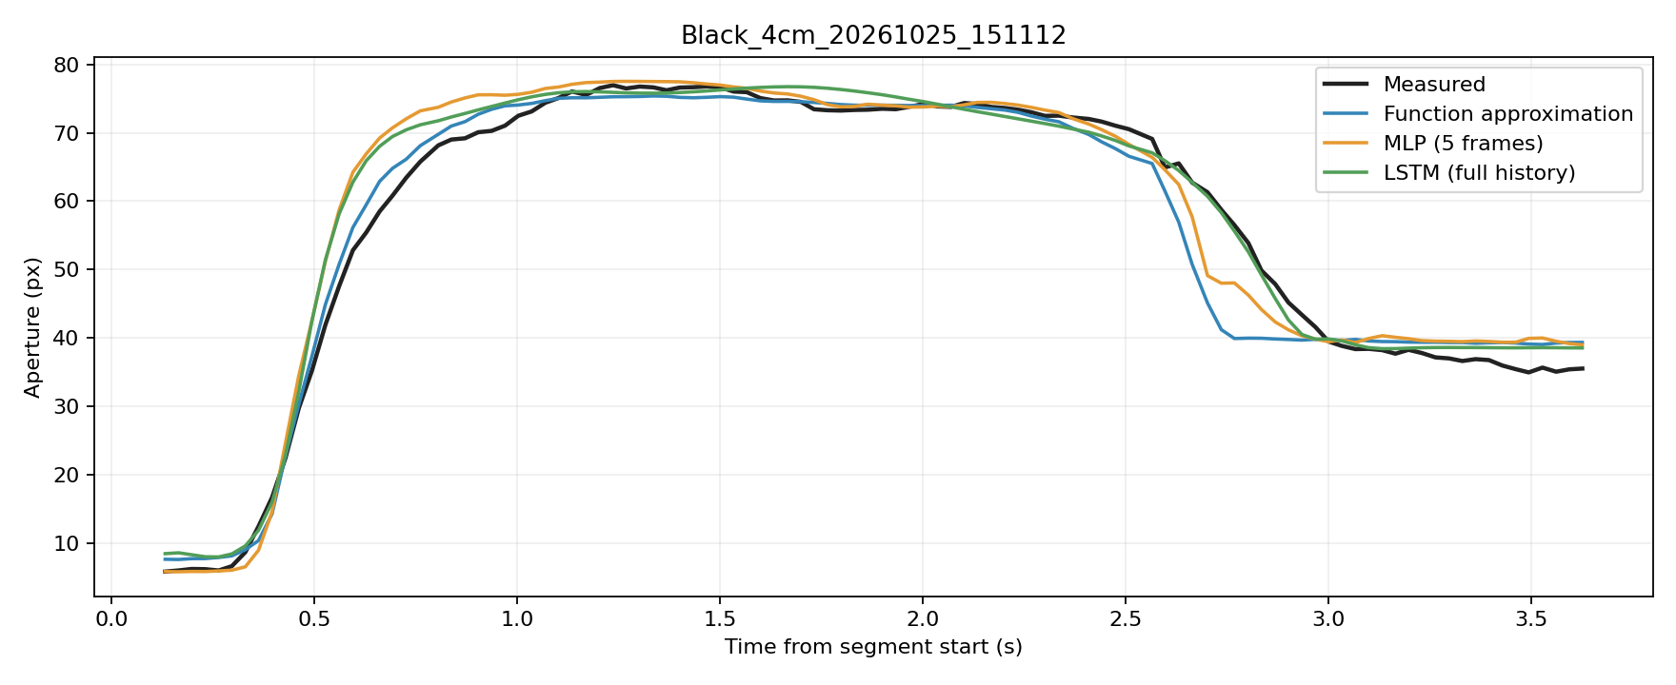
Slow Example

Slide 4
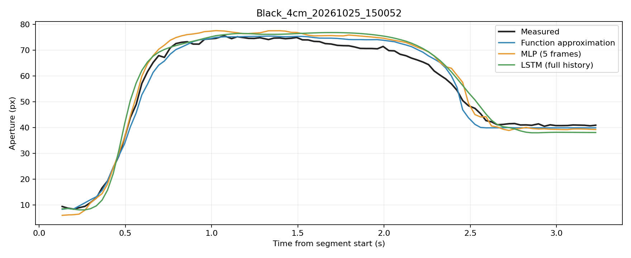
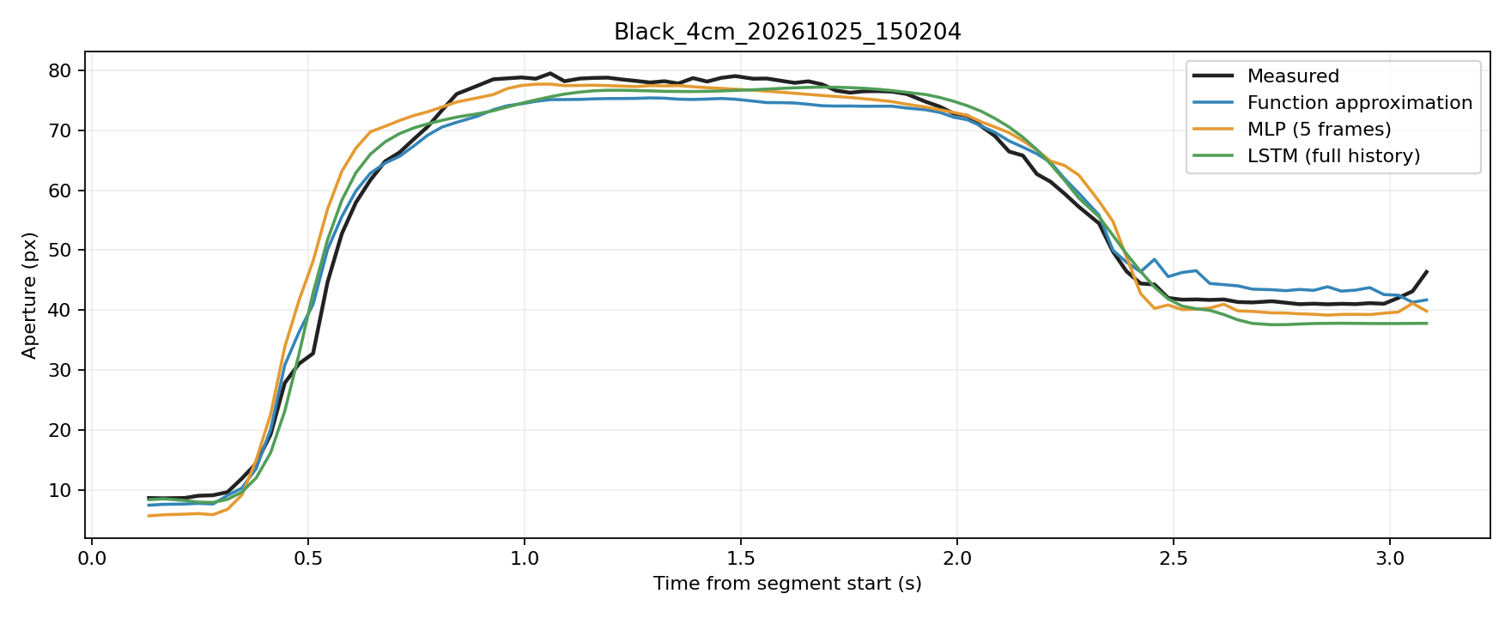
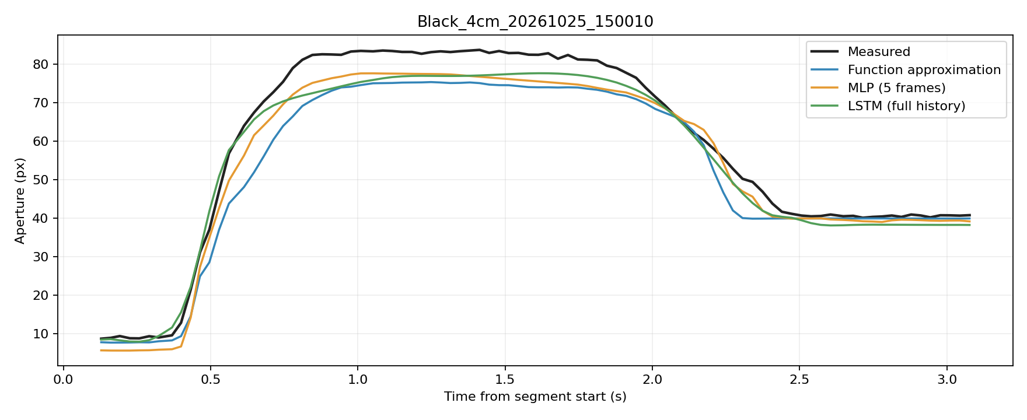
Normal Example

Slide 5
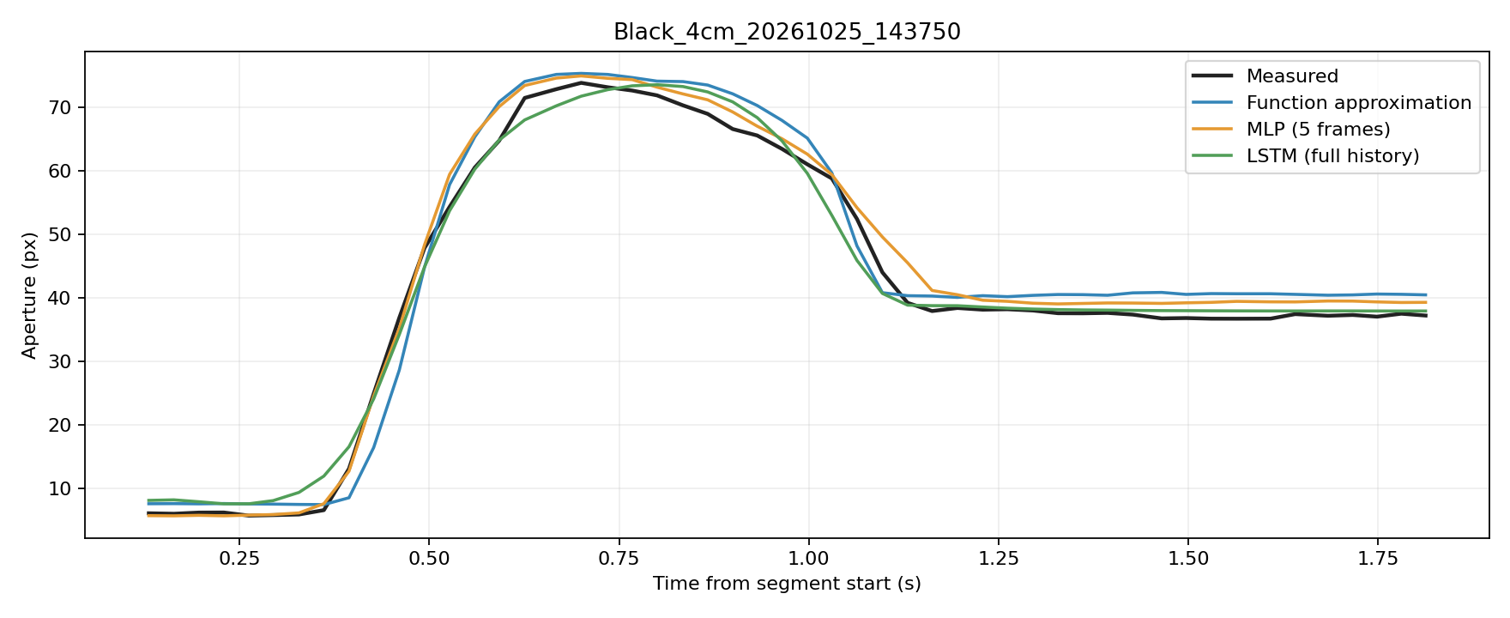
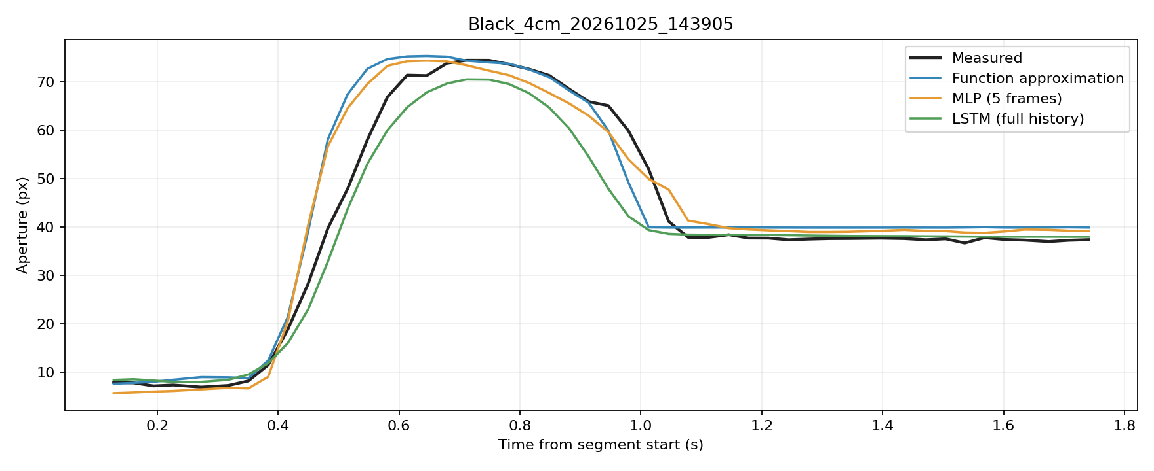
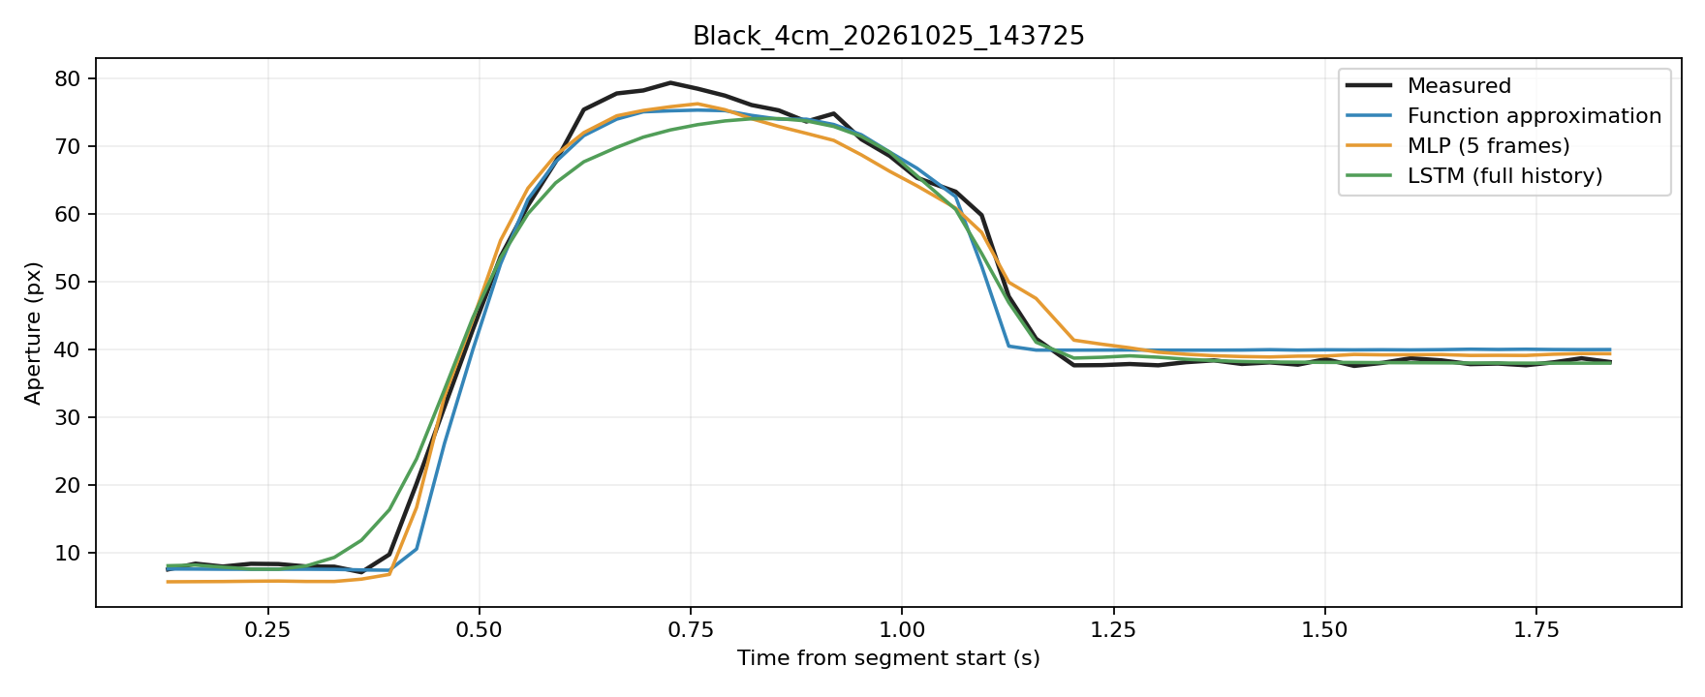
Fast Example

Slide 6
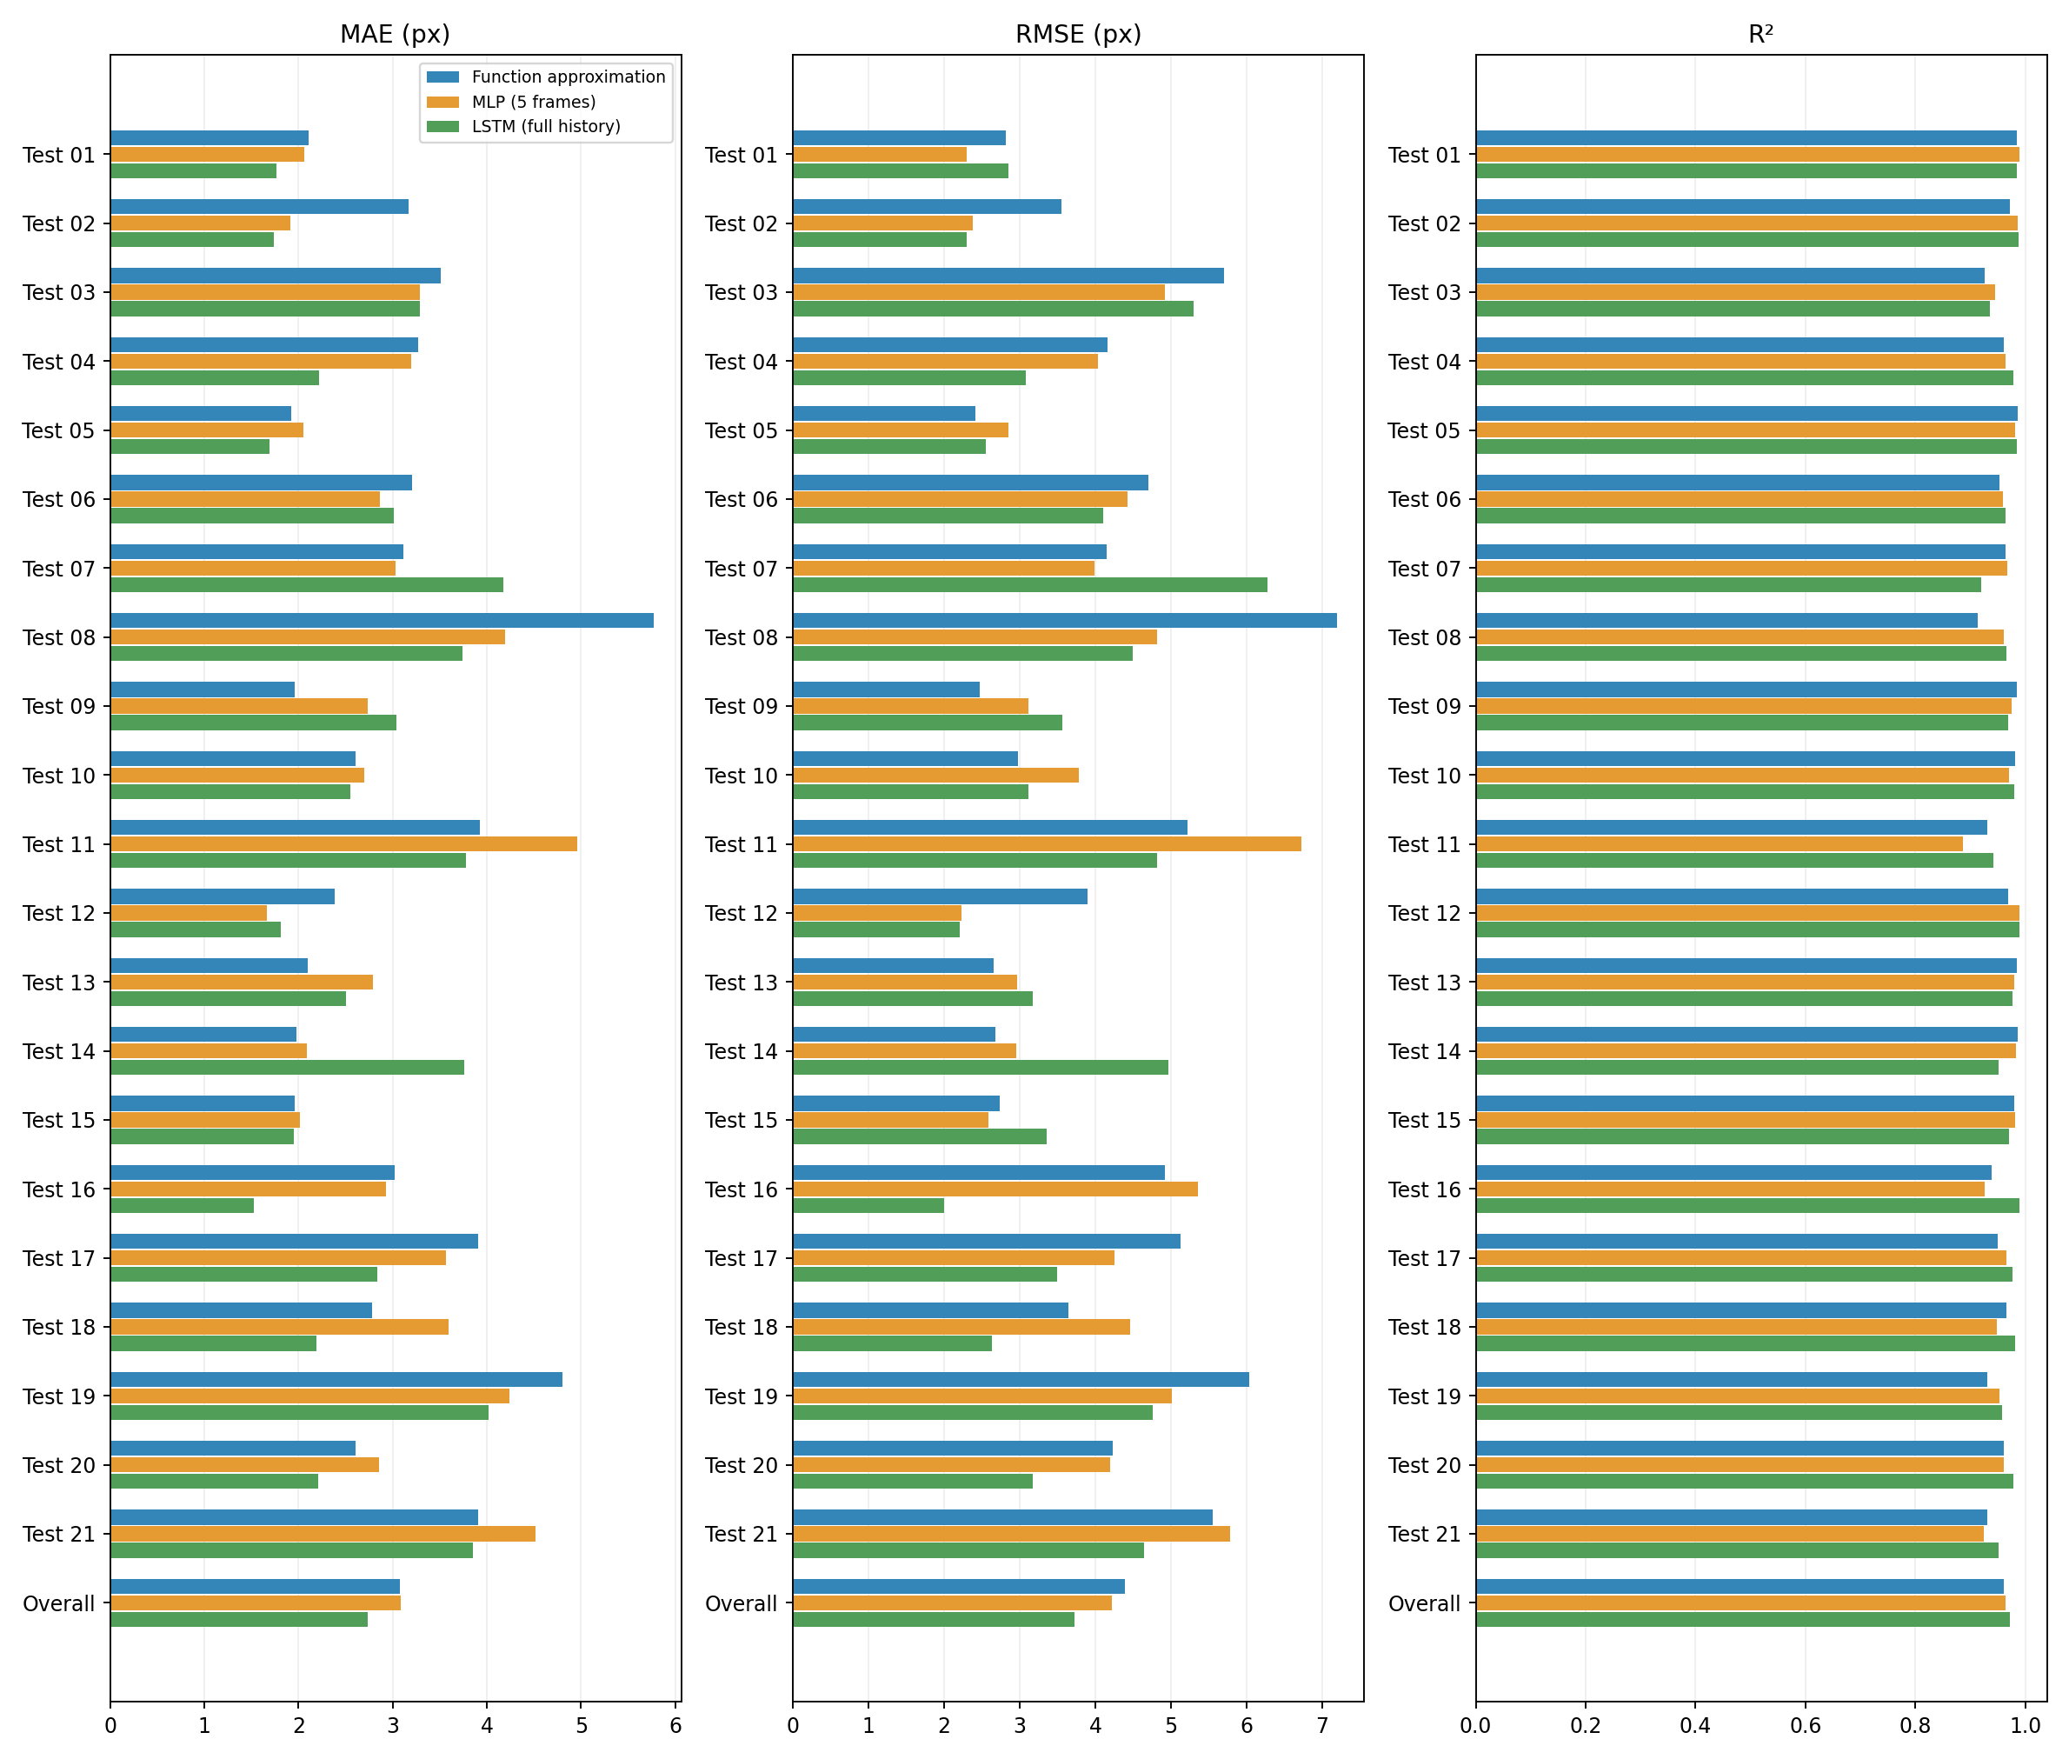
Detailed Validation Results

Slide 7
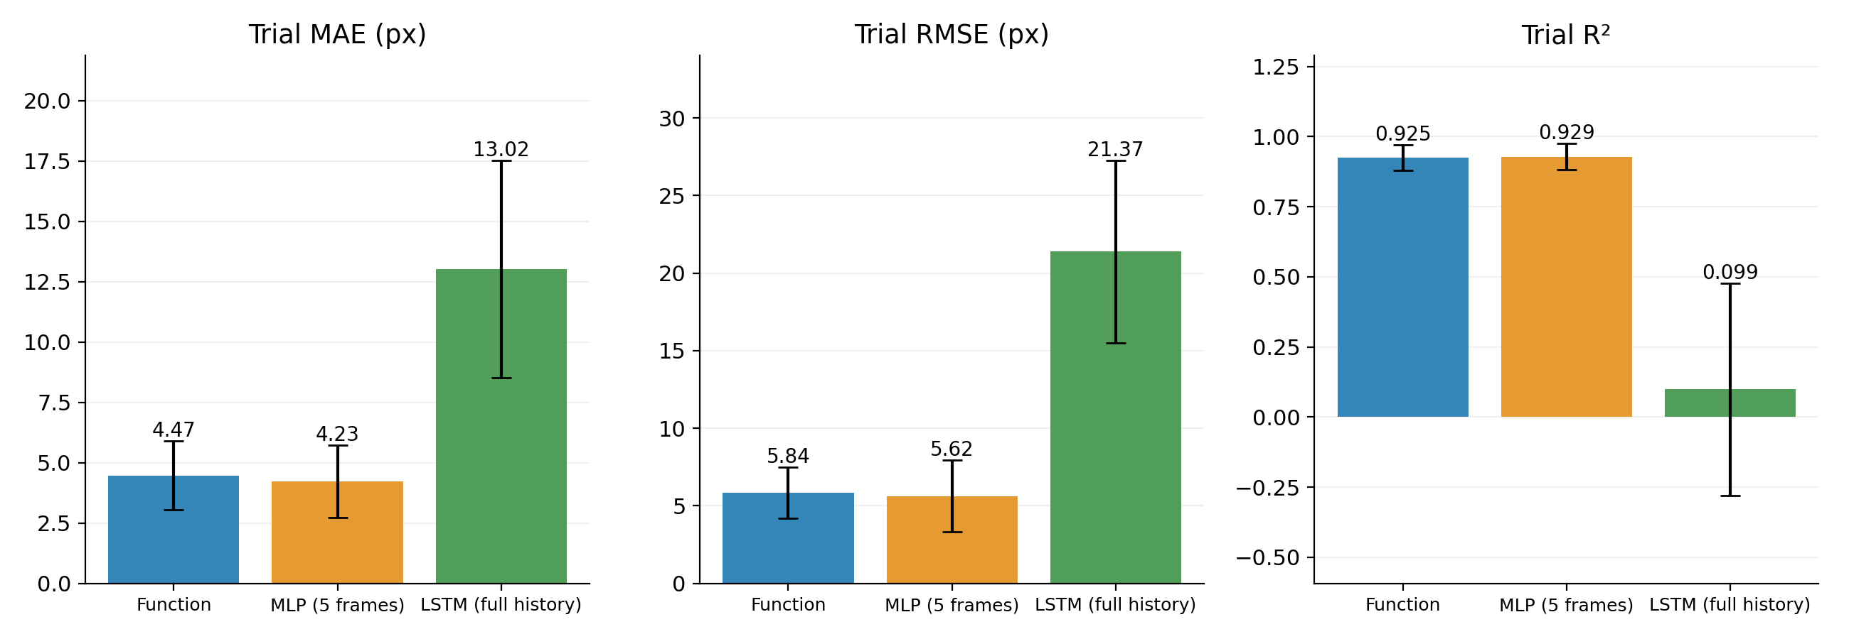
Real-time: Overall Performance
Three grasping trials per speed condition, for a total of nine trials.
Problem：The LSTM predictions currently keep increasing during the initial phase, making the model unsuitable for real-time inference at this stage. I will investigate this issue further.

Slide 8
