Slide 1
A Vision-Based Regression Model for
Semi-Autonomous Prosthetic Hand Control
Saga University Graduate School of Science and Engineering​
Computer Science & Information Techology Course​
Fukuda Laboratory 25742102 DI XIQING
Supervisor: Professor Osamu Fukuda
Notes:
good morning everyone im d, my research is ...

Slide 2
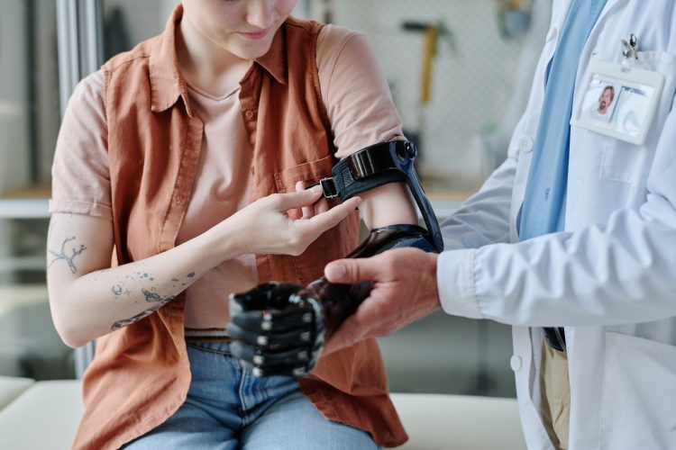
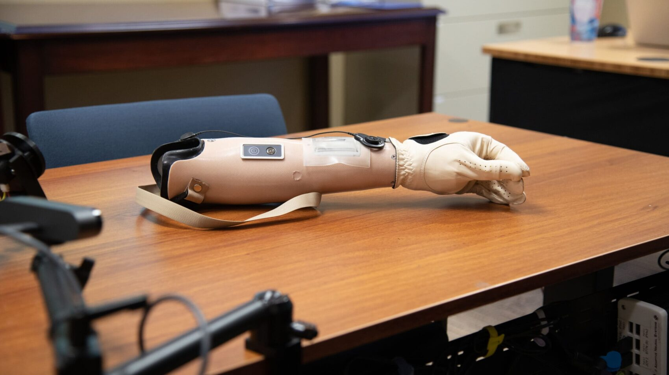
Background
57.7 million people worldwide
have traumatic limb amputation [1]
Prosthetic hands have advanced rapidly
But the rejection rate of prosthetic hands is as high as 44% [2].
Main Reason
High
Cognitive Load [3]
Notes:
Prosthetic hands aim to restore hand function after upper-limb loss
Although prosthetic hands have advanced rapidly

Slide 3
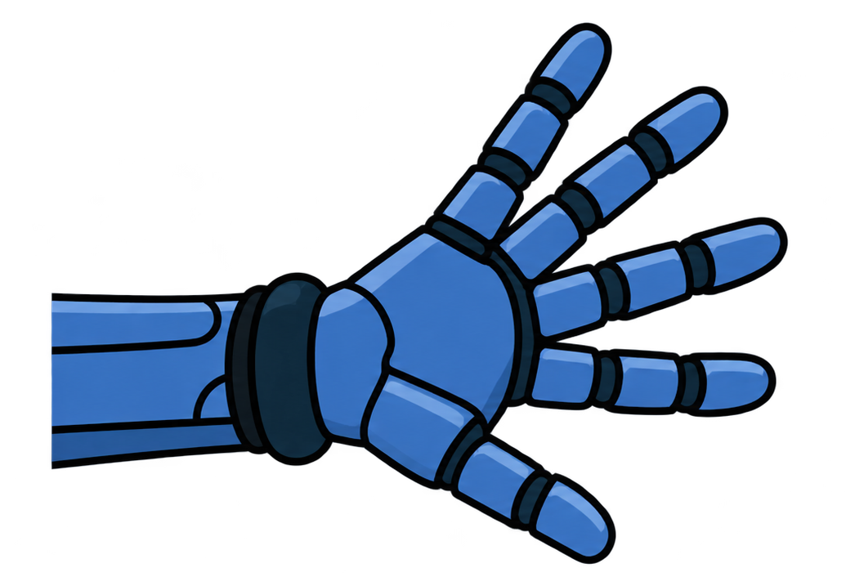

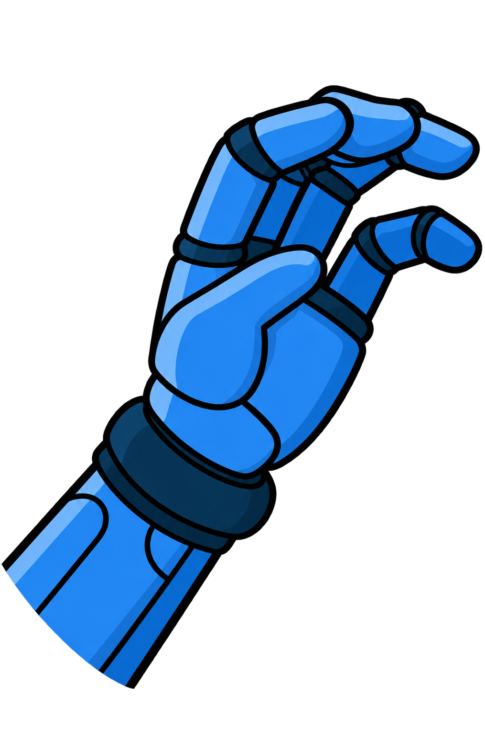
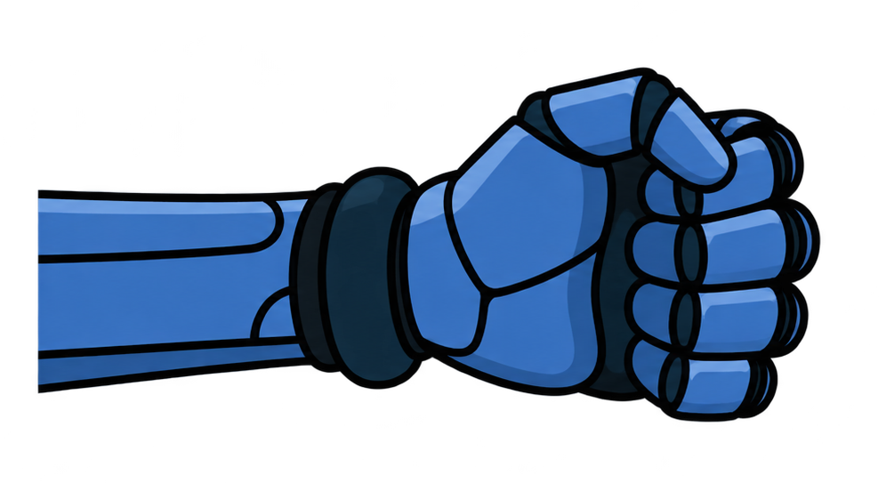
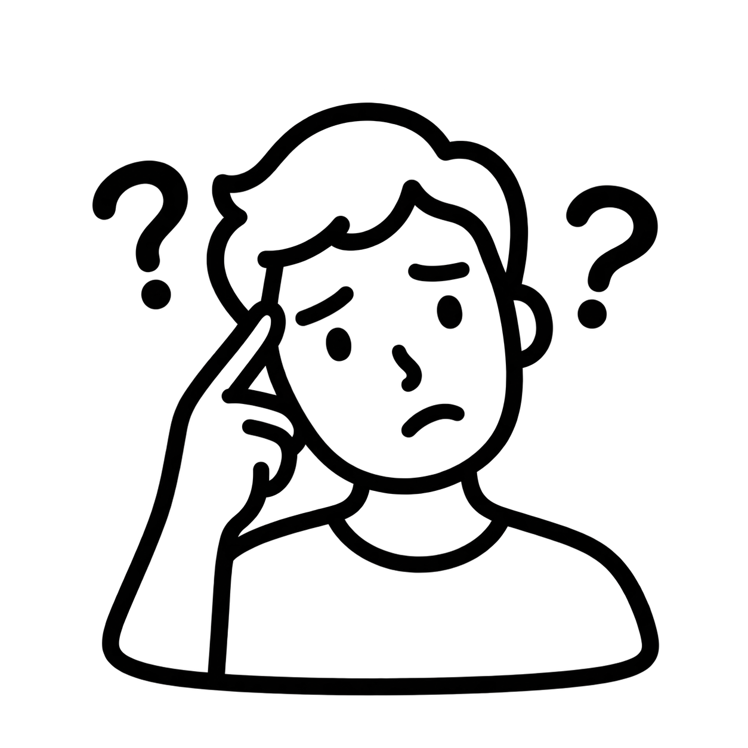
Background
Conventional Prosthetic Hand:
Conscious selection and adjustment
Natural Grasping :
Automatic adjustments during grasping
Semi-autonomous control may reduce the need for constant user attention.
Notes:
In ..., The user need to do Conscious selection and adjustment. increases cognitive load and Learning costs.
If combined with this mechanism, let the system handle some functions.

Slide 4
Related Work
Author | Title | Objective | Method | Result
Thomas et al.[4] | Haptic shared control improves neural efficiency during myoelectric prosthesis use | Help users grasp fragile objects: too little force causes slipping, while too much can crush the object, requiring precise grip-force control. | The system first records the user’s grip force during a successful grasp and learns the target force. During subsequent grasps, it automatically regulates grip force, while the user only needs to trigger grasping. | The shared control method not only improved grasping performance but also demonstrated higher neural efficiency, as measured by prefrontal cortex activity.
Vasile et al.[5] | Continuous wrist control on the hannes prosthesis a vision-based shared autonomy framework | Help users orient the prosthetic wrist during grasping, reducing the need for manual adjustments and compensatory body movements. | Using visual information, the system automatically adjusts wrist orientation during grasping, while the user controls finger opening and closing. | The system was deployed on the Hannes prosthesis and operated at 15 Hz, demonstrating continuous wrist adjustment during approach and automatic wrist positioning before grasping.
Semi-Autonomous control allows the system to handle part of the movement while preserving user control, offering a potential way to reduce the user’s congnitive load.
Notes:
develop the system to let the system control grasp force. the system first learn the force of user grasp, and then the
Control of wrist orientation was delegated to the system. Reduced the users manual operations. user only need to controls opening and closing

Slide 5
Research Objective & Question
Based on the relationship between hand–object distance and fingertip aperture during natural grasping,
This study aims to use visual sensors to identify objects and measure hand–object distance to assist prosthetic hand grasping.
RQ1
Is there a consistent relationship between hand–object distance and fingertip aperture during reach-to-grasp movements?
RQ2
How accurately can a regression model predict fingertip aperture from hand–object distance during reach-to-grasp movements?
RQ3
Can using the model to assist control reduce the cognitive load on prosthetic hand users?
Notes:
So in my research, I would like to build on the fact that

Slide 6



System Architecture
EMG Sensor
EMG Signal
Fingertip Apeature Fine-Adjustment Commands
Model
Model
Robotic Hand
Camera
Hand–Object
Distance
Fingertip
Apeature
MLP
Comparing Different Models
Planned work:
Notes:
这是系统架构，由Camera获取手与目标的距离，输入进模型中，当前使用的是，预测Fingertip Apeature。当有错误情况时，用户再通过EMG信号，进行微调。
and achieve control of the robotic hand

Slide 7

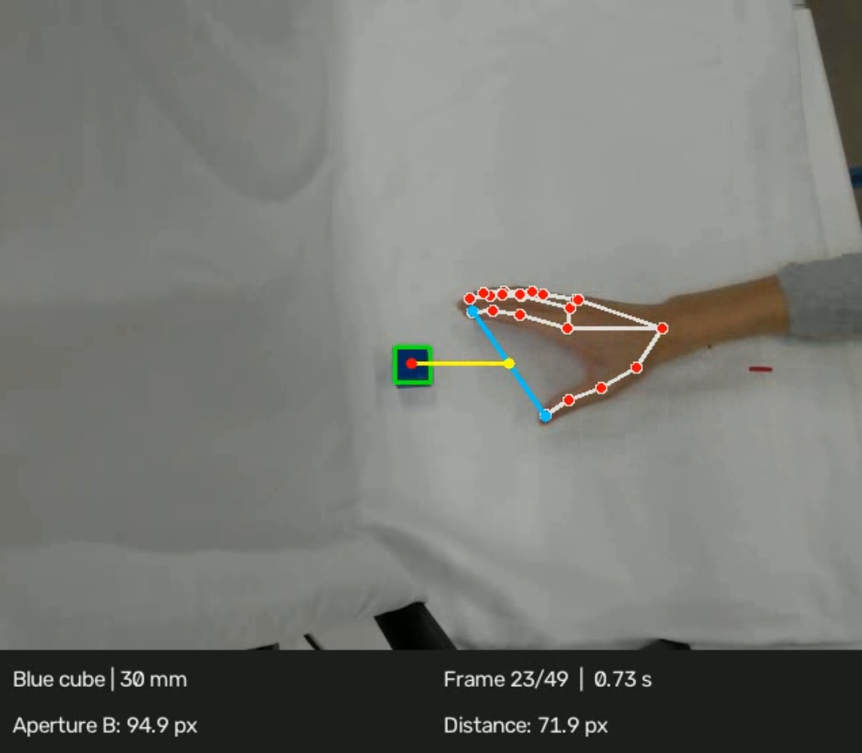

Visual Processing
The camera is fixed in the world coordinate frame and provides a top-down view.
MediaPipe and OpenCV are used to detect hand landmarks and cube.
Hand–Object Distance
Distance from the fingertip midpoint to the object center.
Pixels (px)
Fingertip Aperture
Distance between the thumb and index fingertips.
Pixels (px)
the units: [px] converting to [mm]
Planned work:
Notes:
The visual part will use two variable
the both units was px, in future will convert to millimeters

Slide 8
Model
5-frame temporal window MLP
Hand–Object
Distance
Fingertip
Aperture
[dₜ₋₄, dₜ₋₃, dₜ₋₂, dₜ₋₁, dₜ]
âₜ
2 hidden layer, each with 32 neurons.
Loss Function
Preprocessing
Training Data
MAE
Normalization
30 trials
Notes:
he input is a vector of distance from current frame and previous four frames。

Slide 9
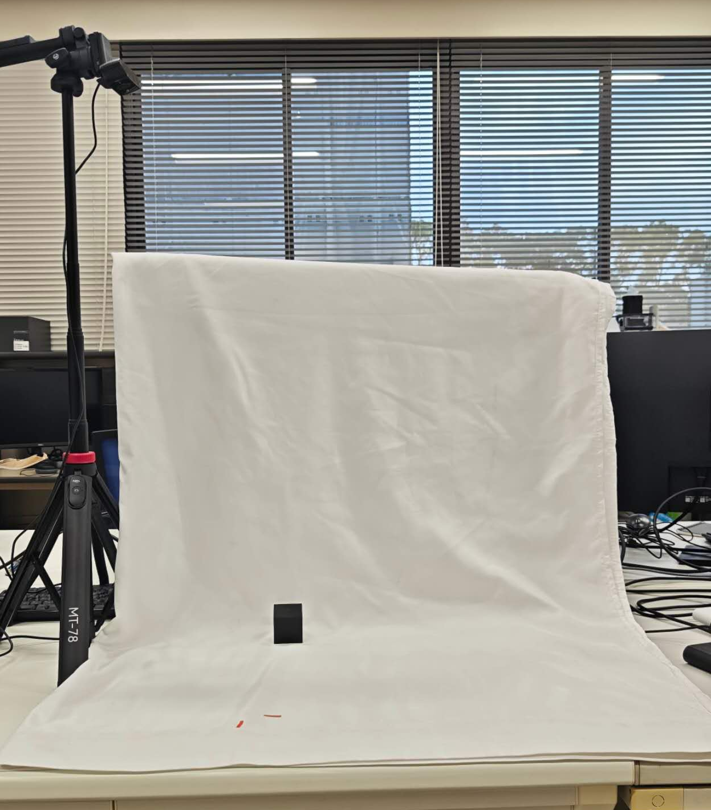
Experimental Setup
An overhead web camera captures visual data.
750mm
30mm
Initial hand position.
30 mm from the object.
Notes:
The camera is mounted about 750 mm above the workspace.
the hand initial position is 30mm away in front of the cube。

Slide 10
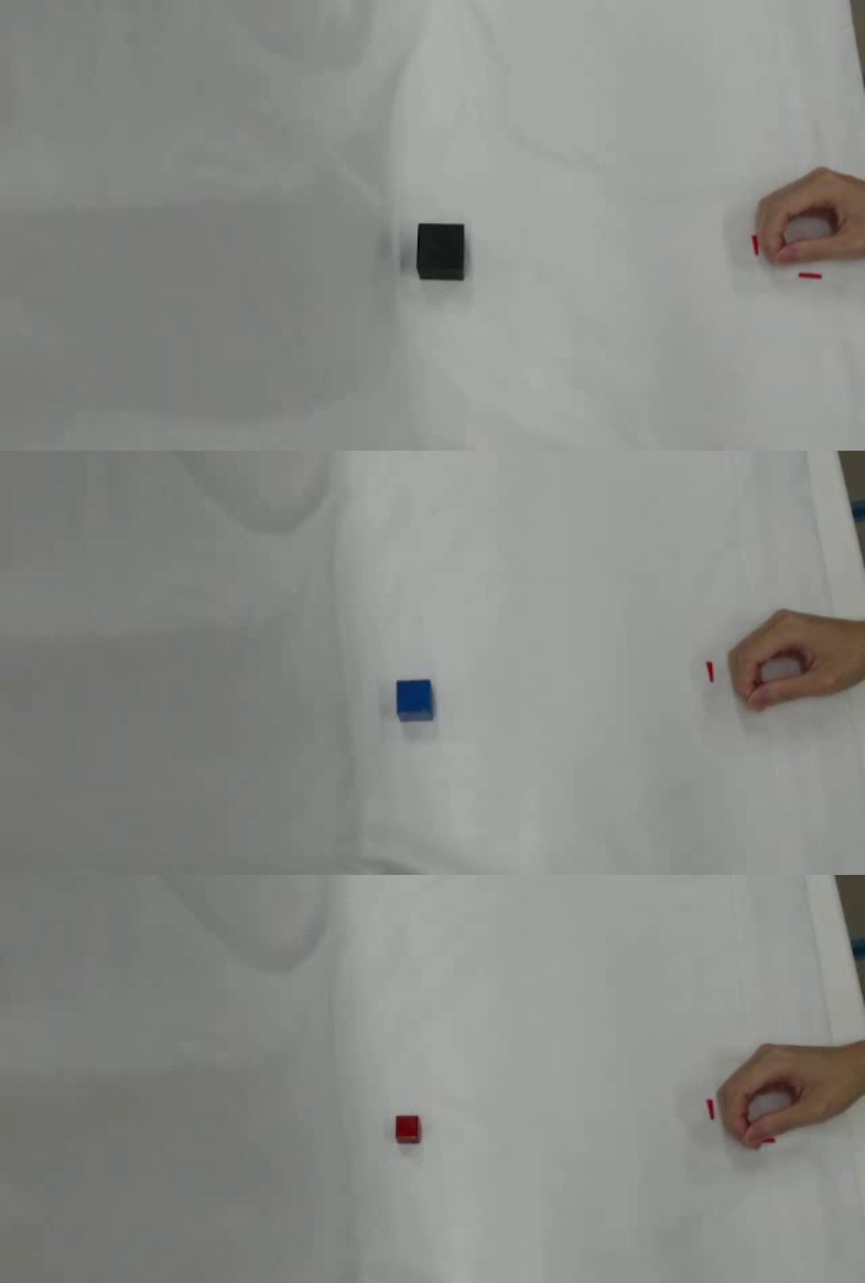
Data Collection
Collect grasping movement data from participants using cubes of different sizes.
Experimental Conditions
Task: Natural reach-to-grasp movement
Initial hand position: table edge
Object position: 30 mm from the table edge
Object types: 20mm red cube, 30mm blue cube, and 40 mm black cube.
Add three speed conditions: fast, normal, and slow.
Planned work:
Notes:
Each trial consists of one natural reach-to-grasp movement。
this is the demonstration video
We used three cubes as experimental conditions: a 20 mm red cube, a 30 mm blue cube, and a 40 mm black cube.

Slide 11
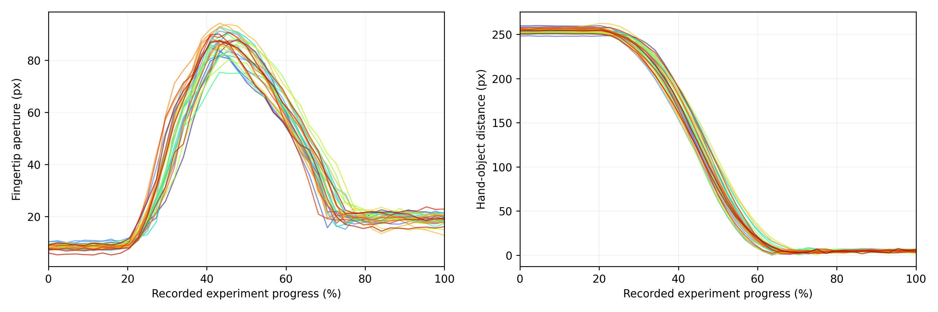
Data Relationship Analysis
30 trial with a 20 mm cube
Maximum Aperture Timing
44.32 ± 2.37%
Distance at Maximum Aperture (px)
134.77 ± 16.17
Fingertip Aperture Normalized RMSE
5.30% ± 1.86%
Hand–Object Distance Normalized RMSE
2.26% ± 1.12%
The data showed high consistency, suggesting a consistent relationship between hand–object distance and fingertip aperture during reach-to-grasp movements.
Notes:
this is dataset 30 trials 20mm cube, overlaid the fingertip aperture and the distance curve。both curve show similar pattern。
the key event were also consistent，during the reach to grasp，the finger first open then close。reach maximum aperture at about 44.32 percent。when the distance was about 134.77pixel。

Slide 12
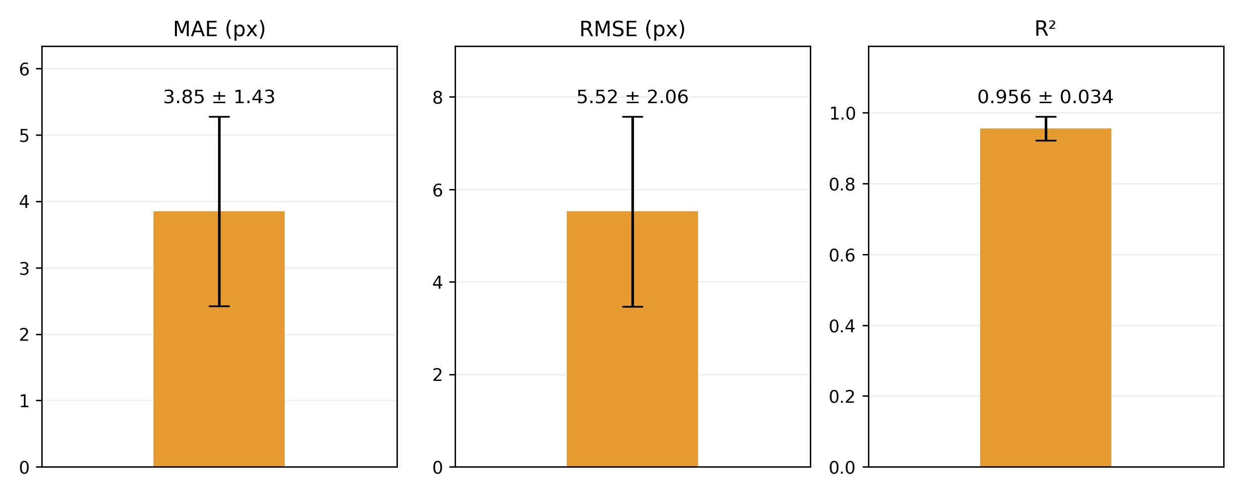
Offline Validation – Overall Performance
27 validation trials across three cube sizes (9 trials per size)
MAE
RMSE
R²
3.85
5.52
0.956
px
px
Notes:
To evaluate how accurately the model predicts fingertip aperture, we first conducted offline validation using nine trials per cube size, for a total of 27 trials.
These results indicate relatively small prediction errors.

Slide 13
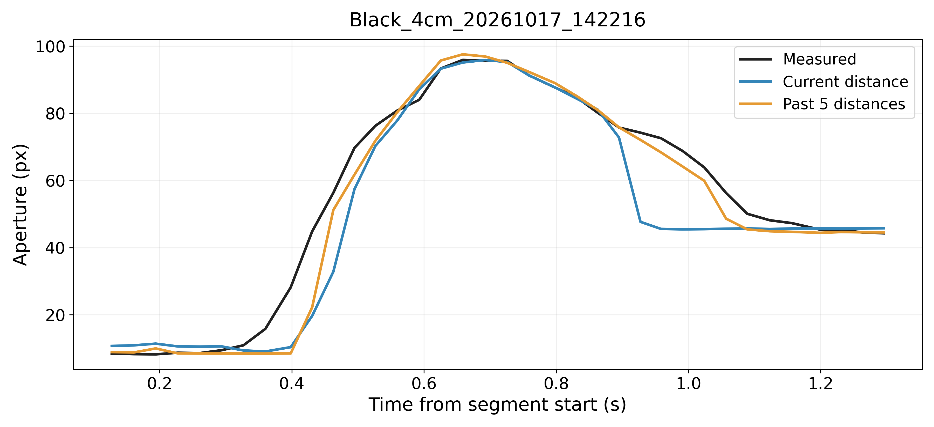
Offline Validation – Phase-Wise Analysis
Initial Phase (stable)
Grasping Phase (changing)
Hold Phase (stable)
10 frames
Variable duration
10 frames
Notes:
The grasping process can be divided into three phases: Initial, Grasping , and Hold. Fingertip aperture remains stable during the Initial and Hold phases, it is changing during the Grasping phase.

Slide 14
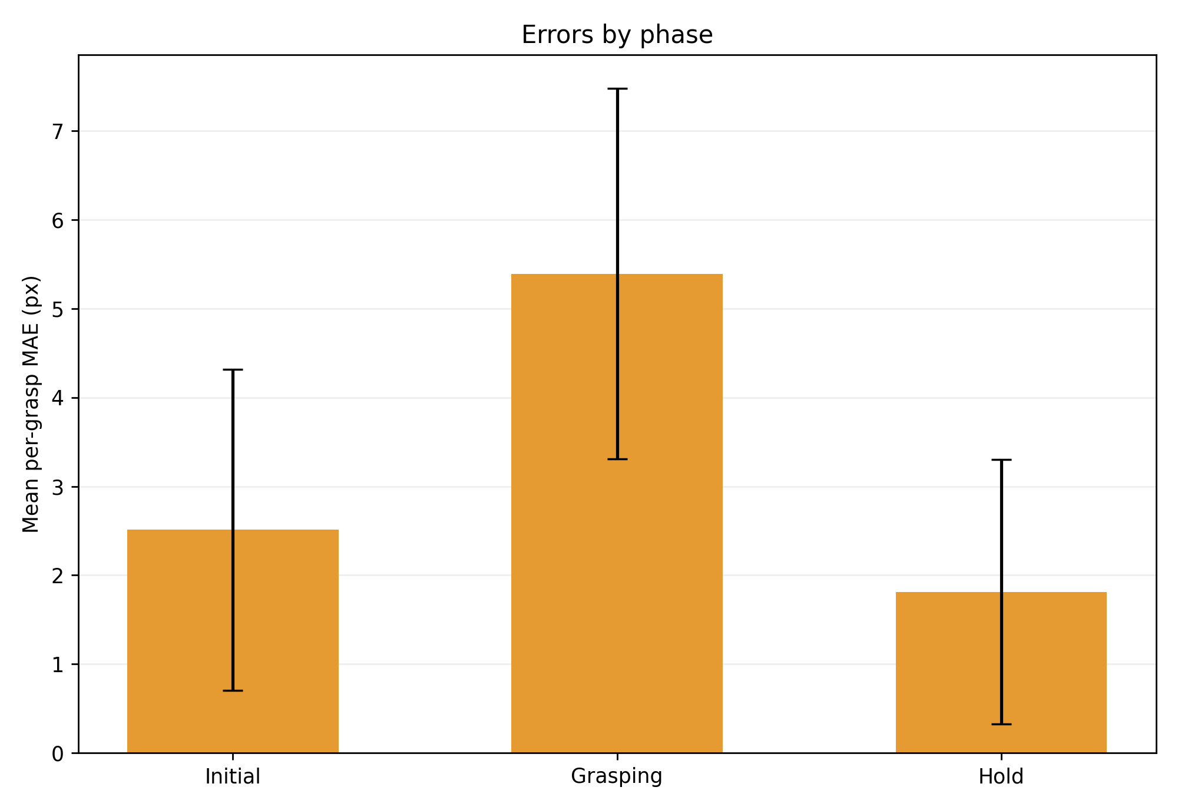
Offline Validation – Phase-Wise Analysis
Grasping Phase (changing) : Predicting aperture is more challenging.
Notes:
so Predicting aperture is more challenging in Grasping Phase
this phase is an important measure of the models capability. However, all three phases are important to prosthetic hand control.

Slide 15
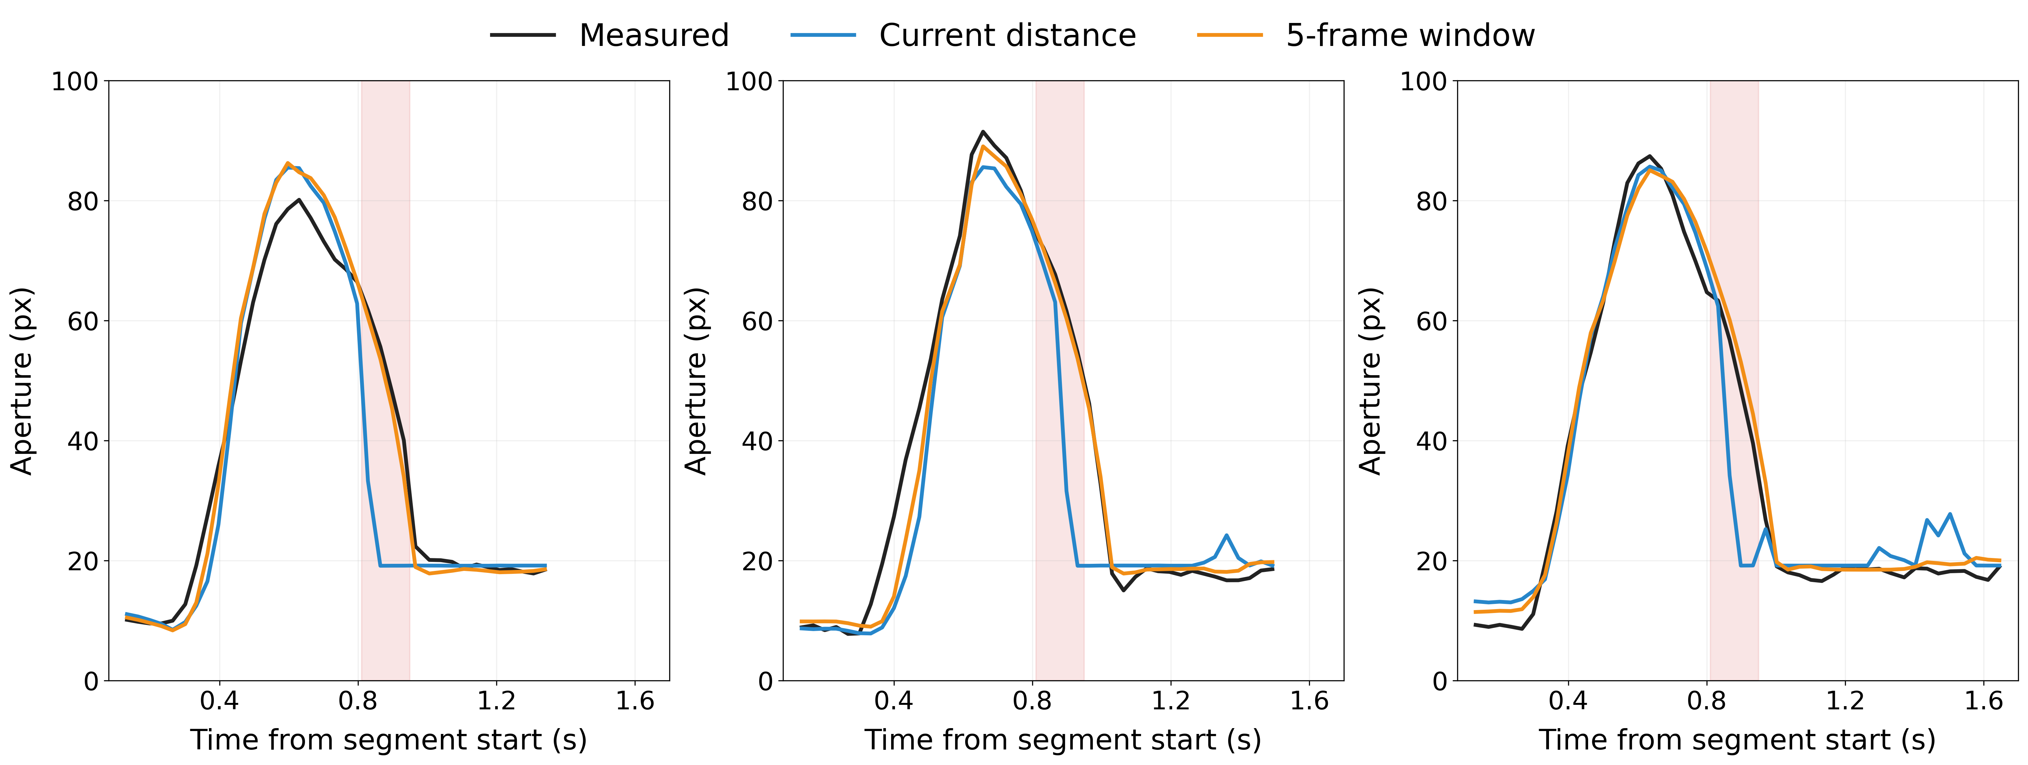
Effect of Temporal Window
Without a temporal window : The model learns only the mapping between distance and fingertip aperture, resulting in larger errors during rapid changes.
With a temporal window : The model can utilize short-term motion context to read temporal trends, improving prediction accuracy.
Comparison between predicted and ground-truth curves, In the red-highlighted region, the model without a temporal window shows poor prediction performance.

Slide 16
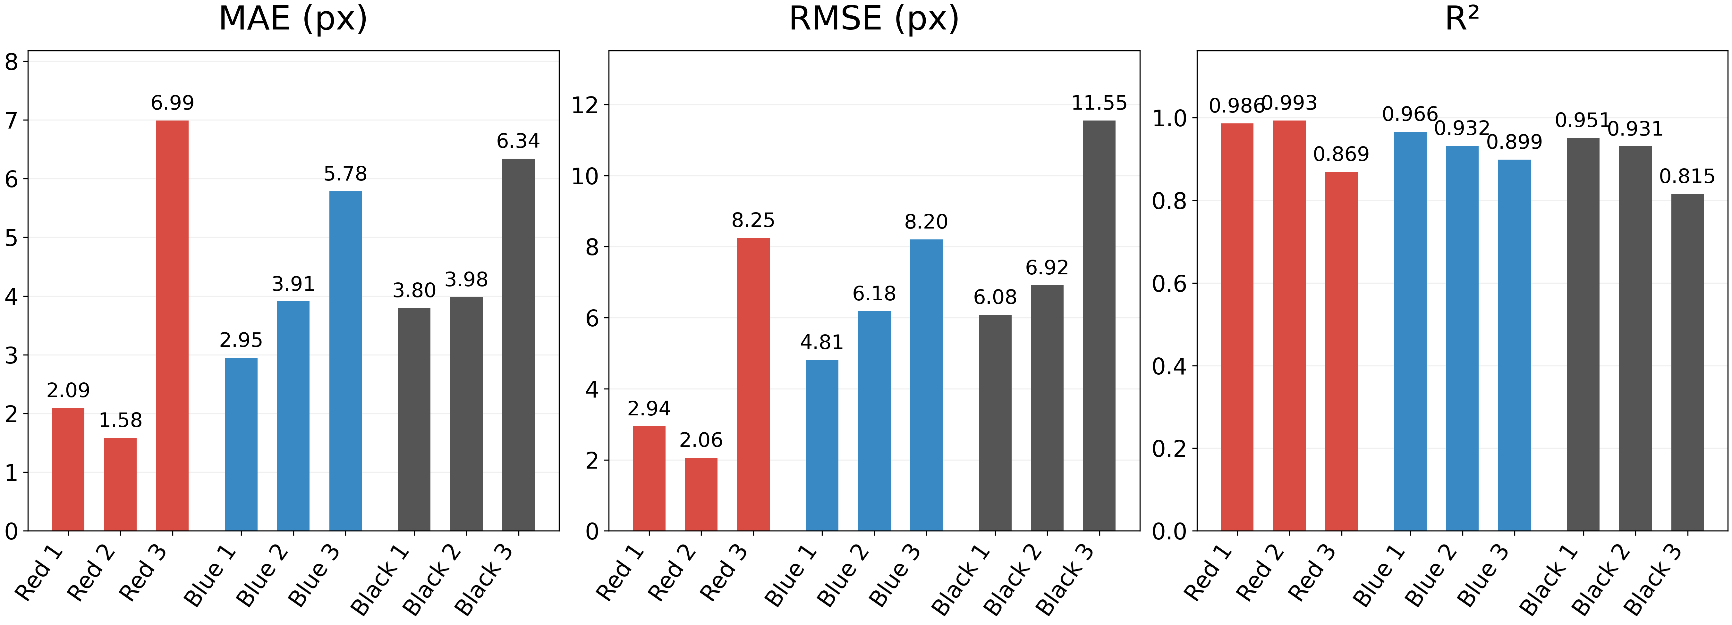
Real-Time Experiment
Three cubes of different colors and sizes were presented in random order, with three trials per cube.
The model achieved an R² above 0.89 in 8 out of 9 real-time trials, demonstrating promising prediction performance.

Slide 17
Summary
Demonstrated a consistent relationship between hand–object distance and fingertip aperture during reach-to-grasp movements.
Developed a regression model that accurately predicts continuous fingertip aperture from hand–object distance.
Developed a real-time system that automatically selects the model based on cube type and predicts fingertip aperture in real time.
Future Work
Conduct grasping experiments under more conditions.
Test Different Models.
Recruit additional participants to evaluate the model's generalization ability.
Integrate the system into the prosthetic hand system.

Slide 18
References
[1] McDonald C L, Westcott-McCoy S, Weaver M R, et al. Global prevalence of traumatic non-fatal limb amputation[J]. Prosthetics and orthotics international, 2021, 45(2): 105-114.
[2] Salminger, S., Stino, H., Pichler, L. H., Gstoettner, C., Sturma, A., Mayer, J. A., ... & Aszmann, O. C. (2022). Current rates of prosthetic usage in upper-limb amputees–have innovations had an impact on device acceptance?. Disability and rehabilitation, 44(14), 3708-3713.
[3] Lalle, A., Migliore, S., Stevenson, J., Bell, E., Pradeep, M., Gunnell, D., ... & Manero II, A. (2026). Multigesture Electromyographic Control Complexity in Upper Limb Prostheses Actuated via Single Sensor Input Contraction Magnitude: Qualitative Study for Evaluating Performance and Cognitive Load. JMIR Rehabilitation and Assistive Technologies, 13(1), e88528.
[4] Thomas, N., Miller, A. J., Ayaz, H., & Brown, J. D. (2023). Haptic shared control improves neural efficiency during myoelectric prosthesis use. Scientific reports, 13(1), 484.
[5] Vasile F, Maiettini E, Pasquale G, et al. Continuous wrist control on the hannes prosthesis: A vision-based shared autonomy framework[C]//2025 IEEE International Conference on Robotics and Automation (ICRA). IEEE, 2025: 15107-15113.

