Slide 1
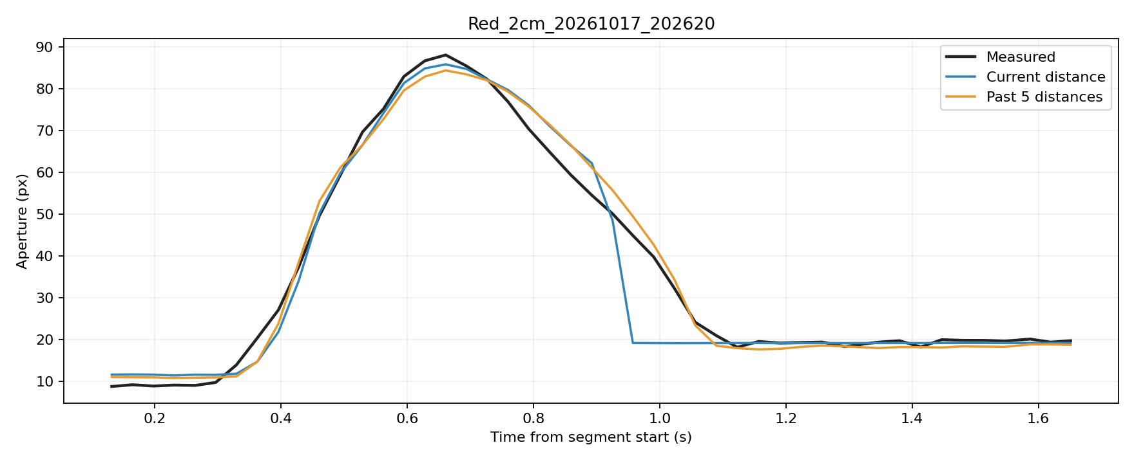
The predicted finger closure is too fast toward the end.
The same issue occurred in last week’s data and was resolved by adding a temporal window.

Slide 2
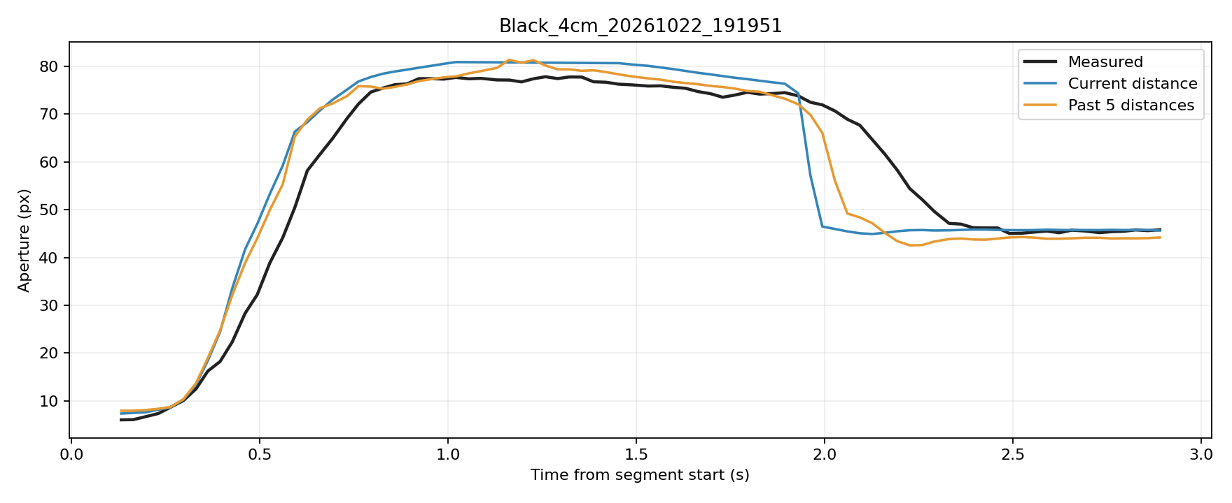
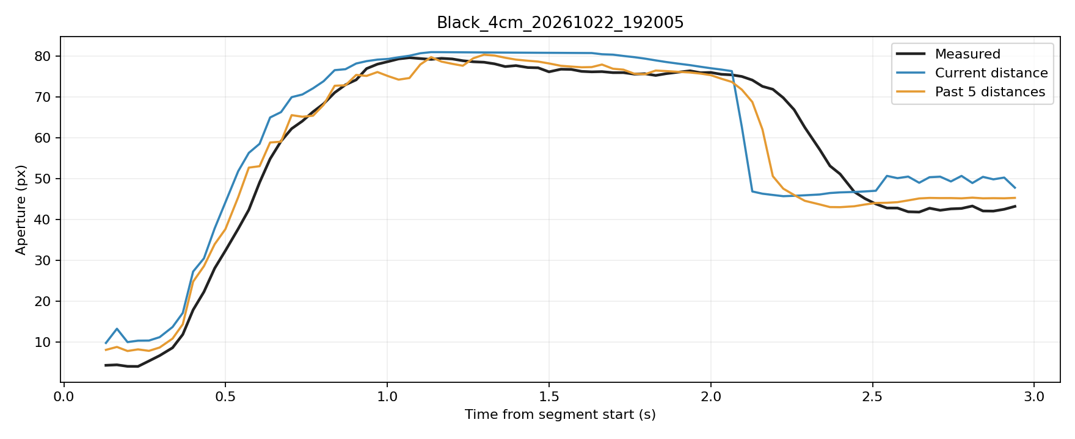
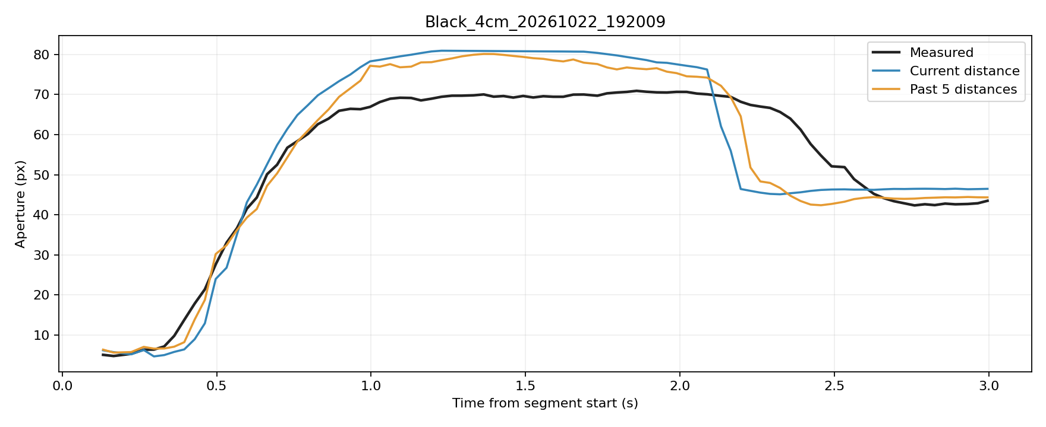
However, the issue still occurs when the movement lasts longer, possibly because the fingers remain open for too long.

Slide 3
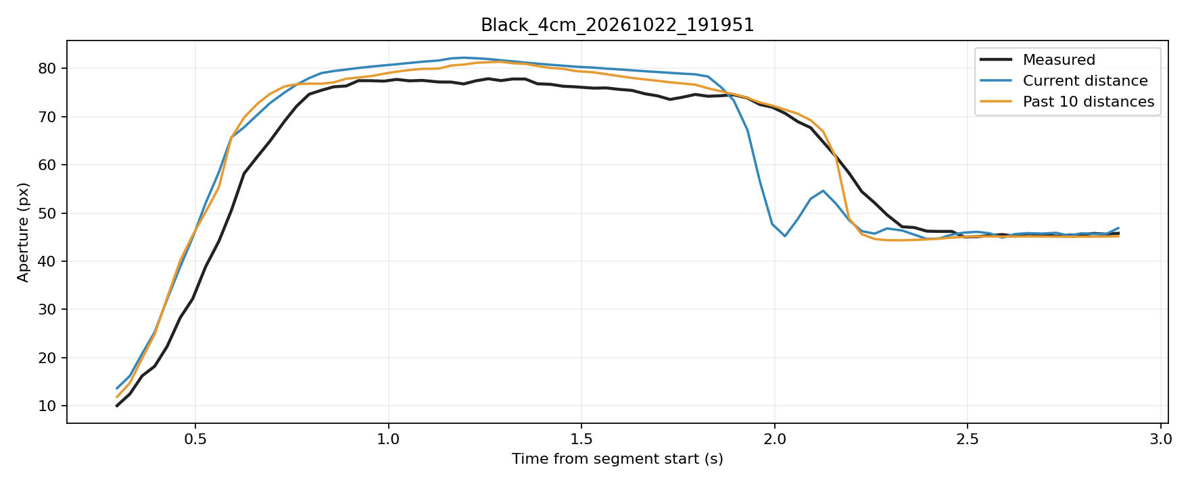
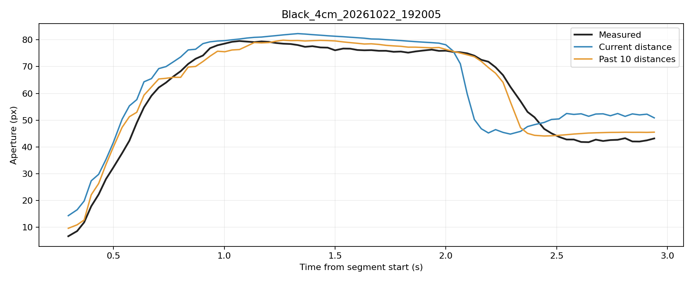
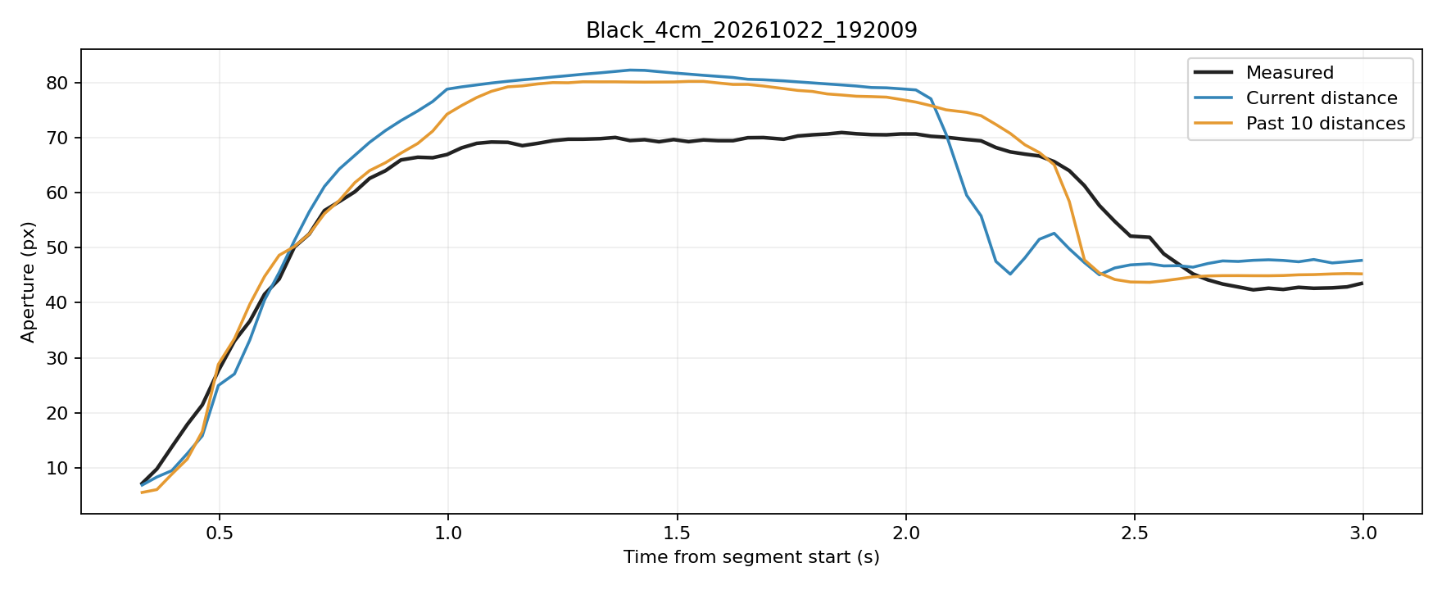
I increased the temporal window to 10 frames. This delayed the abrupt drop, but the decline was still too steep.

Slide 4
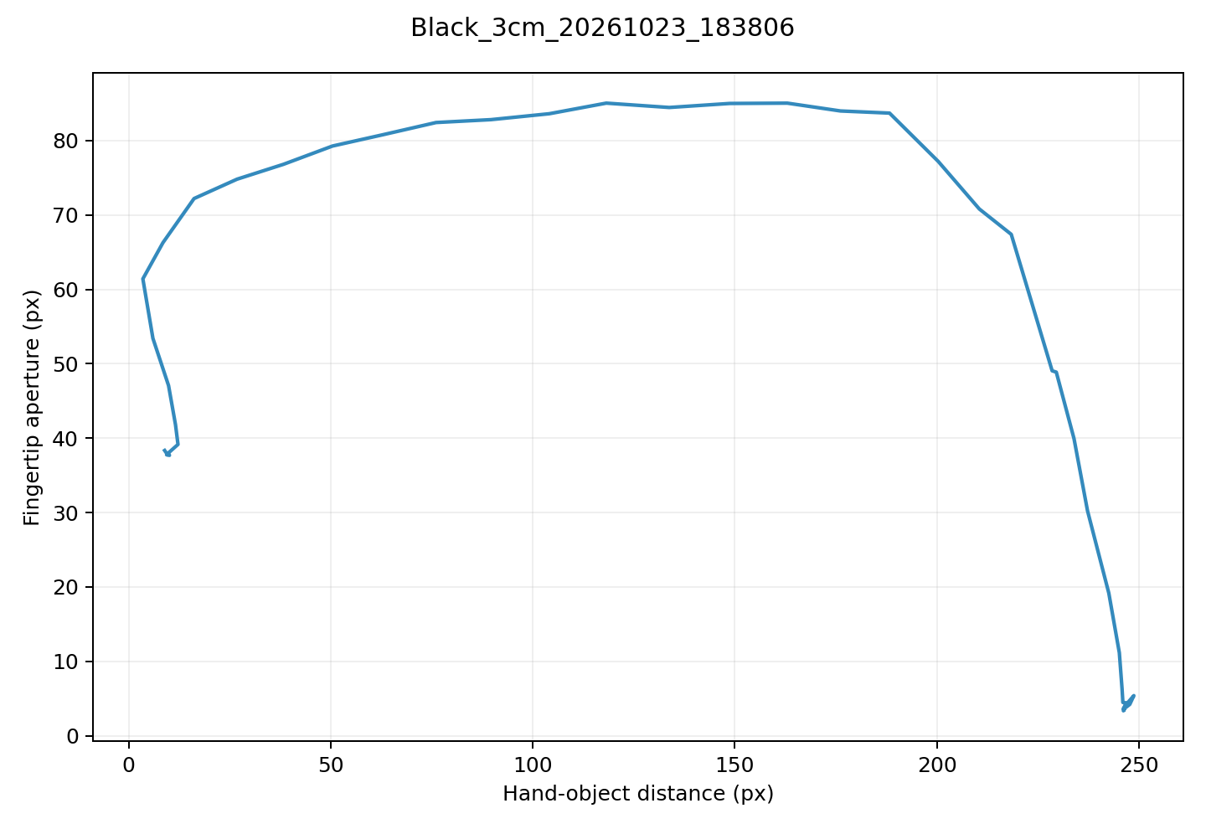
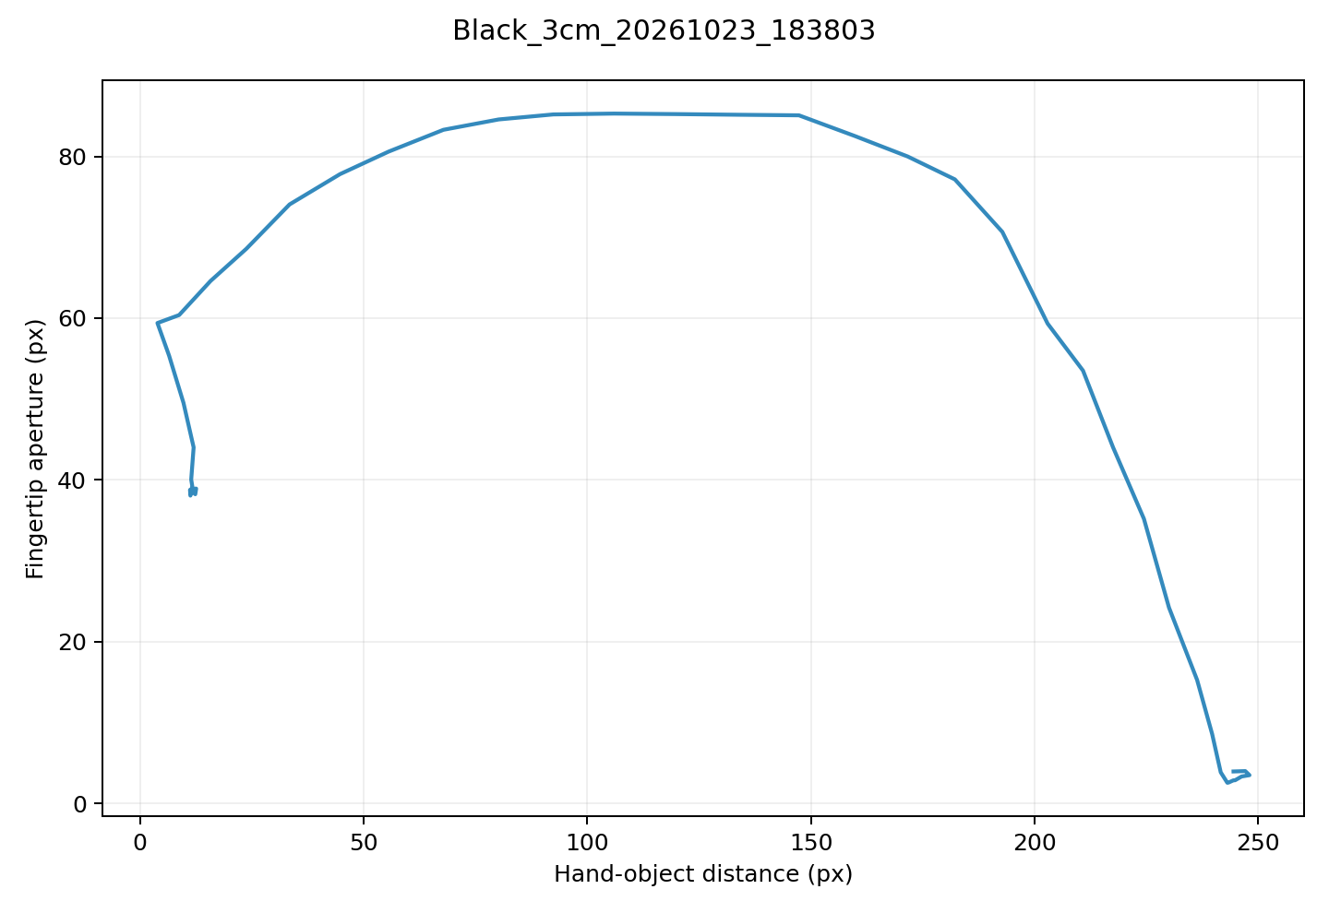
I think this mainly comes from my grasping pattern: after opening my hand, I close my fingers quickly as I approach the object.
This appears as a sharp drop in fingertip distance toward the end of the curve.
I also examined the grasping patterns of the other two participants, and one showed a pattern similar to mine.

Slide 5
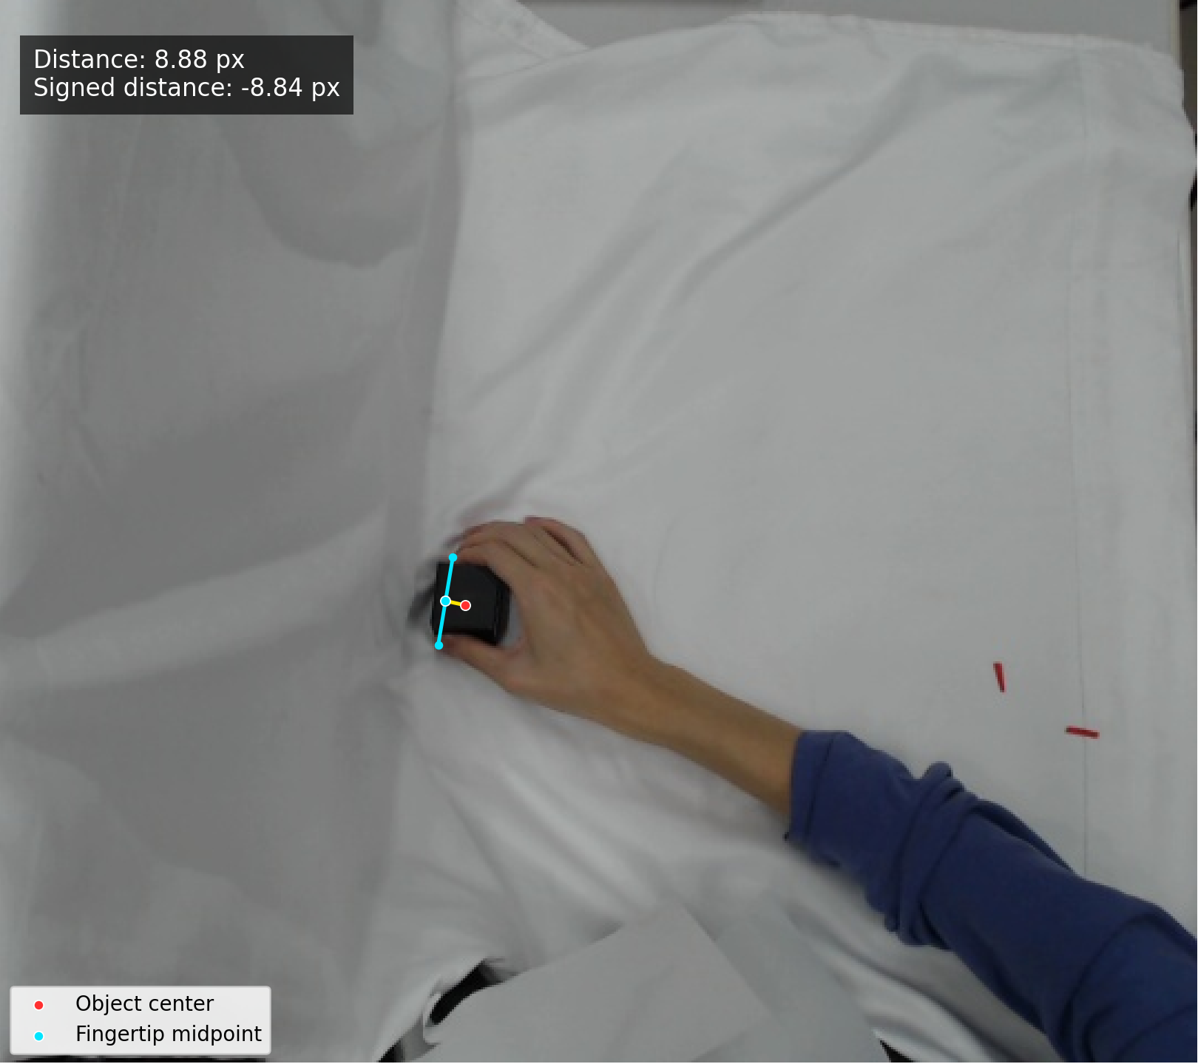
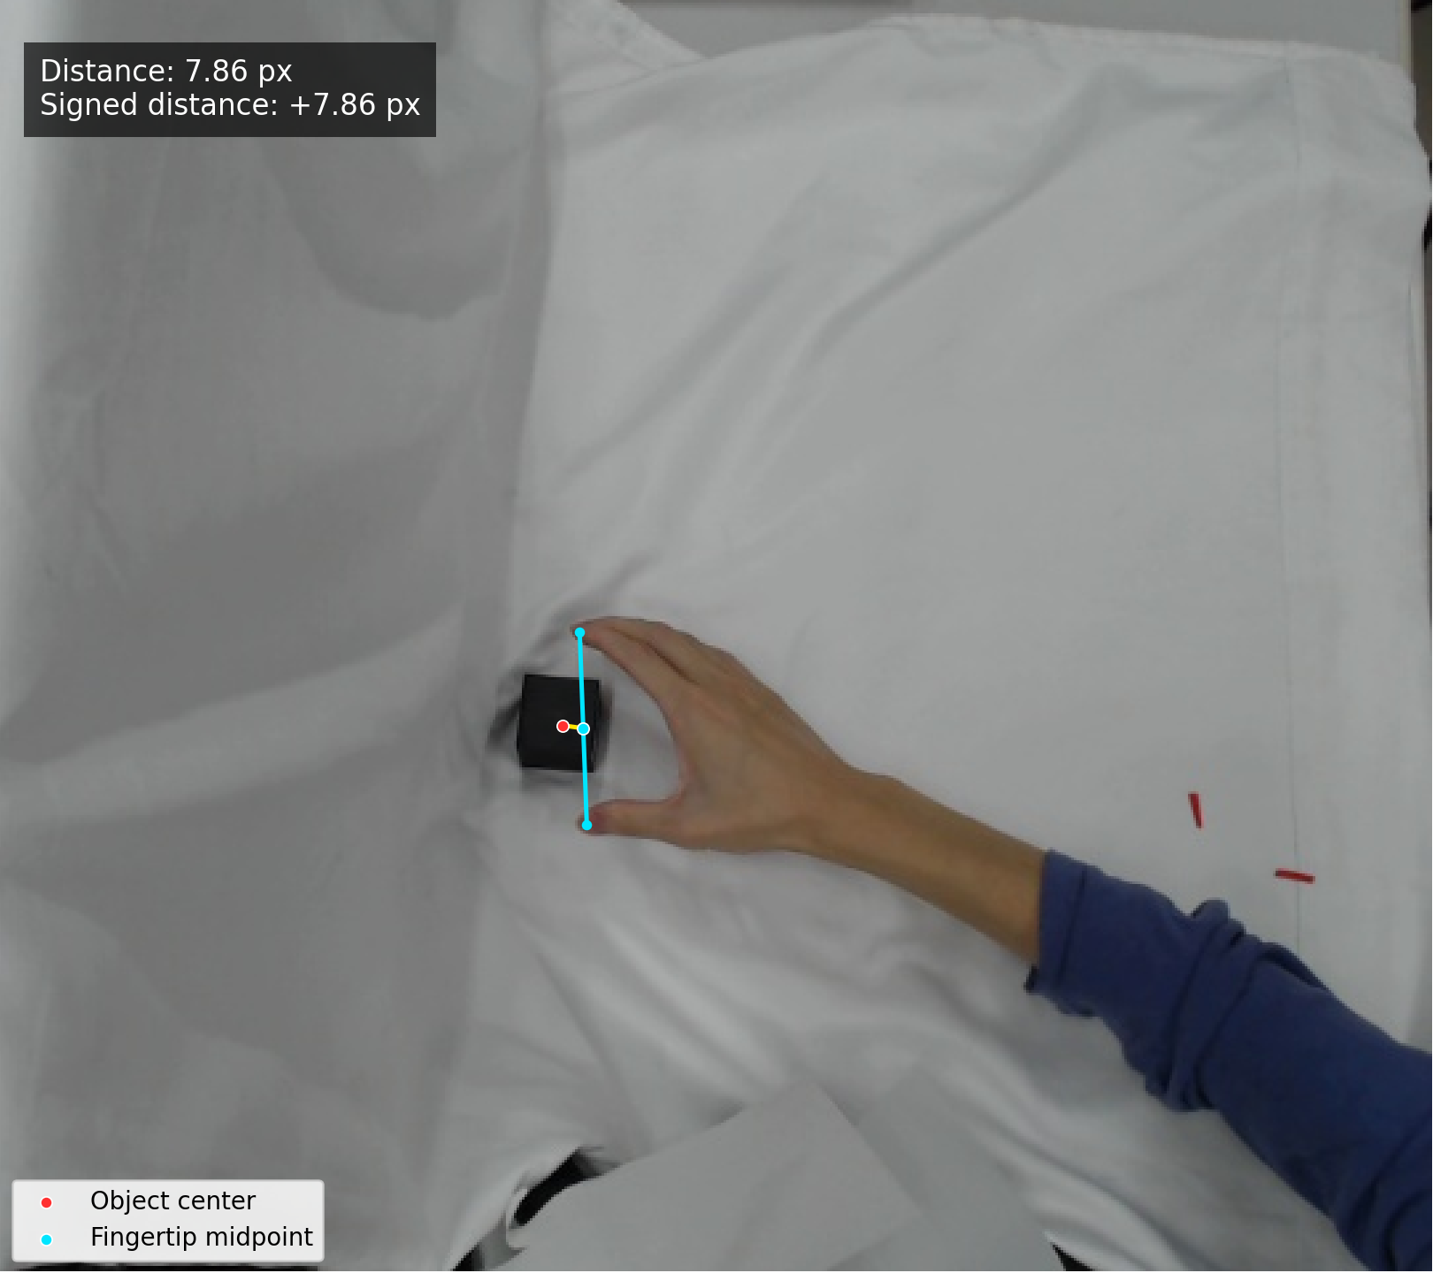
Also, because the distance is measured between the object’s center and the midpoint between the two fingertips, it can decrease to zero and then increase again.

Slide 6
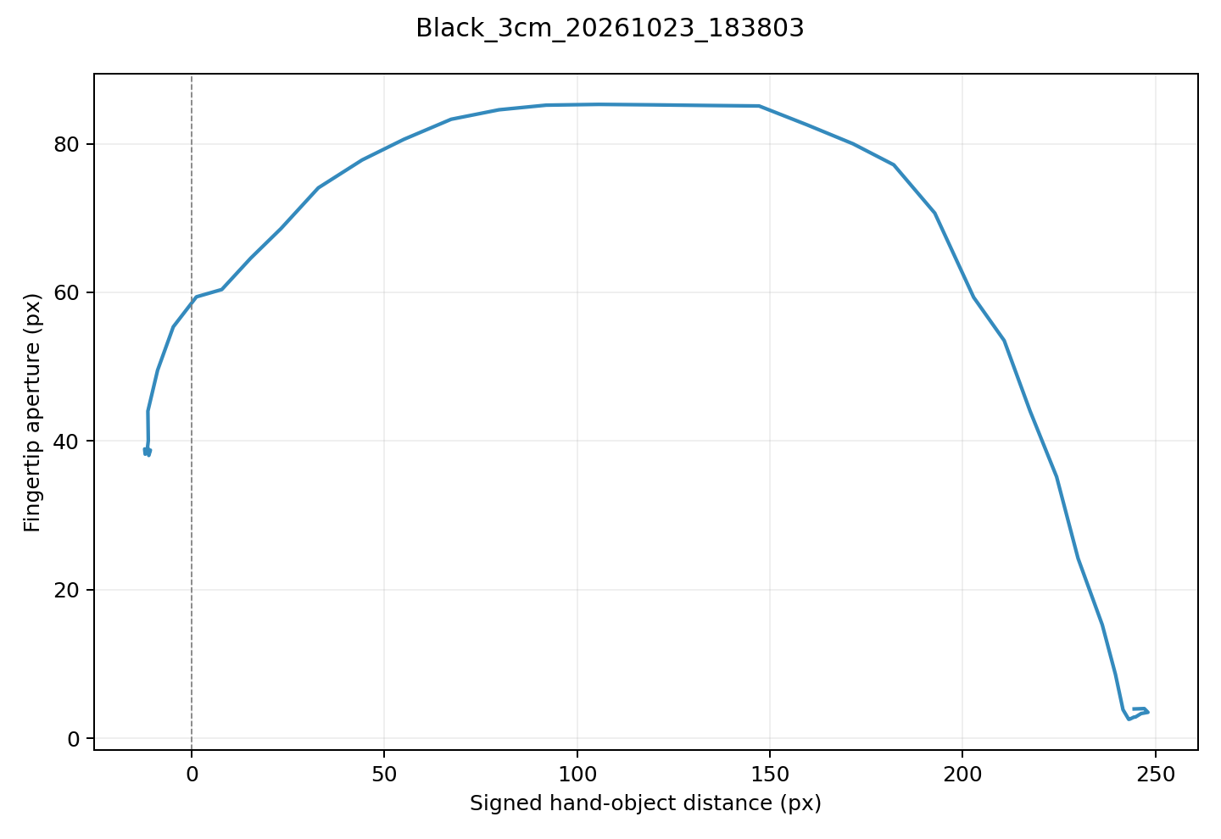
Before and after introducing signed distance,
showing a clearer relationship.
Without signed distance
With signed distance

Slide 7
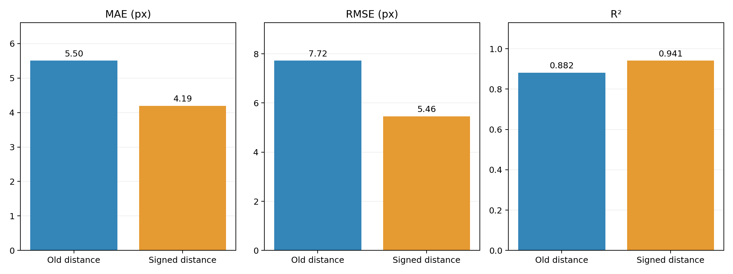
Introducing negative values improved the results.
I compared both versions using the same training and test sets with a 5-frame window. The orange curve shows the results with signed distance.

Slide 8
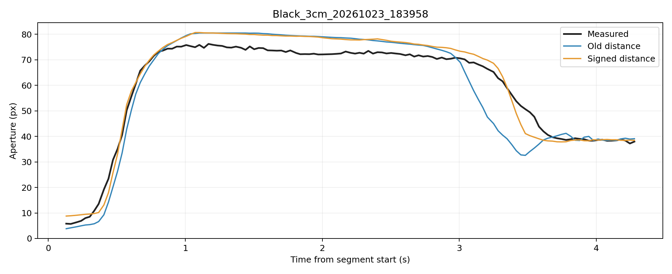
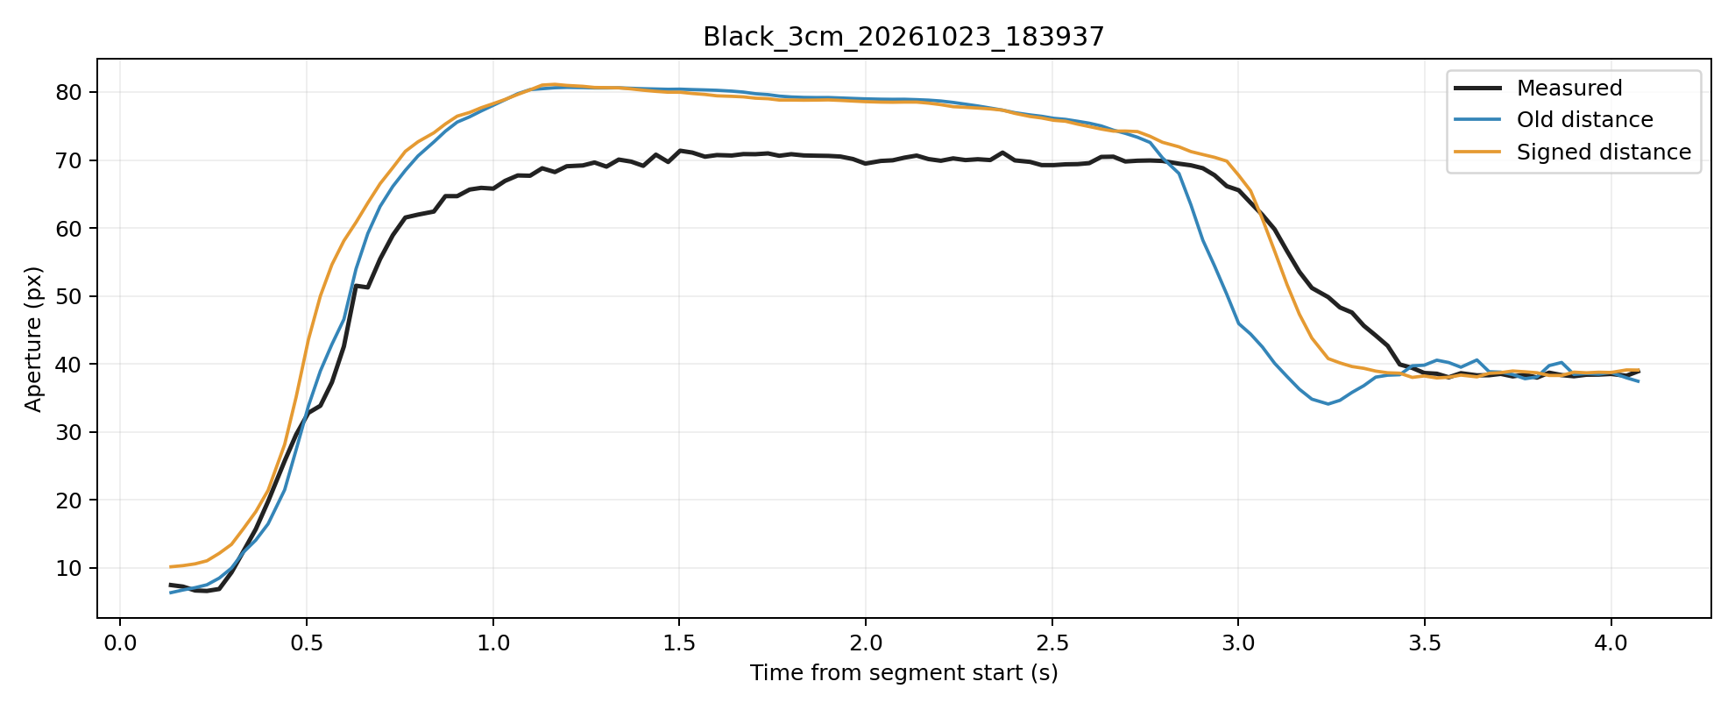
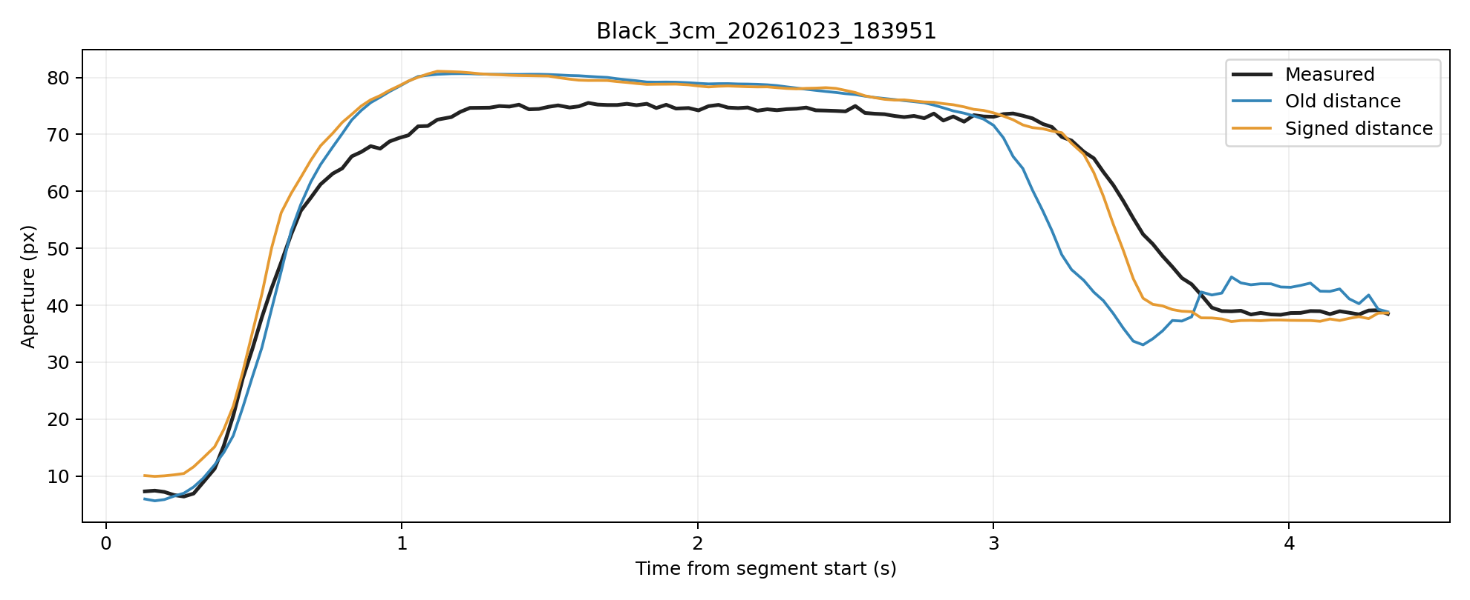
Example comparison

