Slide 1
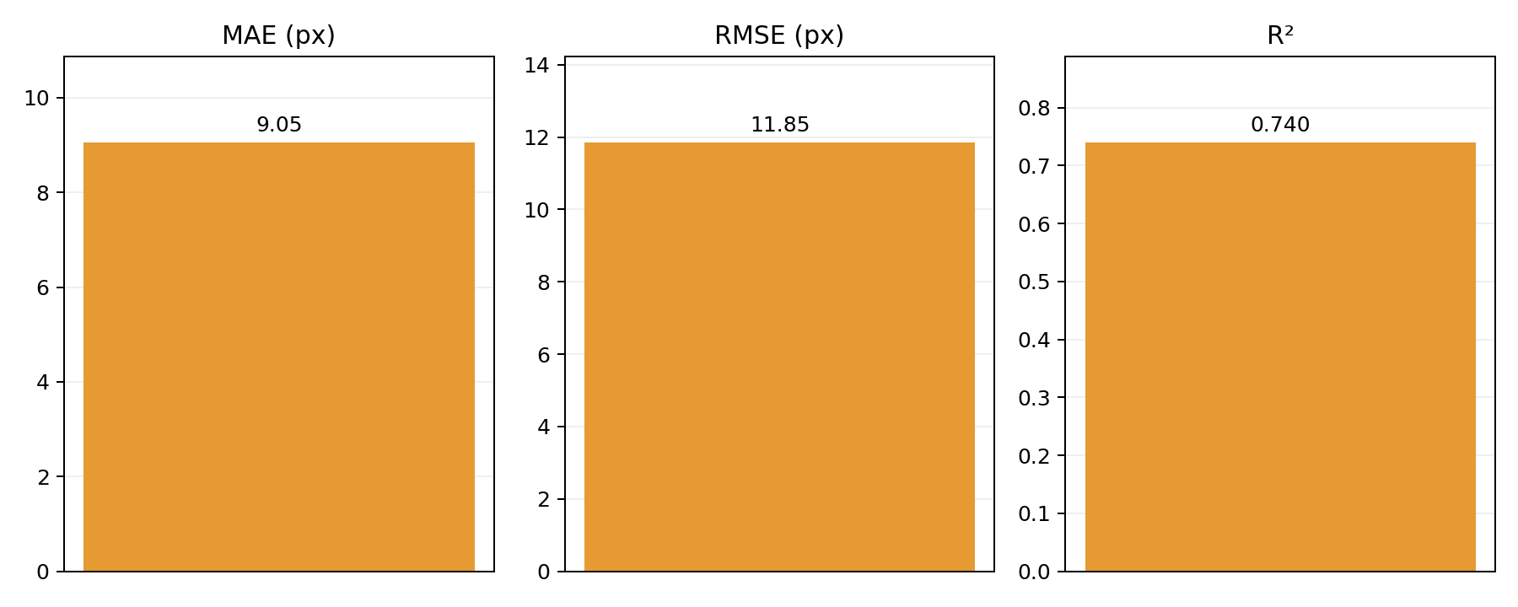
Training set without including slow grasping data
19 validation trials
MAE
RMSE
R²
9.05
11.85
0.740
px
px

Slide 2
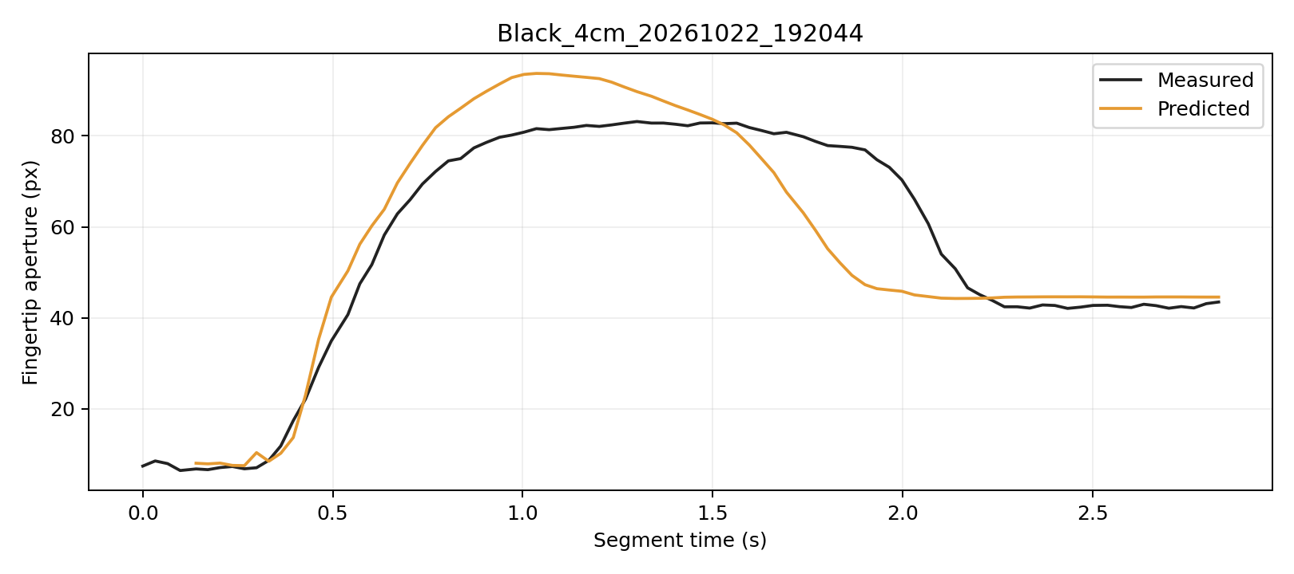
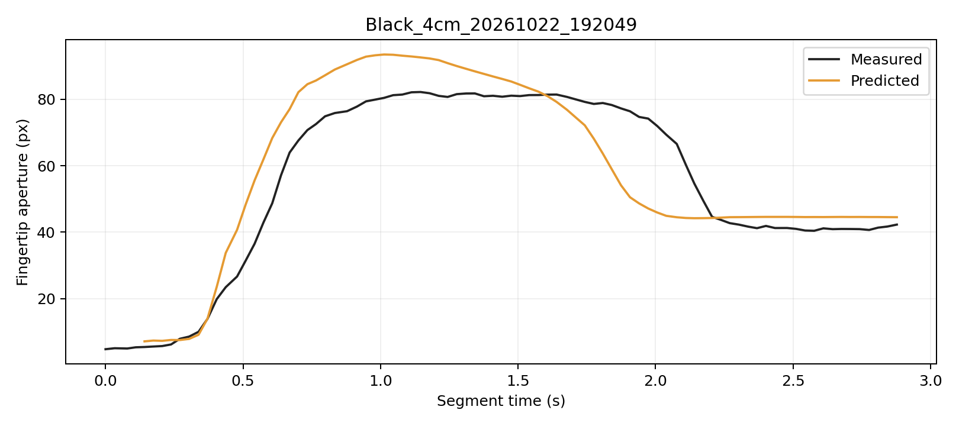
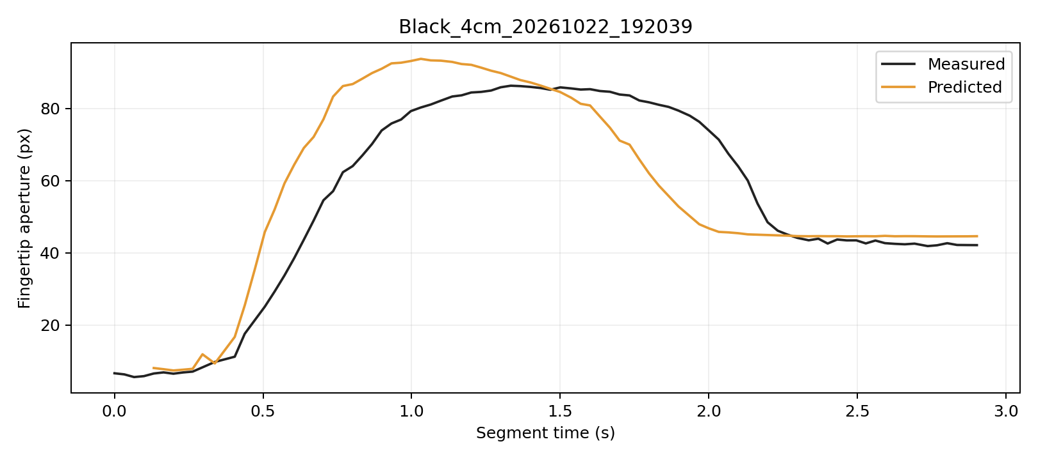
Prediction Example

Slide 3
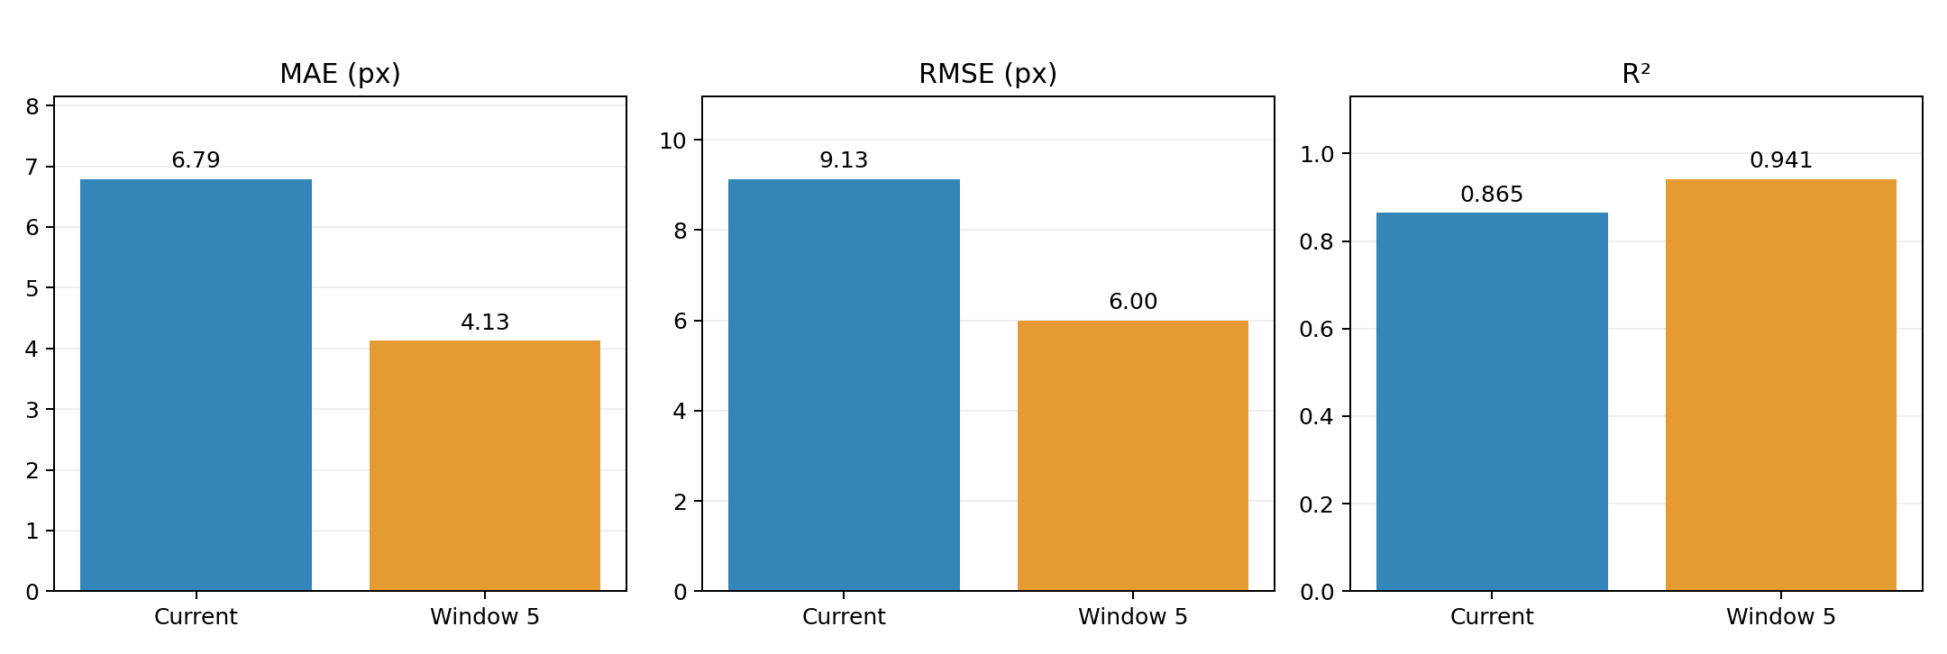
Trained using 20 trials of normal grasping (1s) and 20 trials of slow grasping (3s).
MAE
RMSE
R²
4.13
6
0.941
px
px

Slide 4
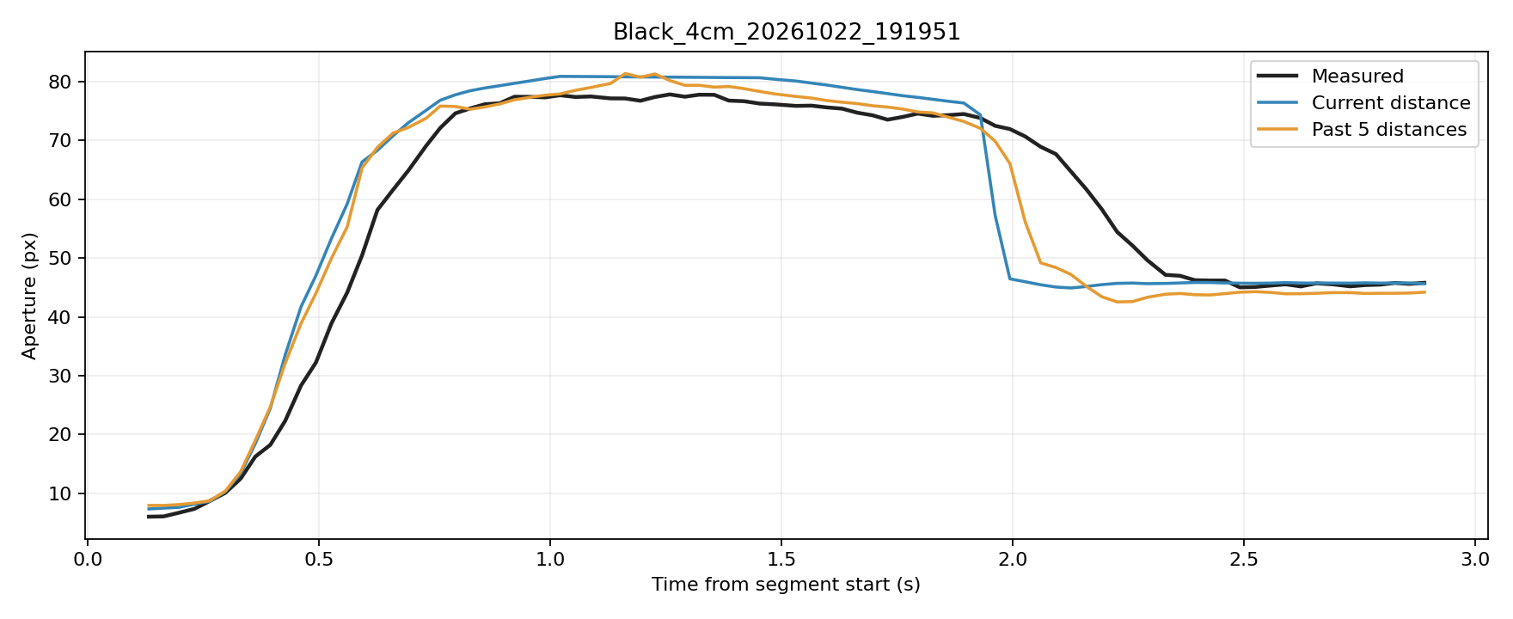
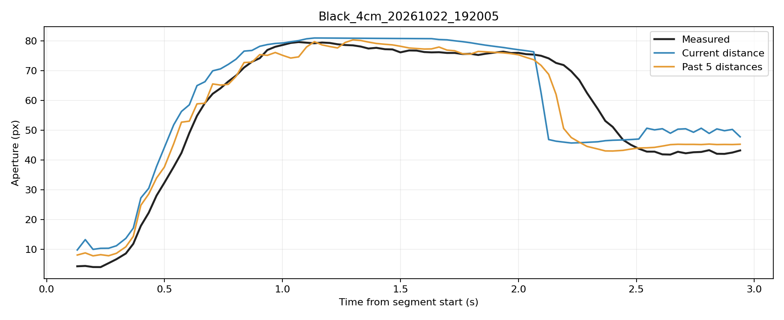
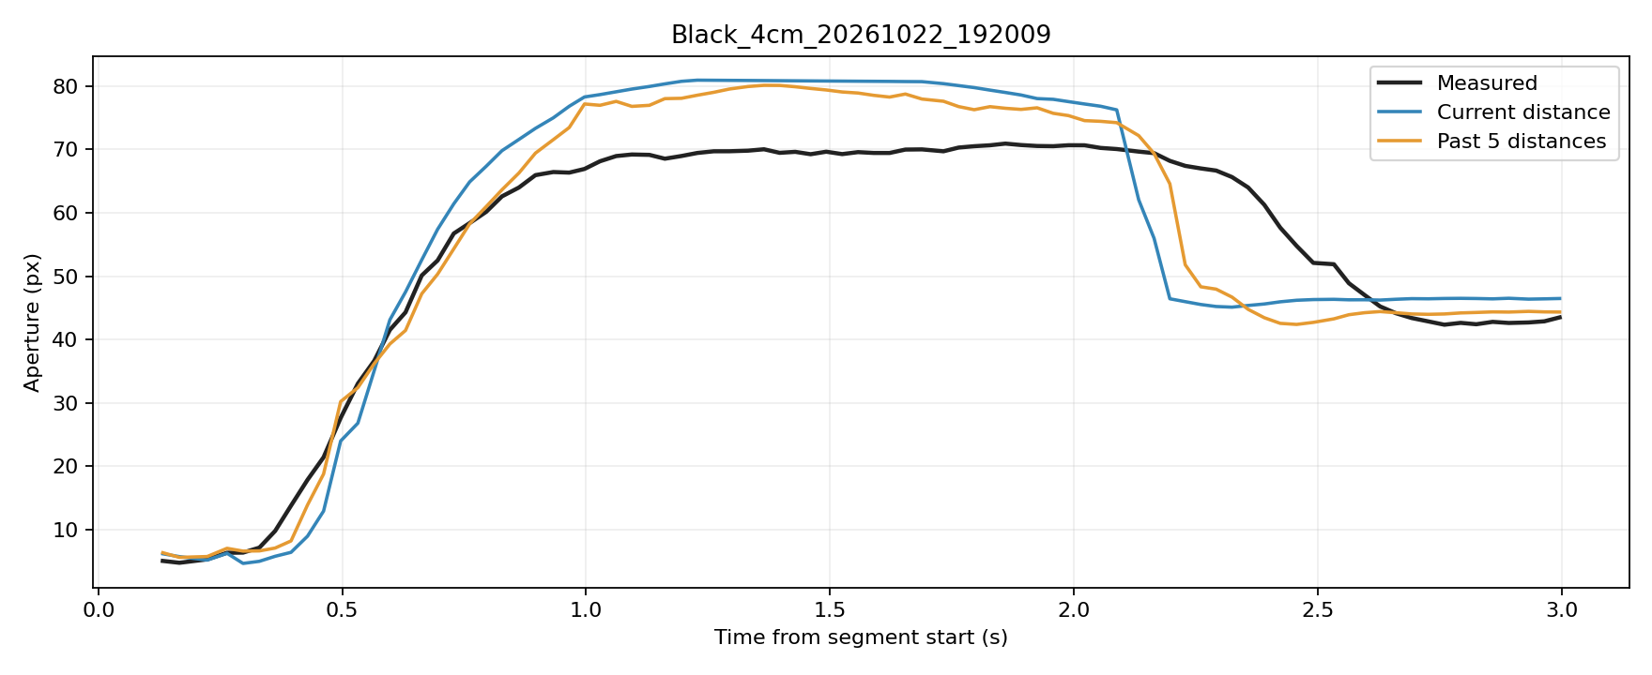
Prediction Example

