Slide 1
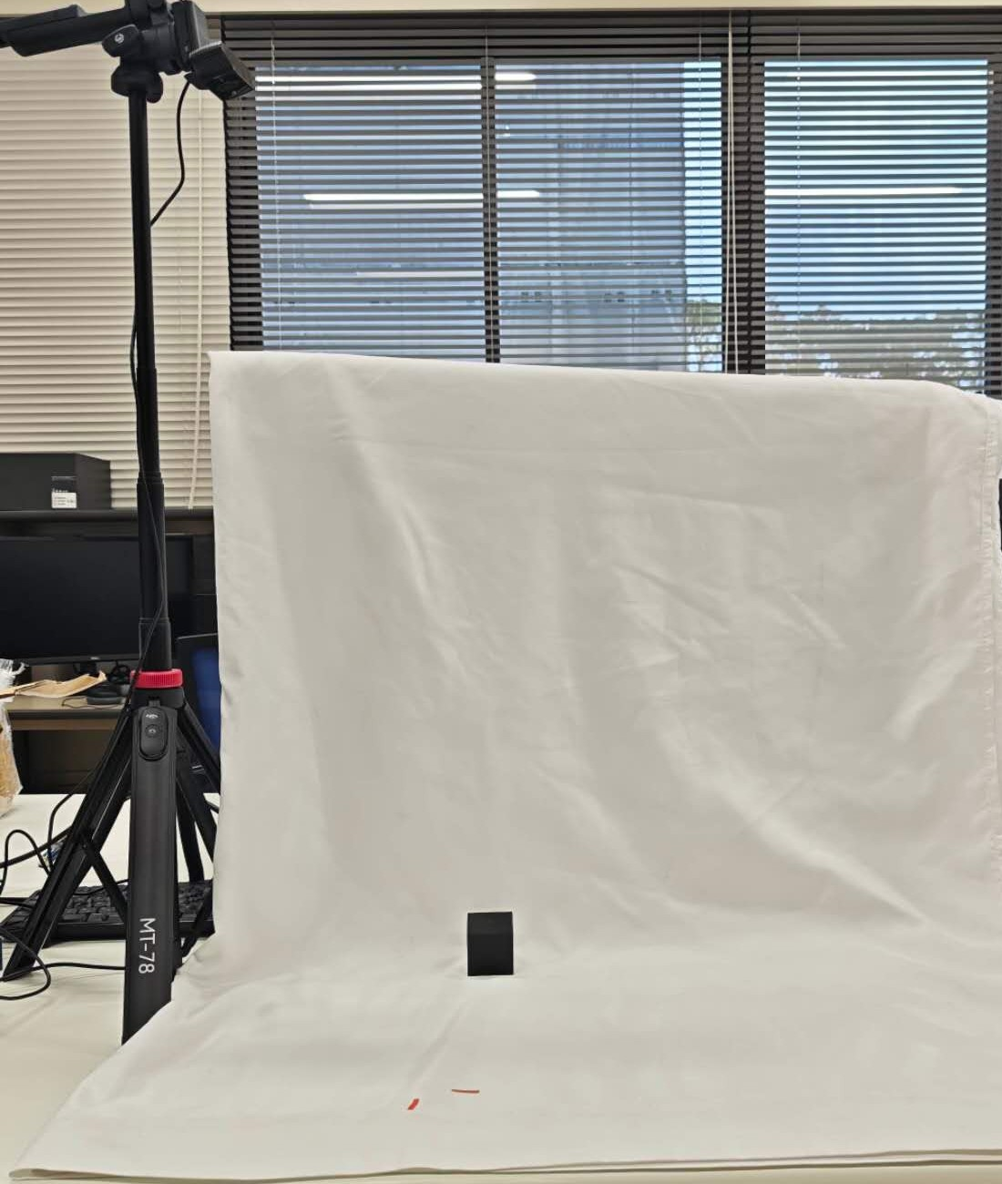
Experimental Setup
Overhead camera
Recording conditions
Camera recording
30 fps
Cube side lengths
20, 30 and 40 mm
Initial hand-object distance
250–350 mm
Trial duration
1–4 s
Target cube
Planar grasping recorded from above
Saga University, Fukuda Laboratory
Notes:
Setup photograph extracted from slide 8 of Zemi/output/Di_Zemi_English_Final.pptx. Recording conditions use confirmed experiment settings from the user: 20/30/40 mm cubes, initial hand–object distance 250–350 mm and trial duration 1–4 s. Camera recording is nominally 30 fps. Camera model, calibrated camera height and resolution are omitted pending verification.

