Slide 1
A Vision-Based Regression Model for
Semi-Autonomous Prosthetic Hand Control
Saga University Graduate School of Science and Engineering​
Computer Science & Information Techology Course​
Fukuda Laboratory 25742102 DI XIQING
Supervisor: Professor Osamu Fukuda
Notes:
good morning everyone im d, my research is ...

Slide 2
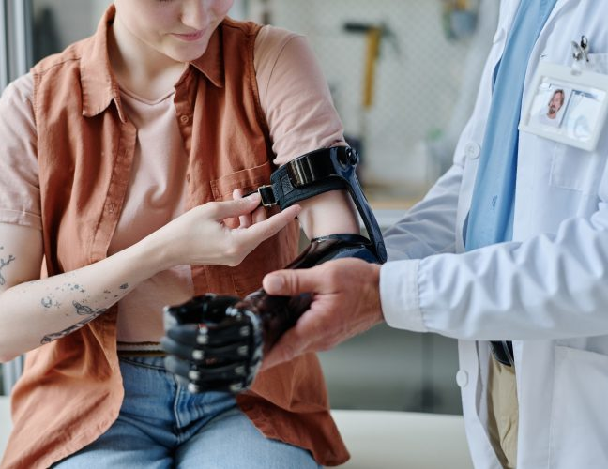
Background
44%
Rejection rate of prosthetic [2].
Command Complexity
Selecting and generating gesture commands can increase cognitive workload [3].
Attention Demands
Prosthetic control requires attention and increase cognitive load [4].
Approximately 57.7 million people worldwide are living with traumatic limb loss [1]
Prosthesis users consciously perform adjustments that occur automatically in natural grasping
Notes:
モデルを比べる前に、まずデータを確認します。立方体ごとに100試行の d–l 曲線を重ね描きし、試行間で一貫しているか、最大開口がどこで現れるか、サイズや速さでどう変わるかを見ます。

Slide 3
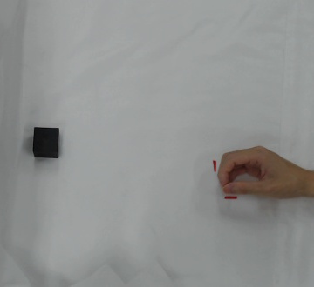
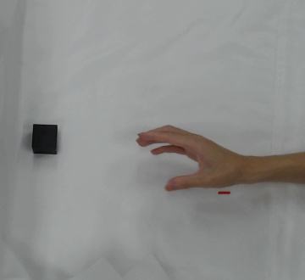
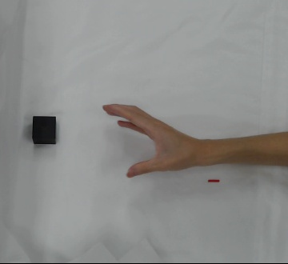
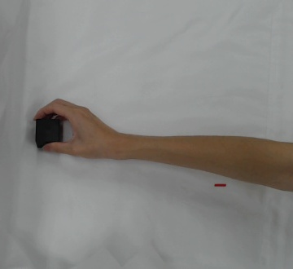
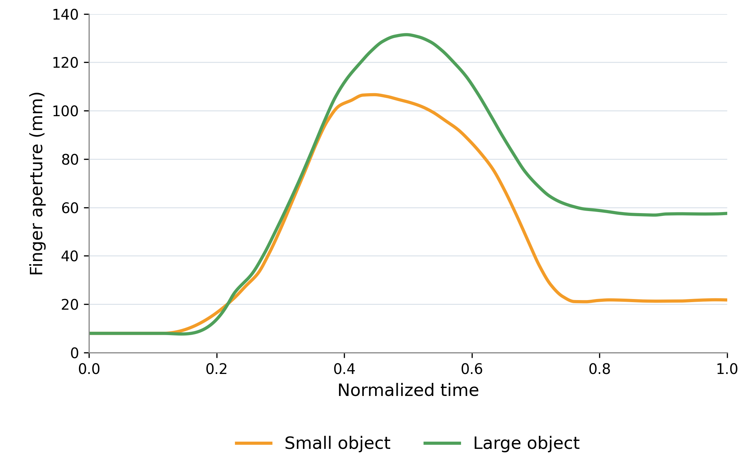
Human Grasping Without Conscious Effort
① Initial Closed
② Opening
③ Wide Open
④ Closing to Grasp
Actual grasping sequence (overhead camera view)
Typical Changes in Finger Aperture
Opening and closing
The fingers open during reaching and close
before contacting the object. [5]
1
Adjustment to object size
Larger objects generally lead to a larger
maximum grip aperture. [6]
2
3
Without Explicit Size Judgement
Patients can scale their grip aperture to object size despite impaired size perception. [7]
Notes:
モデルを比べる前に、まずデータを確認します。立方体ごとに100試行の d–l 曲線を重ね描きし、試行間で一貫しているか、最大開口がどこで現れるか、サイズや速さでどう変わるかを見ます。

Slide 4
Proposed Approach
Human
Observe the hand and object
Internal model in the brain
(automatic)
Fingers open and close
Proposed
Overhead camera
Grasp model
Distance -> Aperture
Prosthetic hand (future)
User: EMG-based
initiation and fine adjustment (future)
Why Distance?
Hand–object distance determines closure onset [8].
Why an Overhead View?
The positions of the hand and object can be measured together.
Notes:
モデルを比べる前に、まずデータを確認します。立方体ごとに100試行の d–l 曲線を重ね描きし、試行間で一貫しているか、最大開口がどこで現れるか、サイズや速さでどう変わるかを見ます。

Slide 5
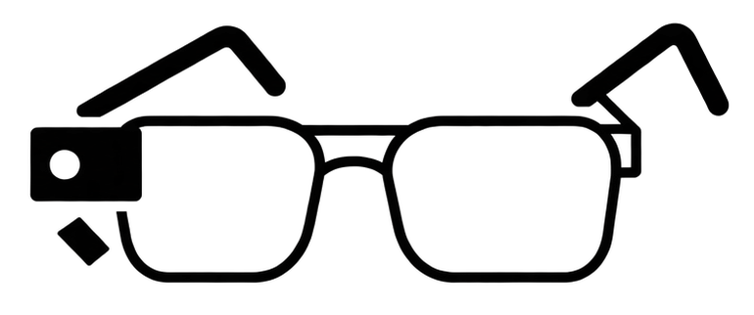
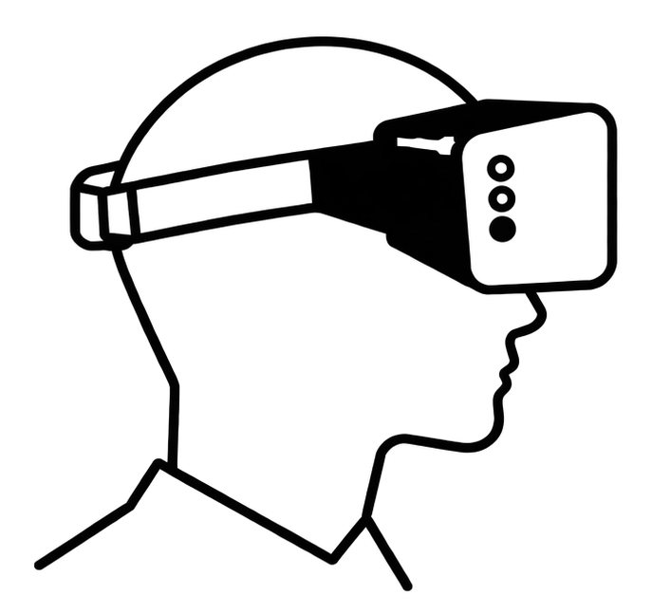
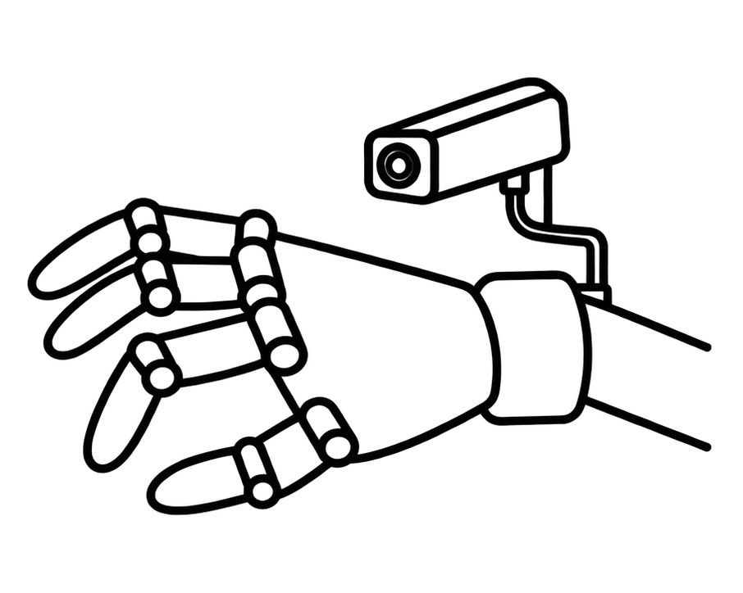
Related Work
First-Person Cameras (Wearable)
Overhead Cameras (Externally Fixed)
Common in human grasp measurement
(marker-based and markerless motion capture) [15]
Markovic 2014, 2015 [9, 10]
Glasses
In prosthetic control, mainly discussed
as a future possibility [11]
Wang 2022 [11]
Head
This Study
Use an overhead camera to learn
automatic human aperture adjustment
Ghazaei 2017 [12]
Vasile 2025 [13]
He 2019 [14]
Prosthesis
Apply the viewpoint used in grasp measurement to prosthetic aperture control
Notes:
モデルを比べる前に、まずデータを確認します。立方体ごとに100試行の d–l 曲線を重ね描きし、試行間で一貫しているか、最大開口がどこで現れるか、サイズや速さでどう変わるかを見ます。

Slide 6
Research Question
Can hand–object distance measured by an overhead camera
predict finger aperture during grasping?
1
2
3
Distance–Aperture
Relationship
Which Model Is Effective
Real-Time Feasibility
How does finger aperture
vary with hand–object
distance?
Which model best predicts finger aperture?
Can the model predict finger aperture in real time?
Notes:
モデルを比べる前に、まずデータを確認します。立方体ごとに100試行の d–l 曲線を重ね描きし、試行間で一貫しているか、最大開口がどこで現れるか、サイズや速さでどう変わるかを見ます。

Slide 7
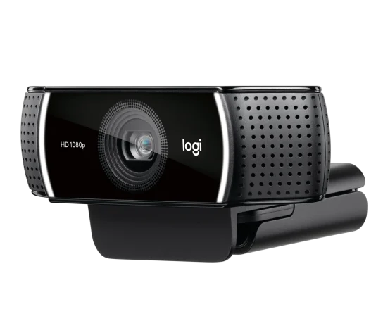
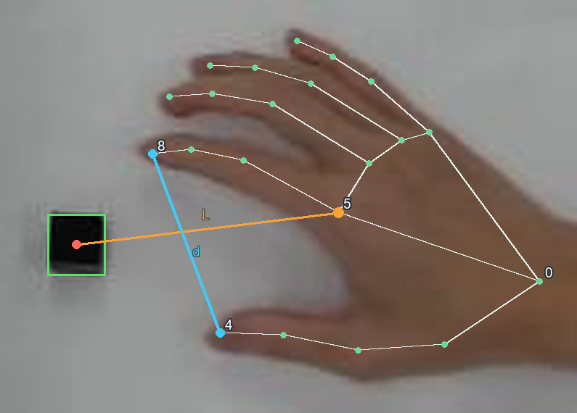
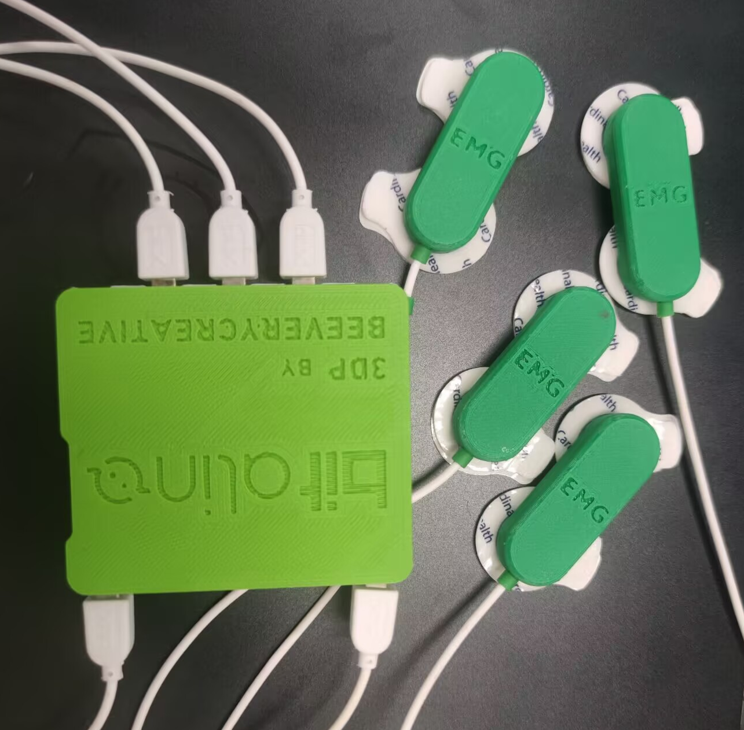
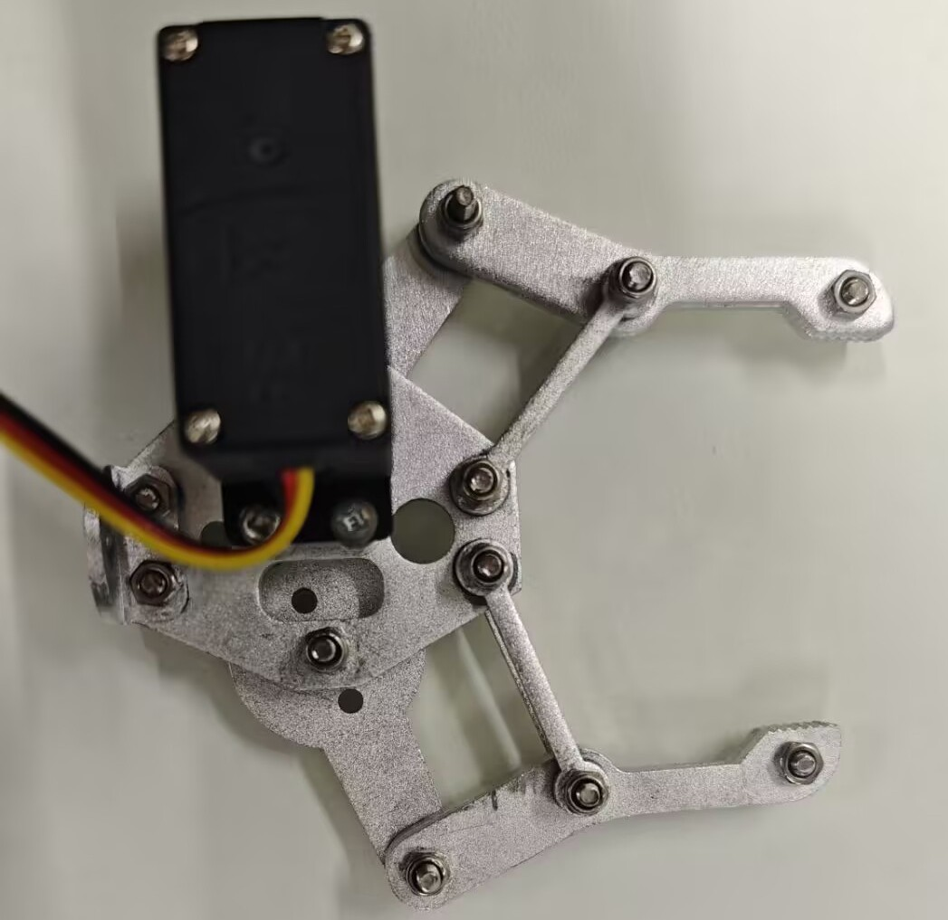
System Architecture
l = L / L0
Model
l, v, s → d̂
v
Overhead Camera
30 FPS
Feature
extraction
s
d
Fingertip distance
Detect fingertips using MediaPipe
L
Hand–object distance
Finger-base marker to object center
Scope of this study
Normalized distance
L / L0 (L0 = 300 mm)
Unit conversion
Actual side length / side length in pixels
l
mm
EMG (future)
Prosthesis (future)
Generate (l_t, d_t) time series at 30 Hz (about every 33 ms)
Notes:
モデルを比べる前に、まずデータを確認します。立方体ごとに100試行の d–l 曲線を重ね描きし、試行間で一貫しているか、最大開口がどこで現れるか、サイズや速さでどう変わるかを見ます。

Slide 8
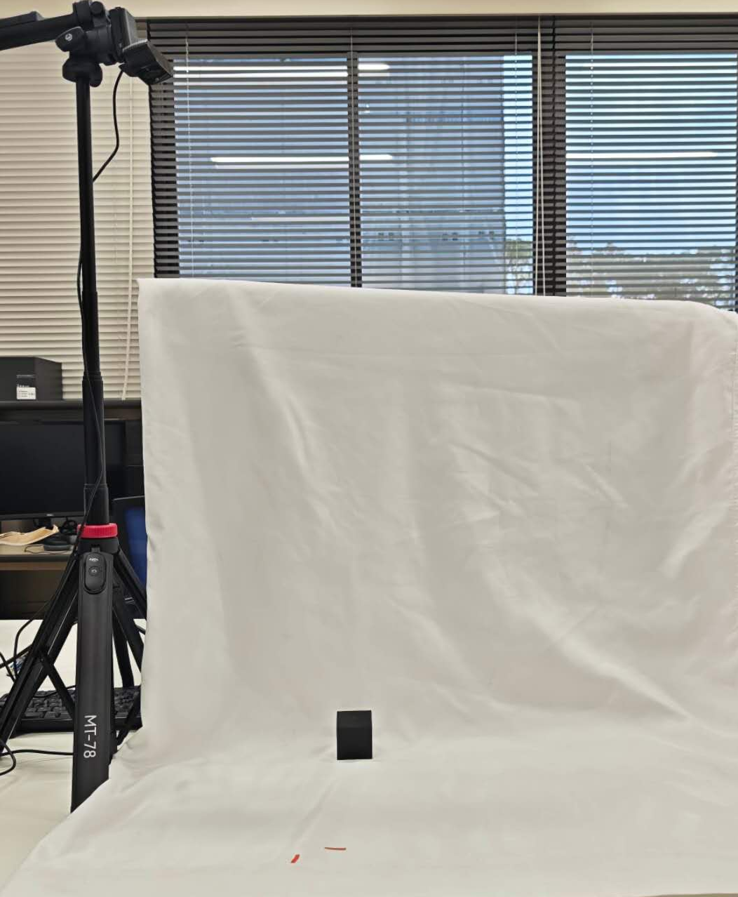
Experimental Setup
Overhead Camera
Recording conditions
Camera recording
30 fps
Cube side lengths
20, 30 and 40 mm
Initial hand-object distance
250–350 mm
Target Object
Trial duration
1–4 s
Planar grasping recorded from above
Notes:
モデルを比べる前に、まずデータを確認します。立方体ごとに100試行の d–l 曲線を重ね描きし、試行間で一貫しているか、最大開口がどこで現れるか、サイズや速さでどう変わるかを見ます。

Slide 9
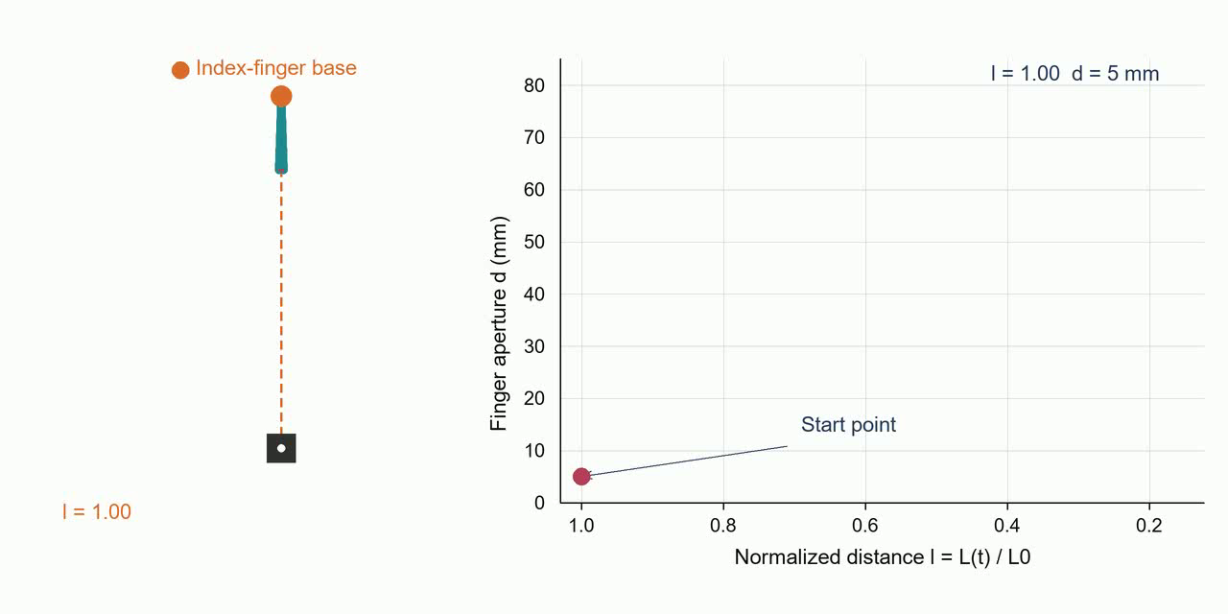
Relationship Between Input l and Output d
Motion Demonstration
Distance–Aperture Relationship
l : distance from the index-finger base to the object center, normalized by its initial value.
d : distance between the thumb tip and the index fingertip
Notes:
モデルを比べる前に、まずデータを確認します。立方体ごとに100試行の d–l 曲線を重ね描きし、試行間で一貫しているか、最大開口がどこで現れるか、サイズや速さでどう変わるかを見ます。

Slide 10
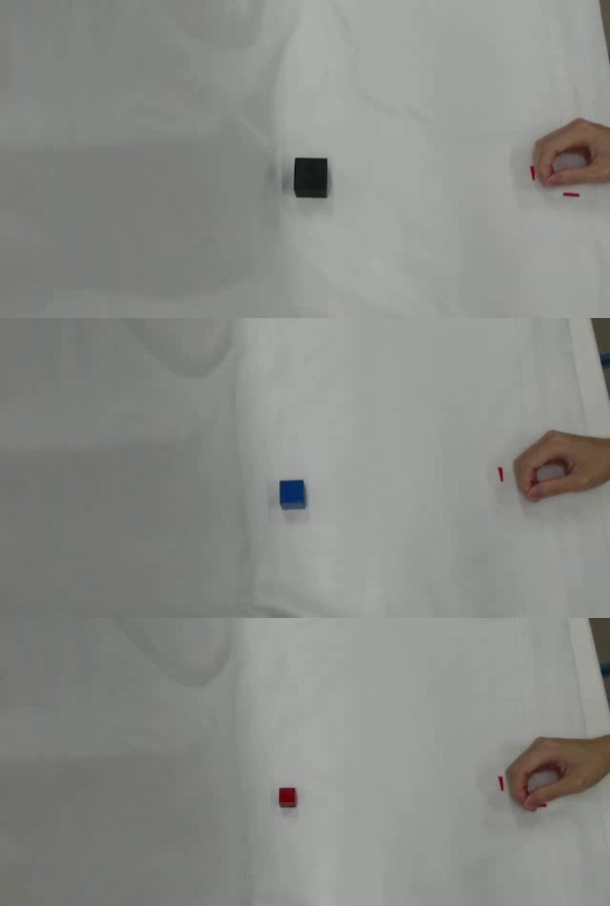
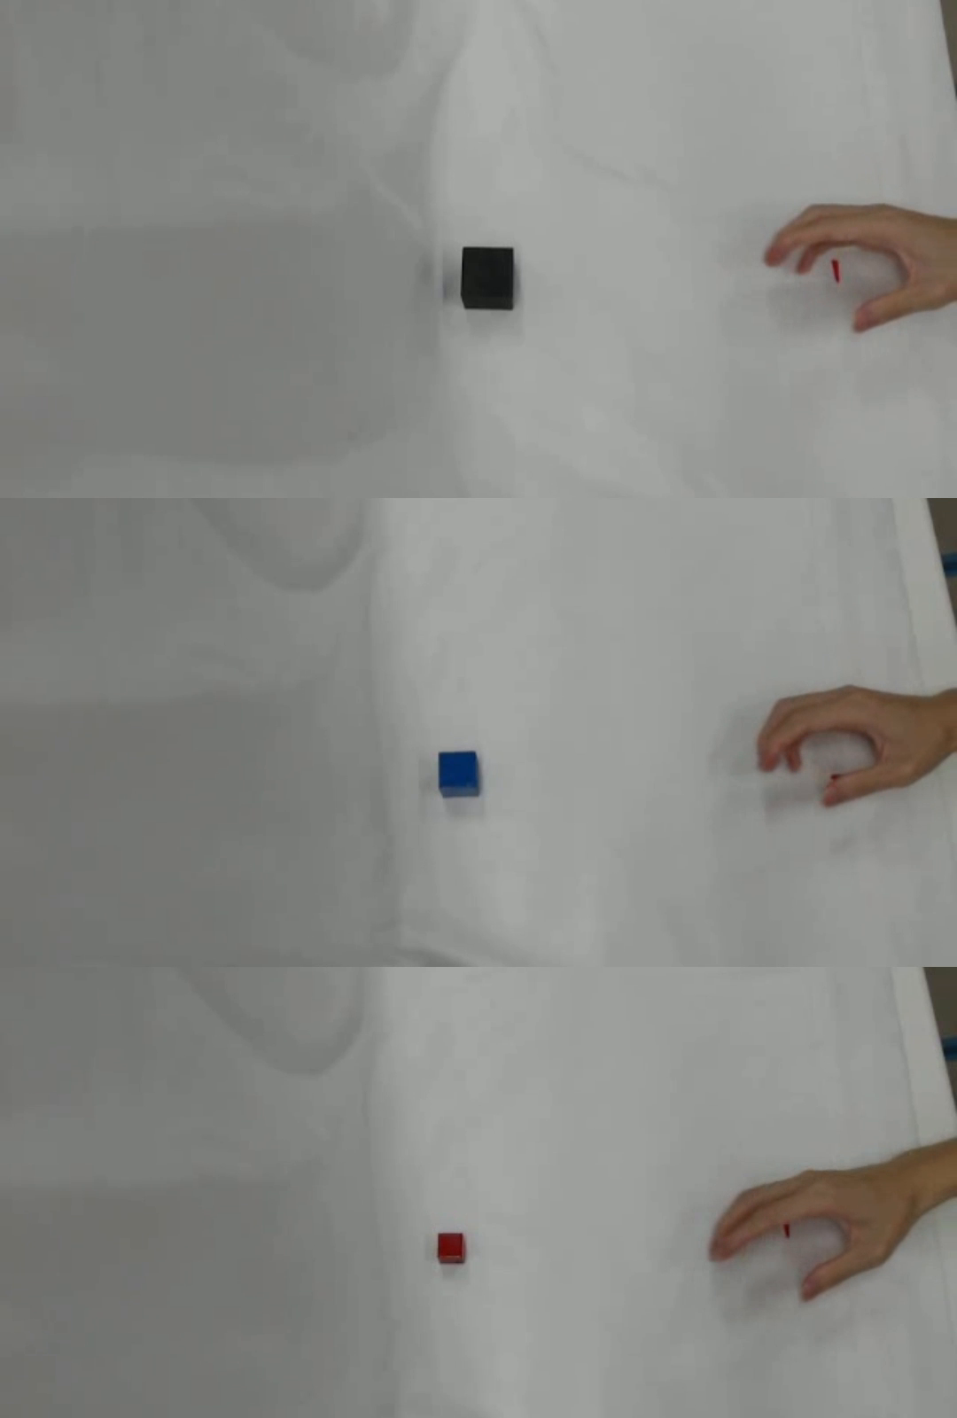
Dataset and Procedure
300
100
1–3 seconds
Trials in total
Trials per cube
Randomized movement duration
Start: 300 mm from the object, fingers closed
Movement: Reach and grasp naturally
Speed: Freely vary duration within 1–3 seconds
Participant: 1 (the researcher)
Movement-duration histogram
(to be added after data collection)
Cubes: red 20, blue 30, black 40 mm
Example trial (previous setup)
Notes:
3種類の立方体それぞれで100試行、合計300試行を計測します。手は物体から300 mm離れた位置で指を閉じて構え、自然に手を伸ばしてつかみます。速さは固定せず、1秒から3秒の範囲で自由に変えます。動画は以前のセットアップのもので、マーカーを付けた状態で撮り直す予定です。

Slide 11
Models
x_t = l_t/l_0 s = cube size (20, 30 or 40 mm) v_t = SG[(L_t+1 − L_t) / Δt] d = finger aperture (mm)
Function Fitting
No history
x_t, v_t, s
Cubic B-spline
d̂ = f(x, v, s)
d̂_t [mm]
10 basis functions + size interaction
x_t−4
MLP
Last 5 frames
x_t−3
x_t−2
d̂_t [mm]
x_t−1
⋮
⋮
x_t
v_t
x_t−4
32 (ReLU)
32 (ReLU)
1 layer, 32 units. Carry h and c forward
LSTM
LSTM
…
LSTM
Linear
d̂_t [mm]
LSTM
Full history
x_0, v_1, s
x_1, v_1, s
x_t, v_t, s
Notes:
モデルを比べる前に、まずデータを確認します。立方体ごとに100試行の d–l 曲線を重ね描きし、試行間で一貫しているか、最大開口がどこで現れるか、サイズや速さでどう変わるかを見ます。

Slide 12
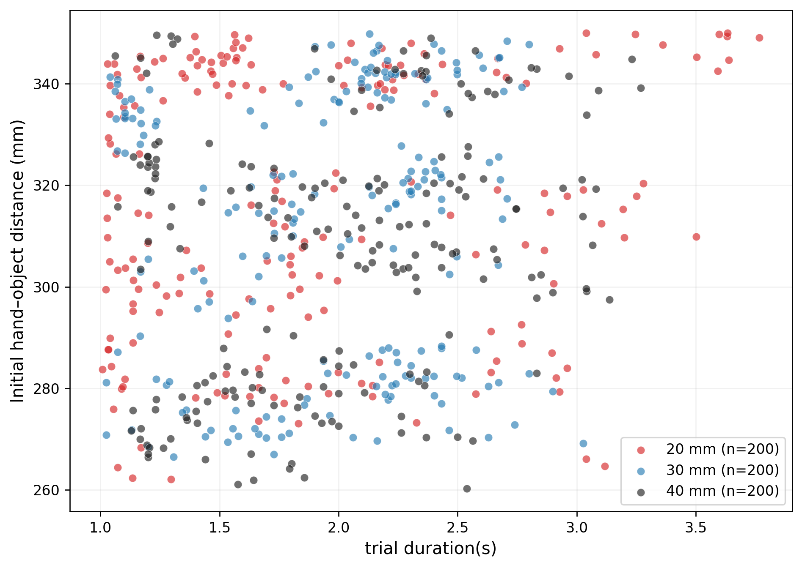
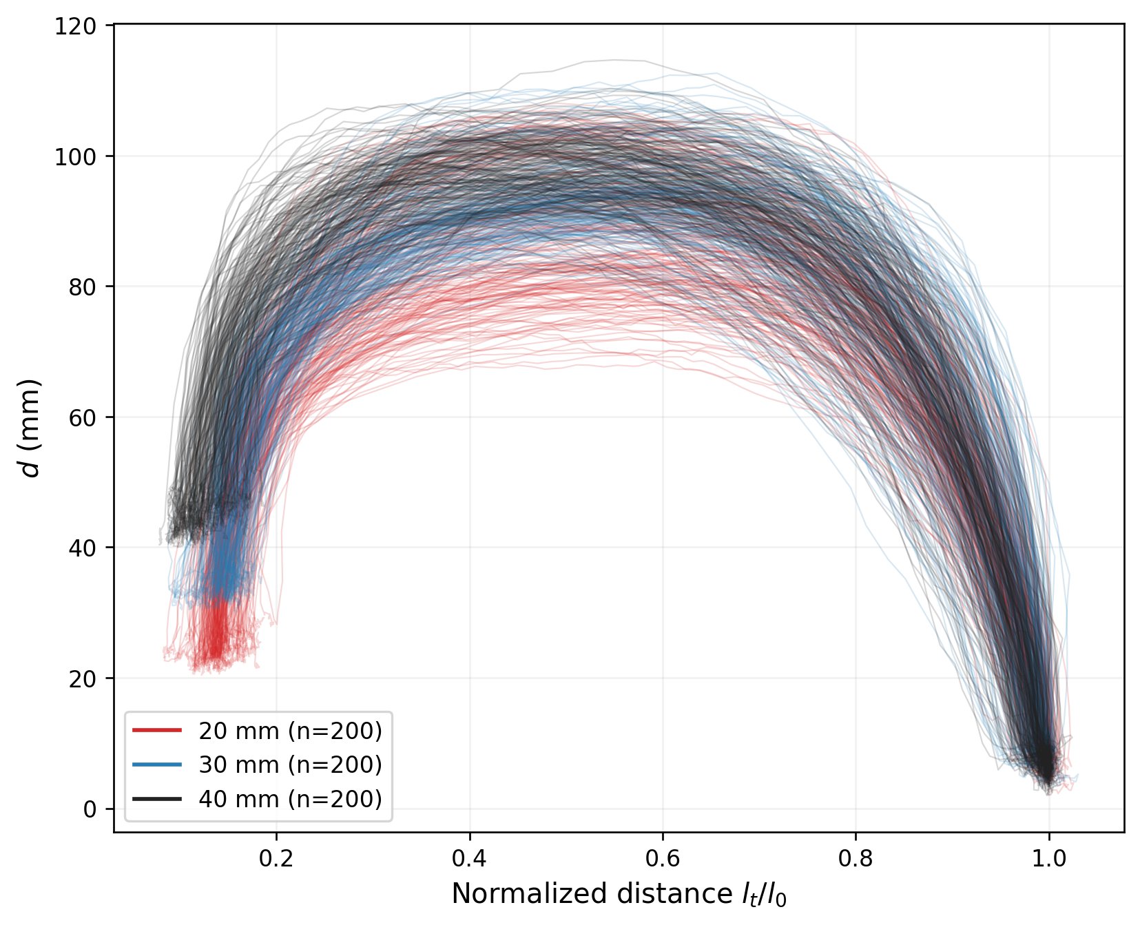
Dataset
Dataset size: 200 trials per cube (600 trials total).
Trial time: 1–4 s.
Initial hand–object distance: 250–350 mm.
(l): hand–object distance (d): finger aperture
Notes:
モデルを比べる前に、まずデータを確認します。立方体ごとに100試行の d–l 曲線を重ね描きし、試行間で一貫しているか、最大開口がどこで現れるか、サイズや速さでどう変わるかを見ます。

Slide 13
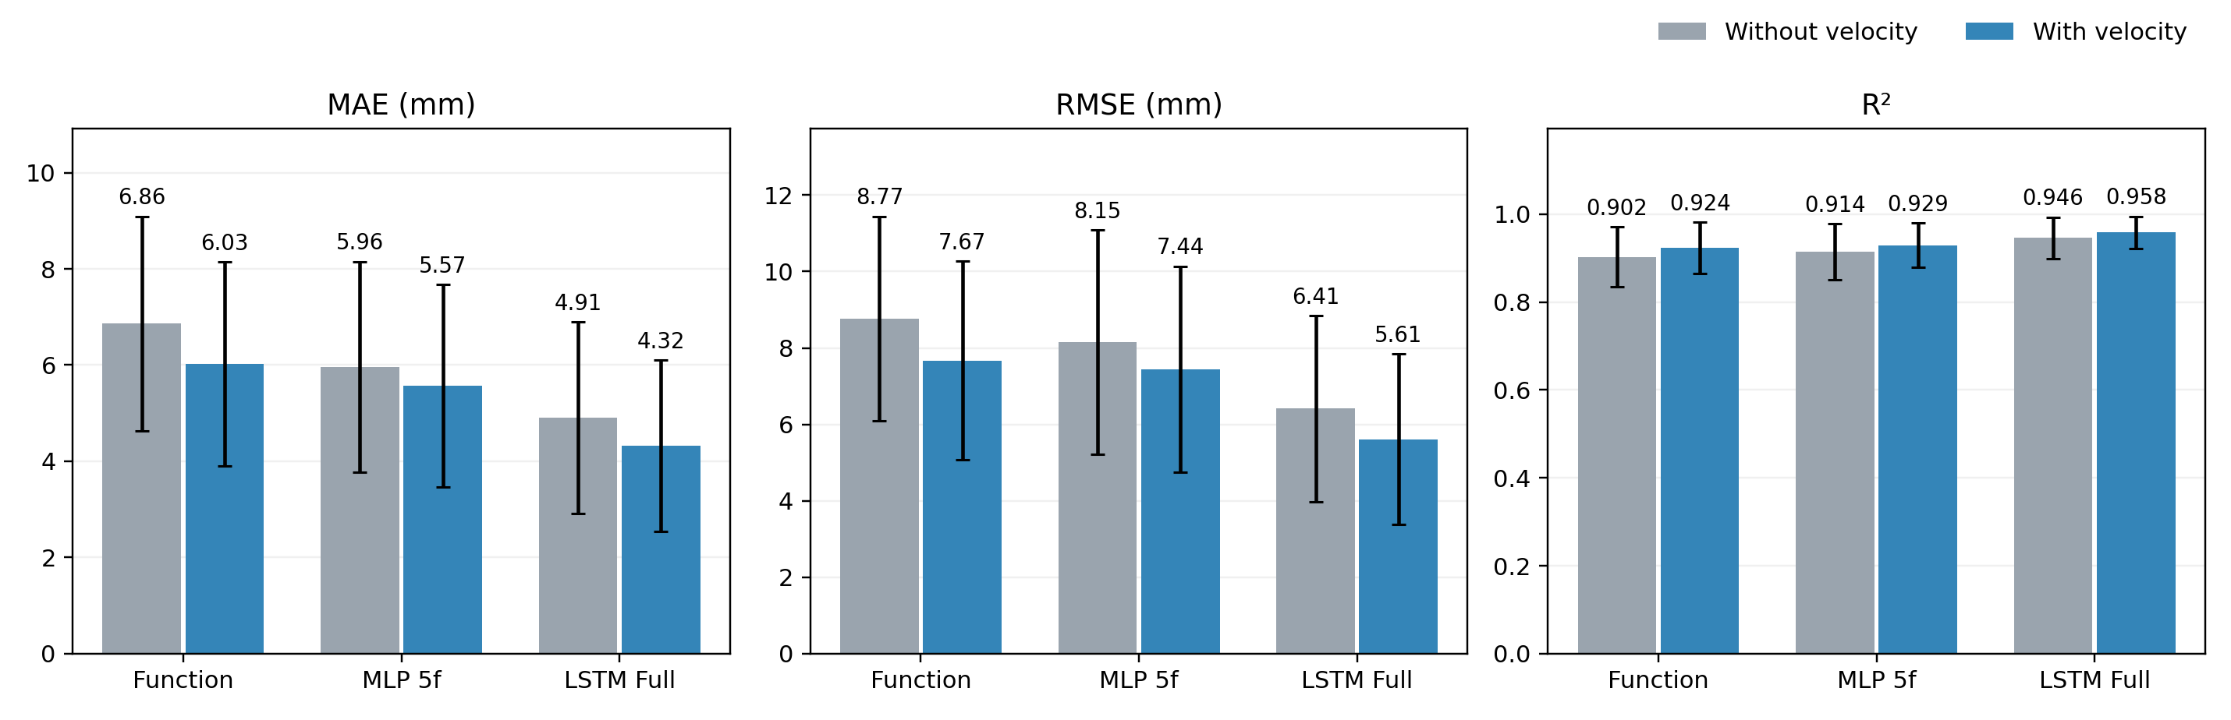
Prediction Performance
600 trials | 5-fold cross-validation
 | MAE [mm] | RMSE [mm] | R²
Function Approximation | 6.03 ± 2.12 | 7.67 ± 2.60 | 0.924 ± 0.058
MLP (5 Frame) | 5.57 ± 2.10 | 7.44 ± 2.70 | 0.929 ± 0.051
LSTM (Full) | 4.32 ± 1.78 | 5.61 ± 2.23 | 0.958 ± 0.037
Notes:
モデルを比べる前に、まずデータを確認します。立方体ごとに100試行の d–l 曲線を重ね描きし、試行間で一貫しているか、最大開口がどこで現れるか、サイズや速さでどう変わるかを見ます。

Slide 14
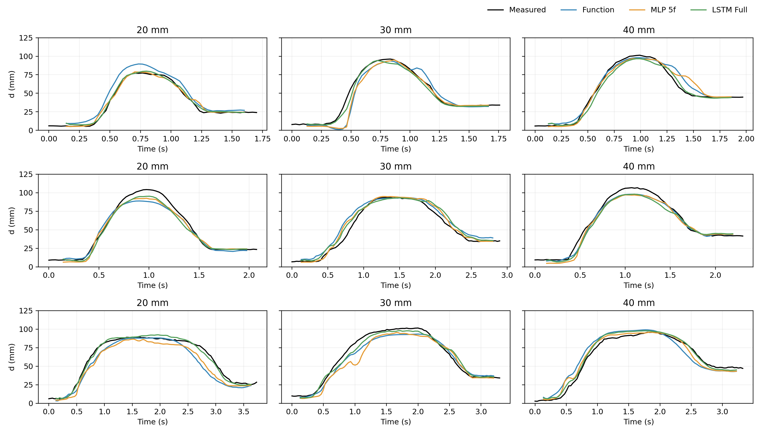
Prediction Examples
Analysis：
The models capture the trend in finger aperture across different sizes, speeds, initial positions.
History information improves the fit during changes in finger aperture.
However, peak finger aperture varies across trials, and these inputs alone may not fully explain this variation.
Notes:
モデルを比べる前に、まずデータを確認します。立方体ごとに100試行の d–l 曲線を重ね描きし、試行間で一貫しているか、最大開口がどこで現れるか、サイズや速さでどう変わるかを見ます。

Slide 15
References
[1] McDonald C L, Westcott-McCoy S, Weaver M R, et al. Global prevalence of traumatic non-fatal limb amputation[J]. Prosthetics and orthotics international, 2021, 45(2): 105-114.
[2] Salminger, S., Stino, H., Pichler, L. H., Gstoettner, C., Sturma, A., Mayer, J. A., ... & Aszmann, O. C. (2022). Current rates of prosthetic usage in upper-limb amputees–have innovations had an impact on device acceptance?. Disability and rehabilitation, 44(14), 3708-3713.
[3] Lalle A, Migliore S, Stevenson J, et al. Multigesture Electromyographic Control Complexity in Upper Limb Prostheses Actuated via Single Sensor Input Contraction Magnitude: Qualitative Study for Evaluating Performance and Cognitive Load[J]. JMIR Rehabilitation and Assistive Technologies, 2026, 13(1): e88528.
[4] Trout M A, Mino F R, Olsen C D, et al. Shared human-machine control of an intelligent bionic hand improves grasping and decreases cognitive burden for transradial amputees[J]. Nature Communications, 2025, 16(1): 10418.
[4] Thomas, N., Miller, A. J., Ayaz, H., & Brown, J. D. (2023). Haptic shared control improves neural efficiency during myoelectric prosthesis use. Scientific reports, 13(1), 484.
[5] Jeannerod M. The timing of natural prehension movements[J]. Journal of motor behavior, 1984, 16(3): 235-254.
[6] Smeets J B J, Brenner E. A new view on grasping[J]. Motor control, 1999, 3(3): 237-271.
[7] Goodale M A, Milner A D, Jakobson L S, et al. A neurological dissociation between perceiving objects and grasping them[J]. Nature, 1991, 349(6305): 154-156.
[8] Rand M K, Squire L M, Stelmach G E. Effect of speed manipulation on the control of aperture closure during reach-to-grasp movements[J]. Experimental Brain Research, 2006, 174(1): 74-85.

Slide 16
References
[9] Marković M, Došen S, Cipriani C, et al. Stereovision and augmented reality for closed-loop control of grasping in hand prostheses[J]. J. Neural Engineering, 2014, 11(4): 046001.
[10] Markovic M, Dosen S, Popovic D, et al. Sensor fusion and computer vision for context-aware control of a multi degree-of-freedom prosthesis[J]. Journal of neural engineering, 2015, 12(6): 066022.
[11] Wang S, Zheng J, Huang Z, et al. Integrating computer vision to prosthetic hand control with sEMG: Preliminary results in grasp classification[J]. Frontiers in Robotics and AI, 2022, 9: 948238.
[12] Ghazaei G, Alameer A, Degenaar P, et al. Deep learning-based artificial vision for grasp classification in myoelectric hands[J]. Journal of neural engineering, 2017, 14(3): 036025.
[13] Vasile F, Maiettini E, Pasquale G, et al. Continuous wrist control on the hannes prosthesis: A vision-based shared autonomy framework[C]//2025 IEEE International Conference on Robotics and Automation (ICRA). IEEE, 2025: 15107-15113.
[14] He Y, Shima R, Fukuda O, et al. Development of distributed control system for vision-based myoelectric prosthetic hand[J]. IEEE Access, 2019, 7: 54542-54549.
[15] Liangsorn N, Tretriluxana S. Evaluating Marker-Based and Markerless Motion Capture Systems in Reach-to-Grasp Task[C]//2024 16th Biomedical Engineering International Conference (BMEiCON). IEEE, 2024: 1-4.

