Slide 1
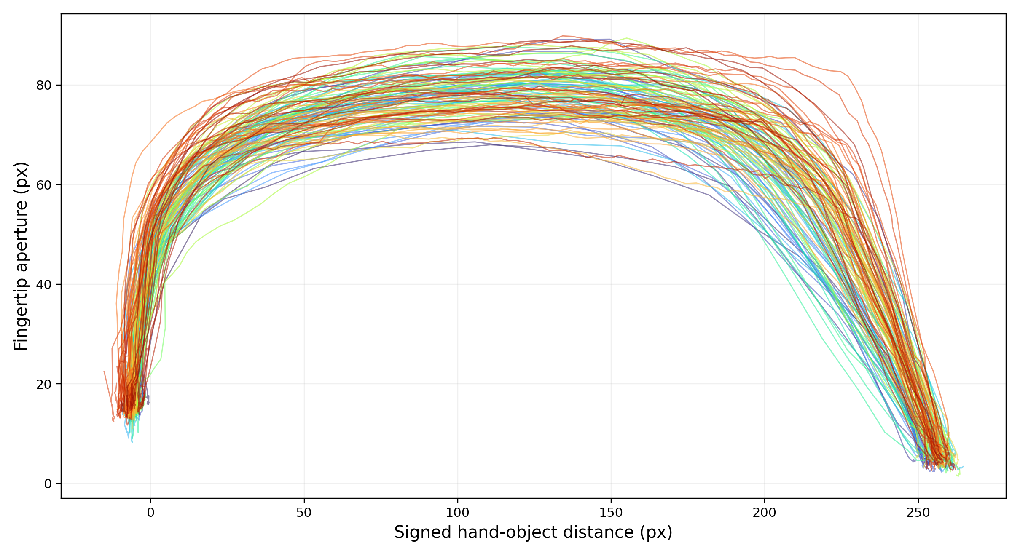
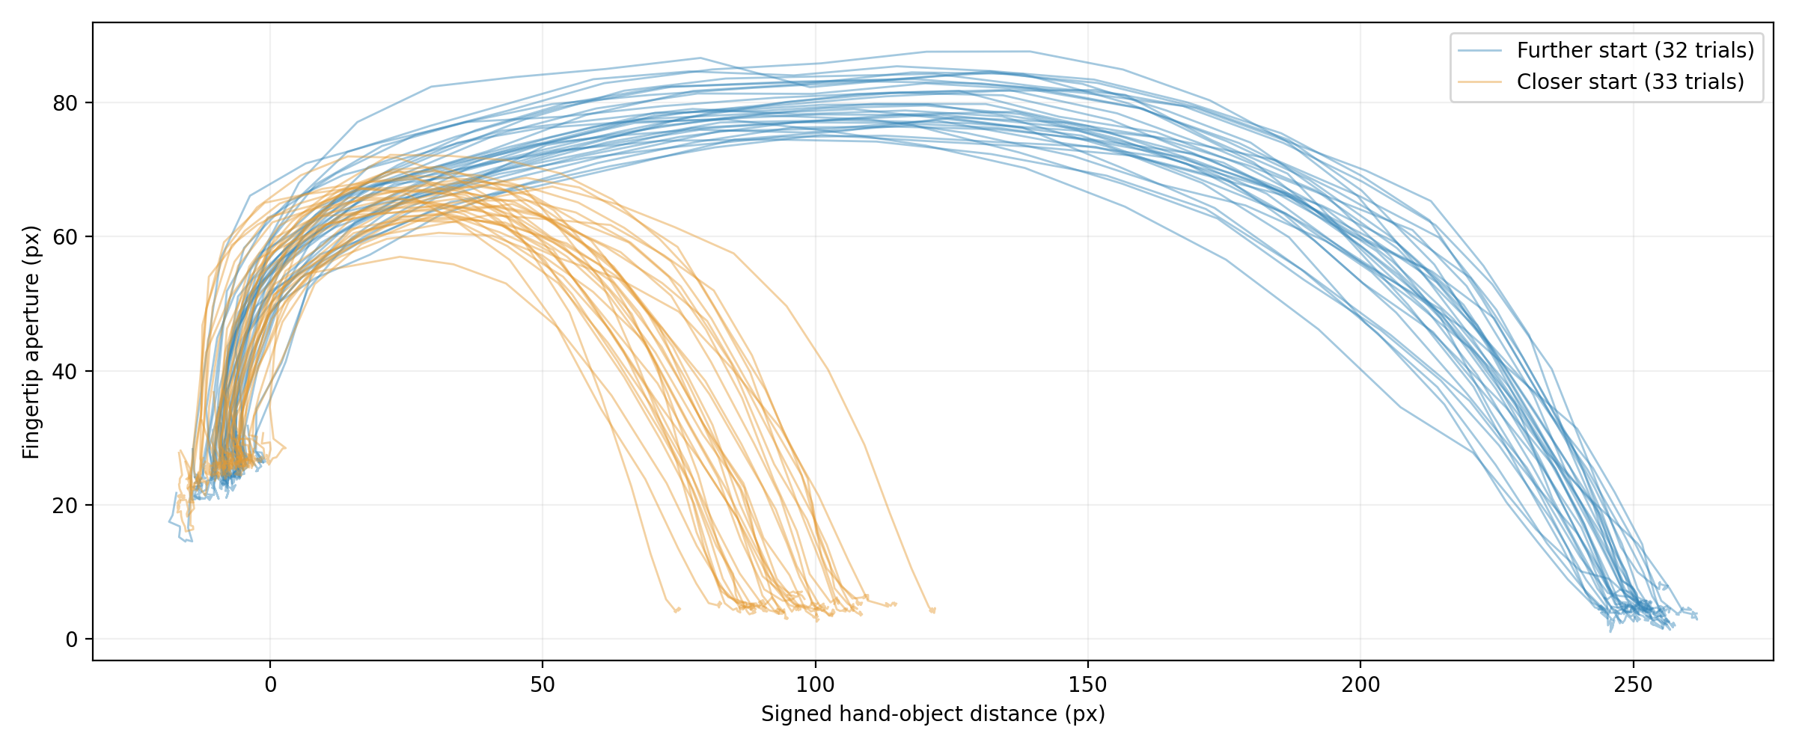
Different Speed
Overlaid curves
Different Initial
Hand Position
Overlaid curves

Slide 2
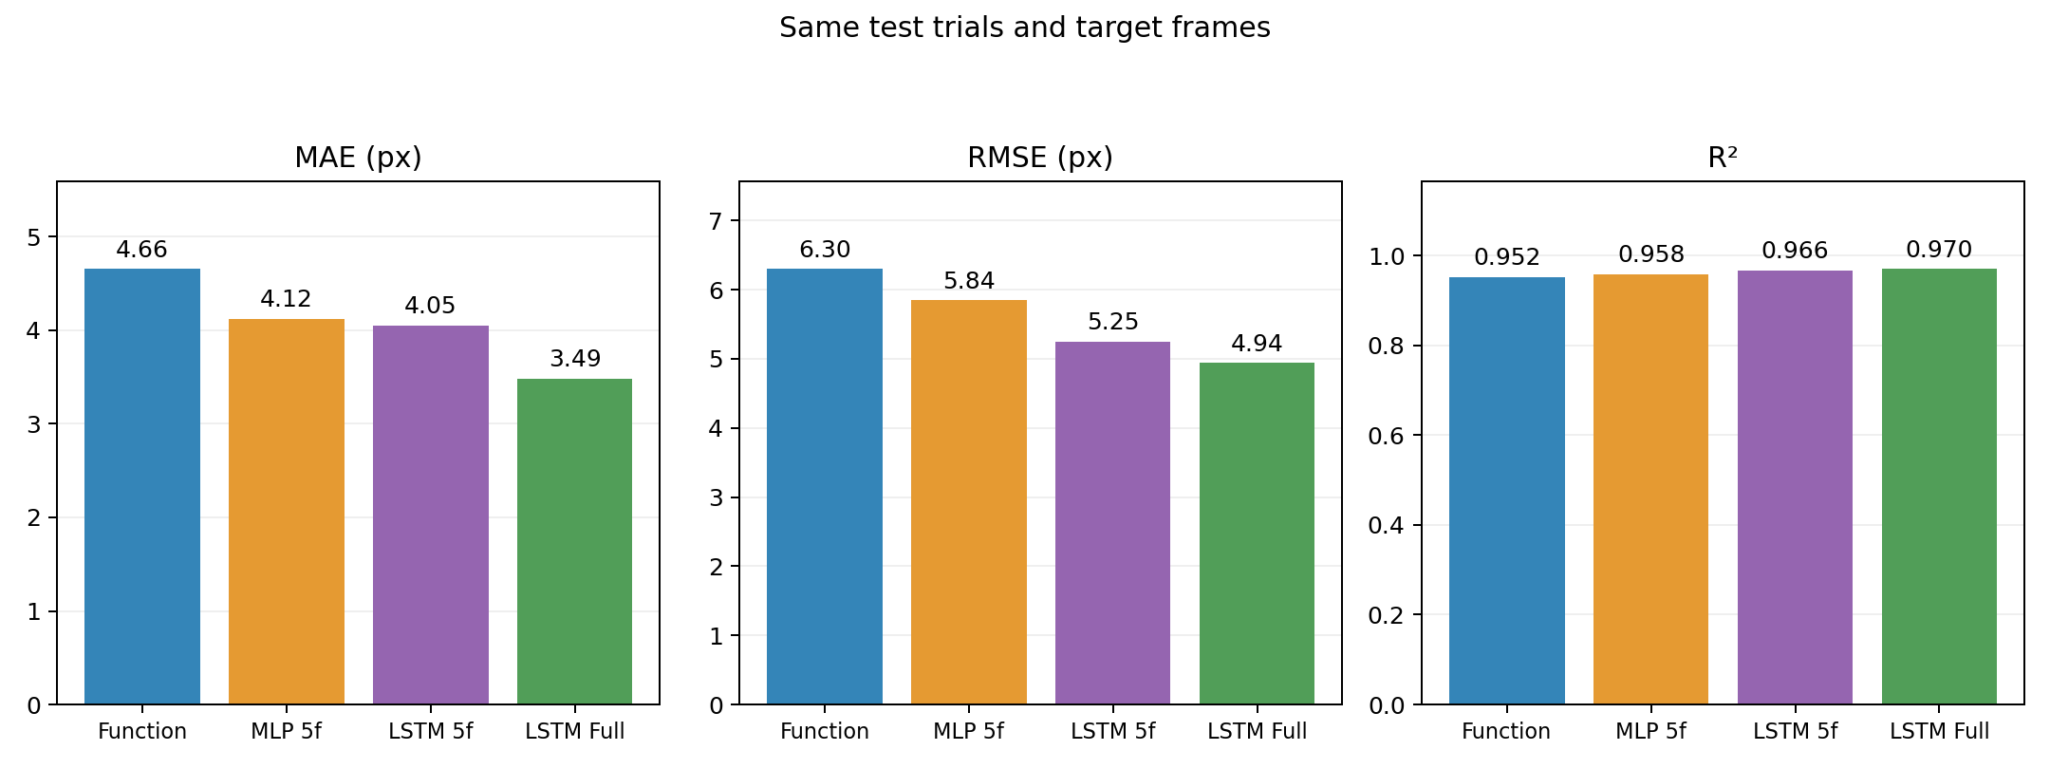
All models perform well with different approach speeds.

Slide 3
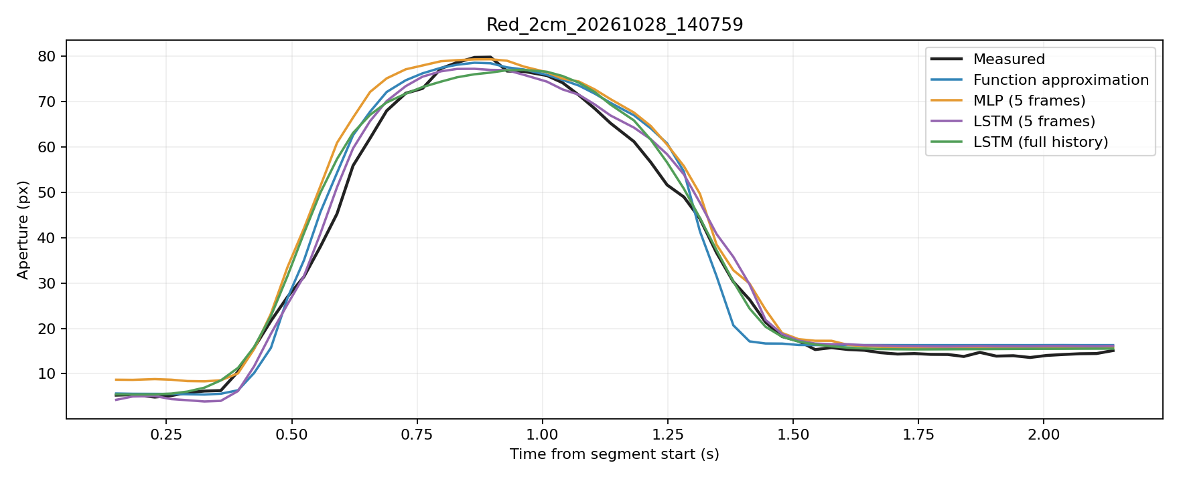
Prediction Example : Fast Speed

Slide 4
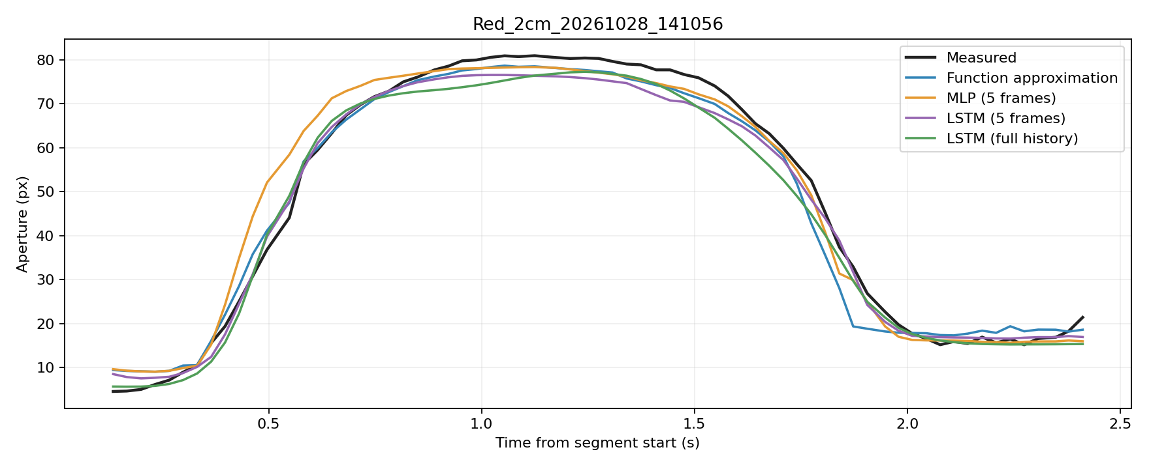
Prediction Example : Normal Speed

Slide 5
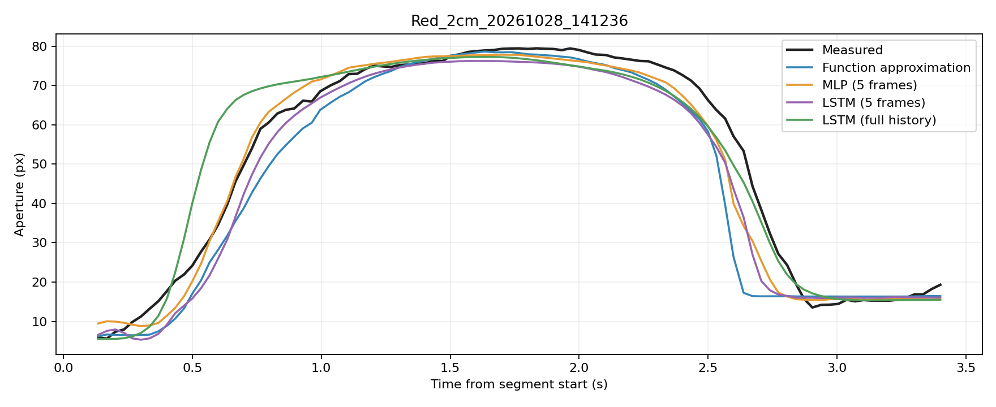
Prediction Example : Slow Speed

Slide 6
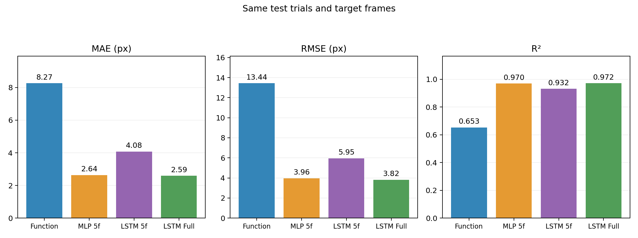
The function approximation performs poorly with different initial hand positions.

Slide 7
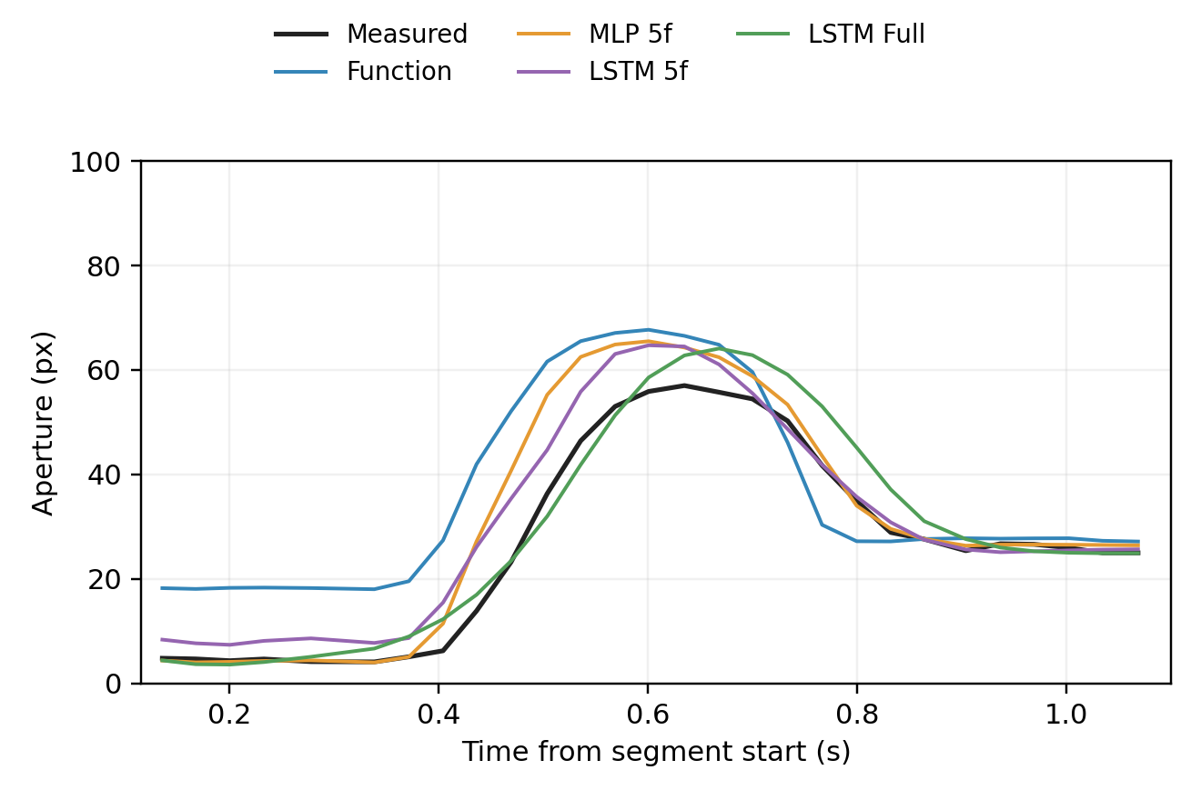
Prediction Example : Initial Hand Position = 100 px

Slide 8
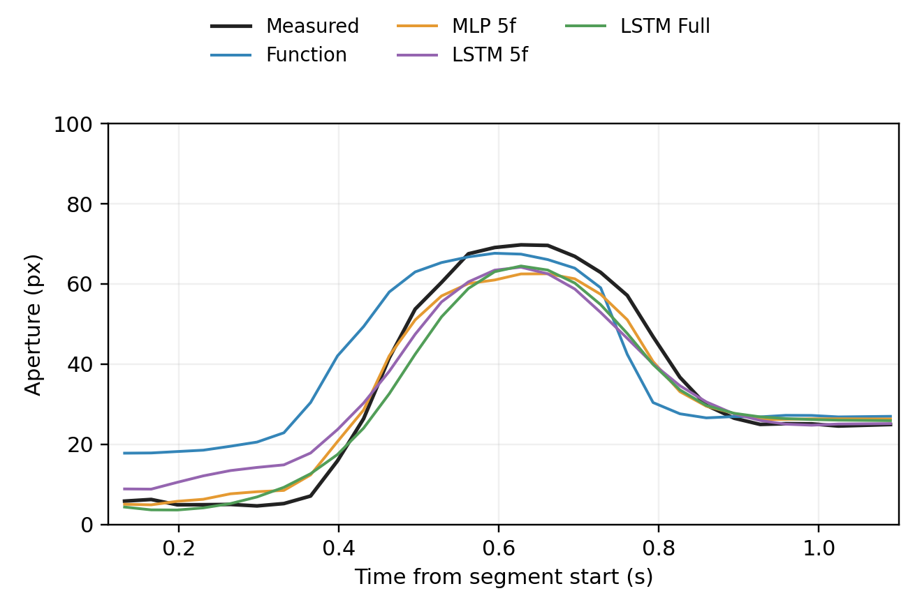
Prediction Example : Initial Hand Position = 100 px

Slide 9
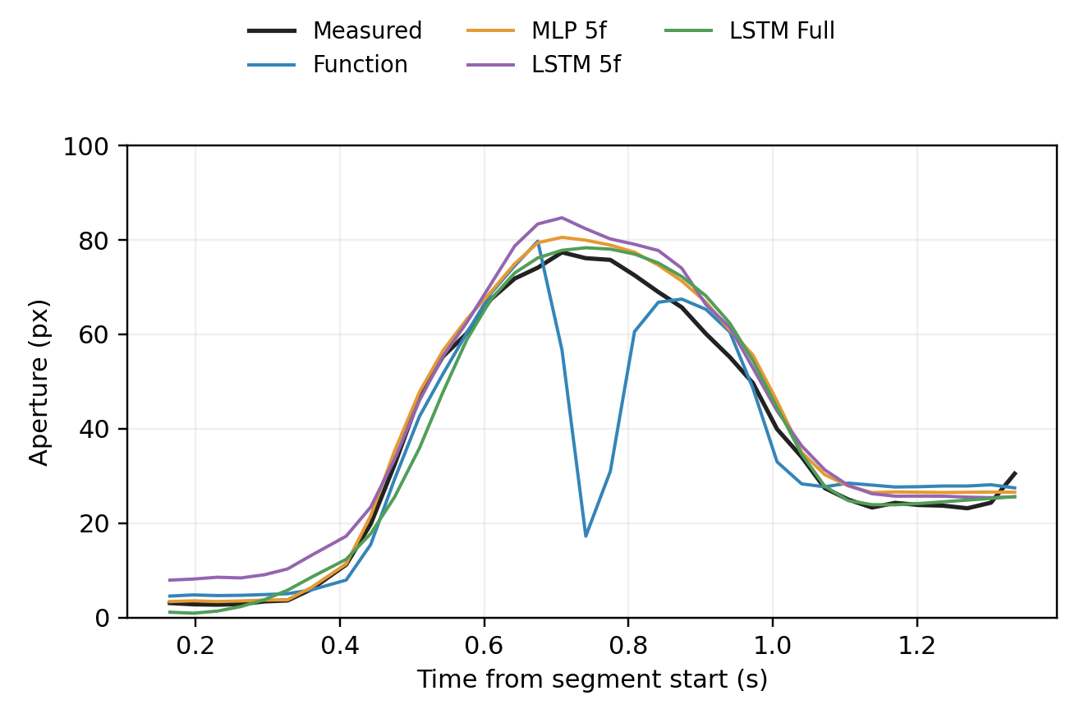
Prediction Example : Initial Hand Position = 250 px
The function approximation predicts two peaks during the grasping phase in all trials.
This may be because the two initial-distance conditions correspond to different apertures at the same distance, leading to fitting errors.

Slide 10
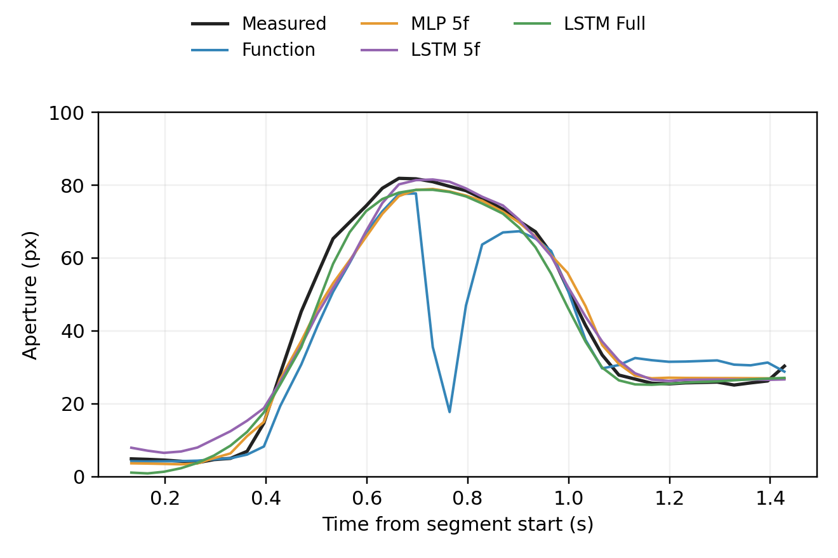
Prediction Example : Initial Hand Position = 250 px

Slide 11
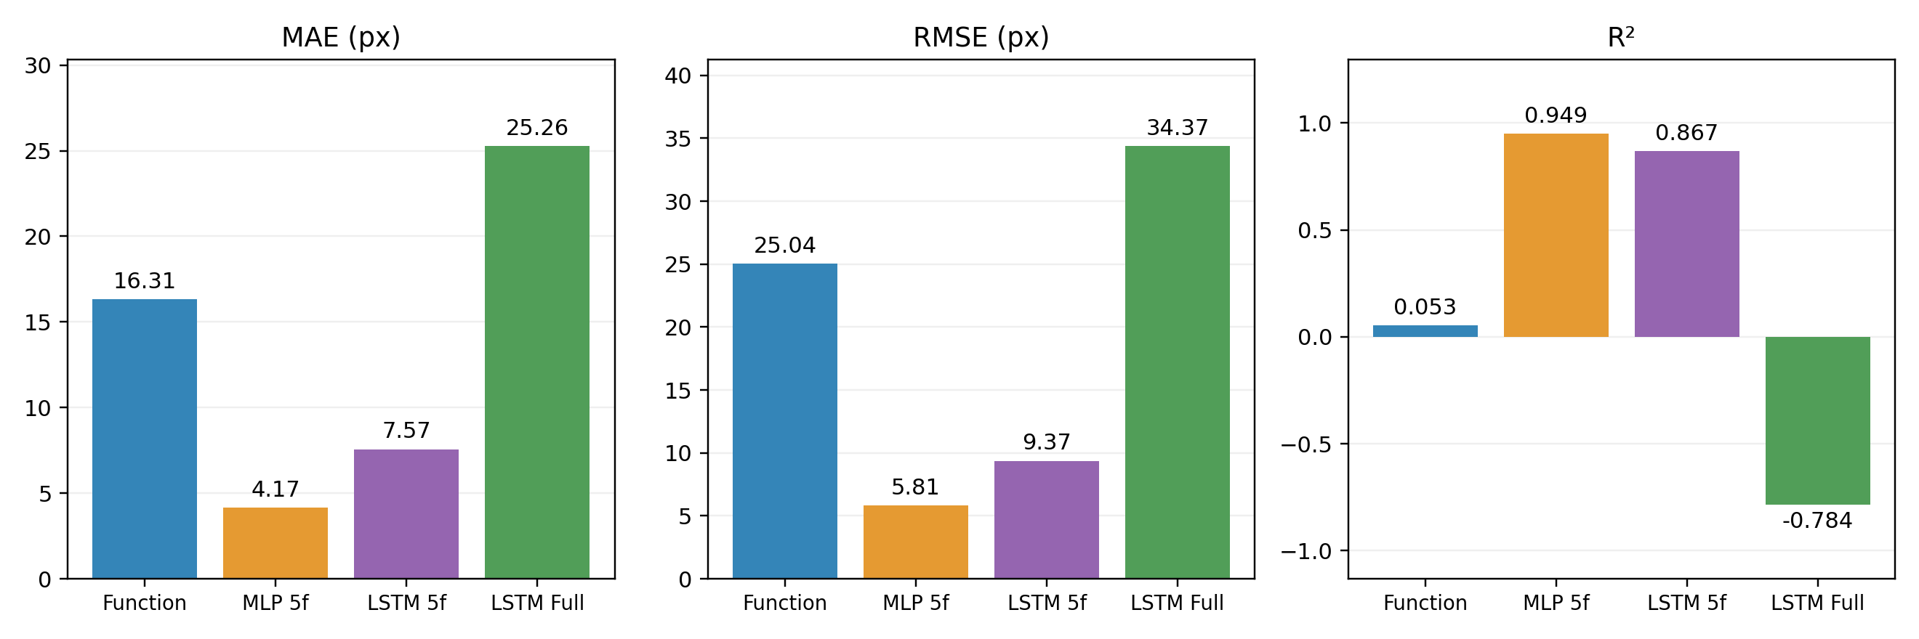
Real-time experiments:
Five grasping trials for each of two initial distances (approximately 100 px and 250 px).
The full-history LSTM still shows prediction issues.
The function approximation produces large errors.
The 5-frame LSTM has higher prediction errors than the 5-frame MLP.

Slide 12
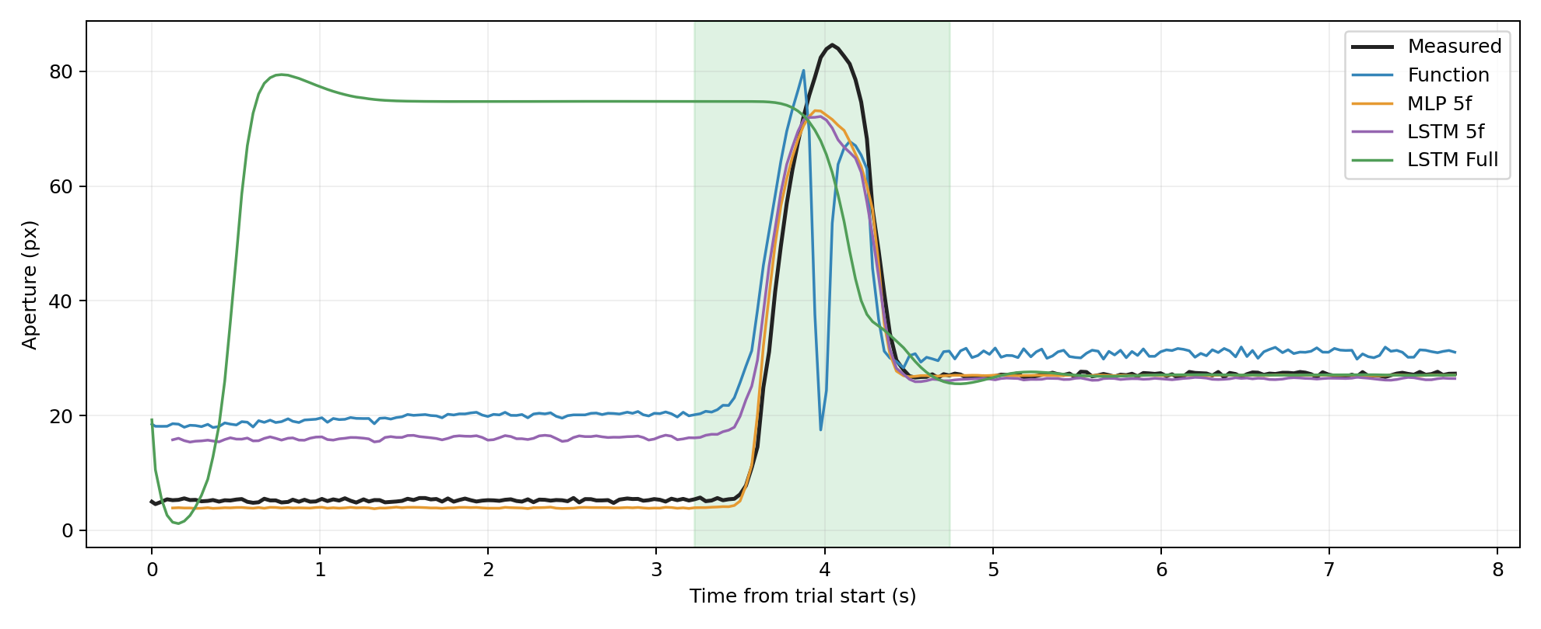
Realtime Prediction Example : Initial Hand Position = 250 px
The program starts while the hand remains stationary.
The full-history LSTM prediction rises to its maximum in start
Error Evaluation Region

