Slide 1
Research Objective & Question
During reach-to-grasp movements, finger opening/closing and hand motion are usually coordinated naturally and unconsciously.
This study aims to investigate the relationship among object apparent size, fingertip aperture, and hand acceleration during grasping, and further examine whether this information can be used to predict the fingertip aperture process.
RQ1
Is there a consistent relationship among object apparent size, fingertip aperture, and hand acceleration during reach-to-grasp movements?
RQ2
Can fingertip aperture during reach-to-grasp movements be predicted using object apparent size and hand acceleration?
Notes:
So in my research, objective is to Replace classification models to Regression Models.
From modular approach to end to end approach to reduce system complexity and loss of important information
RQ is to verify that can the system build on an end-to-end approach combined with regression be successfully applied,

Slide 2
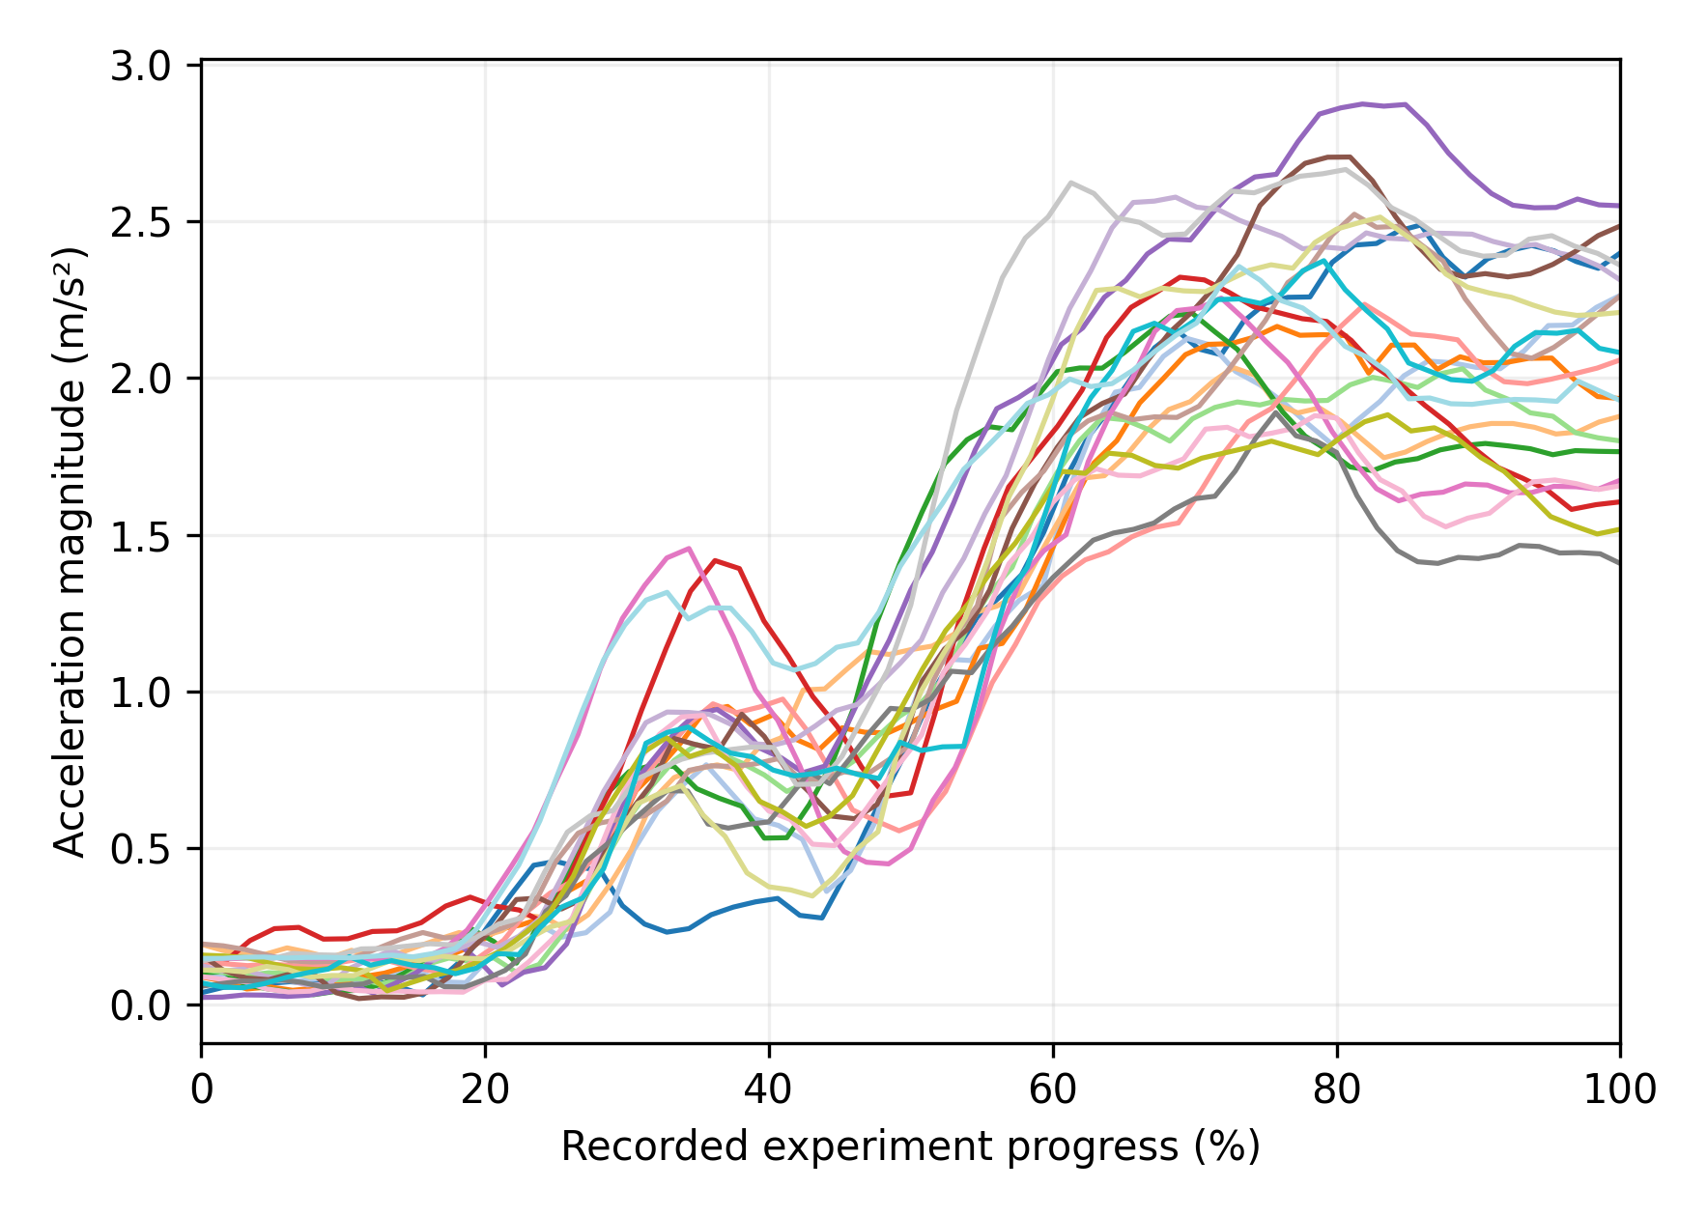
Acceleration Data Optimization
之前的加速度，不归零，说不通。

