Slide 1
A Vision Regression Model for Fingertip Aperture Prediction
Saga University Graduate School of Science and Engineering​
Computer Science & Information Techology Course​
Fukuda Laboratory 25742102 DI XIQING
Supervisor: Professor Osamu Fukuda
Notes:
Hello everyone im d, my research is ...

Slide 2
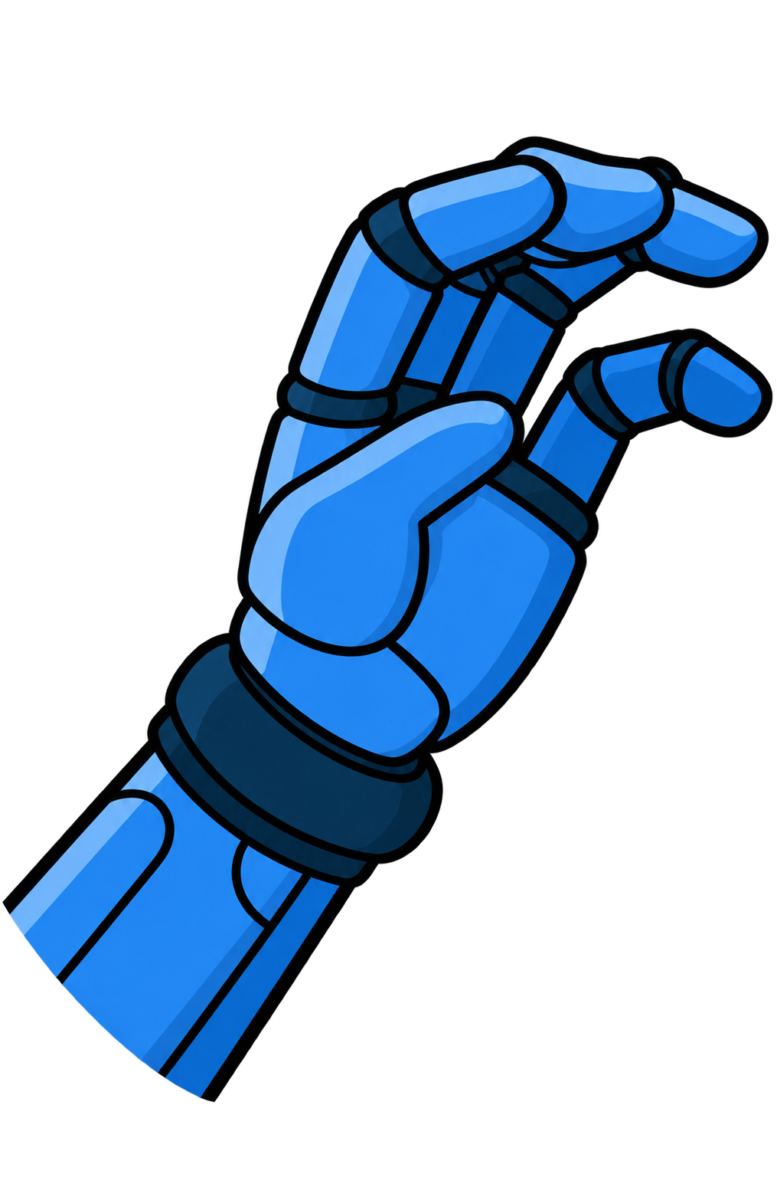
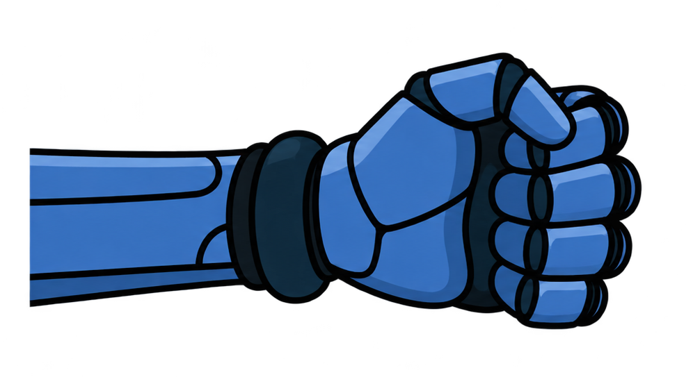
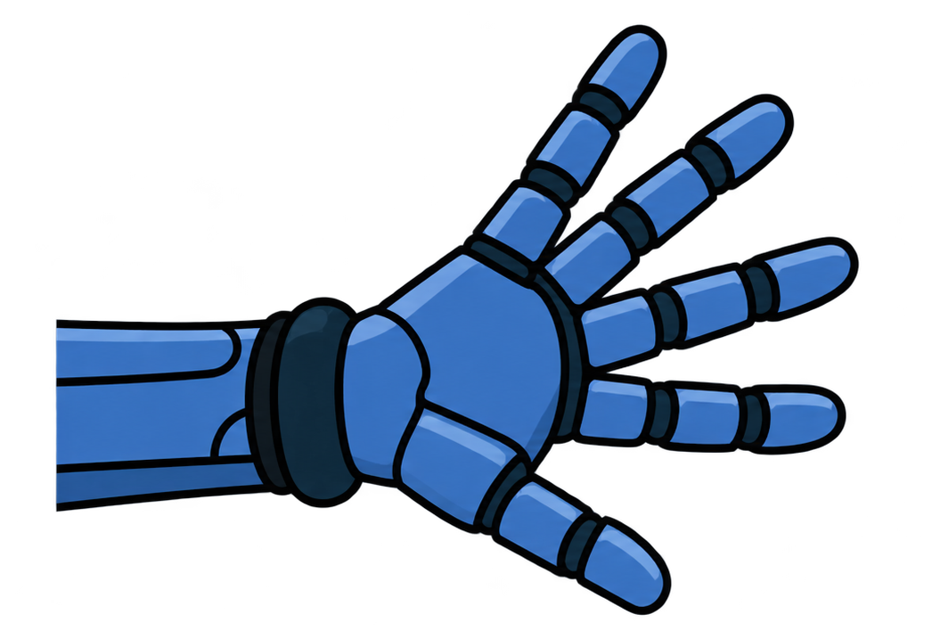
Background
Many hand gesture recognition methods focus on classification.
However, classification alone does not directly describe the continuous changes in finger movements during grasping.
classification 1
classification 2
The Process of Natural Human Grasping
[1] Vásconez, J. P., Barona López, L. I., Valdivieso Caraguay, Á. L., & Benalcázar, M. E. (2022). Hand gesture recognition using EMG-IMU signals and deep q-networks. Sensors, 22(24), 9613.
[2] Zandigohar, M., Han, M., Sharif, M., Günay, S. Y., Furmanek, M. P., Yarossi, M., ... & Schirner, G. (2024). Multimodal fusion of EMG and vision for human grasp intent inference in prosthetic hand control. Frontiers in Robotics and AI, 11, 1312554.
Notes:
Approximately 57.7 million people lost an upper limb.
This significantly impacts their daily lives, so the prosthetic hand research aim to help them.
With computational power and algorithms continue to advance, the prosthetic hand are able to recognize an increasing number of movements

Slide 3
Related Work
Author | Title | Objective | Method
Mangalam et al. | Control of aperture closure during reach-to-grasp movements in immersive haptic-free virtual reality | Investigate factors determine when humans transition from finger opening to closing during object grasping? | Analyze how aperture, hand velocity, and acceleration at the key event - closure onset relate to hand–object distance.
Coats et al. | Predicting the Duration of Reach-to-Grasp Movements to Objects with Asymmetric Contact Surfaces | Investigate how grasping conditions affect movement duration. | Manipulate target distance and fingertip contact surface sizes, and analyze movement time and maximum grip aperture.
These studies demonstrate that reach-to-grasp movements involve multiple interacting variables.
[3] Mangalam, M., Yarossi, M., Furmanek, M. P., & Tunik, E. (2021). Control of aperture closure during reach-to-grasp movements in immersive haptic-free virtual reality. Experimental Brain Research, 239(5), 1651-1665
[4] Coats, R. O., Holt, R. J., Bingham, G. P., & Mon-Williams, M. A. (2018). Predicting the duration of reach-to-grasp movements to objects with asymmetric contact surfaces. Plos one, 13(2), e0193185.
Notes:
1.Vásconez et al. proposed a system, that combine EMG with IMU, adopts a deep reinforcement learning model. Classifies 11 types of grasping movements. The results achieved 97% accuracy.
2.Zandigohar et al.
..
This is currently one reason for the high rejection rate of prosthetic hand.

Slide 4
Research Objective & Question
During reach-to-grasp movements, finger opening and closing are coordinated with the hand’s approach to an object.
This study aims to investigate the relationship between hand–object distance and fingertip aperture, and further examine whether a regression model can predict fingertip aperture from hand–object distance in real time.
RQ1
Is there a consistent relationship between hand–object distance and fingertip aperture during reach-to-grasp movements?
RQ2
How accurately can a regression model predict fingertip aperture from hand–object distance during reach-to-grasp movements?
Notes:
So in my research, objective is to Replace classification models to Regression Models.
From modular approach to end to end approach to reduce system complexity and loss of important information
RQ is to verify that can the system build on an end-to-end approach combined with regression be successfully applied,

Slide 5
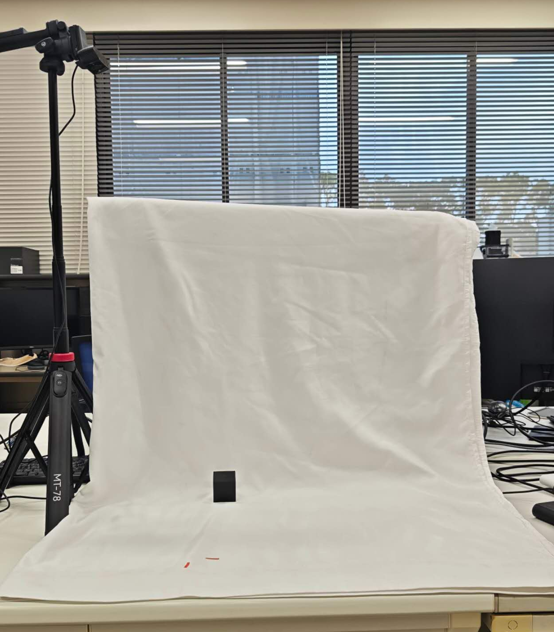
Experimental Setup
An overhead web camera captures visual data.
750mm
30mm
Initial hand position.
30 mm from the object.

Slide 6
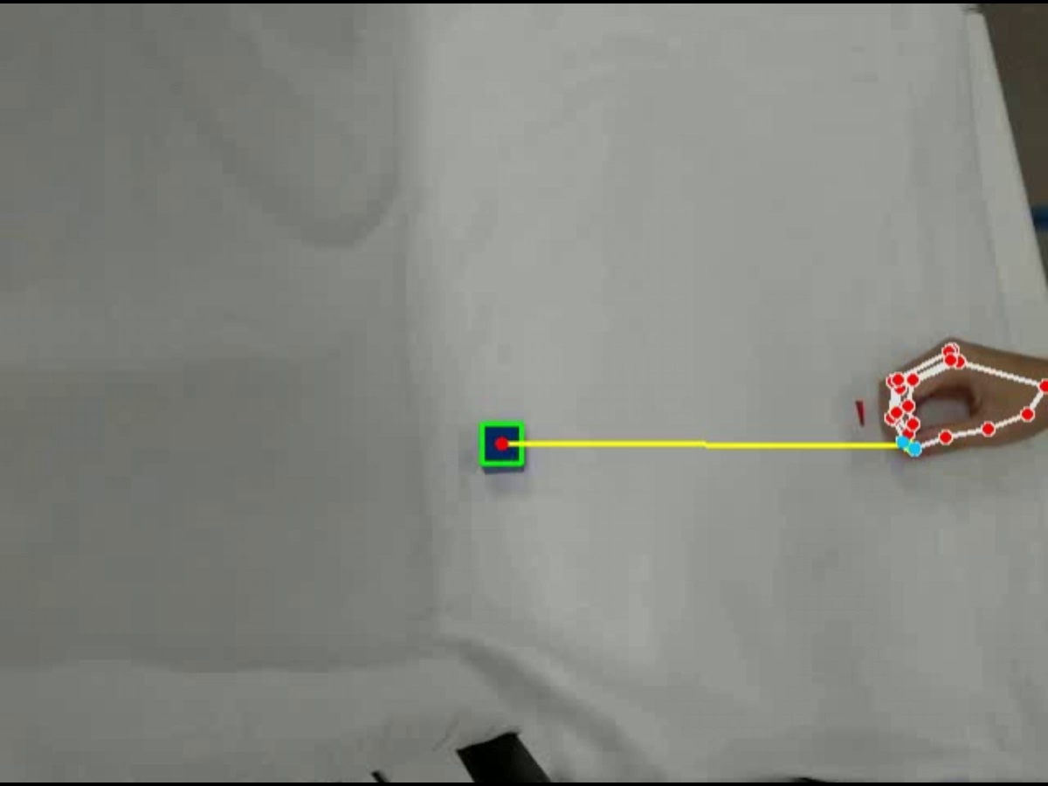
Example Trial
Camera View:

Slide 7

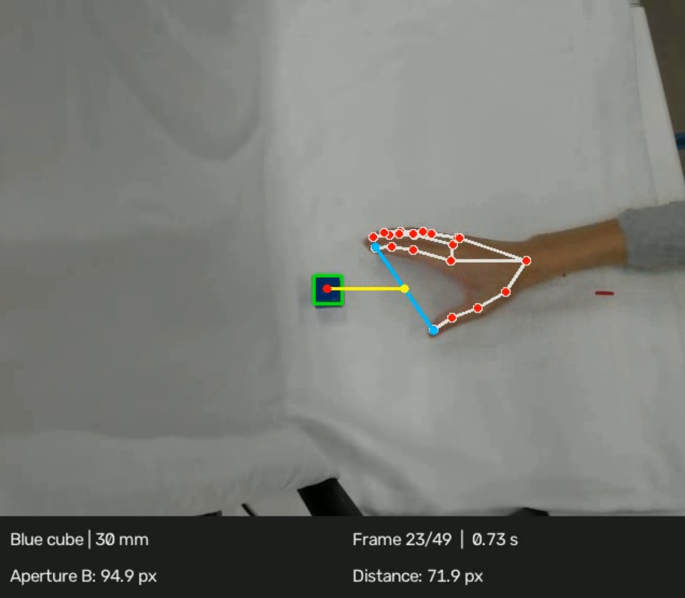

Visual Processing
MediaPipe and OpenCV is used to detect hand landmarks and cube
Hand–Object Distance
Distance from the fingertip midpoint to the object center.
Pixels (px)
Hand–Object Distance
Distance from the fingertip midpoint to the object center.
Pixels (px)

Slide 8
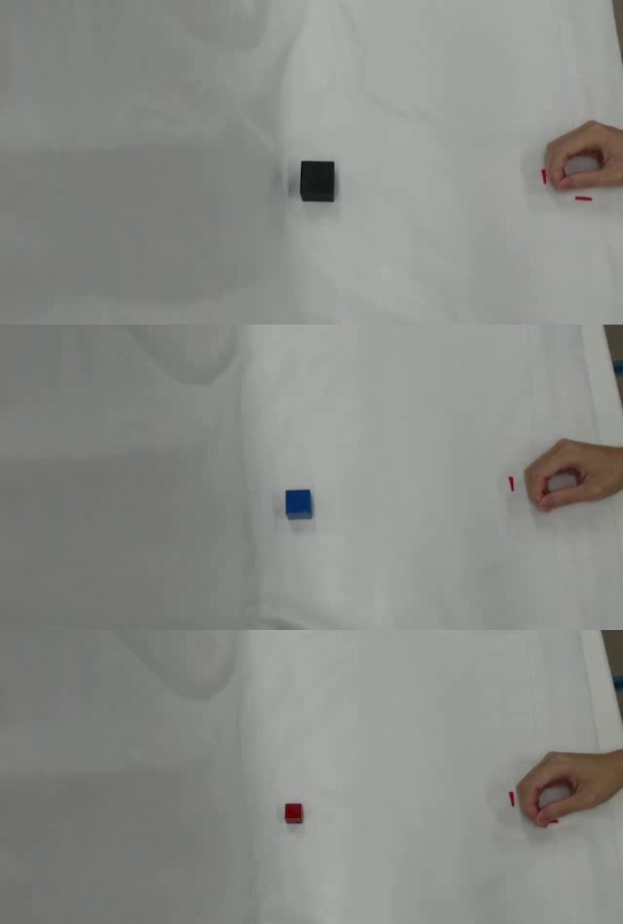
Data Collection
Collect grasping movement data from participants using cubes of different sizes.
Experimental Conditions
Task: Natural reach-to-grasp movement
Initial hand position: table edge
Target position: 30 mm from the table edge
Target size: 20, 30, and 40 mm cubes

Slide 9
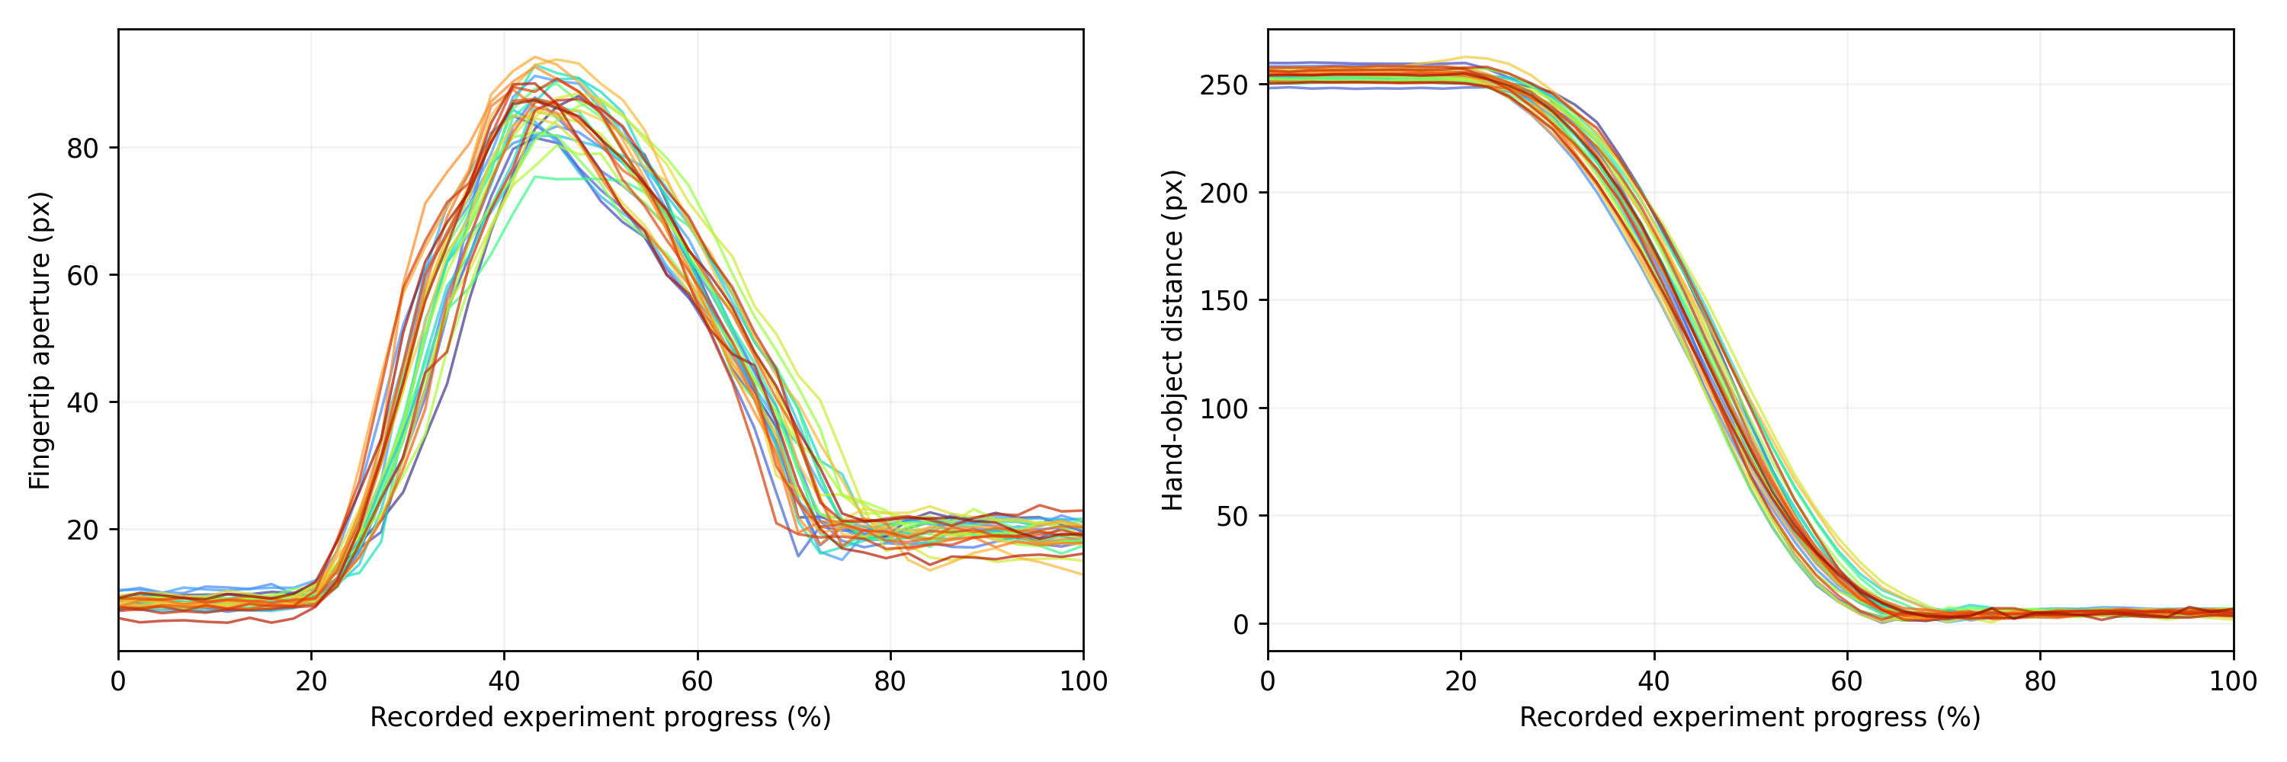
Data Relationship Analysis
30 trial with a 20 mm cube
Maximum Aperture Timing
44.32 ± 2.37%
Distance at Maximum Aperture (%)
52.15 ± 6.70%
Fingertip Aperture Nomalized RMSE
0.0530 ± 0.0186
Hand–Object Distance Nomalized RMSE
0.0226 ± 0.0112
The data showed high consistency across experiments, suggesting a consistent relationship between hand–object distance and fingertip aperture during reach-to-grasp movements.

Slide 10
Model
Can fingertip aperture during reach-to-grasp be predicted from hand–object distance?
5-frame window MLP
Hand–Object
Distance
Fingertip
Aperture
2 hidden layer, each with 32 neurons.
Loss Function
Preprocessing
Training Data
MAE
Normalization
30 trials

Slide 11
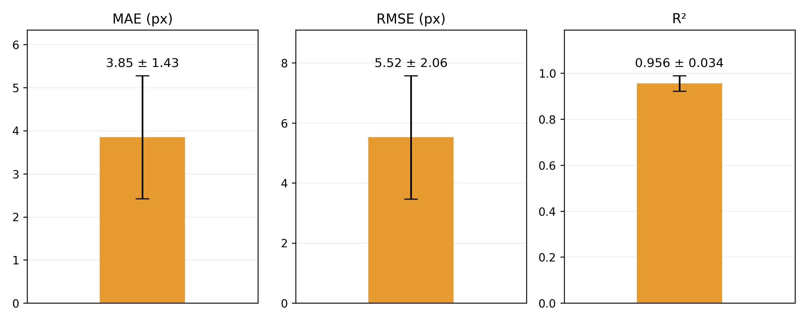
Offline Validation – Overall Performance
27 validation trials across three cube sizes (9 trials per size)
MAE
RMSE
R²
3.87
5.91
0.958
px
px

Slide 12
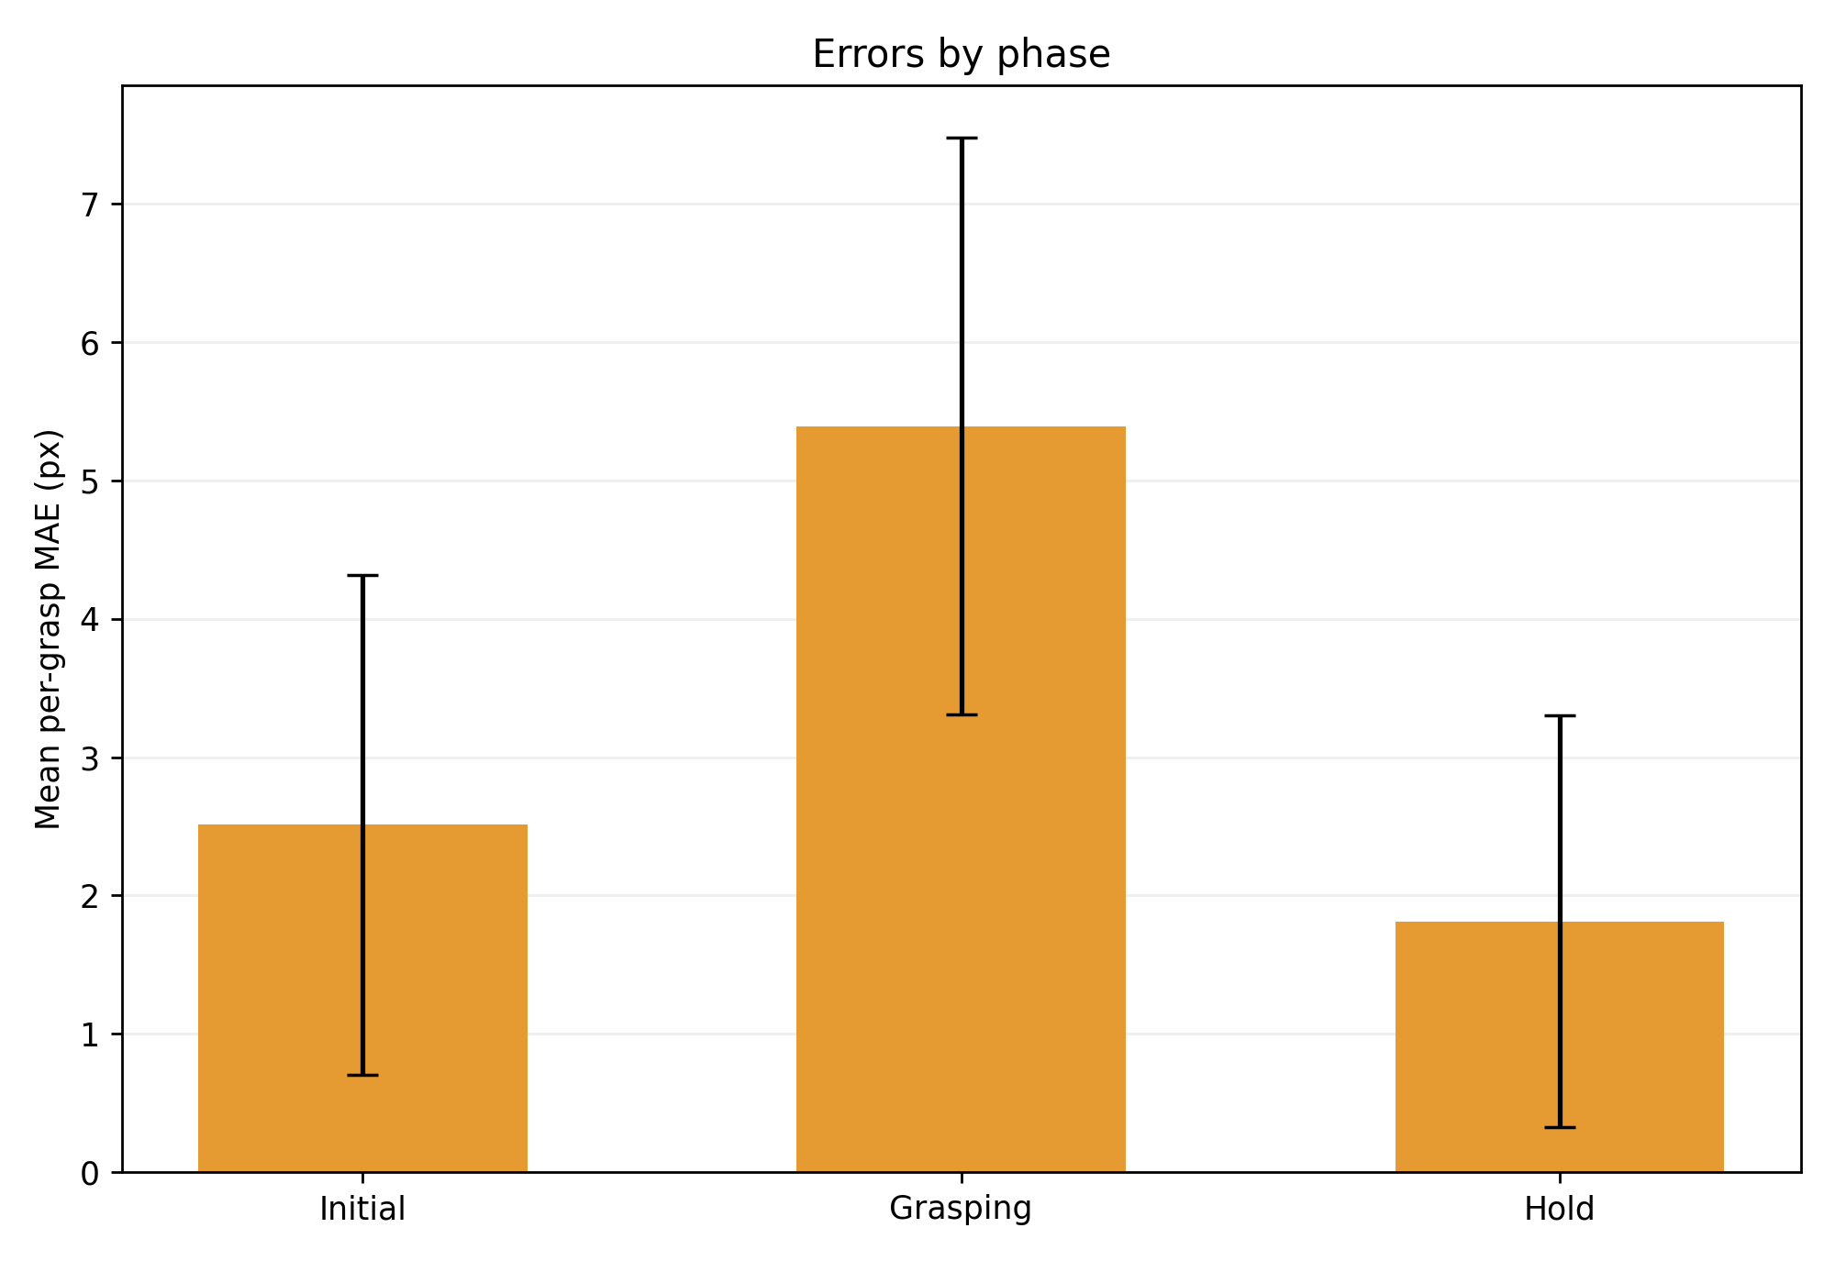
Offline Validation – Phase-Wise Analysis
The grasping phase is the most challenging to predict.
However, the current model can reduce prediction errors during this phase.

Slide 13
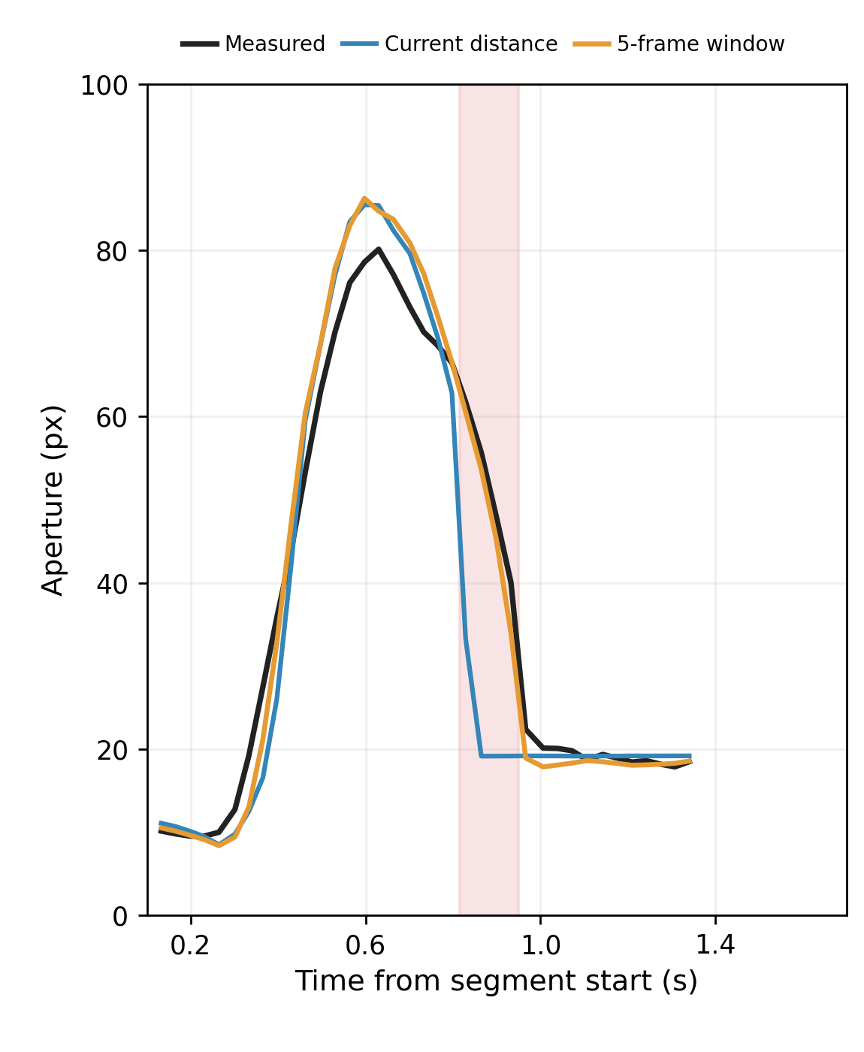
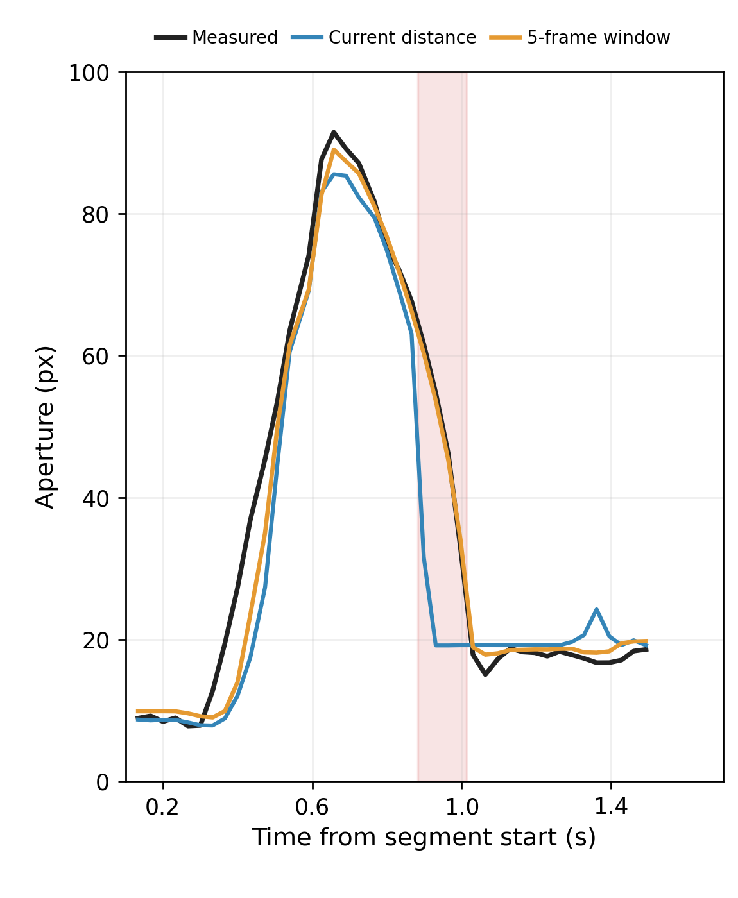
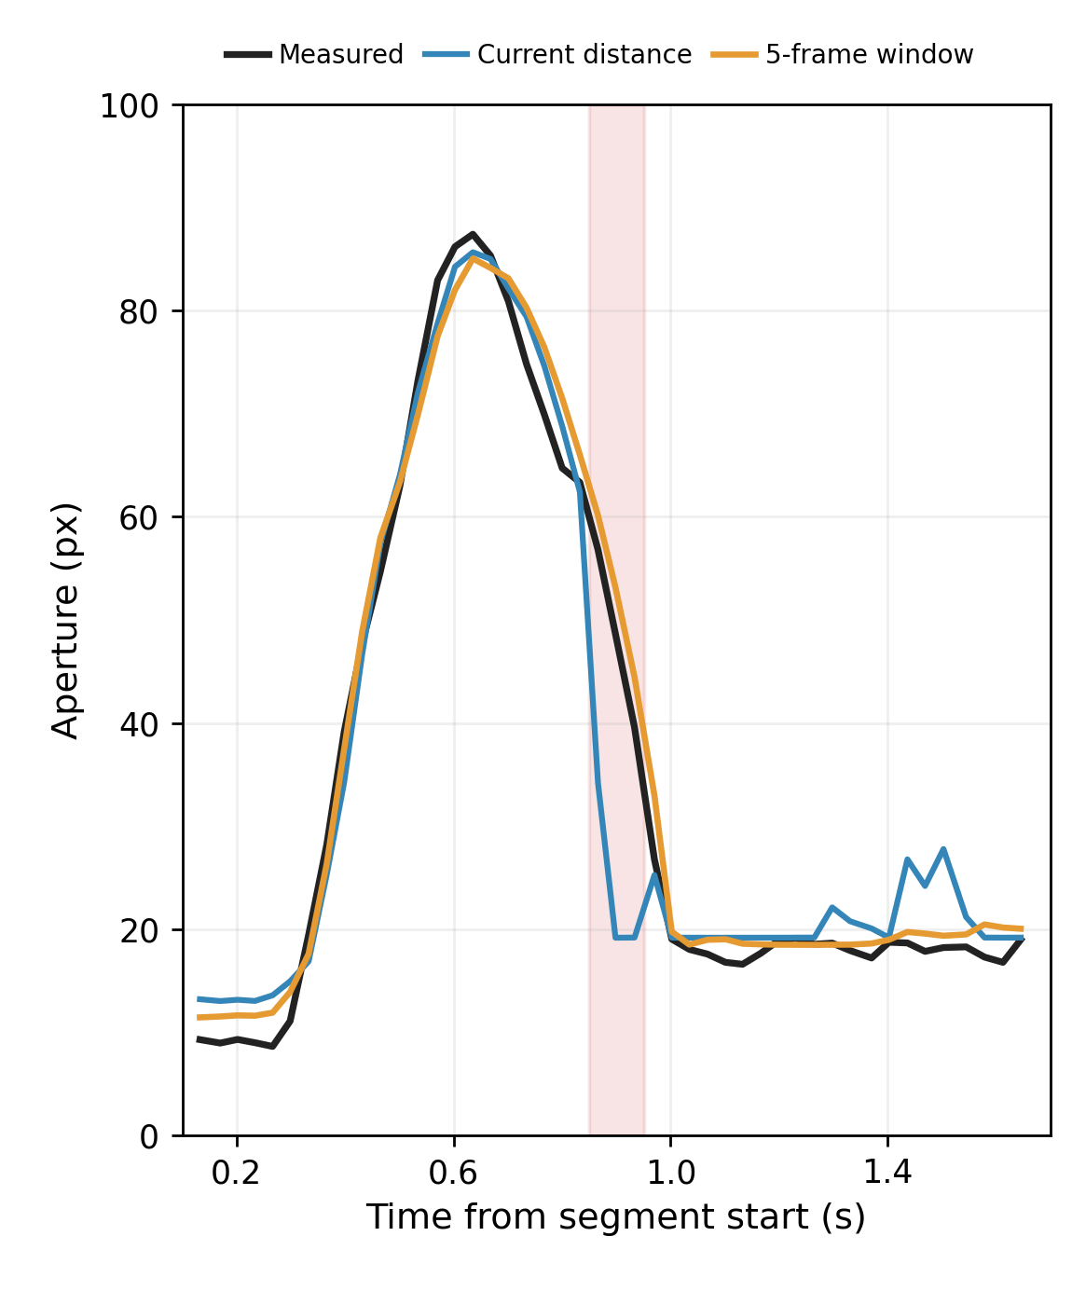
Effect of Temporal Window
Without a temporal window : The model learns only the mapping between distance and fingertip aperture, resulting in larger errors during rapid changes.
With a temporal window:The model can utilize short-term motion context to learn temporal trends, improving prediction accuracy.
Comparison between predicted and ground-truth curves, In the red-highlighted region, the model without a temporal window shows poor prediction performance.

Slide 14
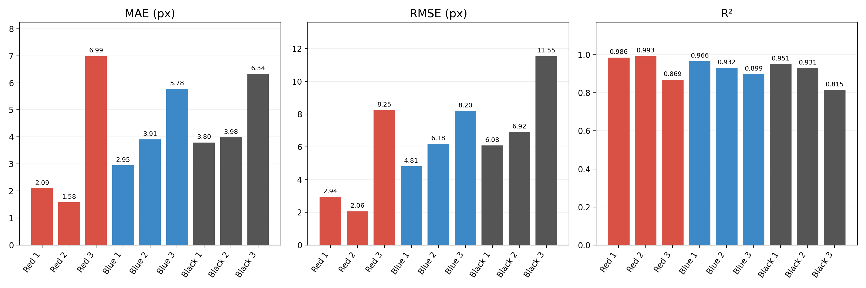
Real-Time Experiment
Procedure:
Three cubes of different colors and sizes were presented in random order, with three trials per cube.
The system identified the target cube and automatically selected the corresponding trained model for real-time prediction.
The model achieved an R² above 0.89 in 8 out of 9 real-time trials, demonstrating promising prediction performance.

Slide 15
Summary
Demonstrated a consistent relationship between hand–object distance and fingertip aperture during reach-to-grasp movements.
Developed a regression model that accurately predicts continuous fingertip aperture from hand–object distance.
Developed a real-time system that automatically selects the appropriate trained model and predicts fingertip aperture in real time.
Future Work
Conduct grasping experiments with a wider variety of objects.
Recruit additional participants to evaluate the model's generalization ability.

Slide 16
References
[1] Vásconez, J. P., Barona López, L. I., Valdivieso Caraguay, Á. L., & Benalcázar, M. E. (2022). Hand gesture recognition using EMG-IMU signals and deep q-networks. Sensors, 22(24), 9613.
[2] Zandigohar, M., Han, M., Sharif, M., Günay, S. Y., Furmanek, M. P., Yarossi, M., ... & Schirner, G. (2024). Multimodal fusion of EMG and vision for human grasp intent inference in prosthetic hand control. Frontiers in Robotics and AI, 11, 1312554.
[3] Mangalam, M., Yarossi, M., Furmanek, M. P., & Tunik, E. (2021). Control of aperture closure during reach-to-grasp movements in immersive haptic-free virtual reality. Experimental Brain Research, 239(5), 1651-1665
[4] Coats, R. O., Holt, R. J., Bingham, G. P., & Mon-Williams, M. A. (2018). Predicting the duration of reach-to-grasp movements to objects with asymmetric contact surfaces. Plos one, 13(2), e0193185.

