Slide 1
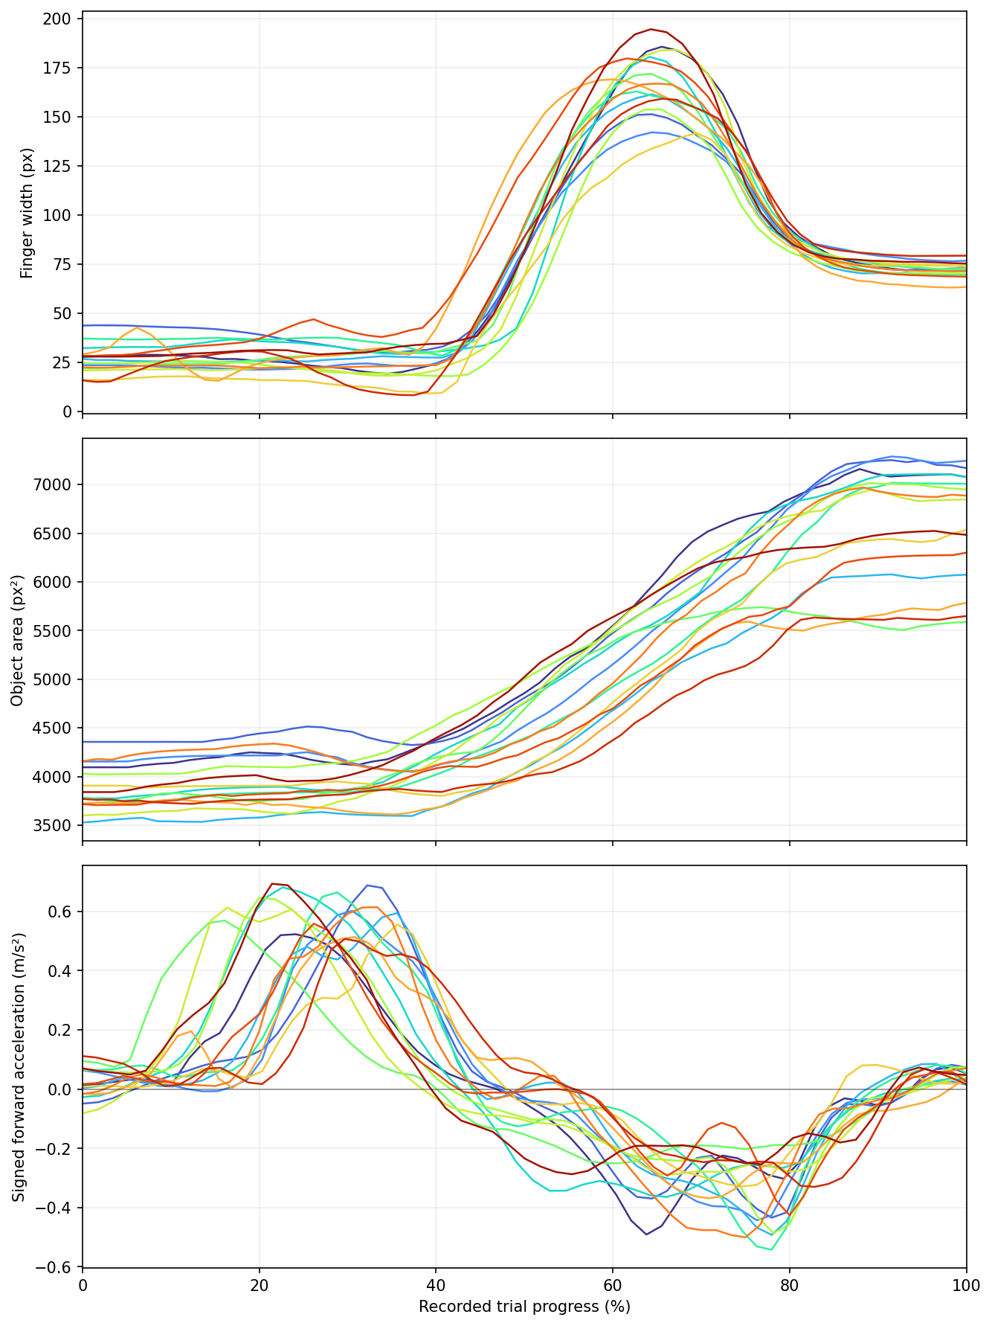
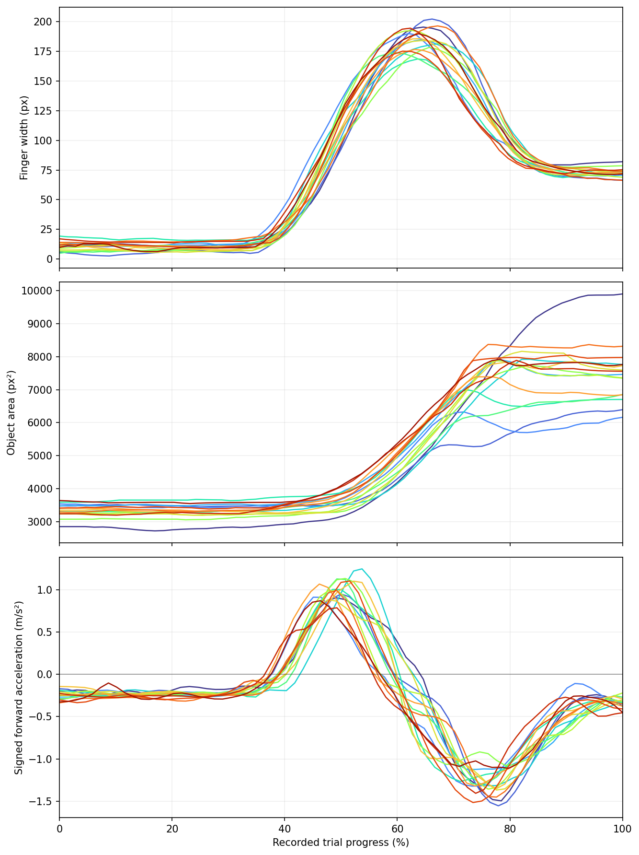
Experiment with participants
Participant 1's data show greater variability.
Participant 1's data
My data

Slide 2
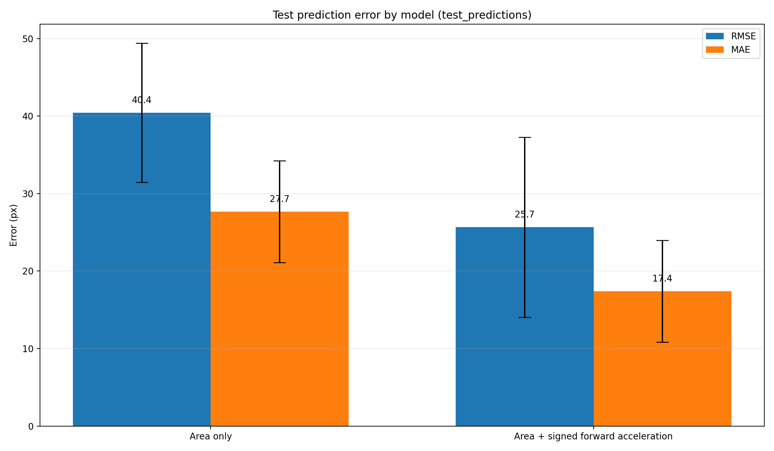
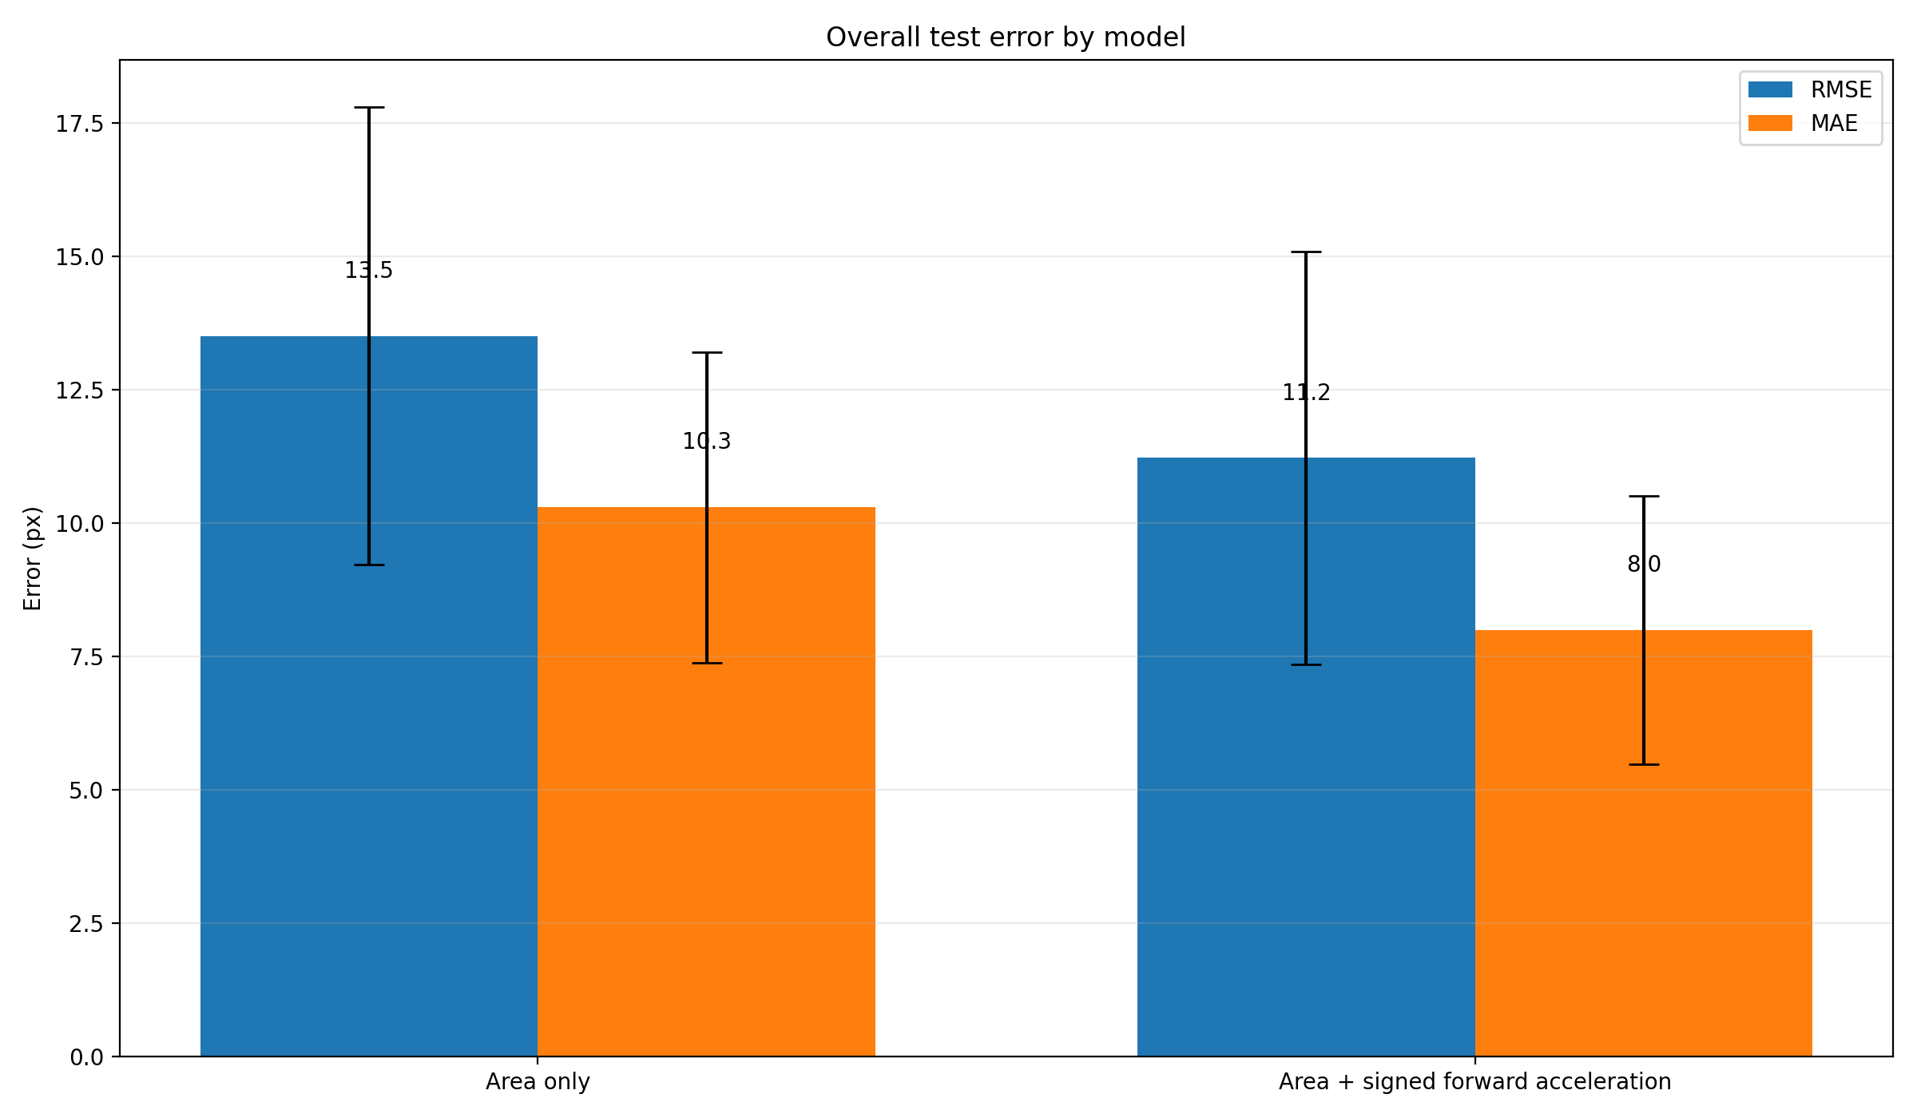
Experiment with participants
The results were not satisfactory.
Participant 1's Result
My Result

Slide 3
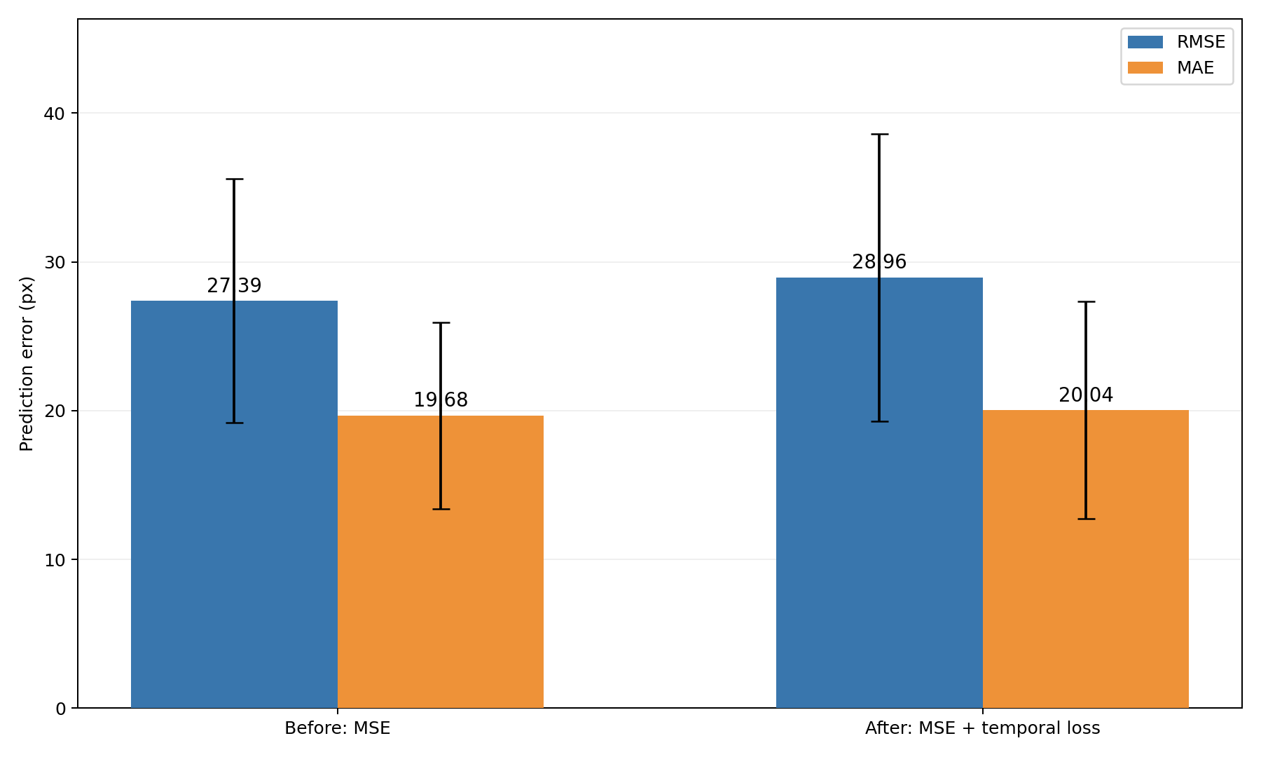
Improving the Loss Function
Temporal loss was added to the loss function to enhance the model's ability to learn temporal dynamics.
But, no improvement in performance.

Slide 4
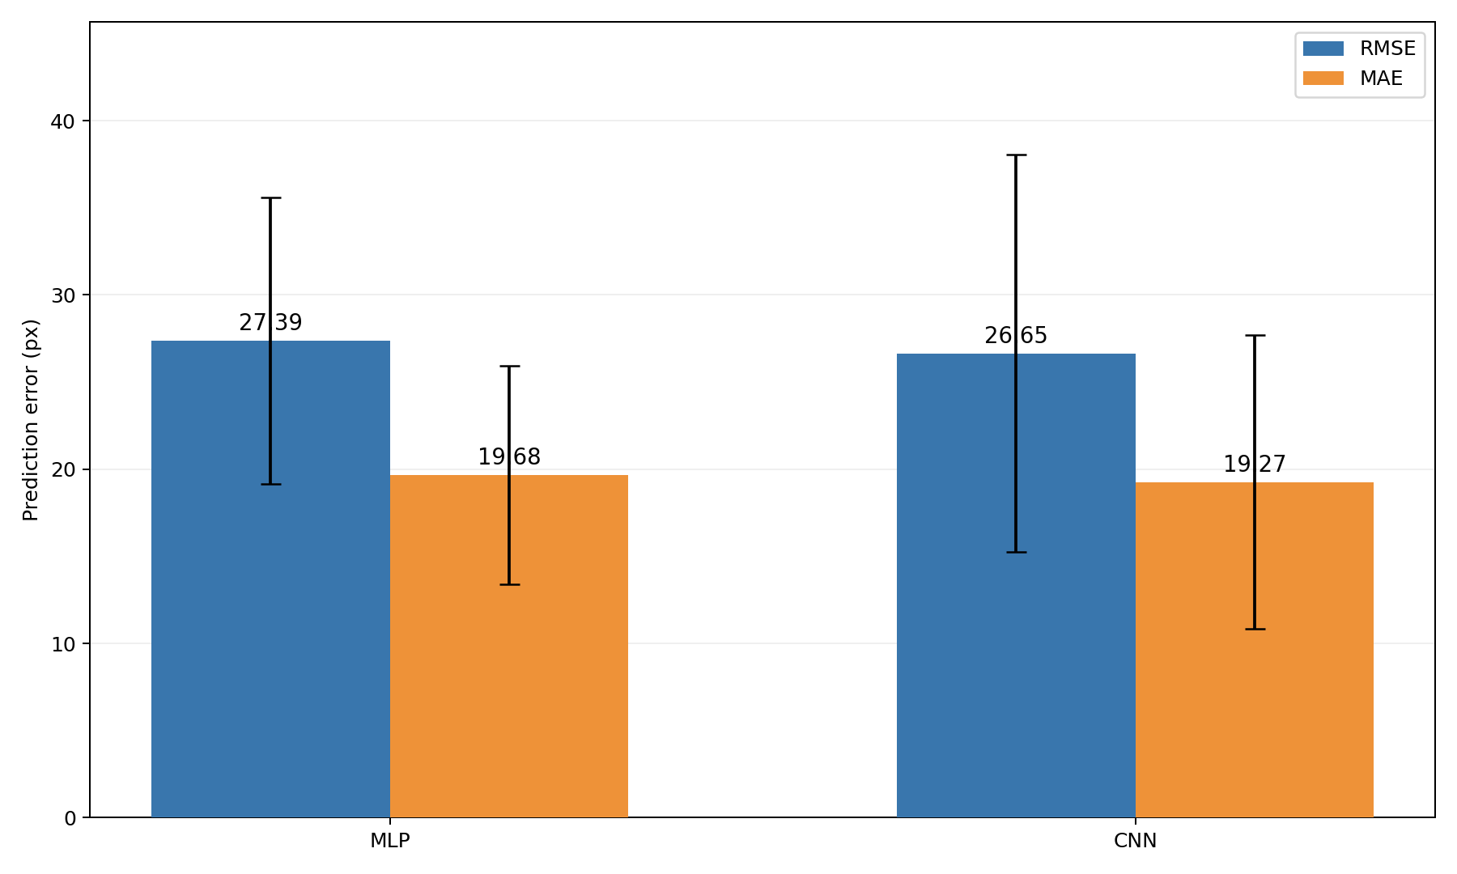
Improving the Model
Use a more powerful model to capture complex variations in acceleration.
But, no improvement in performance.

