Slide 1
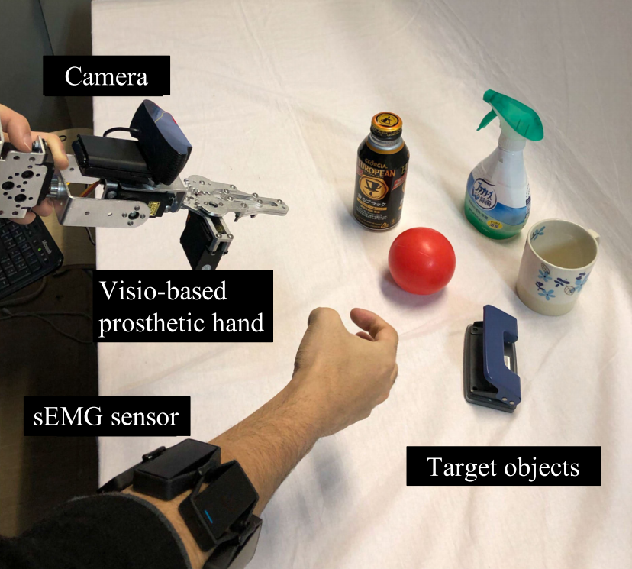
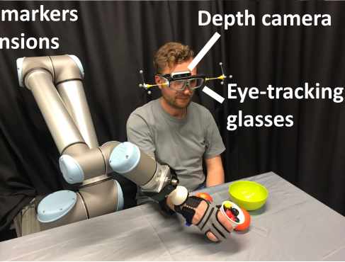
Research Introduction
Research Theme:「Prosthetic Hand Control System depends on Eye Tracking, Computer Vision, and EMG」
Research Content: Add an eye-tracking to the CPS LABO vision-based prosthetic hand
Research Objective: The system smoothly runs。Improve the recognition accuracy and robustness of the prosthetic hand.
CPS LABO Prosthetic Hand
Eye-tracking technology has been adopted in multiple research works.

Slide 2
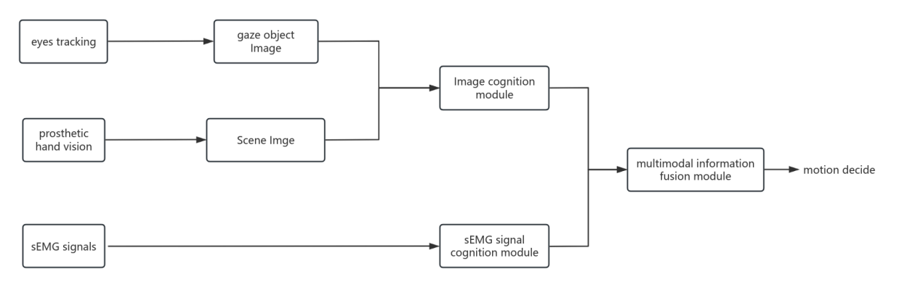
Research Introduction
· Step1：obtain gaze object.
· Step2：comparing gaze object image and hand vision image，confirming the target in image cognition module
· Step3：Fusing image features with sEMG signal features, and then decide motion
System flowchart

Slide 3
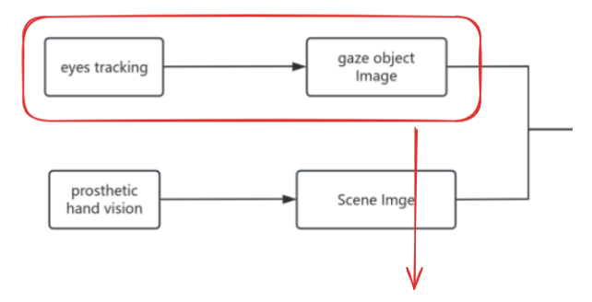

Research Introduction
step1: obtain gaze object
1.coding program：get gaze vector/Gaze Estimation
2.develop hardware: camera + Raspberry Pi system，capture scene & capture gaze
3.obtain gaze object image

