Slide 1
Prosthetic Hand Control System depends on Eye Tracking, Computer Vision, and EMG
Saga University
Computer Science & Information Techology
25742102 DI XIQING
Professor Osamu Fukuda，Yeoh Wen Liang

Slide 2
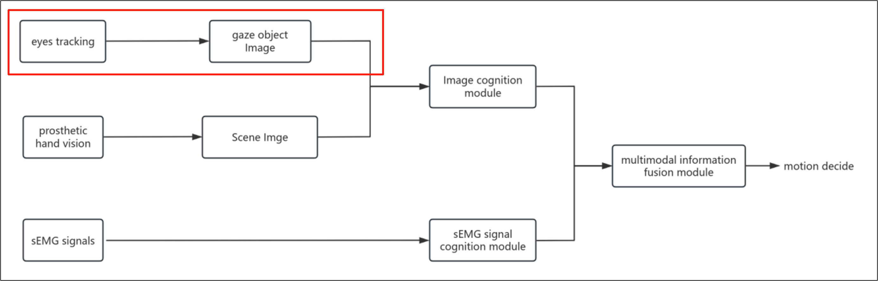
Current work
Current work :
1.coding program：Gaze Target Estimation

Slide 3
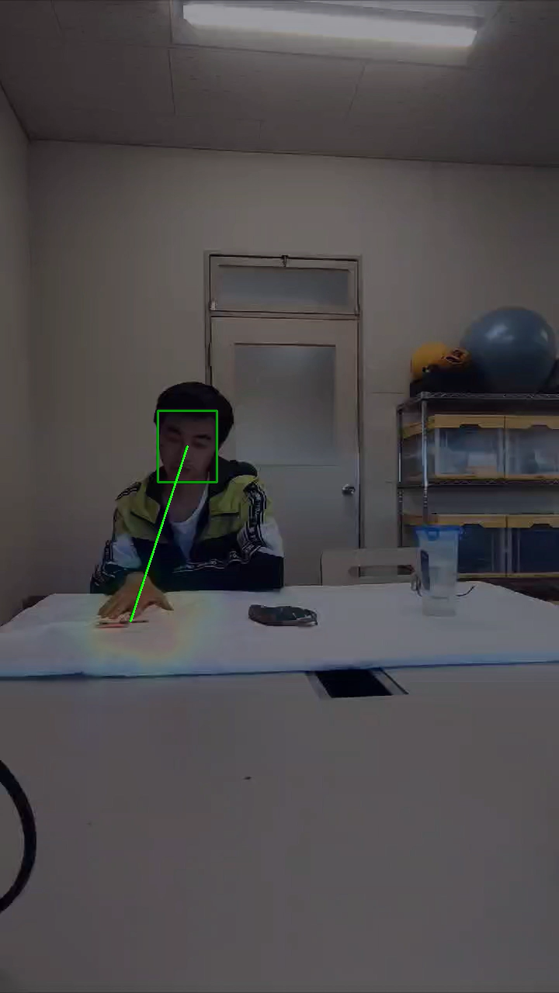

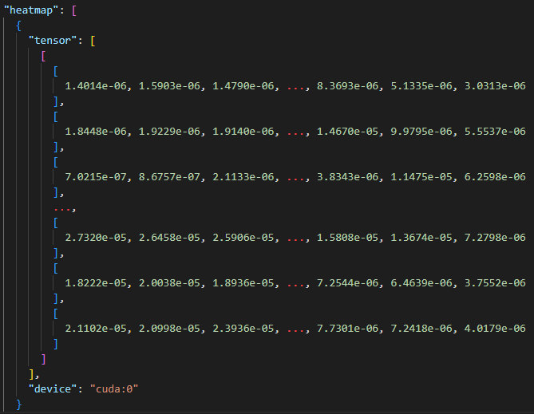
Gaze-LLE: Gaze Target Estimation via Large-Scale Learned Encoders
Input :
Output :

Slide 4
Current problem
Current problem : real-time gaze estimation
1.Study Gaze-LLE model
I will study the structure of the model ,but I think that is difficult currently to modify model
2.Look at research of gaze estimation with depth camera
Recently I search some real-time gaze estimation papers, that use depth camera .I will look at related research.
3.Look at Labo’s prosthetic hand research
Labo’s previous prosthetic hand research whether deal with real-time problem

