Slide 1
Prosthetic Hand Control System depends on Eye Tracking, Computer Vision, and EMG
Saga University
Computer Science & Information Techology
25742102 DI XIQING
Professor Osamu Fukuda，Yeoh Wen Liang

Slide 2
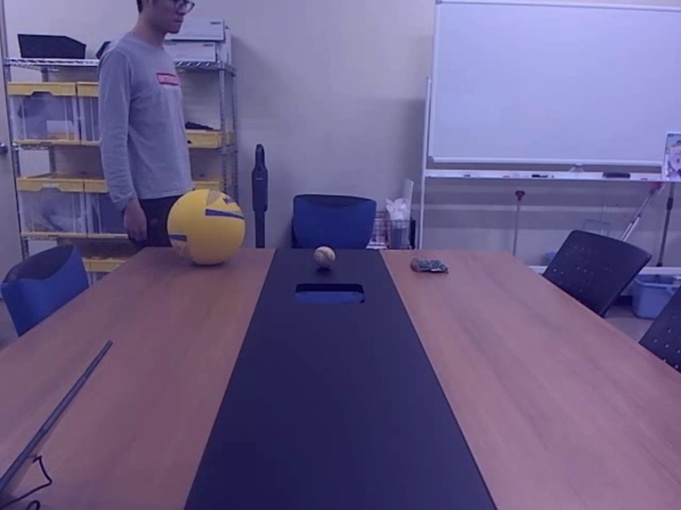
Current work
Real time gaze target estimation :
Gaze target estimation model : CVPR 2020 - Detecting Attended Visual Targets in Video
Face detection algorithm ： Haar Cascade Classifier
main cause of instability :
1. Sometimes the face is not detected
2. Sometimes the bounding boxes are detected in incorrect locations

Slide 3
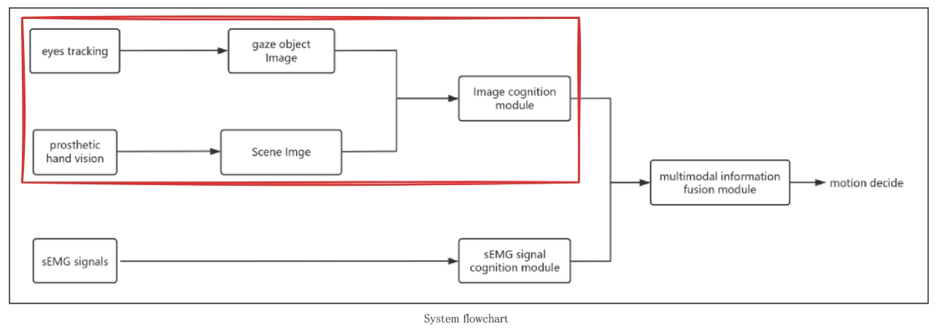
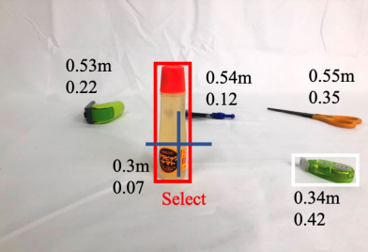
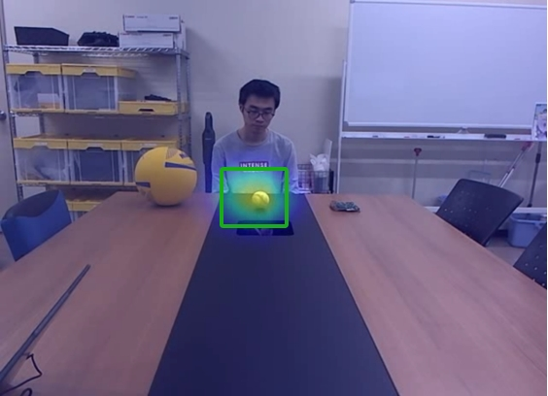
Next step
Labo’s hand vision system combined with the gaze model

