Slide 1
Prosthetic Hand Control System depends on Eye Tracking, Computer Vision, and EMG
Saga University
Computer Science & Information Techology
25742102 DI XIQING
Professor Osamu Fukuda，Yeoh Wen Liang

Slide 2
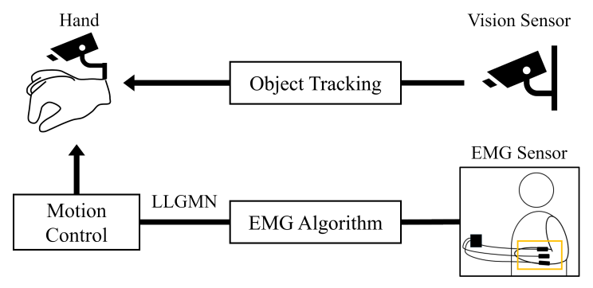

Complete System
Complete system flowchart:
EMG module : Hand movement recognition
Vision module : Object Tracking
System flowchart
EMG sensor

Slide 3
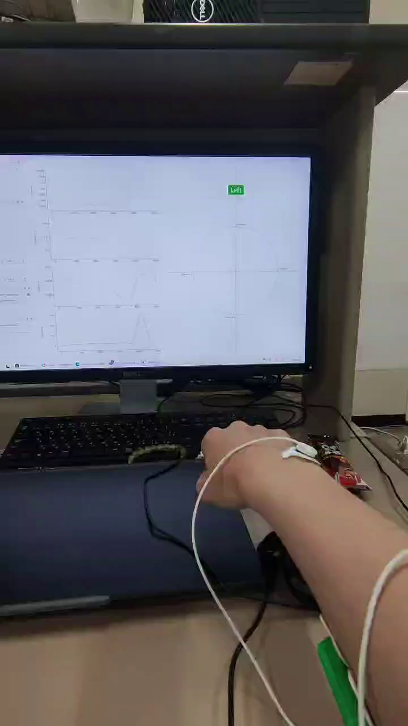
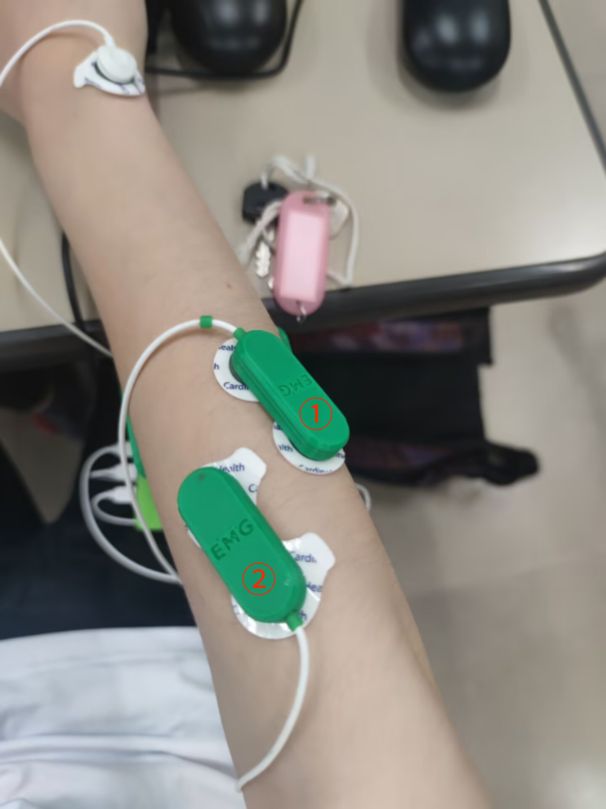
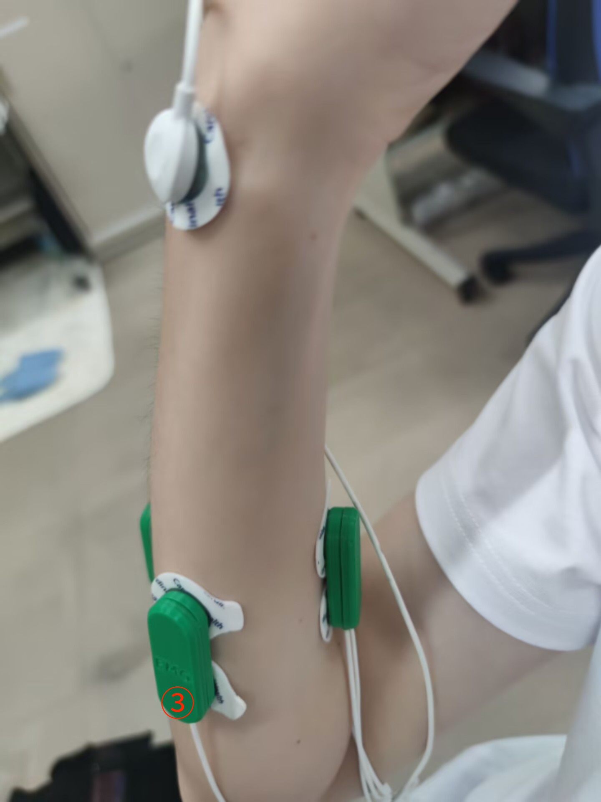
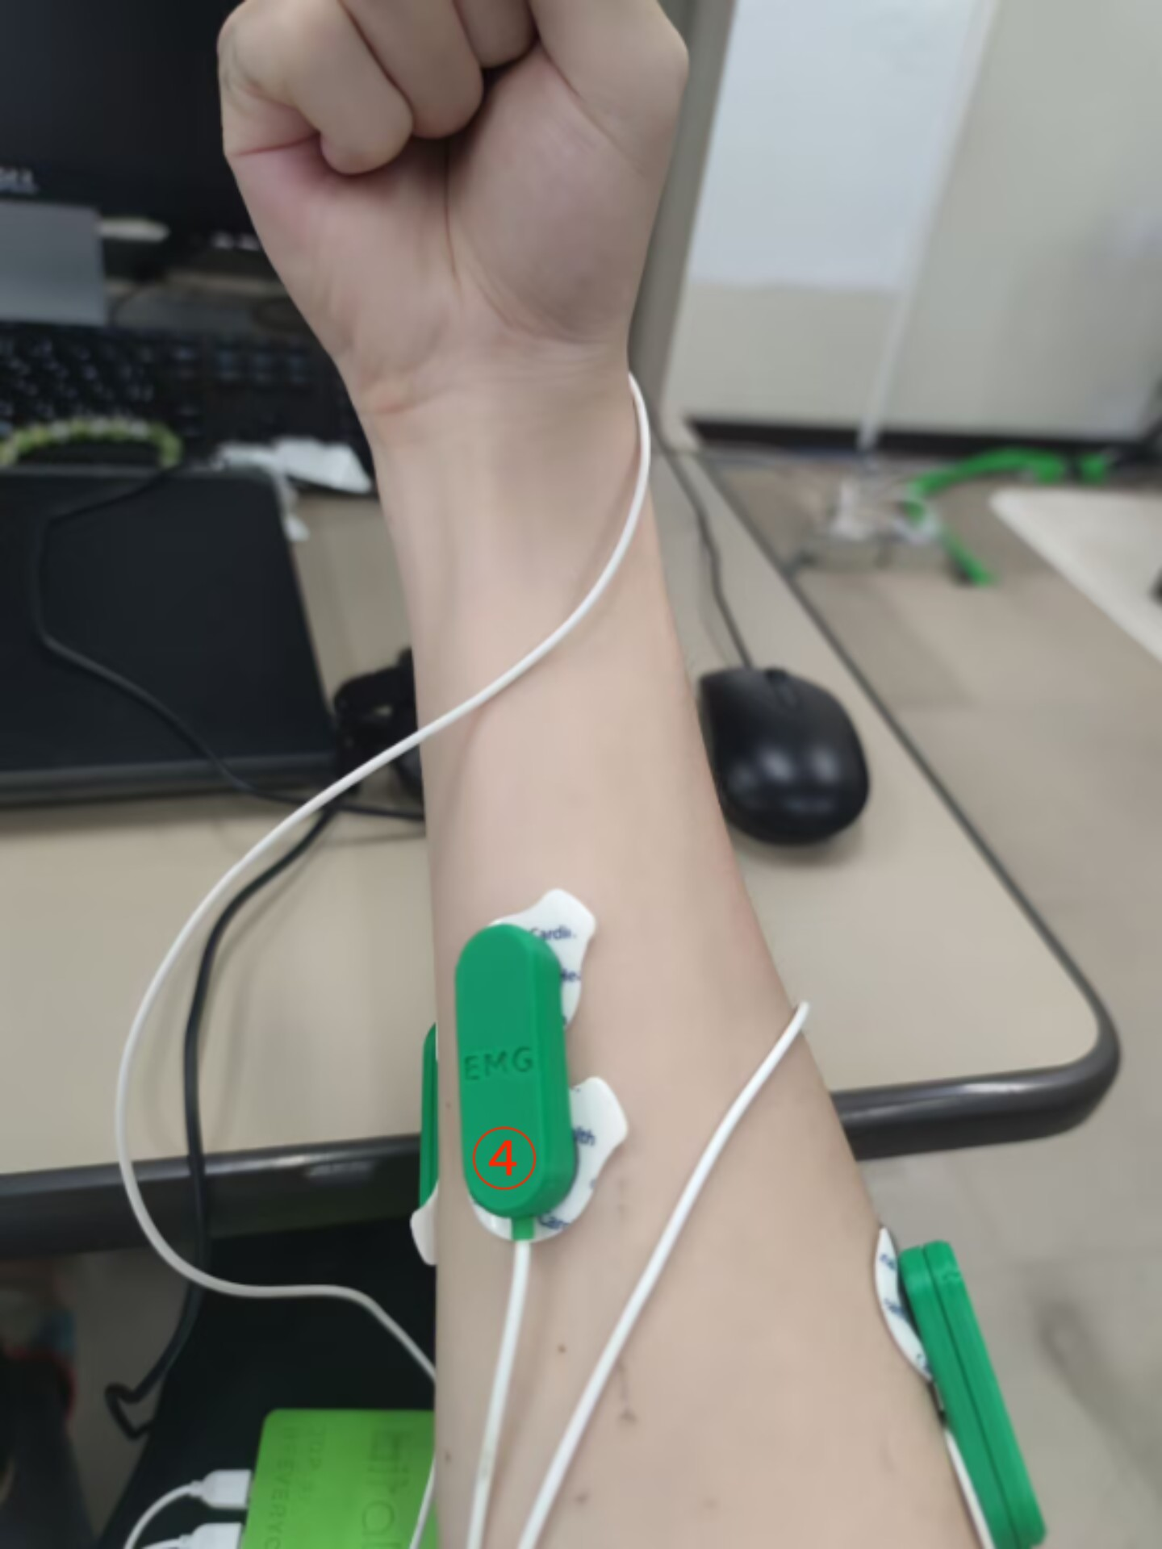
Movement Recognition
4 type of movement recognition :
1.Close (make fist)
2.Open (spread finger)
3.Left (palm bent upward)
4.Right (palm bent downward)
4 channel :

Slide 4
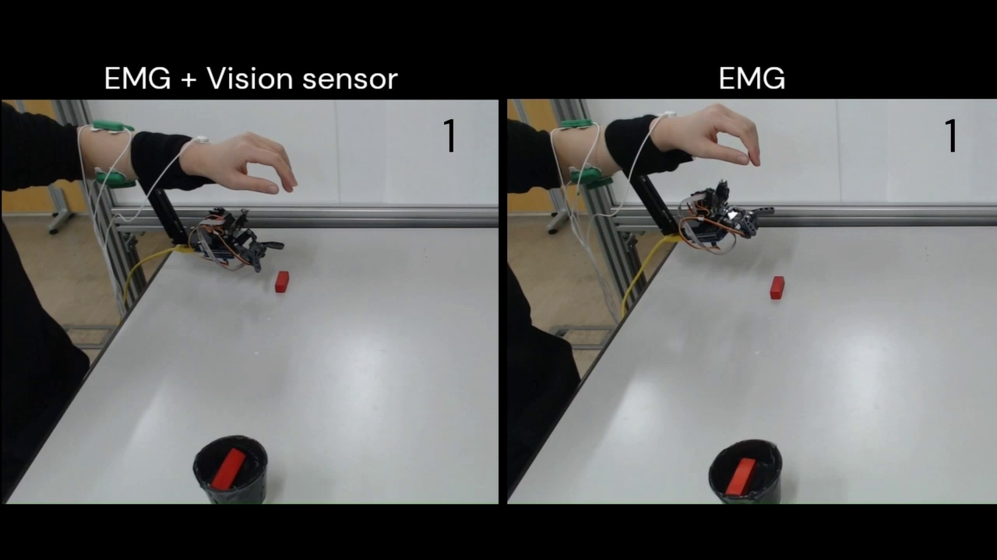
Next step
1.Run through the complete system
2.Learn and read papers related to the techniques in the system
1.Relationship between muscles and hand movements
2.Log-Linearized Gaussian Mixture Network
3.EMG algorithm
......

