Slide 1
Development of vision-based myoelectric hand with object tracking function
Saga University
Computer Science & Information Techology
25742102 DI XIQING
Professor Osamu Fukuda，Yeoh Wen Liang

Slide 2
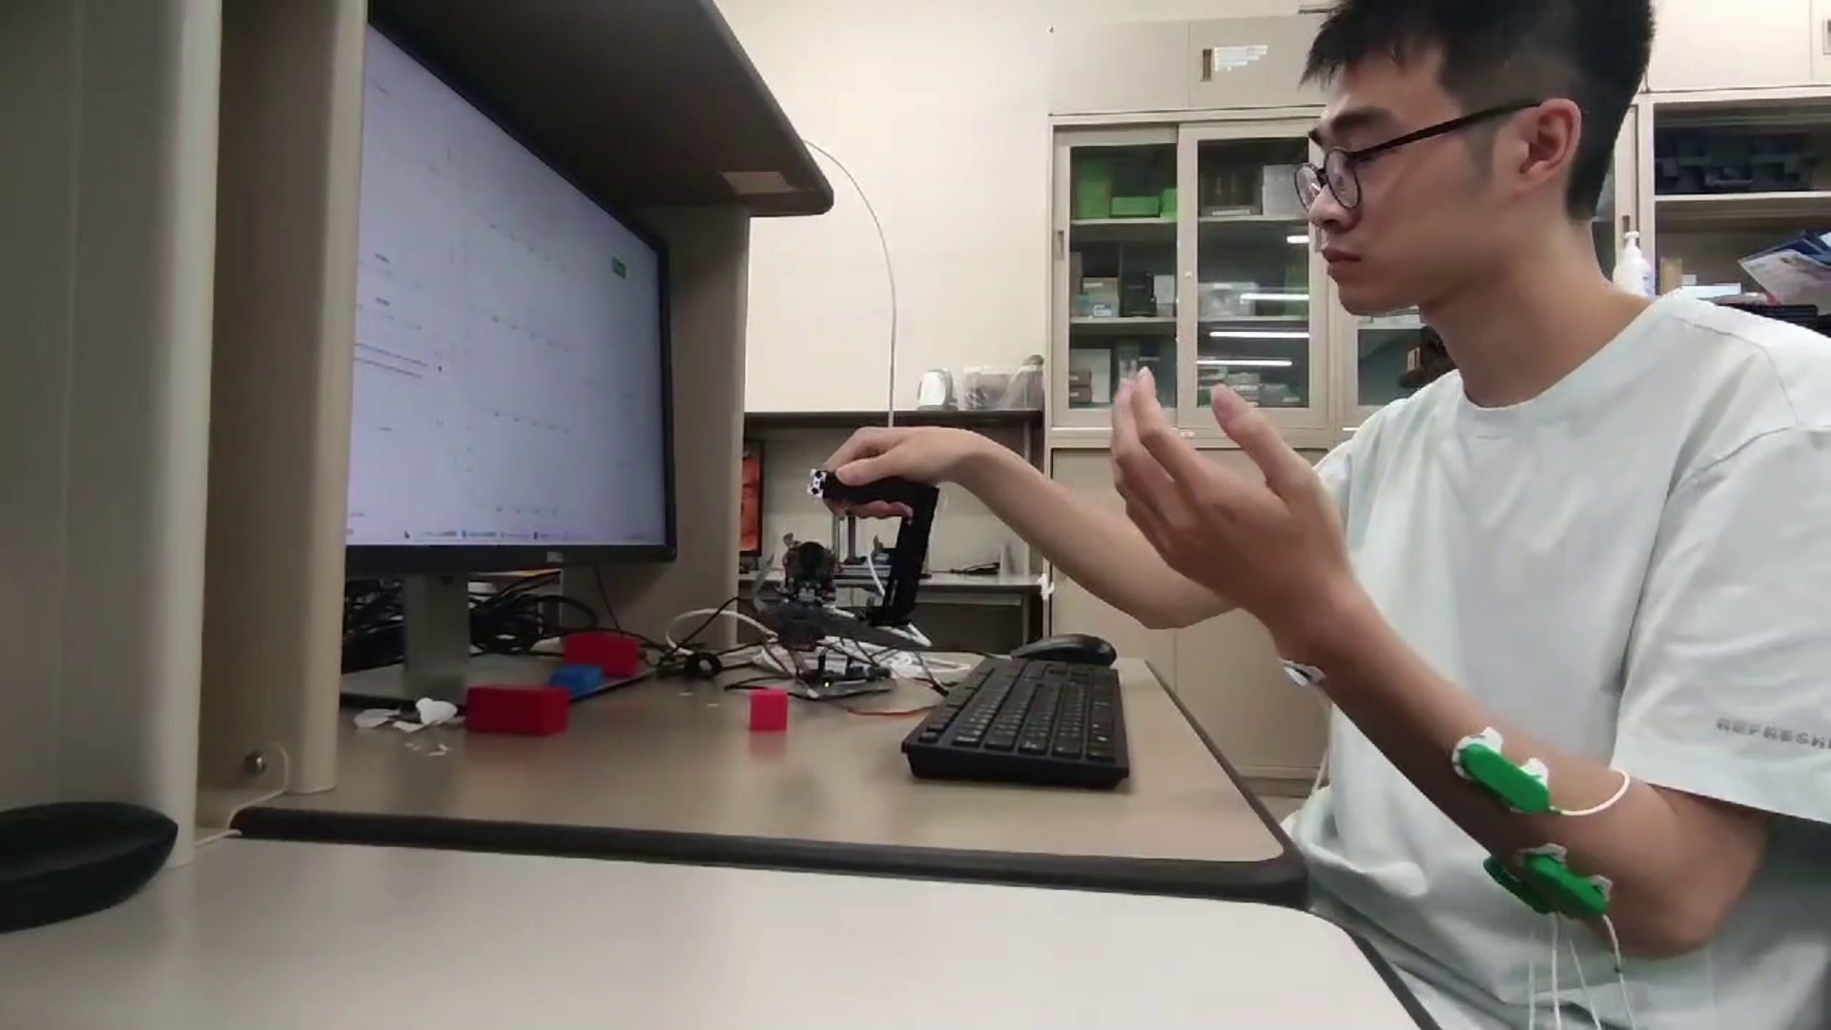
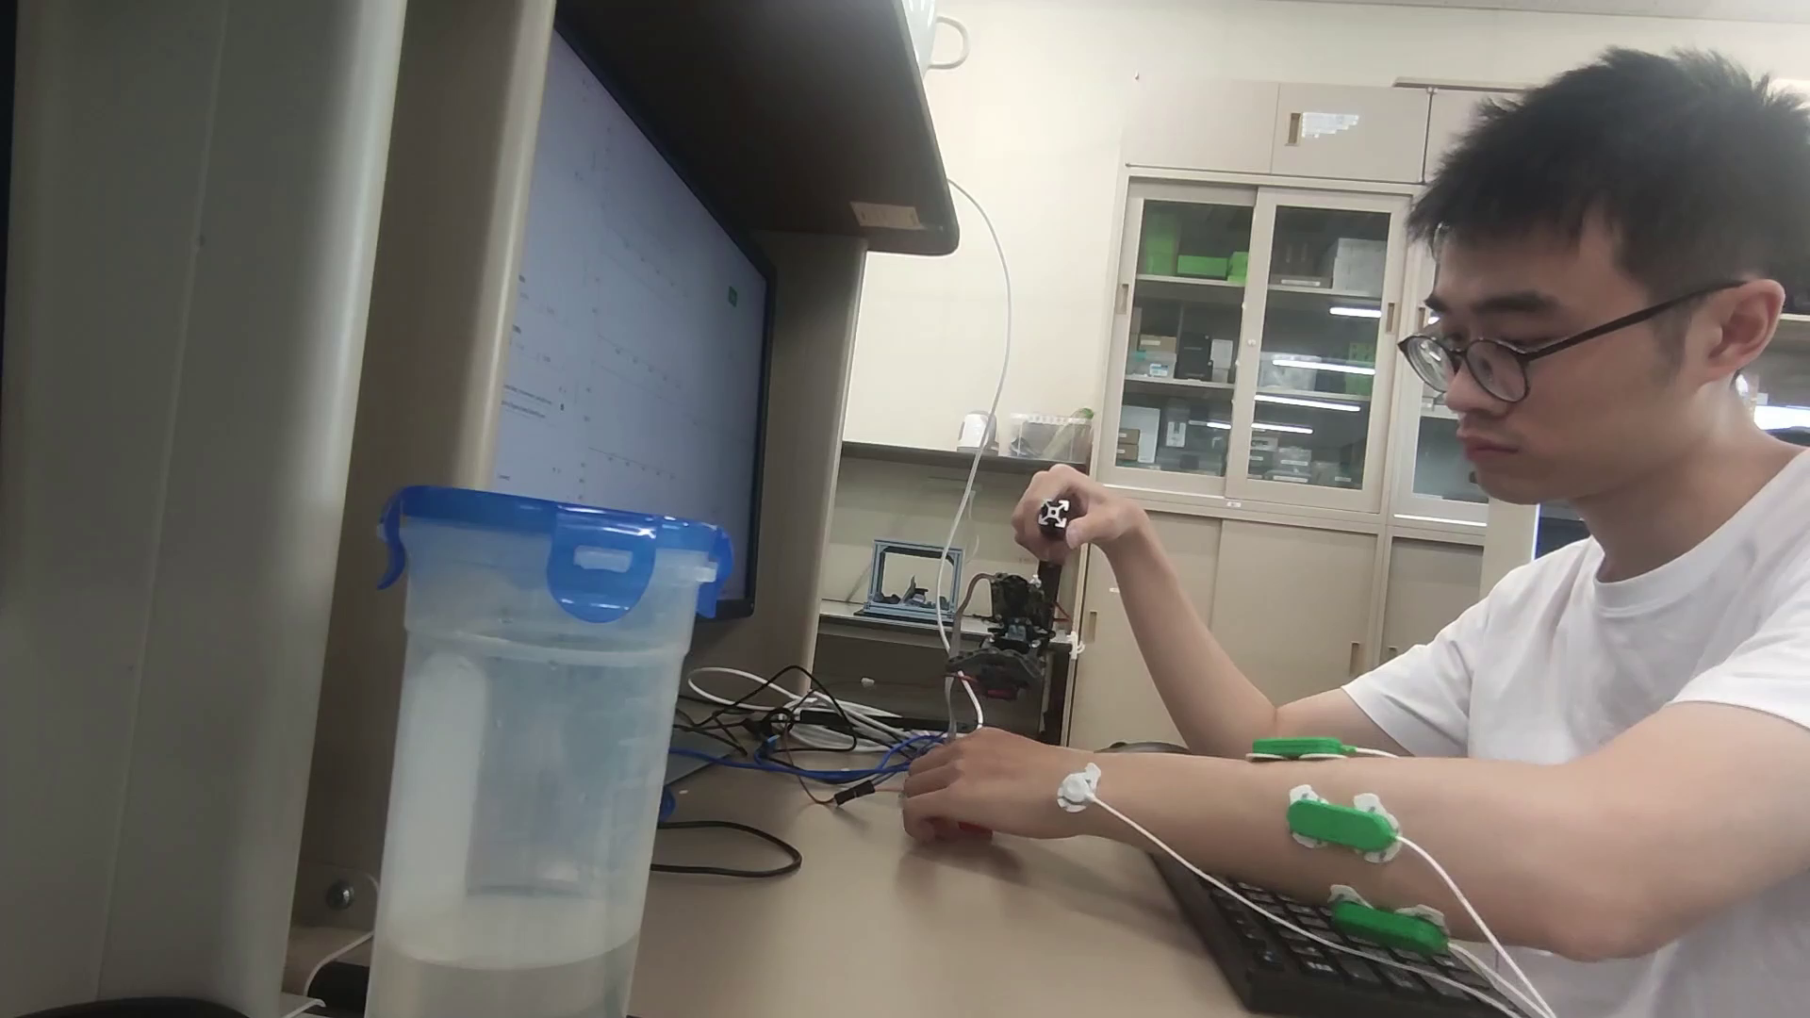
Reproduce
Myoelectric hand
Vision based myoelectric hand
Recognition module recognize all motor intent (left、right、open、close), to control hand
Recognition module recognize open and close motor intent, myoelectric hand rotate left and right due to vision sensor to track object
# BUG:currently rotate is not stable

Slide 3
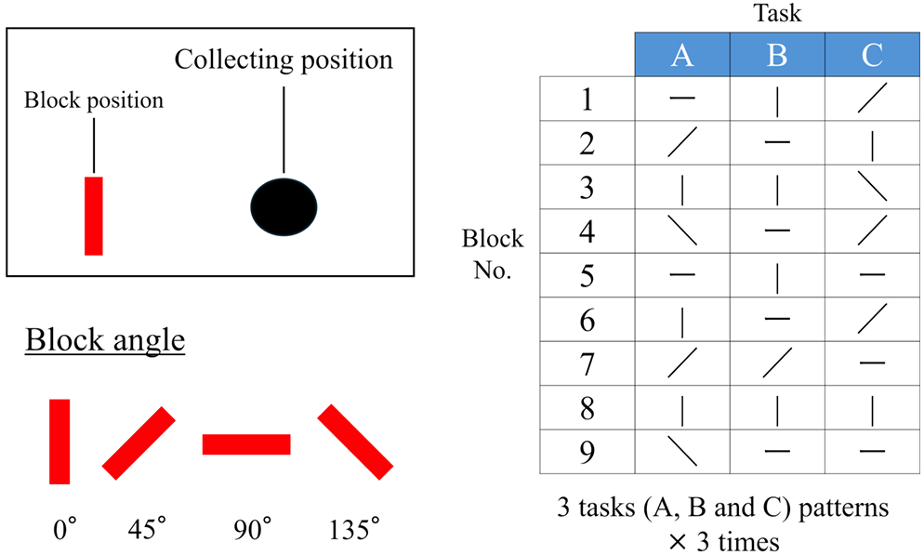
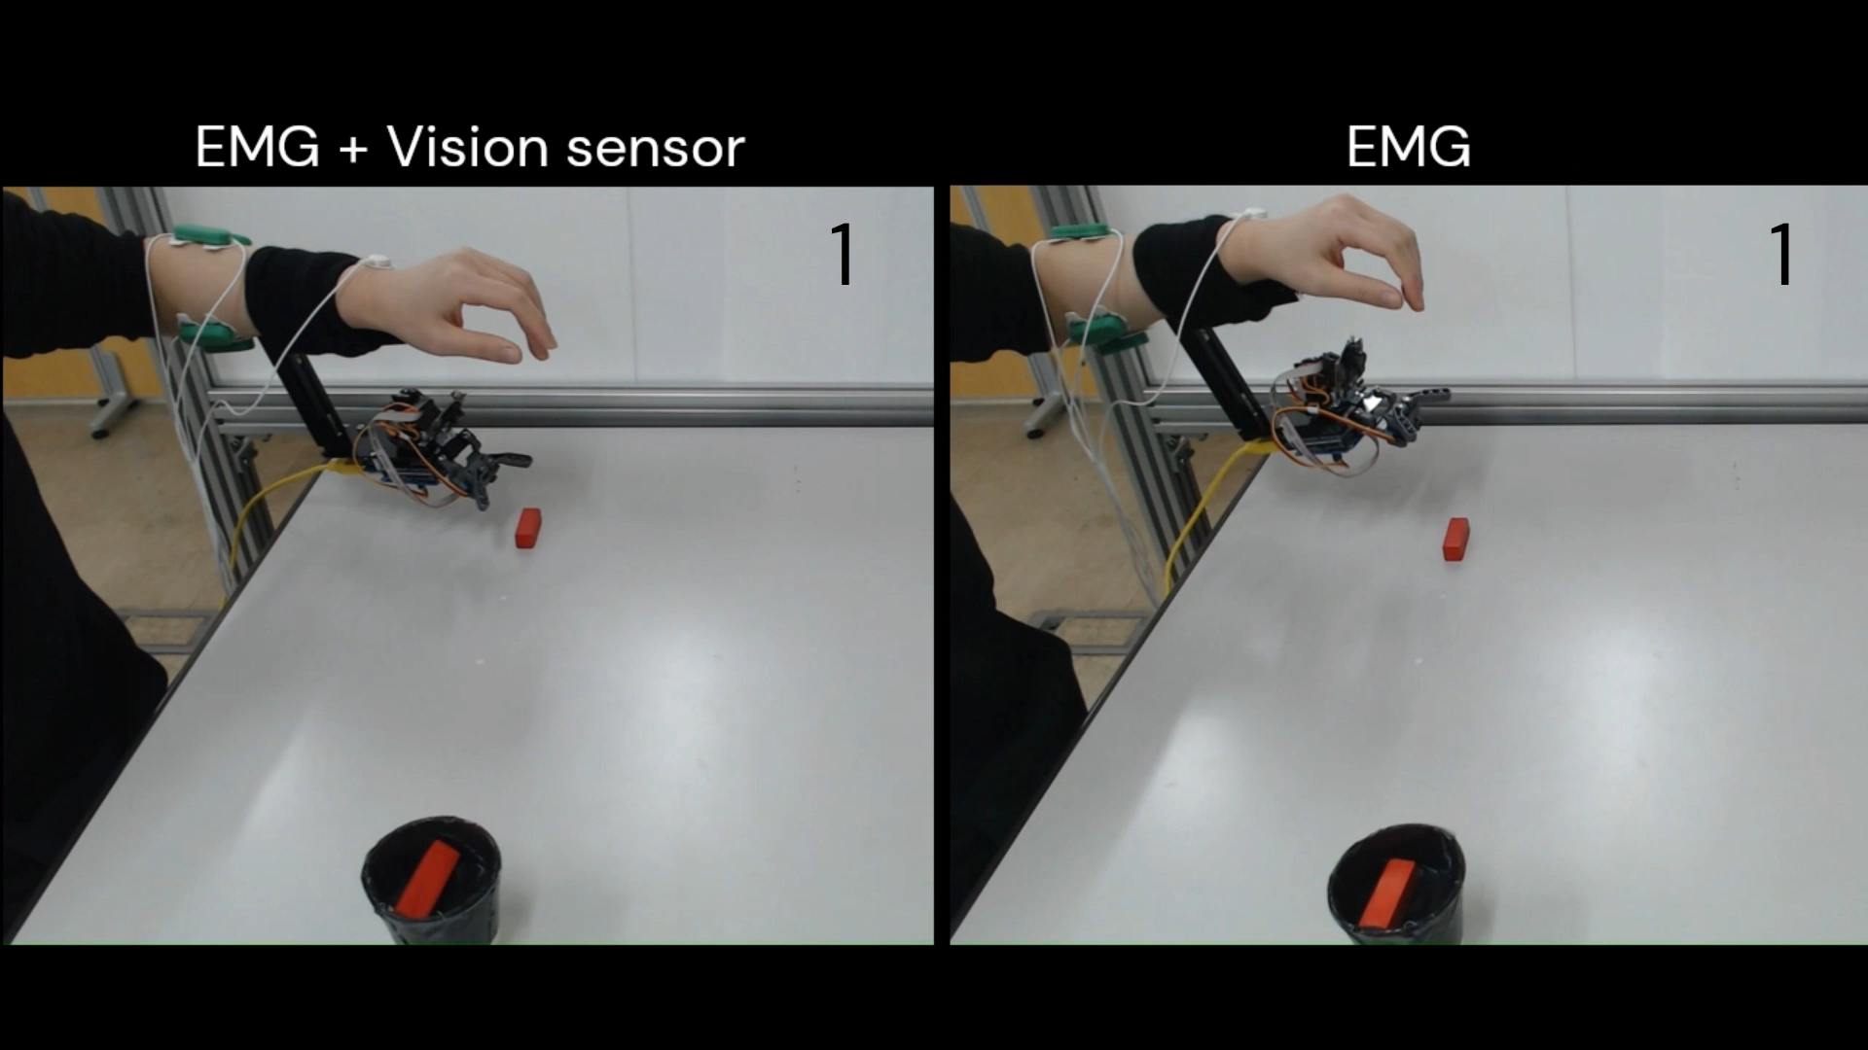
EMG Signal Recognition Module
Experiment：
Campare the impact of having vision sensor or not on efficiency.
Four diffrent block angle, the hand need rotate to grab

Slide 4
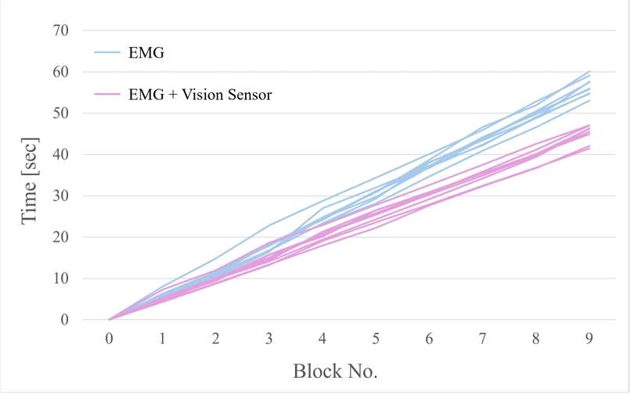
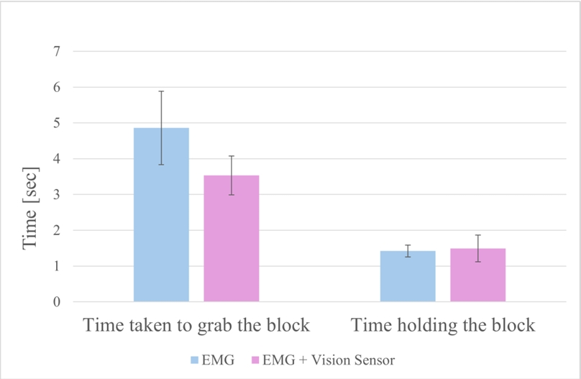
EMG Signal Recognition Module
Experiment Result：
①:not having vision sensor average time taken:56.5s
②:having vision sensor average time taken:45.2s
no different in ‘grab holidng’ time,
significant different in ‘try to grab’ time

Slide 5


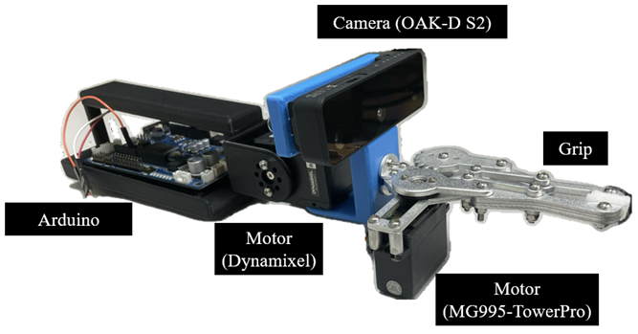
In later
roughly outlined this paper structure
organizing the signal processing formulas
found and read some of the references
learn the another vision based myoelectric hand

