Slide 1
Development of vision-based myoelectric hand with object tracking function
Saga University
Computer Science & Information Techology
25742102 DI XIQING
Professor Osamu Fukuda，Yeoh Wen Liang

Slide 2
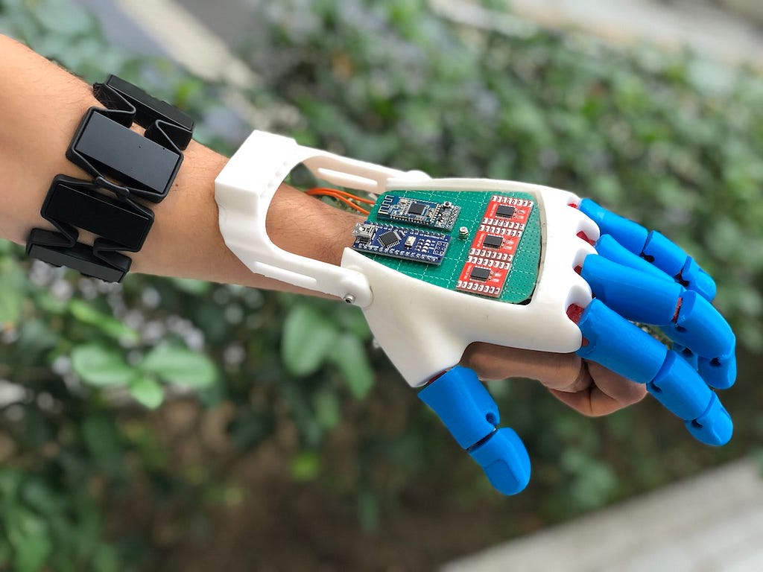
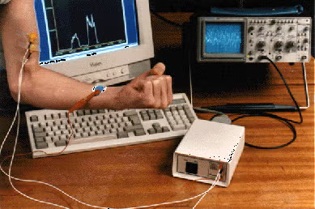
Introduce
Key Word: Electromyography, Prosthetic hand, Computer vision, Object tracking
Introduce：
Prosthetic hand - Replace real hand，mimic all real hand movements,for who have lost hand.
Fukuda O, Sakaguchi D, He Y, et al. Bimodal control of a vision-based myoelectric hand[J]. IEEE Access, 2021, 9: 98369-98380.
Mendez V, Iberite F, Shokur S, et al. Current solutions and future trends for robotic prosthetic hands[J]. Annual Review of Control, Robotics, and Autonomous Systems, 2021, 4(1): 595-627.
Electromyographic (EMG) signal：
  Generated during muscle contraction
  Can be acquire from surface of skin
  Include motor intent information

Slide 3
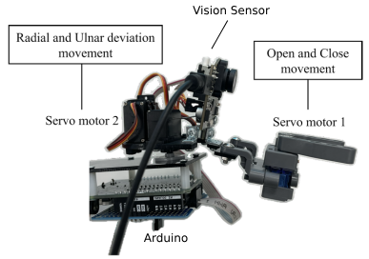
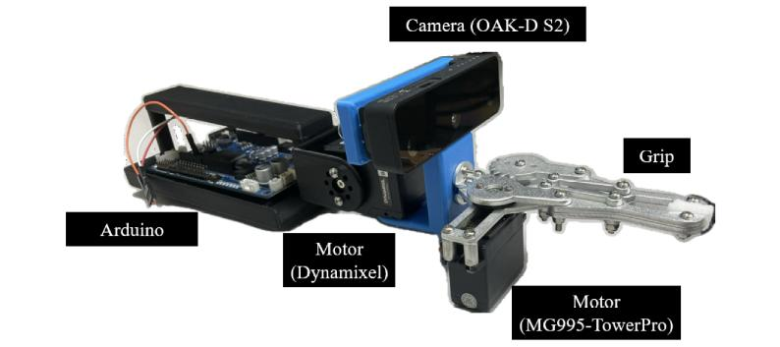
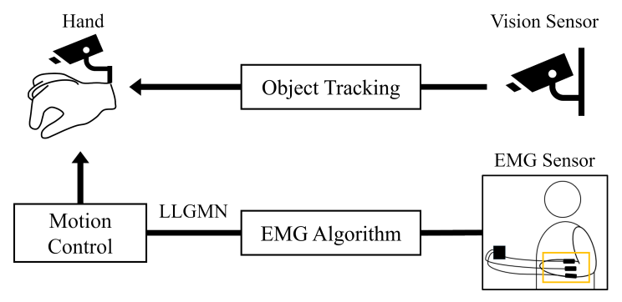
Two Type of Vision Based Myoelectric Hand
Two type of vision based myoelectric hand：
System flow
  Vision module
    capture object information,and drive the robotic hand to tracking object
  EMG signal recognition module
    acquire and process emg signal，recognize operator‘s motor intent

Slide 4
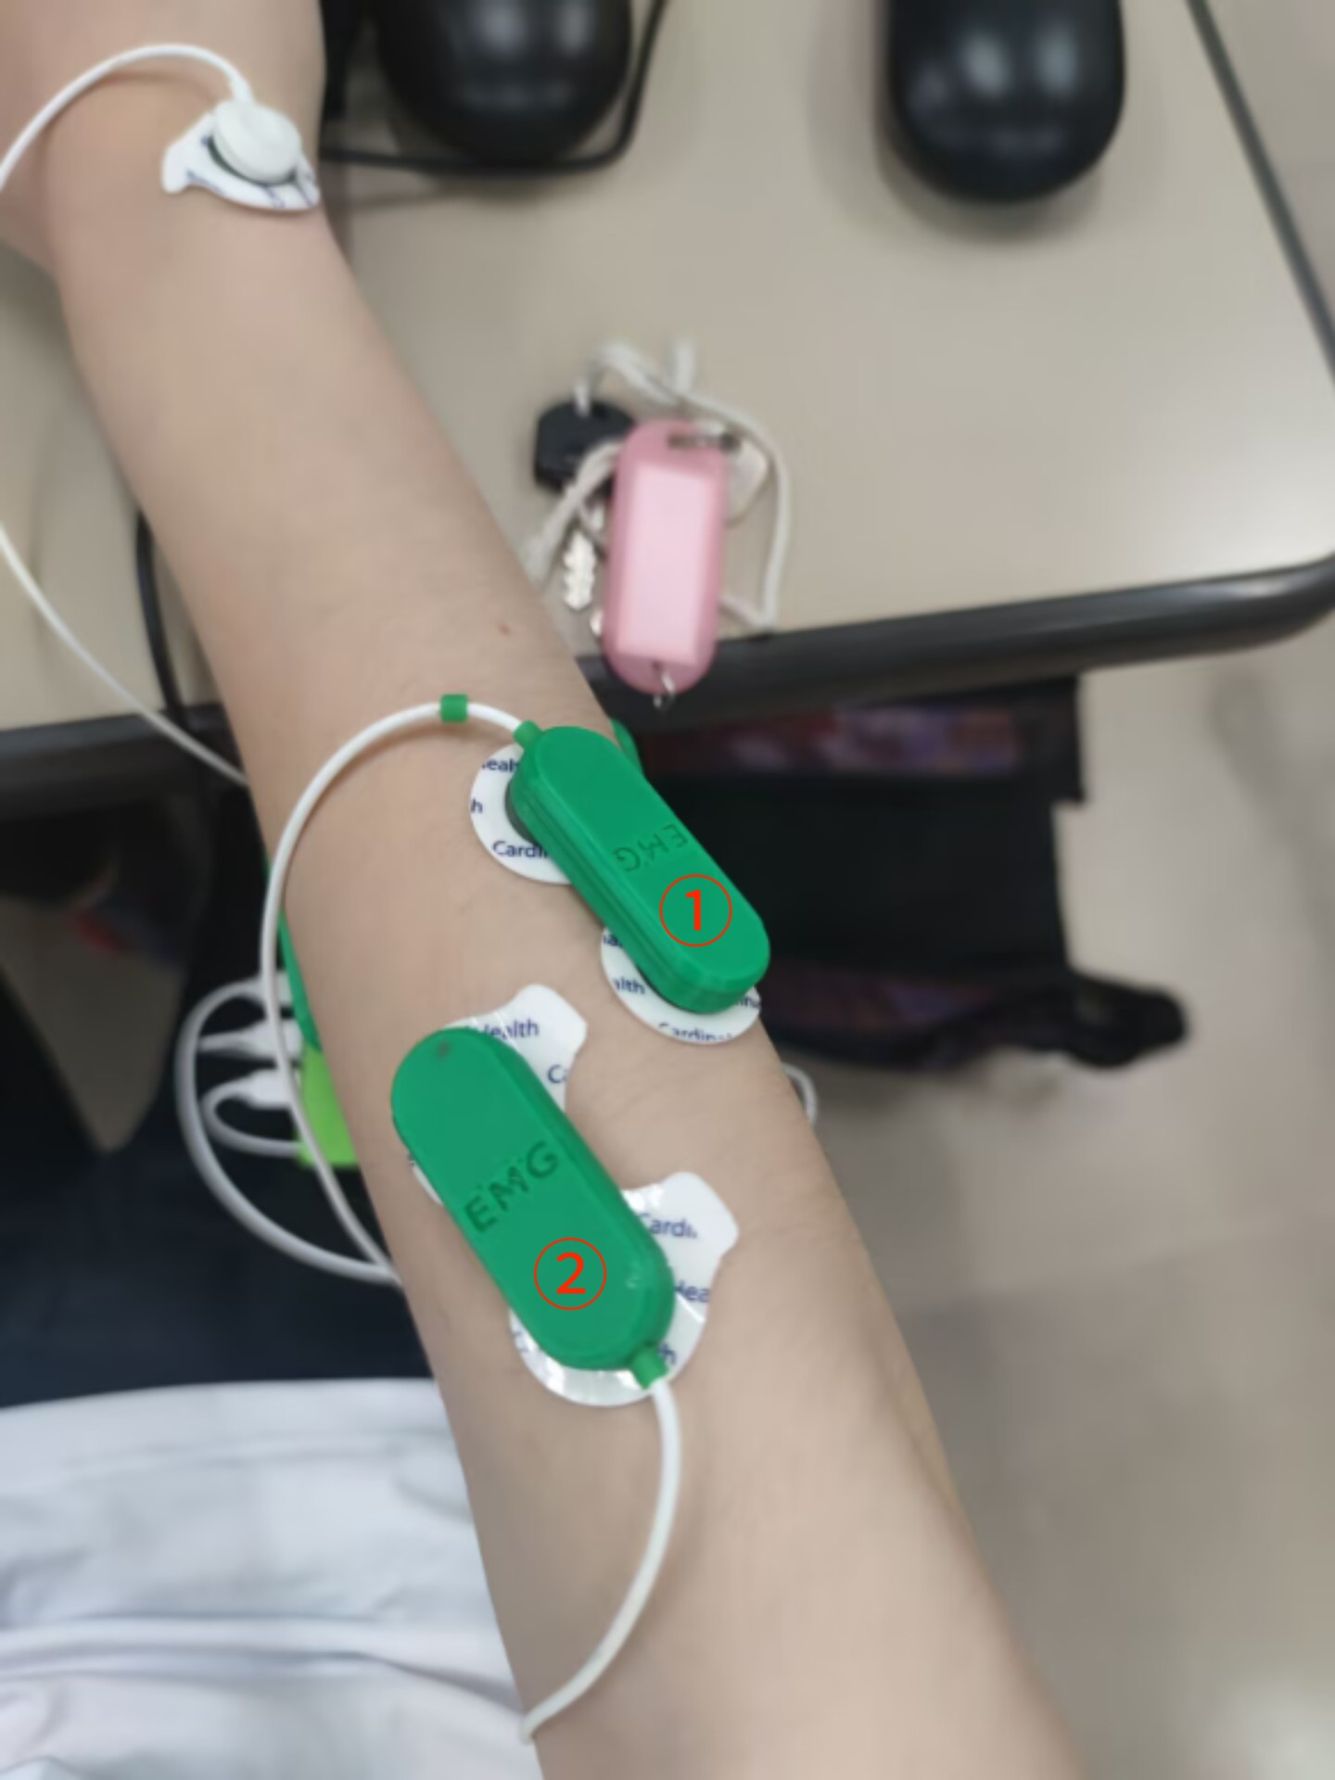
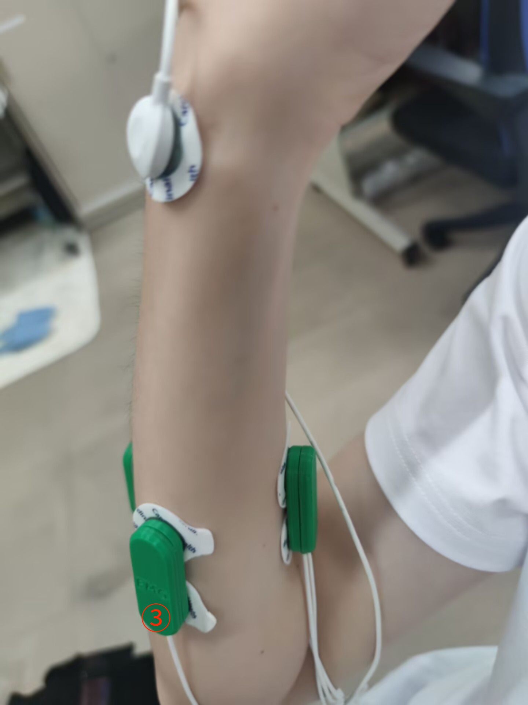
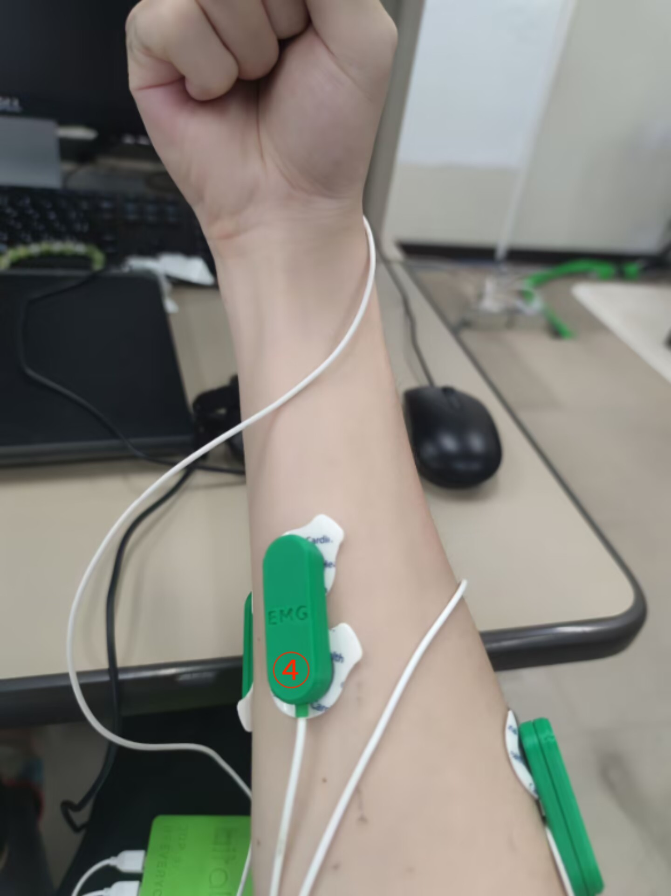

EMG Signal Recognition Module
EMG Signal Recognition Module：
1)Signal Acquisition：
Four pairs of electrodes were used as four channel, attached to the forearm muscles。These muscles are highly involved in the movements of experiment.
4 channel (4 pairs of electrodes)
Device：Bitalino musclebit
Bluetooth for signal transmission
1000hz frequency
Gomez-Correa, M., Ballesteros, M., Salgado, I., & Cruz-Ortiz, D. (2023). Forearm sEMG data from young healthy humans during the execution of hand movements. Scientific data, 10(1), 310.

Slide 5
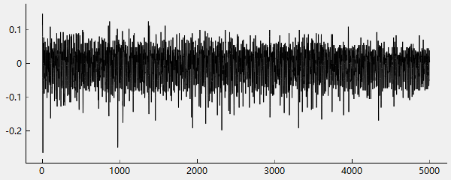

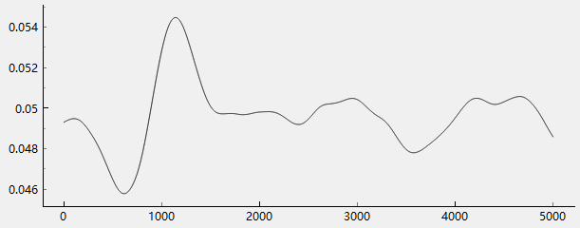

EMG Signal Recognition Module
EMG Signal Recognition Module：
2)Signal Processing：
△ full-wave rectification、envelope filtering
△ min-max normalization
focus on the force change，and reduce the influence of force values
△ channle normalization
facilitate model training and inference
Fukuda O, Tsuji T, Kaneko M, et al. A human-assisting manipulator teleoperated by EMG signals and arm motions[J]. IEEE transactions on robotics and automation, 2003, 19(2): 210-222.

Slide 6
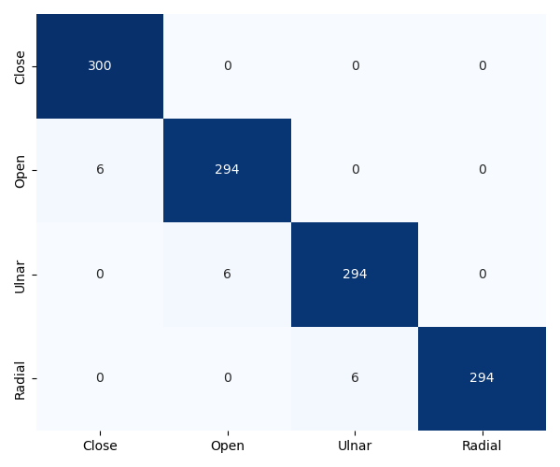
EMG Signal Recognition Module
EMG Signal Recognition Module：
3)Signal Recognition：
Recognition algorithm model : Log-Linearized Gaussian Mixture Network (LLGMN).
LLGMN is a statistical model based on the Gaussian Mixture Model (GMM). It enables high-speed and high-accuracy recognition with a small amount of data.
in this research,we defined four motion,hand open,close,left and right rotate,the model is trained with 700 data samples for each motion.tested with 300 data samples.
Tsuji T, Fukuda O, Ichinobe H, et al. A log-linearized Gaussian mixture network and its application to EEG pattern classification[J]. IEEE Transactions on Systems, Man, and Cybernetics, Part C (Applications and Reviews), 2002, 29(1): 60-72.

Slide 7
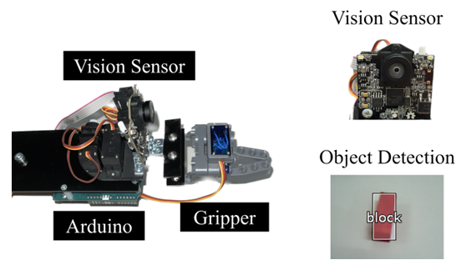
Vision module
4.Vision Module：
vision sensor : pixy2 camera.
pixy2 has built-in algorithms for line tracking and object recognition.and pixy2 has built-in image processing chip，camera can independently processing images，without relying on external computer resources。
vision sensor to recognize red color block，calculate object’s center coordinate，and control the robotic hand to tracking the object。

Slide 8
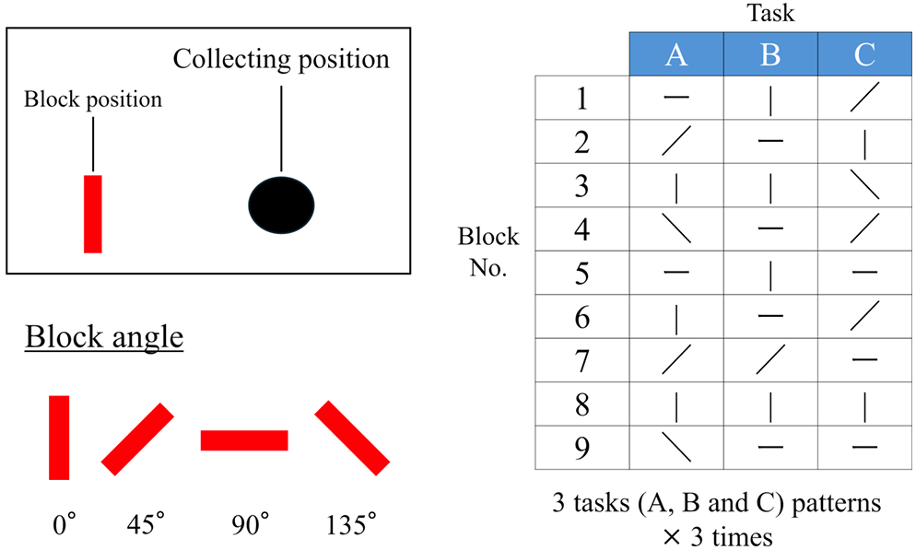
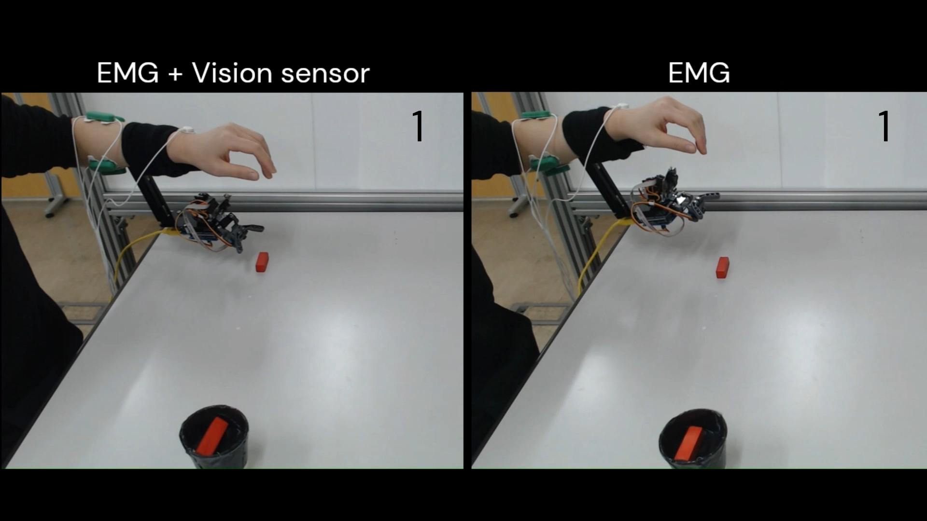
Experiment
Experiment：
Compare the influence of having vision sensor or not on efficiency.
Four diffrent block angle, the hand need rotate to grab

Slide 9
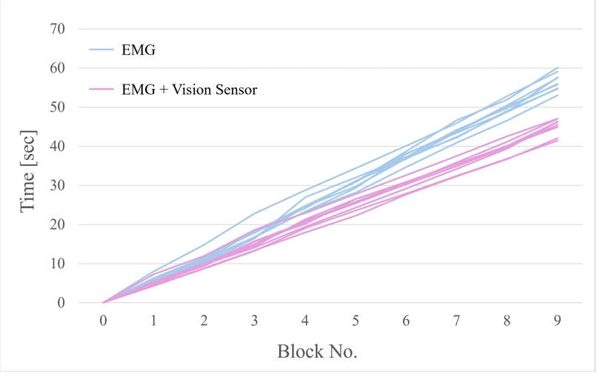
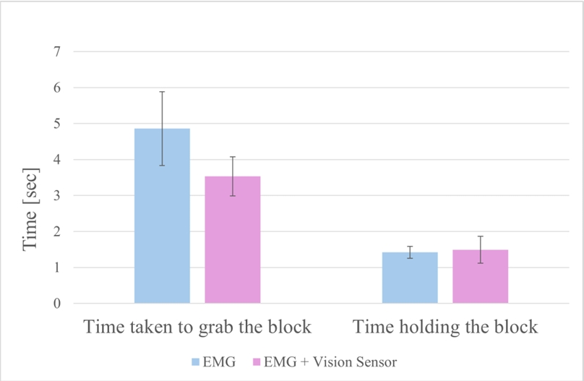
Result
Experiment Result：
①:not having vision sensor average time taken:56.5s
②:having vision sensor average time taken:45.2s
no different in ‘grab holidng’ time,
significant different in ‘try to grab’ time

Slide 10
Summary And Future Plan
Summary：
This research developed a myoelectric hand that combines a vision sensor and an EMG sensor, and design a experiment to validate feasibility of the vision based myoelectric hand.The result provide vision based myoelectric hand is more efficient
Future Plan：
I will continue to explore the application of depth cameras in myoelectric hands basing on senpai’s experiment.
At the same time, I will also try to improve the performance of the myoelectric hand to handle a wider range of motion in daily life scene.

