Slide 1
Development of a Myoelectric Hand Based on Deep Learning
Saga University
Computer Science & Information Techology
25742102 DI XIQING
Professor Osamu Fukuda，Yeoh Wen Liang

Slide 2
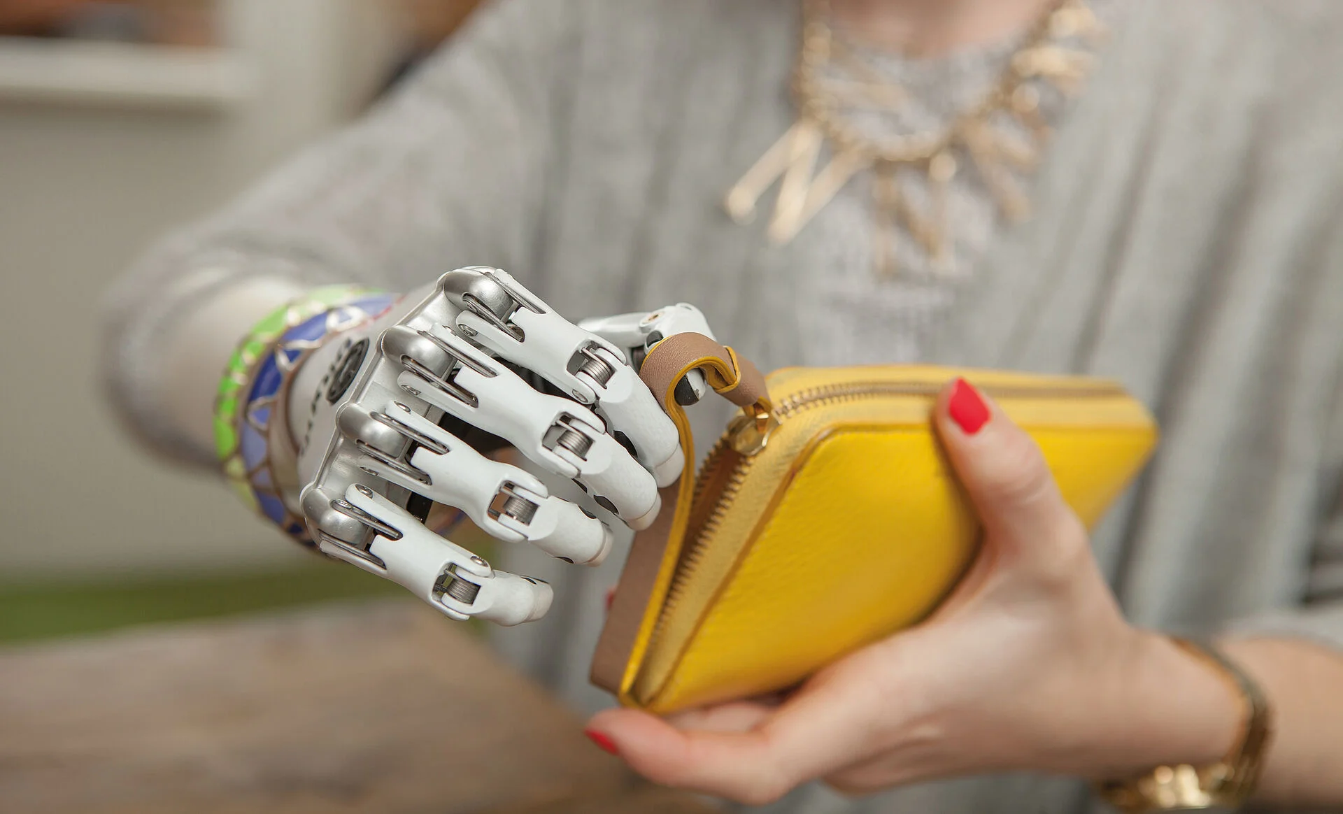
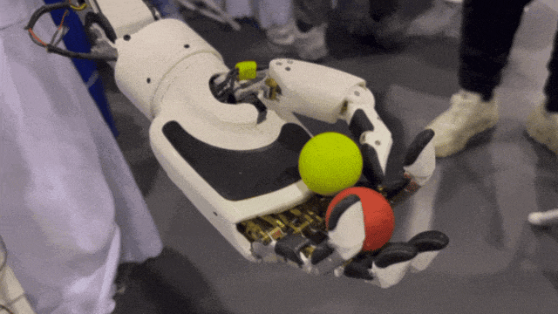
Introduction
According to statistics, as of 2017, there were 577 million people in world who had lost an upper limb[1].
lost an hand not only causes inconvenience in daily life, but also leads to long-term psychological challenges for patients. In many countries it has been recognized as a public health issue.
With advances in robotic hand, human-like robotic hands are entering public view.
They perform more flexible, higher degrees of freedom, and can move as freely as human hands.
real-time signal transmission and accurately recognizing the operator’s intention are also important research directions.
[1] McDonald C L, Westcott-McCoy S, Weaver M R, et al. Global prevalence of traumatic non-fatal limb amputation[J]. Prosthetics and orthotics international, 2021, 45(2): 105-114.

Slide 3
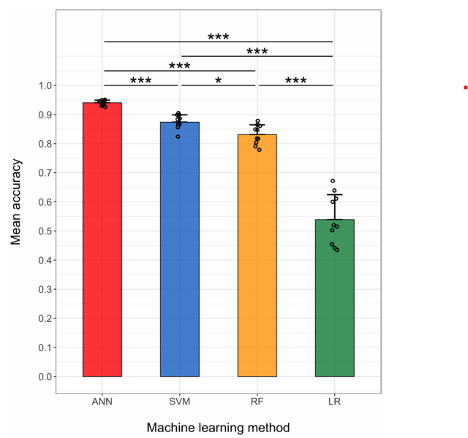
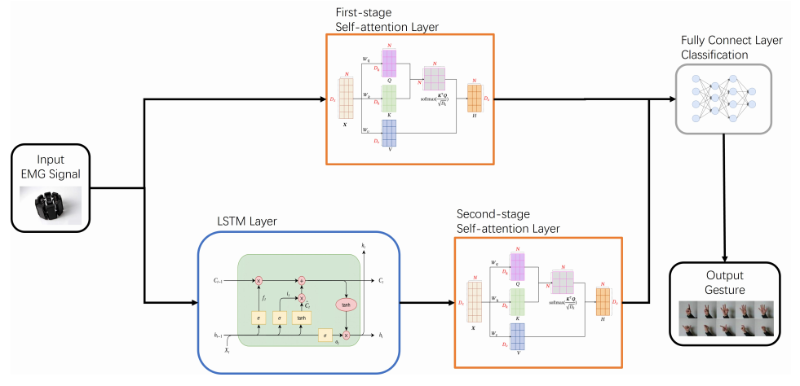
Related research
Lee et al. compared ANN with traditional machine learning algorithms to recognize ten different hand gestures.
The results demonstrate that the accuracy of the ANN is higher than that of traditional machine learning models.
That shows the advantages of neural network algorithms in EMG signal recognition.
[2] Lee K H, Min J Y, Byun S. Electromyogram-based classification of hand and finger gestures using artificial neural networks[J]. Sensors, 2021, 22(1): 225.
Zhang et al. developed an improved LSTM model that achieved high-accuracy recognition of five different movements.
[3] Zhang H, Qu H, Teng L, et al. LSTM-MSA: A novel deep learning model with dual-stage attention mechanisms forearm EMG-based hand gesture recognition[J]. IEEE transactions on neural systems and rehabilitation engineering, 2023, 31: 4749-4759.

Slide 4
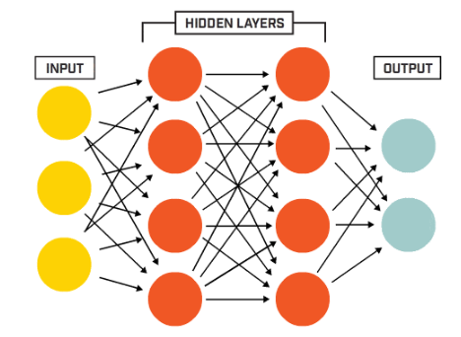
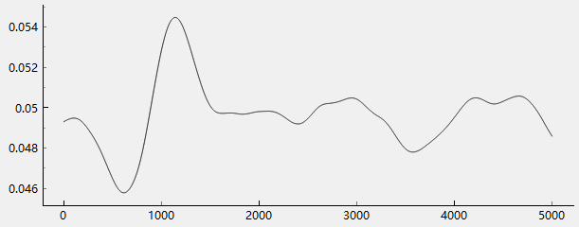
EMG Recognition
LSTM (Long Short-Term Memory)
LSTM is one of the most classic models for processing time-series data, can effectively capture temporal context, it very useful for EMG signal recognition.
Transformer
Transformer is currently a mainstream and widely studied model. In EMG recognition, it can learn the correlations among channels, which is expected to significantly improve the accuracy for a large number of gesture classes.
MLP
As one of the most basic models in deep learning, MLP cannot directly handle time-series data. However, by manually extracting features from the signals and feeding them into the model, it can still be used for recognition.
EMG signal is time-series data, It appears as a waveform in time axis.

Slide 5
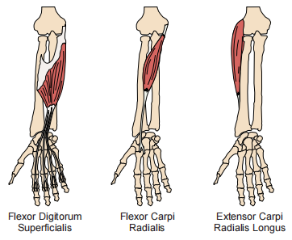
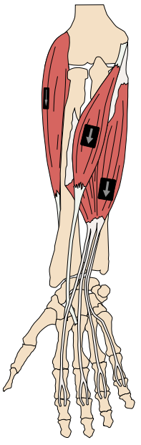
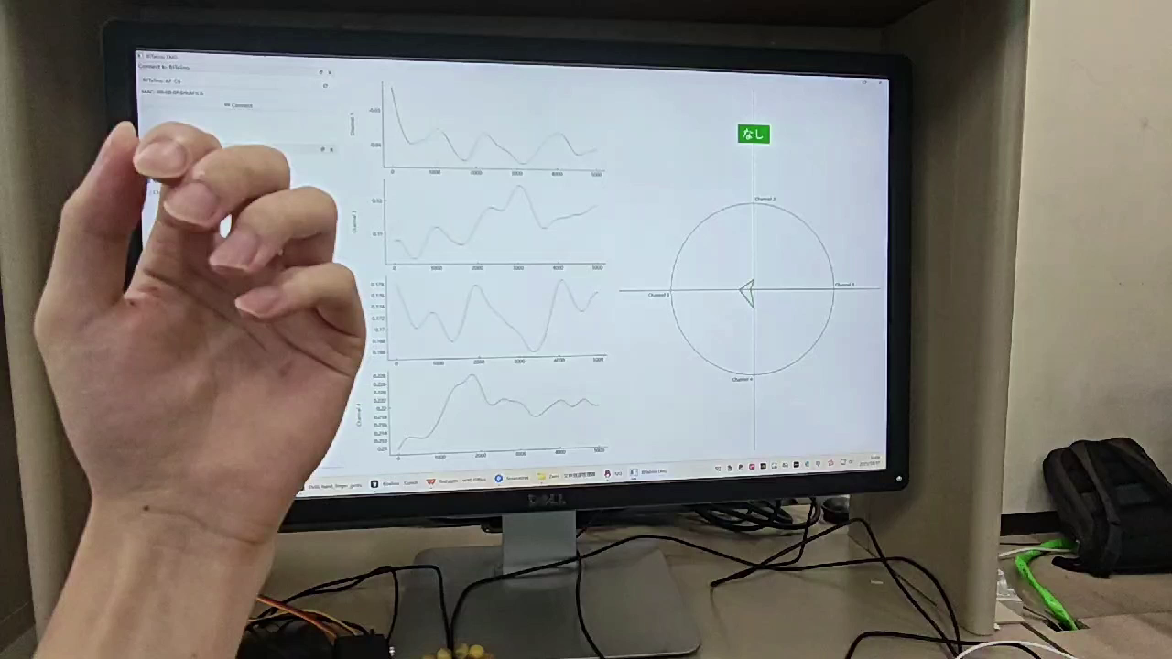


Electrode Placement
The placement of electrodes is important. Their purpose is to measure the activation of a specific muscle during a particular movement; therefore, they should be placed over the muscle responsible for that movement and avoid overlapping signals from multiple muscles.
Example : Extensor Carpi Radialis Longus(ECRL)
️
Open hand
Close hand
Wrist extension
Wrist flexion

Slide 6
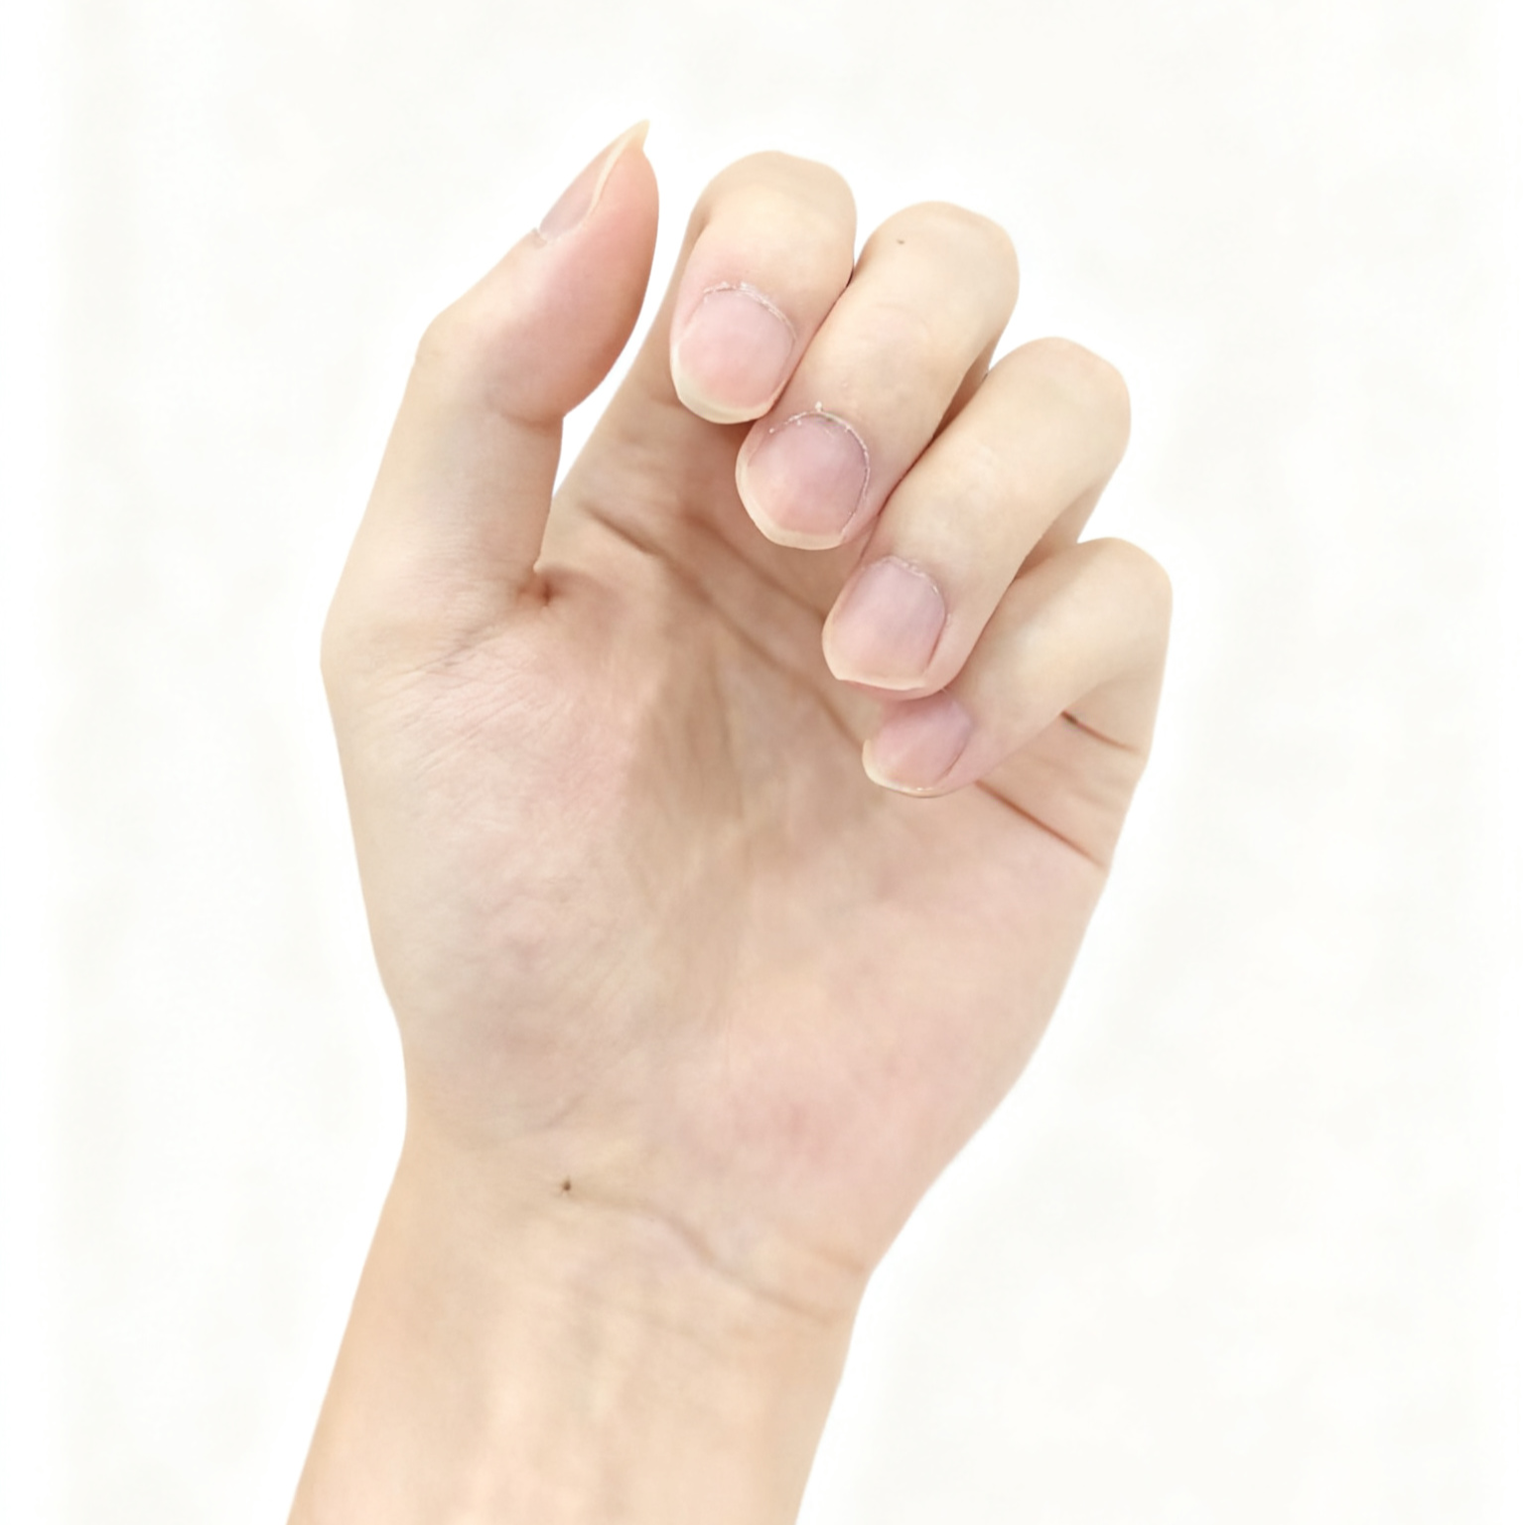
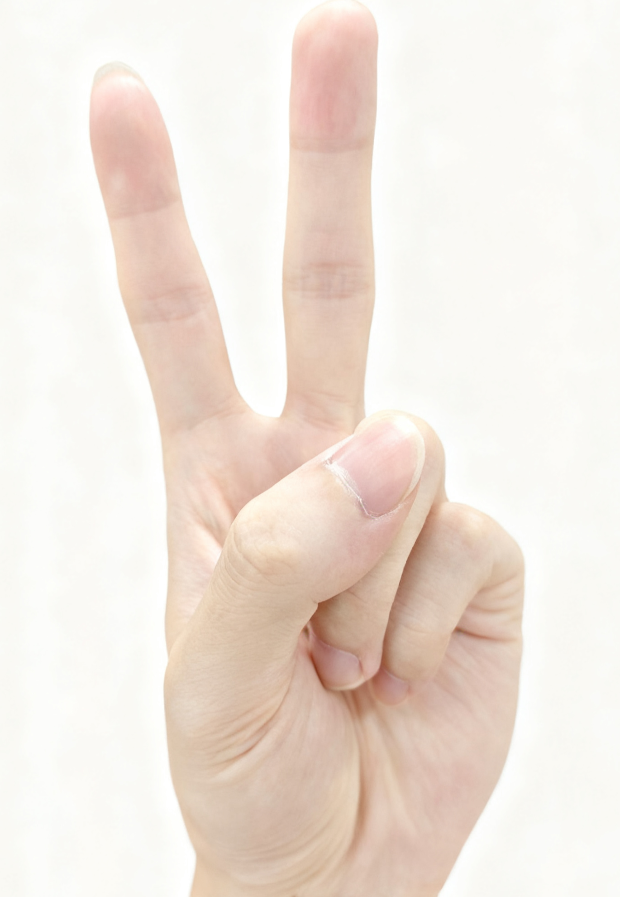
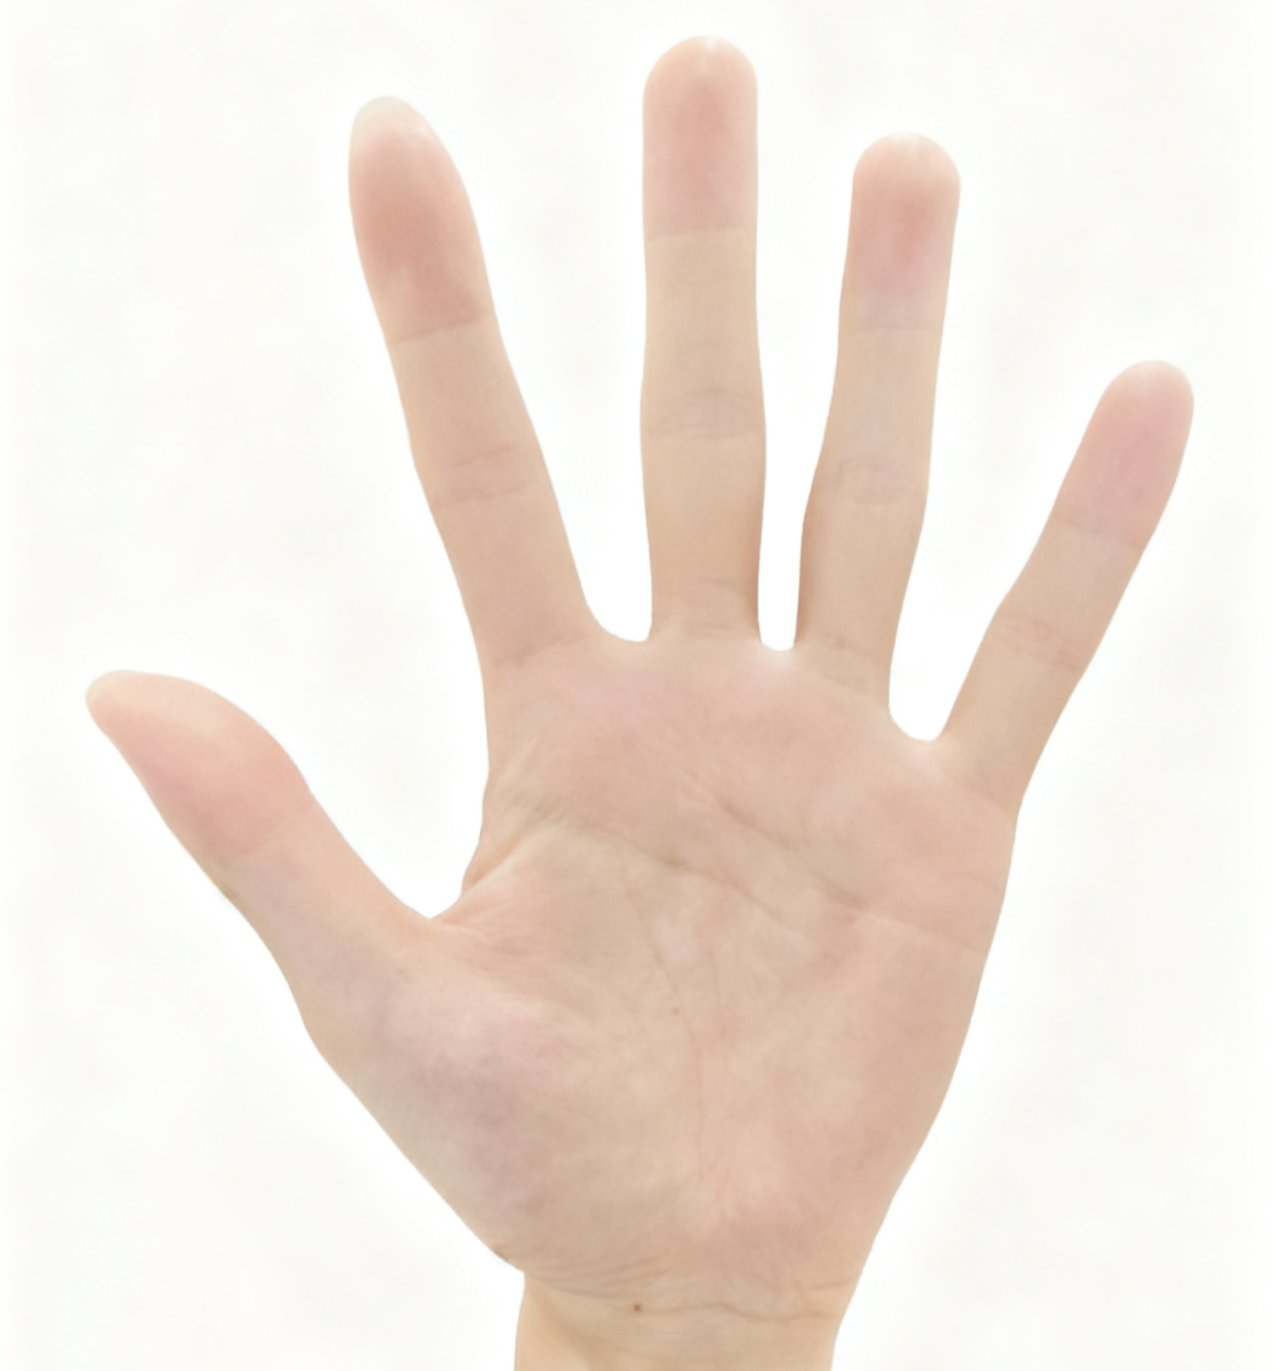
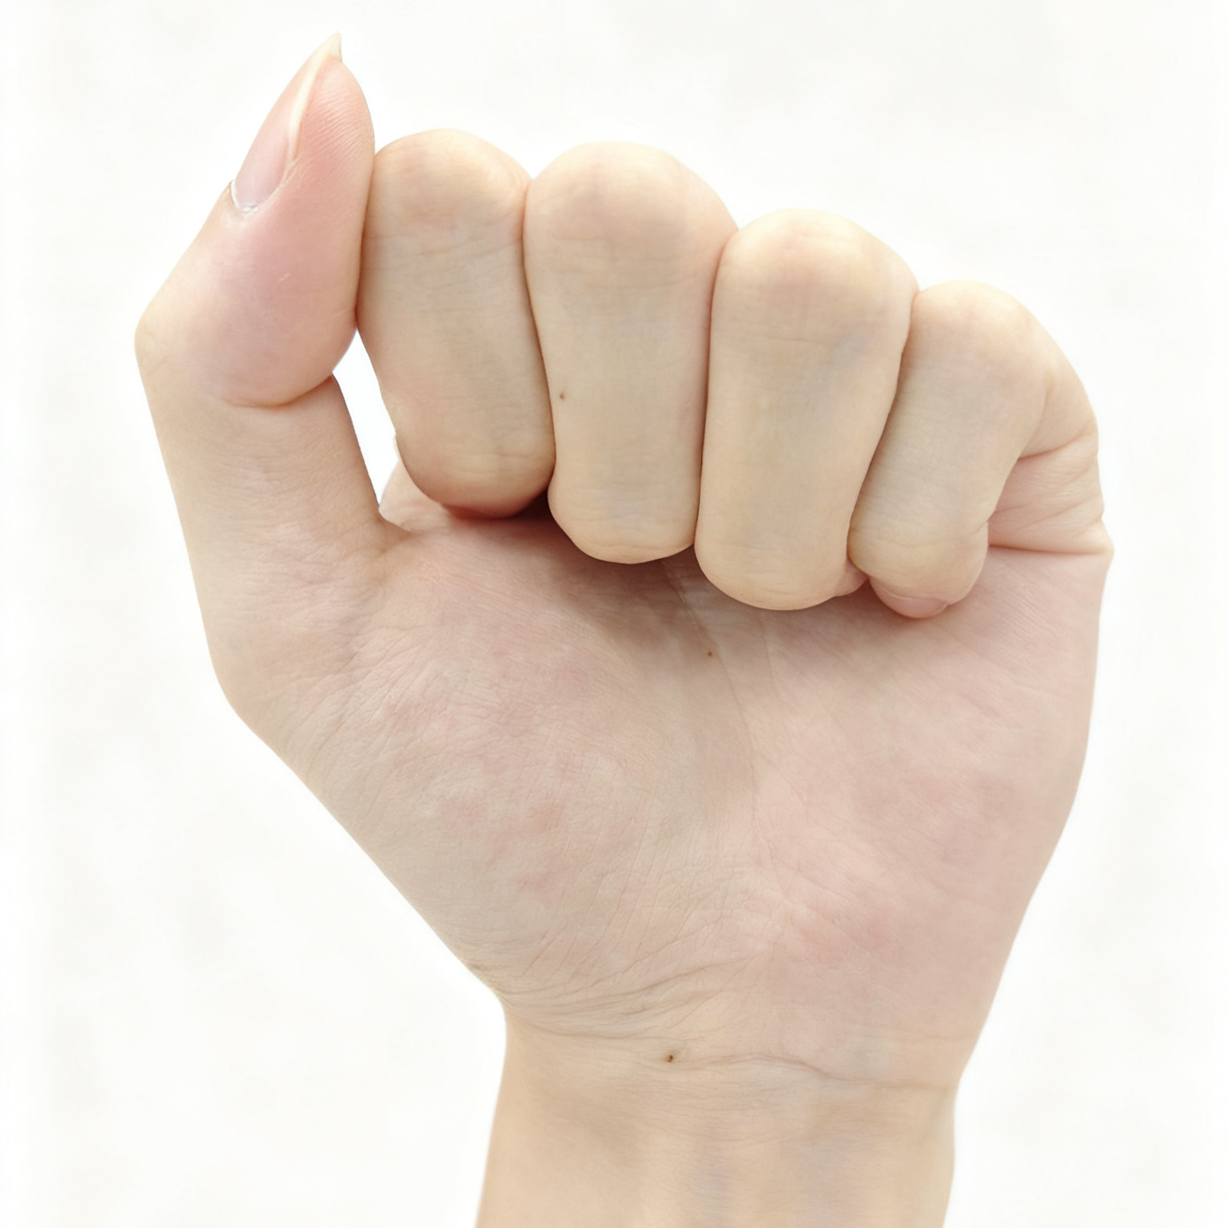
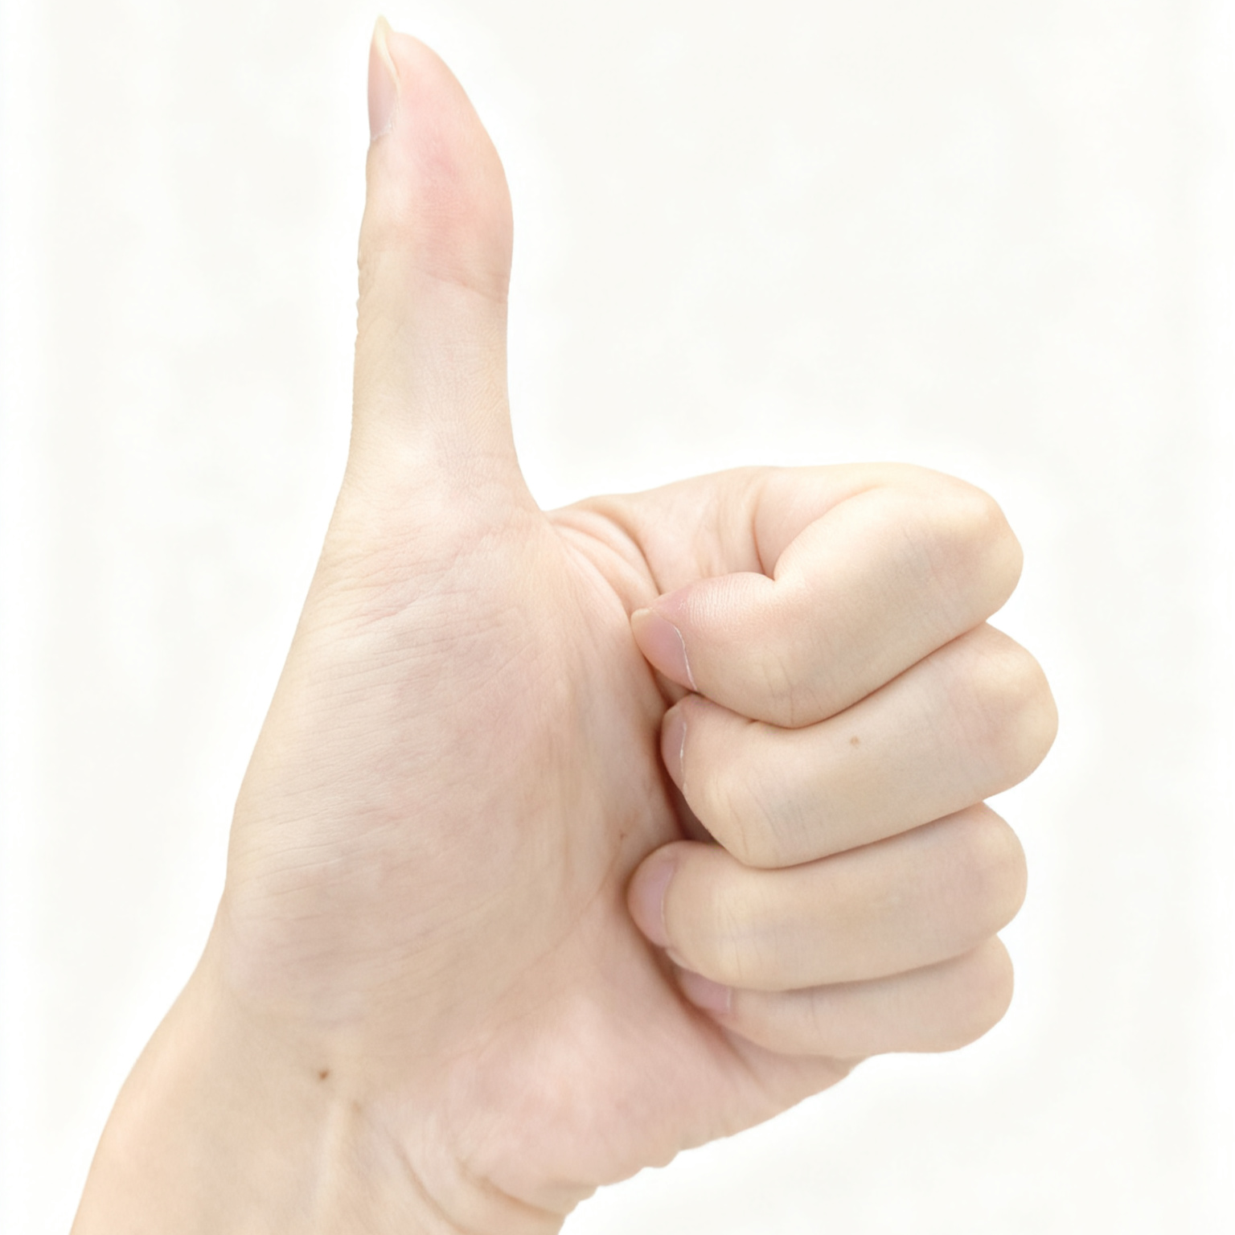
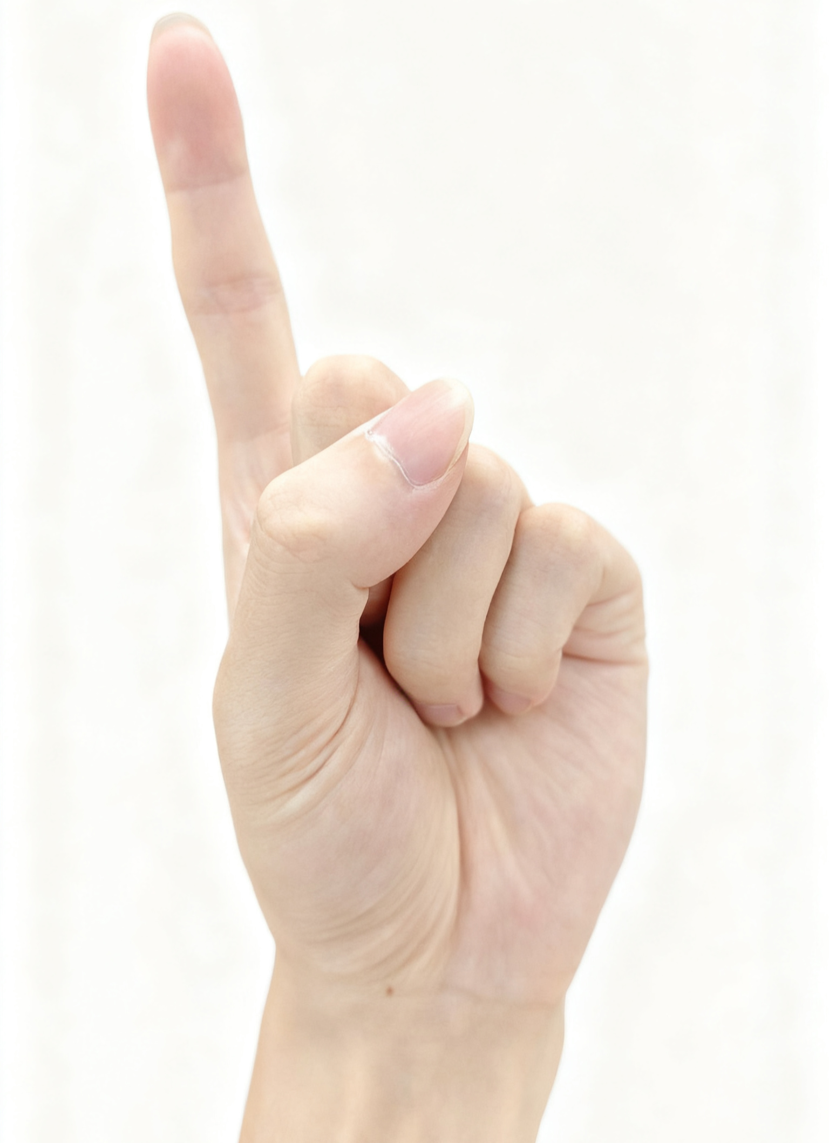
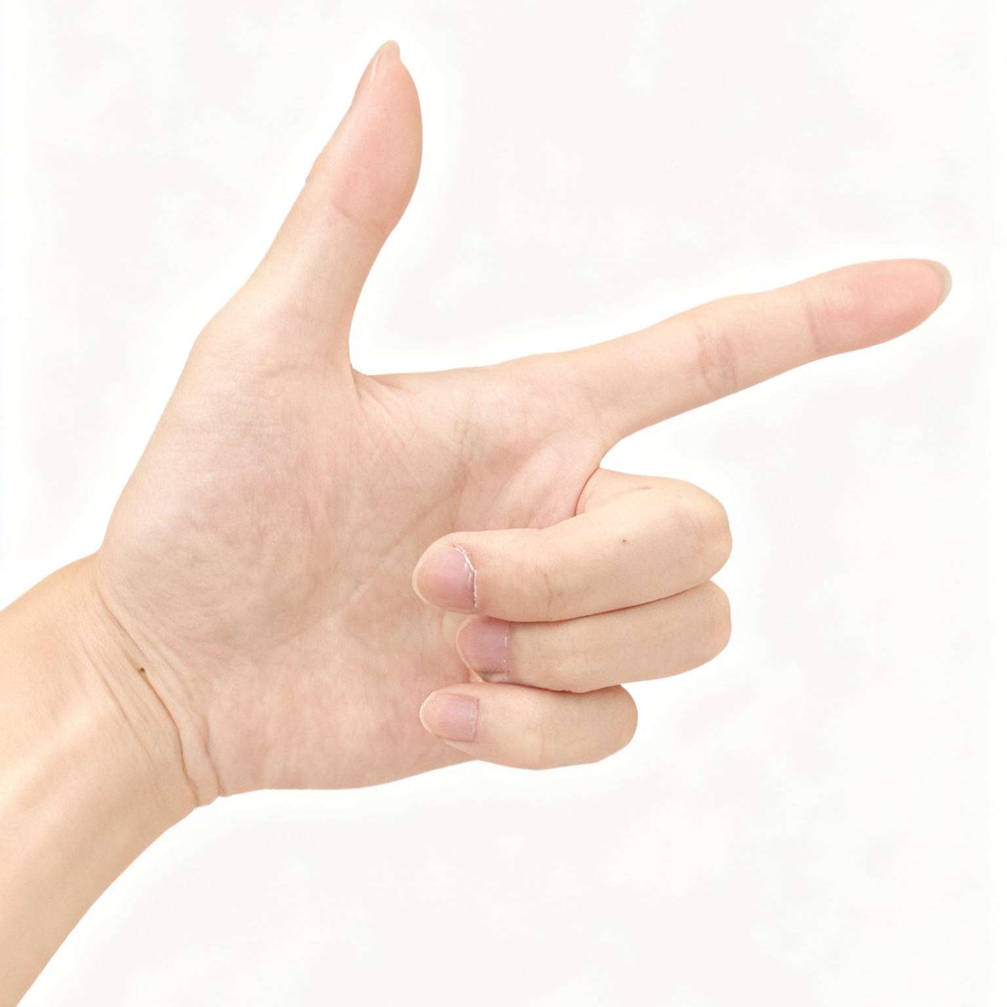
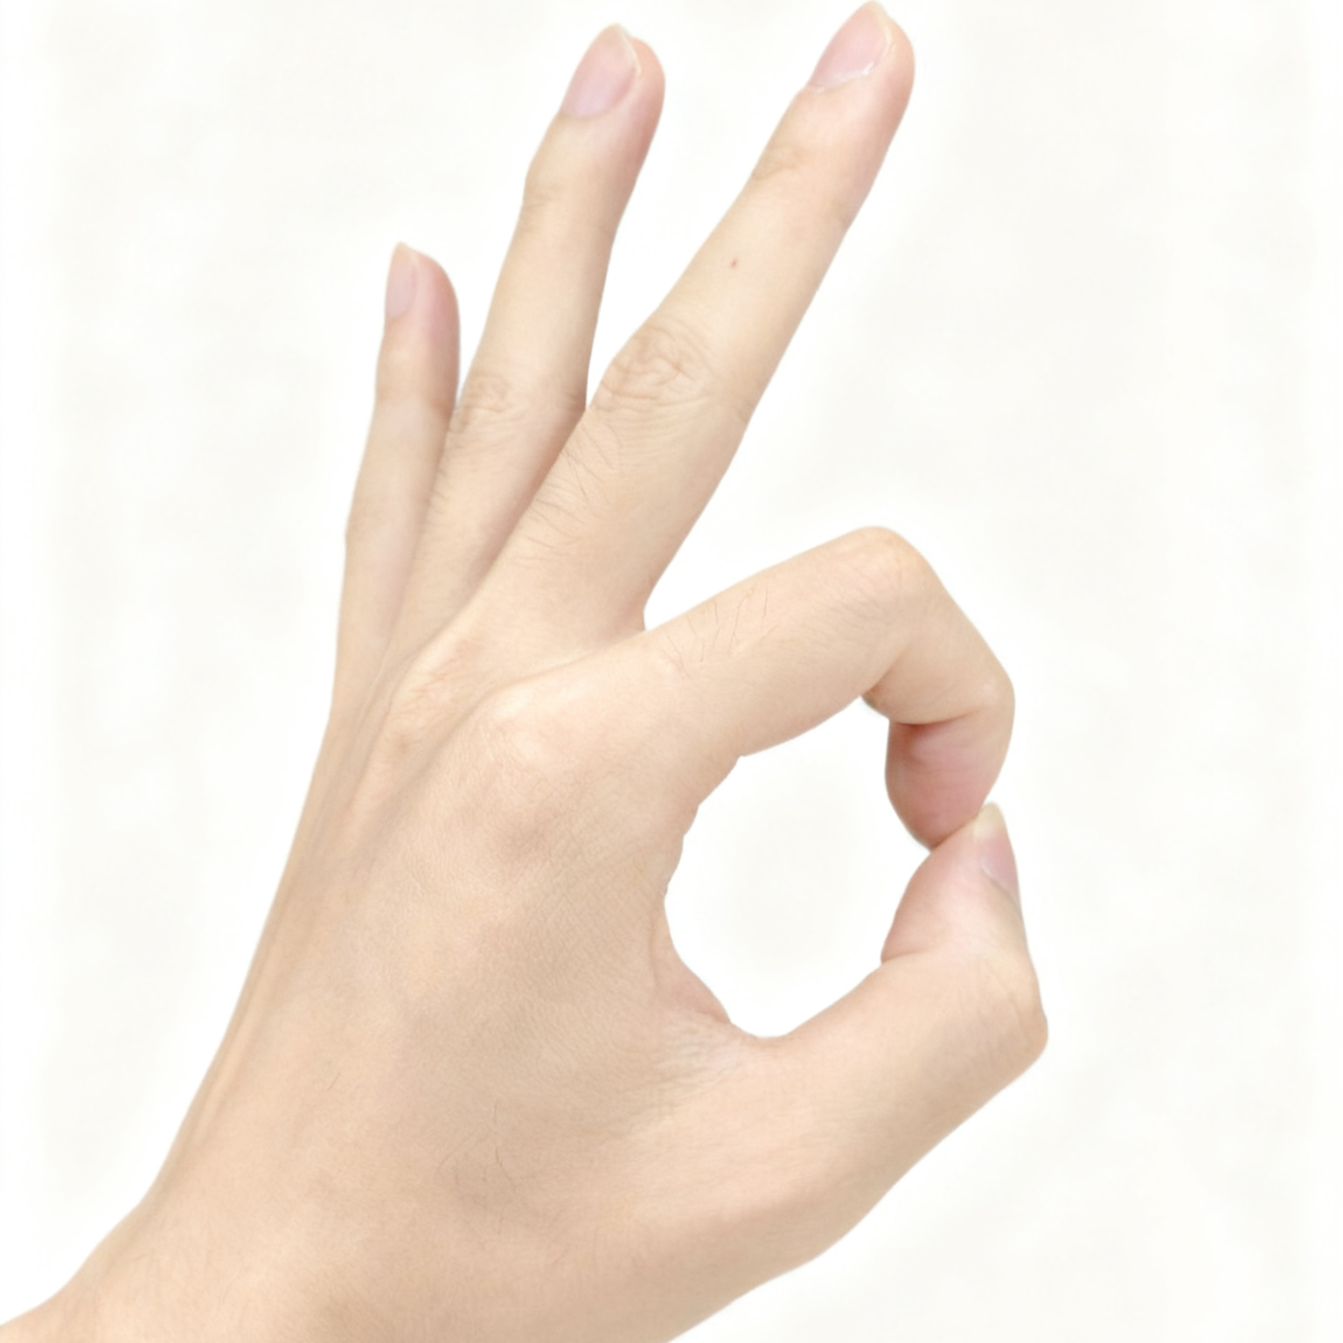

Electrode Placement
Abductor Pollicis Longus (APL): Shows significant activation when the thumb is extended
Extensor Indicis (EI): Shows significant activation when the index finger is extended
Extensor Digitorum (ED): Shows significant activation when the index, middle, and ring fingers are extended
Flexor Digitorum Superficialis (FDS): Shows clear activation when the index, middle, and ring fingers are flexed
Gesture
Rest
Two
Paper
Rock
Good
One
Gun
Ok

Slide 7
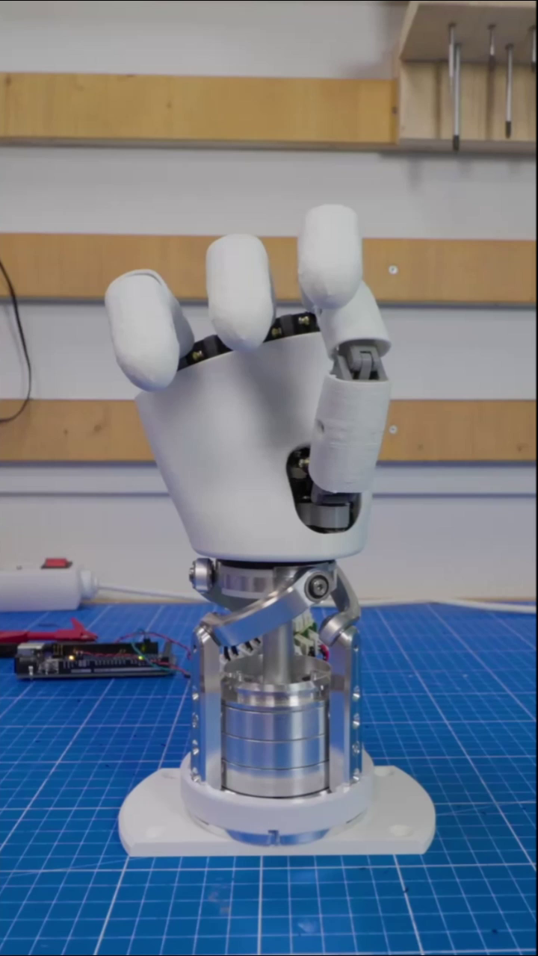
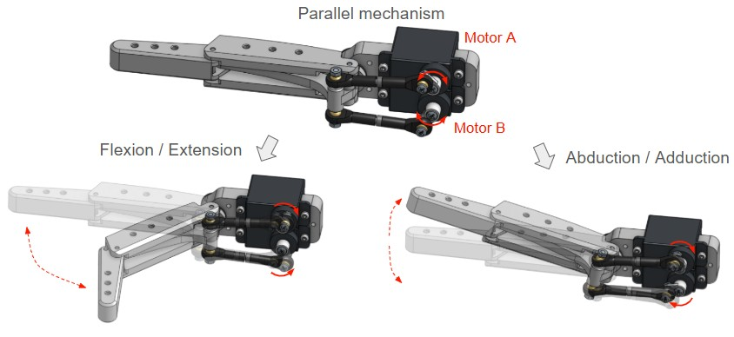
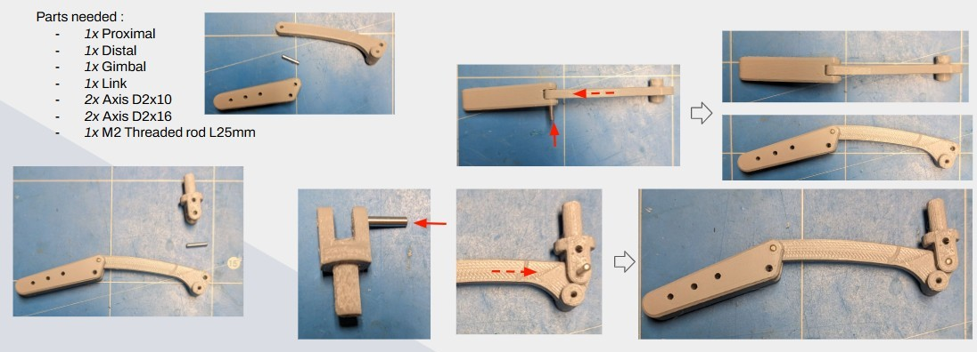
3D-printed robotic hand
AmazingHand (open-source robotic hand)
4 fingers, 2 phalanxes per finger, total 8 degrees of freedom.

Slide 8
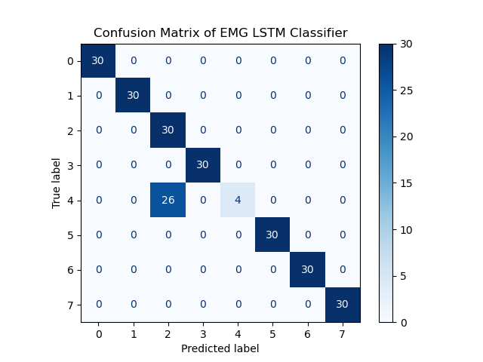
Experiment
To compare the performance and characteristics of different models and select the one most suitable for practical applications, I designed an experiment inviting 3 adult males and 3 adult females as participants.
The participants were required to perform all the gestures, and the corresponding EMG signals were recorded as test data. The data of each participant were input into each model to evaluate the test accuracy of each model. The participants also performed real-time recognition tasks to test potential issues that may arise in actual use.
Result
Currently, I’m only testing a LSTM model, not applying it to real-time recognition yet. The confusion matrix shows that LSTM works well for EMG signal recognition, but gesture 4 (rock) is often misclassified as OK. This part needs further understanding and optimization.

Slide 9
Summary
In this research, multiple deep learning models will be developed and applied to EMG signal recognition with the goal of achieving real-time high accuracy. Using an open-source anthropomorphic robotic hand as the foundation, a robotic hand will be assembled, and the real-time EMG recognition program will be integrated to enable real-time control. Experiments involving multiple participants will be conducted to evaluate the overall performance and usability of the system.
Future Plan
it may be necessary to continuously optimize the robotic hand to make it more flexible, reduce latency, and improve the convenience of EMG signal acquisition. When the robotic hand becomes stable, I plan to design more movement based on real-life scenarios. In addition, more sensors will be added to the hand to enhance its perception of the environment.

