Slide 1
Real-Time Prosthetic Hand Control Based on Bimodal Fusion of Vision and EMG
Saga University
Computer Science & Information Techology
25742102 DI XIQING
Professor Osamu Fukuda，Yeoh Wen Liang

Slide 2

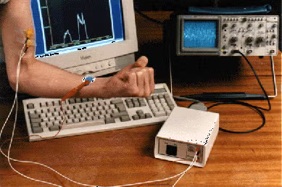


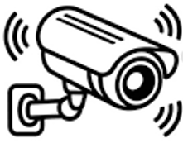


Introduction
577 million people in world
who had lost an upper limb[1].
Electromyographic (EMG) signal：
  Generated during muscle contraction
  Reflect motor intent
  EMG features in different movements have overlap
Environment perception by the vision sensor
Reflect motor intent by EMG sensor
[1] McDonald C L, Westcott-McCoy S, Weaver M R, et al. Global prevalence of traumatic non-fatal limb amputation[J]. Prosthetics and orthotics international, 2021, 45(2): 105-114.

Slide 3
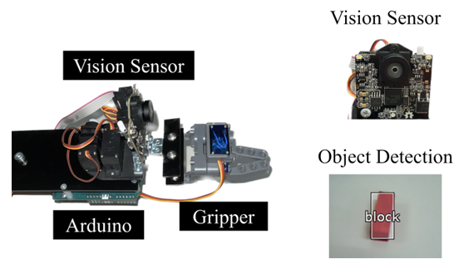
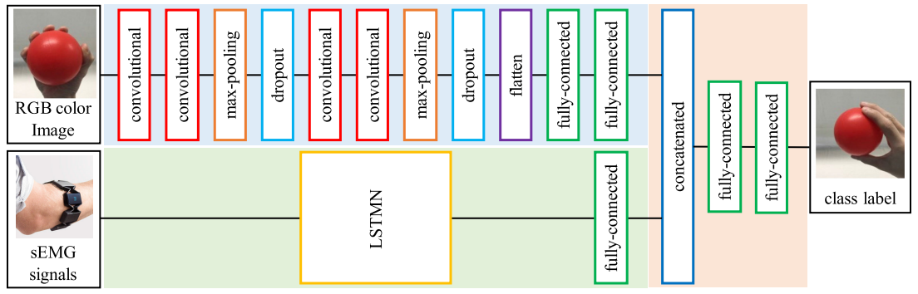
Previous Research
use vision sensor to tracks targets
can running in real time
implement the grab movement
but visual information was not used for movement recognition
System achieved high accuracy recognition
But, not applied in real world scenarios, not real time
[2] Fukuda O, Sakaguchi D, He Y, et al. Bimodal control of a vision-based myoelectric hand[J]. IEEE Access, 2021, 9: 98369-98380.

Slide 4
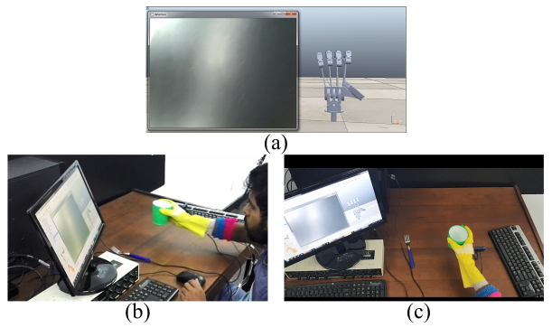
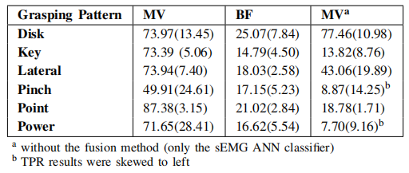
Related research
Real-time fusion system combining vision and EMG
Use a Majority Vote algorithm, which reduced latency and achieved real-time.
But, the Majority Vote algorithm does not take advantage of neural networks, so its accuracy still needs improvement.
[3] Perera D M, Madusanka D G K. Vision-EMG fusion method for real-time grasping pattern classification system[C]//2021 Moratuwa Engineering Research Conference (MERCon). IEEE, 2021: 585-590.

Slide 5
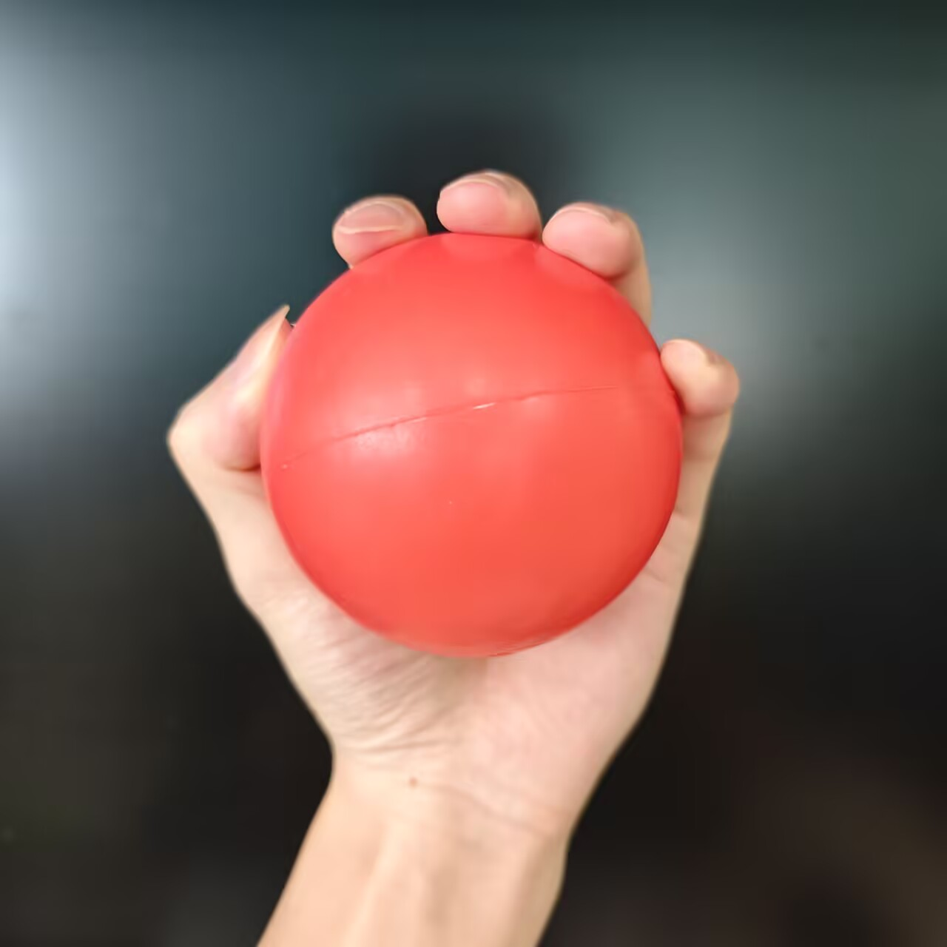
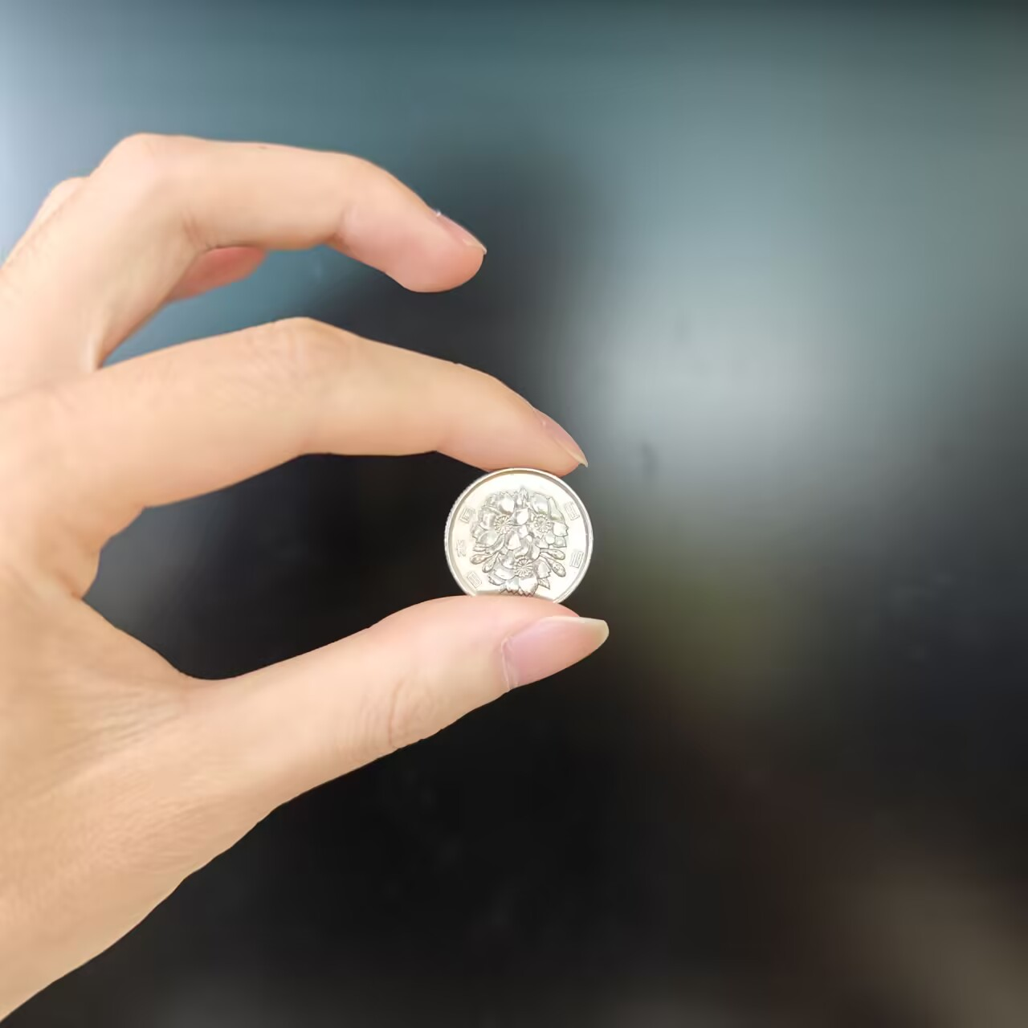
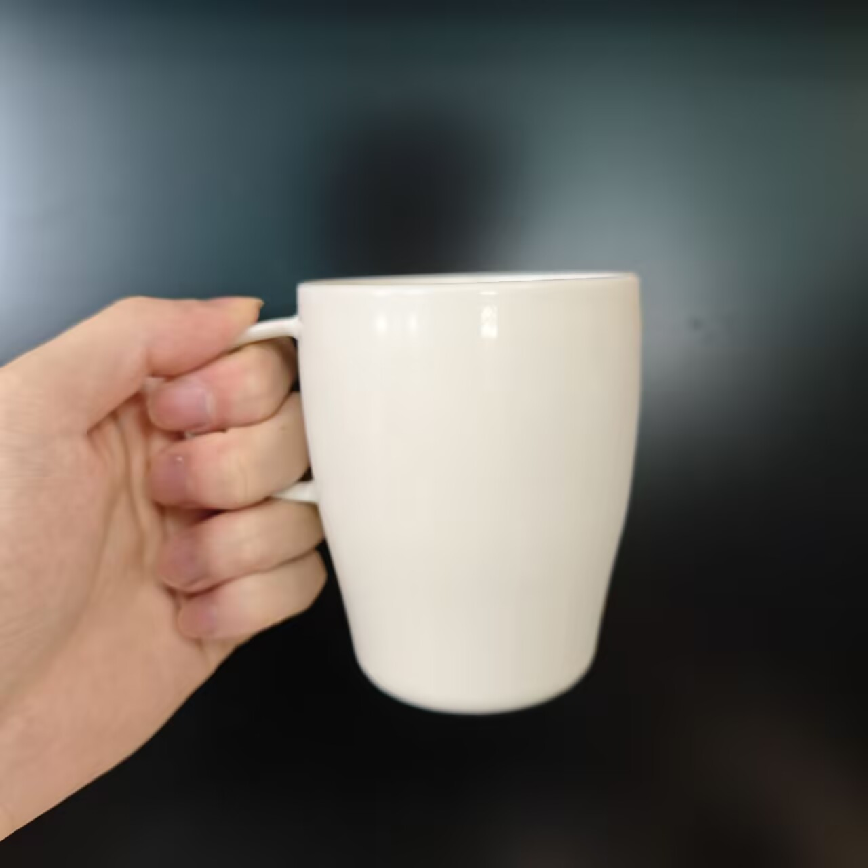
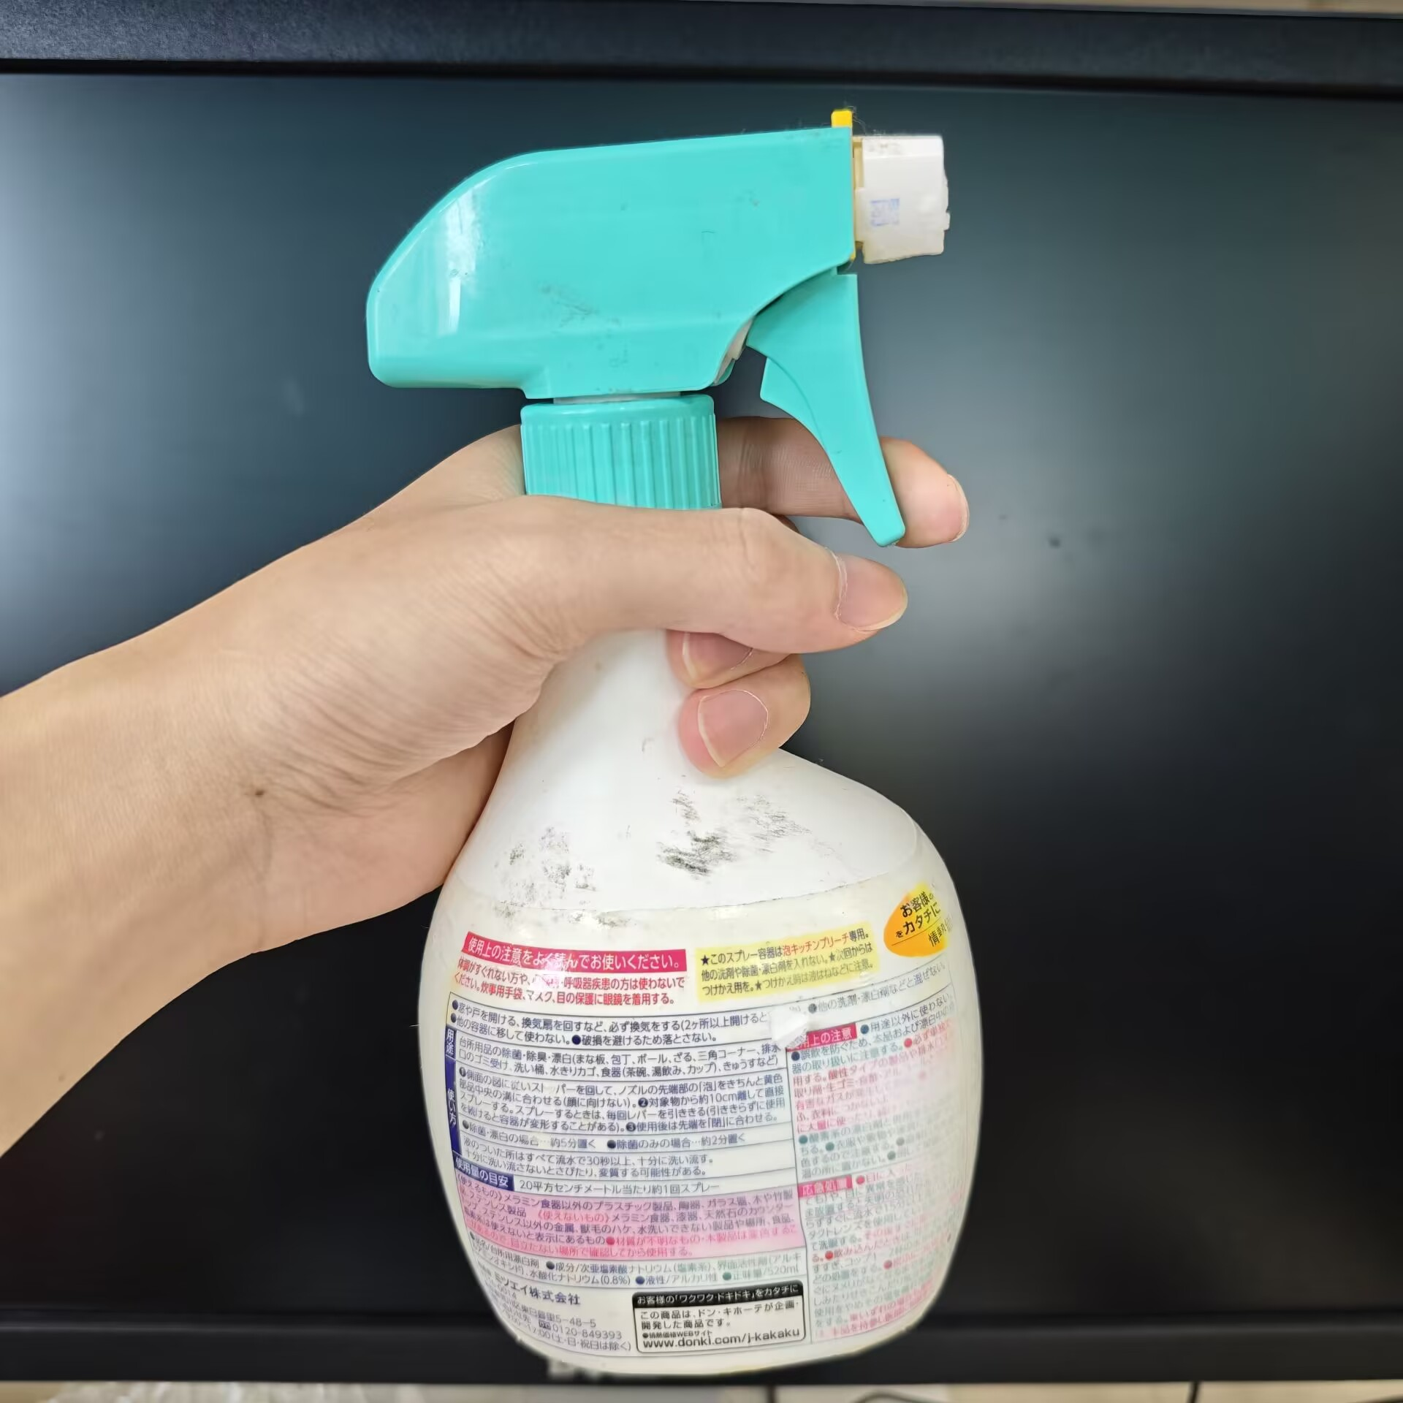
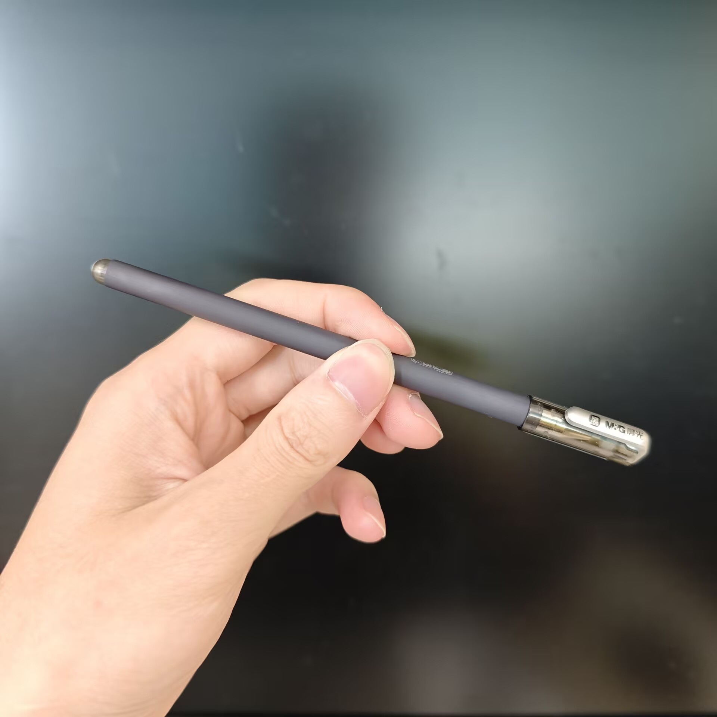
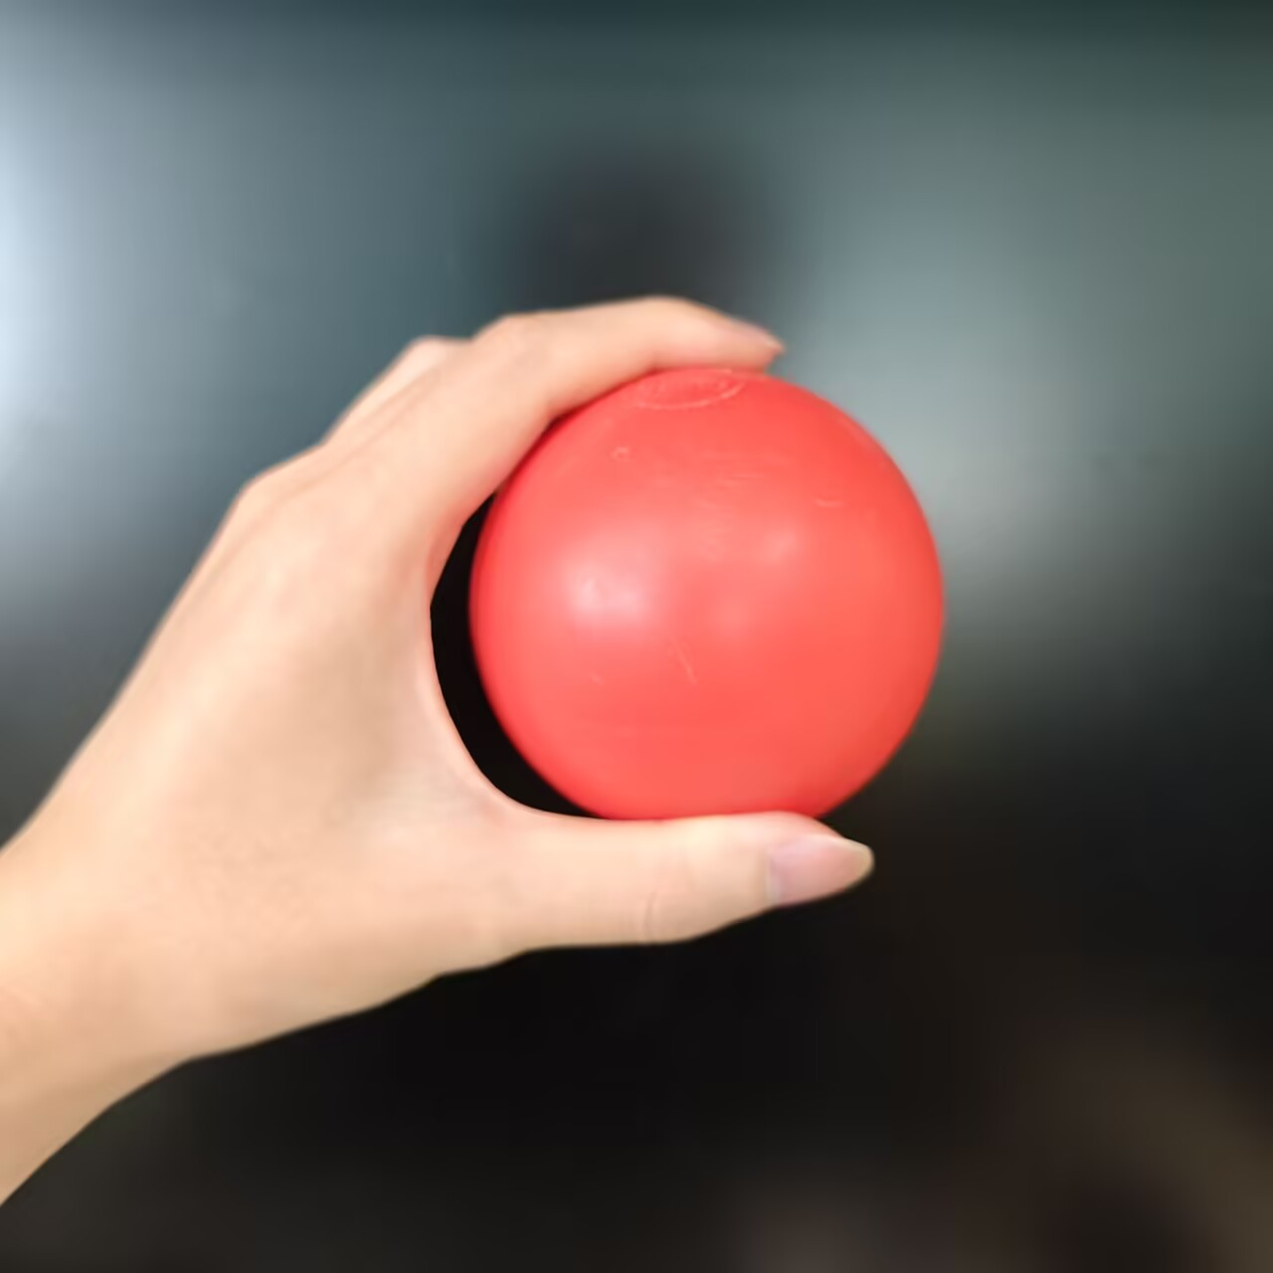
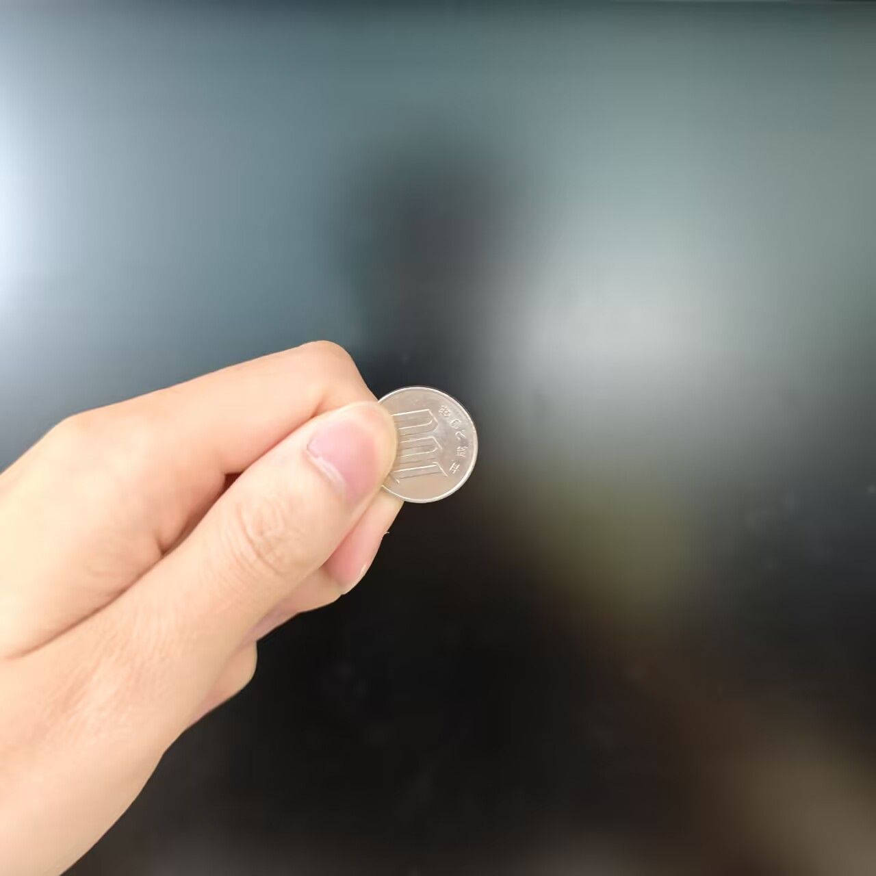
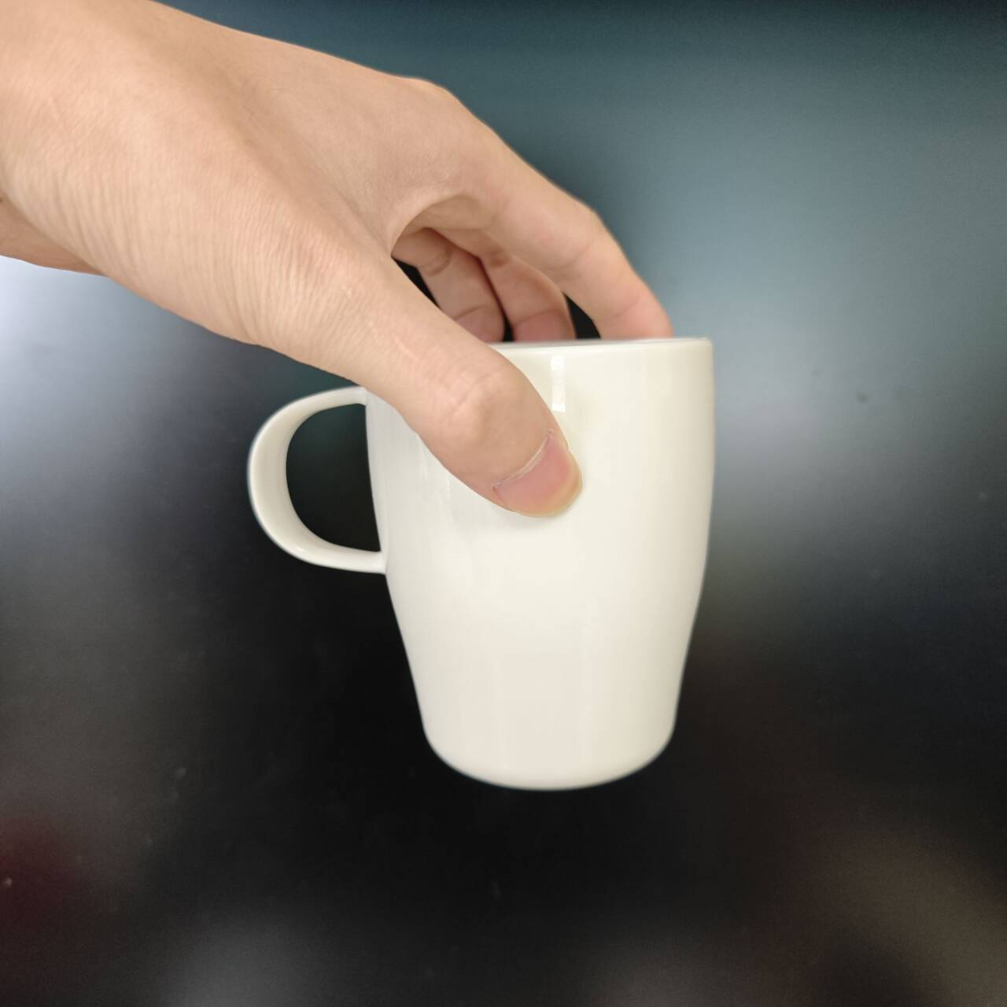
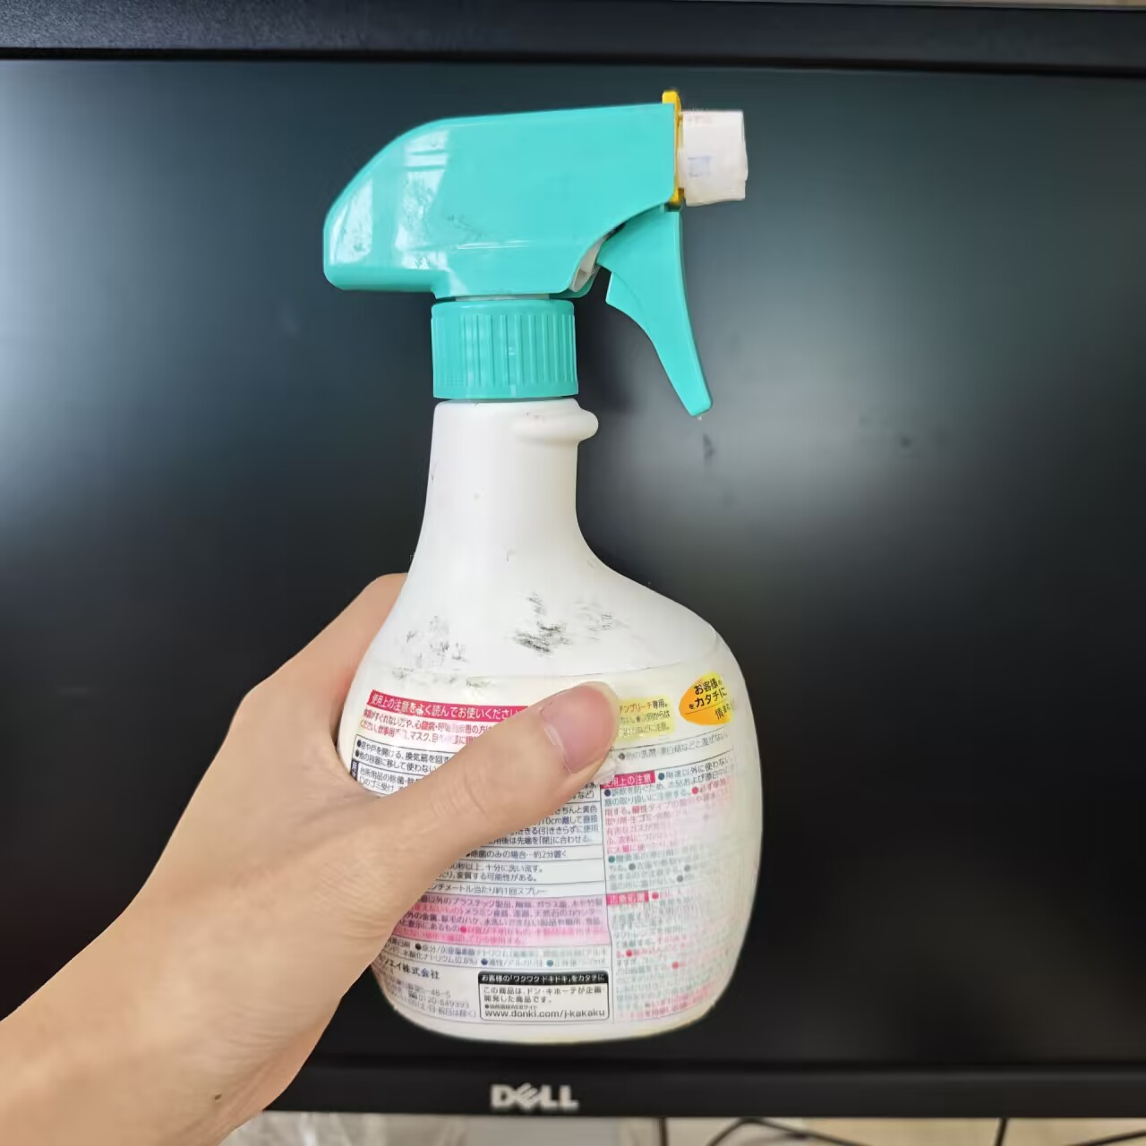
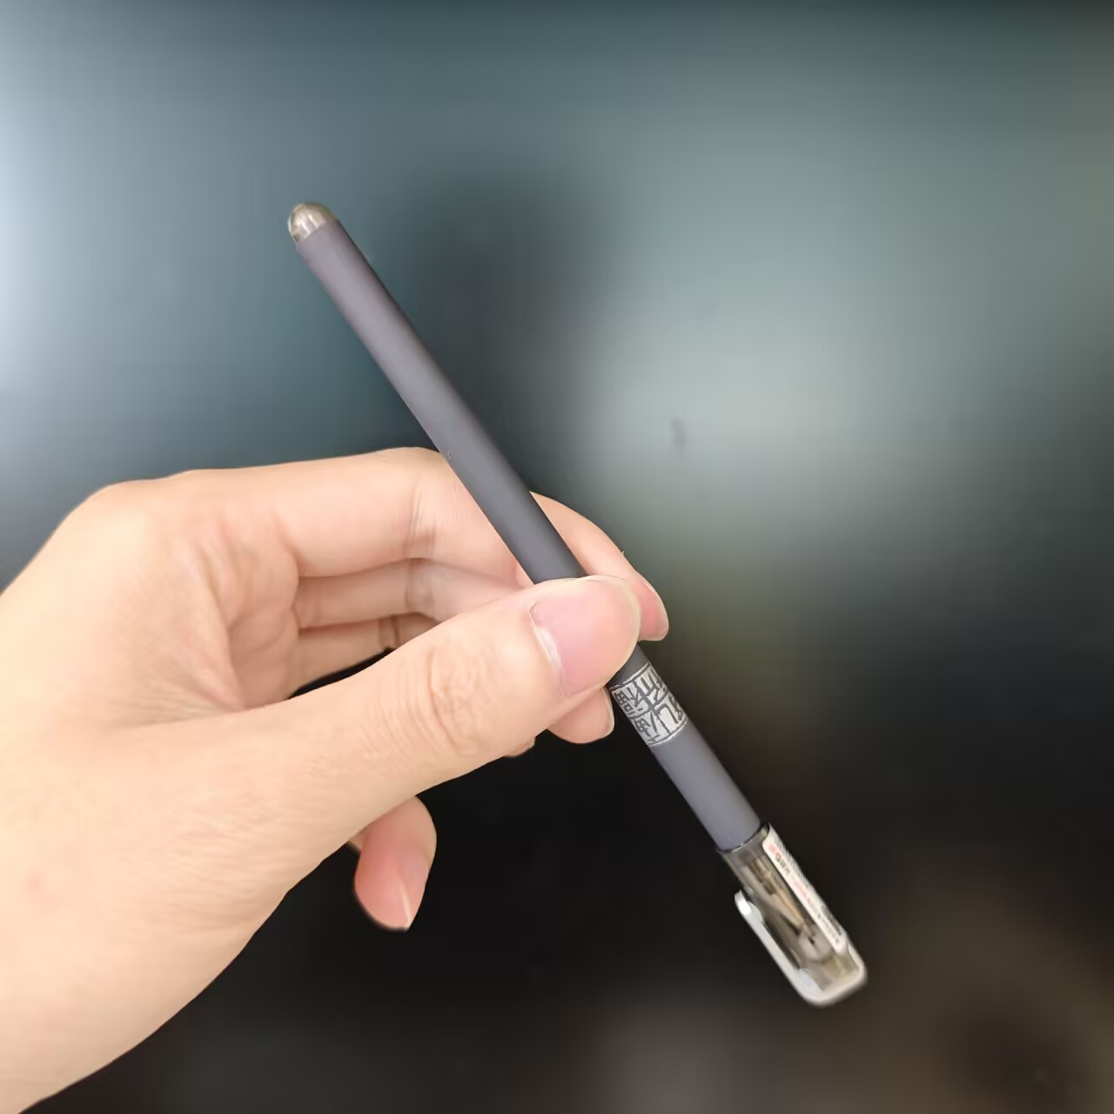
Research Goals
Based on previous researchs, develop a real-time bimodal control system
Real-time recognition in real-world scenarios
A light network that can run in real time on the Consumer-grade GPU
Maintains high accuracy in real-world scenarios
Recognize 10 gestures for 5 types of objects.

Slide 6
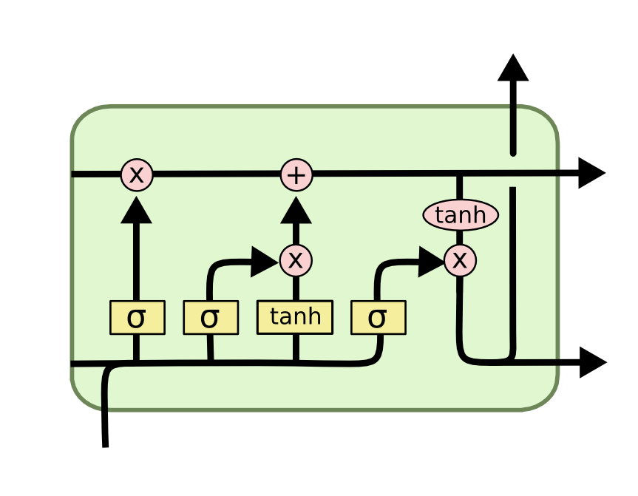
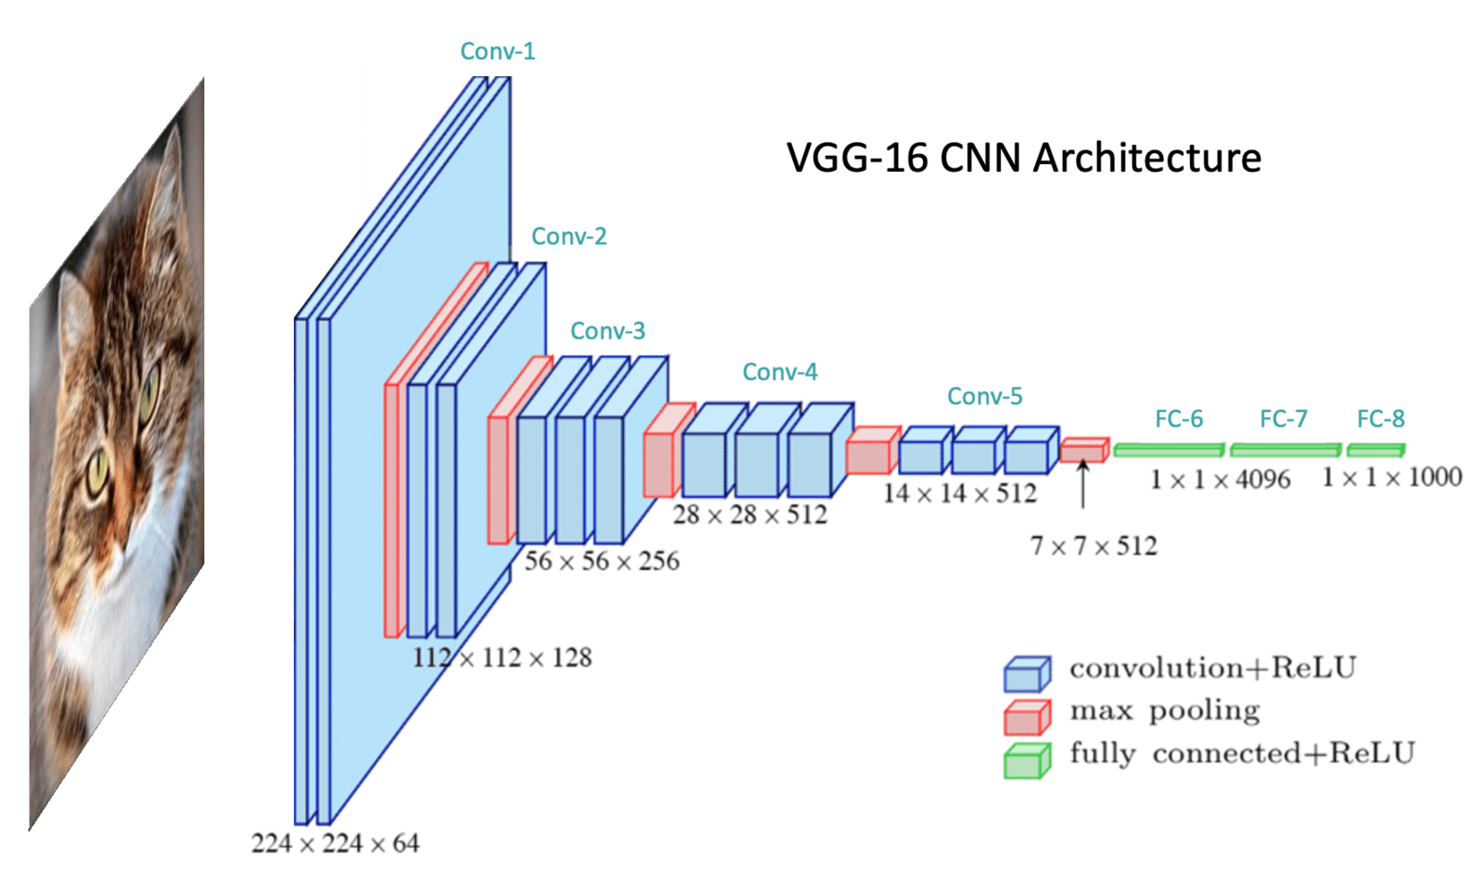
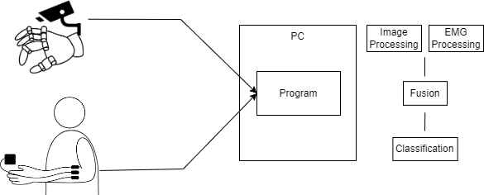
System flow
Light CNN
Light LSTM

Slide 7

Preliminary Experiment
Objective :
Preliminarily verify the feasibility of the system.
Condition :
Use a part of the dataset for testing.
Experiment
Objective :
Verify the system’s accuracy.
Participants :
5 males and 5 females.
Condition :
Five objects are placed in the scene in a random order.
For each object, two corresponding gestures are randomly selected and instructed to the participant.
Recognizing all five objects once is defined as one round.
In the second round, the objects are again placed in a random order, but the gestures selected is the one not chosen in the first round.

Slide 8
Summary
In this research, i will build a real-time bimodal fusion system. The main goal is to expand the range of gesture recognition while ensuring real-time performance. And, i will conduct a experiments to verify the feasibility of the proposed system.
Future Plan
In future work, I plan to implement the robotic hand structure using 3D print and integrate it into the system. At the same time, I will expand more gesture types that used in daily life. other sensors may also be introduced as auxiliary interfaces.

