Slide 1
Prosthetic Hand Control Based on Muscle
Synergy
Saga University
Computer Science & Information Techology
25742102 DI XIQING
Professor Osamu Fukuda，Yeoh Wen Liang

Slide 2
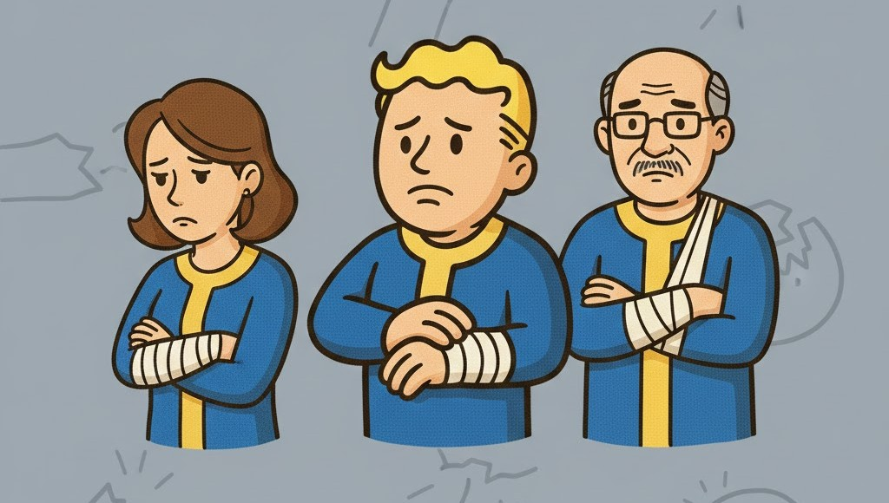
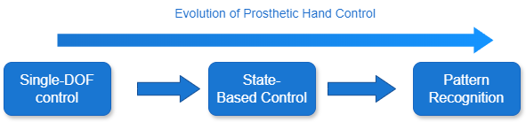
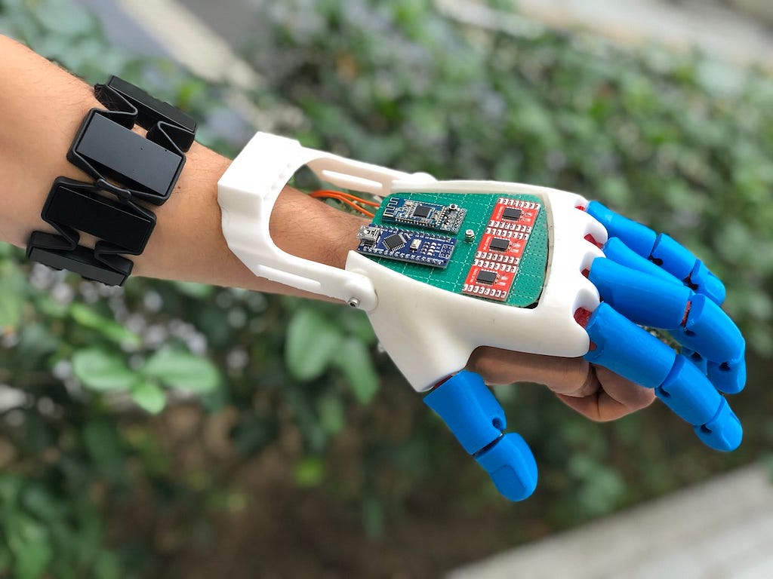

Background
577 million people in world
who had lost an upper limb.
Challenges
The required training dataset increases.
Need to collect EMG signals for all motion in advance.
Re-collection and retraining are required when improve.

Slide 3
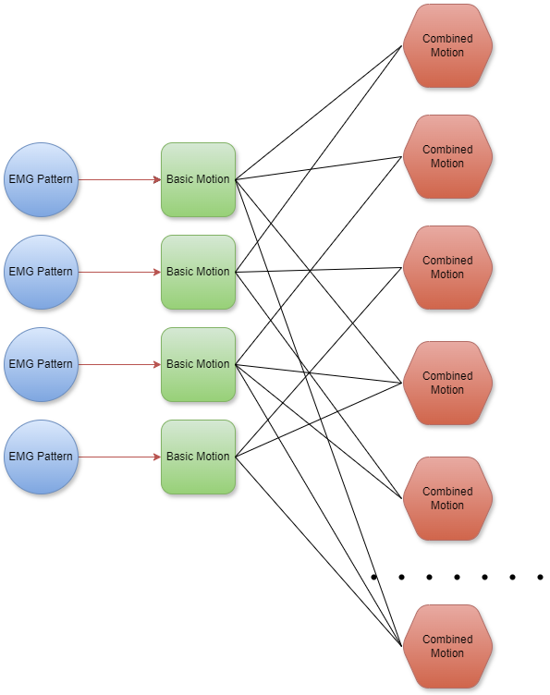
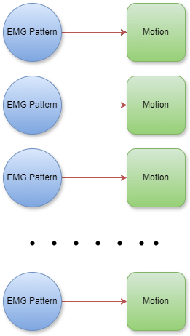
Differences in recognition methods
Pattern Recognition：
Muscle Synergy Combine：

Slide 4

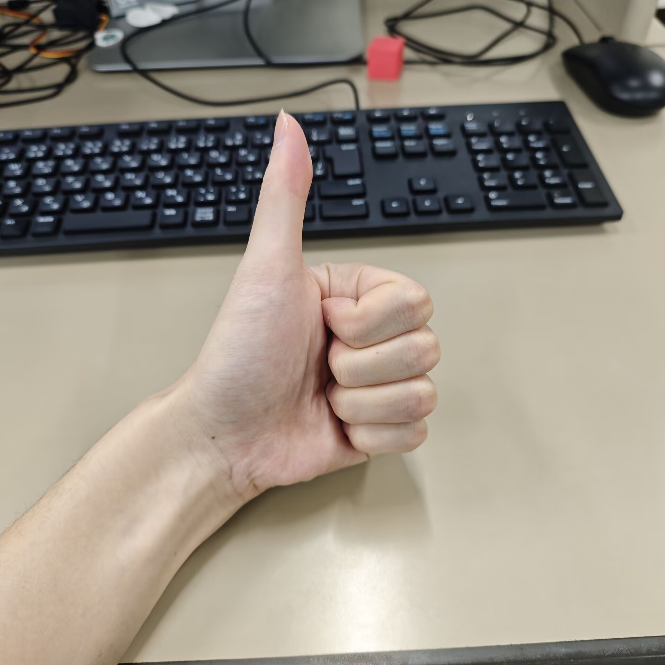
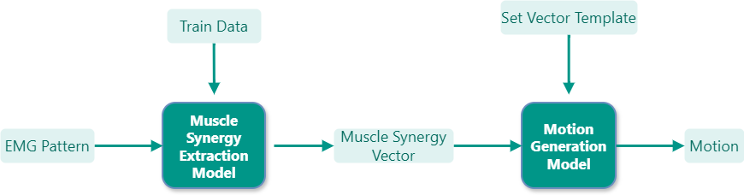
Muscle Synergy Vector
Example
M1:Thumb
M2:Index Finger
M3:Middle Finger
M4:Ring&Little
[0.05, 0.31, 0.31, 0.33]
Flowchart

Slide 5
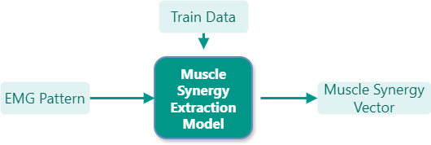

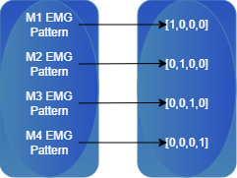
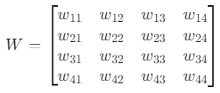


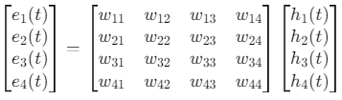
Muscle Synergy Extraction Model
Mapping Relationship
Transformation Formula

Slide 6
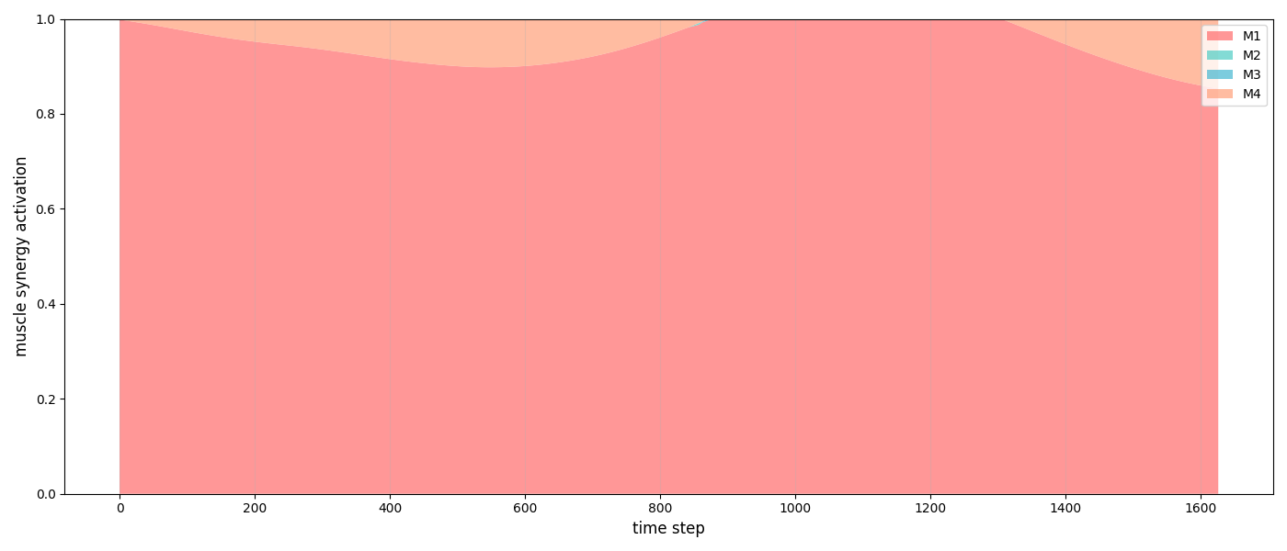
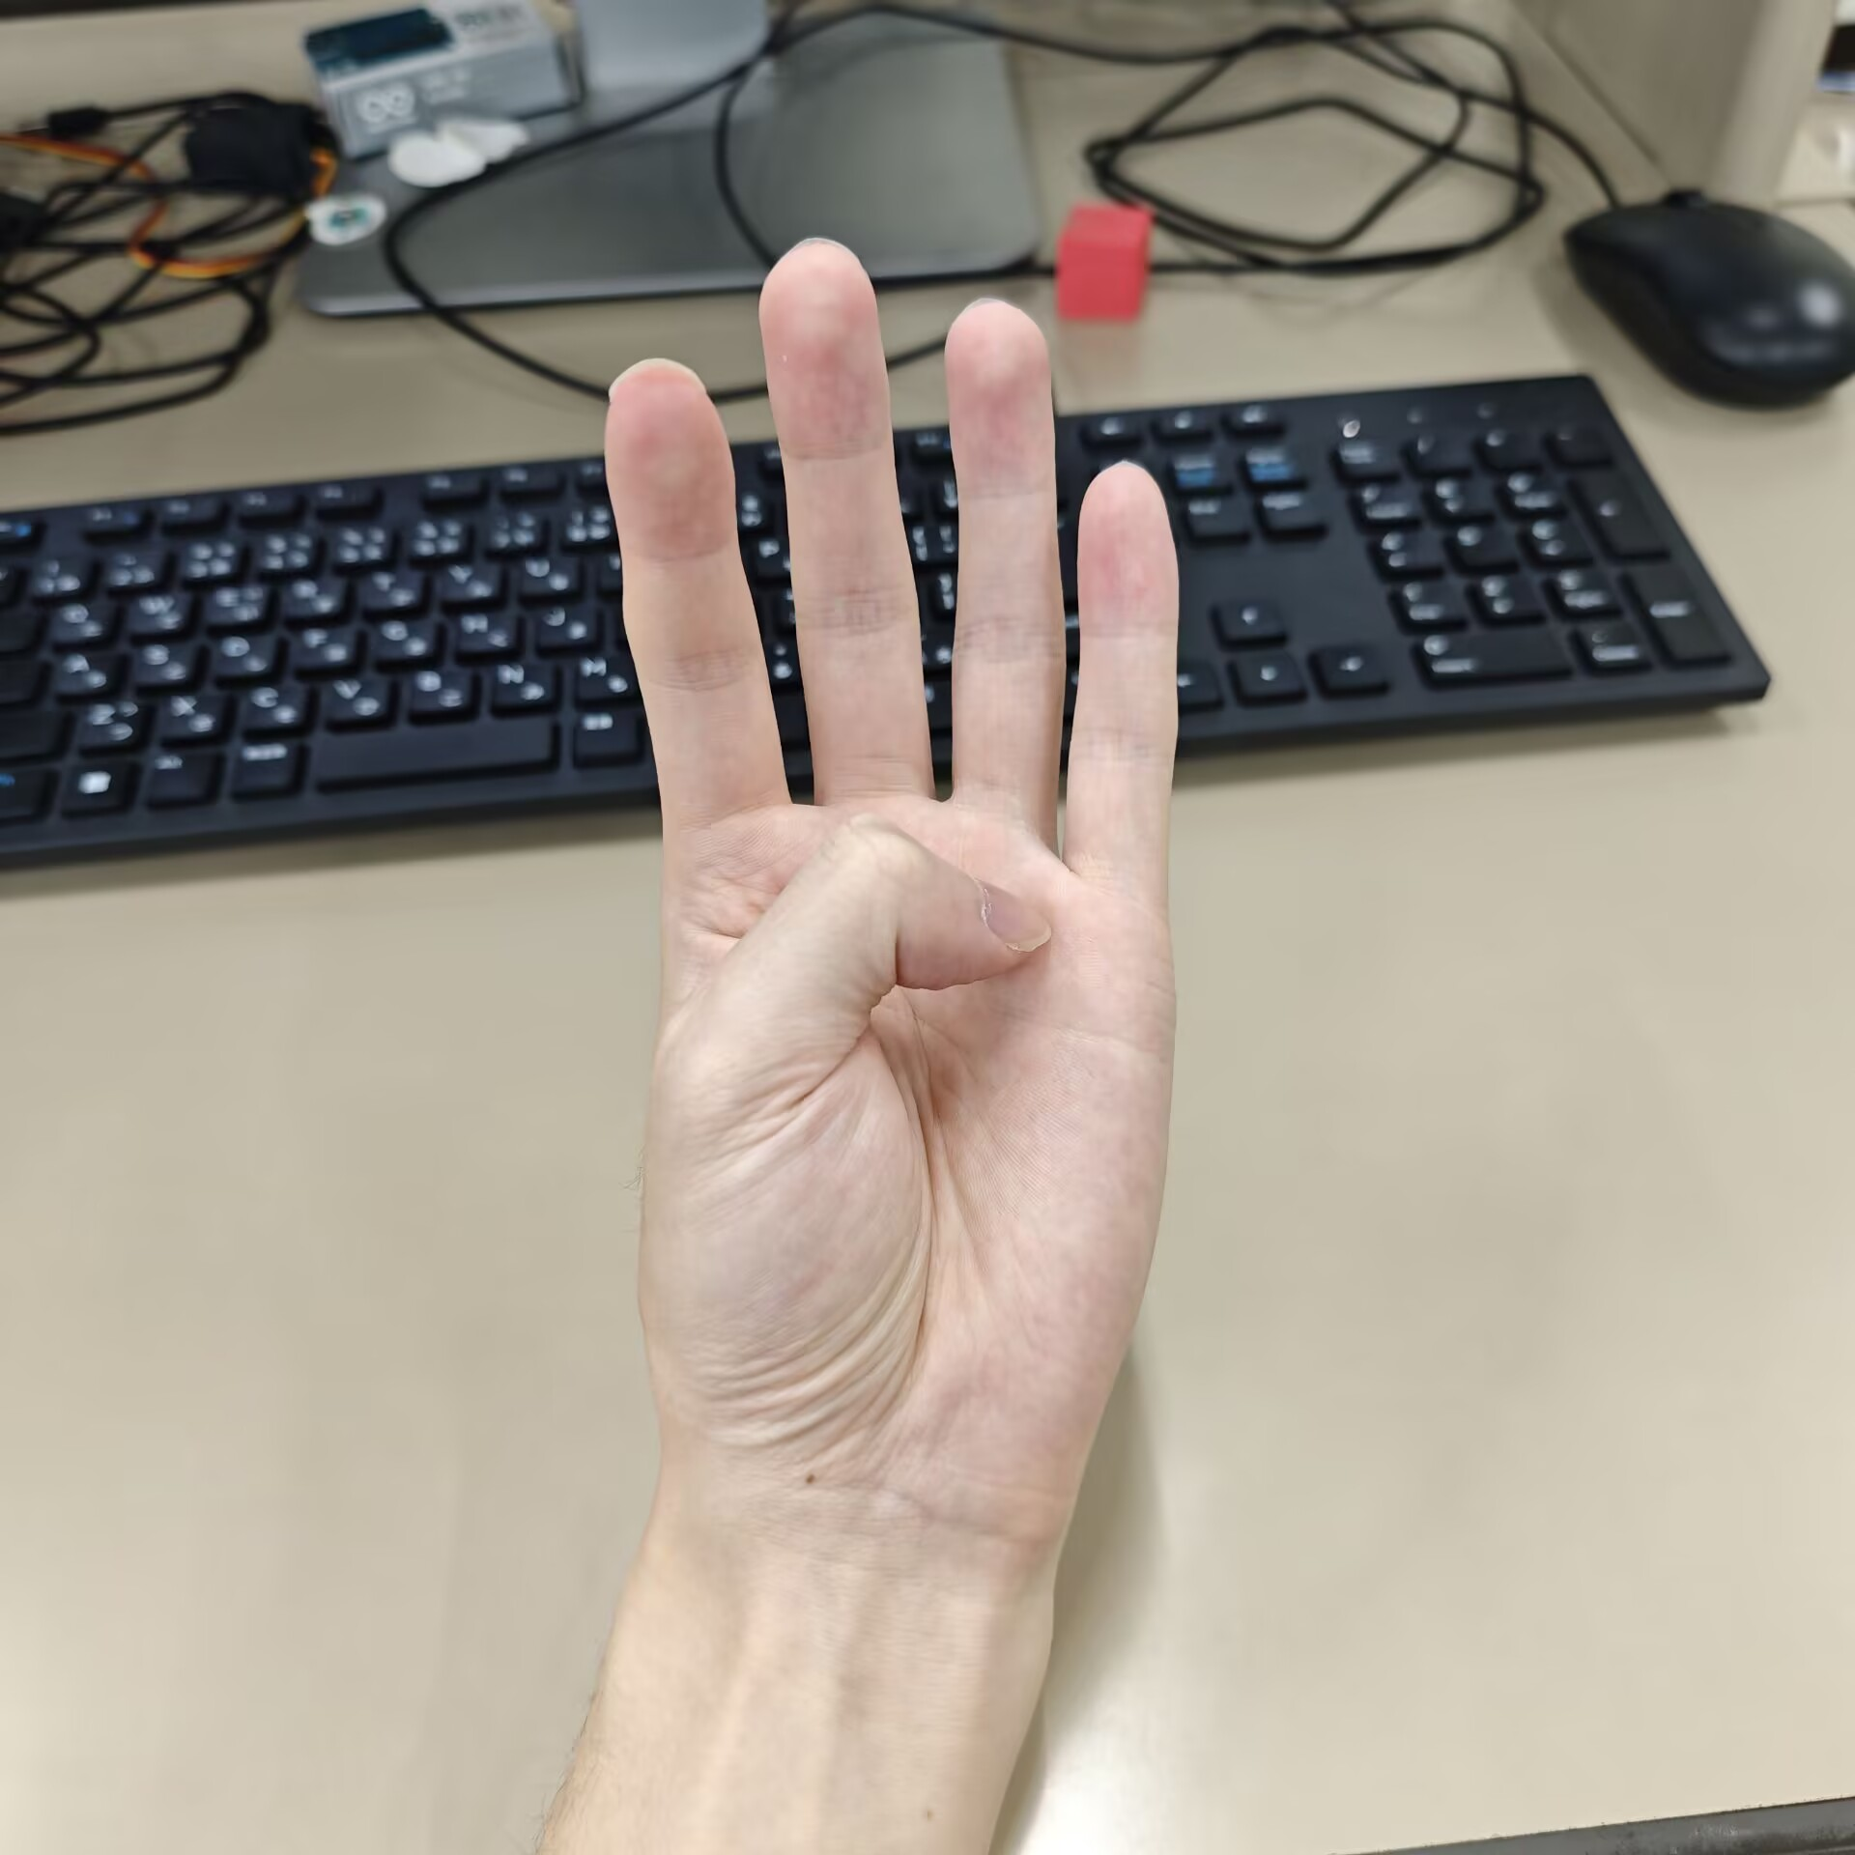
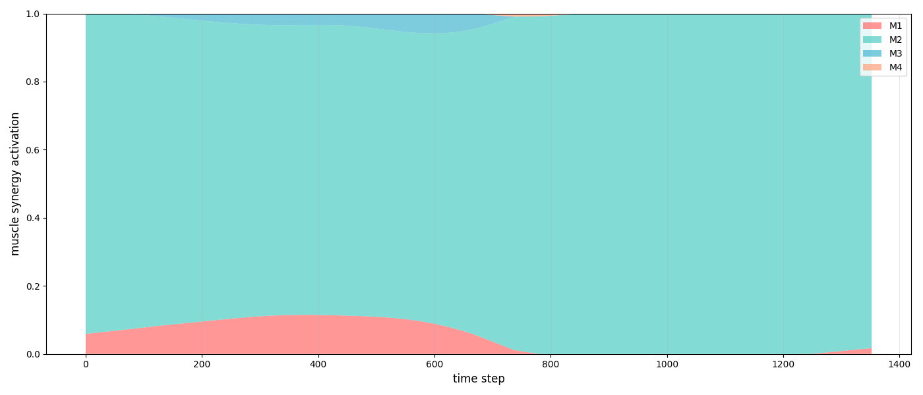
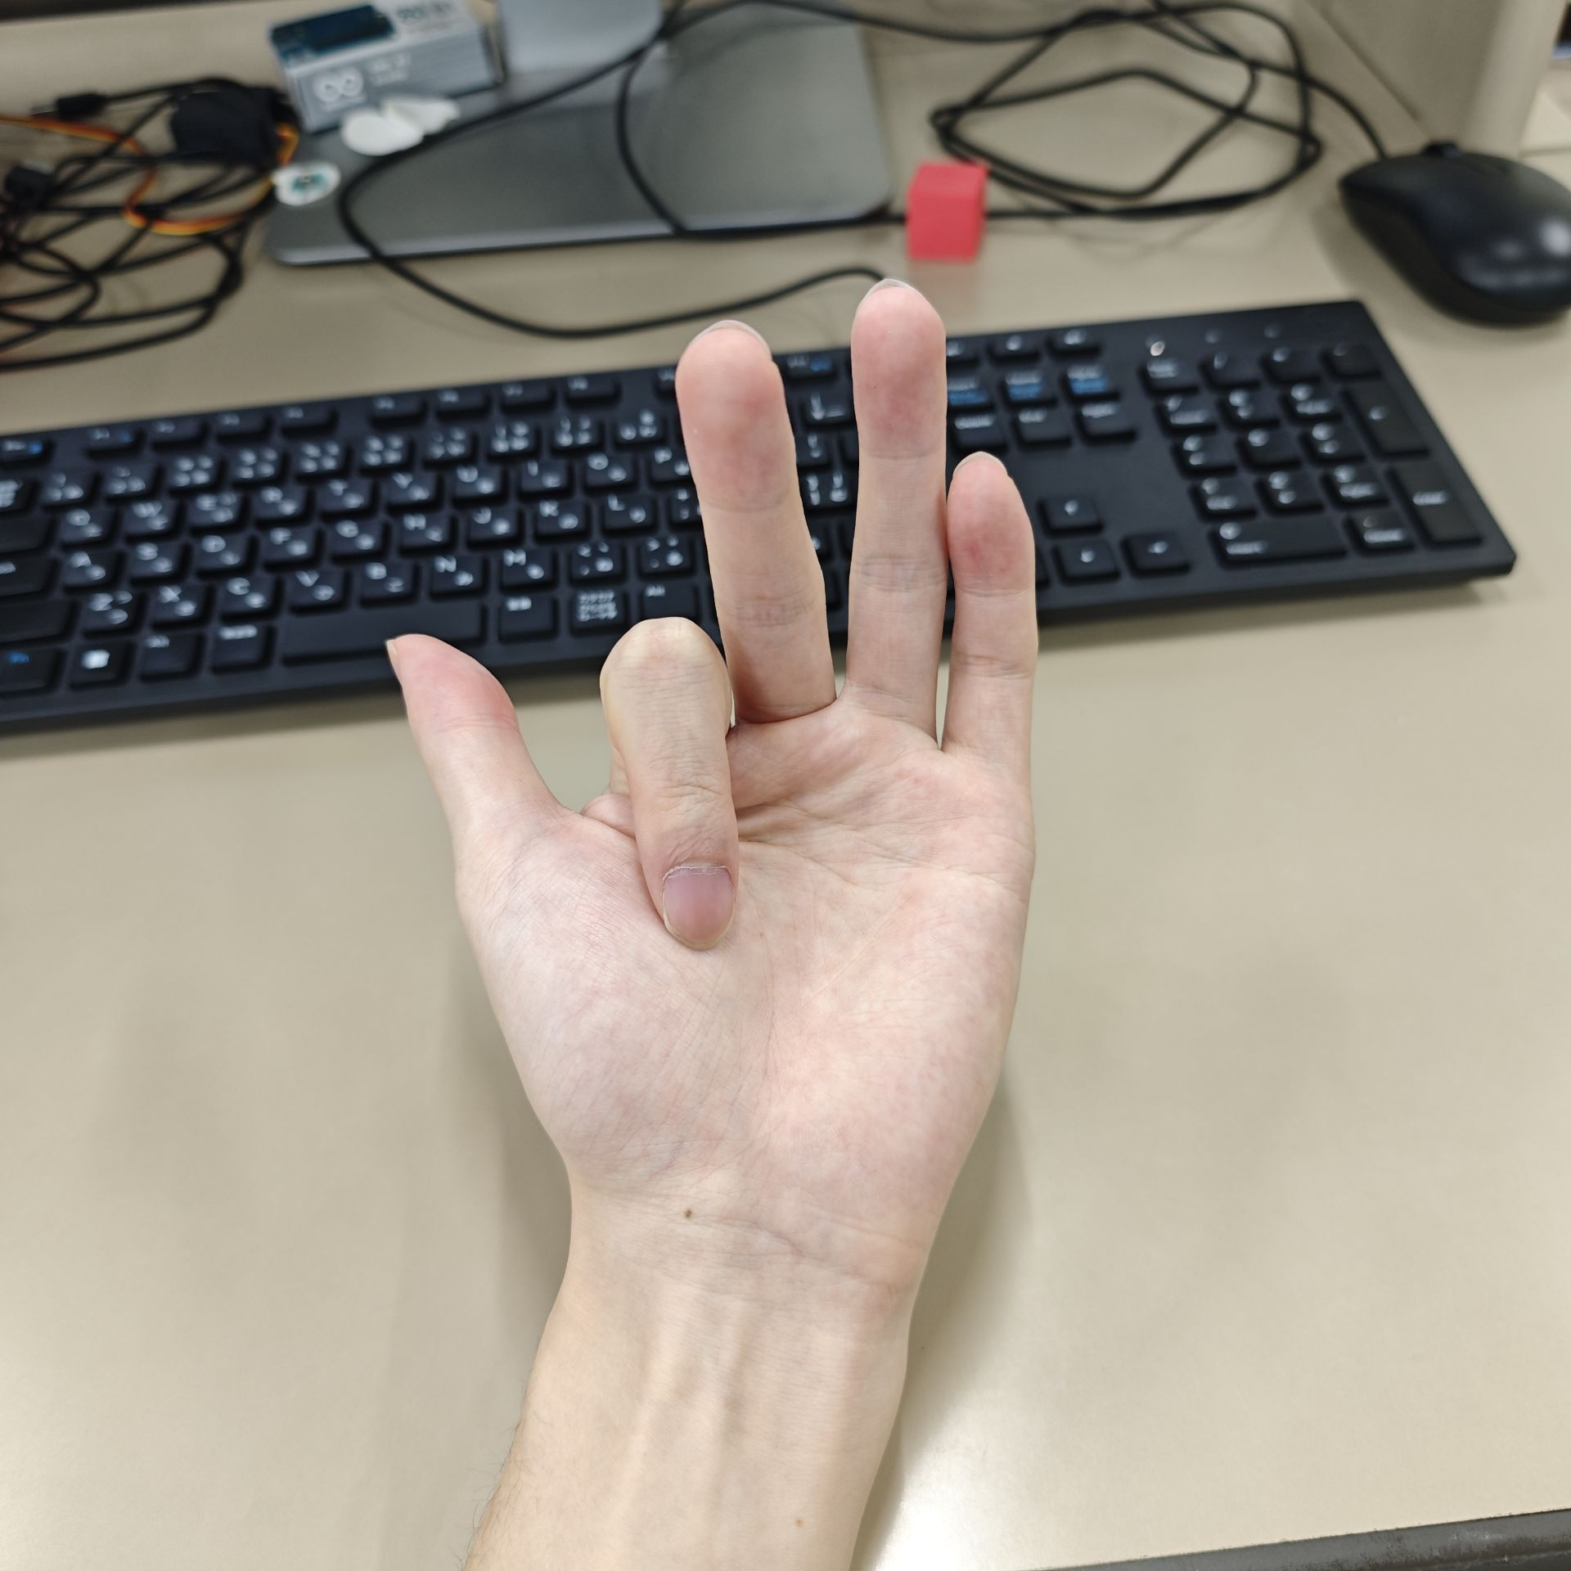
Synergy Distribution in Test Data
M1:Thumb Flexion
M2:Index Finger Flexion

Slide 7
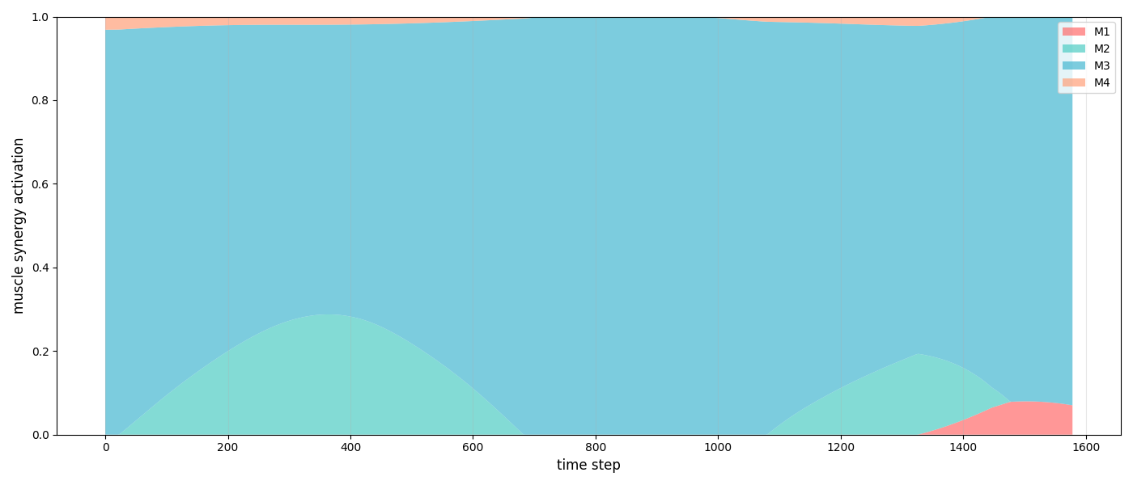
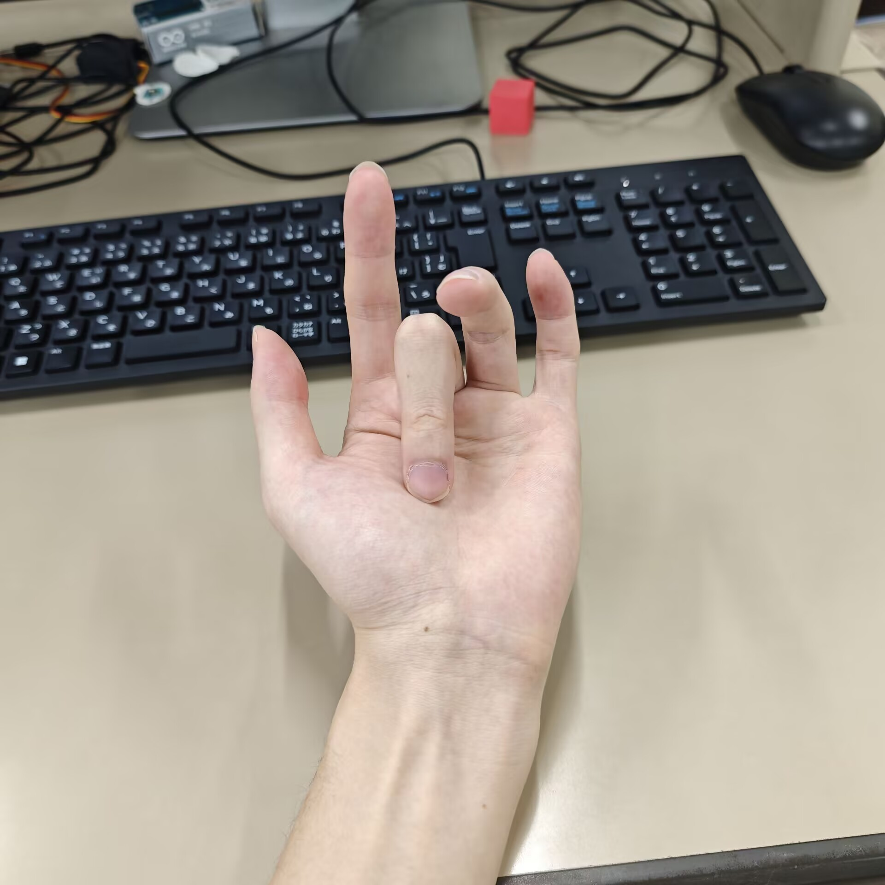
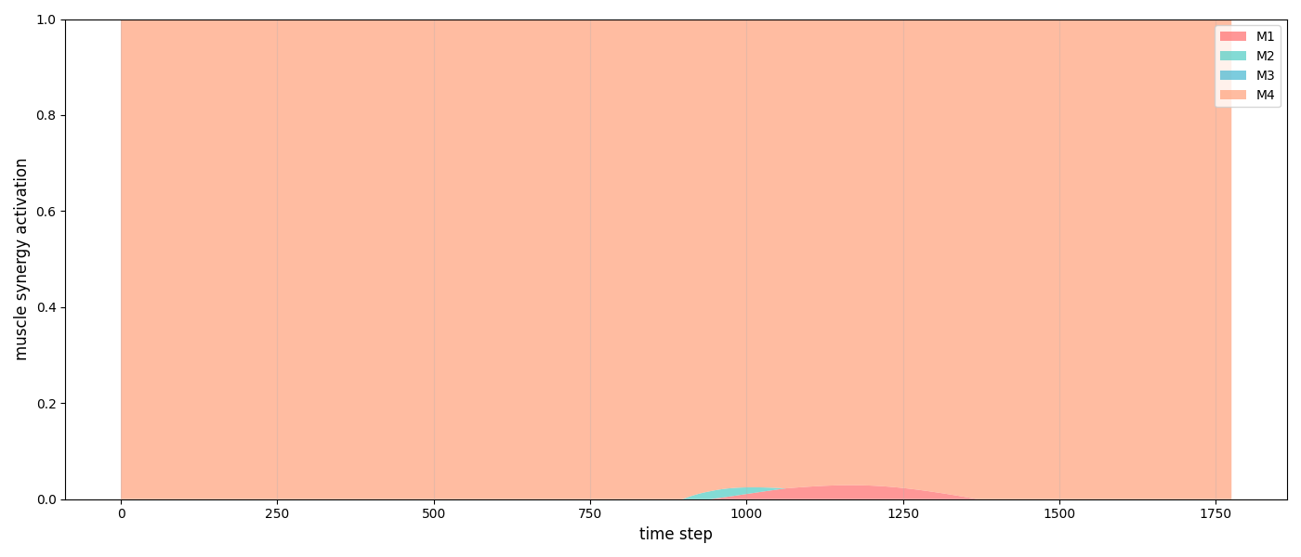
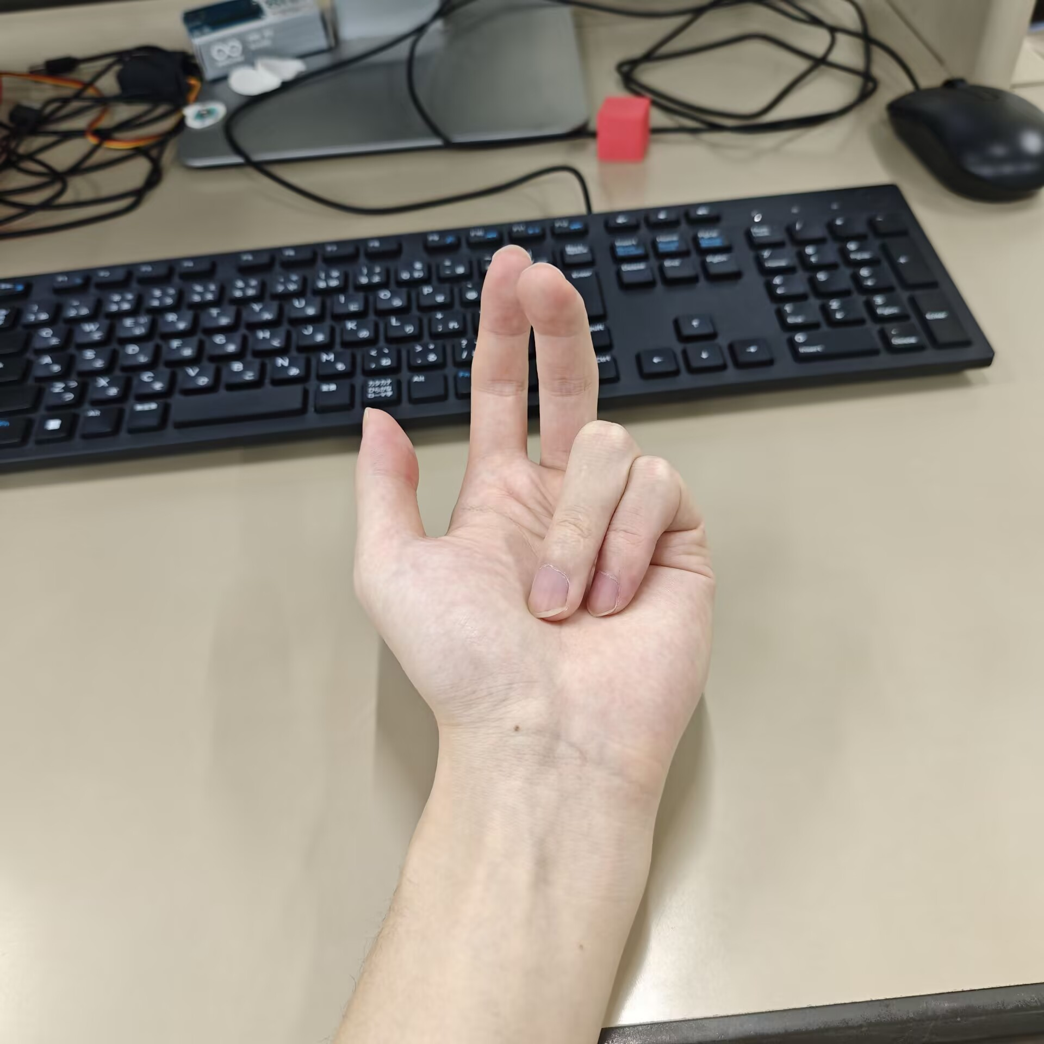
Synergy Distribution in Test Data
M3:Middle Finger Flexion
M4:Ring&Little Finger Flexion

Slide 8
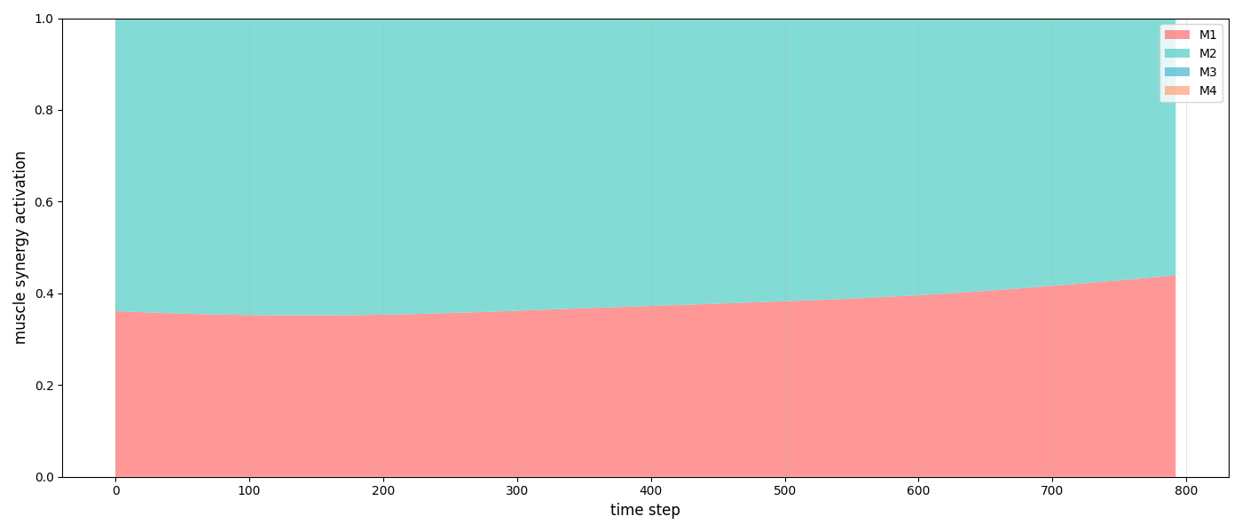
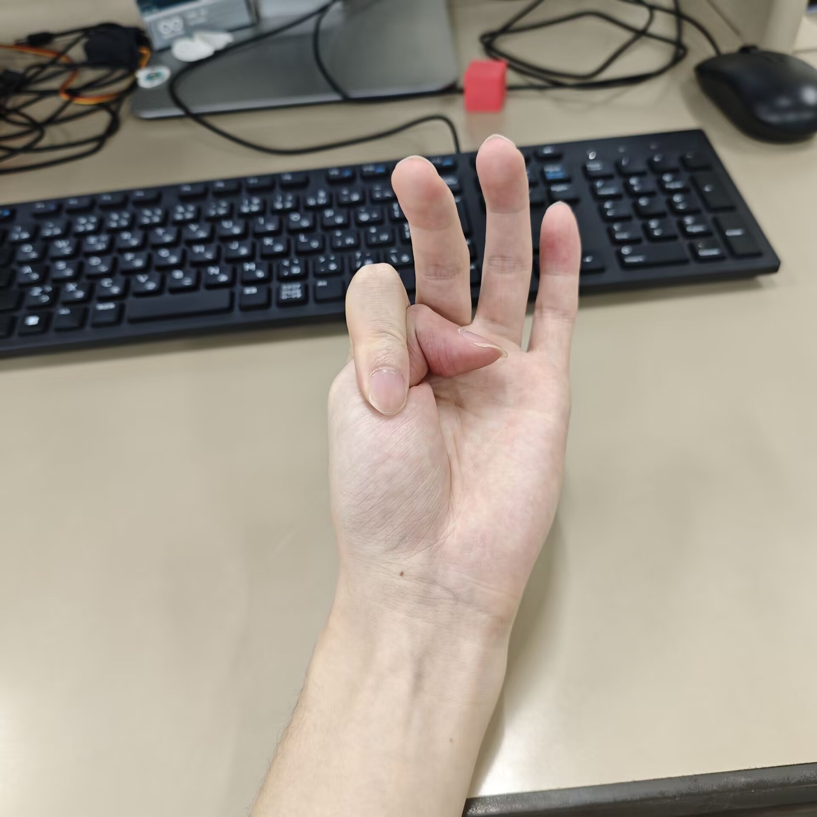
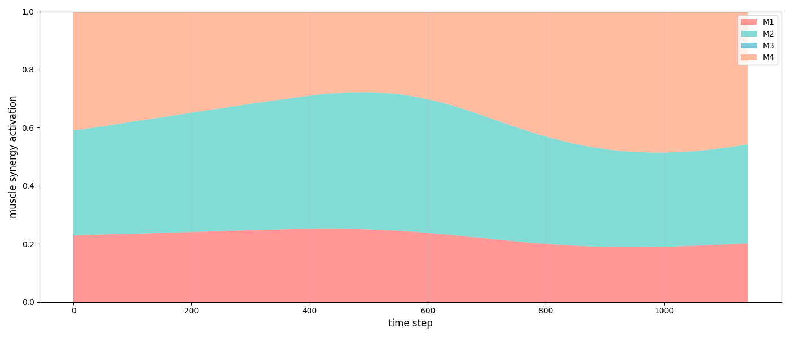
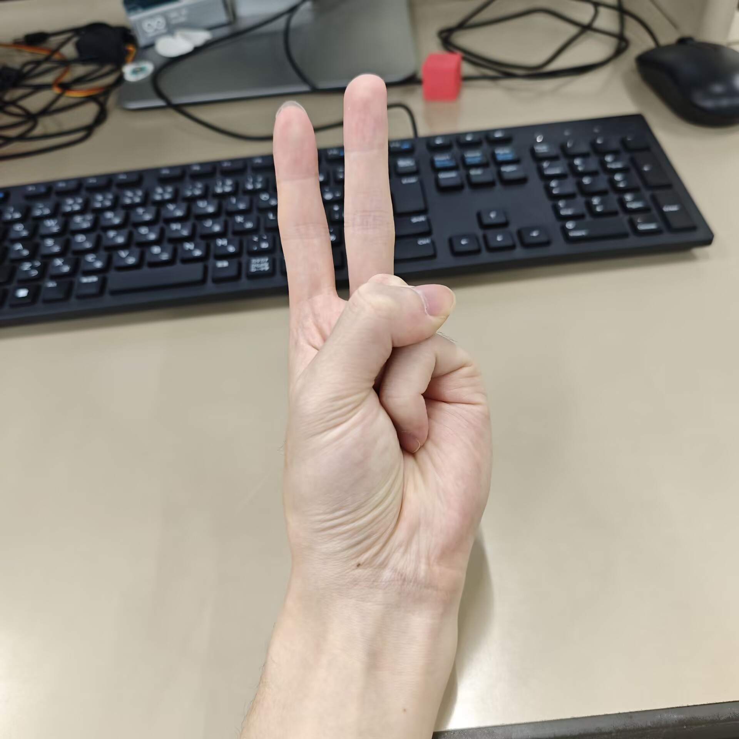
Synergy Distribution in Test Data
M5:Thumb+Index Finger
Error Result
M6:Thumb+Ring&Little Finger

Slide 9
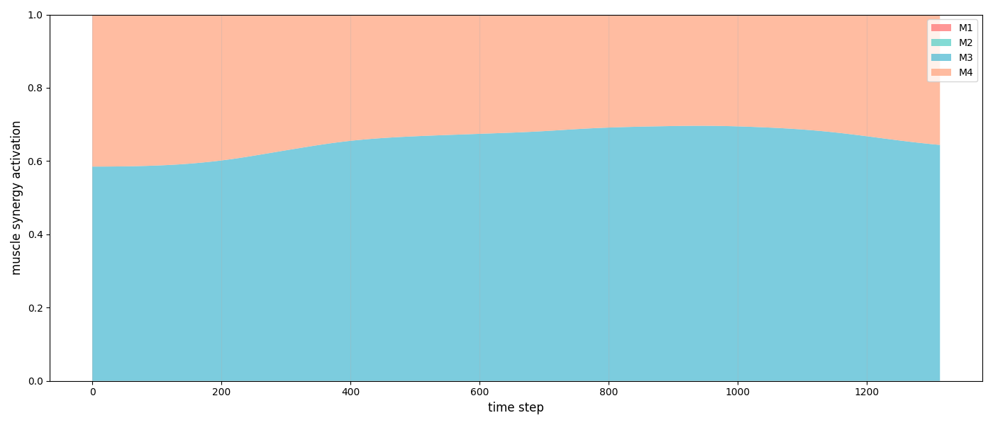
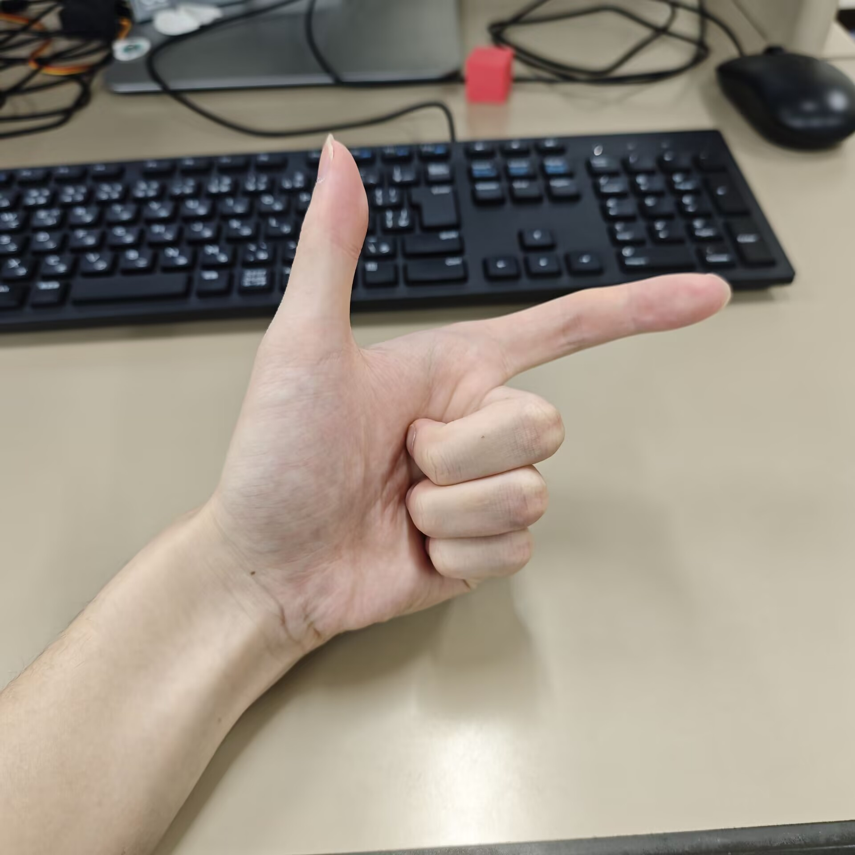
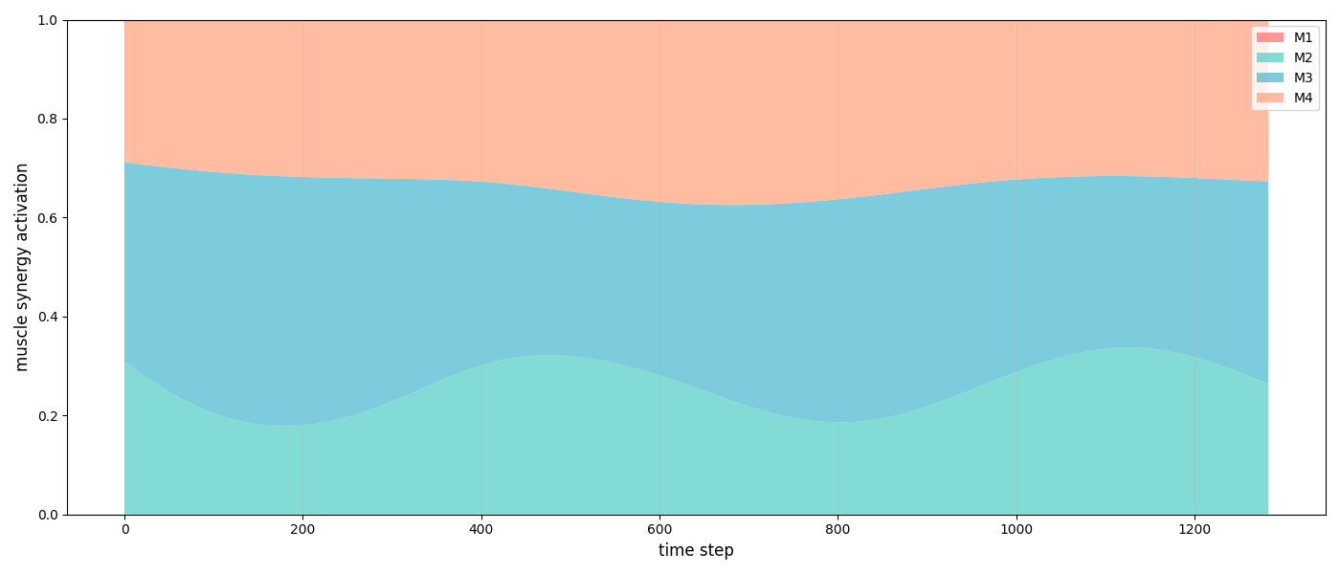
Synergy Distribution in Test Data
M7:Middle+Ring&Little Finger
M8:Index+Middle+ Ring&Little Finger

Slide 10
Summary
I think this is a good preliminary result. I successfully reproduces the muscle synergy theory at an initial stage.
Future Plan
- To accomplish the motion generation model.
- To find the novelty.
- Modify the extraction model
- Invite more participants to verify the theory.
- Achieve real-time performance.

Slide 11
References
[1] Farag H O, Gaber M M, Awad M I, et al. Myoelectric Prosthetic Hands: A Review of Muscle Synergy, Machine Learning and Edge Computing[J]. ACM Computing Surveys, 2025, 57(12): 1-33.
[2] Furui A, Eto S, Nakagaki K, et al. A myoelectric prosthetic hand with muscle synergy–based motion determination and impedance model–based biomimetic control[J]. Science Robotics, 2019, 4(31): eaaw6339.
[3] d'Avella A, Saltiel P, Bizzi E. Combinations of muscle synergies in the construction of a natural motor behavior[J]. Nature neuroscience, 2003, 6(3): 300-308.

