Slide 1
A Multimodal Fusion-based Shared Control System for Prosthetic Hands Aiming at Unconscious Grasping Adjustment
Saga University
Computer Science & Information Techology
25742102 DI XIQING
Professor Osamu Fukuda

Slide 2



Background
As computational power and algorithms continue to advance, prosthetic hand are able to recognize an increasing number of movements.
But the rejection rate of prosthetic hands is as high as 40% [1].
Problems in real-world usage:
As the number of executable movements increases, the error rate rises rapidly.
In real-world scenarios, users need to maintain a high level of concentration to achieve control.
[1] Biddiss, E. A., & Chau, T. T. (2007). Upper limb prosthesis use and abandonment: a survey of the last 25 years. Prosthetics and orthotics international, 31(3), 236-257.

Slide 3
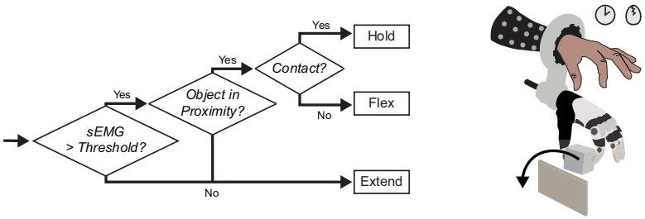
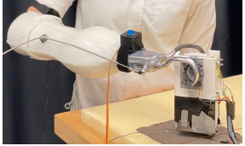
Related Research
Shared control:
Low-level execution is handled autonomously by the system, while the user provides high-level intent.
Marshall et al. used infrared sensors and pressure sensors to develop a shared control algorithm that gradually adjusts the control weighting between the human and the system as the user-controlled prosthetic hand approaches an object [2].
Thomas et al. focused on achieving precise control of prosthetic grasping force through shared control.
First, the operator manually performs grasping tasks, during which the model learns and records the user’s preferred grasping force as a target value. After this learning phase, the operator only needs to generate a grasping EMG signal, and the prosthetic hand can grasp objects with minimal error relative to the desired force.
[2] Trout, M. A., Mino, F. R., Olsen, C. D., Hansen, T. C., Teramoto, M., Warren, D. J., ... & George, J. A. (2025). Shared human-machine control of an intelligent bionic hand improves grasping and decreases cognitive burden for transradial amputees. Nature Communications, 16(1), 10418.
[3] Thomas, N., Miller, A. J., Ayaz, H., & Brown, J. D. (2023). Haptic shared control improves neural efficiency during myoelectric prosthesis use. Scientific reports, 13(1), 484.

Slide 4
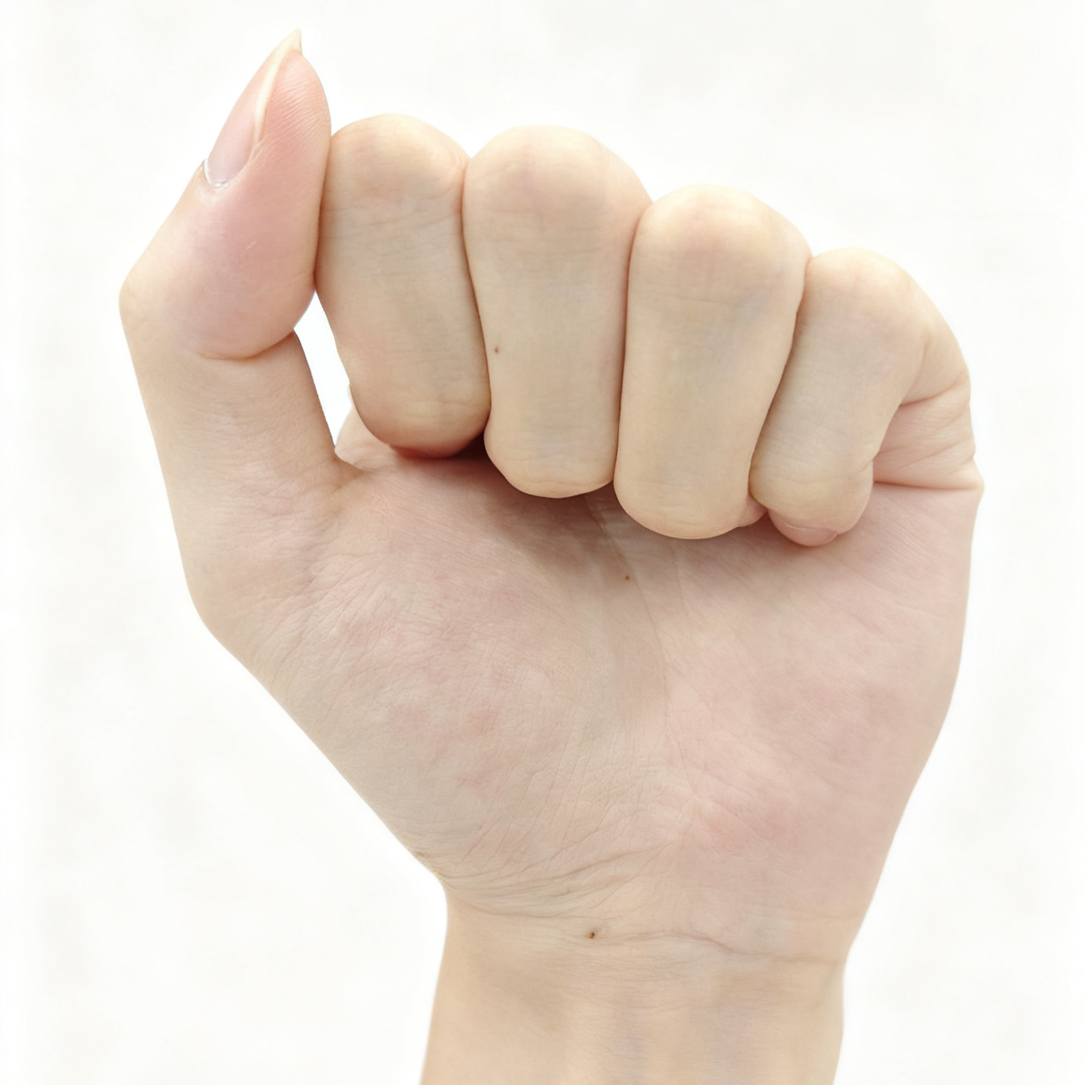
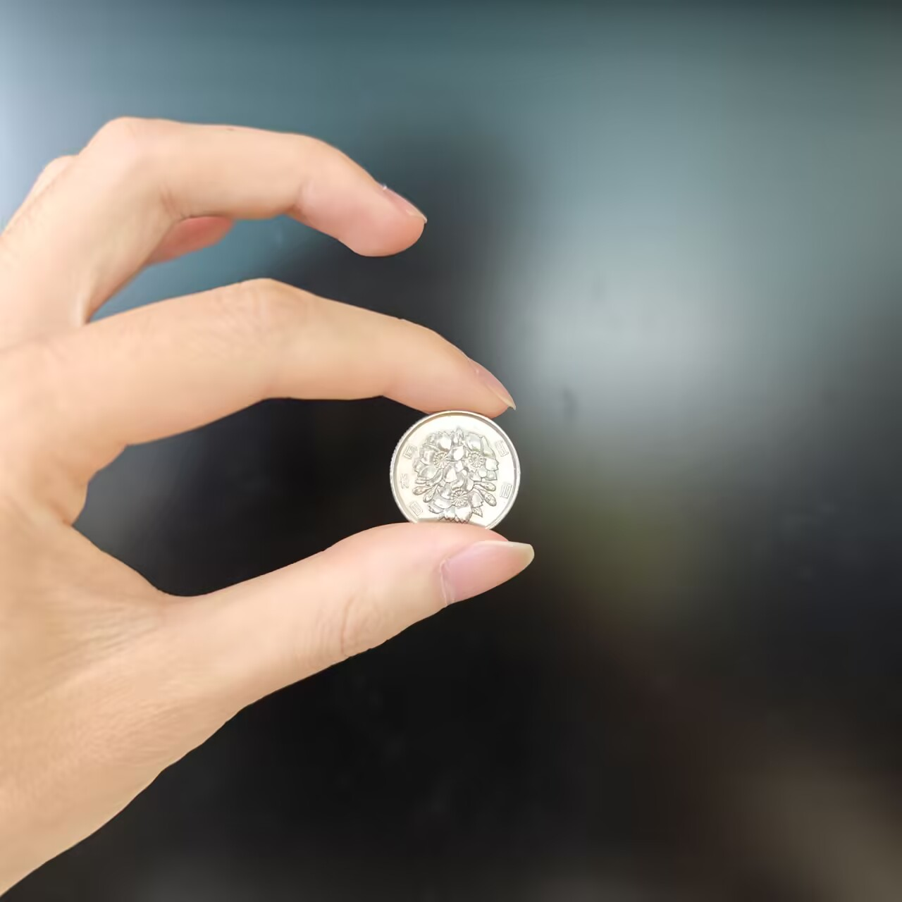
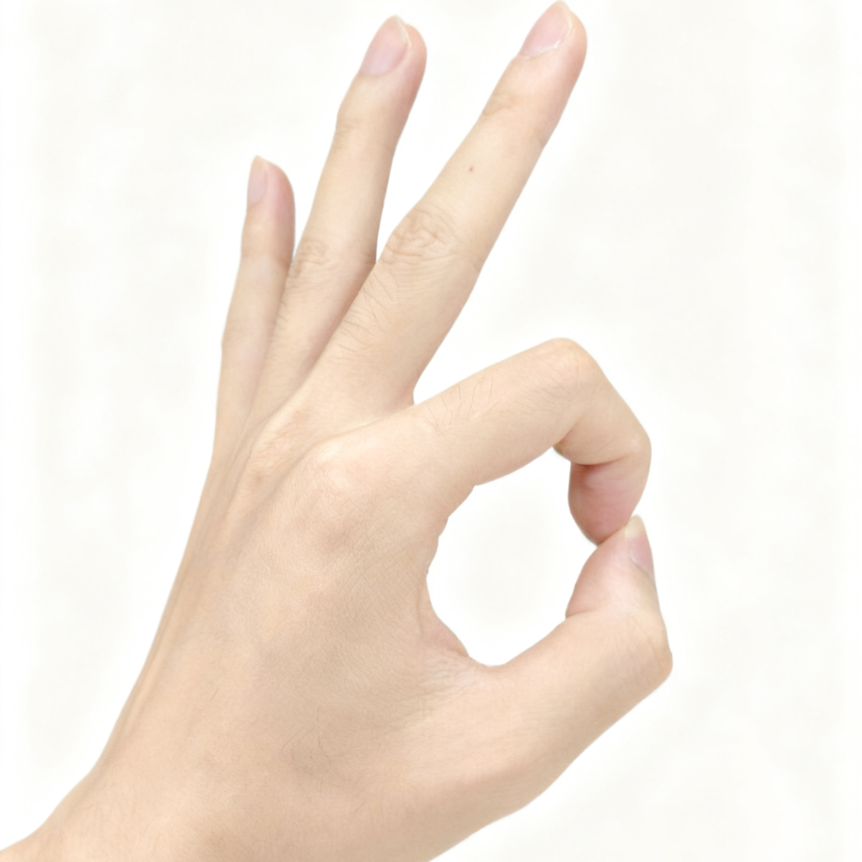
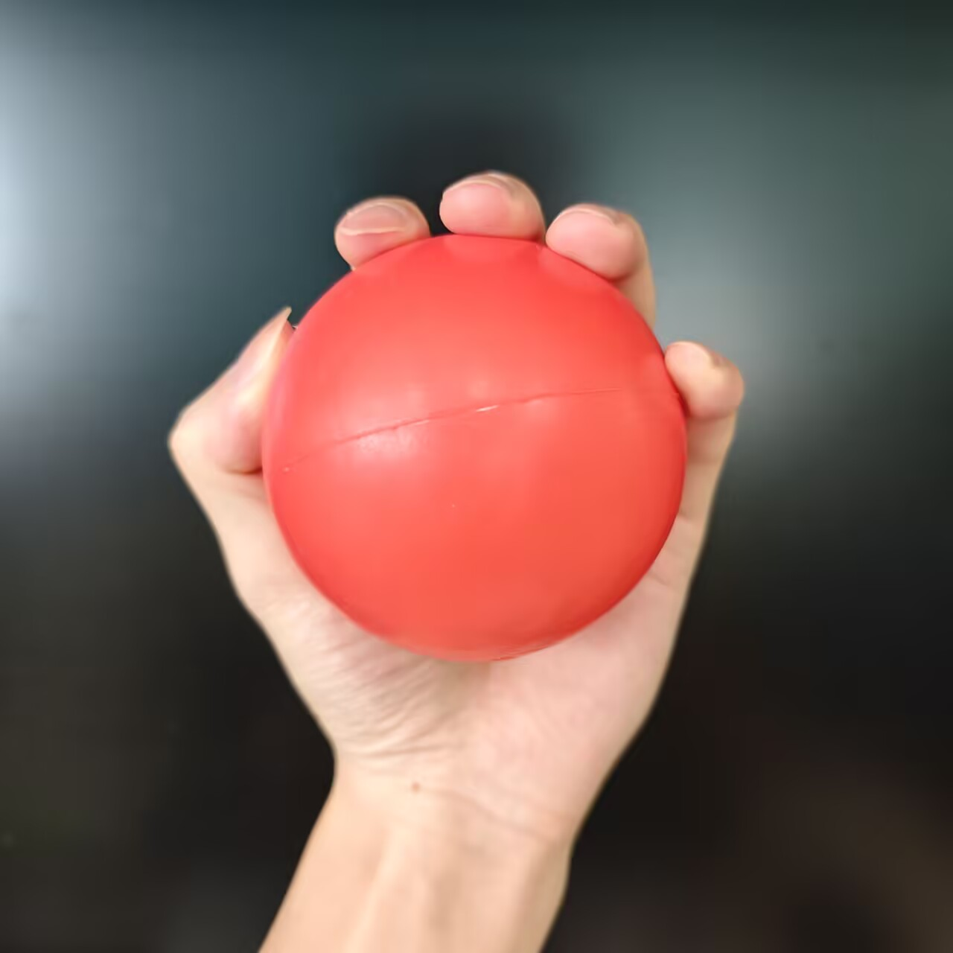
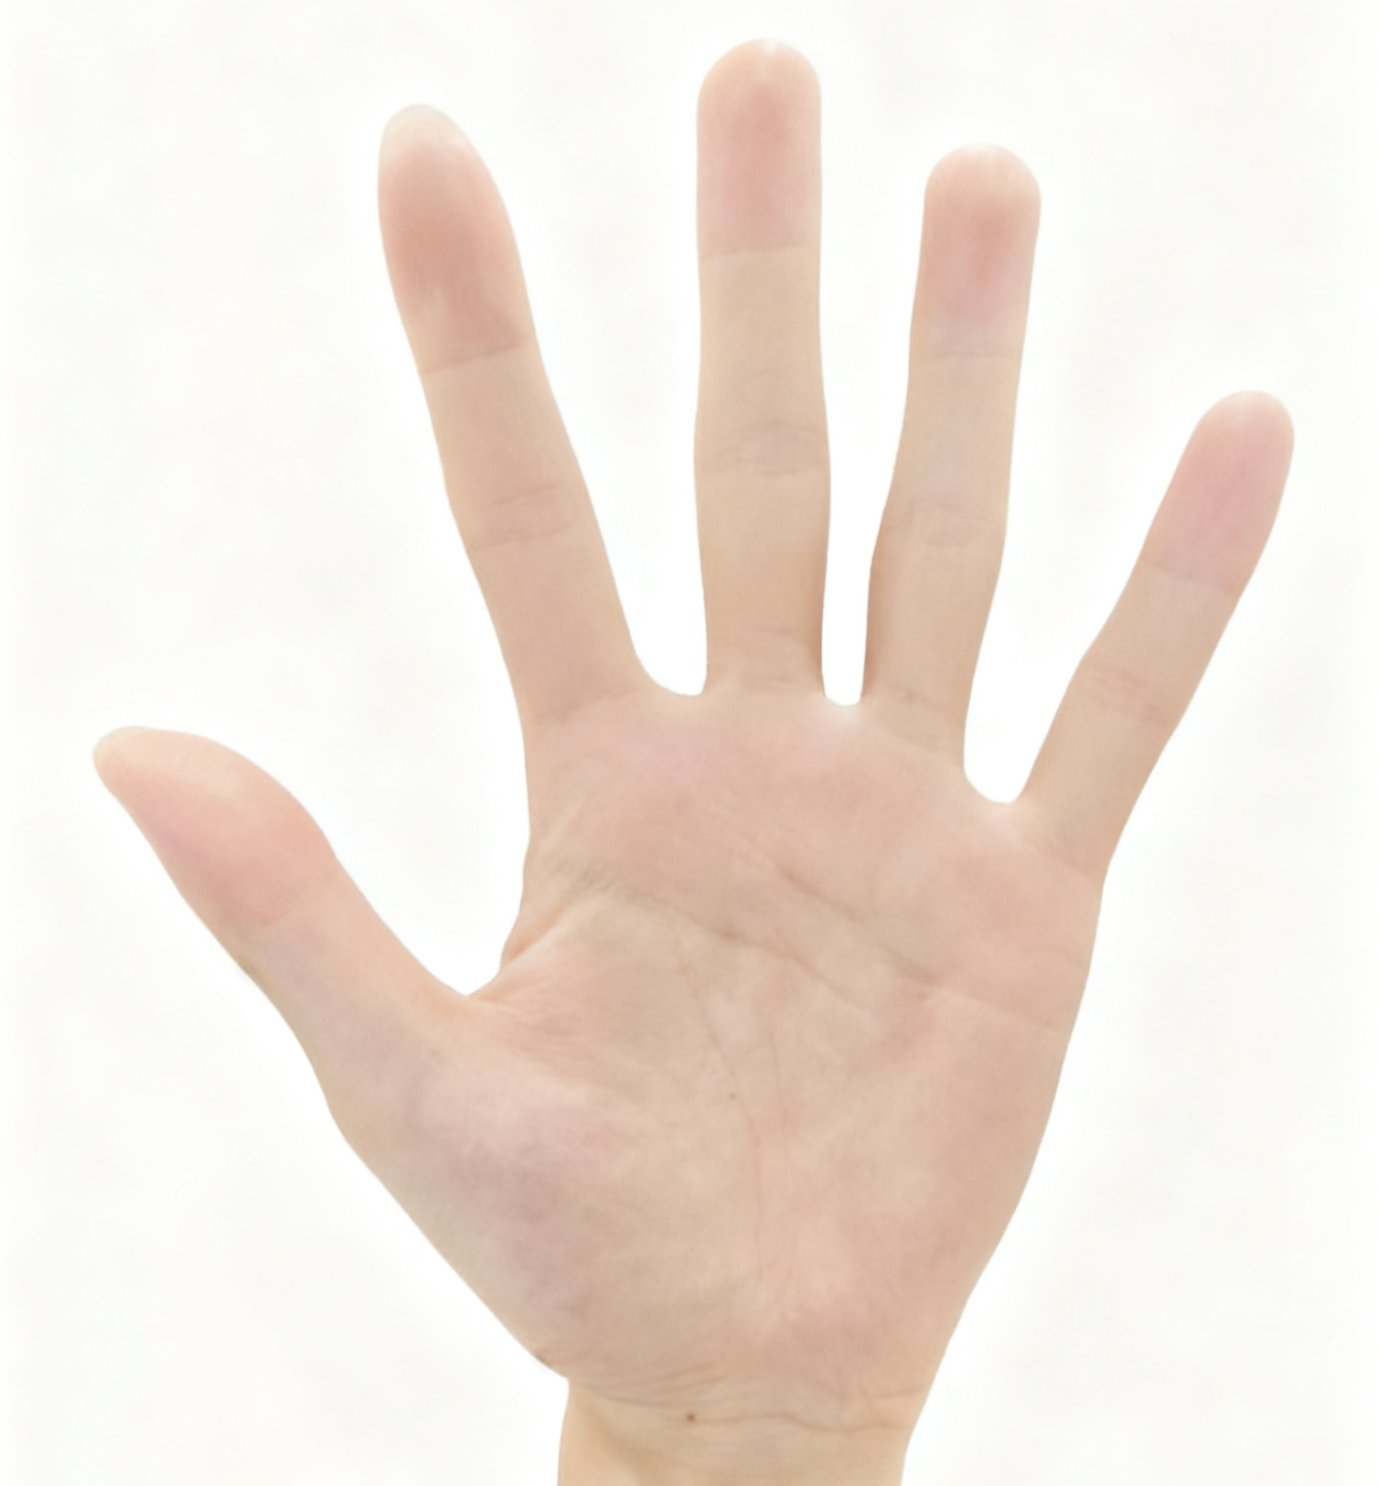
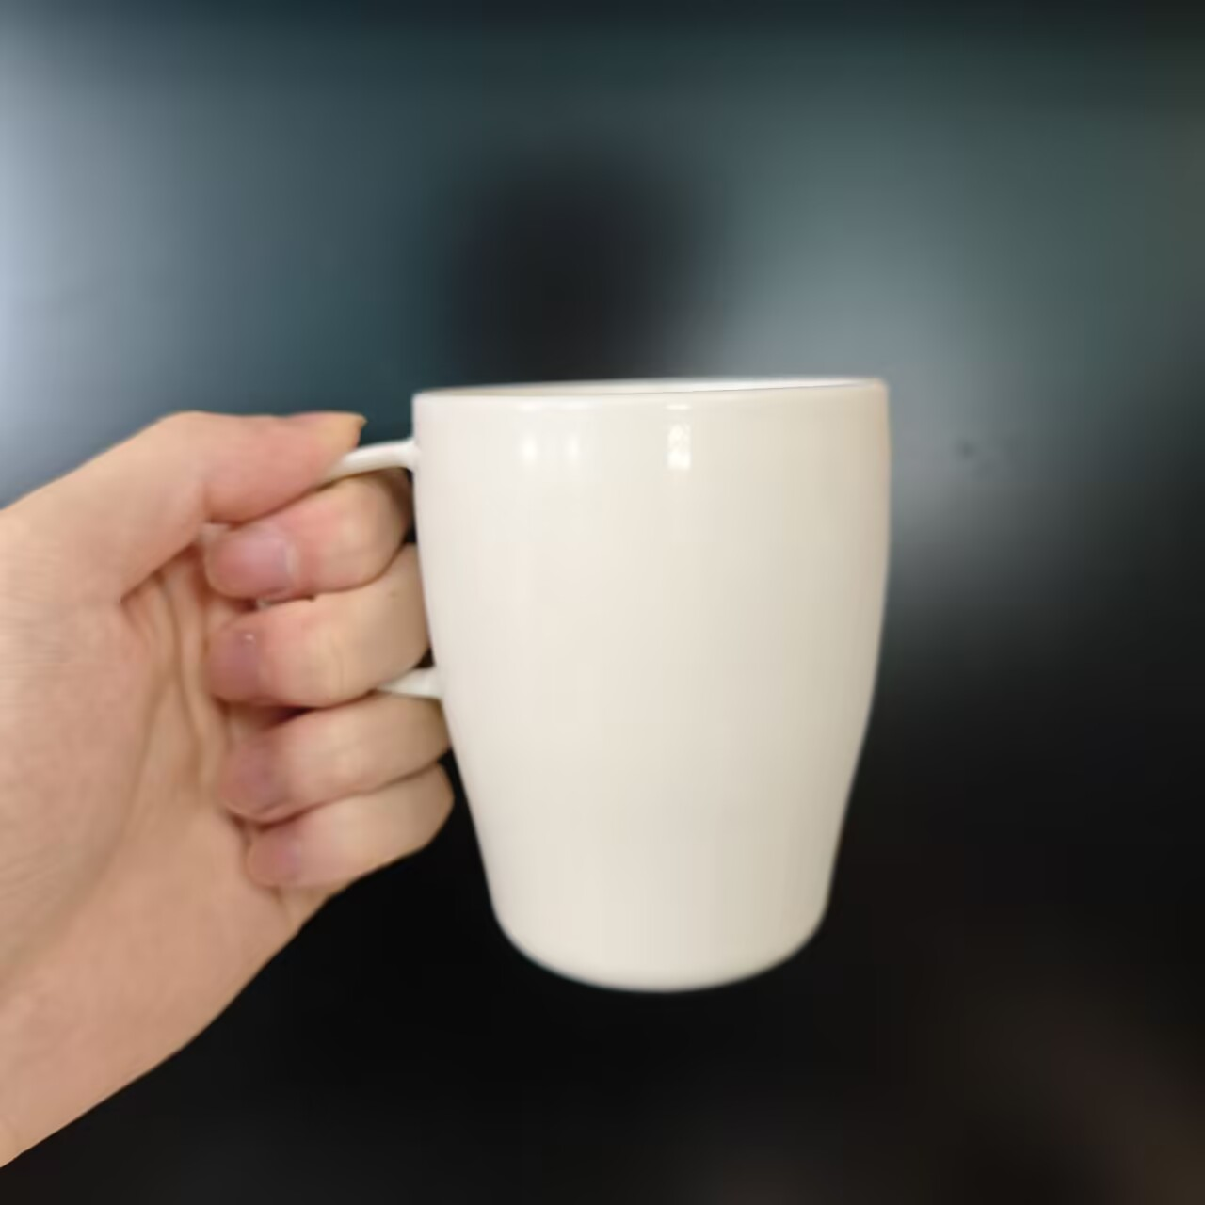

Research Objective
focuses on addressing the fine-tuning of hand movements during the object grasping process.
Previous Research
This Research
▸ By defining different movements, and based on multimodal sensor data, a neural network is used to ultimately classify them into a single category.
▸ A regression model is adopted instead of predefining discrete movements; it continuously fine-tunes the output in real time based on feedback from multiple sensors.
.....

Slide 5



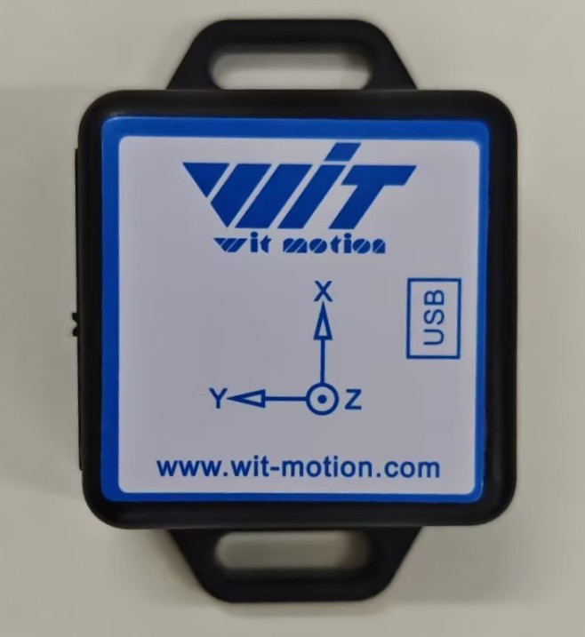



System Architecture
EMG Sensor
Temporal Feature
1 DOF gripper is used to validate the feasibility of the regression model.
Camera
Fusion
Visual Feature
Output
Opening Width
IMU Sensor
Model Training Method - Imitation Learning
The operator manually controls the prosthetic hand.
Record sensors data and hand opening width.
Temporal Feature
Train the model.

Slide 6
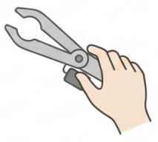




Experiment
Condition A: Manual Control
Objective :
Evaluate the system’s performance, and its ability to reduce the operator’s cognitive load
Participants :
10 healthy adults
Condition B: EMG-Only Control
Scene:
Grasping different size objects under three conditions
Condition C: Proposed System Control

Slide 7



Evaluation
Performance
Cognitive load
Task Completion Time
NASA-TLX [4]
Grasp Success Rate
[4] Hart, S. G., & Staveland, L. E. (1988). Development of NASA-TLX (Task Load Index): Results of empirical and theoretical research. In Advances in psychology (Vol. 52, pp. 139-183). North-holland.

Slide 8
Summary
The objective of research is to reduce the cognitive load of prosthetic users and to address the decline in recognition accuracy caused by an increasing number of movements classes.
The research proposes a multimodal fusion-based shared control system for a prosthetic hand, aiming to achieve unconscious grasping adjustment.
The system employs a regression model that integrates features from EMG, camera, and IMU to continuously and adaptively adjust the hand’s opening width in real time.
Design a comparative experiment to evaluate the effectiveness of the proposed system, using performance and cognitive load as evaluation metrics.

Slide 9
References
[1] Biddiss, E. A., & Chau, T. T. (2007). Upper limb prosthesis use and abandonment: a survey of the last 25 years. Prosthetics and orthotics international, 31(3), 236-257.
[2] Trout, M. A., Mino, F. R., Olsen, C. D., Hansen, T. C., Teramoto, M., Warren, D. J., ... & George, J. A. (2025). Shared human-machine control of an intelligent bionic hand improves grasping and decreases cognitive burden for transradial amputees. Nature Communications, 16(1), 10418.
[3] Thomas, N., Miller, A. J., Ayaz, H., & Brown, J. D. (2023). Haptic shared control improves neural efficiency during myoelectric prosthesis use. Scientific reports, 13(1), 484.
[4] Hart, S. G., & Staveland, L. E. (1988). Development of NASA-TLX (Task Load Index): Results of empirical and theoretical research. In Advances in psychology (Vol. 52, pp. 139-183). North-holland.

