Slide 1
An End-to-End Multimodal Fusion-based Shared Control System for Prosthetic Hands Aiming at Unconscious Grasping Adjustment
Saga University
Computer Science & Information Techology
25742102 DI XIQING
Professor Osamu Fukuda

Slide 2
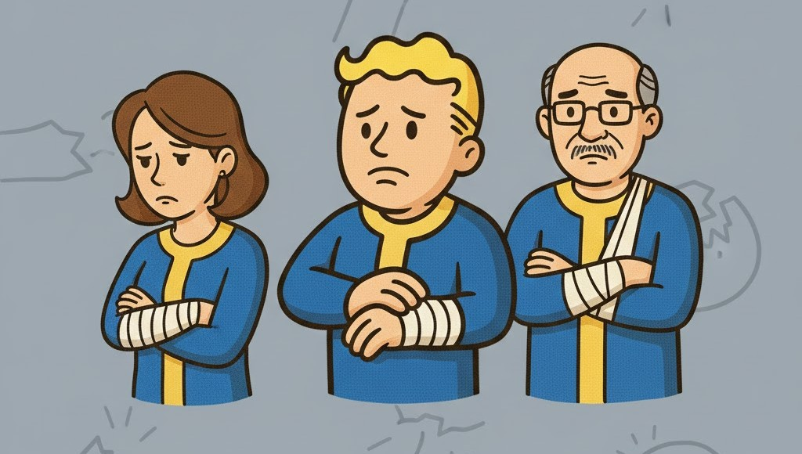





Background
57.7 million people in world
who had lost an upper limb [1]
Computational power and algorithms continue to advance, the prosthetic hand are able to recognize an increasing number of movements [2]

Slide 3


Related Research
Vásconez et al. proposed
EMG + IMU
Deep reinforcement learning model
11 movements
accuracy: 97% [3]
Zandigohar et al. proposed
EMG + Eyes Tracking
Extra-Trees and YOLOv4
14 movements
accuracy: 93% [4]

Slide 4
Research Gap
But the rejection rate of prosthetic hands is as high as 44% [5].
Movement Transition
Cognitive Load
Modular Pipeline
Transitions and adjustments between movements were not considered.
Users need to maintain a high level of concentration to achieve control.
Modular Pipeline will increases system complexity but also may lead to the loss of important information.

Slide 5

Research Novelty
End-to-end training directly uses raw signals, without separate EMG and other modules.
1
Replace the classification model with a regression model to enable real-time dynamic adjustment.
2
Shared control delegates fine movement control to the system, reducing user cognitive load.
3

Slide 6



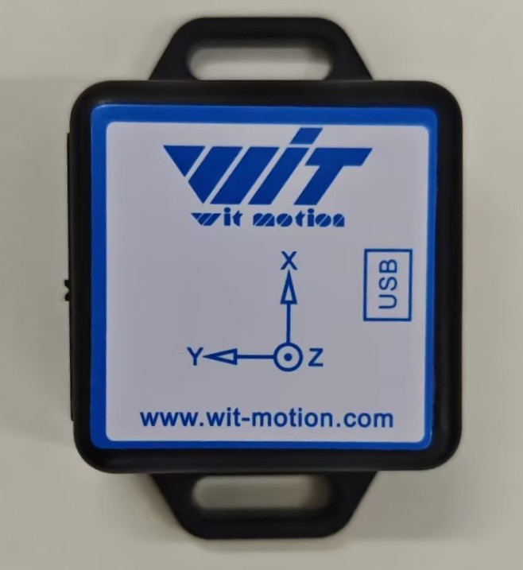



System Architecture
Neural Network
EMG Sensor
Temporal Feature
1 DOF gripper is used to validate the feasibility of the regression model.
Camera
Fusion
Visual Feature
Output
Opening Width
IMU
Model Training Method - Imitation Learning
The operator manually controls the prosthetic hand.
Record sensors data and hand opening width.
Temporal Feature
Train the model.

Slide 7
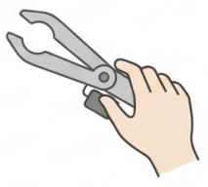





Experiment
Condition A: Manual Control
Objective :
Evaluate the system’s performance, and its ability to reduce the operator’s cognitive load
Participants :
10 healthy adults
Condition B: EMG-Only Control
Scene:
Grasping different size objects under three conditions
Condition C: Proposed System Control

Slide 8



Evaluation
Performance
Cognitive load
Task Completion Time
NASA-TLX [6]
Grasp Success Rate

Slide 9
Summary
The objective of research is to address real-time adjustment of the prosthetic hand and reduce the cognitive load of prosthetic users.
The System Adopts an end-to-end approach without modular separation.
Employs a regression model to continuously adjust the hand’s opening width in real time.
Employs a multimodal fusion-based shared control approach for the prosthetic hand.
Design a comparative experiment to evaluate the feasibility of the proposed system, using performance and cognitive load as evaluation metrics.

Slide 10
References
[1] McDonald C L, Westcott-McCoy S, Weaver M R, et al. Global prevalence of traumatic non-fatal limb amputation[J]. Prosthetics and orthotics international, 2021, 45(2): 105-114.
[2] Chen, Z., Min, H., Wang, D., Xia, Z., Sun, F., & Fang, B. (2023). A review of myoelectric control for prosthetic hand manipulation. Biomimetics, 8(3), 328.
[3] Vásconez, J. P., Barona López, L. I., Valdivieso Caraguay, Á. L., & Benalcázar, M. E. (2022). Hand gesture recognition using EMG-IMU signals and deep q-networks. Sensors, 22(24), 9613.
[4] Zandigohar, M., Han, M., Sharif, M., Günay, S. Y., Furmanek, M. P., Yarossi, M., ... & Schirner, G. (2024). Multimodal fusion of EMG and vision for human grasp intent inference in prosthetic hand control. Frontiers in Robotics and AI, 11, 1312554.
[5] Salminger, S., Stino, H., Pichler, L. H., Gstoettner, C., Sturma, A., Mayer, J. A., ... & Aszmann, O. C. (2022). Current rates of prosthetic usage in upper-limb amputees–have innovations had an impact on device acceptance?. Disability and rehabilitation, 44(14), 3708-3713.
[6] Hart, S. G., & Staveland, L. E. (1988). Development of NASA-TLX (Task Load Index): Results of empirical and theoretical research. In Advances in psychology (Vol. 52, pp. 139-183). North-holland.

