Slide 1
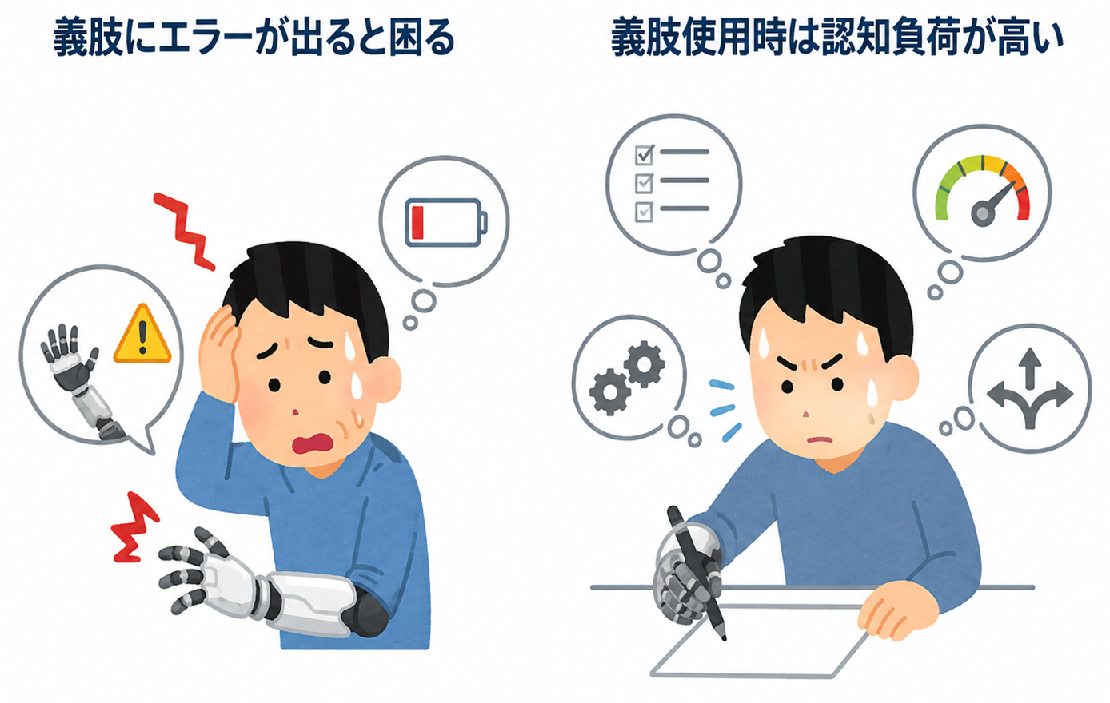
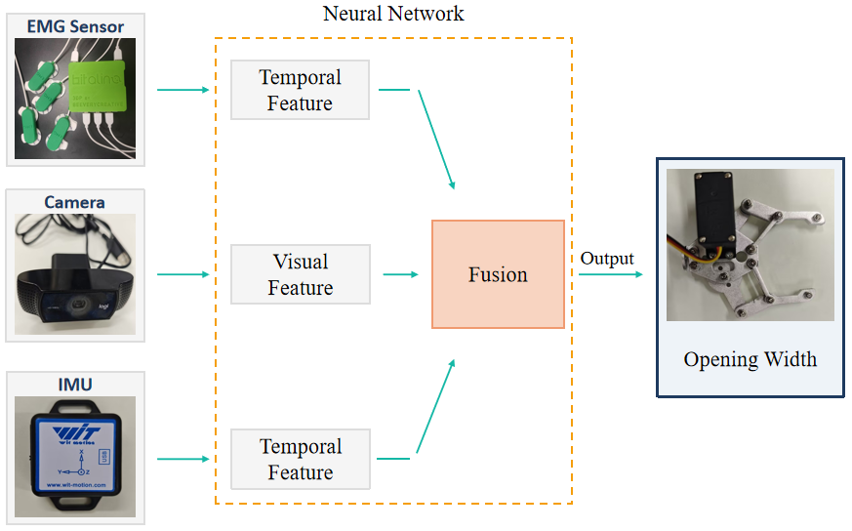
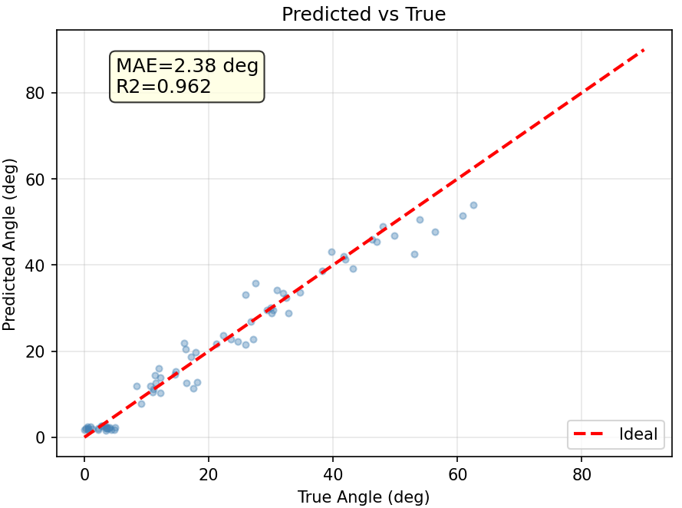
An End-to-End Multimodal Fusion-Based Shared Control System for Prosthetic Hands
This study aims to develop an end-to-end multimodal fusion-based shared-control prosthetic system to address two major limitations of current prosthetic hands: the lack of inter-movement adjustment and the high cognitive load imposed on users during operation.
Objective:
Addressing two major problems, the lack of adjustment between movements and the high cognitive load
By using different sensors, the system detects the user’s intention, target object, and environment to assist the user in grasping tasks.
I think that using this system can reduce the user’s cognitive load and improve the usability of the prosthetic hand.

