Slide 1
End-to-End Multimodal Learning for Continuous Prosthetic Hand Control
Saga University Graduate School of Science and Engineering​
Computer Science & Information Techology Course​
Fukuda Laboratory 25742102 DI XIQING
Supervisor: Professor Osamu Fukuda

Slide 2
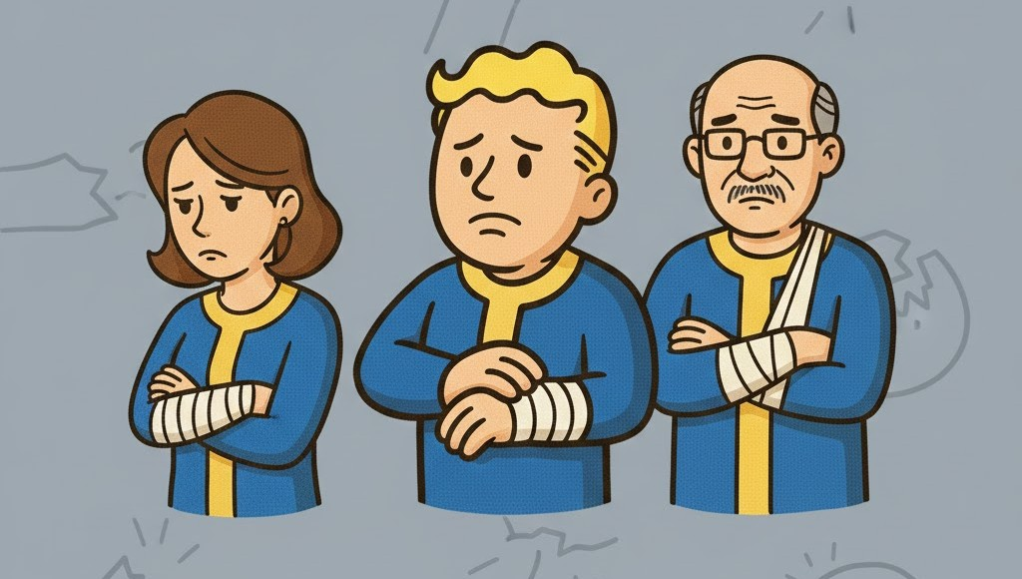


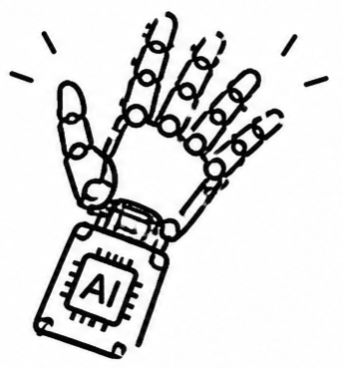


Background
57.7 million people in world
who had lost an upper limb [1]
Computational power and algorithms continue to advance, the prosthetic hand are able to recognize an increasing number of movements [2]

Slide 3


Related Research
Vásconez et al. proposed
EMG + IMU
Deep reinforcement learning model
11 movements
accuracy: 97% [3]
Zandigohar et al. proposed
EMG + Eyes Tracking
Extra-Trees and YOLOv4
14 movements
accuracy: 93% [4]

Slide 4

Research Gap
But the rejection rate of prosthetic hands is as high as 44% [5].
Movement Transition
Transitions and adjustments between movements were not considered.
Cognitive Load
Users need to maintain a high level of concentration to achieve control.
Modular Pipeline
Modular Pipeline increases system complexity but also may lead to the loss of important information.

Slide 5
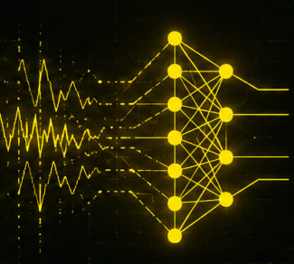
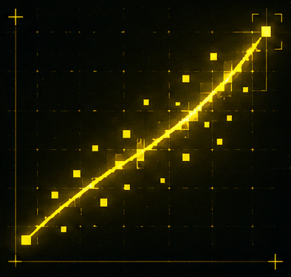
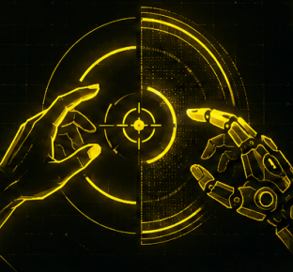
Our proposal
End-to-End
End-to-end training eliminates the need for manual feature extraction or hand-designed intermediate modules, directly mapping raw input signals to output results, enabling joint optimization of the entire system.
Regression
Replace the classification model with a regression model to enable real-time dynamic adjustment.
Shared Control
Shared control delegates fine movement control to the system, reducing user cognitive load.

Slide 6



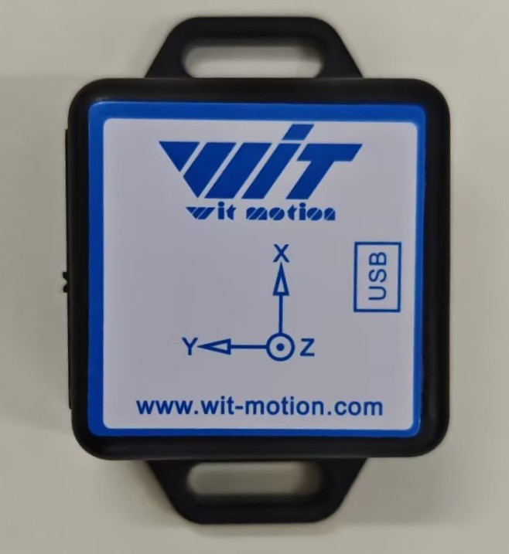



System Architecture
Neural Network
EMG Sensor
CNN
1 DOF gripper is used to validate the feasibility of the regression model.
Camera
Fusion
Visual Feature
Output
Servo Rotation Angle
IMU
Model Training Method - Imitation Learning
The operator manually controls the prosthetic hand.
Record sensors data and hand opening width.
Temporal Feature
Train the model.

Slide 7
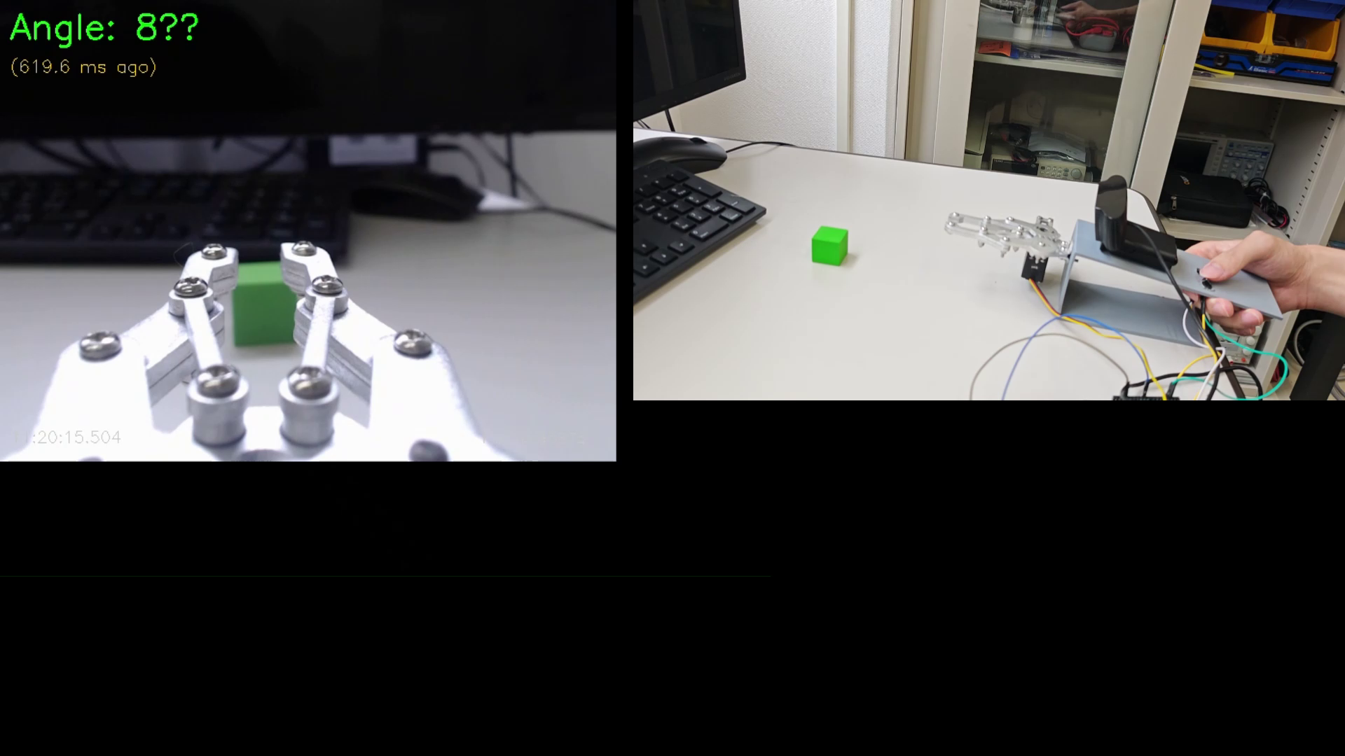
Device
Currently, the camera has been integrated into the system, enabling synchronized acquisition of servo rotation angles and images.

Slide 8
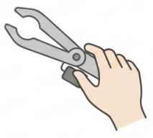





Experiment
Condition A: Manual Control
Objective :
Evaluate the system’s performance, and its ability to reduce the operator’s cognitive load
Participants :
10 healthy adults
Condition B: EMG-Only Control
Scene:
Grasping different size objects under three conditions
Condition C: Proposed System Control

Slide 9



Evaluation
Performance
Cognitive load
Task Completion Time
NASA-TLX [6]
Grasp Success Rate

Slide 10
Summary
Unlike traditional modular pipelines, our system adopts an end-to-end approach that directly maps raw multimodal signals to control outputs.
A regression model is used instead of a classifier, enabling continuous and real-time grasping adjustment.
Based on a shared control, the system autonomously handles the low-level details of the control task, reducing the cognitive load on the user.
Next Steps
I will build a regression model using single camera input to establish a working pipeline. And then, EMG sensors will be introduced to extend the system toward full multimodal end-to-end control.

Slide 11
References
[1] McDonald C L, Westcott-McCoy S, Weaver M R, et al. Global prevalence of traumatic non-fatal limb amputation[J]. Prosthetics and orthotics international, 2021, 45(2): 105-114.
[2] Chen, Z., Min, H., Wang, D., Xia, Z., Sun, F., & Fang, B. (2023). A review of myoelectric control for prosthetic hand manipulation. Biomimetics, 8(3), 328.
[3] Vásconez, J. P., Barona López, L. I., Valdivieso Caraguay, Á. L., & Benalcázar, M. E. (2022). Hand gesture recognition using EMG-IMU signals and deep q-networks. Sensors, 22(24), 9613.
[4] Zandigohar, M., Han, M., Sharif, M., Günay, S. Y., Furmanek, M. P., Yarossi, M., ... & Schirner, G. (2024). Multimodal fusion of EMG and vision for human grasp intent inference in prosthetic hand control. Frontiers in Robotics and AI, 11, 1312554.
[5] Salminger, S., Stino, H., Pichler, L. H., Gstoettner, C., Sturma, A., Mayer, J. A., ... & Aszmann, O. C. (2022). Current rates of prosthetic usage in upper-limb amputees–have innovations had an impact on device acceptance?. Disability and rehabilitation, 44(14), 3708-3713.
[6] Hart, S. G., & Staveland, L. E. (1988). Development of NASA-TLX (Task Load Index): Results of empirical and theoretical research. In Advances in psychology (Vol. 52, pp. 139-183). North-holland.

