Slide 1
End-to-End Multimodal Learning for Continuous Prosthetic Hand Control
Saga University Graduate School of Science and Engineering​
Computer Science & Information Techology Course​
Fukuda Laboratory 25742102 DI XIQING
Supervisor: Professor Osamu Fukuda

Slide 2
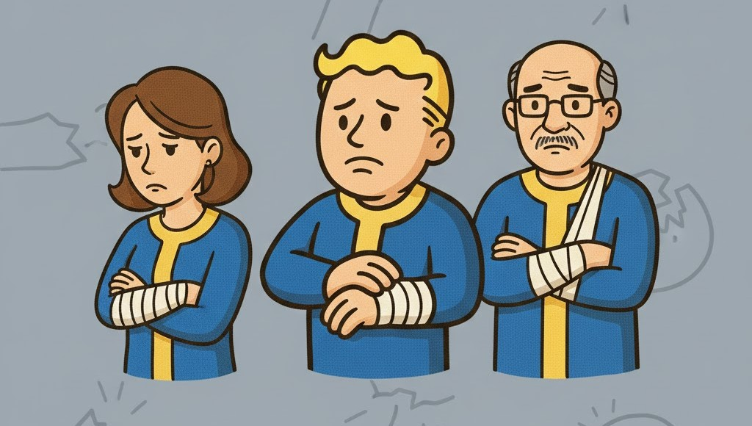


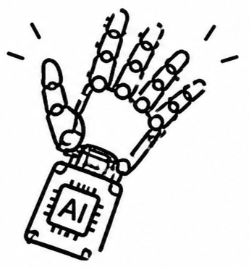


Background
57.7 million people in world
who had lost an upper limb [1]
Computational power and algorithms continue to advance, the prosthetic hand are able to recognize an increasing number of movements [2]

Slide 3


Related Study
Vásconez et al. proposed
EMG + IMU
Deep reinforcement learning model
11 movements
accuracy: 97% [3]
Zandigohar et al. proposed
EMG + Eyes Tracking
Extra-Trees and YOLOv4
14 movements
accuracy: 93% [4]

Slide 4


Research Objective
But the rejection rate of prosthetic hands is as high as 44% [5].
Movement Transition
Regression
Transitions and adjustments between movements were not considered.
Replace the classification model with a regression model to enable real-time continuous adjustment.
Cognitive Load
Shared Control
Users need to maintain a high level of concentration to achieve control.
Shared control delegates fine movement control to the system, reducing user cognitive load.
Modular Approach
End-to-End
Modular Approach increases system complexity but also may lead to the loss of important information.
directly mapping raw input signals to output results, enabling joint optimization of the entire system.
Notes:
In the studies mentioned above, they all final movement decision is made using a classifier. This situation cause problems in real-world applications. When performed a mistaken movement, need to be corrected, currently the classifier cannot smooth transition between movements. For example, when need to grap diffrent object, they all using five finger, but the position of some finger have slight differences.
The adjustment is cant achieve by classifier. So In this study，i will use regression model to replace classifier model, the output will be continuous adjustment.
Secondly, In the above studies, as more accurate EMG signals are required, operaters need to pay attention more to generate accurate signals. in this study, will reduce the requirement of EMG. The operator only needs to perform two movement, opening hand, closing hand. more detailed control is handled by the system.
Furthermore, currently most prosthetic hand system use the modular approach. for example, in previous studies, system divided into a vision module and emg module. Each module being designed its own ability. This not only increases the complexity of the system, but also each module dont truly interact with another, this more like command passing.
so this study use end to end approach, the raw signal directly map the output, without manually intervening in the model's learning processing.

Slide 5



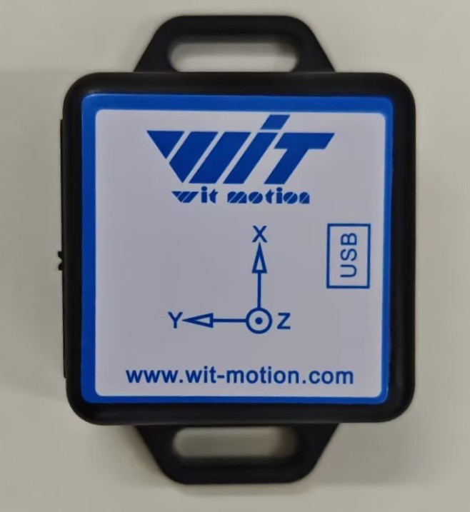
System Architecture
Neural Network
EMG Sensor
EMG
Feature
1 DOF gripper is used to validate the feasibility of the regression model.
Camera
Fusion
Image Feature
Output
Motor Rotation Angle
IMU
IMU
Feature
Notes:
this is the overall system architecture, system will use three type of sensor, currently i implement camera, they acquire its own data as input, after feature extaction and fusion, then map to the motor rotation angle that represent the opening angle of the gripper.

Slide 6
Current Implementation
Integration of the Vision Sensor
ResNet18
Camera
Image Feature
Servo Rotation Angle
Extract image information and convert it into a feature vector
Map it to a number
Notes:
i first implemented the integration of the vision sensor. the model use the convolutional neural network , resnet-18 to extract feature.

Slide 7
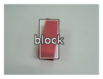
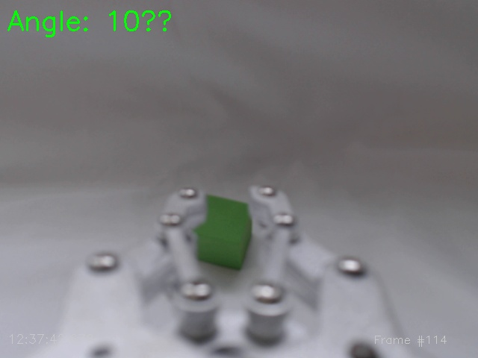
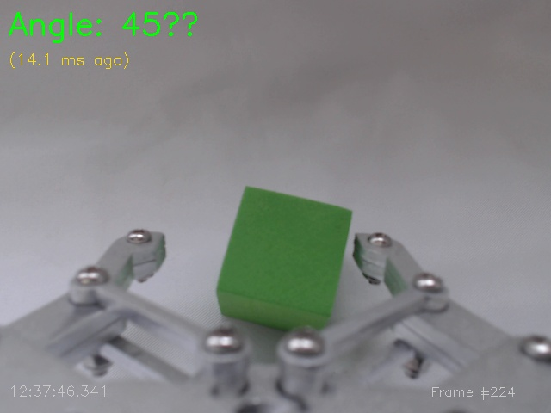
End To End
Previous System
Manual Design
Camera Image
YOLO Object Classification
System Decision
Output Control Commands
Program-Defined Target
Recognition and Tracking
Current System
Training Data
Camera Image
Direct Mapping
Output Angle
Notes:
Comparing with the previous vision module, can observe the feature of the end to end.
This is the process of previous vision module, after using yolo to object classification, need to manually defined rule, such as determining whether an object is target, and which grasping movement should be used.
and now, the end to end approach, can see the camera image directly map the output. other signals are same way.

Slide 8
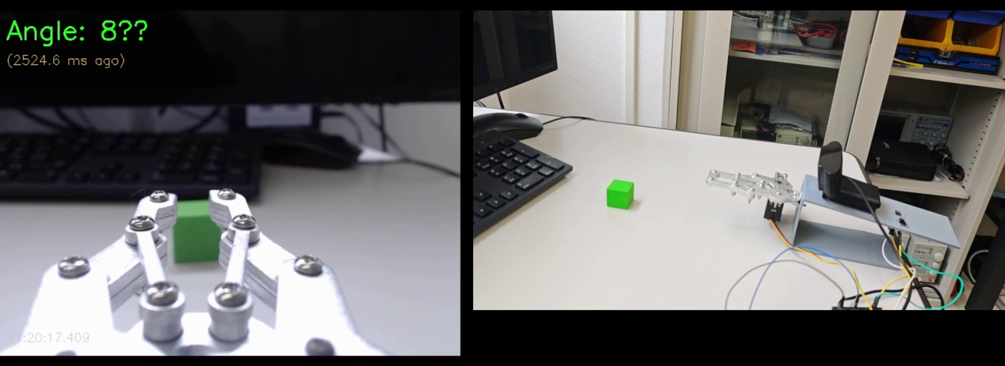
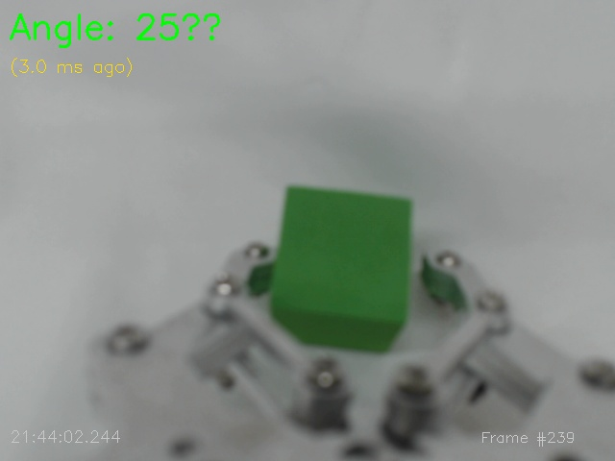
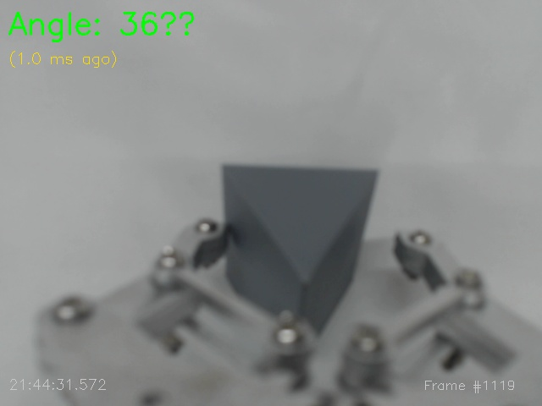
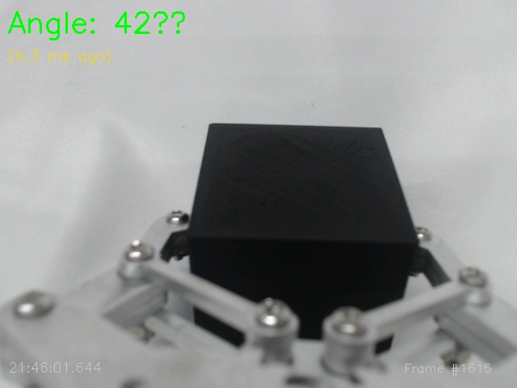
Data Collection
Manual control of the robotic hand for data collection.
Objects
Notes:
so in the system, collecting train data is important. this is collecting data video. when collecting, need operator manually control the gripper to grab object. in the gripper, there are 2 button to control open and close. and in the test will have 3 object of different size.

Slide 9
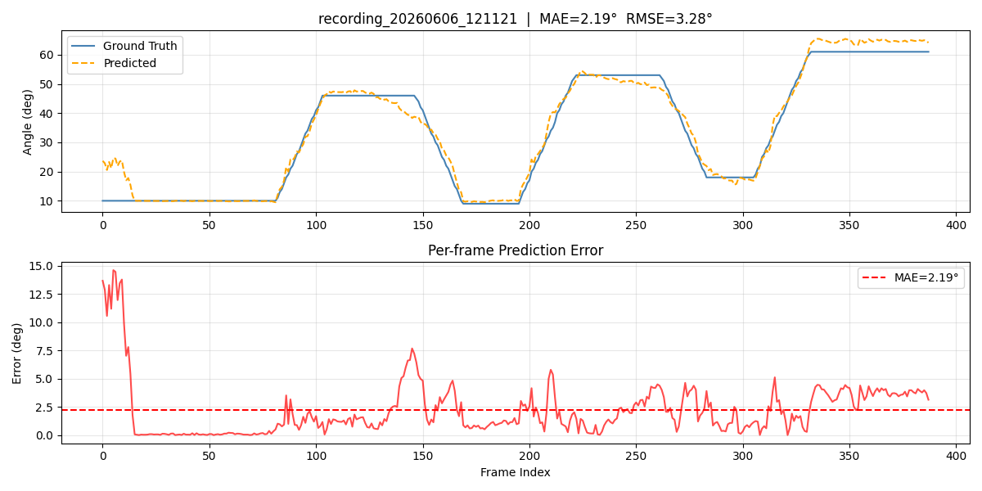
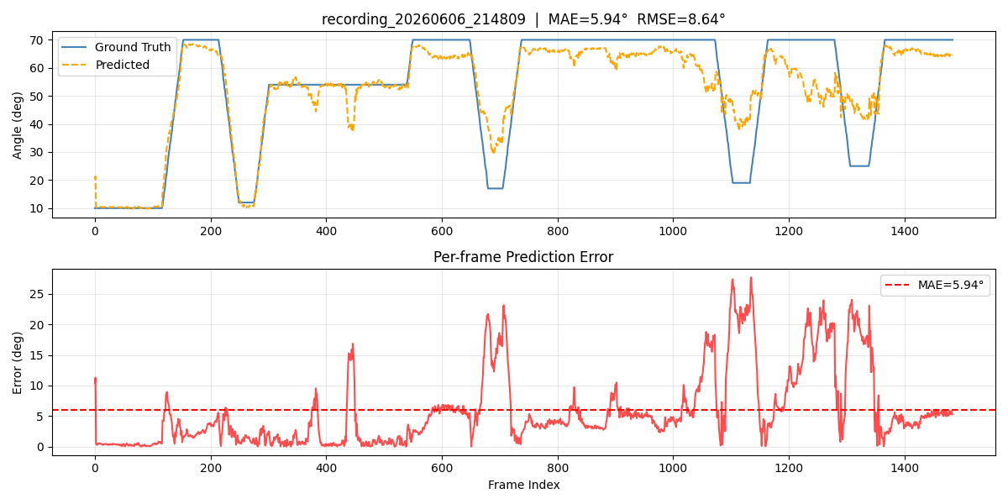
Offline Test
Single-Object Grasping Test
The curves fit well, indicating good performance.
Multi-Object Grasping Test
The performance is not as good as above.
Notes:
in offline test, the top graph show the curves of the predicted and truth value. the curves closer match indicates better performance. the bottom graph shows the angle error.
In the single object grasping test, the performance is good. and in the multi object grasping test, the error rate become higher, but the overall trend are still consistent.
After that, conduct real-time test, the result is bad, the system is almost not work. next objective is to addressing the problem

Slide 10





Experiment
Objective :
Evaluate the system’s performance, and its ability to reduce the operator’s cognitive load
Participants :
10 healthy adults
Condition A: EMG-Only Control
Scene:
Grasping different size objects under two conditions
Condition B: Proposed System Control

Slide 11



Evaluation
Performance
Cognitive load
Task Completion Time
NASA-TLX [6]
Grasp Success Rate

Slide 12
Summary
The first sensor of the system, the camera, has been successfully integrated. The data collection, training, and inference have been completed. Offline test shows promising performance. however, the real time perfomance is not satisfactory.
Next Steps
The next step is to integrate the second sensor, the EMG sensor, and perform the same process of data collection, training, inference, and testing on the system.

Slide 13
References
[1] McDonald C L, Westcott-McCoy S, Weaver M R, et al. Global prevalence of traumatic non-fatal limb amputation[J]. Prosthetics and orthotics international, 2021, 45(2): 105-114.
[2] Chen, Z., Min, H., Wang, D., Xia, Z., Sun, F., & Fang, B. (2023). A review of myoelectric control for prosthetic hand manipulation. Biomimetics, 8(3), 328.
[3] Vásconez, J. P., Barona López, L. I., Valdivieso Caraguay, Á. L., & Benalcázar, M. E. (2022). Hand gesture recognition using EMG-IMU signals and deep q-networks. Sensors, 22(24), 9613.
[4] Zandigohar, M., Han, M., Sharif, M., Günay, S. Y., Furmanek, M. P., Yarossi, M., ... & Schirner, G. (2024). Multimodal fusion of EMG and vision for human grasp intent inference in prosthetic hand control. Frontiers in Robotics and AI, 11, 1312554.
[5] Salminger, S., Stino, H., Pichler, L. H., Gstoettner, C., Sturma, A., Mayer, J. A., ... & Aszmann, O. C. (2022). Current rates of prosthetic usage in upper-limb amputees–have innovations had an impact on device acceptance?. Disability and rehabilitation, 44(14), 3708-3713.
[6] Hart, S. G., & Staveland, L. E. (1988). Development of NASA-TLX (Task Load Index): Results of empirical and theoretical research. In Advances in psychology (Vol. 52, pp. 139-183). North-holland.

