Slide 1
End-to-End Multimodal Learning for Continuous Prosthetic Hand Control
Saga University Graduate School of Science and Engineering​
Computer Science & Information Techology Course​
Fukuda Laboratory 25742102 DI XIQING
Supervisor: Professor Osamu Fukuda
Notes:
Hello everyone im d, my research is ...

Slide 2
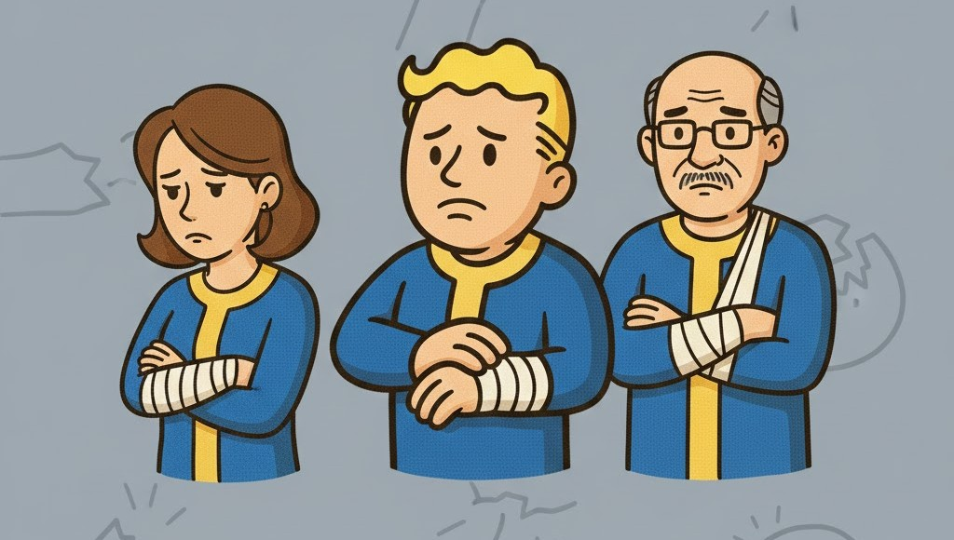


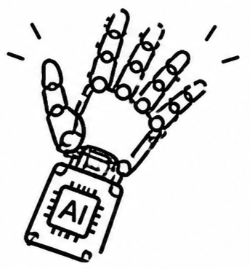


Background
57.7 million people in world
who had lost an upper limb [1]
Computational power and algorithms continue to advance, the prosthetic hand are able to recognize an increasing number of movements [2]
Notes:
Approximately 57.7 million people lost an upper limb.
This significantly impacts their daily lives, so the prosthetic hand research aim to help them.
With computational power and algorithms continue to advance, the prosthetic hand are able to recognize an increasing number of movements

Slide 3


Related Study
Vásconez et al. proposed
EMG + IMU
Deep reinforcement learning model
11 movements
accuracy: 97% [3]
Zandigohar et al. proposed
EMG + Eyes Tracking
Extra-Trees and YOLOv4
14 movements
accuracy: 93% [4]

Slide 4


Research Objective
But the rejection rate of prosthetic hands is as high as 44% [5].
Movement Transition
Regression
Transitions and adjustments between movements were not considered.
Replace the classification model with a regression model to enable real-time continuous adjustment.
Cognitive Load
Shared Control
Users need to maintain a high level of concentration to achieve control.
Shared control delegates fine movement control to the system, reducing user cognitive load.
Modular Approach
End-to-End
Modular Approach increases system complexity but also may lead to the loss of important information.
directly mapping raw input signals to output results, enabling joint optimization of the entire system.
Notes:
In the studies mentioned above, they all final movement decision is made using a classifier. This situation cause problems in real-world applications. When performed a mistaken movement, need to be corrected, currently the classifier cannot smooth transition between movements. For example, when need to grap diffrent object, they all using five finger, but the position of some finger have slight differences.
The adjustment is cant achieve by classifier. So In this study，i will use regression model to replace classifier model, the output will be continuous adjustment.
Secondly, In the above studies, as more accurate EMG signals are required, operaters need to pay attention more to generate accurate signals. in this study, will reduce the requirement of EMG. The operator only needs to perform two movement, opening hand, closing hand. more detailed control is handled by the system.
Furthermore, currently most prosthetic hand system use the modular approach. for example, in previous studies, system divided into a vision module and emg module. Each module being designed its own ability. This not only increases the complexity of the system, but also each module dont truly interact with another, this more like command passing.
so this study use end to end approach, the raw signal directly map the output, without manually intervening in the model's learning processing.

Slide 5



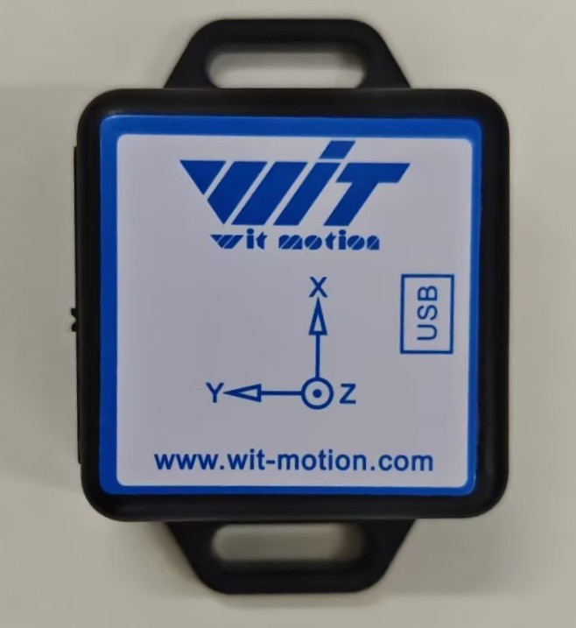
System Architecture
System
EMG Sensor
512-D feature vector
1D CNN
32-D feature vector
Camera
Fusion
ResNet18
512-D feature vector
Motor Rotation Angle
IMU
Network
Notes:
this is the overall system architecture, system will use three type of sensor, currently i implement camera, they acquire its own data as input, after feature extaction and fusion, then map to the motor rotation angle that represent the opening angle of the gripper.

Slide 6
Fusion Strategy
EMG
Camera
Grasping Intention
Target Size
Open/Close/Stay
23.5/62.1/33.3...
Fusion
Output
Notes:
Comparing with the previous vision module, can observe the feature of the end to end.
This is the process of previous vision module, after using yolo to object classification, need to manually defined rule, such as determining whether an object is target, and which grasping movement should be used.
and now, the end to end approach, can see the camera image directly map the output. other signals are same way.

Slide 7
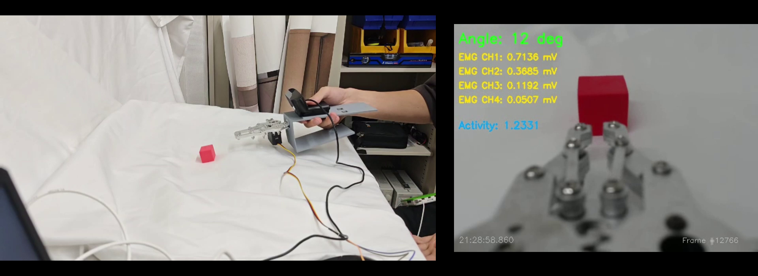
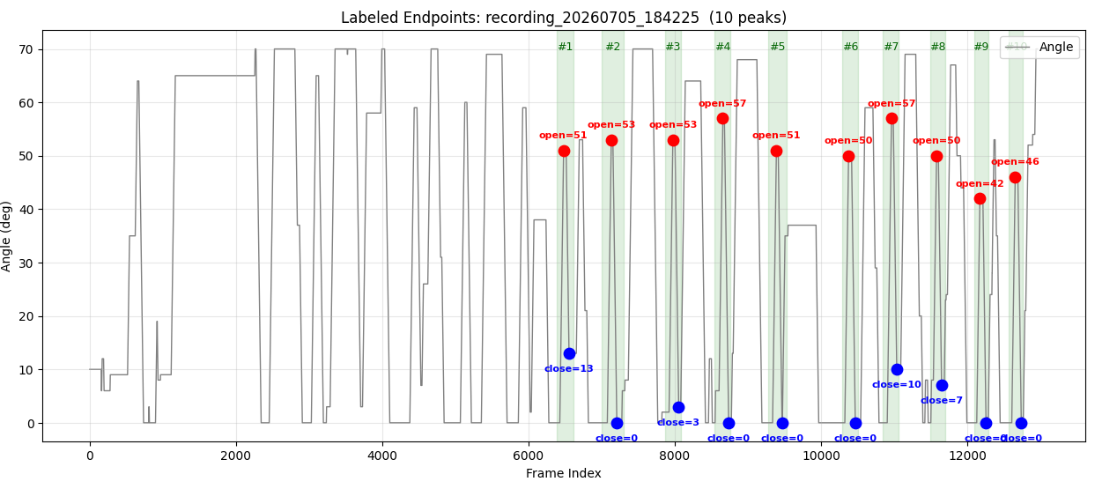
Data Collection
Data Processing
Discard the data collected during the initial setup and debugging.
Label the opening and closing peaks in each data segment
Notes:
so in the system, collecting train data is important. this is collecting data video. when collecting, need operator manually control the gripper to grab object. in the gripper, there are 2 button to control open and close. and in the test will have 3 object of different size.

Slide 8
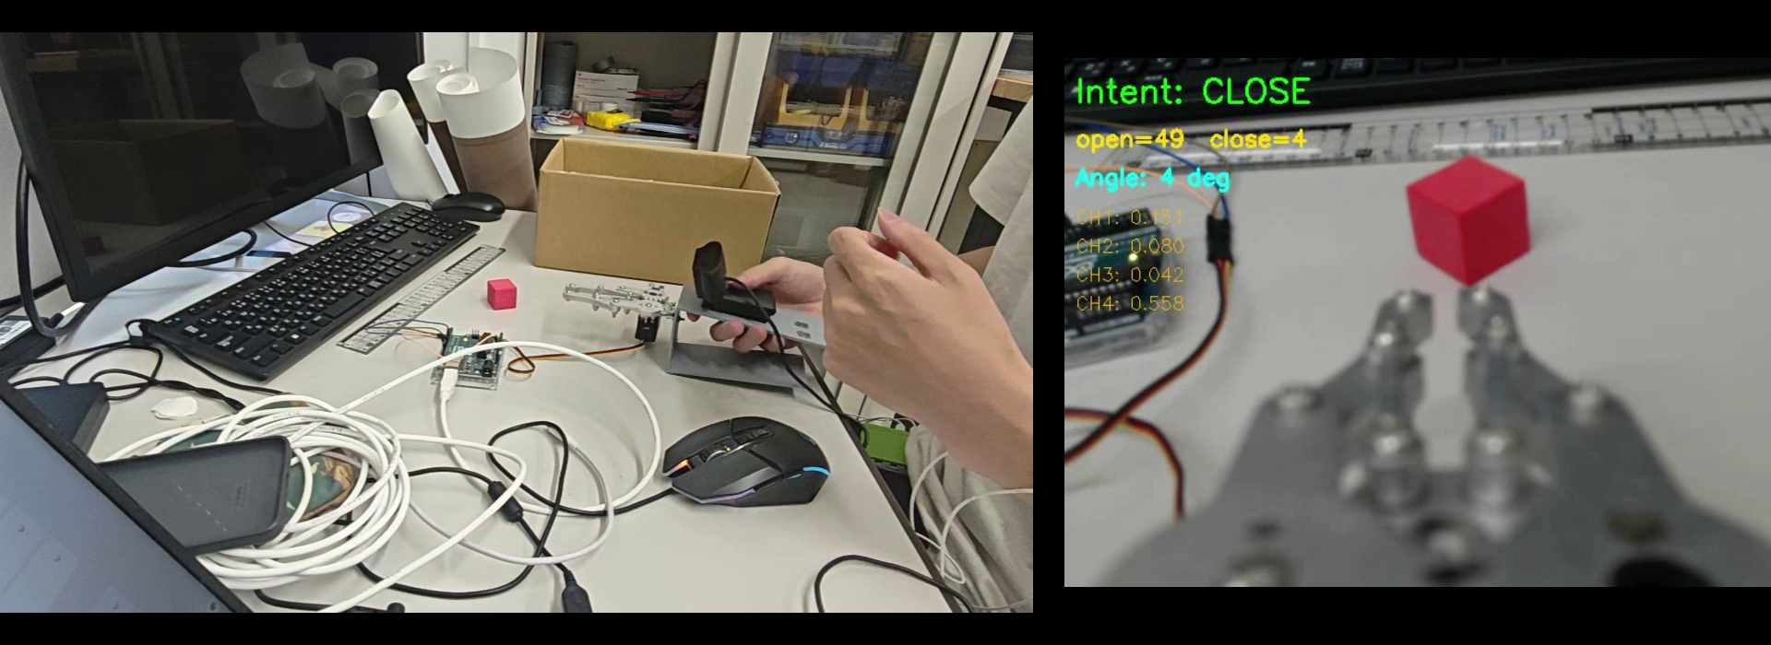
Real-Time Inference
# At the current stage, only the system's real-time inference capability has been tested
# next step is to record data that grasping experiments on various objects, enabling the model to learn grasping angles for different objects.
Notes:
so in the system, collecting train data is important. this is collecting data video. when collecting, need operator manually control the gripper to grab object. in the gripper, there are 2 button to control open and close. and in the test will have 3 object of different size.

Slide 9





Experiment
Objective :
Evaluate the system’s performance, and its ability to reduce the operator’s cognitive load
Participants :
10 healthy adults
Condition A: EMG-Only Control
Scene:
Grasping different size objects under two conditions
Condition B: Proposed System Control

Slide 10



Evaluation
Performance
Cognitive load
Task Completion Time
NASA-TLX [6]
Grasp Success Rate

Slide 11
Summary
The two sensors, the camera and EMG, have been successfully integrated. Button-based control has been replaced with EMG-based control, and synchronized data acquisition and recording have been successfully implemented.
Next Steps
Complete the fusion algorithm, enable real-time inference, and achieve basic system functionality.

Slide 12
References
[1] McDonald C L, Westcott-McCoy S, Weaver M R, et al. Global prevalence of traumatic non-fatal limb amputation[J]. Prosthetics and orthotics international, 2021, 45(2): 105-114.
[2] Chen, Z., Min, H., Wang, D., Xia, Z., Sun, F., & Fang, B. (2023). A review of myoelectric control for prosthetic hand manipulation. Biomimetics, 8(3), 328.
[3] Vásconez, J. P., Barona López, L. I., Valdivieso Caraguay, Á. L., & Benalcázar, M. E. (2022). Hand gesture recognition using EMG-IMU signals and deep q-networks. Sensors, 22(24), 9613.
[4] Zandigohar, M., Han, M., Sharif, M., Günay, S. Y., Furmanek, M. P., Yarossi, M., ... & Schirner, G. (2024). Multimodal fusion of EMG and vision for human grasp intent inference in prosthetic hand control. Frontiers in Robotics and AI, 11, 1312554.
[5] Salminger, S., Stino, H., Pichler, L. H., Gstoettner, C., Sturma, A., Mayer, J. A., ... & Aszmann, O. C. (2022). Current rates of prosthetic usage in upper-limb amputees–have innovations had an impact on device acceptance?. Disability and rehabilitation, 44(14), 3708-3713.
[6] Hart, S. G., & Staveland, L. E. (1988). Development of NASA-TLX (Task Load Index): Results of empirical and theoretical research. In Advances in psychology (Vol. 52, pp. 139-183). North-holland.

Slide 13
Fusion Strategy
1 - Concatenation Fusion
2 - Residual Fusion
544D
F
512D
F
32D
F
32D
F
Base
concat
Result
512D
F
Adjusted
3 - Modified Gated Fusion
EMG
Camera
Grasping Intention
Target Size
Notes:
Comparing with the previous vision module, can observe the feature of the end to end.
This is the process of previous vision module, after using yolo to object classification, need to manually defined rule, such as determining whether an object is target, and which grasping movement should be used.
and now, the end to end approach, can see the camera image directly map the output. other signals are same way.

Slide 14
Current Implementation
Sync
33ms
Neural Network
EMG Sensor
EMG
Feature
Fusion
Output
Camera
Image Feature
Motor Rotation Angle
1D CNN
ResNet18
Fusion Strategy
32-D feature vector
512-D feature vector
Notes:
确认了同步时间33ms
尝试了几种融合策略，最终选择了这个

Slide 15
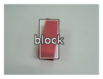
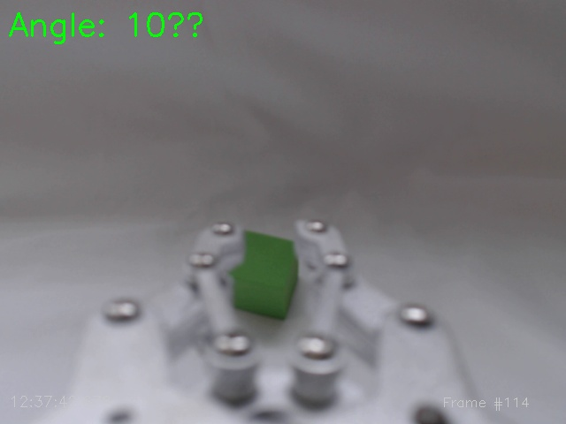
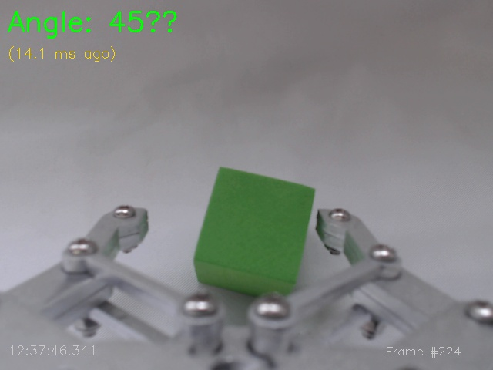
End To End
Previous System
Manual Design
Camera Image
YOLO Object Classification
System Decision
Output Control Commands
Program-Defined Target
Recognition and Tracking
Current System
Training Data
Camera Image
Direct Mapping
Output Angle
Notes:
Comparing with the previous vision module, can observe the feature of the end to end.
This is the process of previous vision module, after using yolo to object classification, need to manually defined rule, such as determining whether an object is target, and which grasping movement should be used.
and now, the end to end approach, can see the camera image directly map the output. other signals are same way.

