Slide 1
End-to-End Multimodal Learning for Continuous Prosthetic Hand Control
Saga University Graduate School of Science and Engineering​
Computer Science & Information Techology Course​
Fukuda Laboratory 25742102 DI XIQING
Supervisor: Professor Osamu Fukuda
Notes:
Hello everyone im d, my research is ...

Slide 2
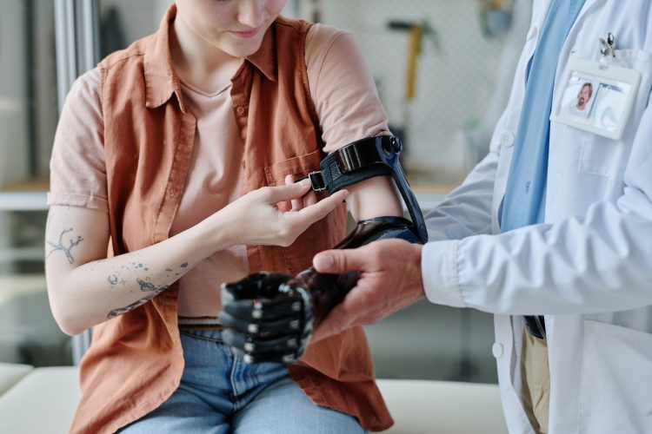


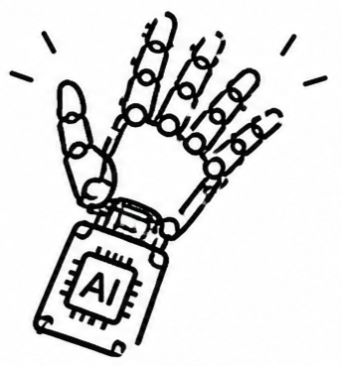


Background
57.7 million people in world
who had lost an upper limb [1]
Computational power and algorithms continue to advance, the prosthetic hand are able to recognize an increasing number of movements [2]
Notes:
Approximately 57.7 million people lost an upper limb.
This significantly impacts their daily lives, so the prosthetic hand research aim to help them.
With computational power and algorithms continue to advance, the prosthetic hand are able to recognize an increasing number of movements

Slide 3


Related Study
Sensors Combine : EMG + Eyes Tracking
Model : Extra-Trees and YOLOv4
Grasping Movements Number : 14
Accuracy : 93% [4]
Sensors Combine : EMG + IMU
Model : Deep reinforcement learning
Grasping Movements Number : 11
Accuracy : 97% [3]
Strengths
combining multiple sensors, using classification models.
can achieve multiple grasping movements with high recognition accuracy.
Limitations
Although have the high accuracy of a wide range movements types, but in real-world task scenarios, even a single movements can be adjusted differently.
Notes:
1.Vásconez et al. proposed a system, that combine EMG with IMU, adopts a deep reinforcement learning model. Classifies 11 types of grasping movements. The results achieved 97% accuracy.
2.Zandigohar et al.
..
This is currently one reason for the high rejection rate of prosthetic hand.

Slide 4


Research Objective & Question
Classification Models
Regression Models
Transitions and adjustments between movements are not considered.
Using regression model to enable real-time continuous adjustment.
Modular Approach
End-to-End Approach
Modular Approach increases system complexity but also may lead to the loss of important information.
Directly mapping raw input signals to output results, enabling joint optimization of the entire system.
Research Question
Can the system build on an end-to-end approach combined with regression be successfully applied, while improving efficiency and reducing cognitive load?
Notes:
So in my research, objective is to Replace classification models to Regression Models.
From modular approach to end to end approach to reduce system complexity and loss of important information
RQ is to verify that can the system build on an end-to-end approach combined with regression be successfully applied,

Slide 5


System Architecture
EMG Sensor
instead of multiple intention,
simplifed 3 intention
EMG Signal
1D CNN
Intention classification
Open/Close/Stay
DecisionFusion
End to End Approach
Directly map
Camera
Image
ResNet18
Corresponding size /servo angle
Different Approach
Previous Vision Branch
Control Output
Object Recognition
Predict Bounding Box
Camera Image
YOLO Object Classification
Compute the Size
Notes:
this the System architeture, now i include two type of sensor.
In EMG Branch，still use a classification model，but instead of ...，grasp or not。This significantly reduces the cognitive load.
and in vision branch, diffrent previous, this time adopt end to end approach, Image directly map ...
In other words, the network no longer performs object recognition, dont draw a bounding box in the image.
finally, will be fusion the decision, output the control result.

Slide 6
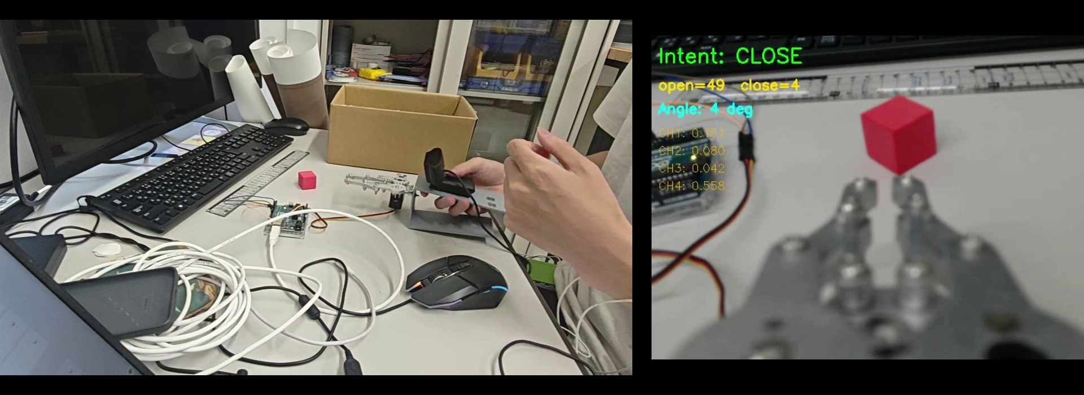
Real-Time Inference Demo
Current objects, the model learns the opening/closing size/angle
Robotic hand automatically determines the suitable size.
# At the current stage, only the system's real-time inference capability has been tested
# next step is to record data of grasping different objects, enabling the model to learn grasping angles for different objects.
Notes:
robotic hand will ..., when i want to grasp, the robotic hand will open suitable size. In the ui we can see, the open and close angle will be continusly adjustment, represent the regresion model are continuous to output a result. Here can see hand vision vedio is slow, when i make the slide, also notice. and i search, this is cuz pyhon need to runing inference so,in the record will have delay. this not affect actual use. But indeed, the two sensors have different frequencies, there can be some misalignment when synchronizing the data. i dont to carefully check.
At the current stage, i just simplely test the system whether it can be running
next step is to record data of grasping different objects, enabling the model to learn grasping angles for different objects.

Slide 7
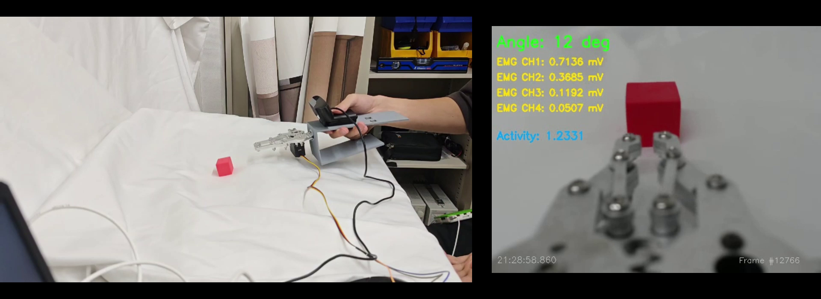
Training
Imitation learning:
Records the operator grasping objects using EMG-Only mode (manual mode).
The system will learns the operator's usage habits.
A grasping process consists of: closed state → moving toward the object → opening the hand → closing to grasp.
Records
Image, EMG Signal, Angle
Notes:
this is training procedure, the system adopts imitation learning. so i record the Image and emg signal and angle, feed into system, system will be learning, Learns the angle as output, directly corresponding to the synchronized image. so in the record,

Slide 8
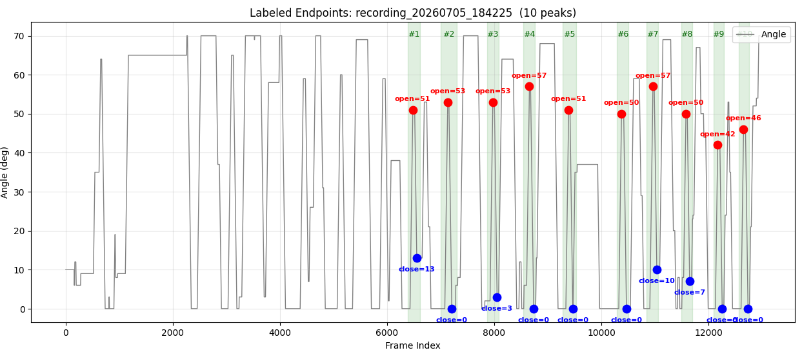
Data Processing
label:
Each grasping process is labeled with the peak (open) and trough (closed) values.
Discarded data:
System startup calibration phase
Angle Change Curve
Notes:
This is the angle change curve. this part is discarded data that is system startup calibration phase.
the green range is valid value, it is one gasping process, so each angle change in grasping process, is a peak curve. After several testing, i found instead of raw angle data, labeling the peak and trough values, feed into model to learning, will let the system perform better.
and due to the peak shape, i can automaticly to labeling

Slide 9





Experiment
Objective :
Evaluate the system’s performance, and its ability to reduce the operator’s cognitive load
Participants :
10 healthy adults
Condition A: EMG-Only Control
Scene:
Grasping different size objects under two conditions
Condition B: Proposed System Control
Notes:
For to evaluate.... I design the experiment. the scen is let the participants to grasp different size object

Slide 10



Evaluation
Performance
Cognitive load
Task Completion Time
NASA-TLX [5]
Grasp Success Rate
Notes:
There are two metrics.

Slide 11
Summary
The two sensors, the camera and EMG, have been successfully integrated.
Record control mode, Button-based control has been replaced with EMG-based control.
Synchronized data acquisition and recording have been successfully implemented.
Achieved decision fusion, successfully enabling real-time inference.
Next Steps
Completed grasping tests on multiple objects, and preparing to conduct the experiment.
Notes:
now in my research, the two...

Slide 12
References
[1] McDonald C L, Westcott-McCoy S, Weaver M R, et al. Global prevalence of traumatic non-fatal limb amputation[J]. Prosthetics and orthotics international, 2021, 45(2): 105-114.
[2] Chen, Z., Min, H., Wang, D., Xia, Z., Sun, F., & Fang, B. (2023). A review of myoelectric control for prosthetic hand manipulation. Biomimetics, 8(3), 328.
[3] Vásconez, J. P., Barona López, L. I., Valdivieso Caraguay, Á. L., & Benalcázar, M. E. (2022). Hand gesture recognition using EMG-IMU signals and deep q-networks. Sensors, 22(24), 9613.
[4] Zandigohar, M., Han, M., Sharif, M., Günay, S. Y., Furmanek, M. P., Yarossi, M., ... & Schirner, G. (2024). Multimodal fusion of EMG and vision for human grasp intent inference in prosthetic hand control. Frontiers in Robotics and AI, 11, 1312554.
[5] Hart, S. G., & Staveland, L. E. (1988). Development of NASA-TLX (Task Load Index): Results of empirical and theoretical research. In Advances in psychology (Vol. 52, pp. 139-183). North-holland.

