Slide 1
Multimodal Shared Control for Prosthetic Hands: Continuous Adjustment for Reduced Cognitive Load
Saga University Graduate School of Science and Engineering​
Computer Science & Information Techology Course​
Fukuda Laboratory 25742102 DI XIQING
Supervisor: Professor Osamu Fukuda

Slide 2
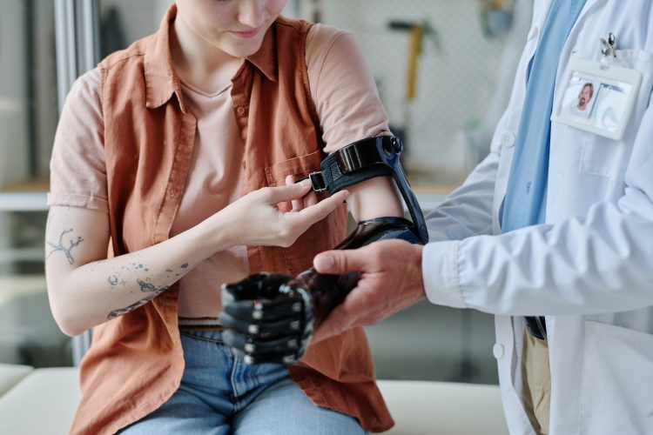


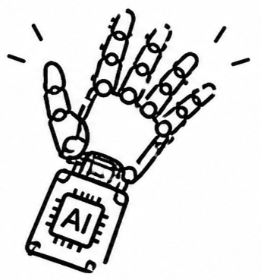


Background
57.7 million people worldwide
have traumatic limb amputation
East Asia 11.2 million
South Asia 9.7 million [1]
As computational power, algorithms, and sensor continue to advance, this goal is being approached ever more closely [2]
Notes:
在这个世界上约有57.7m人患有肢体残疾，This issue is especially serious in Asia，East Asia and South Asia accounting for about 11.2 million and 9.7 million cases
This significantly impact their rest lives, Researchers are dedicated to developing prosthetic hands can perfectly restore human hand function.
prosthetic hands are able to recognize an increasing variety of hand gestures.

Slide 3


Related Study
Sensors : EMG + Eyes Tracking
Model : Extra-Trees and YOLOv4
Grasping gestures Number : 14
Accuracy : 93% [4]
Sensors : EMG + IMU
Model : Deep reinforcement learning
Grasping gestures Number : 11
Accuracy : 97% [3]
Research Gap
Although have the high accuracy of a wide range gesture variety. Expanding the "variety" only addresses the problem of "which grasp pattern to select". It does not resolve the continuous, effortless adjustment like the human hand.
Notes:
1.Vásconez et al. proposed a system, that combine EMG with IMU, adopts xx model. Classifies 11 variety of grasping movements. The results achieved 97% accuracy.
2.Zandigohar et al.
This is precisely the aspect of natural grasping that consumes the most cognitive resources.

Slide 4
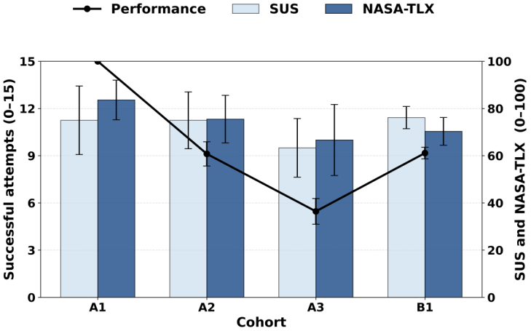
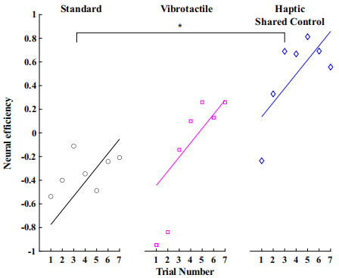
Related Study
A1 : 1 Gesture
A2 : 3 Gesture
A3 : 5 Gesture
As the number of gestures to be recognized increases,
cognitive load increases significantly [5]
Autonomous Control System :
Automatically closes to a target grip force
Low-level tasks
Autonomous control could better improve neural efficiency [6]
Notes:
1.In Lalle's study, the number of recognizable gestures was set at three levels, from low to high. The results showed that as the....
2.In Thomas's study, they proposed a system that automates the low-level task of determining how much force to apply when grasping an object. The results showed that this approach could better improve neural efficiency.

Slide 5


Research Objective
Multiple Commands
Simplified Commands
The user needs to issue multiple hand gesture commands.
Simplified to only two commands: grasp and release.
No Fine-Tuning After Decision
Continuous Fine-Tuning
It functions like a one-shot decision. once made, it is never revisited or adjusted.
During the grasping process, the prosthetic hand automatically fine-tunes itself to grasp the object.
Research Question
Is it possible to use a camera and other sensors to achieve automatic, continuous adjustment during the grasping process.
Notes:
So, in my research, I aim to develop a prosthetic hand simplifies the user's EMG input from multiple hand gesture commands. to just two command, grasp and release.
And during the grasping process, the hand will automatically adjust to grasp the object.

Slide 6


System Architecture
EMG Sensor
responsible for determining the user's general intention.
EMG Signal
1D CNN
Intention classification
Open/Close/Stay
DecisionFusion
End to End Approach
Directly map
Camera
Image
ResNet18
Corresponding size /motor angle
Different Approach
Previous Vision Branch
Control Output
Object Recognition
Predict Bounding Box
Camera Image
YOLO Object Classification
Compute the Size
Notes:
this the System architeture, now i include two type of sensor.
In EMG Branch，use a 1D CNN to recognize three types of EMG signals: open, close, and stay. In the grasping task, the EMG branch is responsible...
vision branch used to recognize the scene and output an Corresponding size. diffrent previous now the network no longer performs object recognition, During the grasping process — for example, as the hand moves toward the target — the size is continuously adjusted
finally, the outputs of the two branches are combined into a single result: whether to grasp or release, and what angle the prosthetic hand should reach.

Slide 7
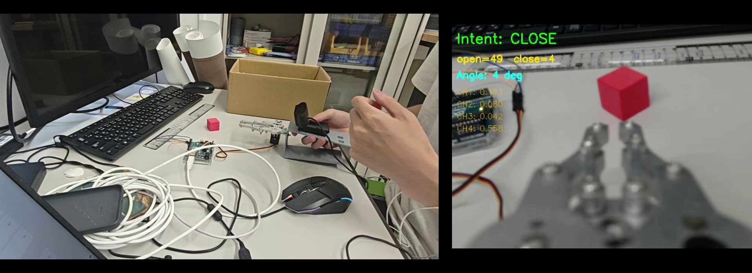
Real-Time Inference Demo
Open and Close angle
Small continusly adjust
Robotic hand automatically open and close the suitable size.
# At the current, only the preliminary system has been tested
# next step is to test that grasp different objects.
Notes:
this is .... demostrate video, the robotic hand will ..., here is open and close angle ui, can see continusly small adjust.
Here can see hand vision vedio is slow, when i make the slide, also notice. and i search, this is cuz pyhon need to runing inference so,in the record will have delay. this not affect actual use. But indeed, the two sensors have different frequencies, there can be some misalignment when synchronizing the data. i dont to carefully check.

Slide 8
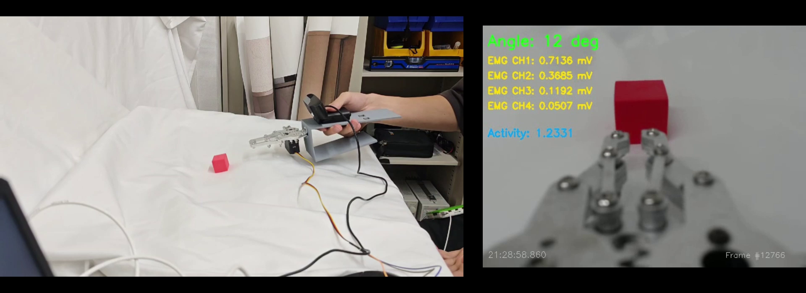
Training
Imitation learning:
Records the operator use EMG-Only mode (manual mode) to grasp objects.
The model directly maps the input image data to the output servo motor angle
Recorded data:
① Image
② EMG Signal
③ Motor Angle
Notes:
this is training data record, the training adopts imitation learning. operator use EMG-Only mode to grasp objects.
During this process, the image, EMG signal, and servo motor angle are all recorded and saved. In the vision branch, the model also directly maps the input image data to the output servo motor angle

Slide 9
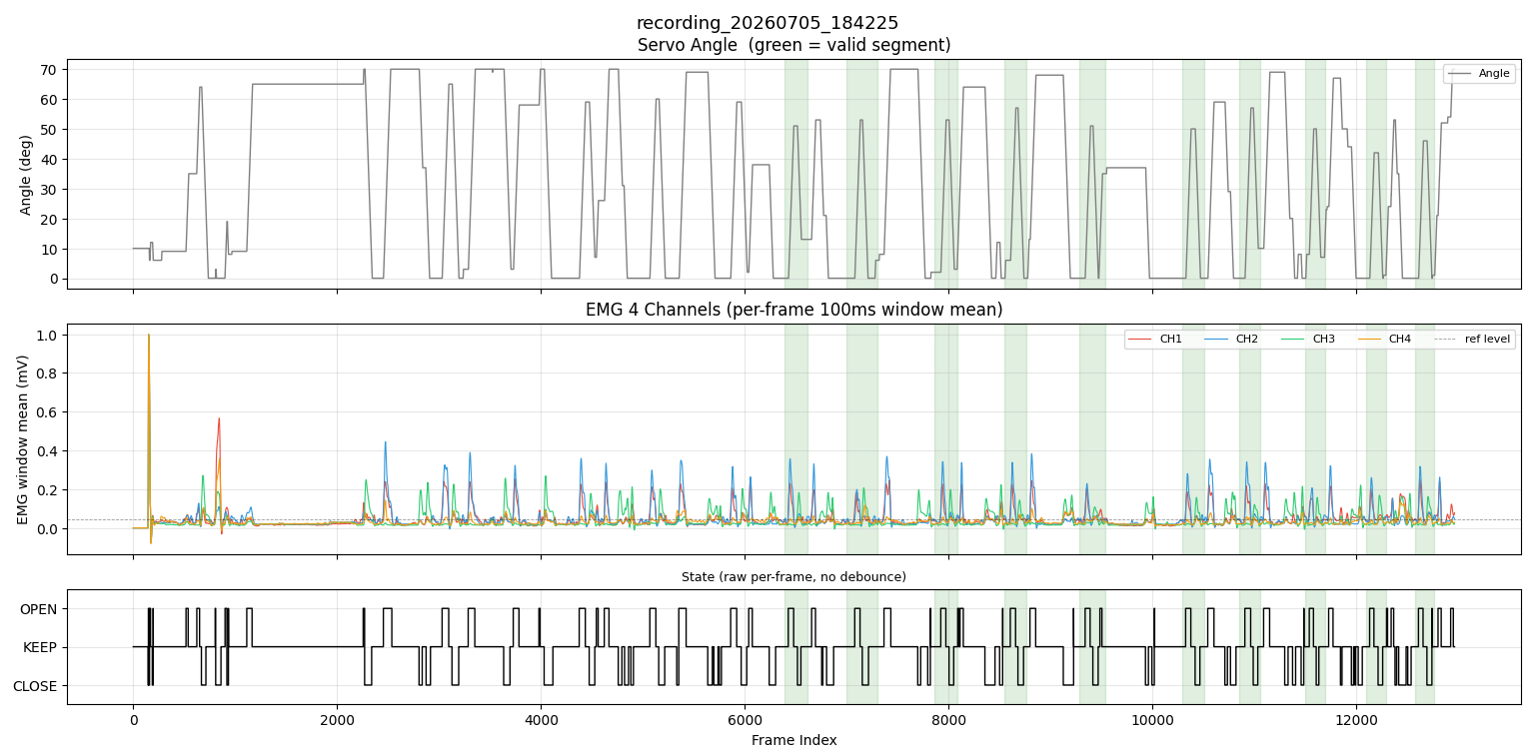
Training Data
Grasping process:
Closed state → Moving toward object → Opening hand → Closing to grasp.
Mark valid data
(by pressing a button during recording)
Notes:
when system starts running, it automatically records data in sync. However, during recording, there is a large amount of irrelevant data that does not correspond to the actual grasping process. Feeding this data into training would contaminate the model. so I later added a manual marking the valid data grasping segment . And each valid data segment corresponds to one complete grasping process. start close state...

Slide 10





Experiment
Objective :
Evaluate the system’s performance, and its ability to reduce the operator’s cognitive load
Participants :
10 healthy adults
Condition A: EMG-Only Control
Scene:
Grasping different size objects under two conditions
Condition B: Proposed System Control
Notes:
For to evaluate.... I design the experiment. the scen is let the participants to grasp different size object

Slide 11



Evaluation
Performance
Cognitive load
Task Completion Time
NASA-TLX [5]
Grasp Success Rate
Notes:
There are two metrics.

Slide 12
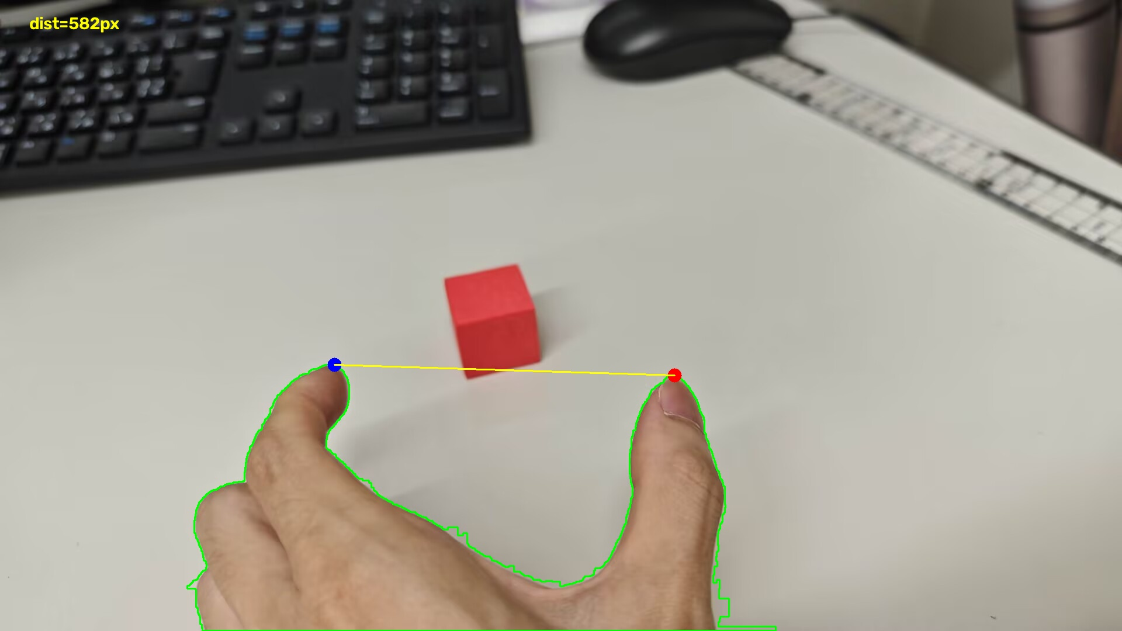
Summary
The two sensors, the camera and EMG, have been successfully integrated.
Synchronized data acquisition and recording have been successfully implemented.
Achieved decision fusion, successfully enabling real-time inference.
Next Steps
Will switch the data recording from the prosthetic hand to the human hand, in order to learn a more natural grasping process.
Notes:
However, current prosthetic grasping is still not natural enough. next step

Slide 13
References
[1] McDonald C L, Westcott-McCoy S, Weaver M R, et al. Global prevalence of traumatic non-fatal limb amputation[J]. Prosthetics and orthotics international, 2021, 45(2): 105-114.
[2] Chen, Z., Min, H., Wang, D., Xia, Z., Sun, F., & Fang, B. (2023). A review of myoelectric control for prosthetic hand manipulation. Biomimetics, 8(3), 328.
[3] Vásconez, J. P., Barona López, L. I., Valdivieso Caraguay, Á. L., & Benalcázar, M. E. (2022). Hand gesture recognition using EMG-IMU signals and deep q-networks. Sensors, 22(24), 9613.
[4] Zandigohar, M., Han, M., Sharif, M., Günay, S. Y., Furmanek, M. P., Yarossi, M., ... & Schirner, G. (2024). Multimodal fusion of EMG and vision for human grasp intent inference in prosthetic hand control. Frontiers in Robotics and AI, 11, 1312554.
[5] Lalle, A., Migliore, S., Stevenson, J., Bell, E., Pradeep, M., Gunnell, D., ... & Manero II, A. (2026). Multigesture Electromyographic Control Complexity in Upper Limb Prostheses Actuated via Single Sensor Input Contraction Magnitude: Qualitative Study for Evaluating Performance and Cognitive Load. JMIR Rehabilitation and Assistive Technologies, 13(1), e88528.
[6] Thomas, N., Miller, A. J., Ayaz, H., & Brown, J. D. (2023). Haptic shared control improves neural efficiency during myoelectric prosthesis use. Scientific reports, 13(1), 484.

