Slide 1
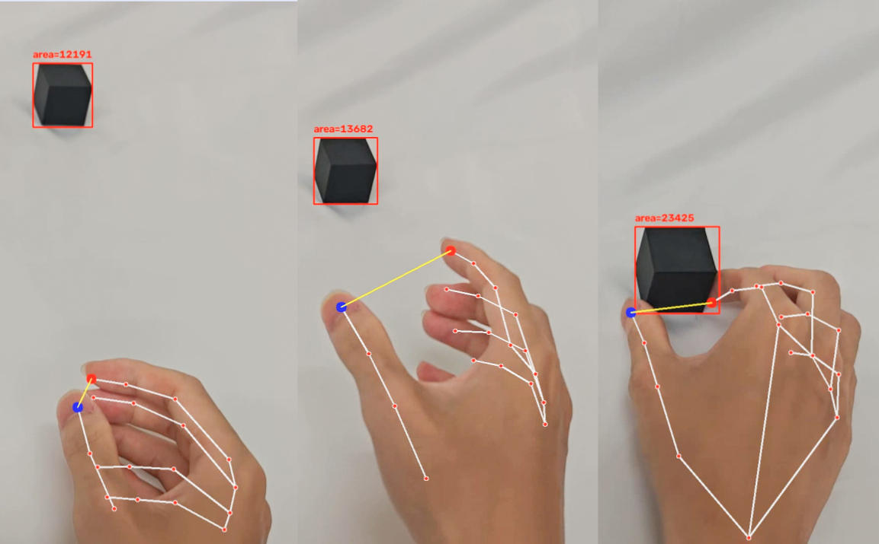
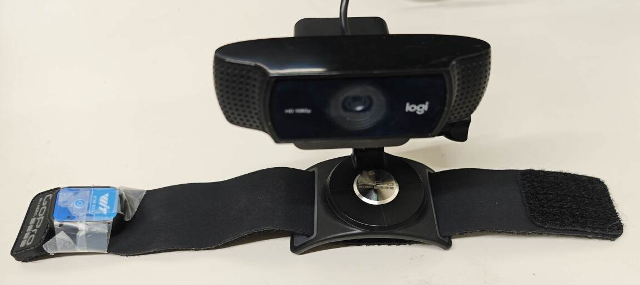
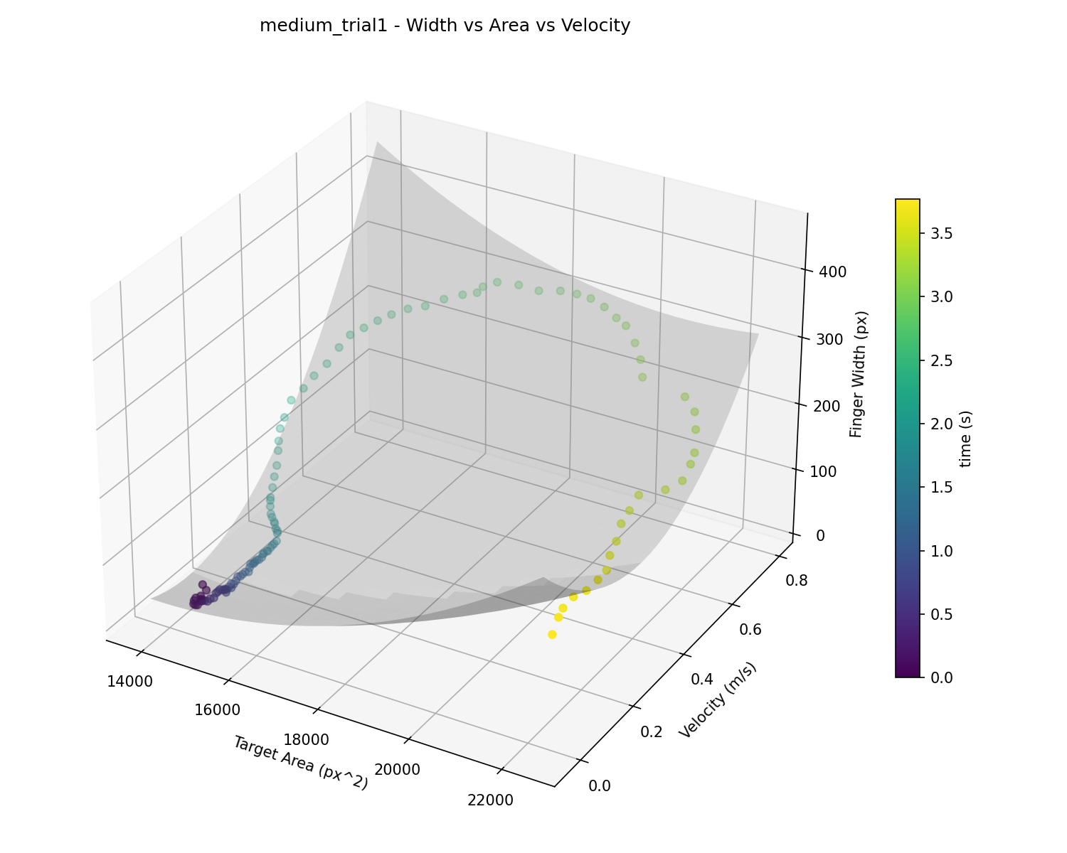
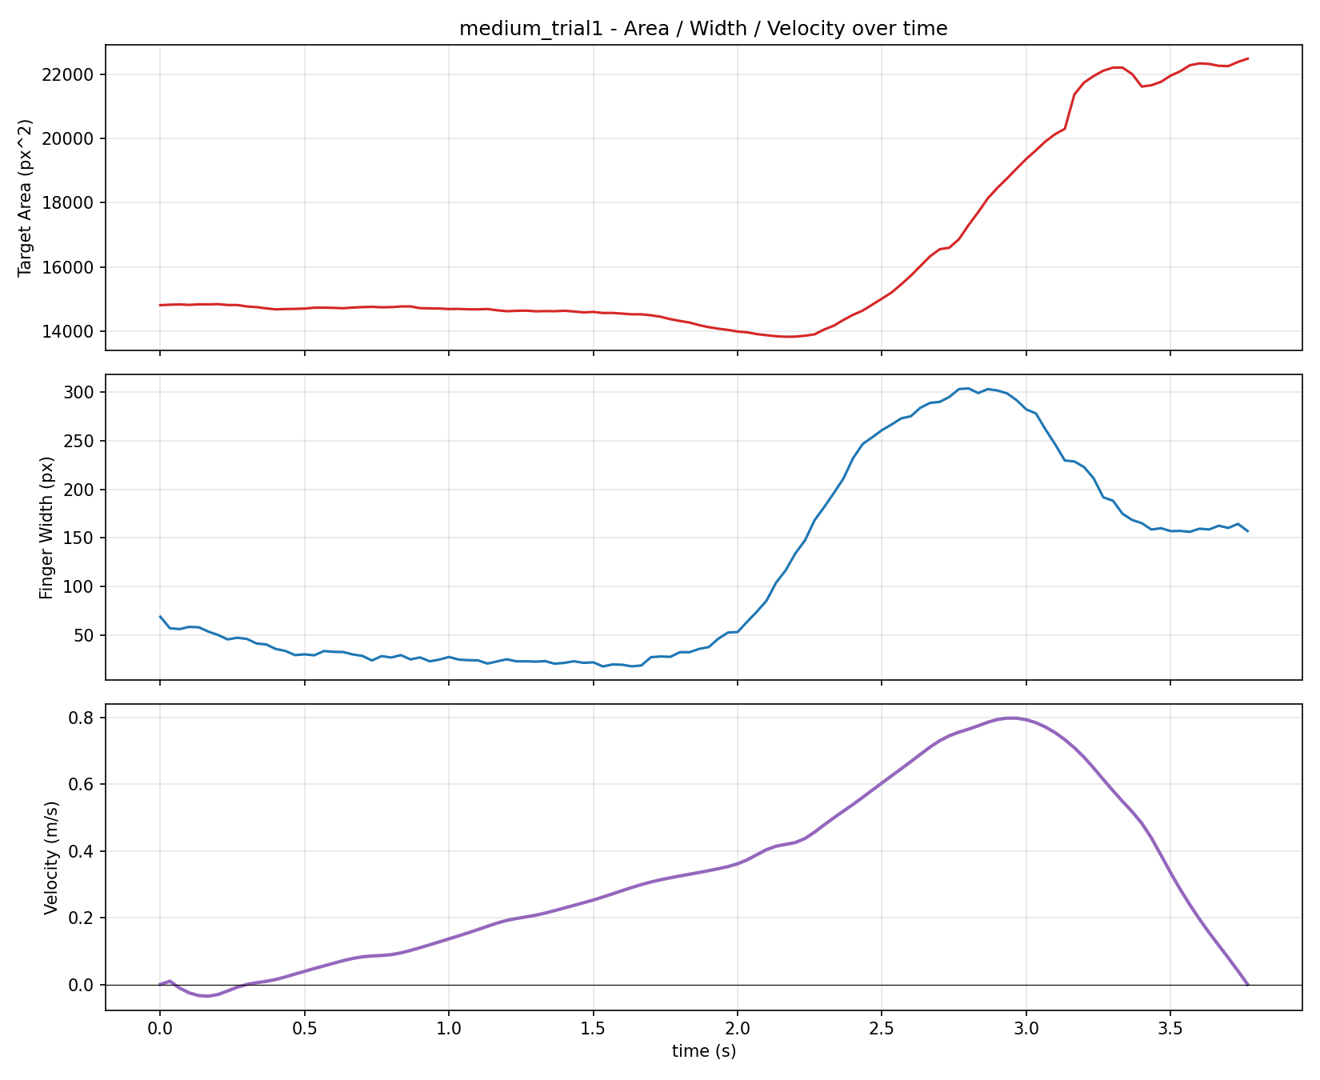
A Multimodal Fusion-Based Prosthetic Hand Control System via Natural Grasping
3
タスク
Most current prosthetic hands rely on preset pattern recognition — once a grasp category is identified, no further adjustment is made. This study records data from natural human grasping to analyze the relationship between target size, velocity, and finger width, providing a predictive basis for the prosthetic hand to mimic human grasping behavior.
Objective
Record data from natural human grasping and build a dynamic model of human grasping to learn this process, with the goal of predicting finger width during grasping.
Record Grasping Process
System
The data collection system uses a camera and IMU to synchronous-ly record grasping velocity,
target object area, and
finger width.
Recording Device
Result
Finger width consistently shows a rise–peak–close pattern and changes with target area and velocity. The same pattern appears across different object sizes.
3D Surface Plot
Data Line Chart

