Slide 1
A Multimodal Fusion-Based Prosthetic Hand Control System via Natural Grasping
Saga University Graduate School of Science and Engineering​
Computer Science & Information Techology Course​
Fukuda Laboratory 25742102 DI XIQING
Supervisor: Professor Osamu Fukuda
Notes:
大家好我叫DI XIQING，来自佐贺大学，福田研究室，我的研究主题是

Slide 2
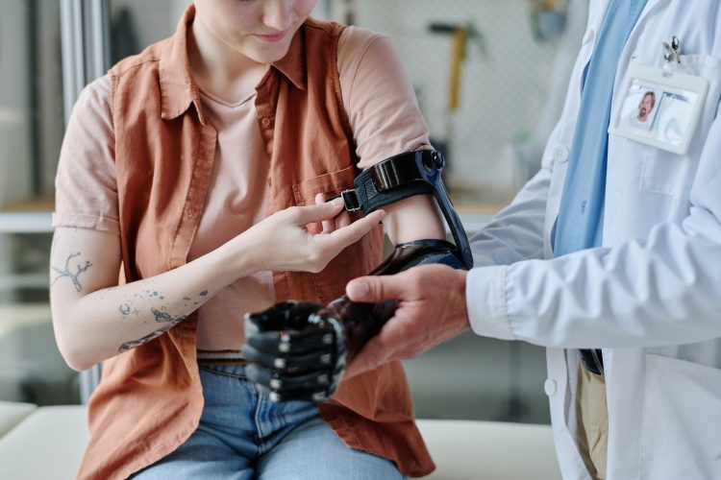


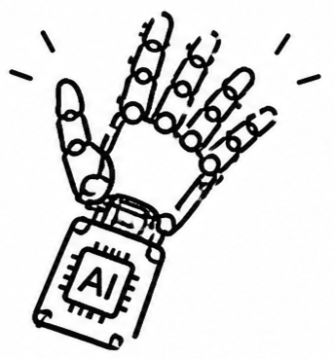


Background
57.7 million people worldwide
have traumatic limb amputations
East Asia 11.2 million
South Asia 9.7 million [1]
As computational power, algorithms, and sensor continue to advance, this goal is being approached ever more closely [2]
Notes:
In the world about 57.7 million people have traumatic limb amputations. This issue is especially serious in Asia，East Asia and South Asia accounting for about 11.2 million and 9.7 million cases
This significantly impact their rest lives, Researchers are dedicated to developing prosthetic hands can perfectly restore human hand function.
...
prosthetic hands are able to recognize an increasing variety of hand gestures.

Slide 3


Related Study
Sensors : EMG + Eyes Tracking
Model : Extra-Trees and YOLOv4
Grasping gestures Number : 14
Accuracy : 93% [4]
Sensors : EMG + IMU
Model : Deep reinforcement learning
Grasping gestures Number : 11
Accuracy : 97% [3]
Research Gap
Although have the high accuracy of a wide range gesture variety. But expanding the "variety" only addresses the problem of "which grasp pattern to select". It does not resolve the continuous, effortless adjustment like the human hand.
Notes:
1.Vásconez et al. proposed a system, that combine EMG sensor with IMU, adopts Deep reinforcement learning model. Classifies 11 variety of grasping movements. The results achieved 97% accuracy.
2.Zandigohar et al.
...
This is the aspect of natural grasping that consumes the most cognitive resources.

Slide 4
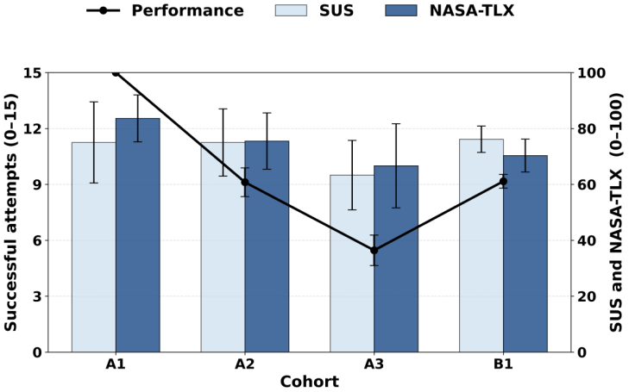
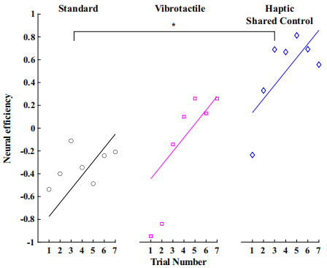
Related Study
A1 : 1 Gesture
A2 : 3 Gesture
A3 : 5 Gesture
As the number of gestures to be recognized increases,
cognitive load increases significantly [5]
Autonomous Control System :
Automatically closes to a target grip force
Low-level tasks
Autonomous control could better improve neural efficiency [6]
Notes:
1.In Lalle's study, the results showed that as the number of gestures to be recognized increases, cognitive load significantly increases.
2.In Thomas's study, they proposed a system that automates the low-level task of determining. The results showed that this approach could better improve neural efficiency.

Slide 5


Research Objective
Multiple Commands
Simplified Commands
The user needs to issue multiple hand gesture commands.
Simplified to only two commands: grasp and release.
No Fine-Tuning After Decision
Continuous Fine-Tuning
It functions like a one-shot decision. once made, it is never revisited or adjusted.
During the grasping process, the prosthetic hand automatically fine-tunes itself to grasp the object.
Research Question
Is it possible to use a camera and other sensors to achieve automatic, continuous adjustment during the grasping process.
Notes:
So, in my research, I aim to develop a prosthetic hand simplifies the user's EMG input from multiple hand gesture commands.
And during the grasping process, the prosthetic hand will automatically adjust to grasp the object.
Research Question is possible to use a camera and other sensors to achieve automatic, continuous adjustment during the grasping process.

Slide 6
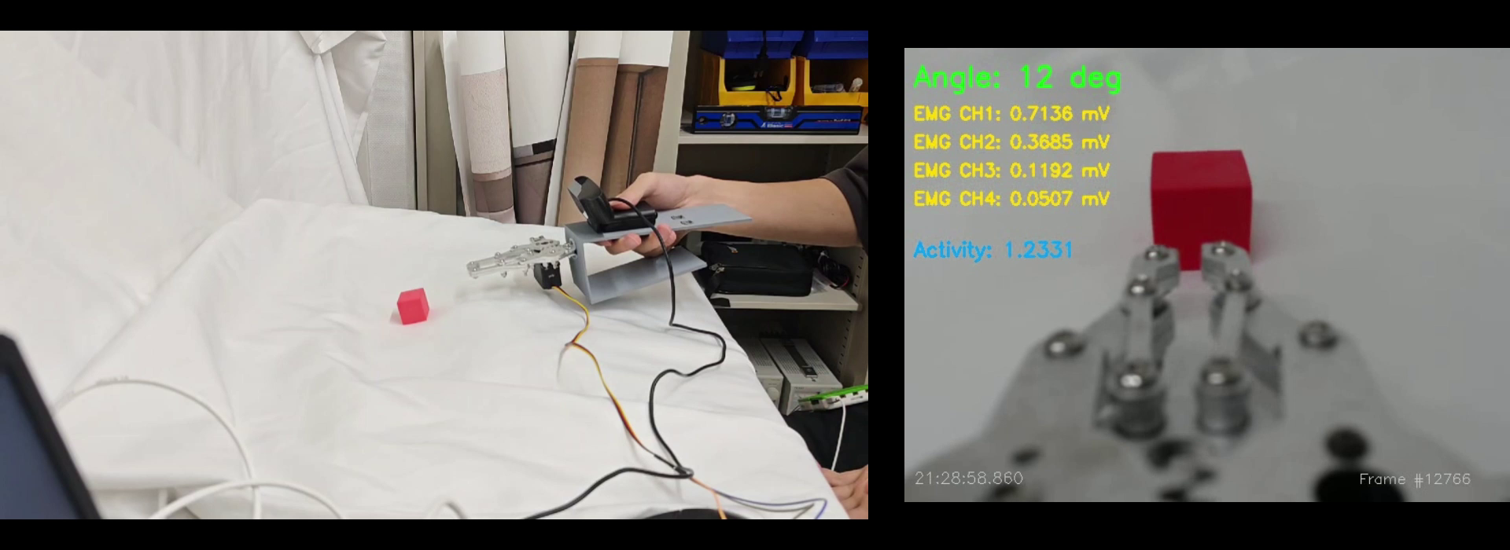
Training
Imitation learning:
Records the operator use EMG-Only mode (manual mode) to grasp objects.
The model directly maps the input image data to the output servo motor angle
Recorded data:
① Image
② EMG Signal
③ Motor Angle
Notes:
This is training data record, the training approch adopts imitation learning. operator use EMG-Only mode to grasp objects.
During this process, the image, EMG signal, and servo motor angle are all recorded and saved. In the vision branch, the model also directly maps the input image data to the output servo motor angle

Slide 7


System Architecture
EMG Sensor
responsible for determining the user's general intention.
EMG Signal
1D CNN
Intention classification
Open/Close/Stay
DecisionFusion
End to End Approach
Directly map
Camera
Image
ResNet18
Corresponding size /motor angle
Different Approach
Previous Vision Branch
Control Output
Object Recognition
Predict Bounding Box
Camera Image
YOLO Object Classification
Compute the Size
Notes:
this the System architeture, now i include two type of sensor.
In EMG Branch，use a 1D CNN to recognize three types of EMG signals: open, close, and stay. In the grasping task, the EMG branch is responsible for determining the user's general intention.
Vision branch used to recognize the scene and output an corresponding size.
Finally, the outputs of the two branches are combined into a single result: whether to grasp or release, and what angle the prosthetic hand should reach.

Slide 8
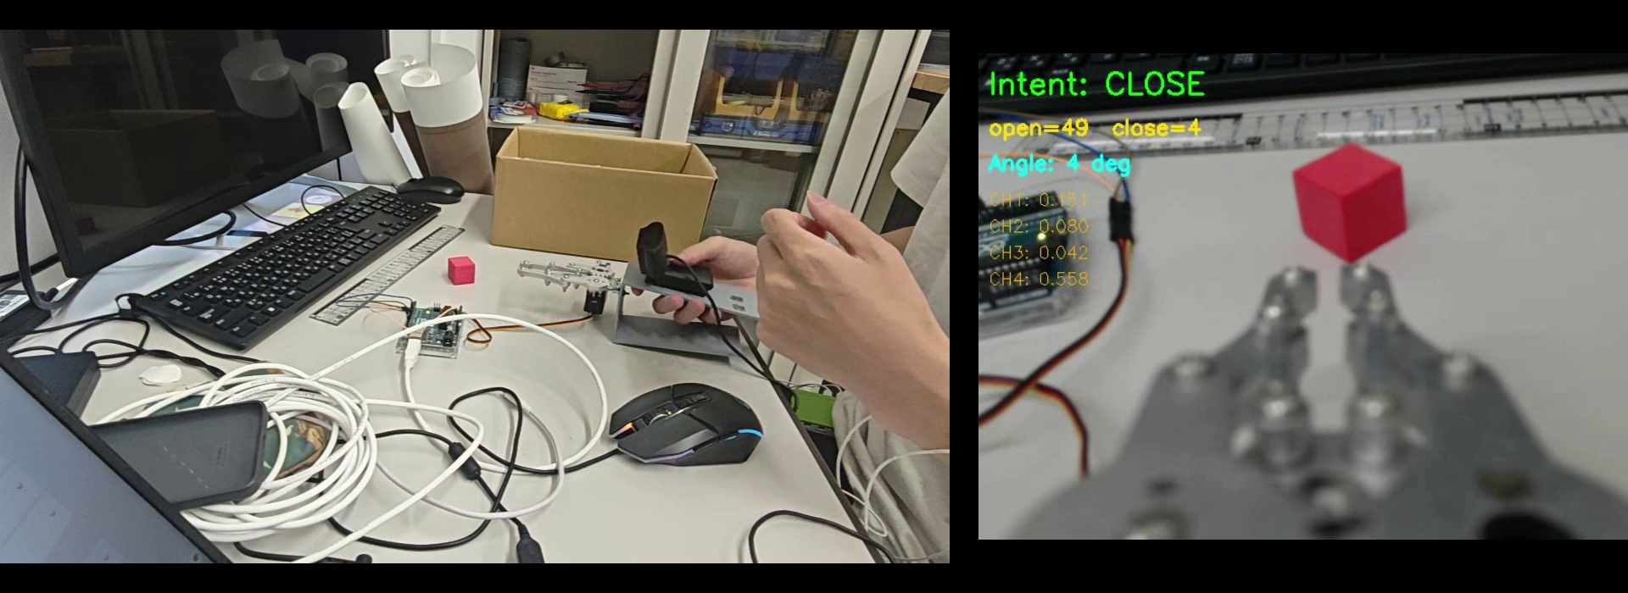
Real-Time Inference Demo
Open and Close angle
Small continusly adjust
Robotic hand automatically open and close the suitable size.
# At the current, only the preliminary system has been tested
# next step is to test that grasp different objects.
Notes:
this is Real-Time Inference demostrate video, the robotic hand will automatically adjust, here is angle ui, can see continusly small adjust.

Slide 9
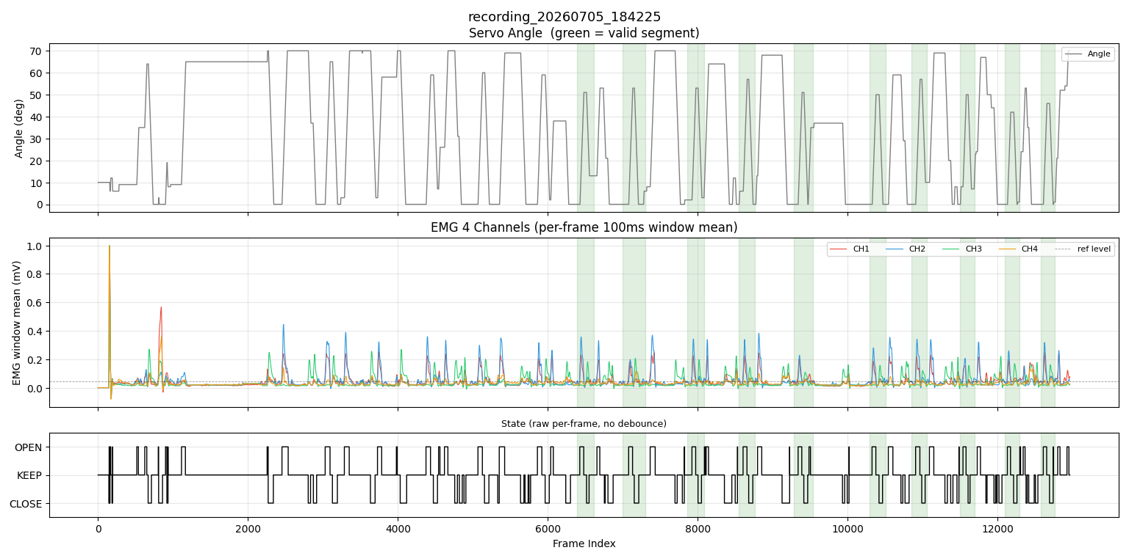
Training Data
Grasping process:
Closed state → Moving toward object → Opening hand → Closing to grasp.
Mark valid data
(by pressing a button during recording)
Notes:
when system starts running, it automatically records data in sync. However, during recording, there is a large amount of irrelevant data that does not correspond to the actual grasping process. Feeding this data into training would contaminate the model. so I later added a manual marking the valid data grasping segment . And each valid data segment corresponds to one complete grasping process. start close state...

Slide 10





Experiment
Objective :
Evaluate the system’s performance, and its ability to reduce the operator’s cognitive load
Participants :
10 healthy adults
Condition A: EMG-Only Control
Scene:
Grasping different size objects under two conditions
Condition B: Proposed System Control
Notes:
For to evaluate.... I design the experiment. the scen is let the participants to grasp different size object

Slide 11



Evaluation
Performance
Cognitive load
Task Completion Time
NASA-TLX [5]
Grasp Success Rate
Notes:
There are two metrics.

Slide 12
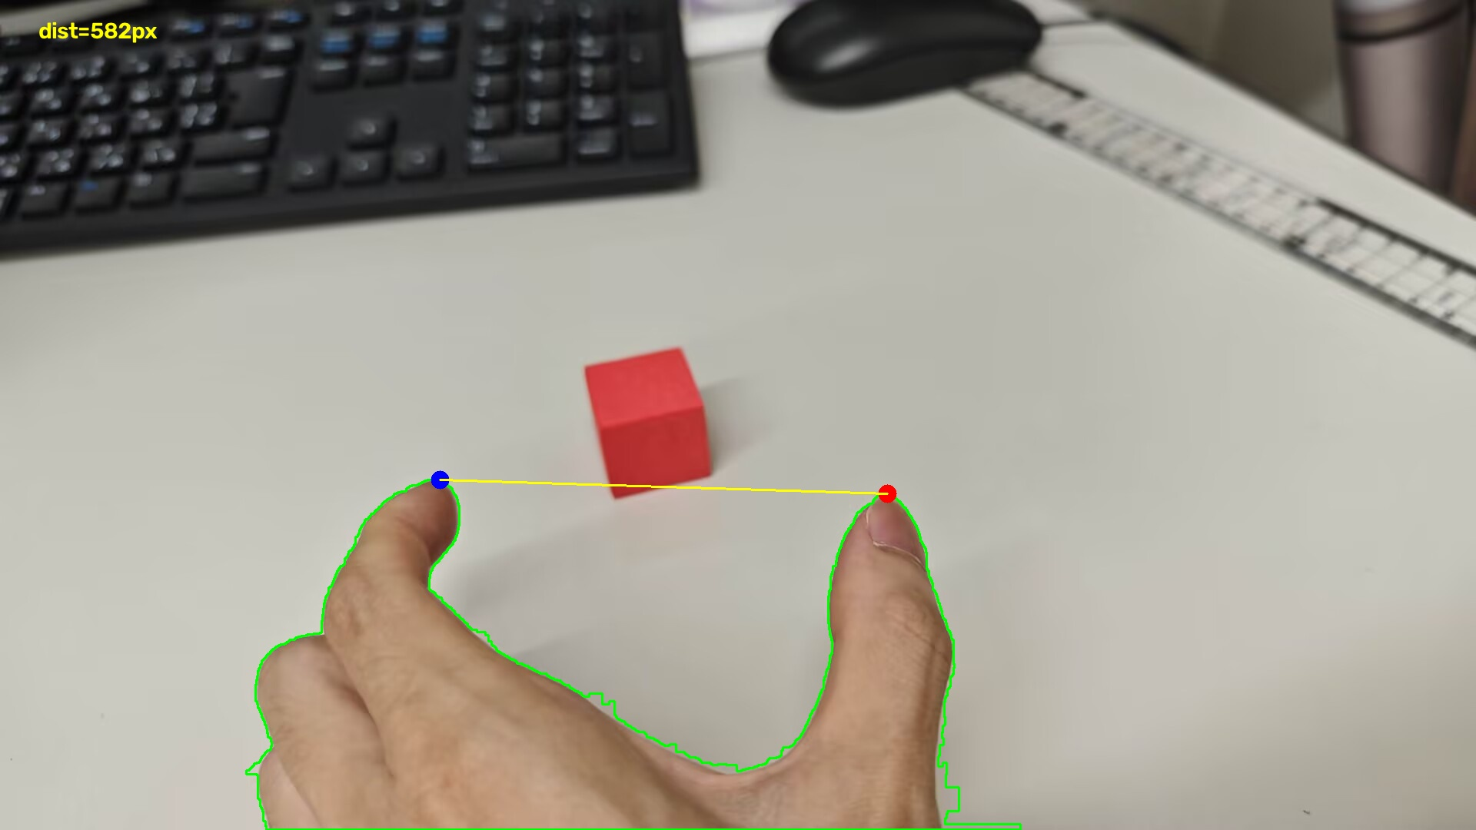
Summary
The two sensors, the camera and EMG, have been successfully integrated.
Synchronized data acquisition and recording have been successfully implemented.
Achieved decision fusion, successfully enabling real-time inference.
Next Steps
Will switch the data recording from the prosthetic hand to the human hand, in order to learn a more natural grasping process.
Notes:
However, current prosthetic grasping is still not natural enough. next step

Slide 13
References
[1] McDonald C L, Westcott-McCoy S, Weaver M R, et al. Global prevalence of traumatic non-fatal limb amputation[J]. Prosthetics and orthotics international, 2021, 45(2): 105-114.
[2] Chen, Z., Min, H., Wang, D., Xia, Z., Sun, F., & Fang, B. (2023). A review of myoelectric control for prosthetic hand manipulation. Biomimetics, 8(3), 328.
[3] Vásconez, J. P., Barona López, L. I., Valdivieso Caraguay, Á. L., & Benalcázar, M. E. (2022). Hand gesture recognition using EMG-IMU signals and deep q-networks. Sensors, 22(24), 9613.
[4] Zandigohar, M., Han, M., Sharif, M., Günay, S. Y., Furmanek, M. P., Yarossi, M., ... & Schirner, G. (2024). Multimodal fusion of EMG and vision for human grasp intent inference in prosthetic hand control. Frontiers in Robotics and AI, 11, 1312554.
[5] Lalle, A., Migliore, S., Stevenson, J., Bell, E., Pradeep, M., Gunnell, D., ... & Manero II, A. (2026). Multigesture Electromyographic Control Complexity in Upper Limb Prostheses Actuated via Single Sensor Input Contraction Magnitude: Qualitative Study for Evaluating Performance and Cognitive Load. JMIR Rehabilitation and Assistive Technologies, 13(1), e88528.
[6] Thomas, N., Miller, A. J., Ayaz, H., & Brown, J. D. (2023). Haptic shared control improves neural efficiency during myoelectric prosthesis use. Scientific reports, 13(1), 484.

