Slide 1
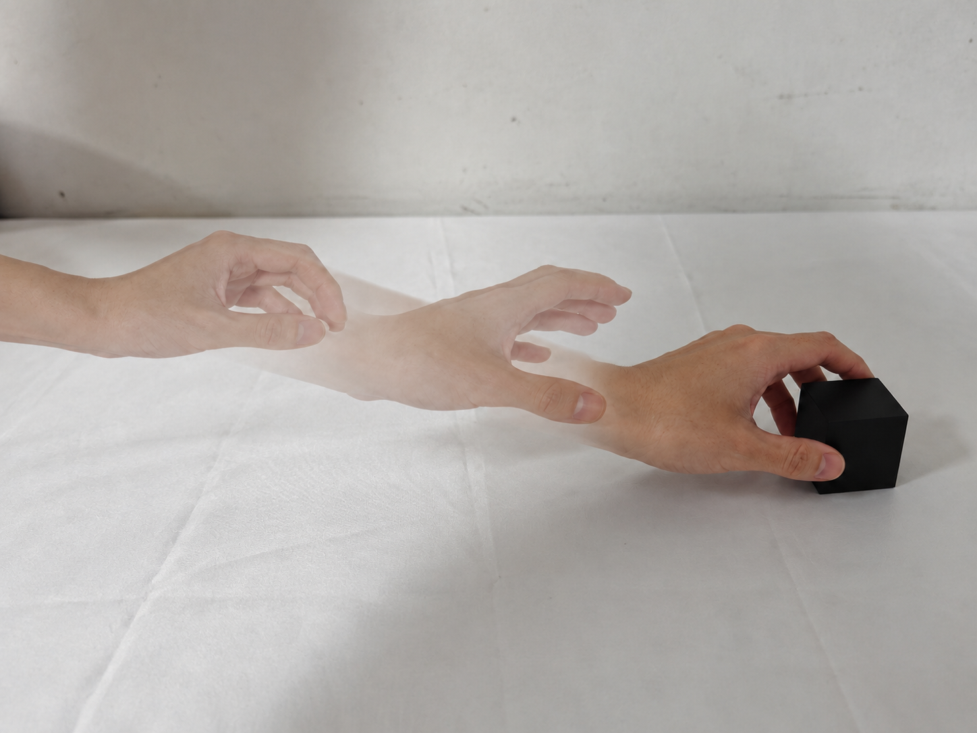
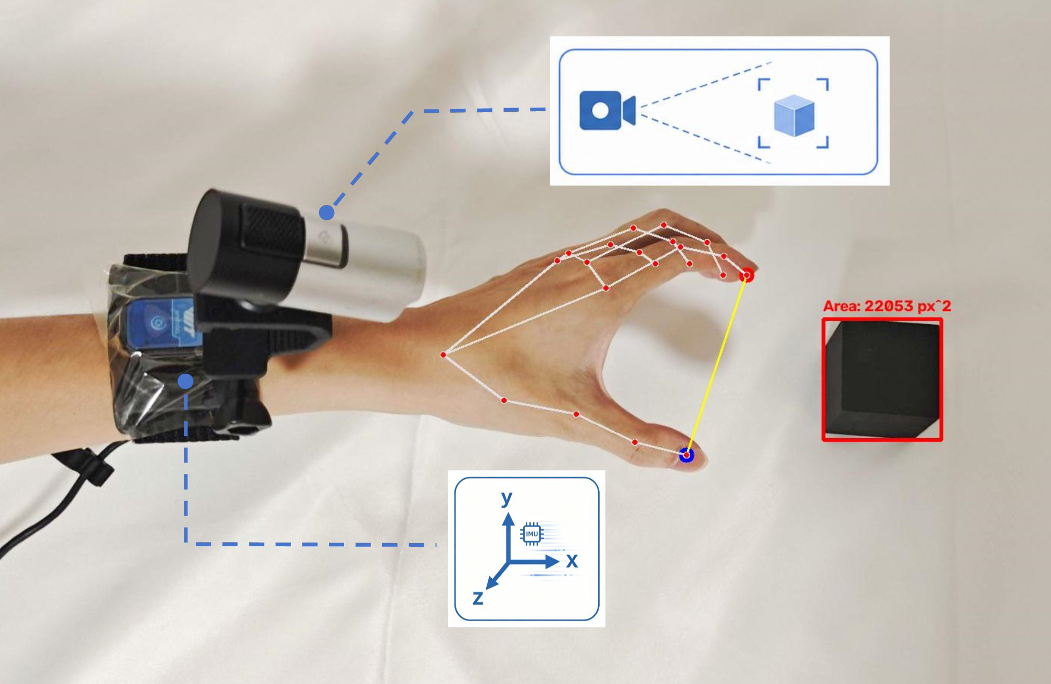
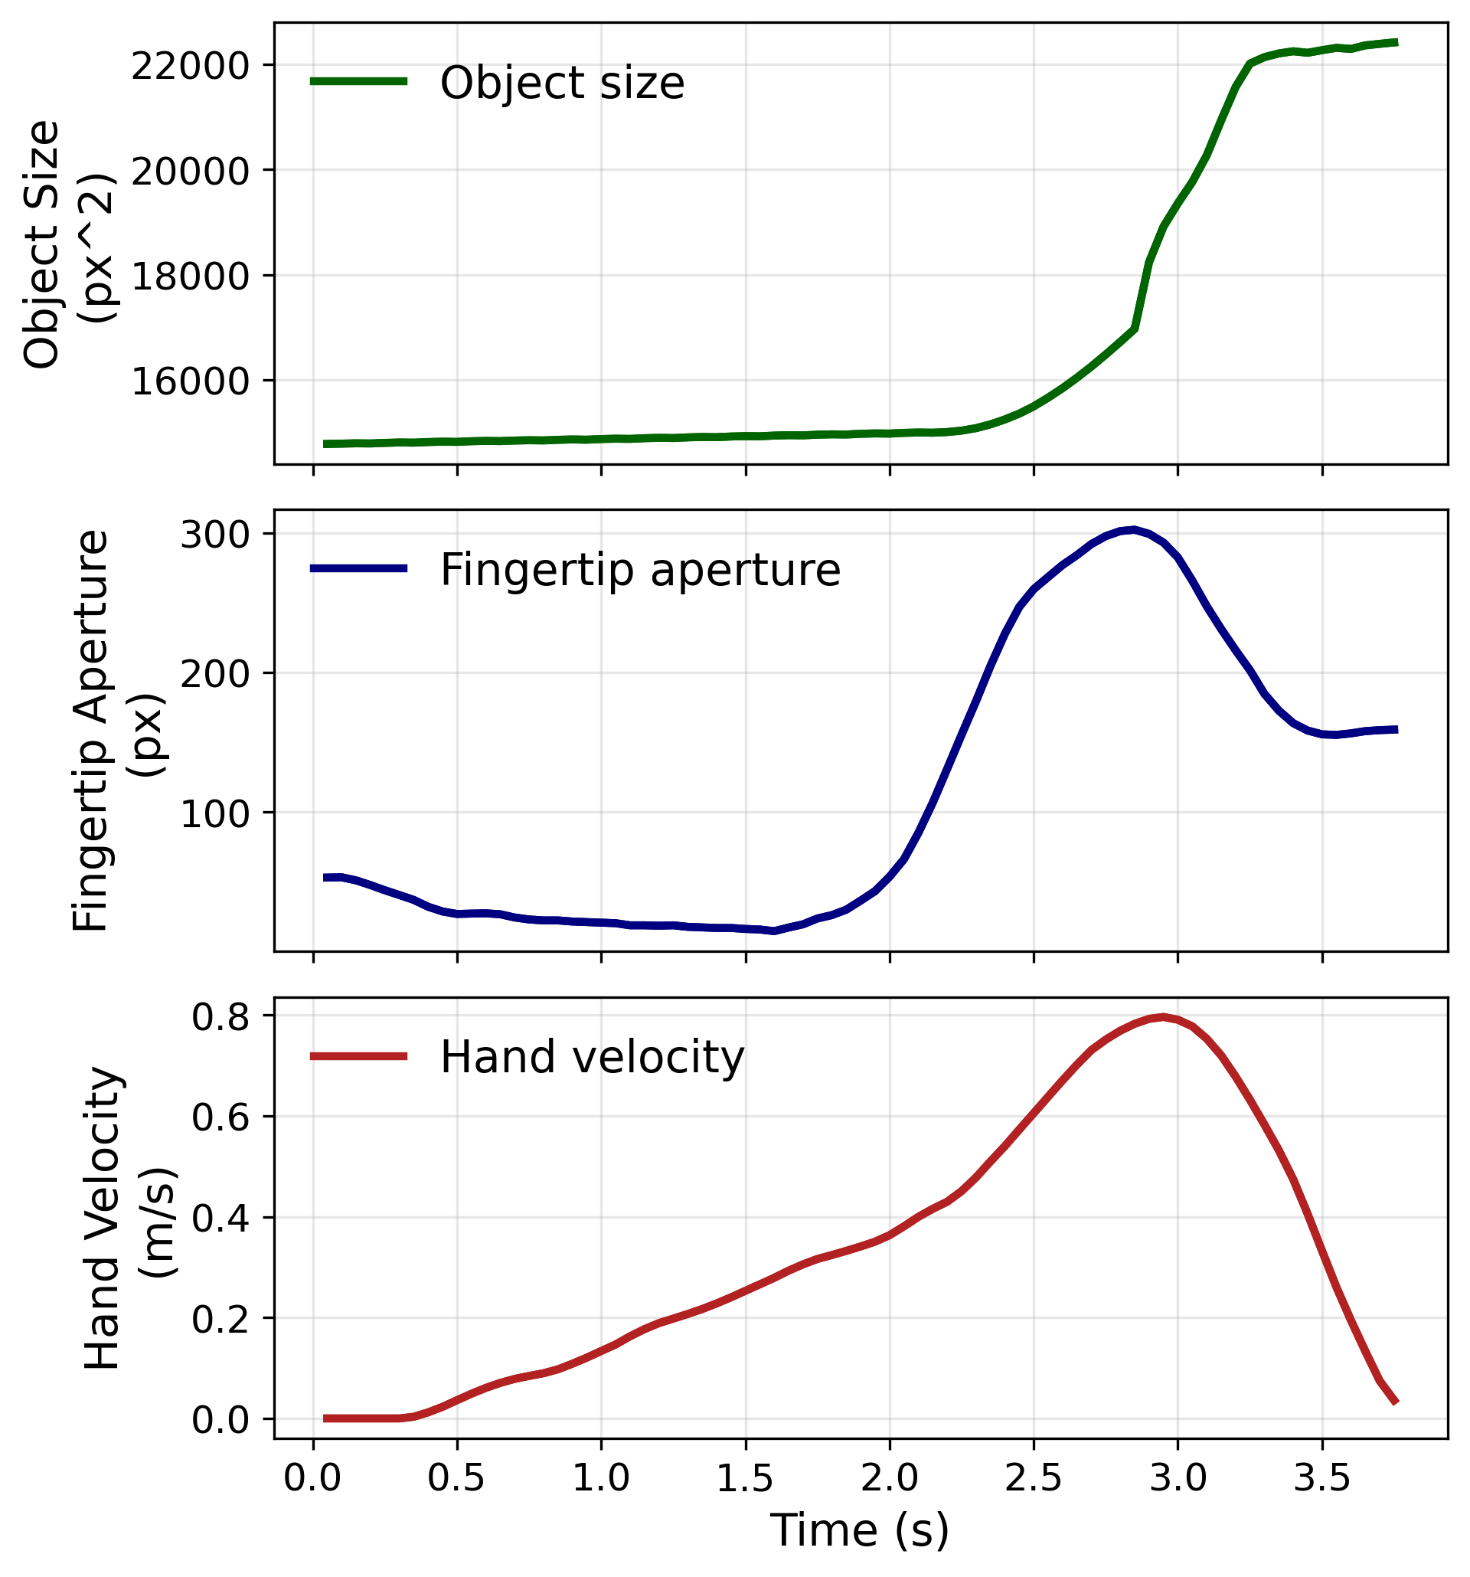
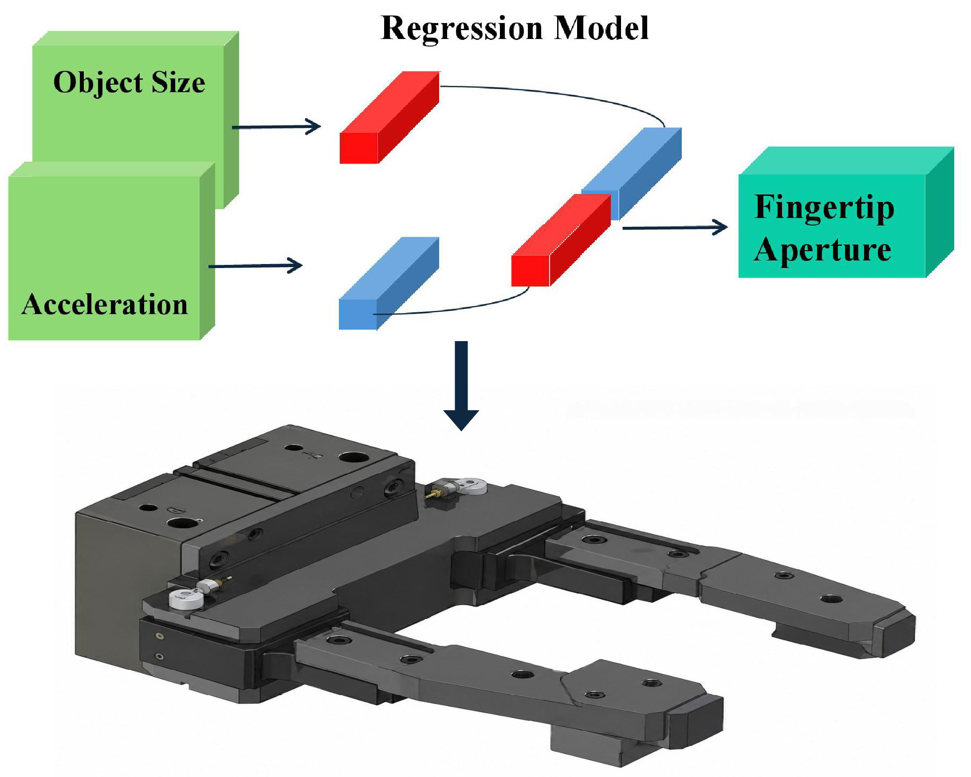
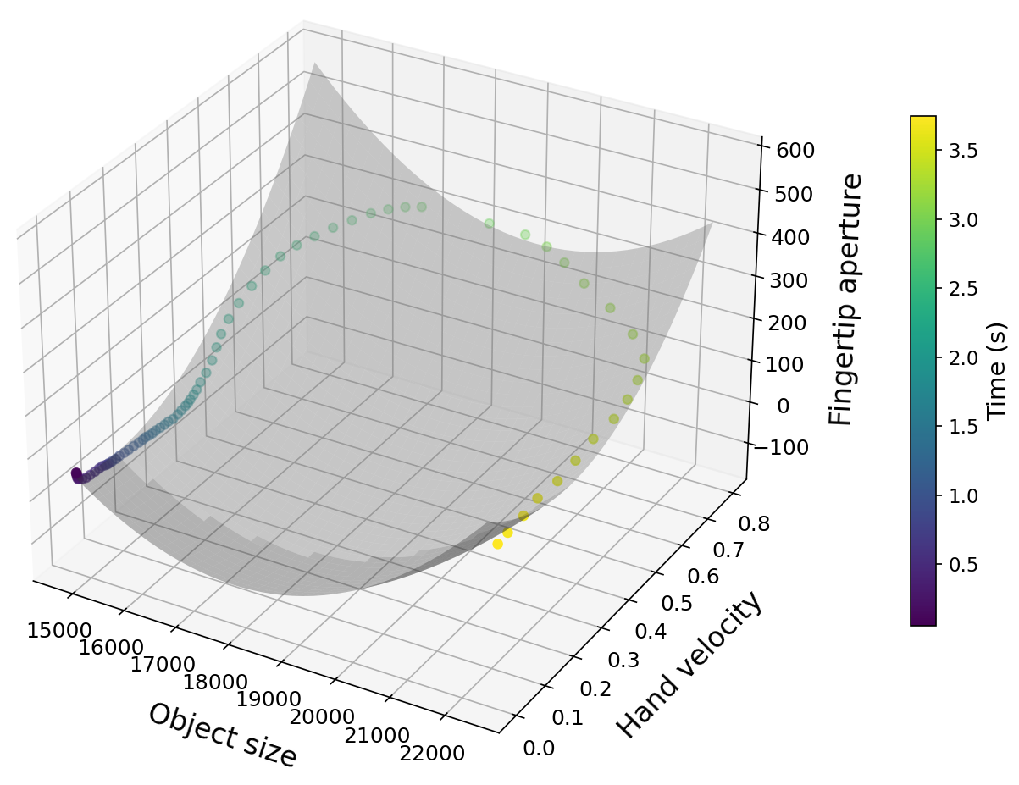
A Vision-Motion Regression Model for Prosthetic Hand Control
This study investigates the relationship between hand motion, object apparent size, and fingertip aperture during reach-to-grasp movements. A camera and 3-axis accelerometer were used to collect synchronized motion and visual data. A regression model was developed to predict fingertip aperture from hand velocity and object apparent size, providing a potential approach for real-time prosthetic hand control.
Objective
In reach-to-grasp movements, hand velocity and object apparent size closely relate to fingertip aperture. This study quantifies that relatio-nship to build a prosthetic control model driven only by vision and acceleration sensors.
Reach-to-Grasp Movements
Methods
A camera and 3-axis accelerometer mounted on the hand record reach-to-grasp movements. Hand velocity is derived from acceleration; object apparent size and fingertip aperture are extracted from video and synchr-onized in normalized time.
System Architecture Data Types
Result
A regression model uses hand vel-ocity and object apparent size as independent variables, fingertip aperture as the dependent variable. Embedded in real-time prosthetic control, it predicts natural grasping motion from sensor data alone.
  Regression Model Data Relationships

