Slide 1
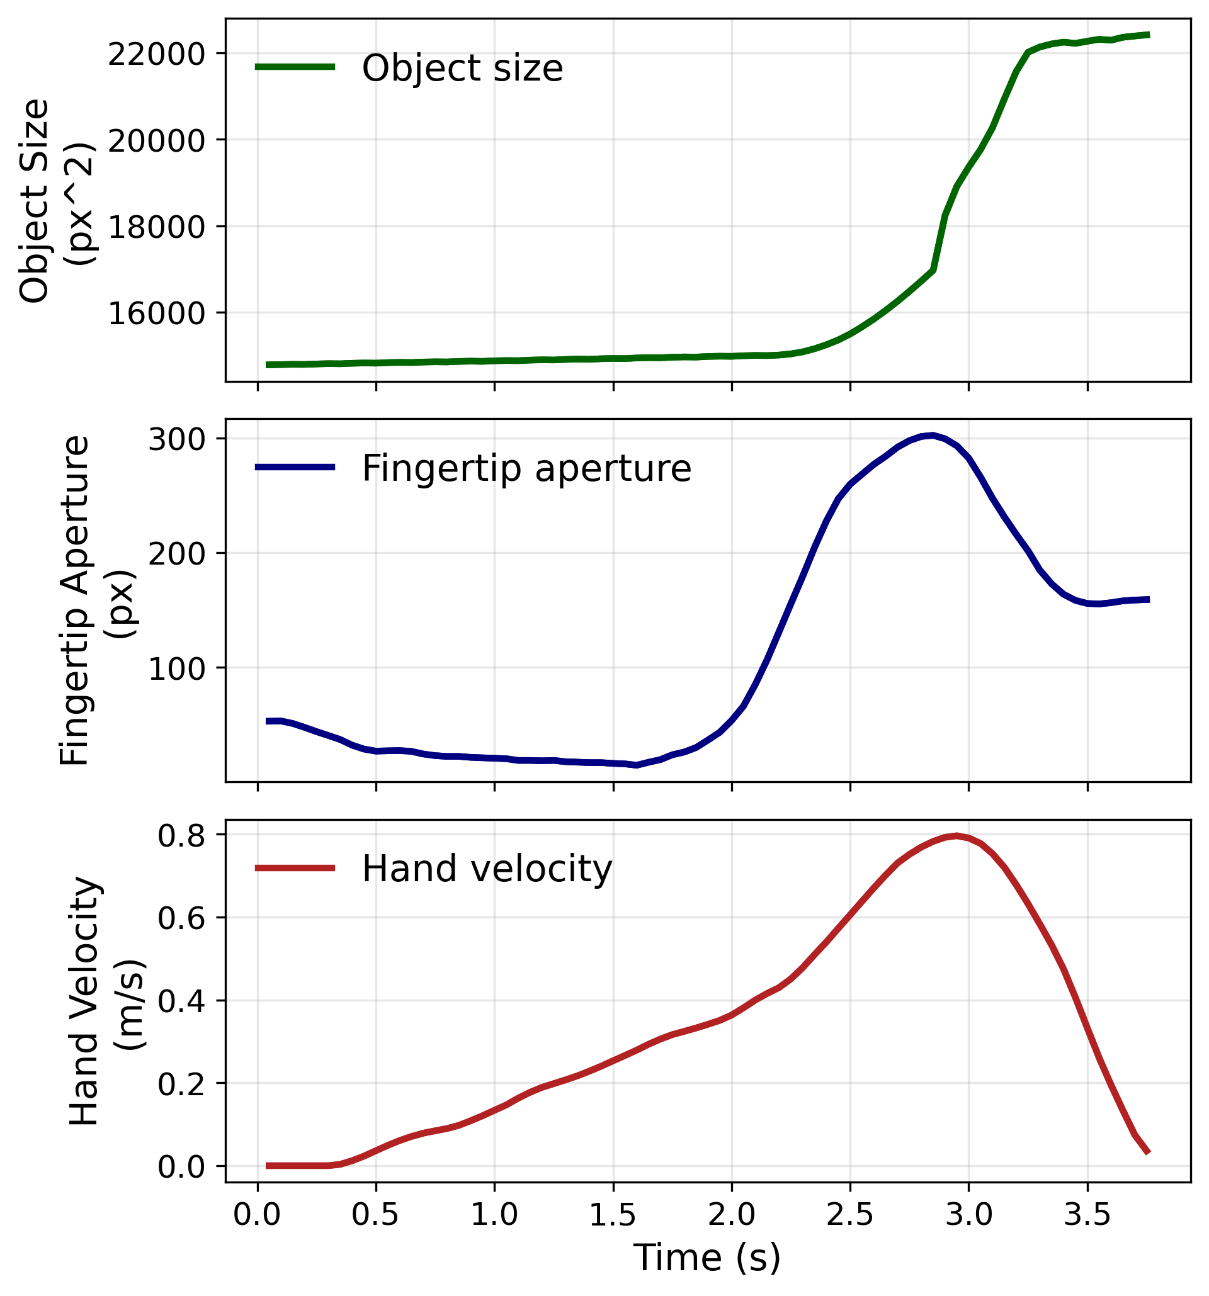
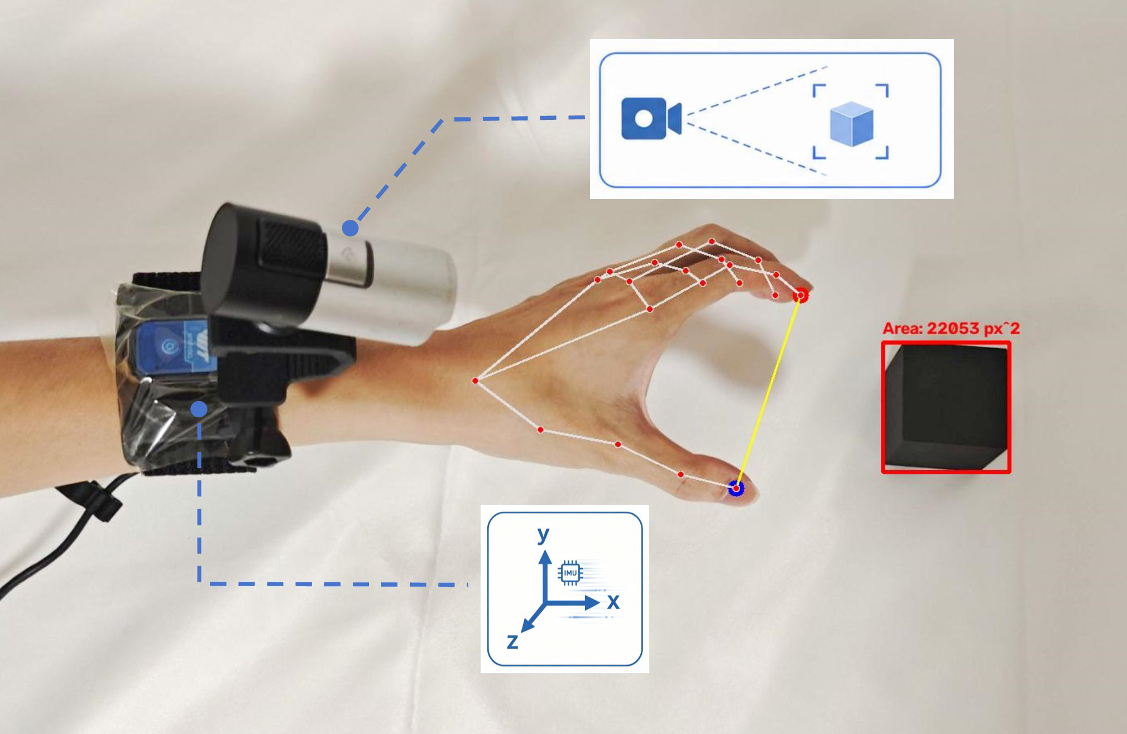
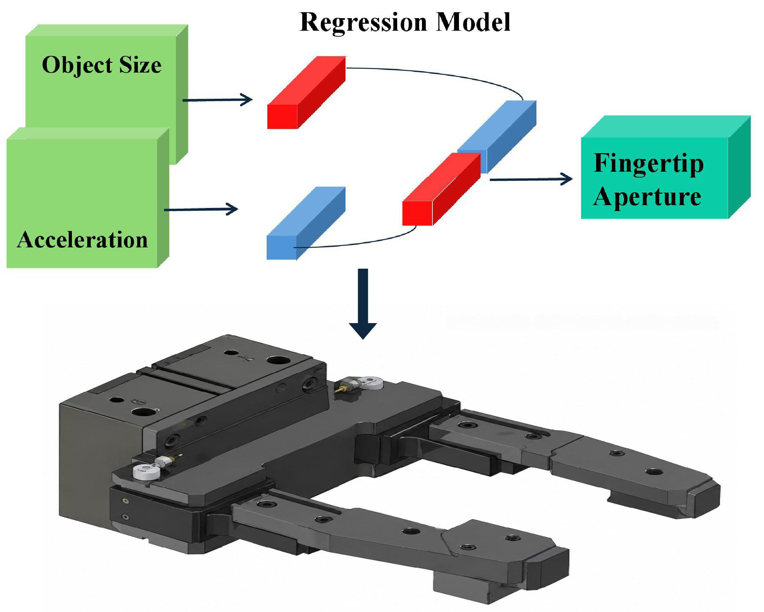
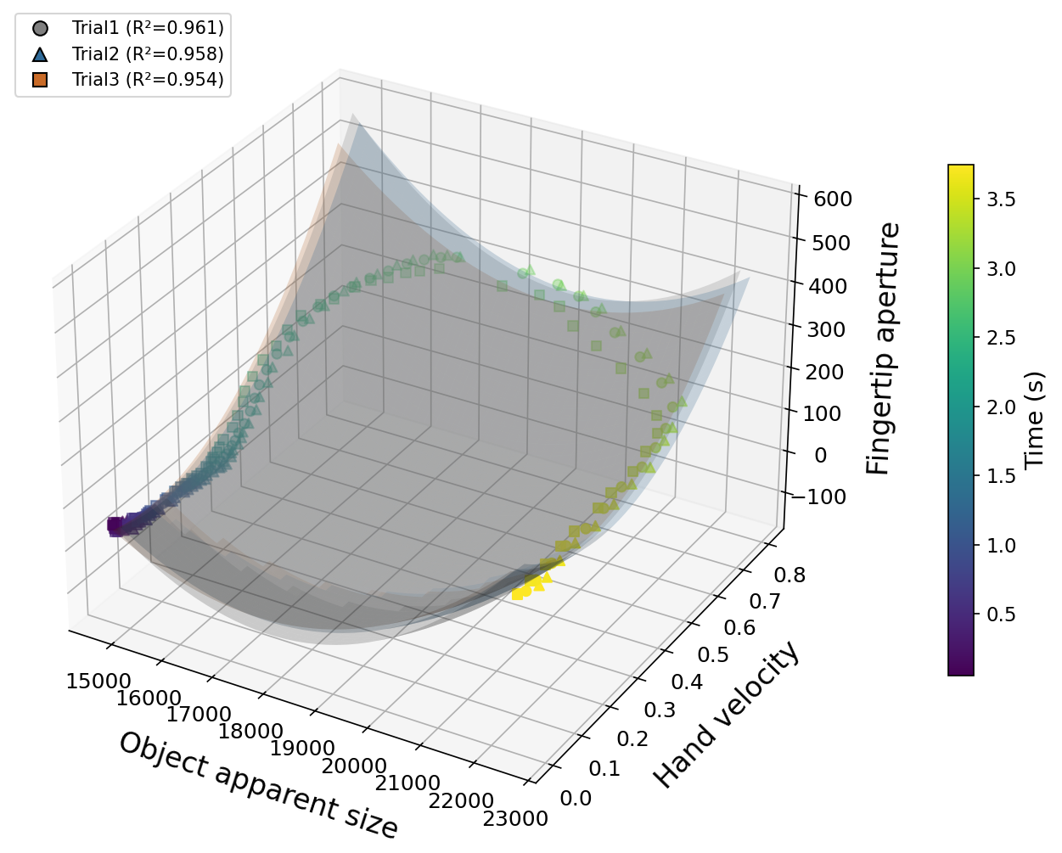
A Vision-Motion Regression Model for Prosthetic Hand Control
This study investigates the relationship between hand motion, object apparent size, and fingertip aperture during reach-to-grasp movements. A camera and 3-axis accelerometer were used to collect synchronized motion and visual data. A regression model was developed to predict fingertip aperture from hand velocity and object apparent size, providing a potential approach for real-time prosthetic hand control.
Objective
In reach-to-grasp movements, hand velocity and object apparent size closely relate to fingertip aperture. This study quantifies that relationship to build a prosthetic control model driven only by vision and acceleration sensors.
Methods
Patterns of object size, fingertip aperture, and hand velocity during a reach-to-grasp movement.
A camera and 3-axis accelerometer mounted on the hand record reach-to-grasp movements. Hand velocity is derived from acceleration; object apparent size and fingertip aperture are extracted from video and synchr-onized in normalized time.
Result
System Architecture
A regression model uses hand vel-ocity and object apparent size as independent variables, fingertip aperture as the dependent variable. Embedded in real-time prosthetic control, it predicts natural grasping motion from sensor data alone.
The three grasping trials follow similar trajectories, suggesting a consistent relationship among these three variables. We use the regression model to learn this relationship

