Slide 1
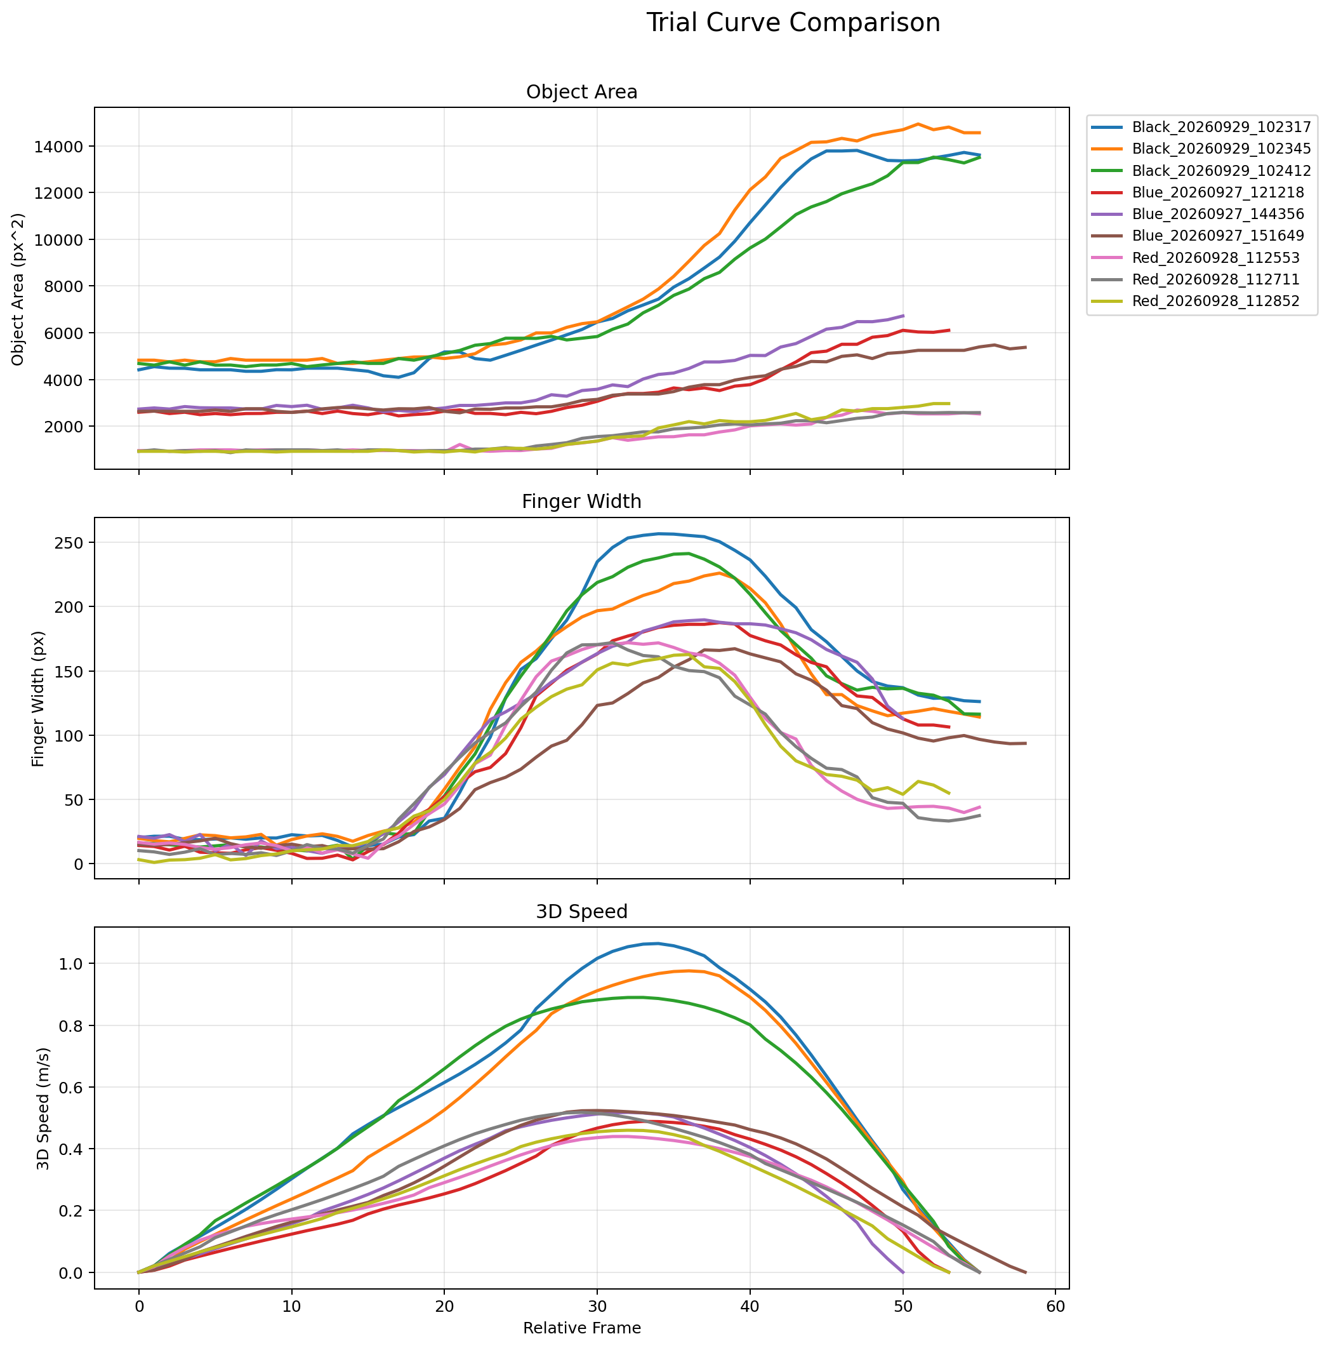
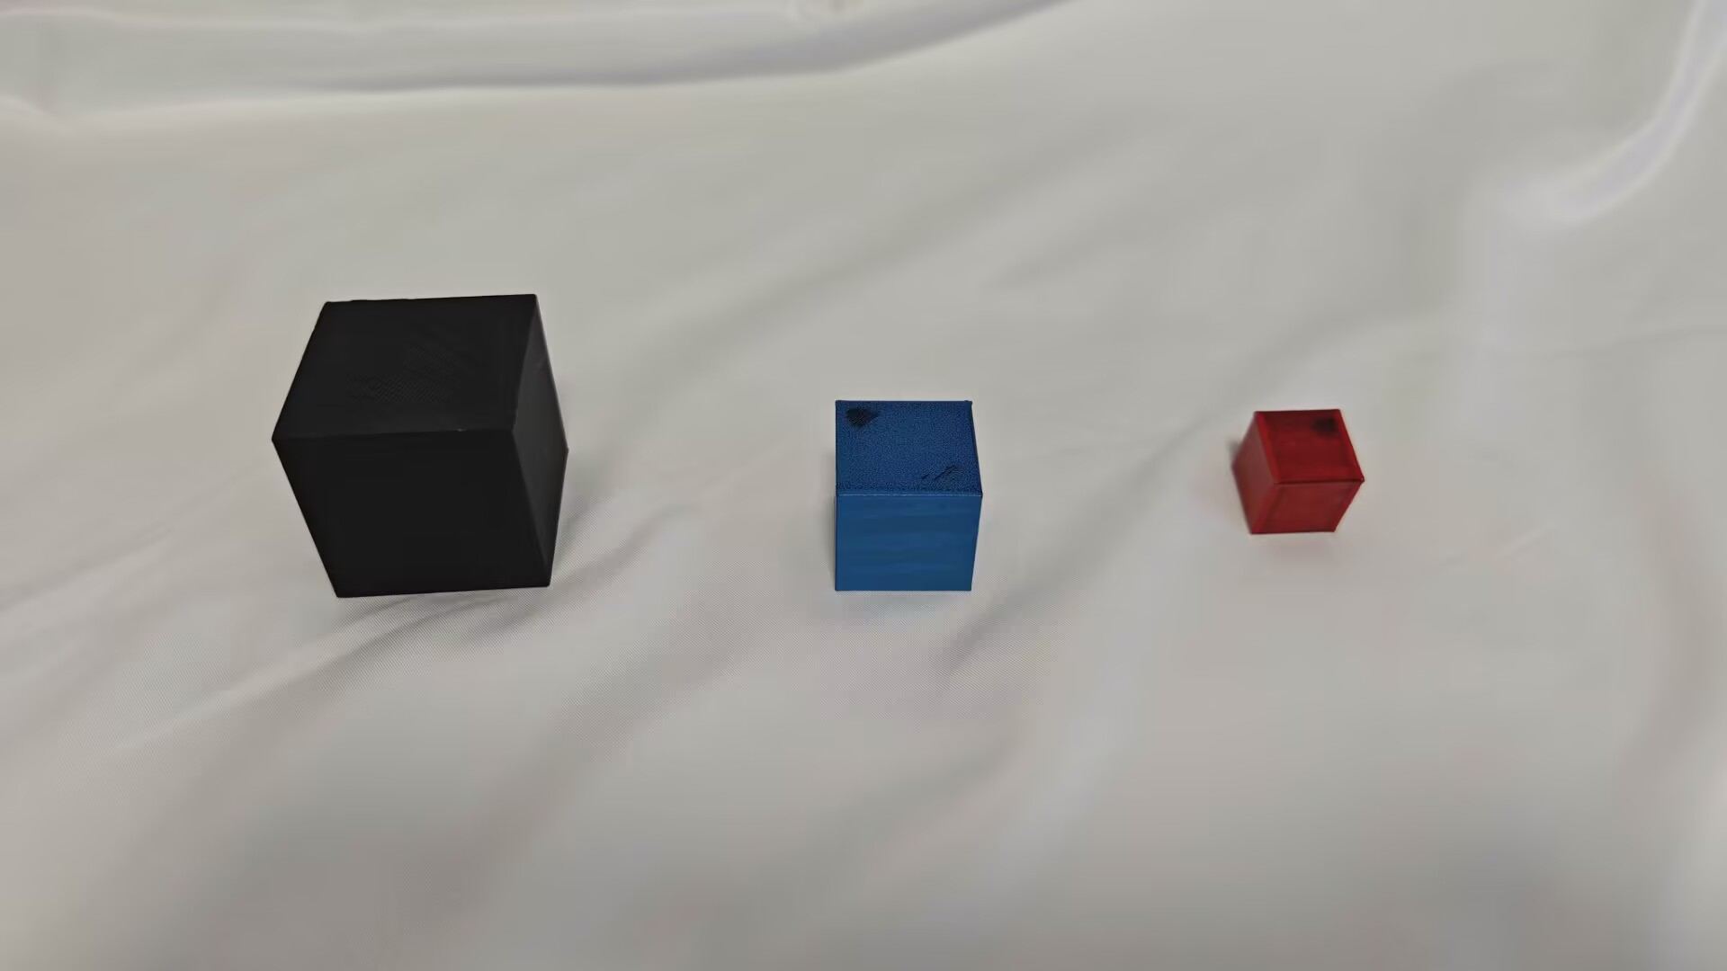
Data Collection
I Optimized the Experimental Workflow
Controlled grasping time,
grasping behavior,
the timing of opening and closing.
#.But the recognition algorithm causes fluctuations in the calculated object area and finger width.

Slide 2
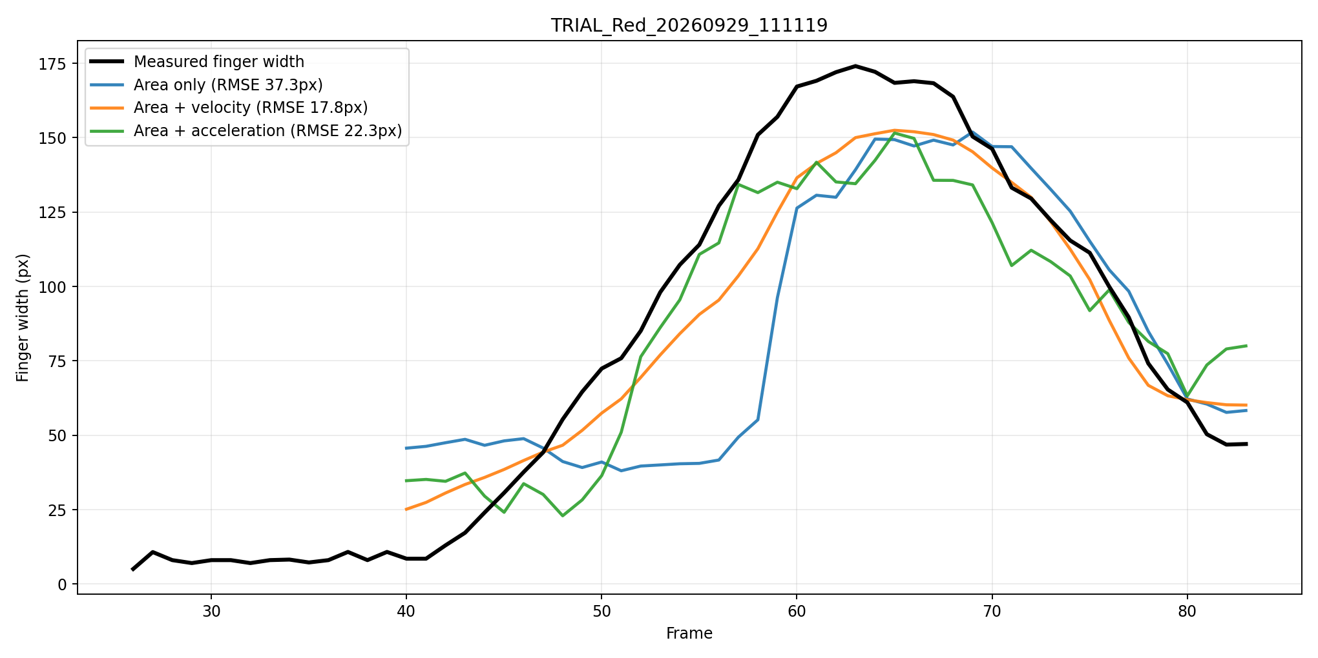
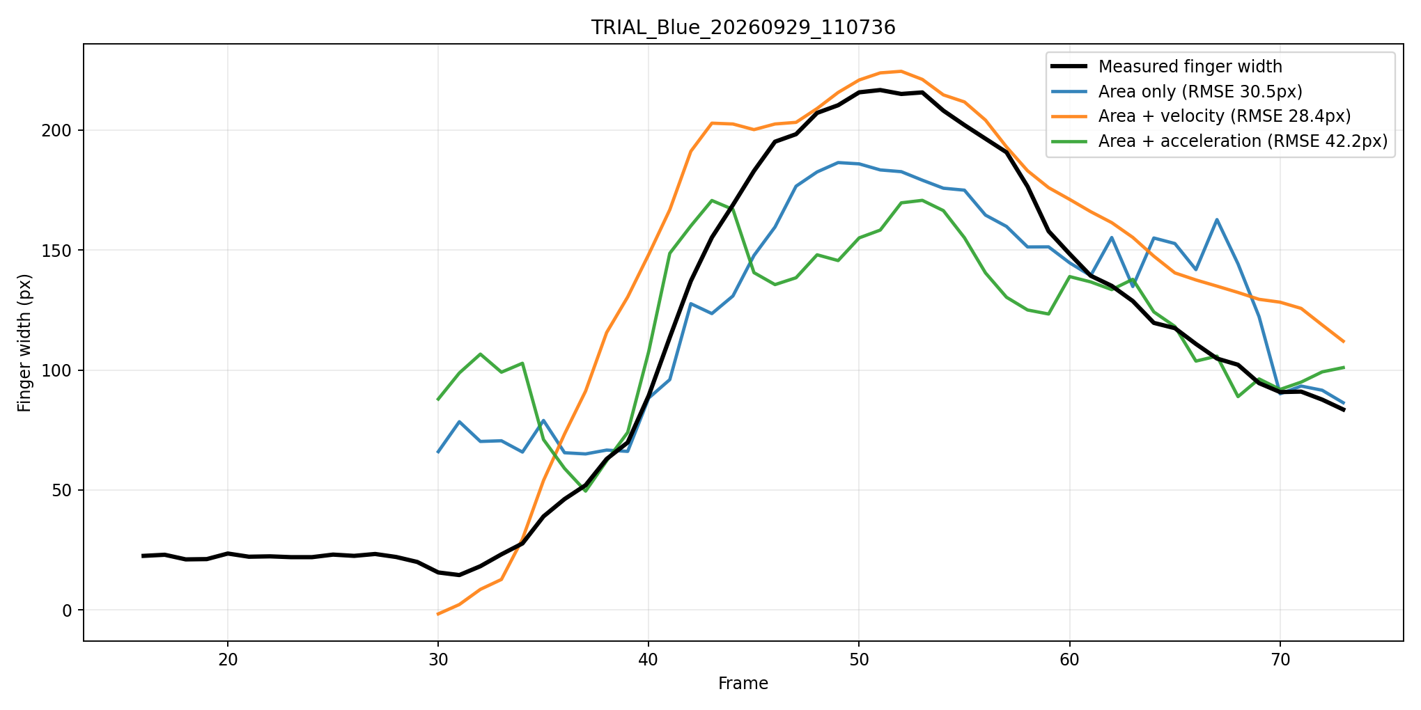
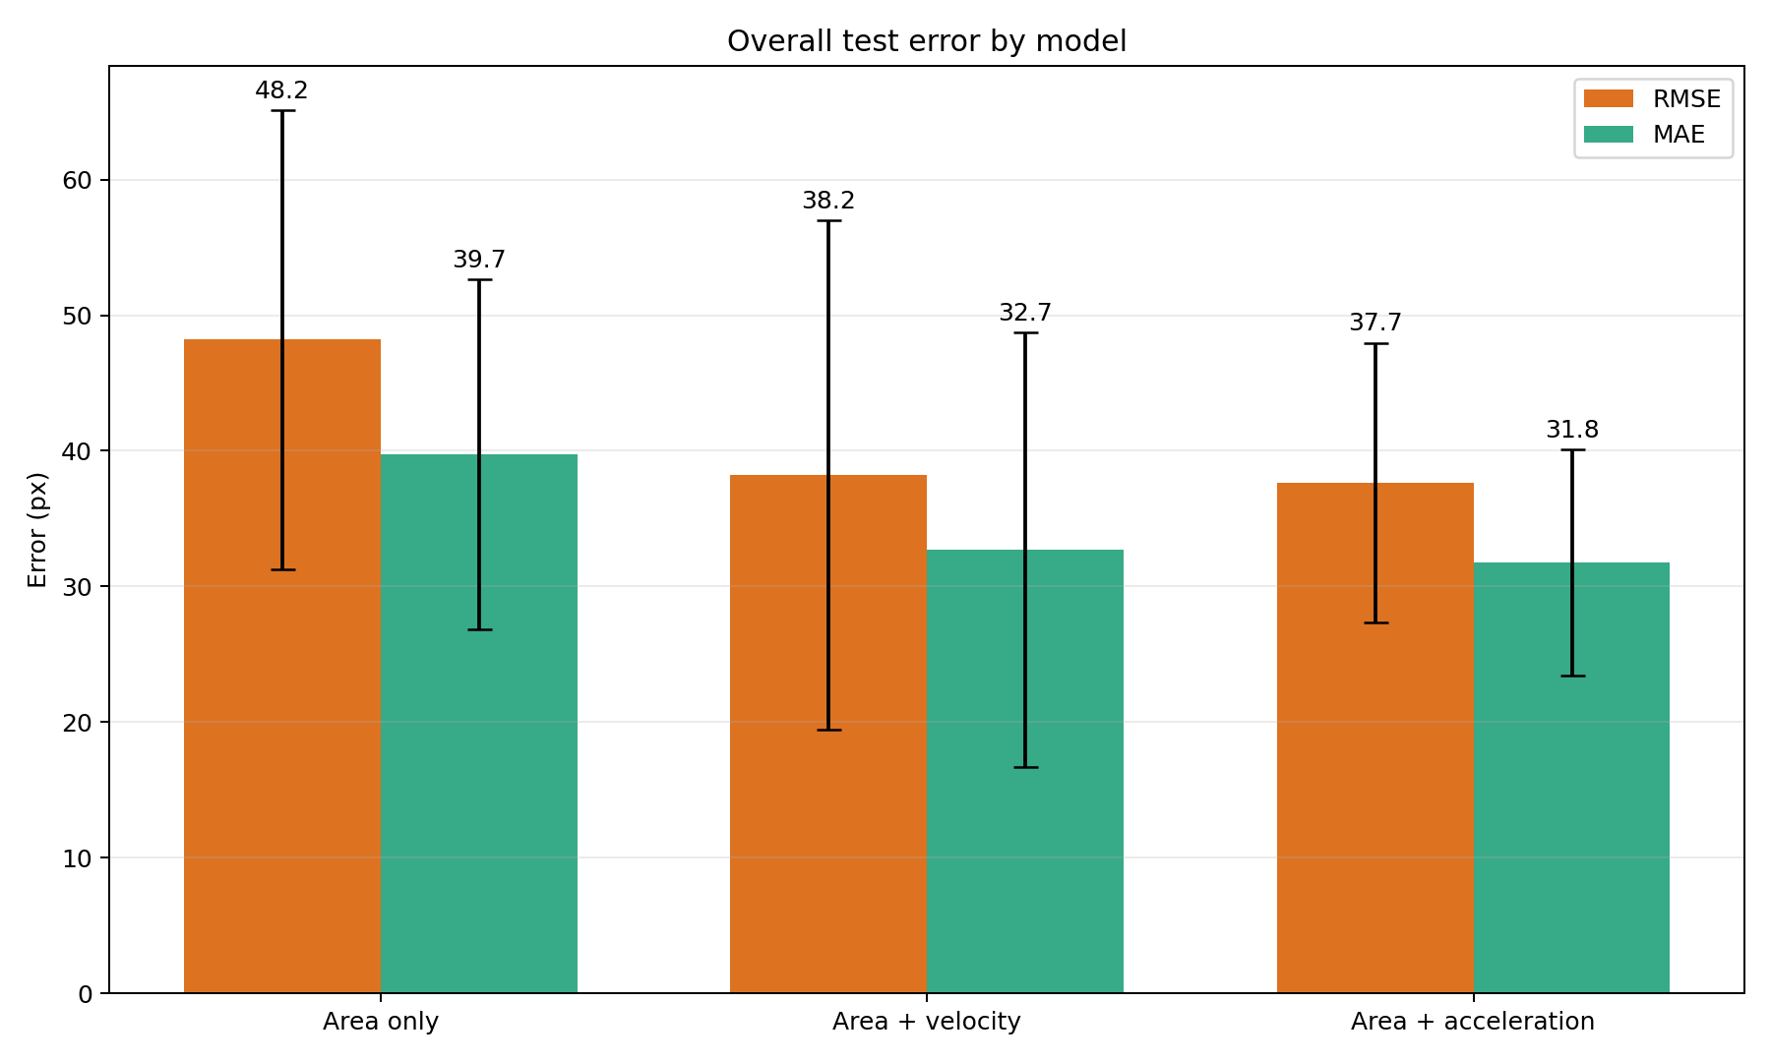
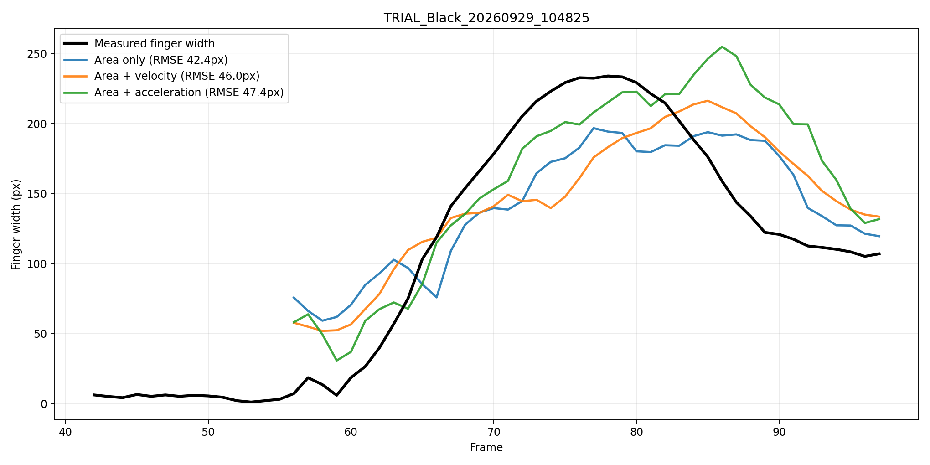
Model and Test Results
Model: 15-Frame Time-Window MLP
Three Input Modes:
Object Area
Object Area + Velocity
Object Area + Acceleration
Training dataset: 3 Object Sizes, 10 trials each
Test dataset: 3 Object Sizes, 3 trials each

Slide 3
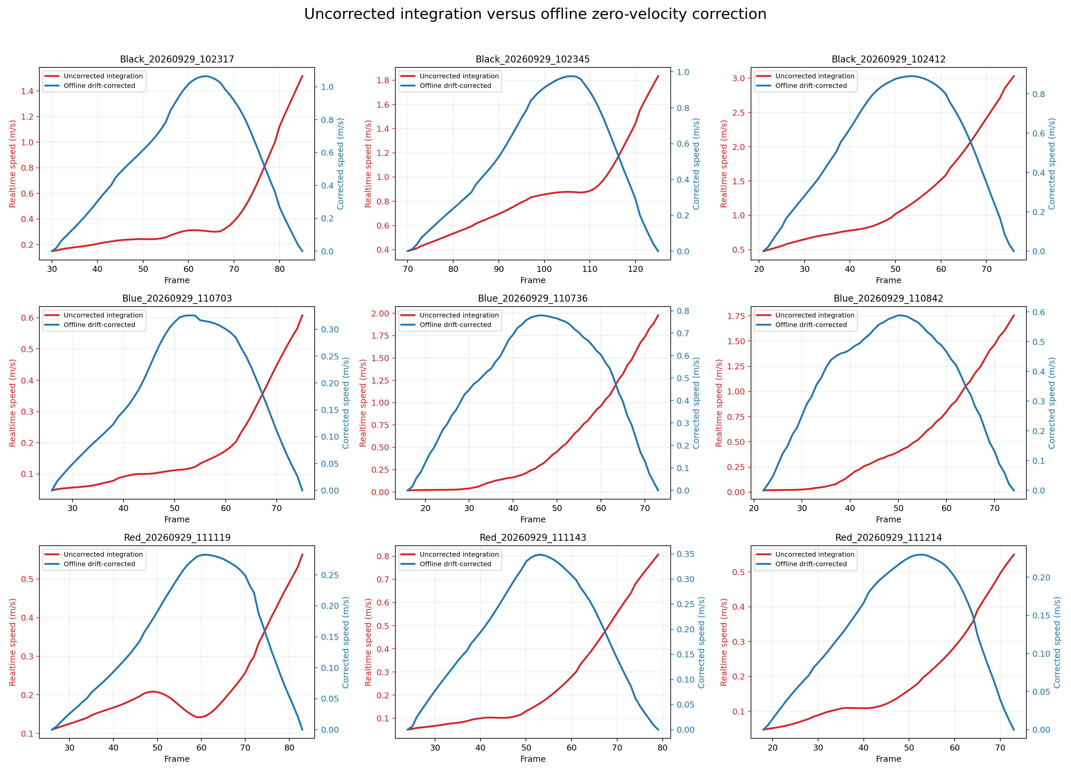
Main Issue
The remaining issue still is the real-time integrated velocity from the IMU. I tried several program adjustments, but that still have some problem.

Slide 4
My Research Proposal
Although the current offline data contain some errors, the predicted curves show the natural pattern of grasping: opening and then closing.
Therefore, I would like to ask whether it would be possible to change the validation method of this study from real-time validation to offline validation.
I would like to revise the focus of this study to investigate whether adding IMU data, such as hand velocity or acceleration, can better reproduce the natural grasping pattern of the human hand. The performance of using only object area will be compared with that of using object area combined with IMU data.
If so, I like to further optimize the training process to reduce prediction errors and make the predicted curves fit the actual data more closely. And invit other participants to validate the proposed method.

