Slide 1
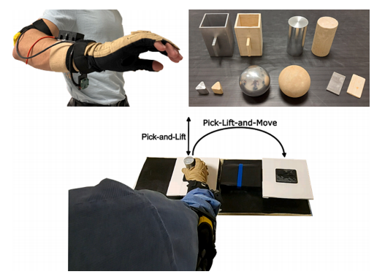
1.Time-independent relationship between digits closure velocity and hand transport acceleration during reach-to-grasp movements
IMU measures acceleration, and the CyberGlove measures finger closing velocity.
The study further classified the grasping movements into three different grasp types.

Slide 2
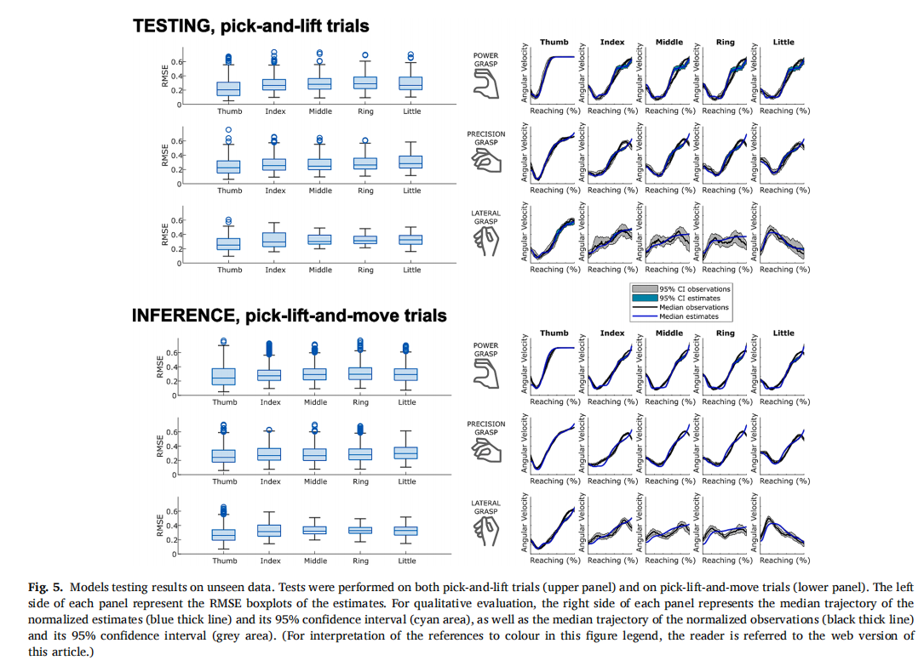
Offline validation using R² and RMSE.

