Slide 1
Generalization Test
Model
Mean RMSE
Mean R² ± Standard Deviation
Area only
45.12px
0.647 ± 0.069
Area + Acceleration
21.77px
0.917 ± 0.040

Slide 2
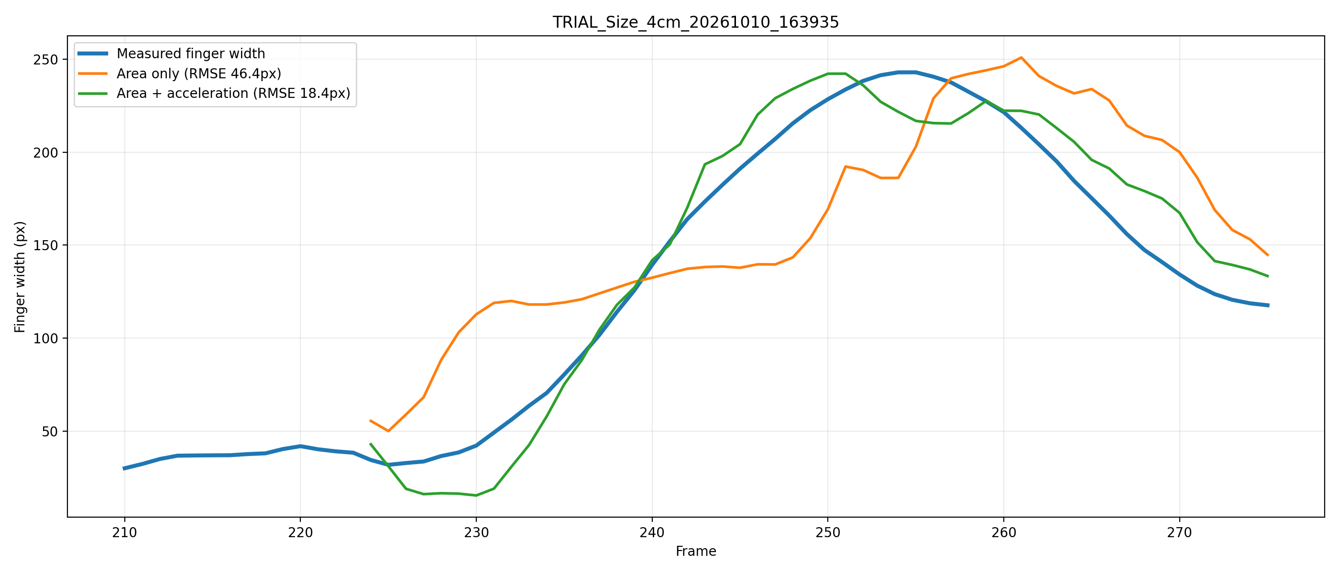
Generalization Test

Slide 3
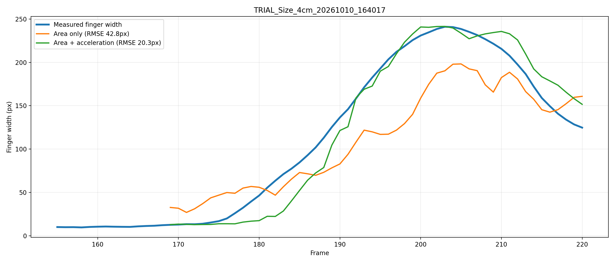
Generalization Test

Slide 4
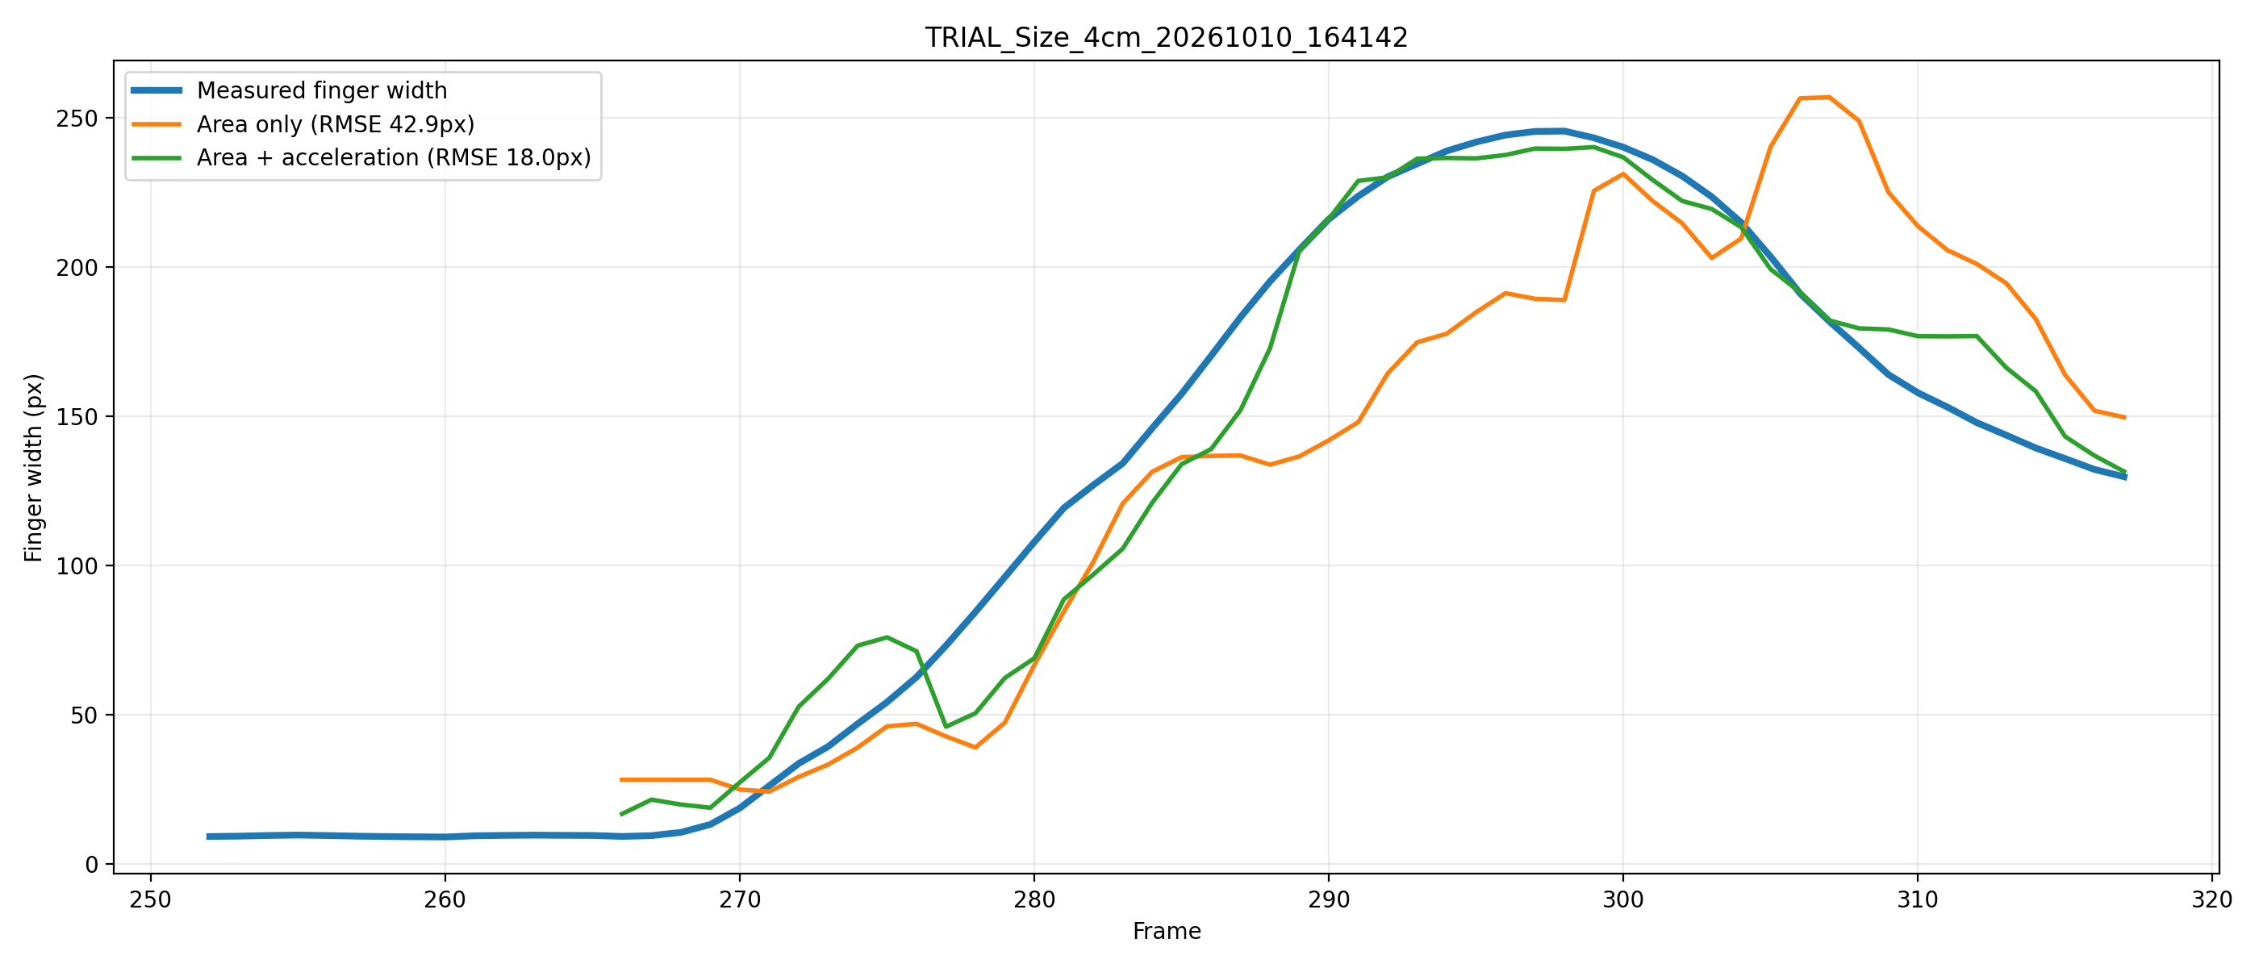
Generalization Test

Slide 5
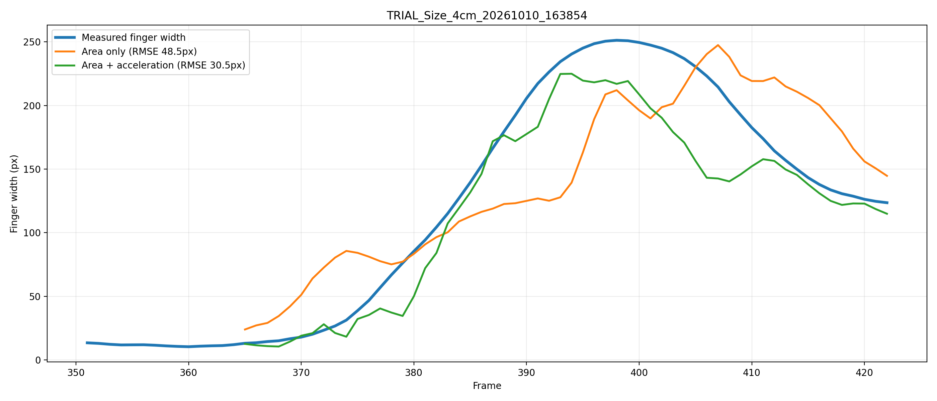
Generalization Test

