Slide 1
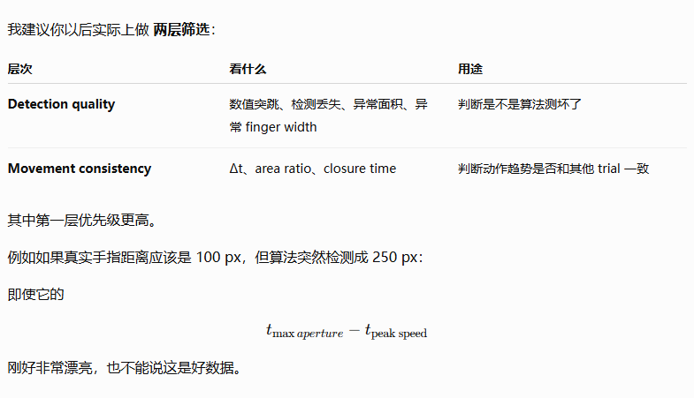

Slide 2
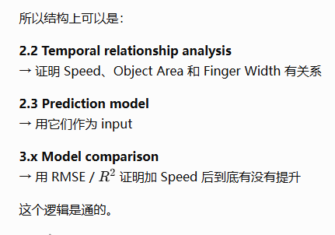
大致流程

Slide 3
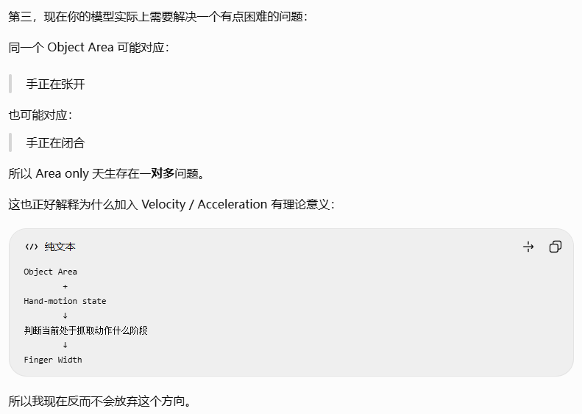
运动信息的作用

Slide 4
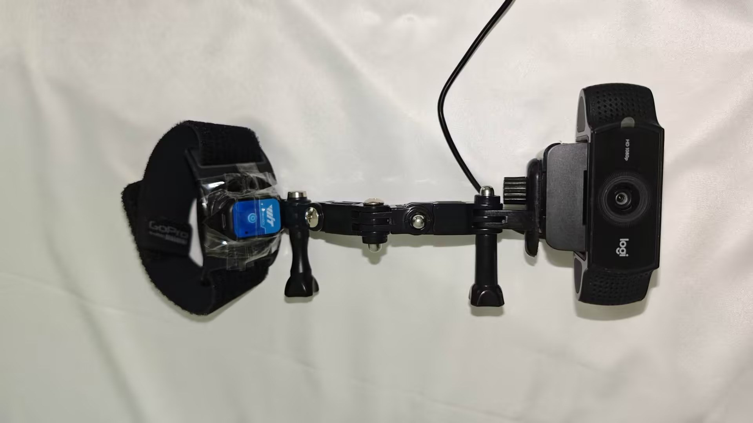
Data Collection
参与者做自然抓取动作
设备
摄像头(30hz)+IMU（50hz）
绑在前臂上

Slide 5
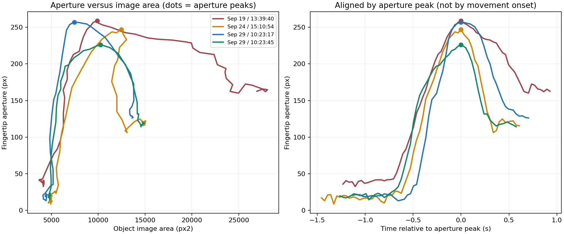

Slide 6
Data Analyze
在 reach-to-grasp 过程中，视觉信息、手部运动和手指开合在时间上是什么关系？

Slide 7
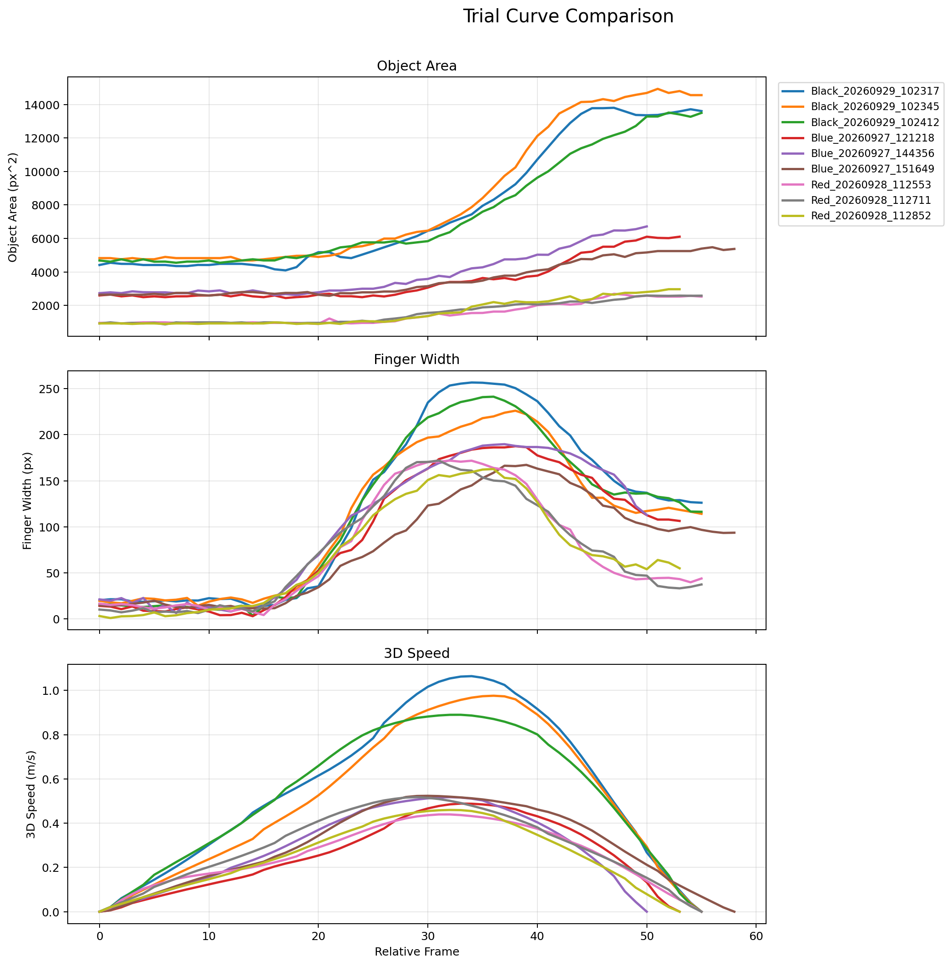
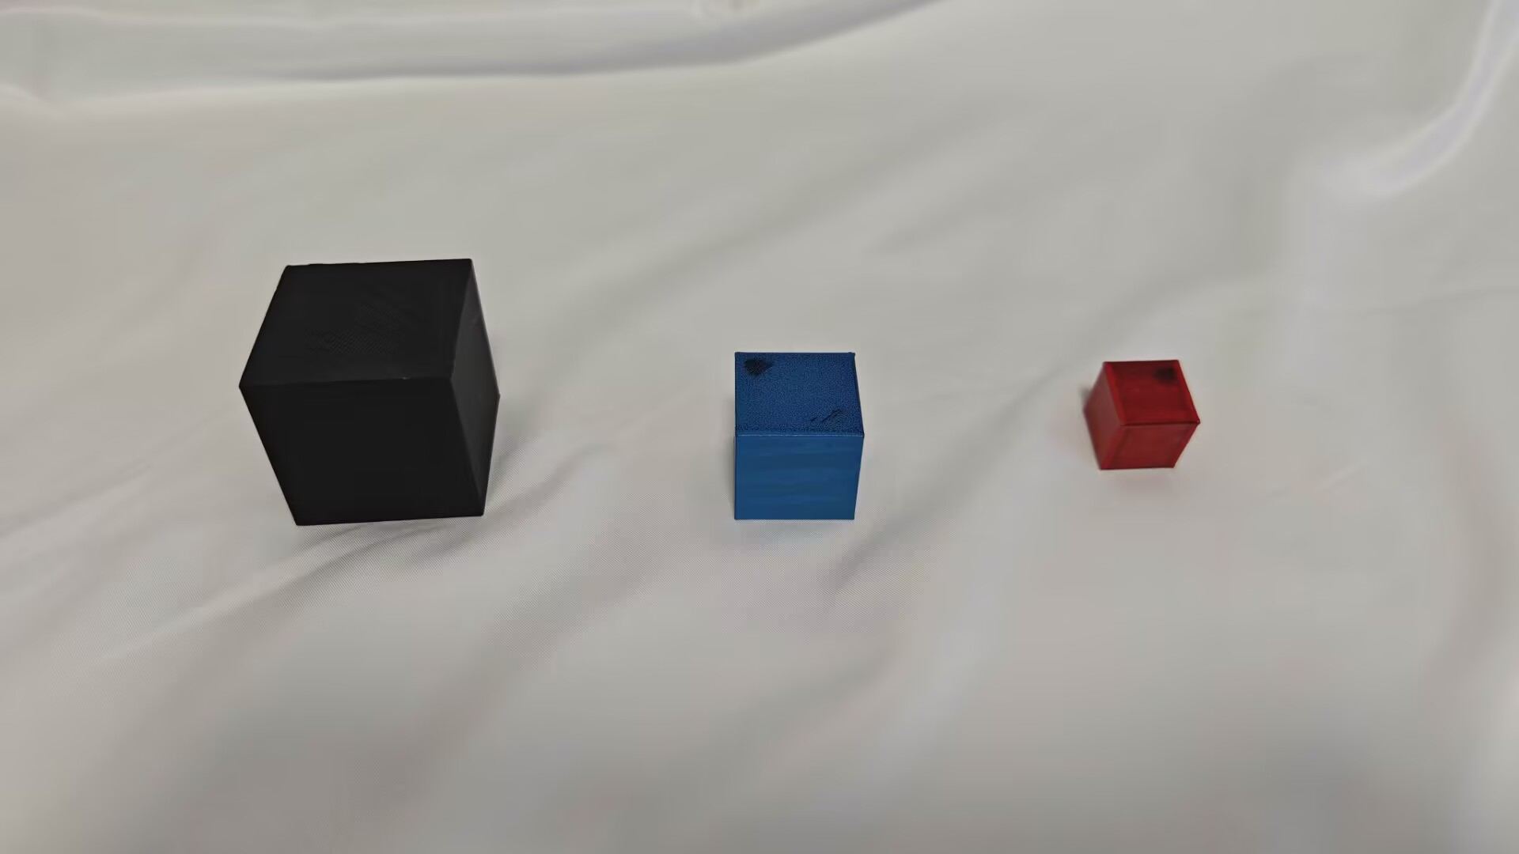
Data Collection
I Optimized the Experimental Workflow
Controlled grasping time,
grasping behavior,
the timing of opening and closing.
#.But the recognition algorithm causes fluctuations in the calculated object area and finger width.

Slide 8
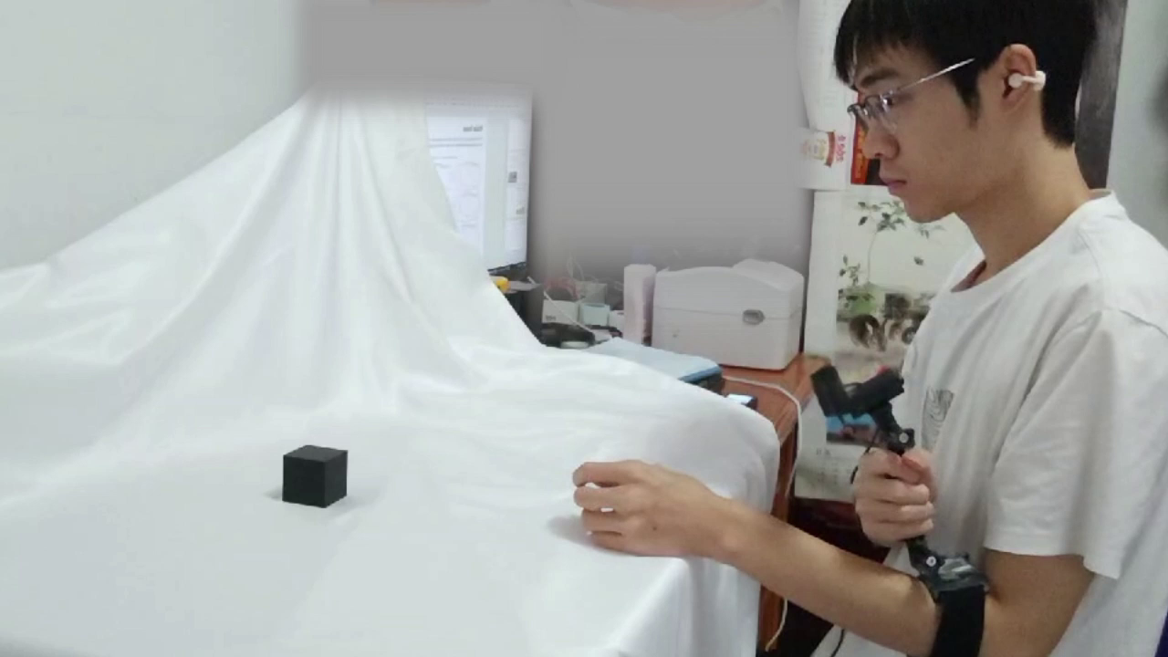
物体种类
Data Collection
3种
实验场景
受验者初始状态手臂自然垂直放下，物体放置于手30cm远处，做自然抓取动作
reach-to-grasp

Slide 9
Data Analyze
Object Area + Hand Motion 是否能更好地预测 Finger Aperture？
Temporal analysis 可以先告诉读者：
Object Area、Hand Speed、Finger Aperture 并不是三条完全无关的曲线，它们在抓取过程中存在规律性的时序关系。
事件 | 定义
T1 Movement onset | IMU 速度明显超过静止基线，表示手开始运动
T2 Maximum aperture | 手指开口达到最大值
T3 Closure half-point | 从最大开口开始，闭合幅度达到 50%
T4 Movement/grasp endpoint | 当前实验记录的最后有效时刻
然后你后面再说：
因此，我们尝试把 visual information 和 hand-motion information 一起作为模型输入。

Slide 10
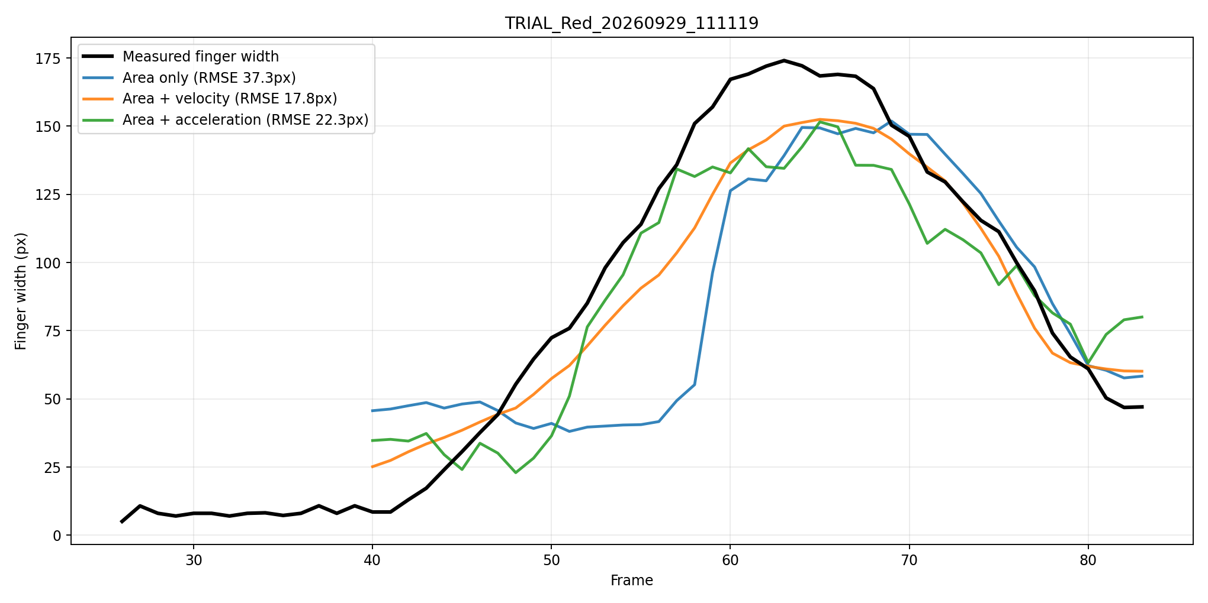
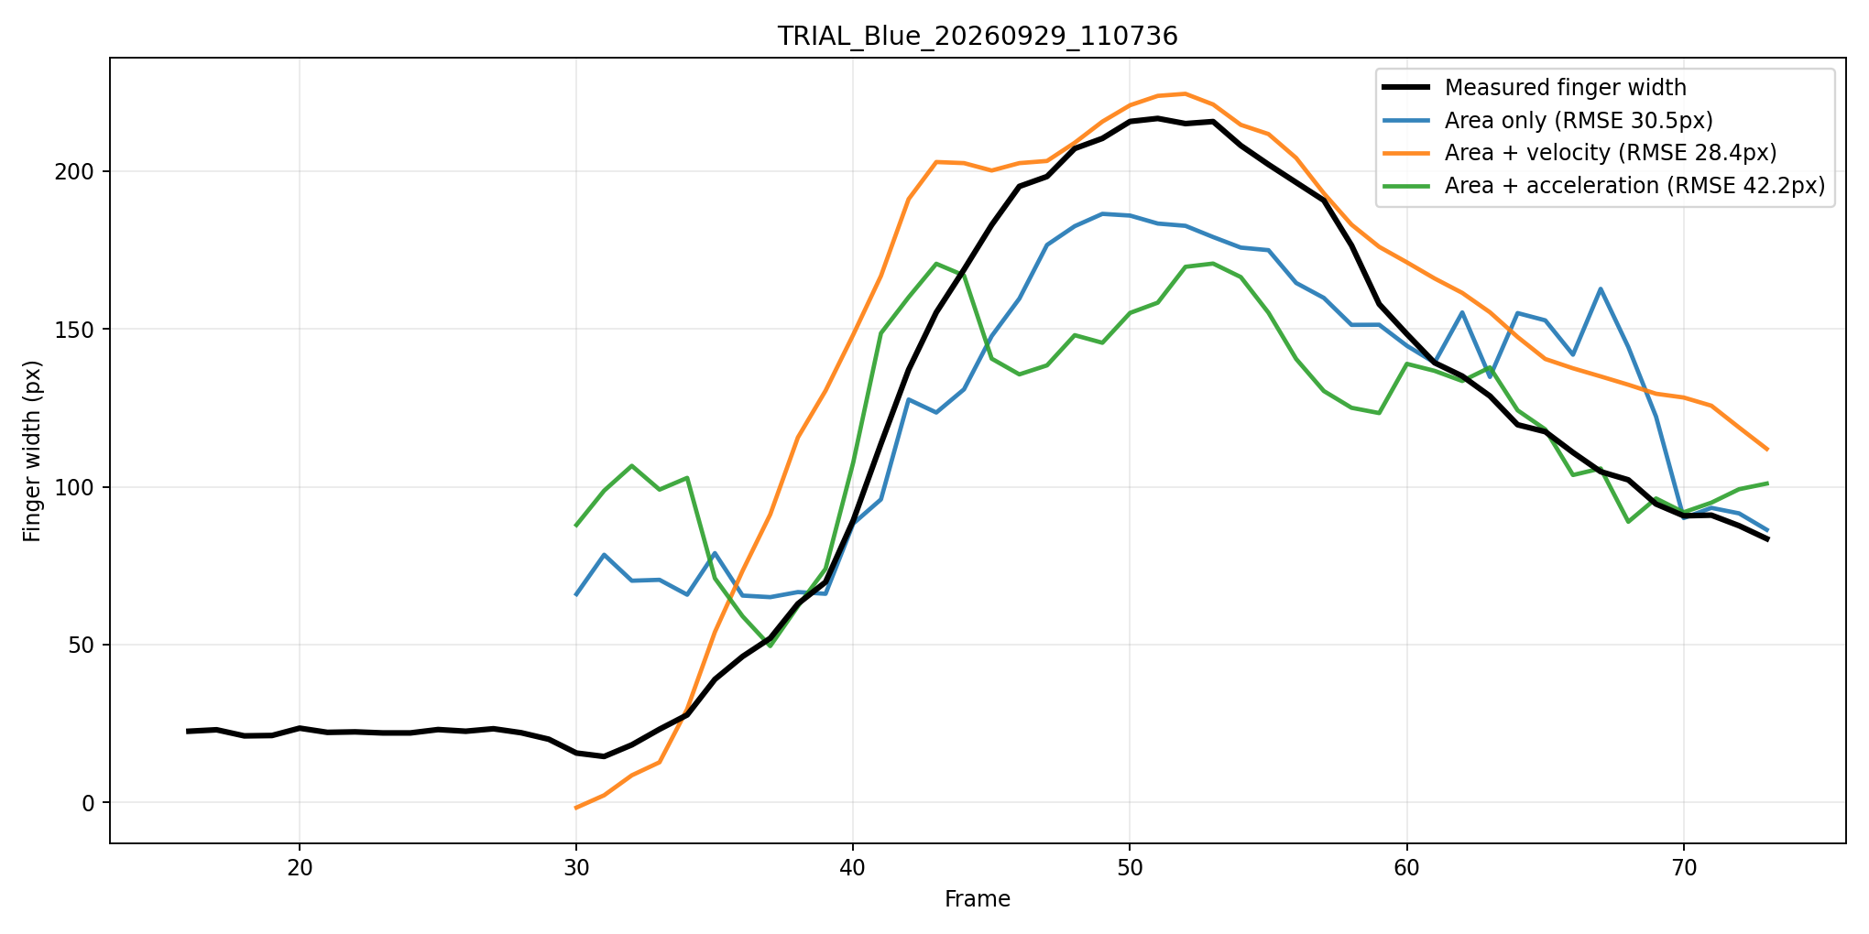
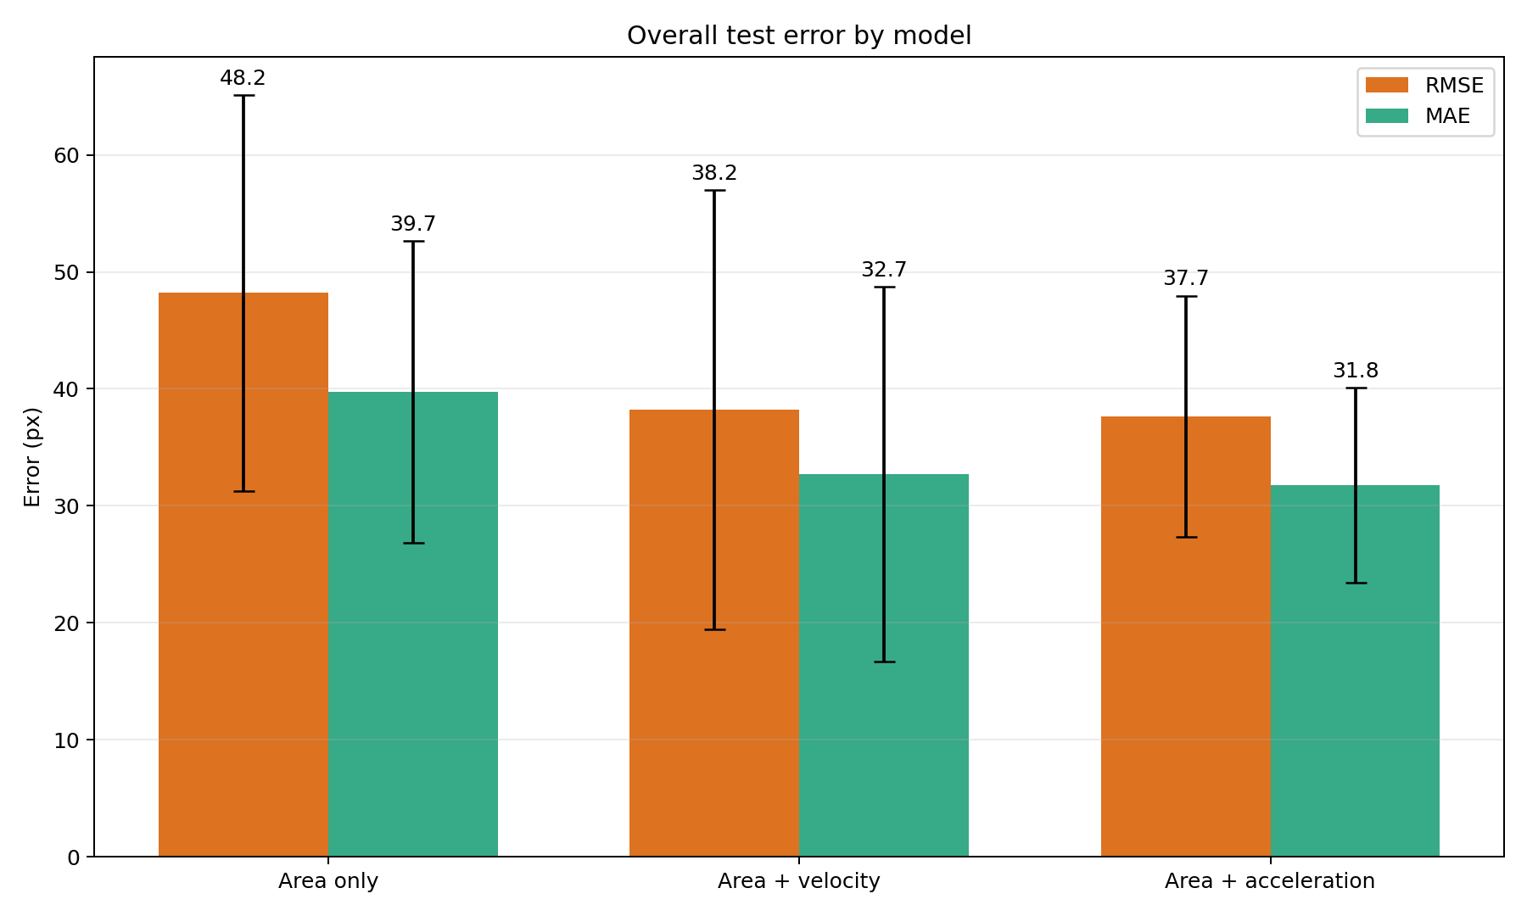
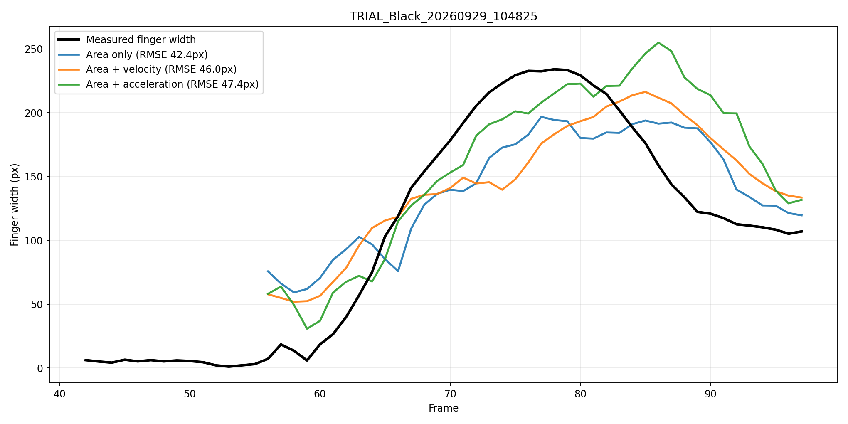
Model and Test Results
Model: 15-Frame Time-Window MLP
Three Input Modes:
Object Area
Object Area + Velocity
Object Area + Acceleration
Training dataset: 3 Object Sizes, 10 trials each
Test dataset: 3 Object Sizes, 3 trials each

Slide 11
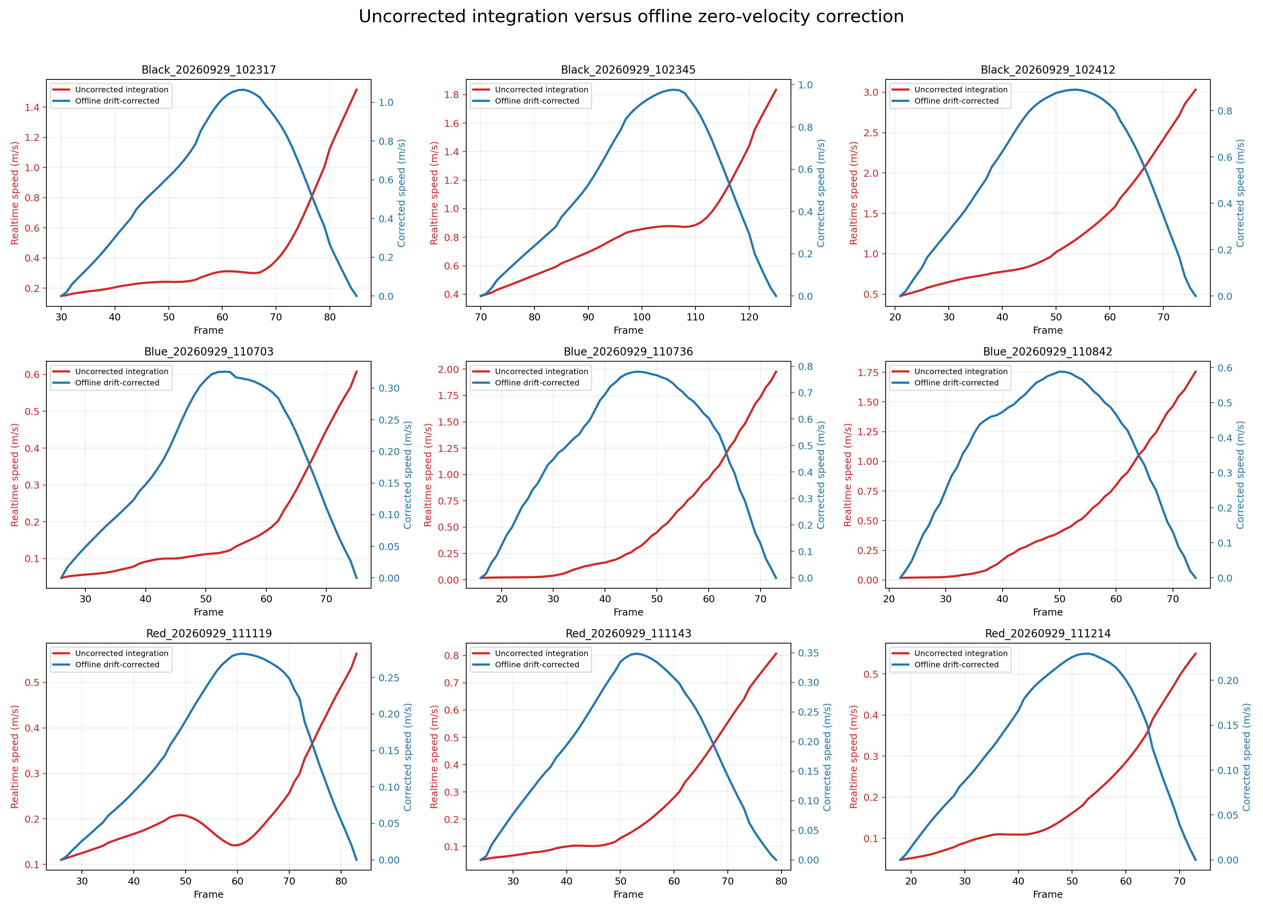
Main Issue
The remaining issue still is the real-time integrated velocity from the IMU. I tried several program adjustments, but that still have some problem.

Slide 12
My Research Proposal
Although the current offline data contain some errors, the predicted curves show the natural pattern of grasping: opening and then closing.
Therefore, I would like to ask whether it would be possible to change the validation method of this study from real-time validation to offline validation.
I would like to revise the focus of this study to investigate whether adding IMU data, such as hand velocity or acceleration, can better reproduce the natural grasping pattern of the human hand. The performance of using only object area will be compared with that of using object area combined with IMU data.
If so, I like to further optimize the training process to reduce prediction errors and make the predicted curves fit the actual data more closely. And invit other participants to validate the proposed method.

