Slide 1
MLP
Input
5-frame window MLP
Output
dₜ₋₄
dₜ₋₃ dₜ₋₂ dₜ₋₁ dₜ
Hand–Object
Distance
Fingertip
Aperture
âₜ
2 hidden layer, each with 32 neurons.
LSTM
Training set: 21 trials per speed condition (63 trials total).
Test set: 9 trials per speed condition (27 trials total).
Input: [dₜ₋₄, dₜ₋₃, dₜ₋₂, dₜ₋₁, dₜ]
Output: âₜ
32 hidden units and 5-frame window

Slide 2
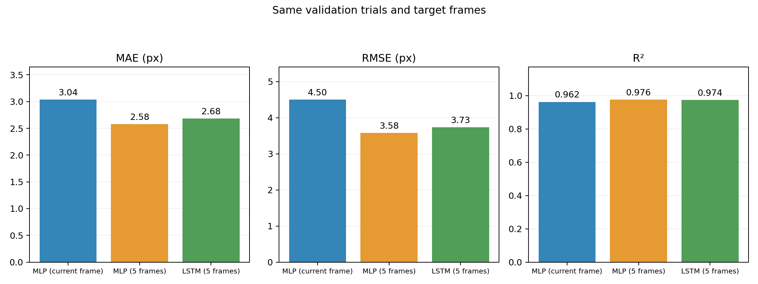
MLP and LSTM currently show similar performance.

Slide 3
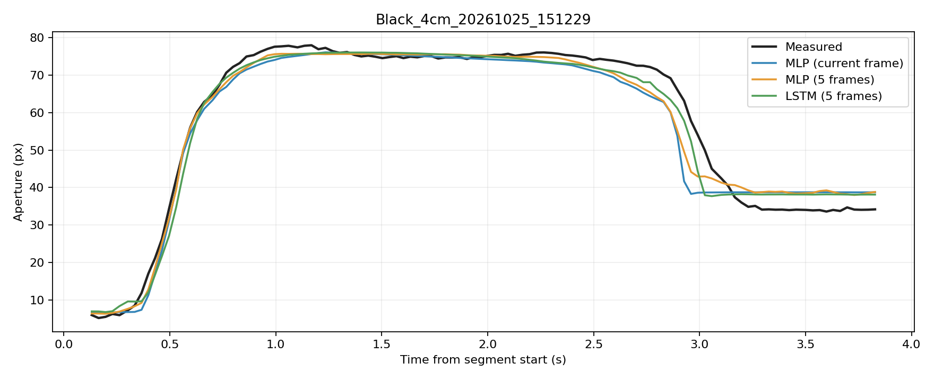
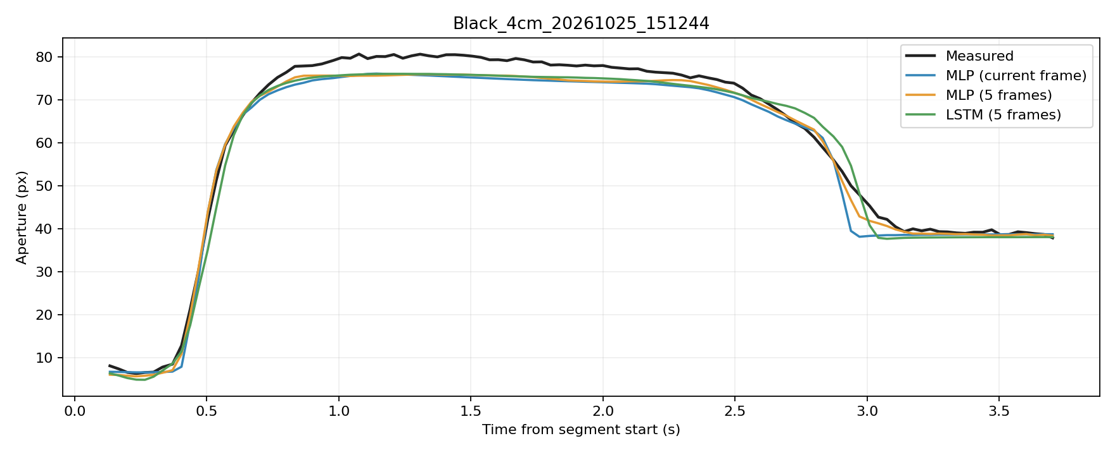
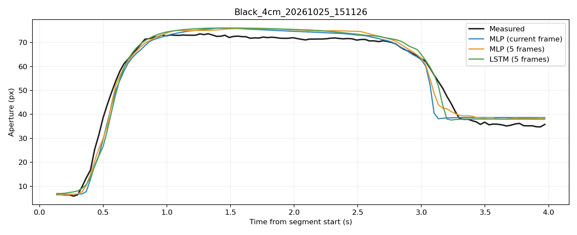
Slow Example

Slide 4
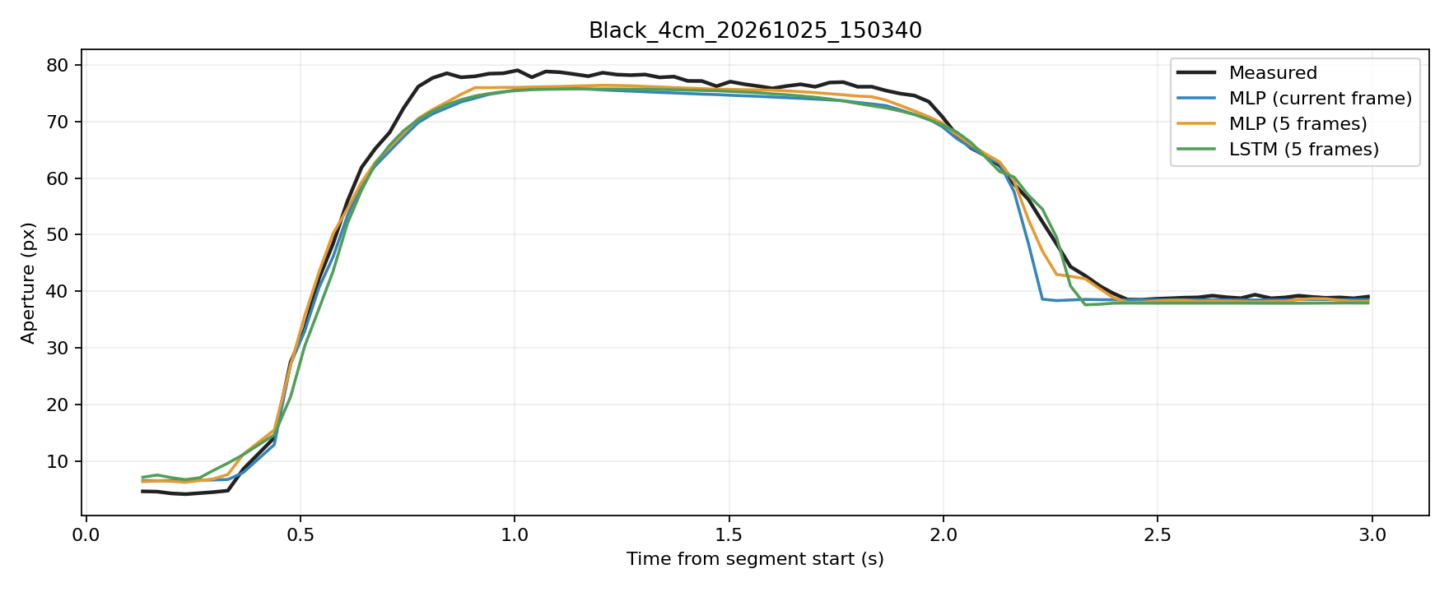
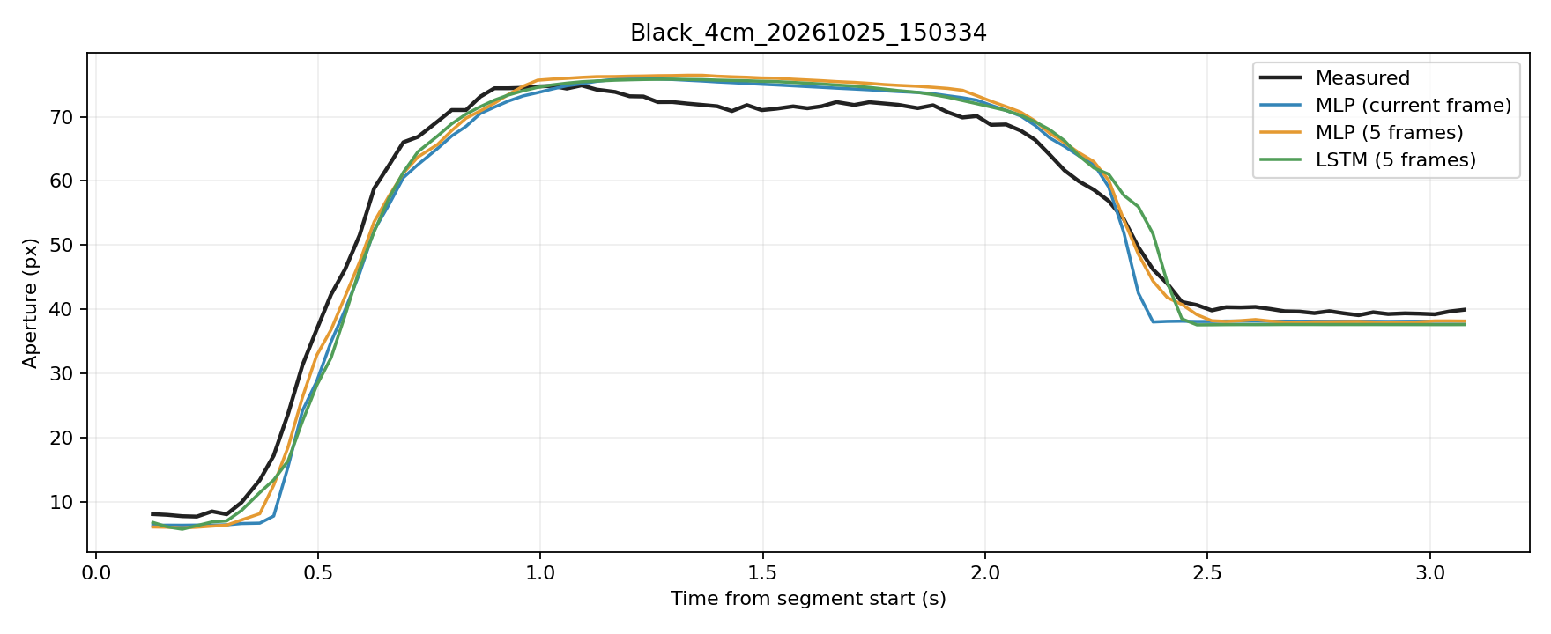
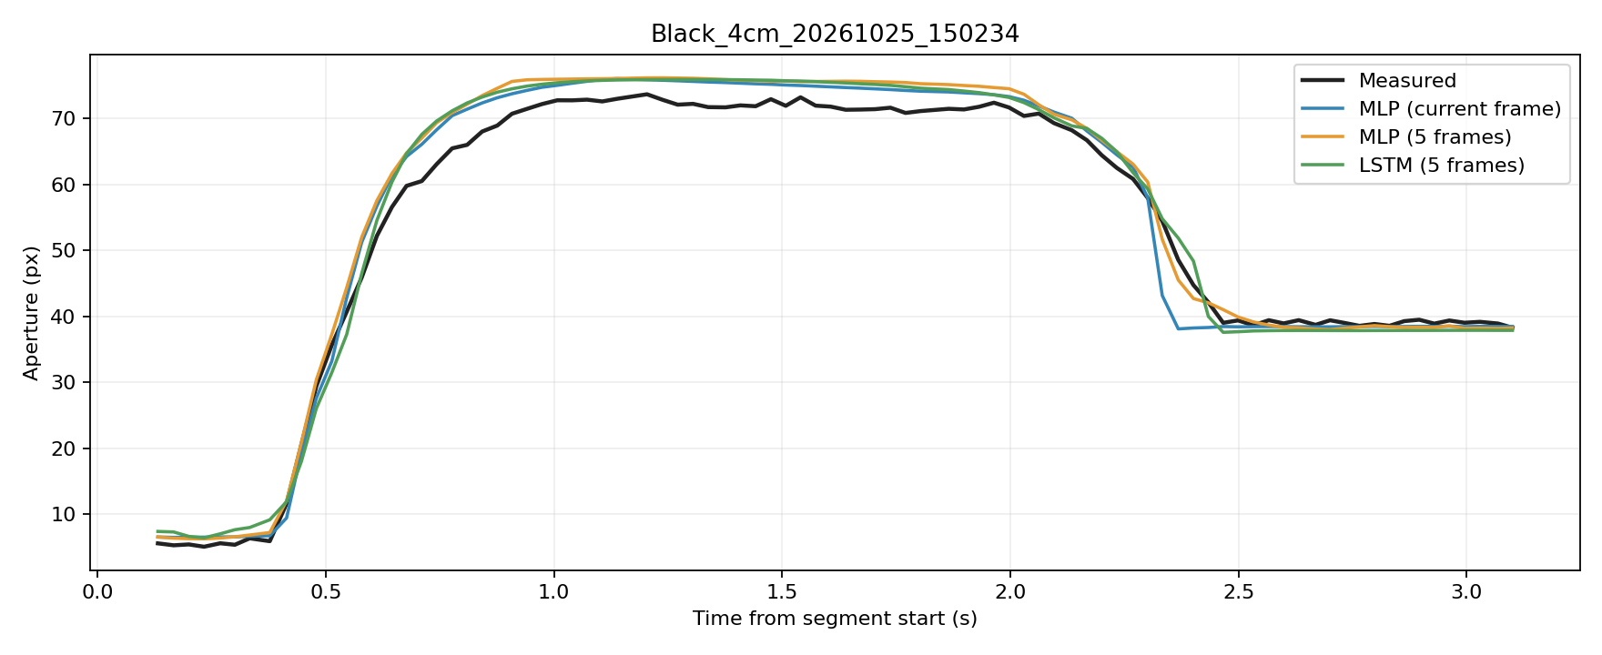
Normal Example

Slide 5
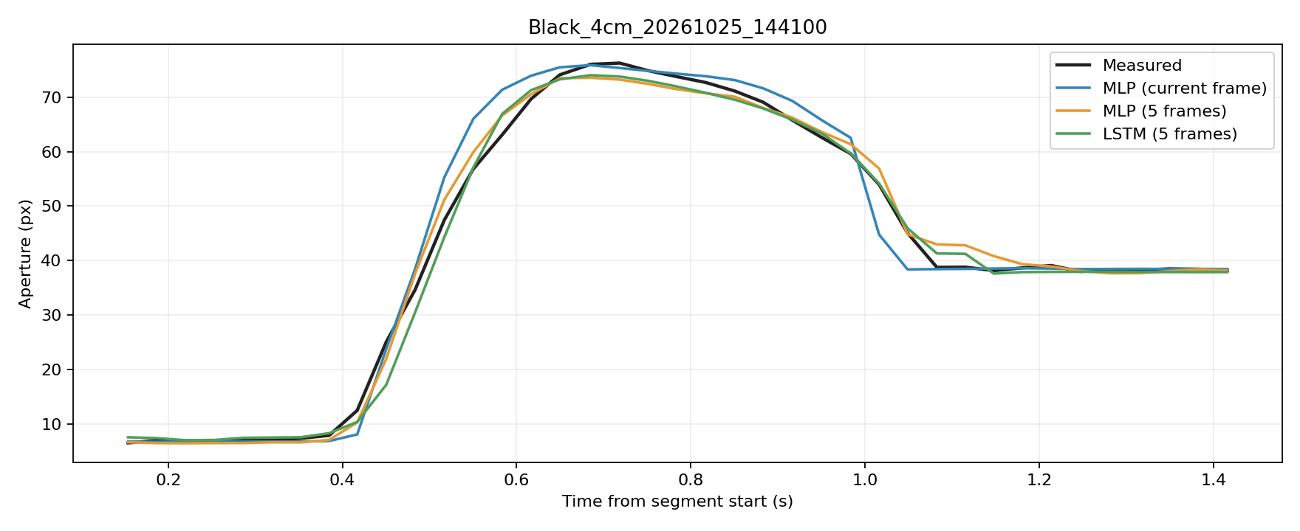
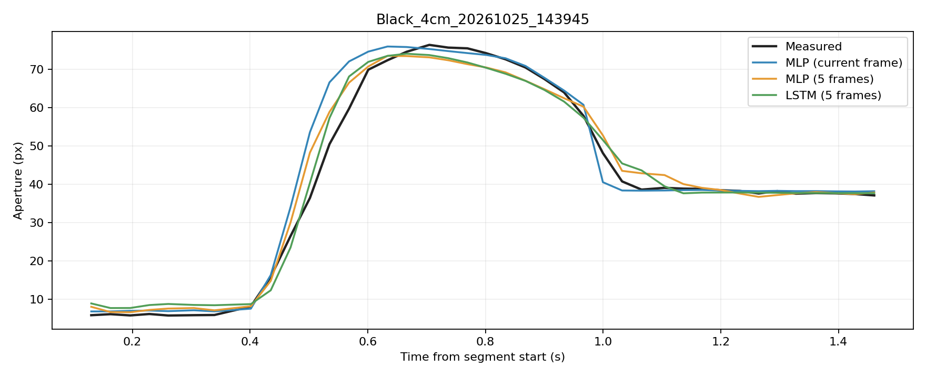
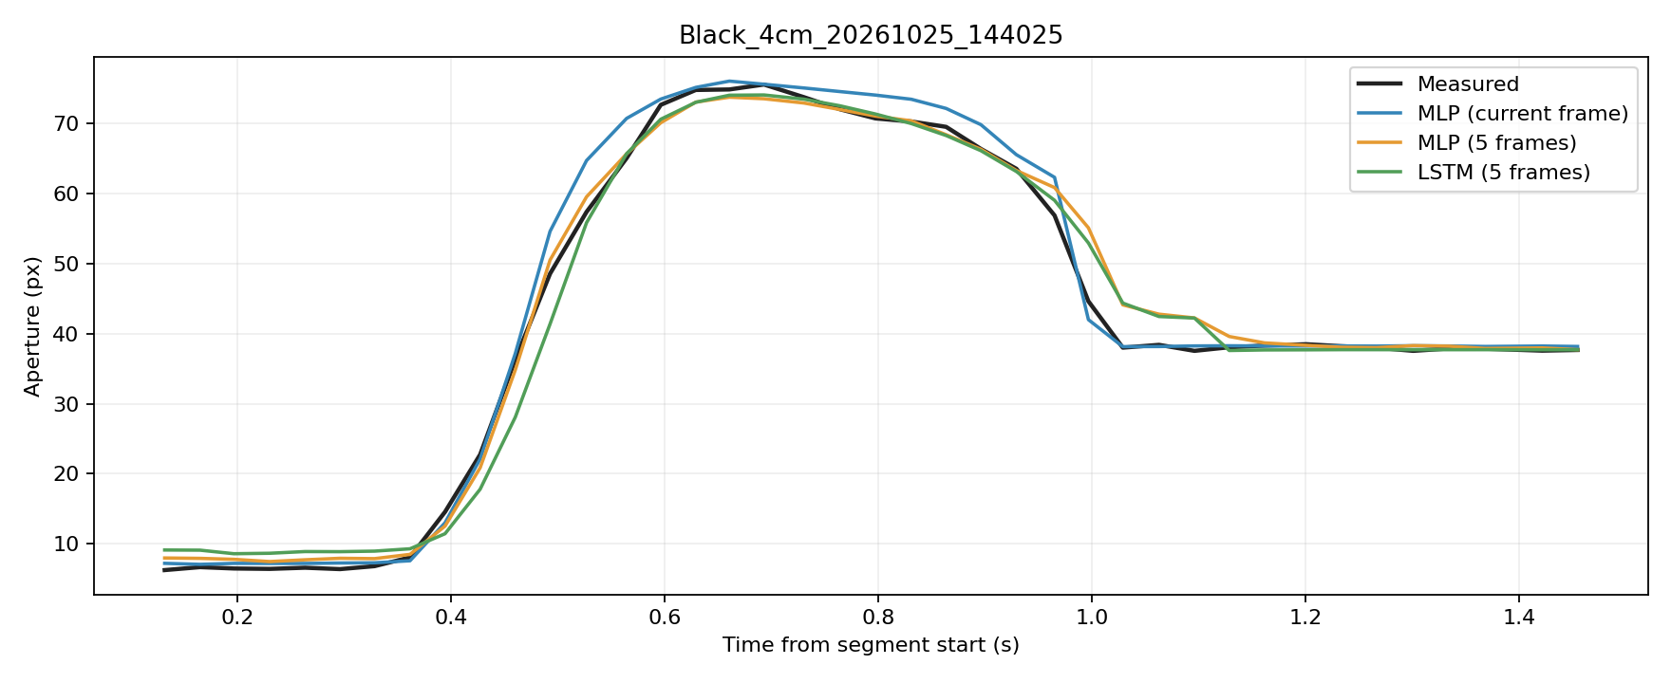
Fast Example

Slide 6
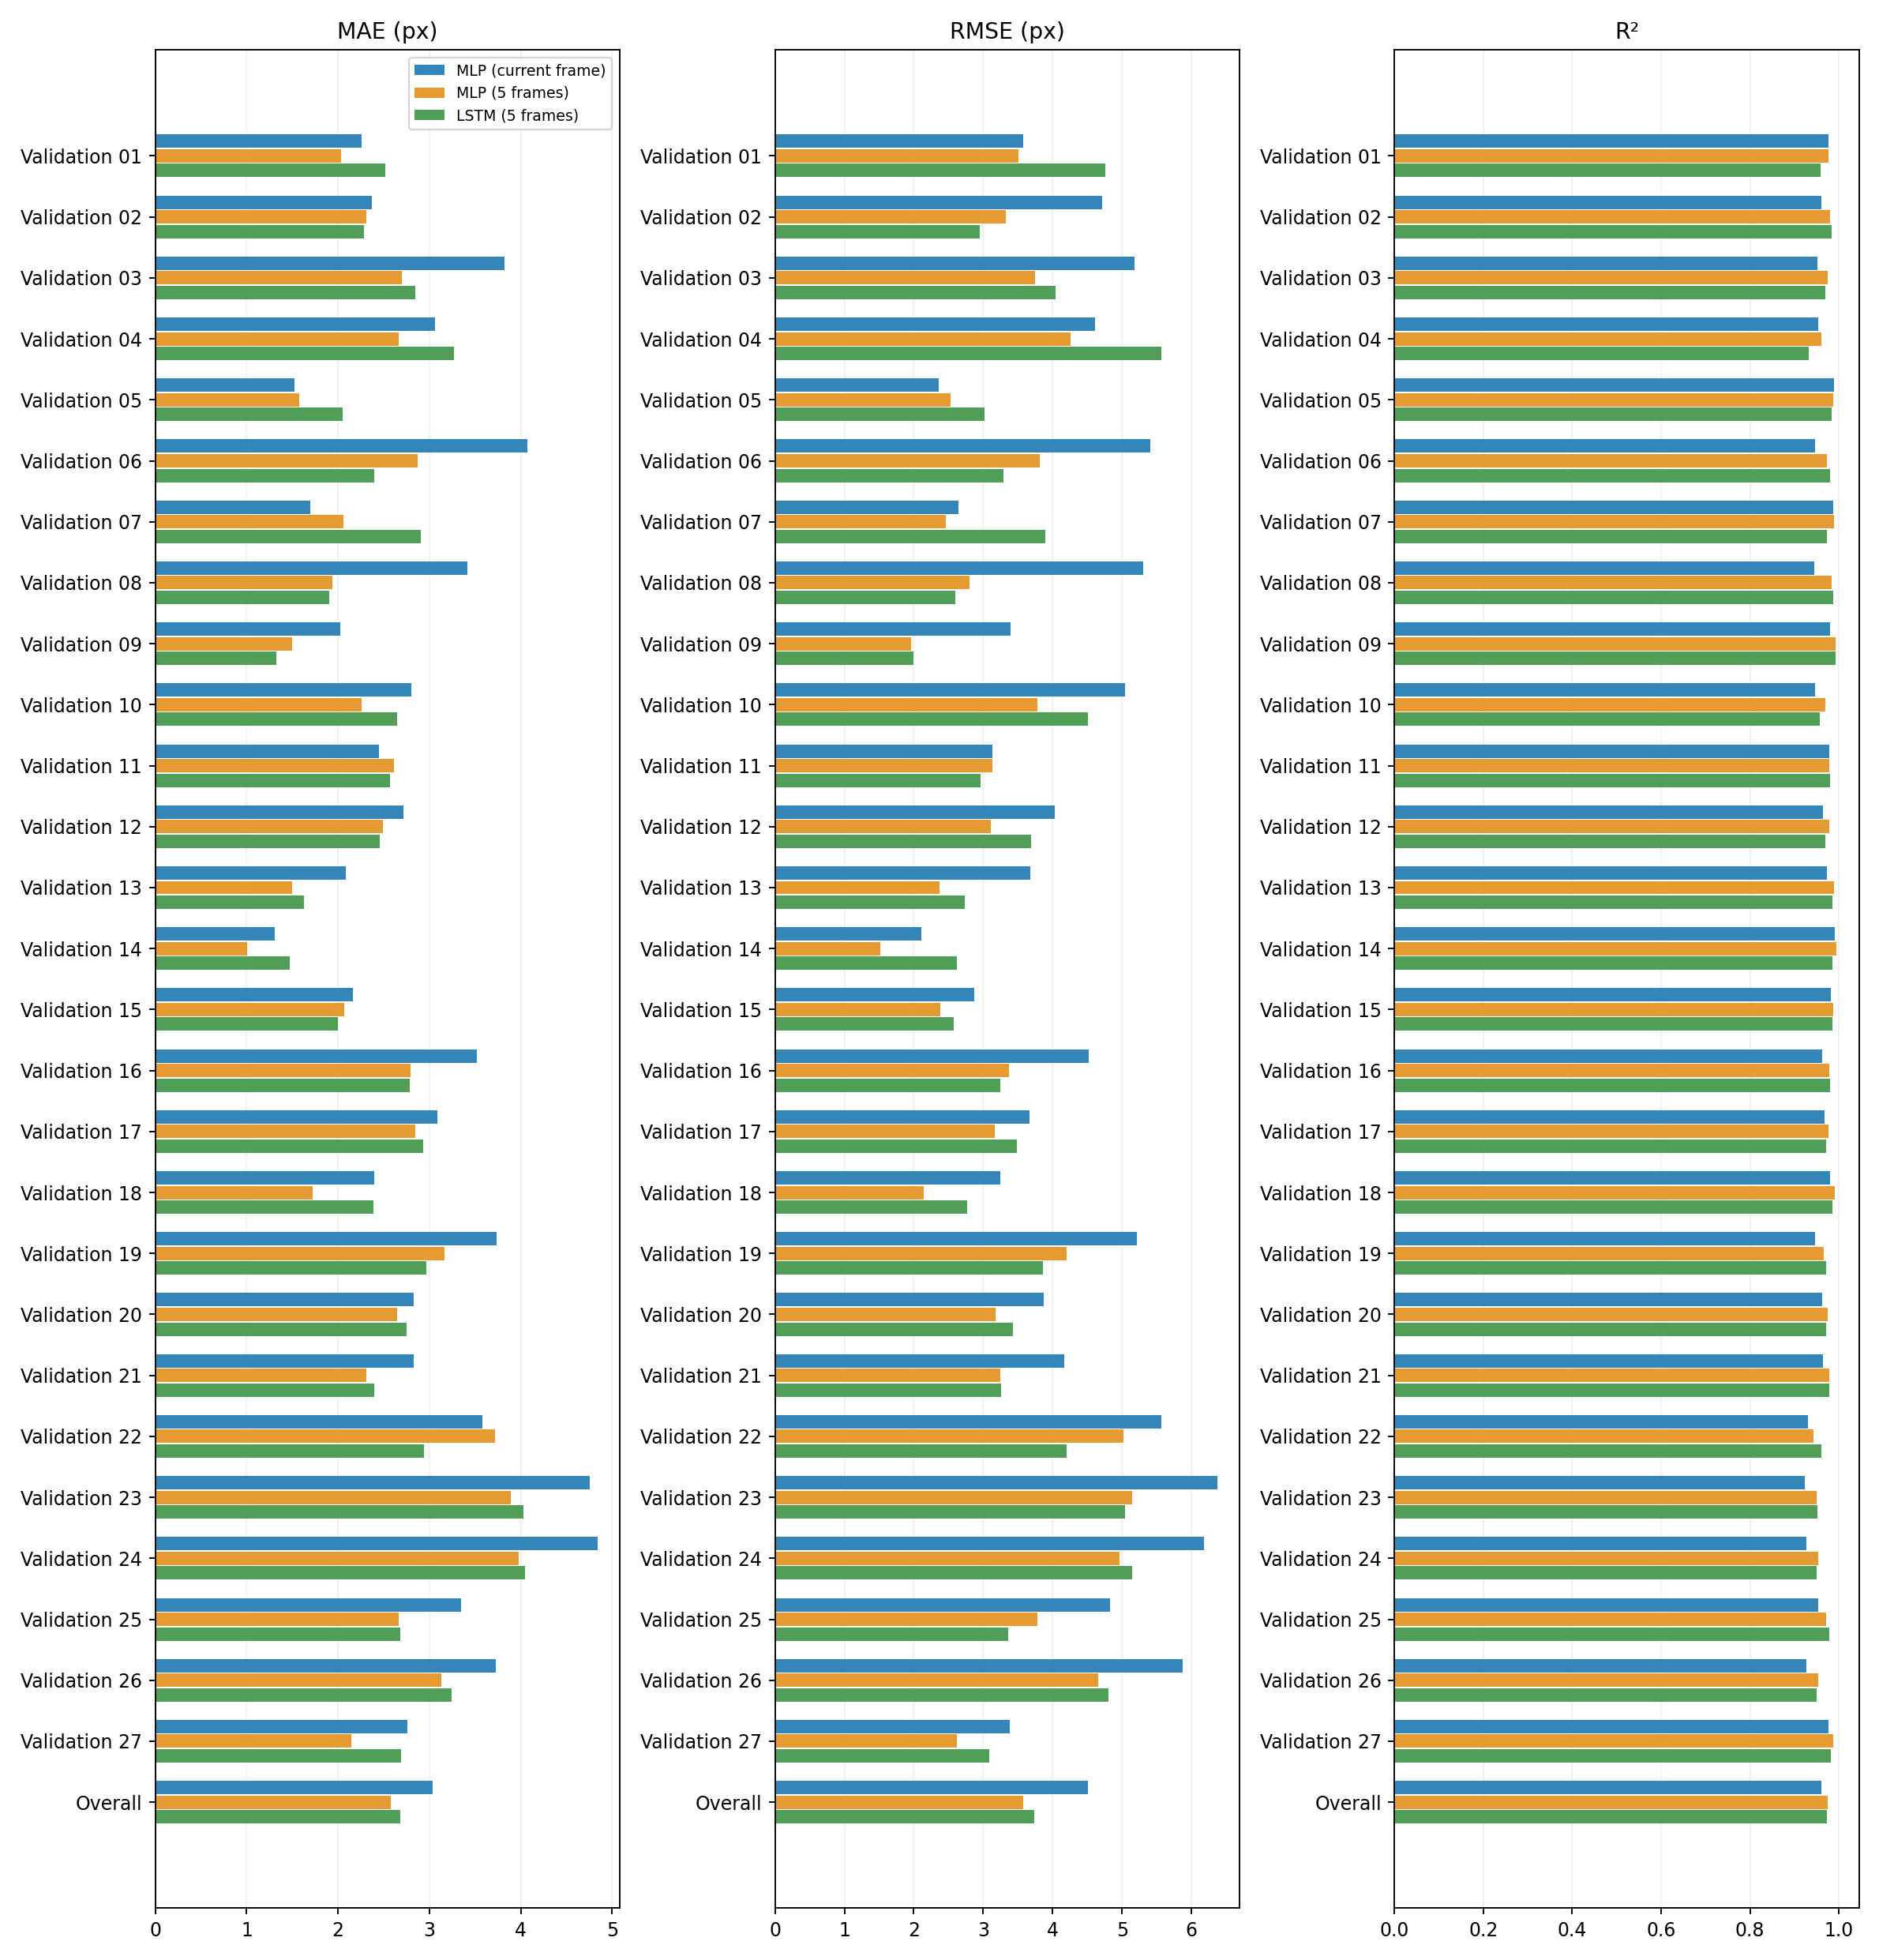
Detailed Validation Results

