Slide 1
Research Objective & Question
During reach-to-grasp movements, finger opening/closing and hand motion are usually coordinated naturally and unconsciously.
This study aims to investigate the relationship among object apparent size, fingertip aperture, and hand acceleration during grasping, and further examine whether this information can be used to predict the fingertip aperture process.
RQ1
Is there a consistent relationship among object apparent size, fingertip aperture, and hand acceleration during reach-to-grasp movements?
RQ2
Can fingertip aperture during reach-to-grasp movements be predicted using object apparent size and hand acceleration?
Notes:
So in my research, objective is to Replace classification models to Regression Models.
From modular approach to end to end approach to reduce system complexity and loss of important information
RQ is to verify that can the system build on an end-to-end approach combined with regression be successfully applied,

Slide 2
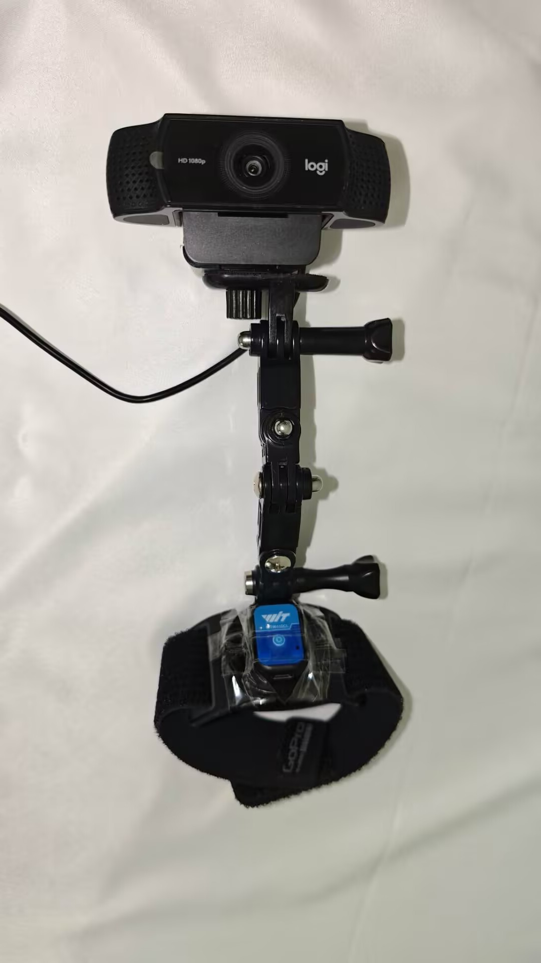
Data Collection
Collect participants grasping data for objects of different sizes.
Web Camera (30hz)
Experimental Conditions
Task: natural reach-to-grasp movement
Initial hand position: table edge
Target position: 30 mm from the table edge
Target size: 20, 25, 30, 35, 40, and 45 mm cubes
Equipment : A recording device consisting of a web camera and an IMU was mounted on the participant's forearm.
50hz

Slide 3
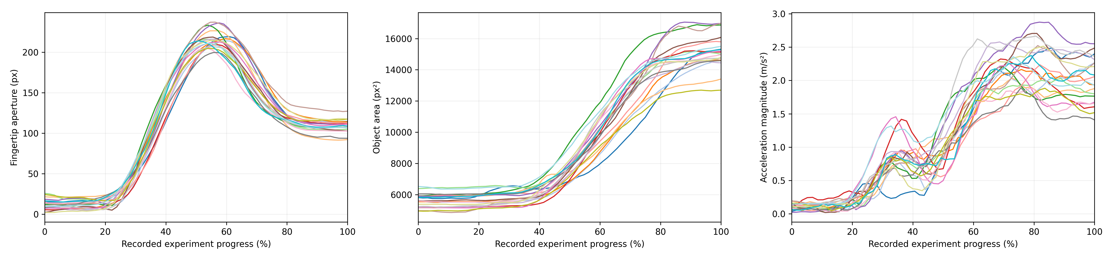
Data Relationship Analysis
20 experiments with a 40 mm object
Object area at maximum aperture / final object area
59.42 ± 4.15%
Mean acceleration during opening
0.611 ± 0.139 m/s²
Maximum aperture timing
55.79 ± 2.45%
Fingertip aperture Normalized RMSE
0.0415 ± 0.0160
Object apparent size
Normalized RMSE
0.0486 ± 0.0313
Object apparent size Normalized RMSE
0.0757 ± 0.0294
The data showed high consistency across experiments, suggesting a consistent relationship among object apparent size, fingertip aperture, and hand acceleration during reach-to-grasp movements.

Slide 4

Model
Further validation
Can fingertip aperture during reach-to-grasp movements be predicted using object apparent size and hand acceleration?
20, 30, 40 mm: 15 training experiments + 5 test experiments
25, 35, 45 mm: 5 experiments for generalization testing
15-frame window MLP
Object Size
Fingertip
Aperture
Acceleration

Slide 5
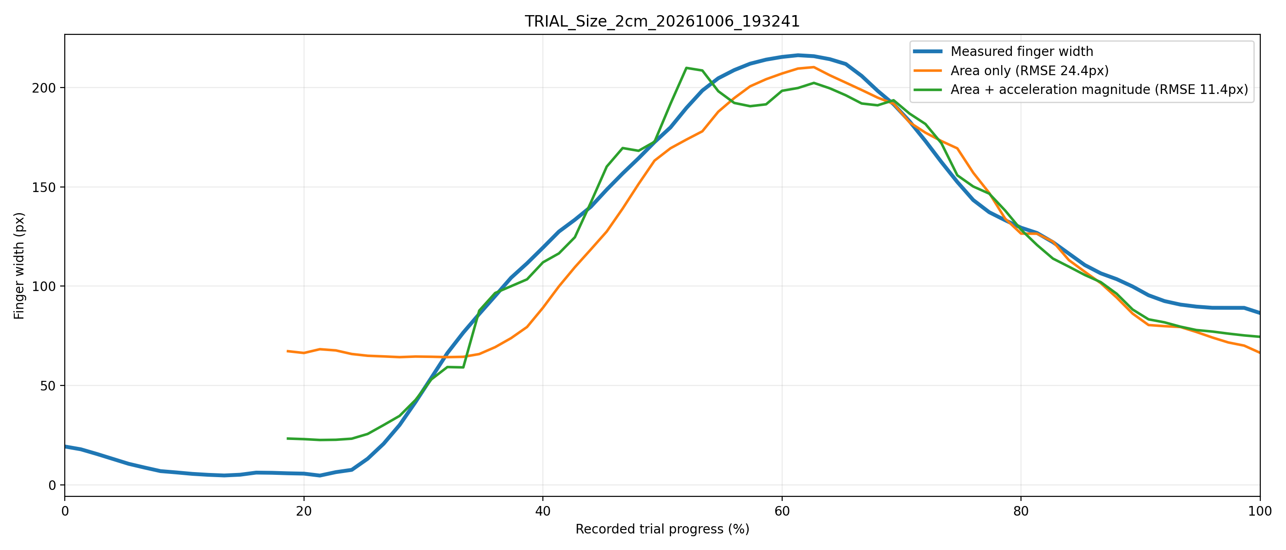
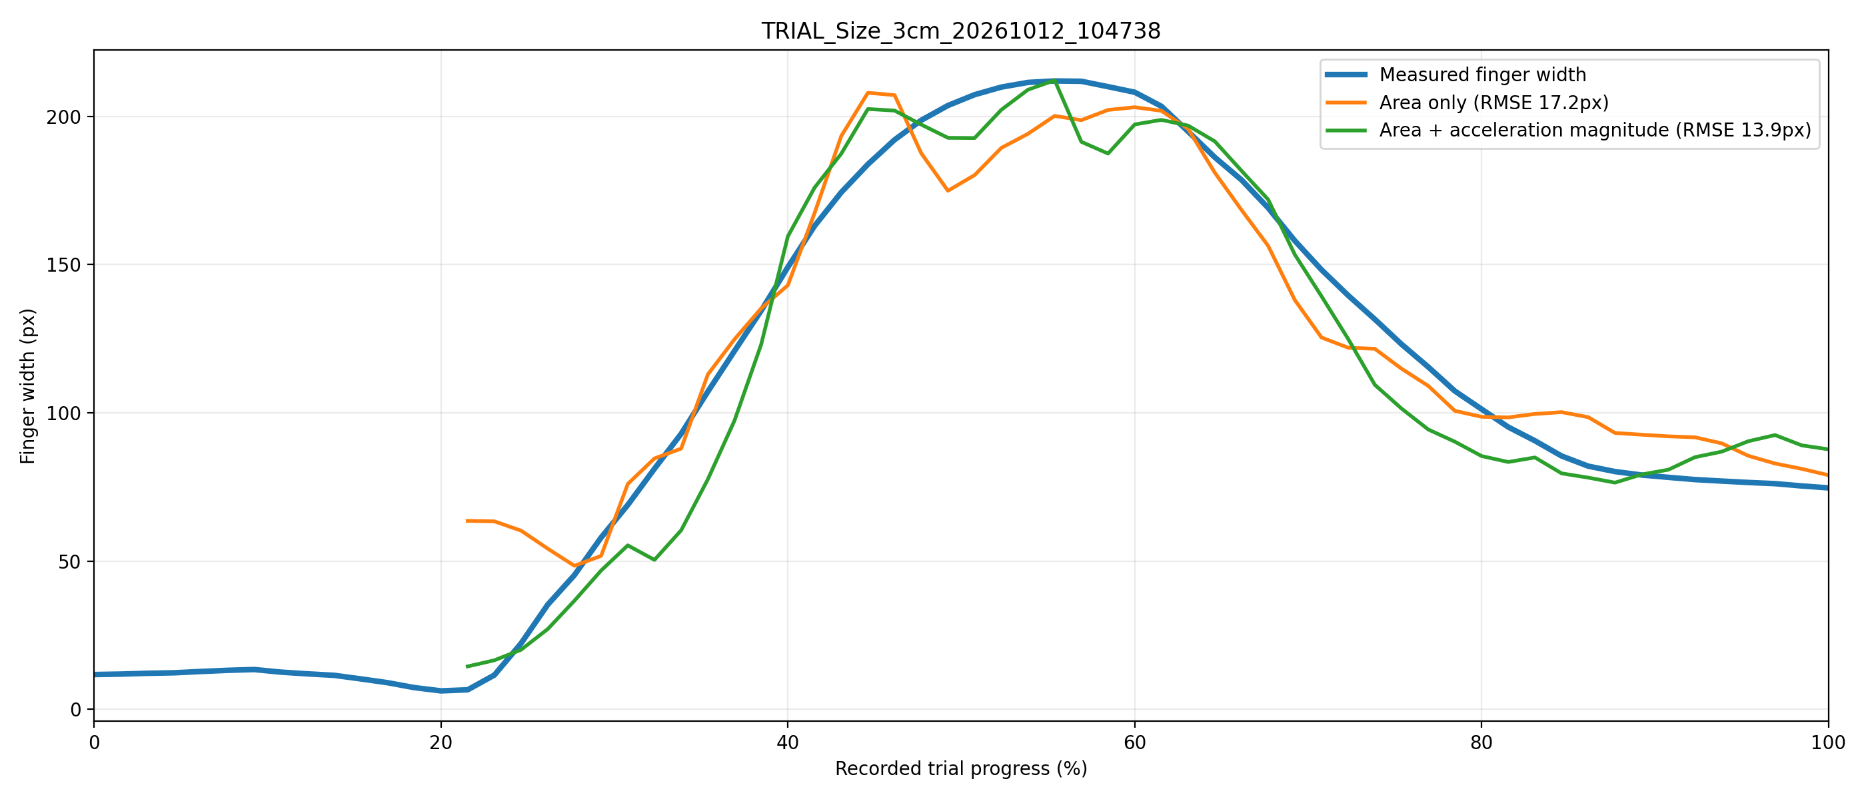
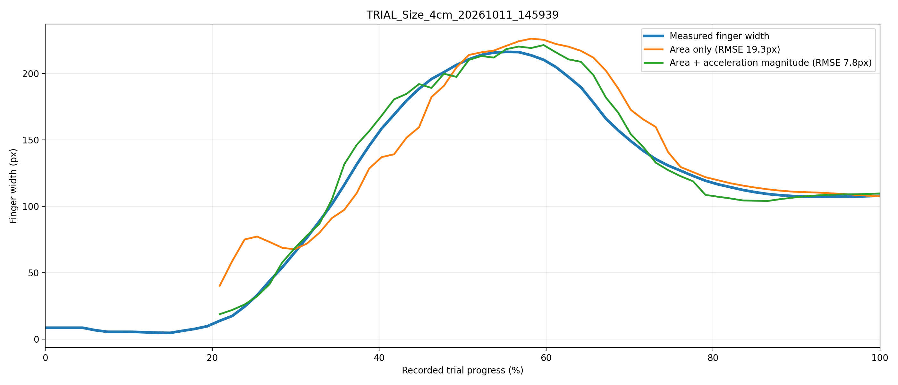
Standard Test
Held-out experiments at trained object sizes.
5 experiments per size.
Object size | object size only | object size + Acceleration
20 mm | 27.7 ± 4.3 | 17.7 ± 5.8
30 mm | 31.3 ± 10.9 | 30.2 ± 11.2
40 mm | 19.1 ± 1.3 | 17.0 ± 6.4
Combining object apparent size with acceleration achieved RMSE below 20 px in selected held-out experiments.
The results suggest that fingertip aperture during natural grasping can be learned from object apparent size and acceleration.

Slide 6
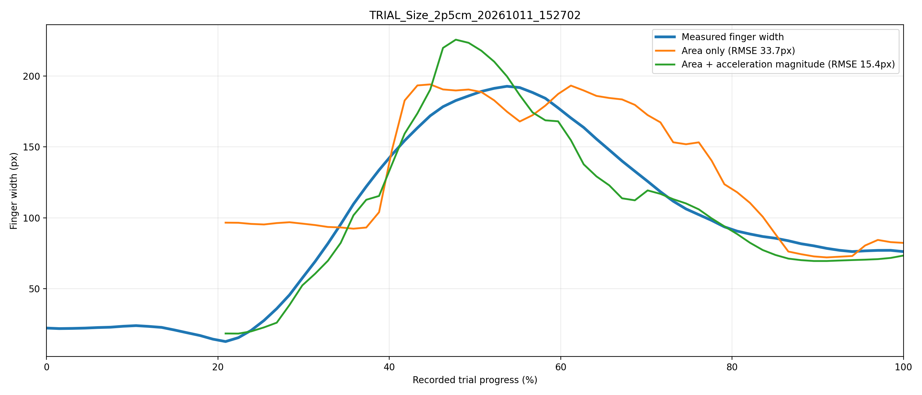
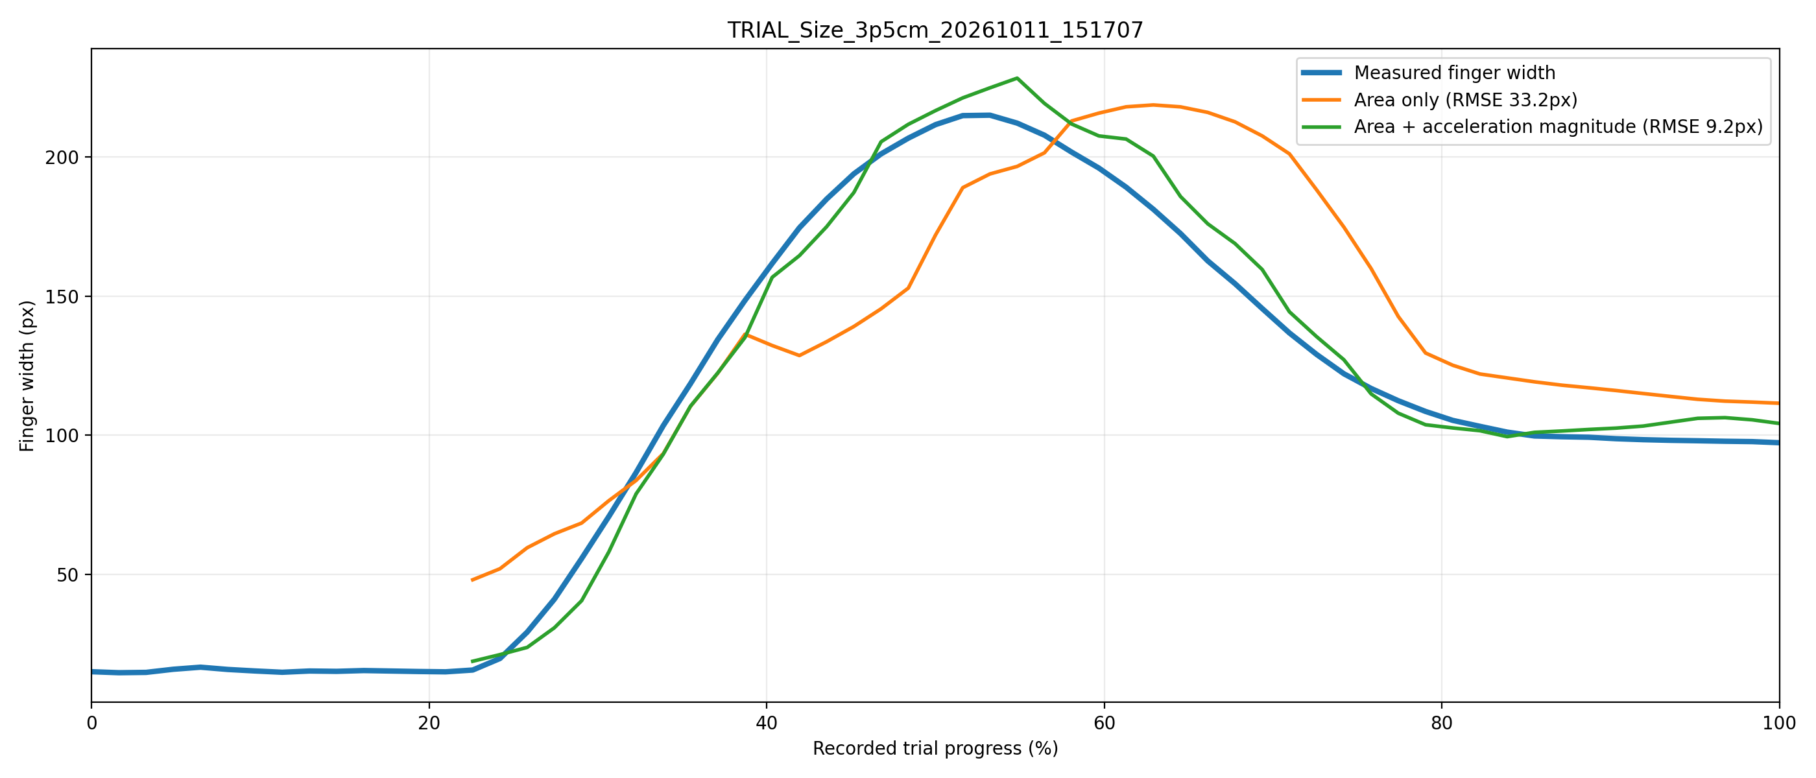
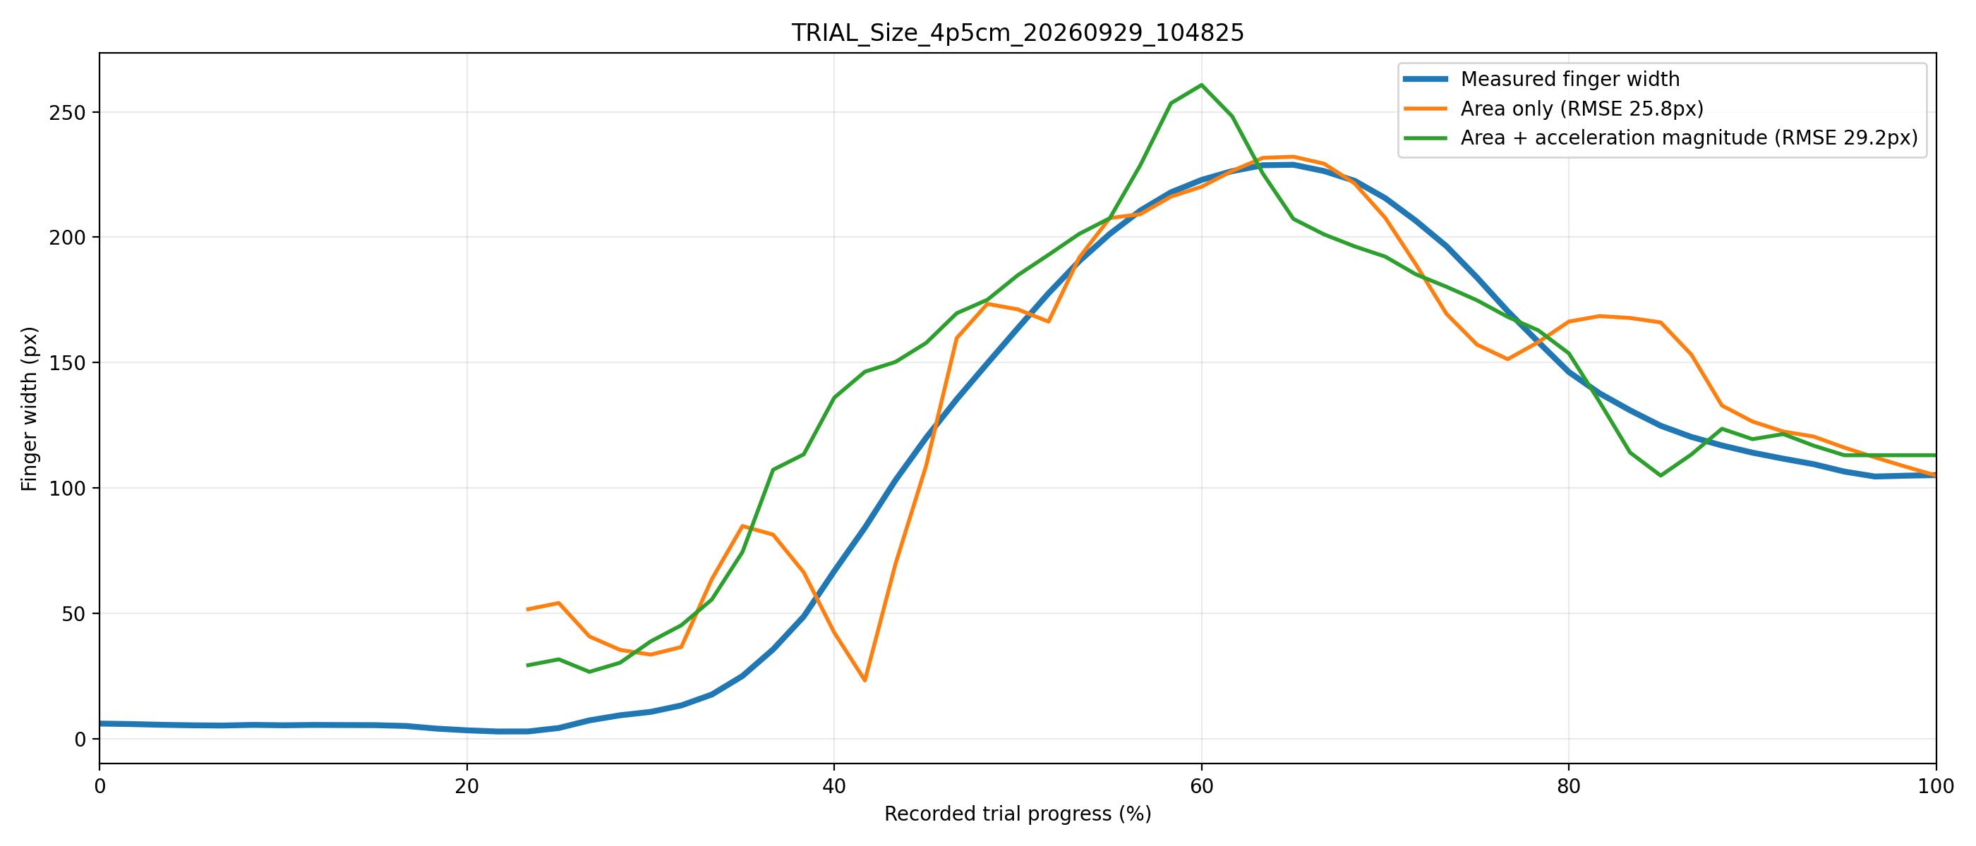
Generalization Test
Held-out experiments at unseen object sizes.
5 experiments per size.
Object size | object size only | object size + acceleration
25 mm（n=7） | 38.8 ± 6.1 | 26.0 ± 9.4
35 mm（n=11） | 37.1 ± 11.9 | 20.6 ± 11.3
45 mm（n=20） | 47.4 ± 13.5 | 43.2 ± 9.8
At unseen sizes of 25 and 35 mm, selected experiments maintained RMSE around 20 px.
suggesting interpolation capability.
At 45 mm,
beyond the training size range, prediction error increased,
indicating limited extrapolation capability and motivating further investigation.

Slide 7
Results and Discussion
The results suggest that fingertip aperture during reach-to-grasp movements can be predicted using object apparent size and hand acceleration.
Adding hand acceleration generally improves aperture prediction compared with using object apparent size alone.
The model shows generalization to unseen object sizes within the training size range. Prediction error increases beyond this range, indicating that extrapolation requires further investigation.

Slide 8
Experimental Error Analysis
△ Equipment-related errors
- Visual measurement variability: Object apparent size and fingertip aperture are estimated using visual algorithms, which may introduce measurement fluctuations.
- IMU measurement uncertainty: Sensor noise may affect measurement accuracy.
△ Experiment-related variability
- Natural grasping variability: Movement speed and grasping strategy may vary between experiments.
- Object position variability: Small differences in object placement may change the reaching trajectory and visual measurements.

