Slide 1
Real-Time Experiment

Slide 2
Model
5-frame window MLP
Distance
Fingertip
Aperture
2 hidden layer, each with 32 neurons.
训练目标:MAE
输入进行了归一化

Slide 3
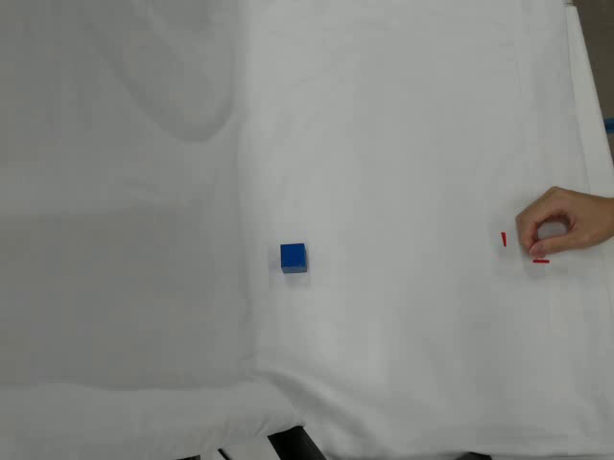
Trail

Slide 4
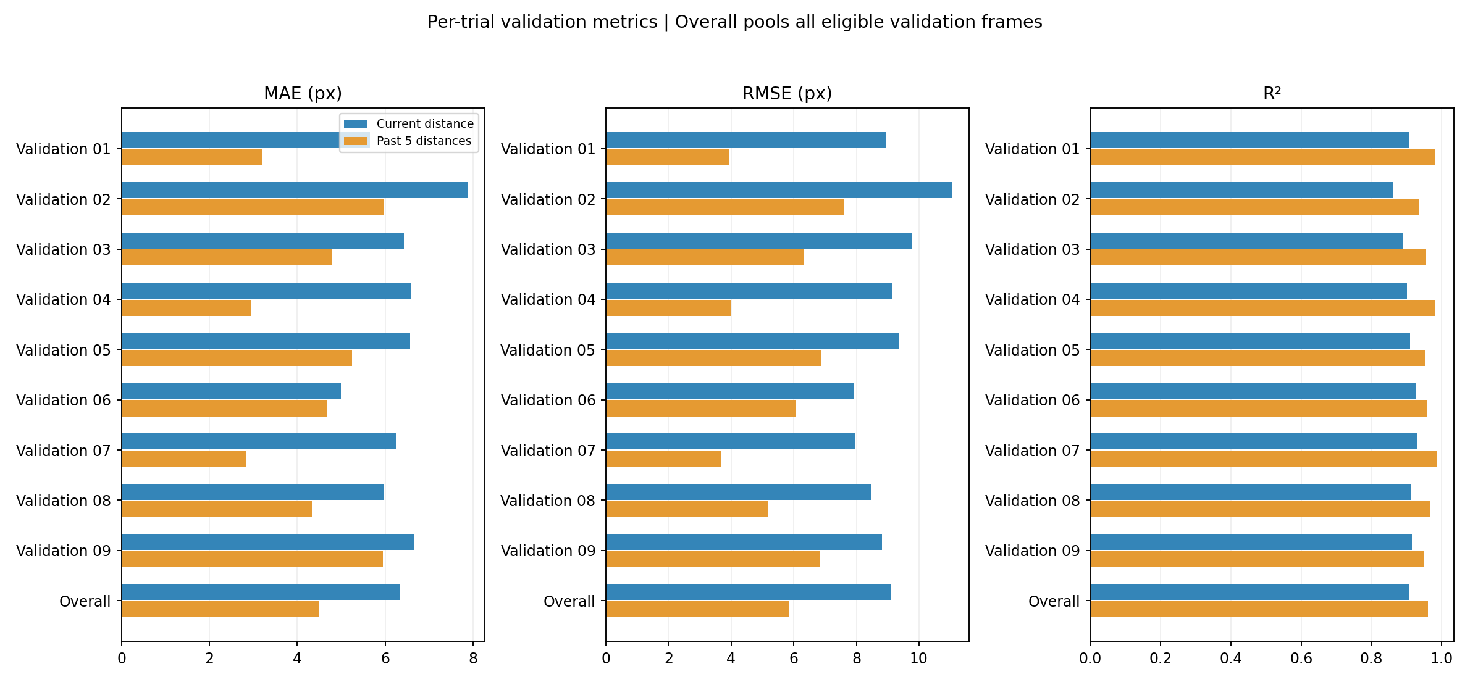
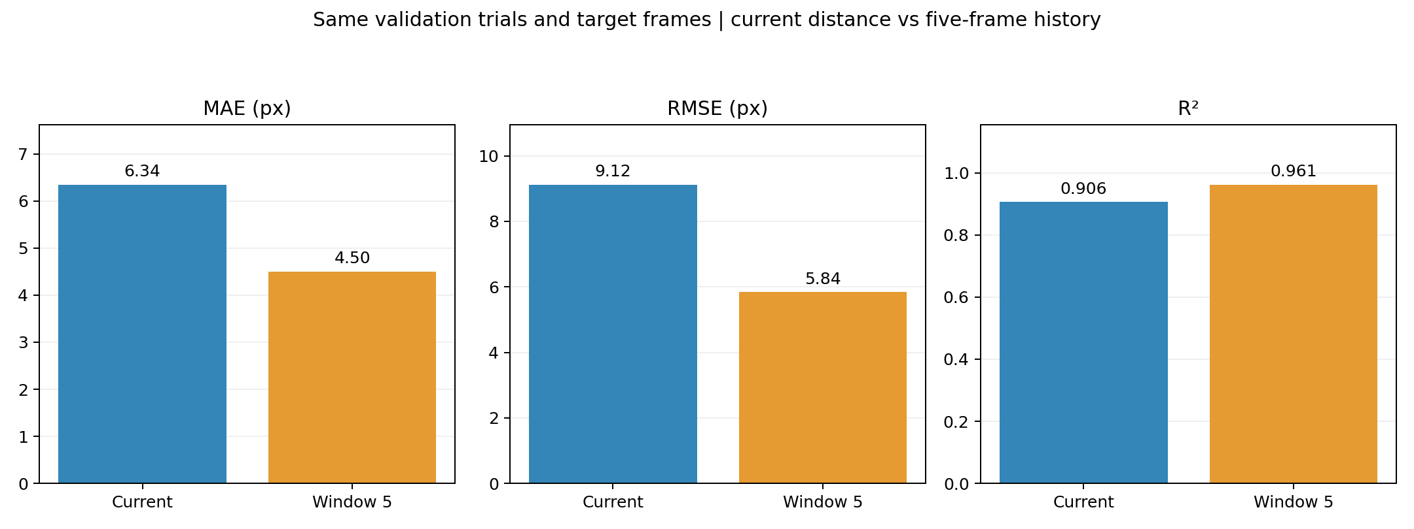
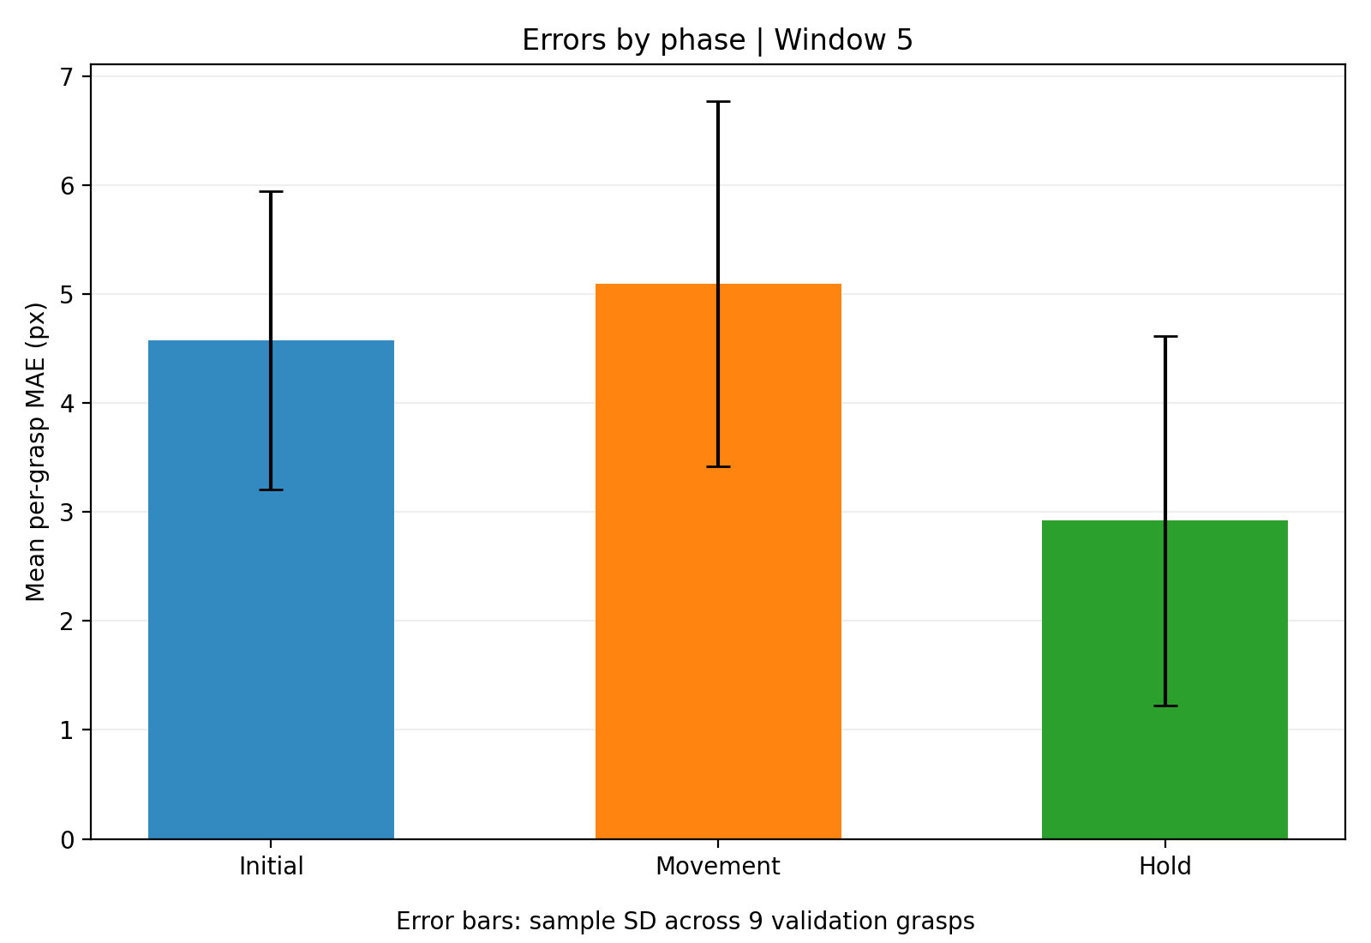
Offline Validation

Slide 5
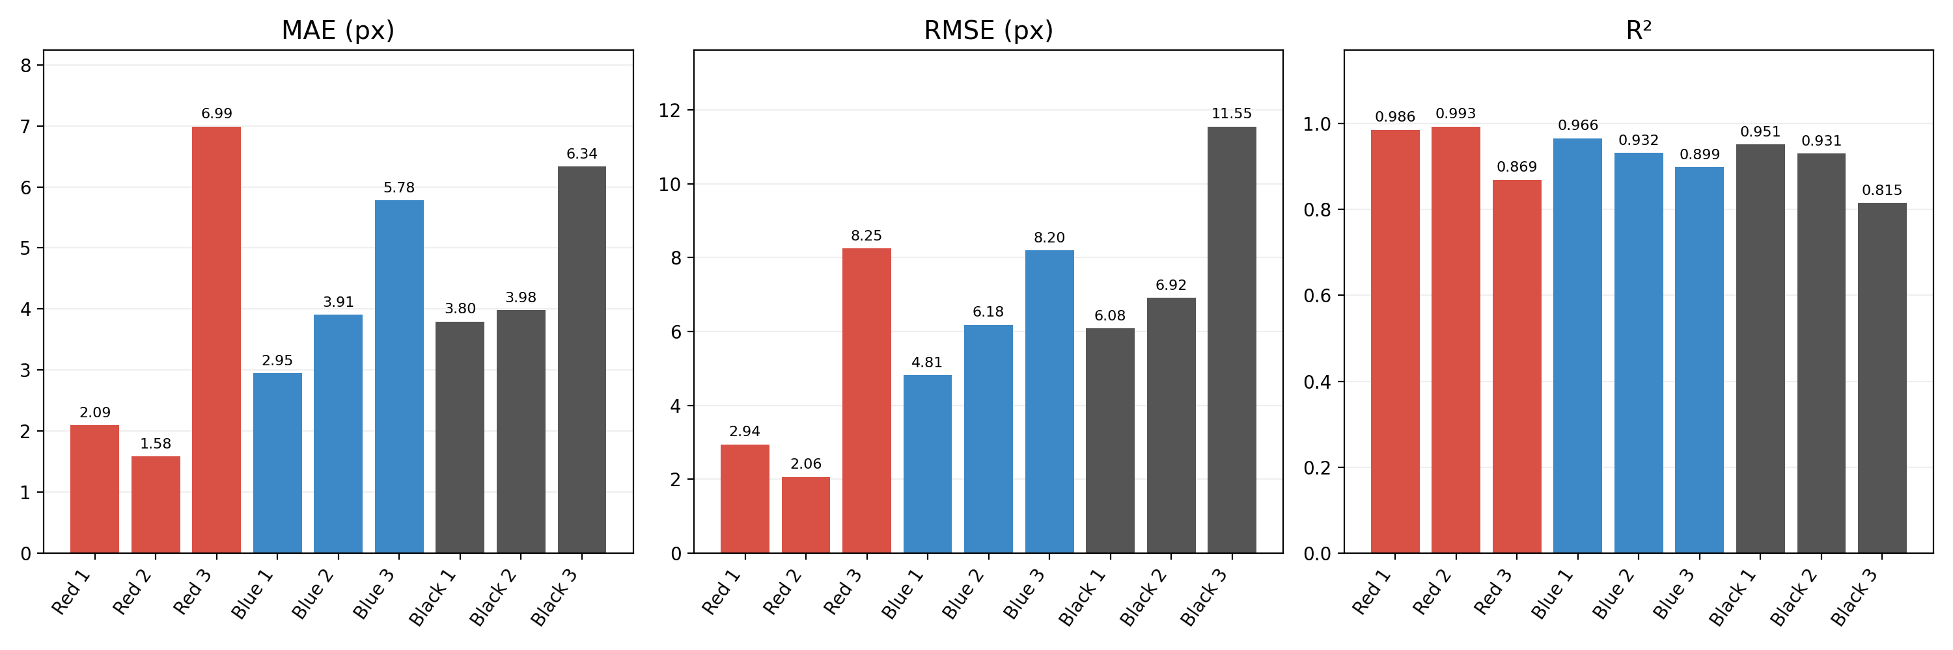
Real-Time Experiment

Slide 6
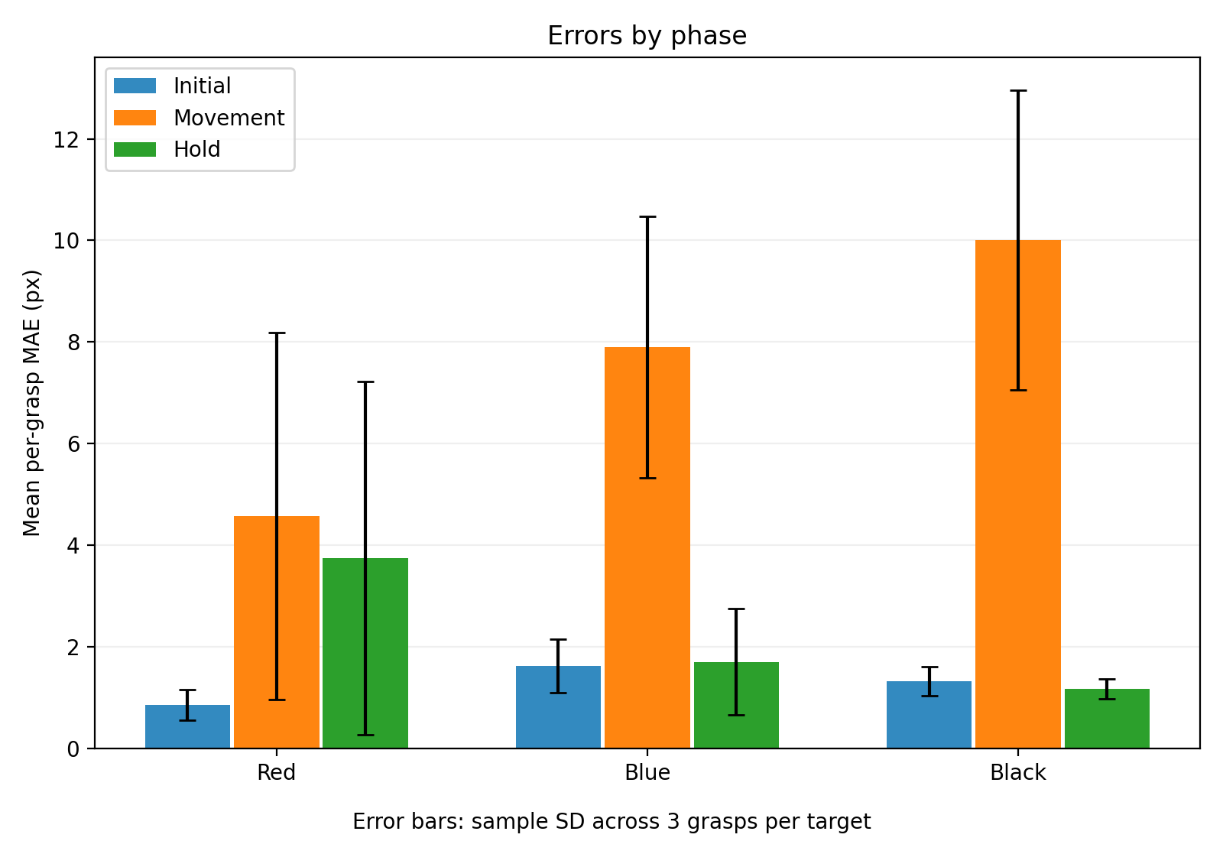
Real-Time Experiment

